Slide 1
Cable Tool

Slide 2
Outline
Installation
Data Preparation
Cable Excel File Format
Archived Netlist File
GUI Introduction
The Report

Slide 3
Installation
Go to \\10.99.6.20\disk_project\dr_tool_gui\cable_tool
Find cable_tool.7z and unzip it to your NB
There should have cable_tool.exe in the folder and double click it

Slide 4
Outline
Installation
Data Preparation
Cable Excel File Format
Archived Netlist File
GUI Introduction
The Report

Slide 5
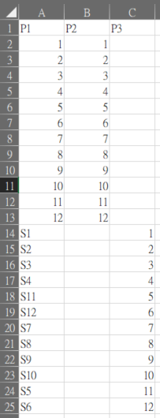
Data Preparation - Cable Excel File Format
Has to be ^P\d for first row
Means P1.10 wired to P2.10
Means P1.S11 wired to P3.5

Slide 6
Outline
Installation
Data Preparation
Cable Excel File Format
Archived Netlist File
GUI Introduction
The Report

Slide 7
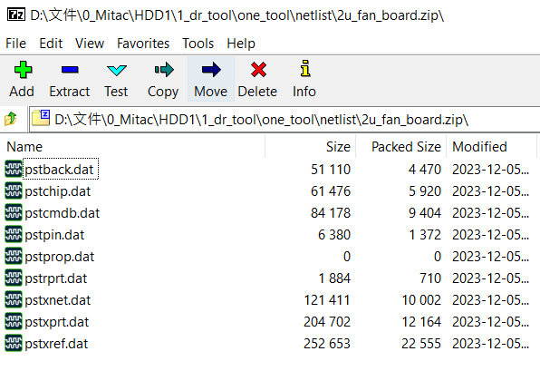
Data Preparation – Archived Netlist File
netlist.zip structure example (must be .zip file)
brdName_netlist.zip
pstback.dat
pstchip.dat
pstcmdb.dat
pstpin.dat
pstprop.dat
pstrprt.dat
pstxnet.dat
pstxprt.dat
pstxref.dat

Slide 8
Outline
Installation
Data Preparation
Cable Excel File Format
Archived Netlist File
GUI Introduction
The Report

Slide 9
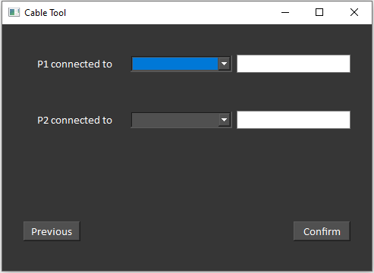
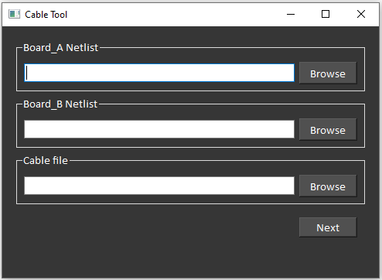
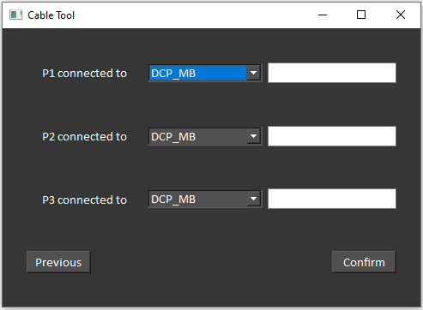
GUI Introduction
If cable had 2 port
Gen report
Port wired to location of board
If cable had 3 port

Slide 10
Outline
Installation
Data Preparation
Cable Excel File Format
Archived Netlist File
GUI Introduction
The Report

Slide 11
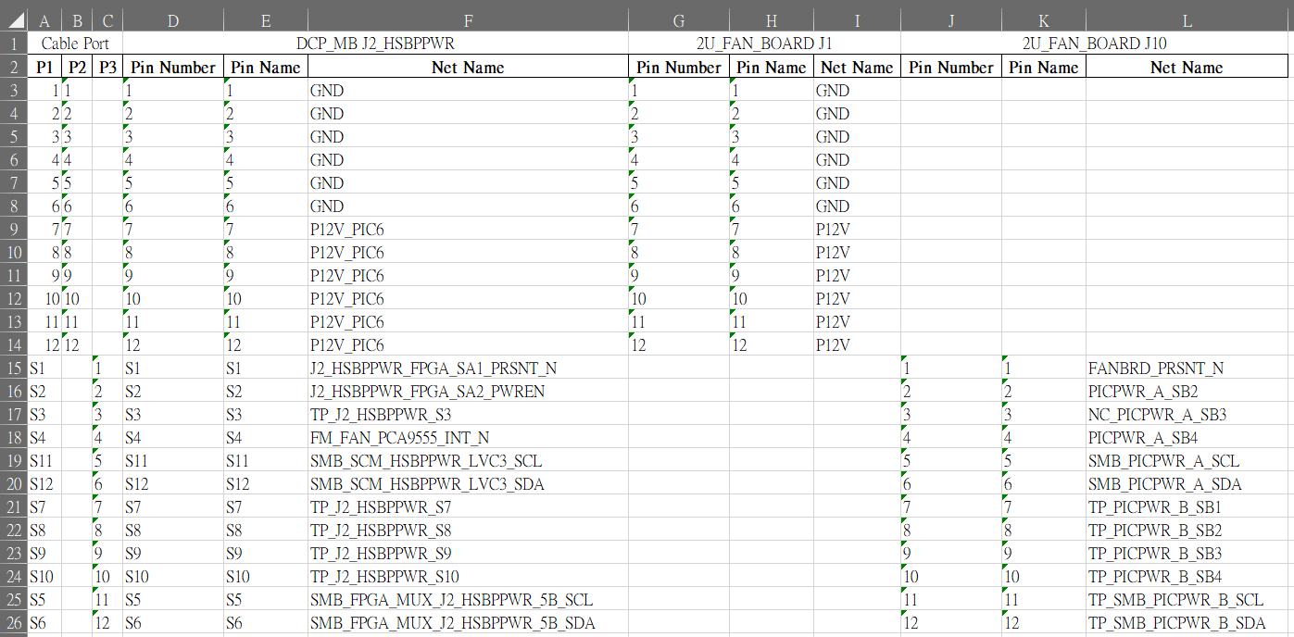
The Report
cable data
J2_HSBPPWR of MB
J2 of fan board
J1 of fan board

Slide 12
End
Copyright © 2020 MiTAC Holdings Corporation. all rights reserved

