Slide 1
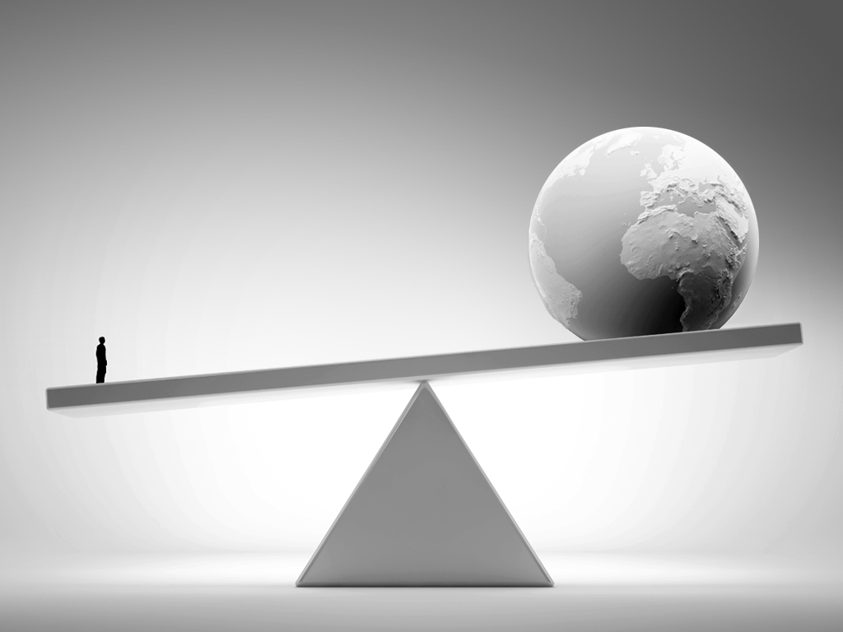
Understanding our world
Matheus N. Gomes

Slide 2

Summary
Introduction
Gross Domestic Product and Human Development index
Conclusion
Data sources and references

Slide 3
Introduction
Is money blame for inequality? Maybe you asked or listened this question. We human have evolving each day and creating new things to improve our life and money was and is very important to do it.

