Slide 1

DBC Whiteboarding Workshop: Intro to Trees
Glenna & Dalal

Slide 2
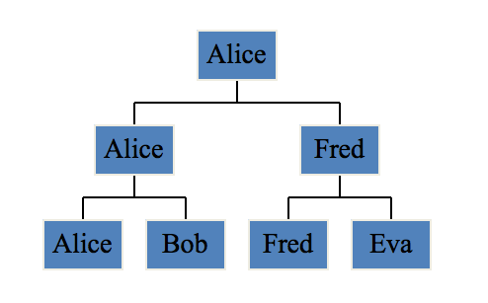
Trees
Notes:
Trees are a type of data structure like arrays or linked lists, but unlike those, trees are not organized linearly. Each item in the tree is a node.
Nodes ONLY have one piece of data and a list of children. Note that there are no circles.
One common application is for representing the possible moves in a game or search problem.

Slide 3
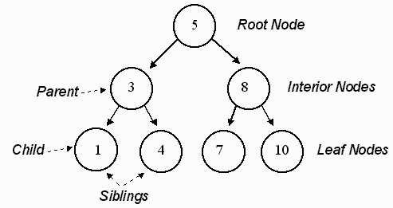
Notes:
Here is a vocab dump.
A tree is a data structure that contains nodes. Each node contains 1 piece of data, here they are numbers.
The node at the very top of the tree is called the root node. The nodes at the bottom of the tree are called the leaf nodes. Leaf nodes have no children.
Parent nodes can have an unlimited number of children, here they all have two because it’s a special kind of tree.
If two nodes share the same parent, they are called siblings nodes.
Can someone name trees that we interact with every day as web developers?
Tree
Node, each has data
Root
Leaves
Html example

Slide 4
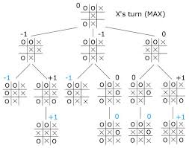
Notes:
Here’s a tree that represents some of the possible outcomes of a tic tac toe game. What DBC challenge does this remind you of?

Slide 5
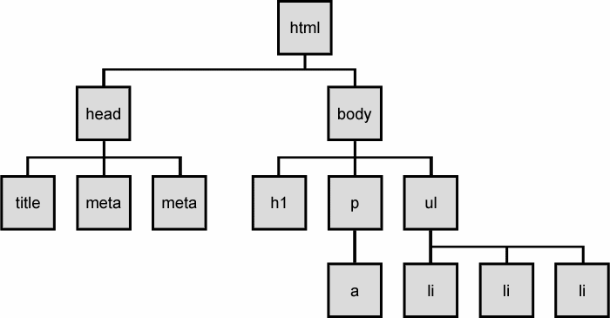
Quiz time!
Notes:
What is the root node of this tree? html
What type of node is the title? child or leaf node
How many children does the body node have? 3
What is the parent of the a node? p (or interior node)
Note that in this tree, some parents have 3 children and some have 1. This is a valid tree. Because each node has an unlimited number of children, it is just called a tree. Or a non-binary tree.

Slide 6
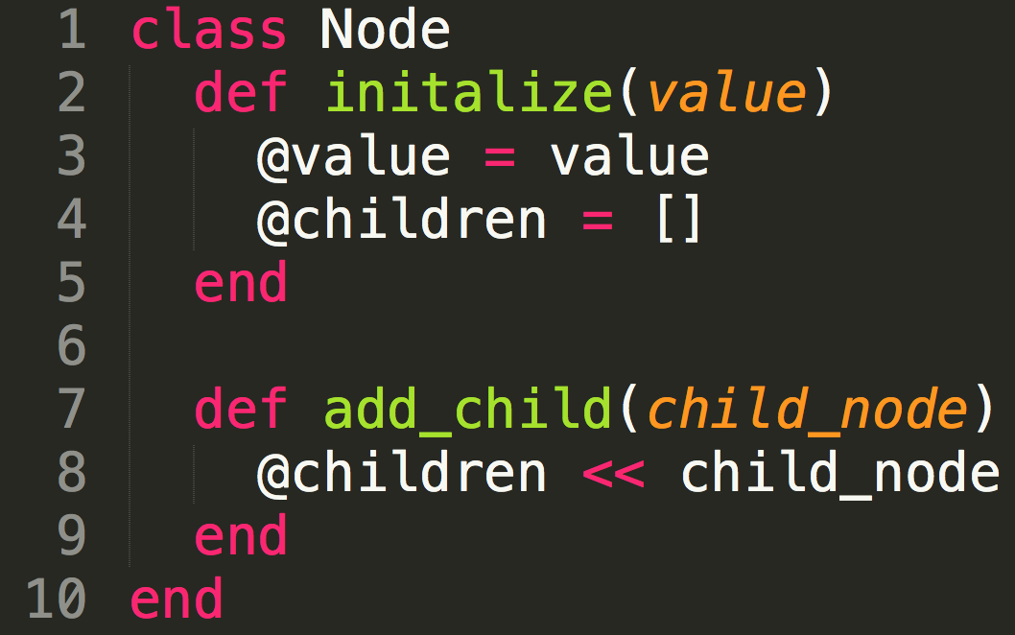
Trees are made of nodes
Notes:
Trees are a type of data structure like arrays or linked lists. Each item in the tree is a node.
Nodes ONLY have one piece of data and a list of children.

Slide 7
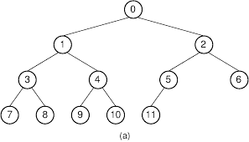
Binary Tree - 2 children max
Notes:
There are some special types of trees. One of them is a binary tree.
In a binary tree, each parent has AT MOST 2 children. You’ll note that 5 only has 1 child here. That is okay, it’s still a binary tree. It’s just a MAX of 2 children.

Slide 8
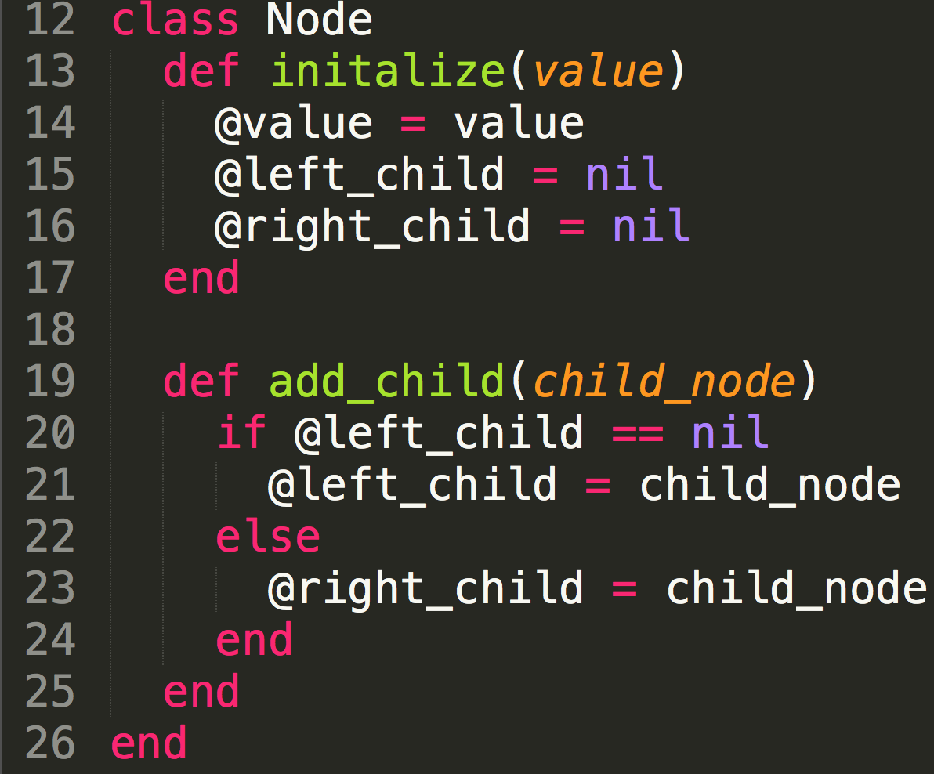
Binary Tree - 2 children max
Notes:
In a binary tree, each parent has AT MOST 2 children. You’ll note that 5 only has 1 child here. That is okay, it’s still a binary tree. It’s just a MAX of 2 children. Now there is one very special type of binary tree.

Slide 9
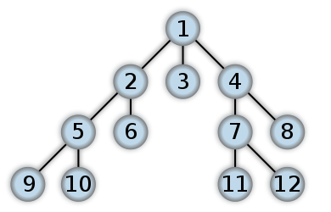
Breadth first search
Notes:
Breadth first: the numbers represent the order in which you would access them in the search. BFS you start at the root node, and then scan each node in the first level starting from the leftmost node, moving towards the right. Then you continue scanning the second level (starting from the left) and the third level, and so on until you’ve scanned all the nodes, or until you find the actual node that you were searching for.
Note that this tree is NOT A BINARY SEARCH TREE

Slide 10
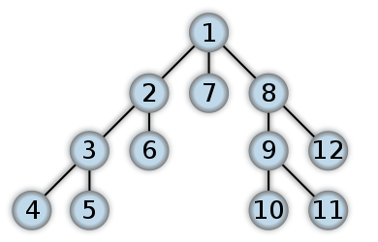
Depth First Search
Notes:
One way to search through a tree is called depth first search. In a depth first search, you start at the root, and follow one of the branches of the tree as far as possible until either the node you are looking for is found or you hit a leaf node ( a node with no children). If you hit a leaf node, then you continue the search at the nearest ancestor with unexplored children
DFS better for visiting every node, or visit every node until we have what we are looking for
If tree is very large, or want to quit when so far from beginning, use bfs

Slide 11
Depth First Search (DFS)
Recursion
“Easiest” for visiting every node
Lower memory requirements (don’t need to store all child pointers at each level)
Breadth First Search (BFS)
Queue (first in first out)
Infinite trees
Want to stop after a certain distance from the root
Notes:
the big advantage of DFS is that it has much lower memory requirements than BFS, because it’s not necessary to store all of the child pointers at each level. Depending on the data and what you are looking for, either DFS or BFS could be advantageous.
For example, given a family tree if one were looking for someone on the tree who’s still alive, then it would be safe to assume that person would be on the bottom of the tree. This means that a BFS would take a very long time to reach that last level. A DFS, however, would find the goal faster. But, if one were looking for a family member who died a very long time ago, then that person would be closer to the top of the tree. Then, a BFS would usually be faster than a DFS. So, the advantages of either vary depending on the data and what you’re looking for.

Slide 12
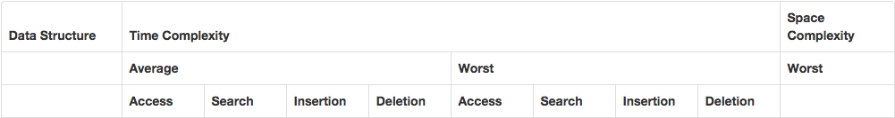
Binary Search Tree
Notes:
Can you tell me what is special about this tree that makes it a binary search tree.
http://articles.leetcode.com/2010/09/determine-if-binary-tree-is-binary.html
The left subtree of a node contains only nodes with keys less than the node’s key.
The right subtree of a node contains only nodes with keys greater than the node’s key.
Both the left and right subtrees must also be binary search trees.

Slide 13
Trees and Big O
Sorted and Balanced Trees:
O(log(n))
average complexity
Notes:
O(log(n)) for search

Slide 14
Trees and Big O
Sorted, not balanced:
O(n)
worst case complexity

Slide 15
Trees and Big O
Not sorted, not balanced:
O(n)
B-tree (NOT Binary Tree - a generalization of a binary tree but a parent can have more than 2 children)

Slide 16
3 Hints for Tree Questions
What kind of tree? Is it a binary tree or a binary search tree?
Does it sound like breadth first (queue) or depth first (recursion)?
If depth first, what is your base case?
Solve for a tree with only 1 parent and two children. Extrapolate from there.
Notes:
Depth-first: Including the base case and the “else” (in if-else statements), there are usually 3 conditional checks.
http://articles.leetcode.com/2010/09/determine-if-binary-tree-is-binary.html

Slide 17
Future Learning
What are: in order, pre order, post order traversal?
What is the runtime of searching a tree?
What are examples of when trees are useful?
When is a tree balanced?
Learn more here: http://www.cs.bham.ac.uk/~jxb/FCS/foundations.pdf
http://www.geeksforgeeks.org/how-to-determine-if-a-binary-tree-is-balanced/

Slide 18
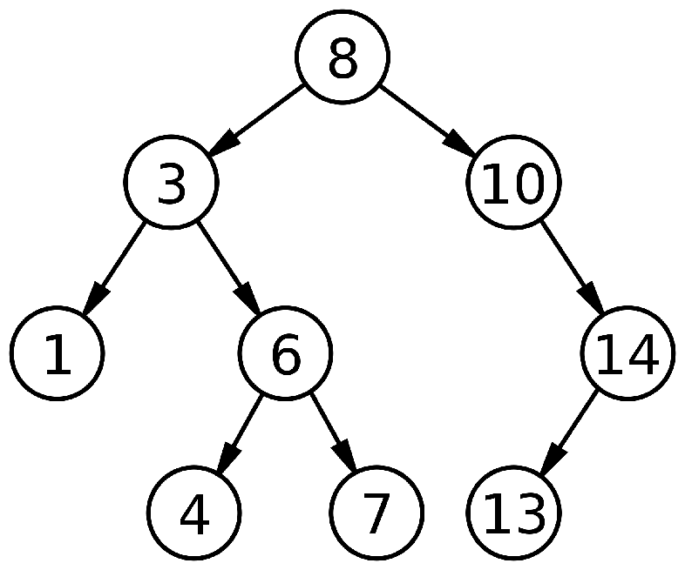
Write the function is_value_present? that takes the root node of a binary search tree and an integer as arguments and returns true or false if the integer is in the tree.
For example, if you were passed this tree and the number 3 -> the function would return true.

Slide 19
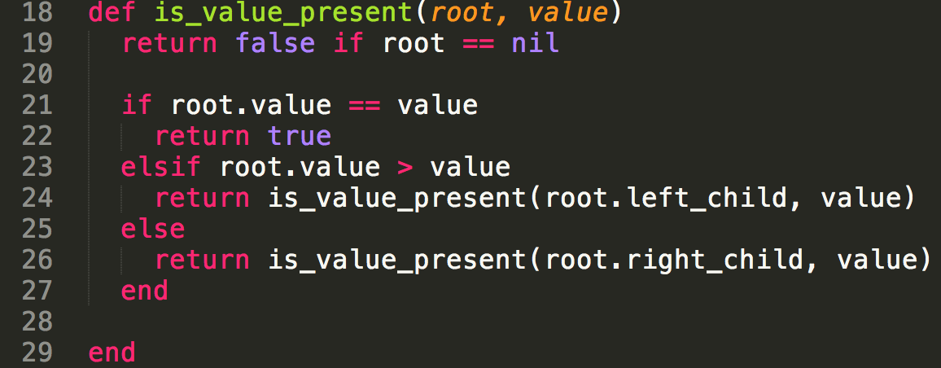
SOLUTION: is_value_present?

Slide 20
Valid Binary Search Tree?
Write a method that takes in a root and returns true -- if the tree is a BST.
HINTS
First Way: Think about how many parameters you need to pass in.
Second Way: Use (and write out) helper methods

Slide 21
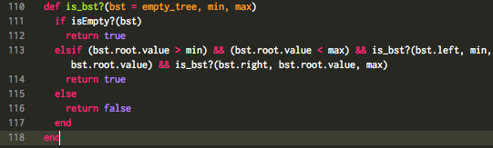
SOLUTION: Valid BST

Slide 22
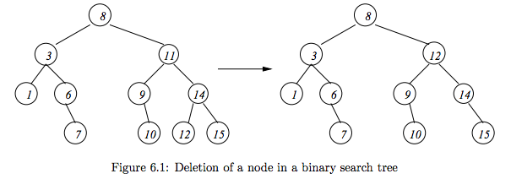
Delete A Node From BST

Slide 23
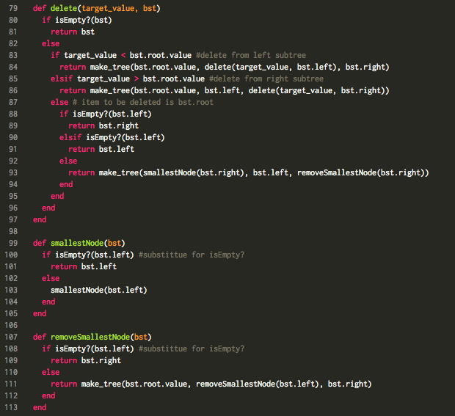
SOLUTION: Deleting a BST Node
If node is a leaf node, remove it
If only one of the node’s subtree is empty, ‘move up’ the remaining subtree.
If the node has two non-empty subtrees, then go to the right subtree and find the left-most node (the smallest number).
Replace this node with the right sibling (if exists); or delete the node.

