Slide 1
Queues and Stacks
Amelia Downs
01/14/15
DBC SF

Slide 2

Queues: A real life example
queue: a fancy British word for line
1
2
3
4
5
6
3
Notes:
You could store these people in an array. But queues are different from arrays based on their ordering. For example….*change slide*

Slide 3
Queues: A real life example
queue: a fancy British word for line
Who entered this queue first?
Who entered this queue last?
Who will leave this queue first?
Who will leave this queue last?
1
2
3
4
5
6
3

Slide 4
Queues: FIFO
First In, First Out
Person 1 entered the line first and will leave the line first.
Only have access to two positions
first
last
1
2
3
4
5
6
First
Last
3

Slide 5
Queues: FIFO
What methods does a queue have?
Remember, you can only access first and last.
1
2
3
4
5
6
First
Last
3

Slide 6
Queues: FIFO
What methods does a queue have?
Remember, you can only access first and last.
Look at last: last
Add to queue: enqueue
Look at first: first
Remove from queue: dequeue
isEmpty?
1
2
3
4
5
6
First
Last
3

Slide 7
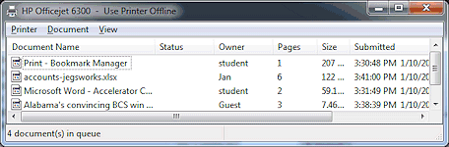
Queue Example: Printer Queue

Slide 8
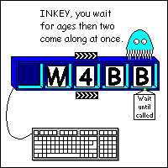
Queue Example: Keyboard Buffer

Slide 9

Stacks: a real life example

Slide 10
Stacks: a real life example
Pretend you can only pick up one book at a time...
Which book entered the stack first?
Which book entered the stack last?
Which book will be removed from the stack first?
Which book will be removed from the stack last?

Slide 11
Stacks: LIFO
Last In, First Out
The yellow book was the last one added to the stack and will be the first to leave.
The last in is called the top
Anything else in the stack is called the rest
You only have access to the top
TOP
REST

Slide 12
Stacks: LIFO
What methods does a stack have?
Remember, you can only access the top.
TOP
REST

Slide 13
Stacks: LIFO
What methods does a stack have?
Remember, you can only access the top.
Look at the top: peek
Remove the top: pop
Add an item to the top: push
isEmpty?
TOP
REST

Slide 14
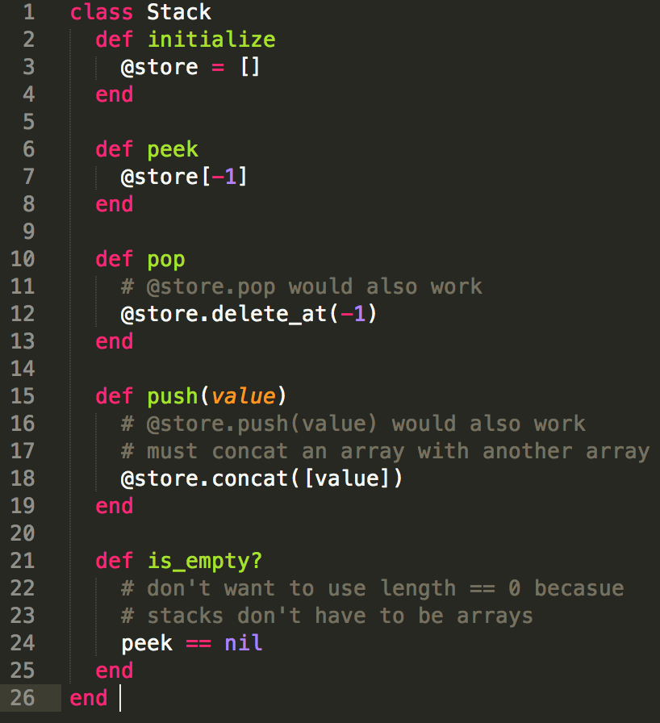
Implementing a Stack

Slide 15
Using a stack to reverse a string
Push all of the characters onto a stack one at a time
Pop all of the characters out of the stack into a new string
str = “stack”

Slide 16
Using a stack to reverse a string
Push all of the characters onto a stack one at a time
Pop all of the characters out of the stack into a new string
str = “tack”
s

Slide 17
Using a stack to reverse a string
Push all of the characters onto a stack one at a time
Pop all of the characters out of the stack into a new string
str = “ack”
t
s

Slide 18
Using a stack to reverse a string
Push all of the characters onto a stack one at a time
Pop all of the characters out of the stack into a new string
str = “ck”
a
t
s

Slide 19
Using a stack to reverse a string
Push all of the characters onto a stack one at a time
Pop all of the characters out of the stack into a new string
str = “k”
c
a
t
s

Slide 20
Using a stack to reverse a string
Push all of the characters onto a stack one at a time
Pop all of the characters out of the stack into a new string
str = “”
k
c
a
t
s

Slide 21
Using a stack to reverse a string
Push all of the characters onto a stack one at a time
Pop all of the characters out of the stack into a new string
str = “”
reversed_str = “”
k
c
a
t
s

Slide 22
Using a stack to reverse a string
Push all of the characters onto a stack one at a time
Pop all of the characters out of the stack into a new string
str = “”
reversed_str = “k”
c
a
t
s

Slide 23
Using a stack to reverse a string
Push all of the characters onto a stack one at a time
Pop all of the characters out of the stack into a new string
str = “”
reversed_str = “kc”
a
t
s

Slide 24
Using a stack to reverse a string
Push all of the characters onto a stack one at a time
Pop all of the characters out of the stack into a new string
str = “”
reversed_str = “kca”
t
s

Slide 25
Using a stack to reverse a string
Push all of the characters onto a stack one at a time
Pop all of the characters out of the stack into a new string
str = “”
reversed_str = “kcat”
s

Slide 26
Using a stack to reverse a string
Push all of the characters onto a stack one at a time
Pop all of the characters out of the stack into a new string
str = “”
reversed_str = “kcats”

Slide 27
Using a stack to implement “undo”
Any time a change is made, push the change onto the stack.
When updo is pressed, pop the top item from the stack.

Slide 28
Using a stack to implement “undo”
Any time a change is made, push the change onto the stack.
When updo is pressed, pop the top item from the stack.
I love algorithms

Slide 29
Using a stack to implement “undo”
Any time a change is made, push the change onto the stack.
When updo is pressed, pop the top item from the stack.
I really love algorithms
I love algorithms

Slide 30
Using a stack to implement “undo”
Any time a change is made, push the change onto the stack.
When updo is pressed, pop the top item from the stack.
I really love algorithms!!!
I really love algorithms
I love algorithms

Slide 31
Using a stack to implement “undo”
Any time a change is made, push the change onto the stack.
When updo is pressed, pop the top item from the stack.
I super really love algorithms!!!
I really love algorithms!!!
I really love algorithms
I love algorithms

Slide 32

What is a STACK overflow?

Slide 33
Whiteboarding Techniques
Draw an example problem and solve it without code
Pseudocode your solution
Code
perfect syntax: optional
unwritten helper functions: recommended
Making sure your interviewers understand your solution is more important than writing perfect code

Slide 34
Question 1
Cheat Sheet
Queue: First in, first out
first
last
enqueue(item) #add
dequeue #remove
is_empty?
Stack: Last in, first out
peek
pop #remove
push(item) #add
is_empty?
Implement a Queue class. You must write all five methods listed on the right side.

Slide 35
Question 2
Cheat Sheet
Queue: First in, first out
first
last
enqueue (add)
dequeue (remove)
is_empty?
Stack: Last in, first out
peek
pop (remove)
push (add)
is_empty?
Implement a Queue class using two stacks.
You may assume you have a stack class with the four methods listed to the right.

Slide 36
Question 3
Cheat Sheet
Queue: First in, first out
first
last
enqueue (add)
dequeue (remove)
is_empty?
Stack: Last in, first out
peek
pop (remove)
push (add)
is_empty?
Write the function #has_matching_parens that takes a string as an argument and returns true if the string has valid parenthesis.
ex.
str = “(I(really)love (al(g)or)ithms)”
has_matching_parens(str) #=> true
Bonus: How would you solve if there were [], (), and {}?

Slide 37
Resources
This Workshop’s Repo
Cracking the Coding Interview by Gayle McDowell
Ruby Monk: Stacks and Queues
Join G+
Give us feedback
Topics to Investigate
Stack overflow
Stack trace
What else (other than arrays) could you make stacks and queues out of?
Circular queues, why and how
Tower of Hanoi

Slide 38
To find the repo, Google:
“intro to whiteboarding DBC”

