Slide 1
The AUDICLE:
Context-sensitive, On-the-fly Programming Environ/mentality
Ge Wang and Perry Cook
Graphics Lunch
3.1.2004 http://soundlab.cs.princeton.edu/

Slide 2
What is this all about?
Motivate the Audicle
Update on ChucK progress
Update On-the-fly programming
Present the Audicle
  Initial design
  Important properties

Slide 3
Roadmap
What is an Audicle?
Background
  Similar entities
  ChucK + on-the-fly programming
The Audicle
  Design
  Faces of the Audicube
  Properties
Future work…

Slide 4
What is an Audicle?

Slide 5
an oracle speaks…
an audicle makes computer music.

Slide 6
Editor
Develop
Debugger
Compiler
Run-time
VM

Slide 7
Editor
Develop
Debugger
Compiler
Run-time
VM

Slide 8
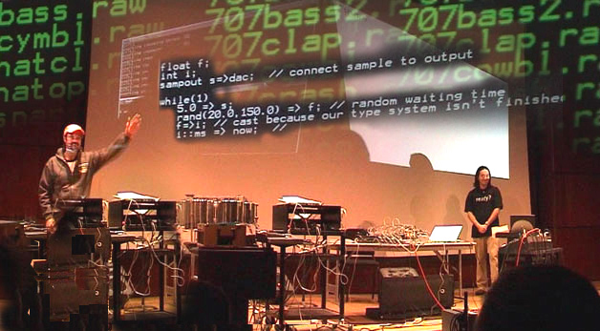
Goals of the Audicle
Complete the loop: development | runtime
Provide more fundamental level of interactivity: On-the-fly programming
For performance, composition, and experimentation

Slide 9
The Audicle is…
A context-sensitive, on-the-fly programming environment
  Context-sensitive: smart editor
  On-the-fly: run-time programmable
A different audio programming mentality…
All of the below:
  Editor, Compiler, VM, Debugger
Based on ChucK
  Compiler and VM

Slide 10
Background
Existing programming environments
  Max/MSP
  MATLAB
  SPICE
  Ptolemy
  Soundium 2
ChucK + On-the-fly Programming
  Timing and concurrency
  The perils of on-the-fly programming…

Slide 11
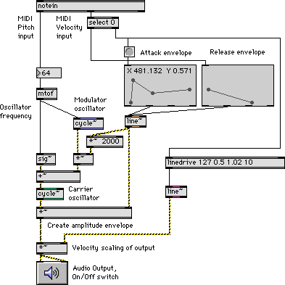
Max / MSP
Graphical audio programming environment
Interconnection of unit generator modules
Real-time and somewhat “on-the-fly”
Quick and visual
Lack low-level programmability, especially that of timing

Slide 12
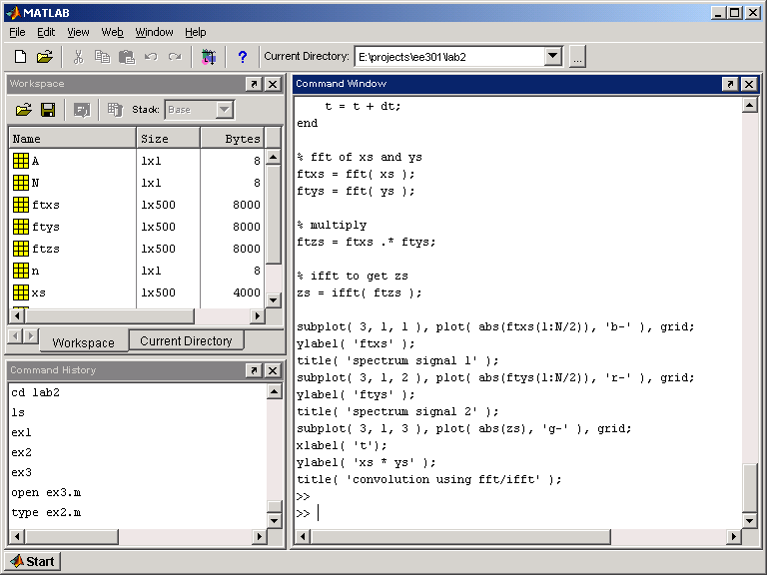
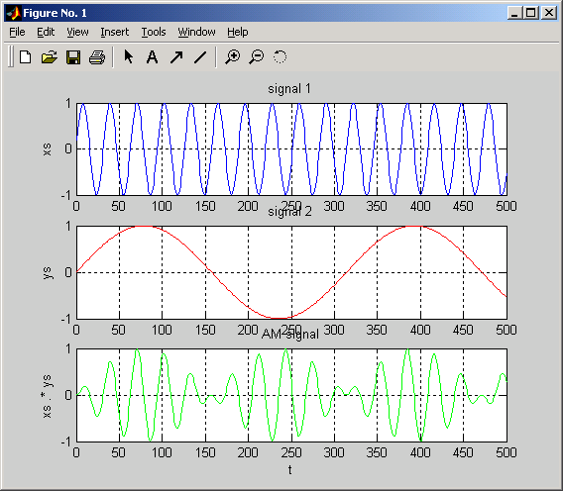
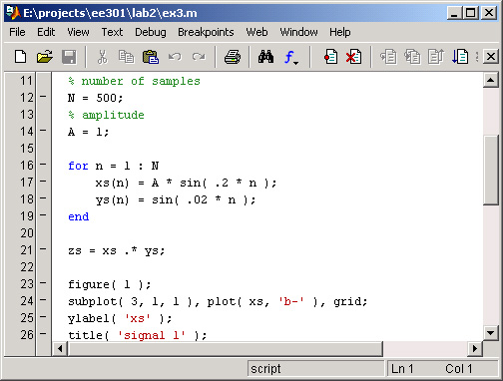
MATLAB

Slide 13
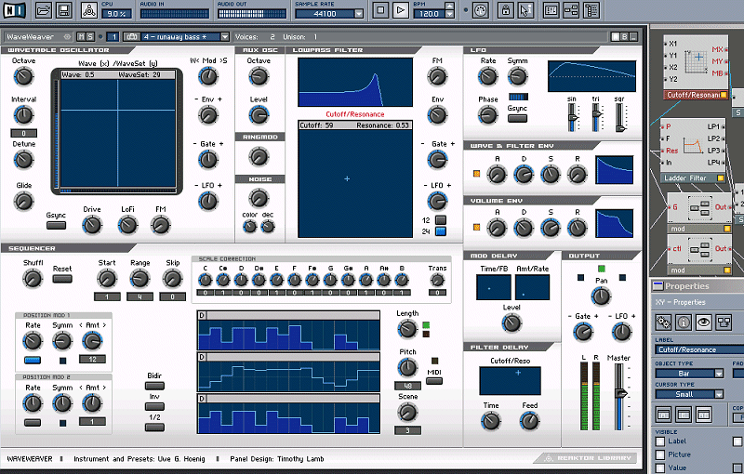
Reaktor

Slide 14
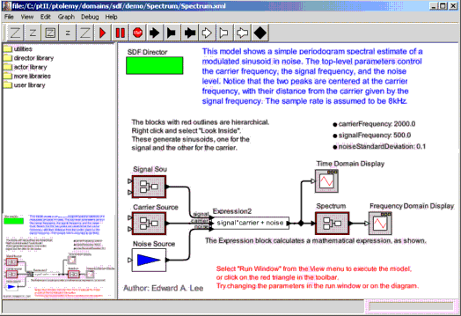
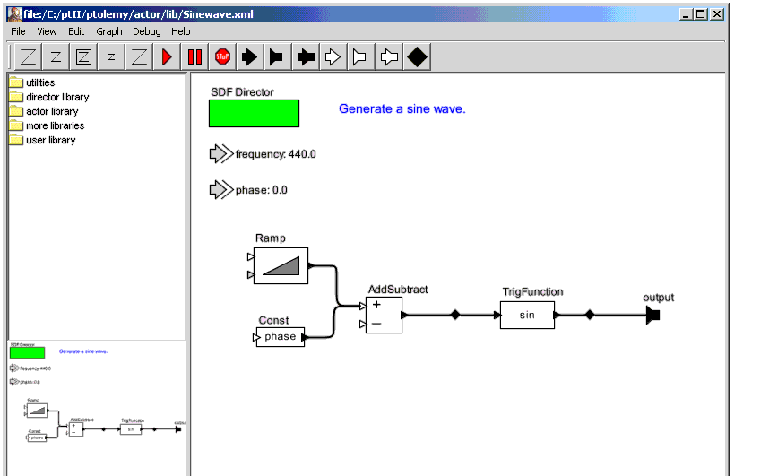
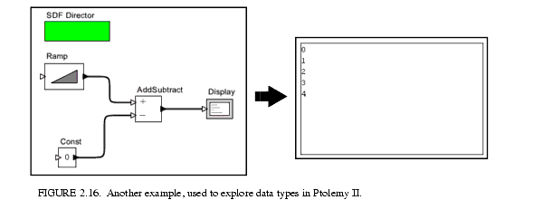
Ptolemy

Slide 15
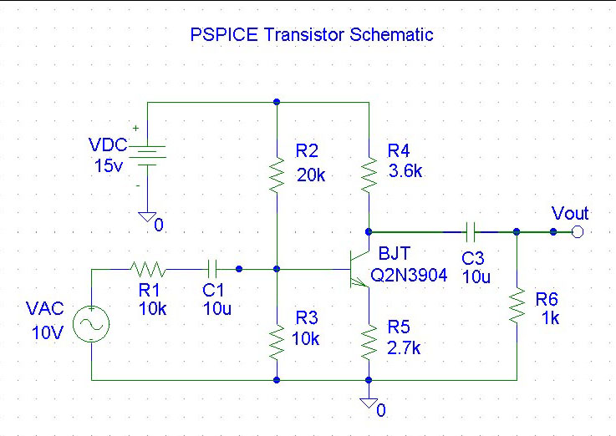
SPICE
SIMPLE DIFFERENTIAL PAIR
VCC 7 0 12
VEE 8 0 -12
VIN 1 0 AC 1
RS1 1 2 1K
RS2 6 0 1K
Q1 3 2 4 MOD1
Q2 5 6 4 MOD1
RC1 7 3 10K
RC2 7 5 10K
RE 4 8 10K .
MODEL MOD1 NPN BF=50 VAF=50
IS=1.E-12 RB=100
CJC=.5PF TF=.6NS
.TF V(5) VIN
.AC DEC 10 1 100MEG
.PLOT AC VM(5) VP(5)
.PRINT AC VM(5) VP(5)
.END

Slide 16
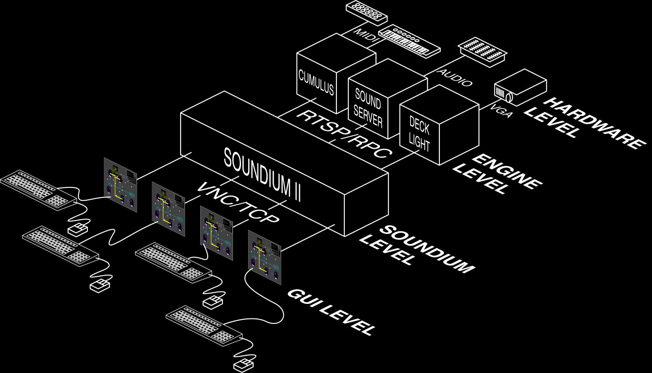
Soundium 2
“Multimedia Playground”
“Real-time Powerpoint”
Scripting language
Patching system
3D engine

Slide 17
ChucK + On-the-fly Programming
Preserve and extend properties of ChucK
  Precise Timing
  Concurrency
  Modularity for on-the-fly programming
Adding “loop-back” constructs in the language
  Editor
  Compiler
  Machine
  Language

Slide 18
ChucK Timing Mechanism
noise => env => biQuad => dac;
    while( true )
    {
    500 + (300 * sin(now*FC)) => biQuad.freq;
    100::ms => now;
    }
Notes:
Chuck operator useful for the rest of the talk, keep it in mind

Slide 19
How It Works
(running)
Execution
Unit
Process
(waiting)
Audio
Engine
Scheduler
Process
now
DAC
future

Slide 20
How It Works
(running)
Execution
Unit
Process
Audio
Engine
Scheduler
now
DAC
future

Slide 21
Consequences of
Timing Mechanism
Consistent, deterministic notion of time
Strong correspondence of program flow and timing
Control rate
  Arbitrary
  Dynamic
  Sample-Synchronous
Timing model makes chuck more powerful by
allowing deterministic concurrency…
Notes:
Amortize – take out
Consistent – what does it mean – change it definitely

Slide 22
Concurrent
Audio Programming
noise => env => biQuad => dac;
    0.0 => float v;
    while( true )
    {
    sin(v*FC) => biQuad.freq;
    1.0 +=> v;
    100::ms => now;
    }
while( true )
{
if( midiin.noteOn() )
midiin.vel => env;
13::ms => now;
}

Slide 23
Properties of Shreds
Resemble non-preemptive threads
User-level constructs (no kernel interaction)
  High-performance
    Context switch
    Synchronization / shreduling
Automatically synchronized by time!
Managed by the ChucK shreduler
Deterministic execution
Notes:
Precisely – get rid of
Synchronize by audio device

Slide 24
How it Works
(running)
Execution
Unit
Shred
(waiting)
(waiting)
Audio
Engine
Shreduler
Shred
Shred
…
now
DAC
future

Slide 25
Consequences of
Concurrency with Timing
Possible to write truly parallel, sample-synchronous audio code
Can work at low and high level
  Fine granularity == power and control
  Arbitrary granularity == flexibility and efficiency
Program on-the-fly…
Notes:
Line end
Correspondence – what does it mean

Slide 26
On-the-fly Programming
Goal: add/modify/remove parts of the program as it is running
Experimentation & performance possibilities
Use the shred mechanism
  Add and remove shreds from the virtual machine
  Use command, network, or Audicle (somehow)…

Slide 27
Propaganda Video

Slide 28
External Interface
execute | add | remove | suspend | resume
  | replace | status
Point of interface
  Command line
  Language-level

Slide 29
Command Line Example
# start VM with an ‘infinite time-loop’
  shell%> chuck -–start `while(true) 1::second=>now’
# add foo.ck
  shell%> chuck --add foo.ck
# replace shred 0 with bar.ck
  shell%> chuck --replace 0 bar.ck
# remove all shreds
  shell%> chuck --remove all

Slide 30
Language-level Example
// add shred from file “foo.ck”
  machine.add( “foo.ck” ) => shred foo;
// advance time by 500 milliseconds
  500::ms +=> now;
// replace foo with “bar.ck”
  machine.replace( foo, “bar.ck” ) => shred bar;
// advance time by 2 second
  2::second +=> now;
// remove bar
  machine.remove( bar );

Slide 31
On-the-fly Timing
Let time pass for some duration (10 seconds)
  now + 10::second => time later;
  later => now;
  // or…
  10::second => now;
Synchronize to some absolute time t
  t => now;
Synchronize to absolute time t or later
  if( t < now ) t => now;
Synchronize to beginning of next period of duration T
  120::ms => dur T;
  T – (now % T) +=> now;
Synchronize to beginning of next period, plus offset D
  T – (now % T) + D +=> now;
Start as soon as possible
  // no code necessary

Slide 32
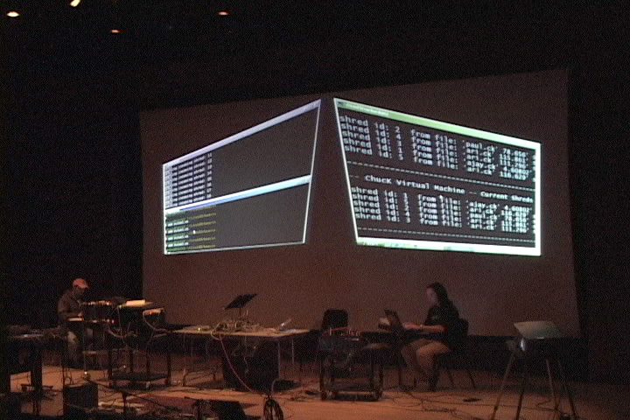
“On-the-fly Counterpoint”
Listening in the Sound Kitchen : 2003.11.14

Slide 33
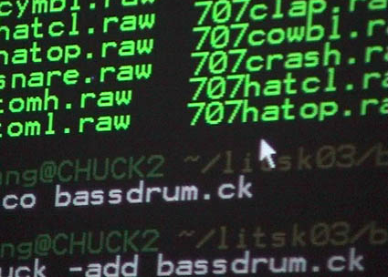
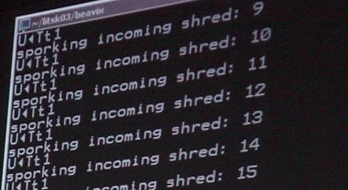
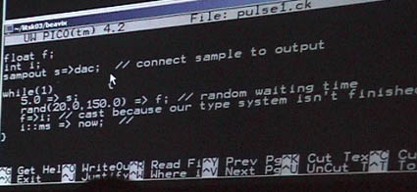
Screenshots from the performance…

Slide 34
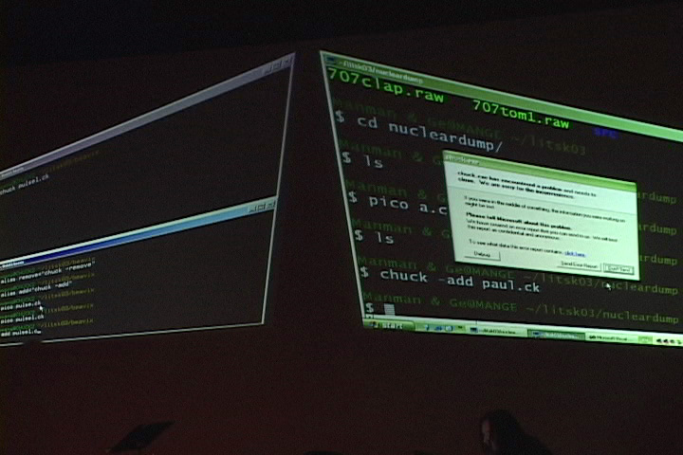
on-the-fly crashing…

Slide 35
We now introduce…

Slide 36
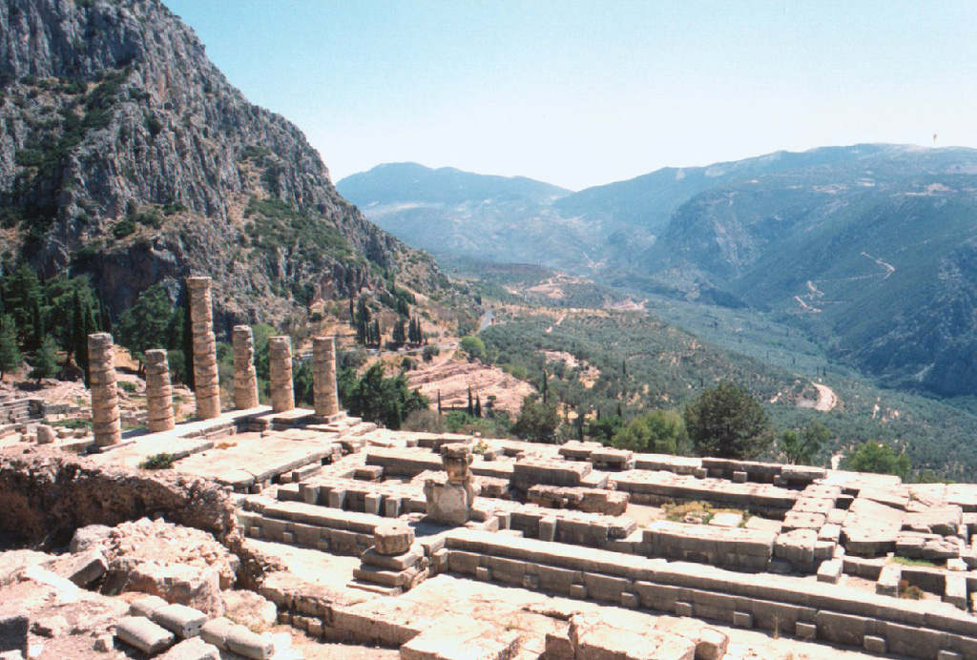
Based on the oracle at Delphi…

Slide 37
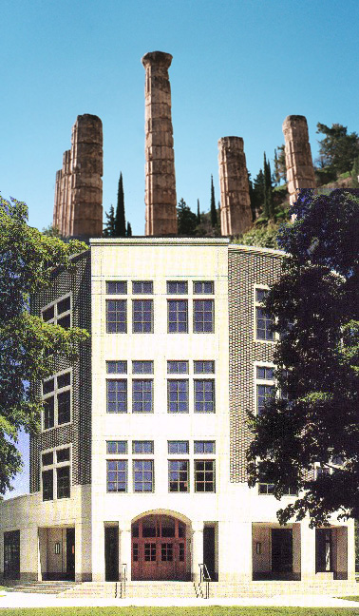
You are here
The Princeton Audicle!

Slide 38
Editor
Debugger
Compiler
VM

Slide 39
Design
ChucK based: tight coupling
Editor-compiler-VM-debugger in same address space
command line + graphical interface (MATLAB)
Interface via the Audicube

Slide 40
ChucK Virtual Machine
Code (“foo.ck”)
Code (“foo.ck”, “bar.ck”)
Process
shred
shred
shred
Chuck
Virtual
Machine
On-the-fly compiler
Shreduler
Execution Unit
Audio Engine
I/O Manager
Notes:
Talk about interactive programming

Slide 41
The Audicube
Many faces
  Can navigate to adjacent ones
  Up, down, left, right
Networked, collaborative

Slide 42
Faces of the Audicube
Cockpit : control panel of the Audicle
Editor: smart editor
Compile-space : program deep structure
Shredder : shred management
Time view : time view
Tabula Rase : whatever the user wants

Slide 43
Cockpit
CPU load
I/O manager
System profiler
Analysis output
Command line 2

Slide 44
Editor
Code editor++
Semantic mapping :
  Concurrent ChucK code <-> graphical flow-graph
  One-to-one correspondence between domains
  Concurrent code segment define boundaries

Slide 45
Compile-space
Deep structure : syntax tree
ChucK operator overloading
Run-time expression lookup
Debugger

Slide 46
Shredder
Shred management
  Add/Remove
  Replace
  Suspend/Resume
Current shred
Use with code editor for on-the-fly programming

Slide 47
Time view
Timeline
Schreduler state
Sampled
Shred timing – linked with Shredder and Editor

Slide 48
Tabula Rasa Face
Graphics rendering space
“Blank slate”

Slide 49
Different views
Different views of program
  Concurrent view (shreds)
  Syntax view (code, objects)
  Timeline view (time, timing)
Different view of programming process

Slide 50
On-the-fly Audicle
Code faster
Debug faster
Synchronize graphics and sound in same timing framework
Audicle is a framework for on-the-fly programming
New way of thinking about real-time and live audio and multimedia programming

Slide 51
Future work
Make it work
Make it right
Make it fast
Make it small
Formalize semantic

Slide 52
Thank you!
Phil Shilane
Benedict Brown
Ari Lazier

Slide 53
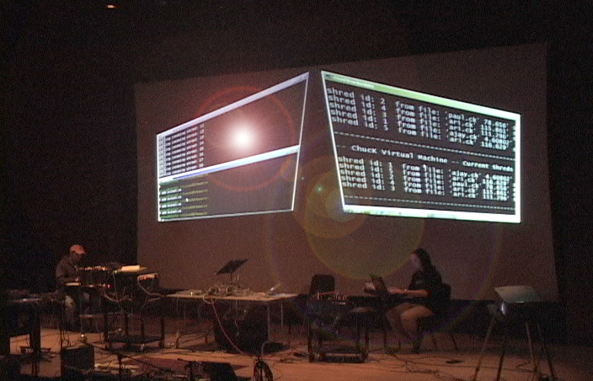
Questions and Comments…
(we need help)
http://chuck.cs.princeton.edu/
http://on-the-fly.cs.princeton.edu/
http://soundlab.cs.princeton.edu/

