Slide 1
The Audicle: Context-Sensitive, On-the-fly Audio Programming Environ/mentality
Ge Wang + Perry Cook
with Ananya Misra + Philip Davidson
Dept. of Computer Science
Princeton University
ICMC 2004

Slide 2
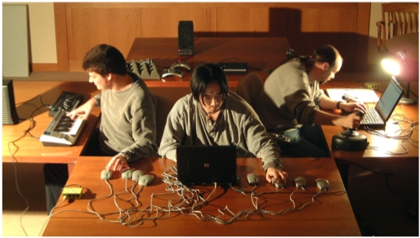
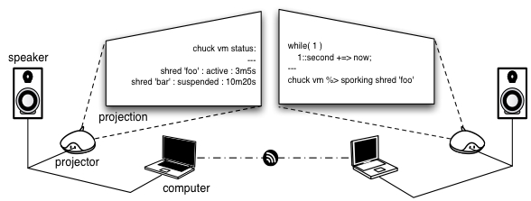
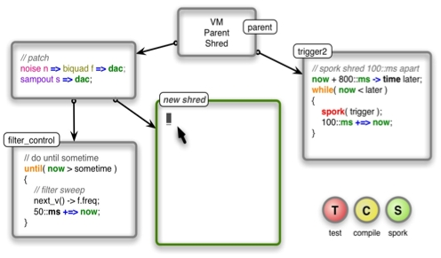
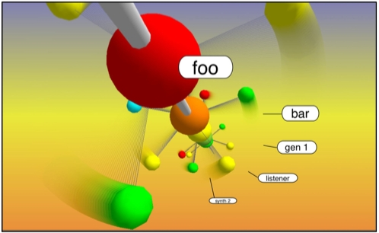

Slide 3
Chapter 1: COGITO
“I think”

Slide 4
(n.) the act of modifying the logic and structure of a program during runtime, for the purpose of rapid experimentation, and exerting expressive control.
on-the-fly programming:

Slide 5
Challenges
Modularity:
  Programmers must be able to reason about code sections and modify them independently.
Timing:
  There must a strong consistency and notion of time and timing between existing and new parts of the program.
Conciseness/manageability:
  Given substantial time constraints, how can ideas be expressed concisely in code? How do we reason about time and data flow easily?
Flexibility:
  Does the system allow programmers to take advantage of the expressive power of the language in a real-time setting?

Slide 6
ChucK
Audio Programming Language
Strongly-Timed -> precise control over time
Dead-simple concurrency model
Straightforward to write and read
  can reason formally about time
Arbitrary control rates
Encourages “thinking” and enables “reasoning” about code

Slide 7
Timing
impulse i => dac;
    // infinite time loop
    while( true )
    {
    // set the next sample
    1.0 => i.next;
    // advance time
    80::samp +=> now;
    }
Notes:
Chuck operator useful for the rest of the talk, keep it in mind

Slide 8
Concurrent
Audio Programming
impulse i => biquad f => dac;
    // time loop
    while( true )
    {
    // impulse train
    1.0 => i.next;
    80::samp +=> now;
    }
0.0 => float t;
while( true )
{
// sweep center freq
math.sin(t) => f.freq;
t + 0.01 => t;
100::ms +=> now;
}

Slide 9
Concurrency
Implemented using “shreds”
  Resemble non-preemptive threads
Automatically synchronized by time!
Possible to easily write truly parallel, sample-synchronous audio code
Can work at low and high level
  Fine granularity == power and control
  Arbitrary granularity == flexibility and efficiency
Solves control-rate issue
Notes:
Precisely – get rid of
Synchronize by audio device

Slide 10
ChucK Concurrency + Timing
No loss of generality
Staying “in the language”
  Express more from within the language
  Greatly reduce need for externals
Good for synthesis
Also good for synthesis research!
Provides natural modularity for on-the-fly programs

Slide 11
ChucK Virtual Machine
Code (“foo.ck”)
Code (“foo.ck”, “bar.ck”)
Process
shred
shred
shred
ChucK
Virtual
Machine
On-the-fly compiler
Shreduler
Execution Unit
Audio Engine
I/O Manager
video + demo
Notes:
Load demo
Change frequency
One low one high
Once you are able to do this

Slide 12
Notes:
Load demo
Change frequency
One low one high
Once you are able to do this

Slide 13
Power Tools Can Maim
Power to spork many, many, many shreds
Power to precisely synchronize shreds
Edit and re-spork
Query for status…
But, Oops…
Which shred is which?
Which version of the edited code did I save?
Who is using all the processor cycles?
What is the relative timing of the shreds?
Who is clipping?
And more questions, leading to…

Slide 14
Chapter 2: INCONDITUS
“unplanned, confused”

Slide 15
ERGO
“therefore…”

Slide 16
Chapter 3: The Audicle

Slide 17
Editor
Develop
Debugger
Compiler
Run-time
VM

Slide 18
Editor
Develop
Debugger
Compiler
Run-time
VM

Slide 19
The Audicle
Began as a “smart” text editor…
Became much more…
Not a GUI
  Highly graphical environment for text-based code
It’s an UI

Slide 20
The Audicle
Insight into real-time programs
Different views of programs
  Syntax (code, objects)
  Concurrency (shreds)
  Time and Timing (time, timing)
  Semantics (type)
Different view of programming process
New way of thinking about real-time and live audio and graphics programming

Slide 21
Design
ChucK based: tight coupling
Editor-compiler-VM-debugger in same address space
command line + graphical interface
Synchronize graphics and sound in same timing framework
Extensible
Interface via the Audicube

Slide 23
Audicle Demo A

Slide 24
Chapter 4: AGNOSCO,
ANIMADVERTO
“to recognize, understand, perceive, and to see”
(insight)
Notes:
Now we can better manage some of the stuff we talked about
Some of the other things we’ve talked about
Who is doing what

Slide 25
Graphics
engine
Audicle
ChucK
Mediator
UI
engine
Console
VM
Space
Named
values
Direct
hooks
Compiler
Space
TnT
Face
Manager
Syntax
Manager
Type
System
Tabula
Rasa
Editor
Shredder

Slide 26
3D Graphics for UI
Graphics -> OpenGL
Time is ripe for real-time 3D graphics
  Full control over look and feel
  Full framerate (30+)
  Fullscreen == immersive
  Hardware accelerated
  Cross Platform
  Downside: more difficult to implement
Graphics for ChucKist and the audience also benefits vicariously
  on-the-fly aesthetic

Slide 27
Audicle Demo B

Slide 28
Reflections + Future Work
The Audicle is about gaining insight into real-time programs and programming
Potential as a powerful composition tool
Supports on-the-fly performance aesthetic
(Careful) tight-coupling is beneficial
3D graphics in the service of UI is good
Keep going!

Slide 29
Thank you!
Ananya Misra
Philip Davidson
Ari Lazier
Paul Lansky
Dan Trueman
Princeton Graphics Group
http://chuck.cs.princeton.edu/

