Slide 1
Co-Audicle: a Collaborative
Audio Programming Space
Ge Wang*, Ananya Misra*,
Philip Davidson, and Perry Cook†
Dept. of Computer Science
Princeton University
*United States Cambodia †Bahrain
ICMC 2005

Slide 2
Co-Audicle
=
Collaborative Audicle
Notes:
The syntax and semantics of chuck have been presented too many times already, this deals with design and implementation and other philosophical topics. Thanks.

Slide 3
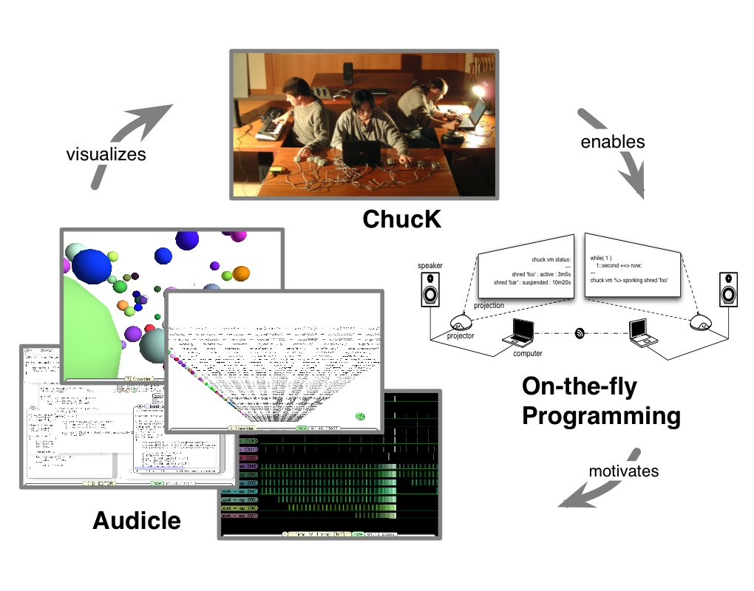

Slide 4
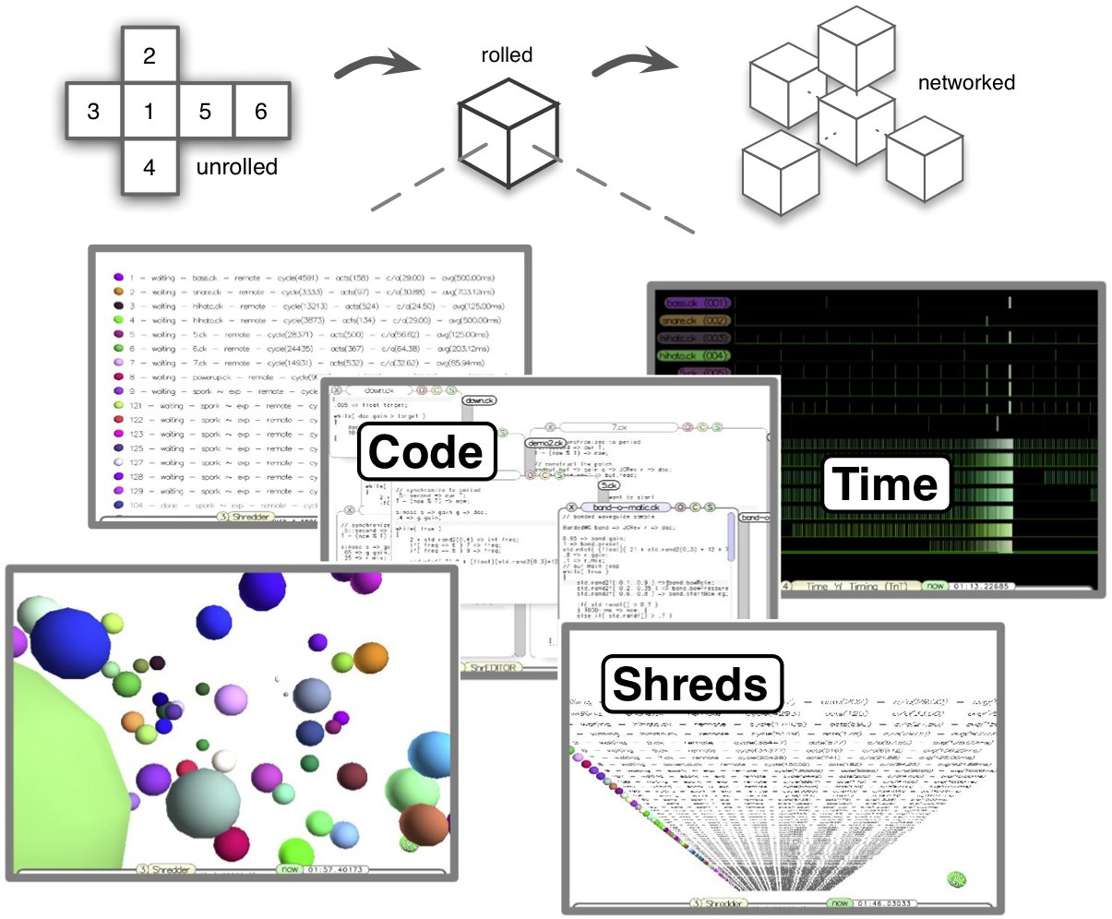

Slide 5
Motivation
multi-user distributed live coding
  performance + improvisation
long-distance audio programming education
collaborative experimentation
providing a wide-area social space
Notes:
Precisely – get rid of
Synchronize by audio device

Slide 6
Research Challenges
synchronization
consistency
defining interaction
Notes:
Precisely – get rid of
Synchronize by audio device

Slide 7
ChucK
precise programmability of time
  timing discovery
  deterministic synchronization
concurrency
  sample-synchronous parallelism
readability
  strong correspondence between code and time
on-the-fly programming
Notes:
Do you want to sleep?
(Question to the audience; rest of this presentation depends on the answer.)

Slide 8
The Audicle
makes on-the-fly programming more manageable
real-time visualization of system state
insight into audio program and the process of writing them
Notes:
Precisely – get rid of
Synchronize by audio device

Slide 9
The Co-Audicle
Notes:
Precisely – get rid of
Synchronize by audio device

Slide 10
Overview
goal: collaborative audio programming in a real-time space by multiple distributed users
two modes
  client/server
  peer-to-peer
Notes:
Precisely – get rid of
Synchronize by audio device

Slide 11
Mutated Client/Server
network of client/server groups
one centralized lookup server
  Spiritual Switchboard
  well-known address
  keeps track of all known servers (universal)
clients can move from group to group
Notes:
Precisely – get rid of
Synchronize by audio device

Slide 12
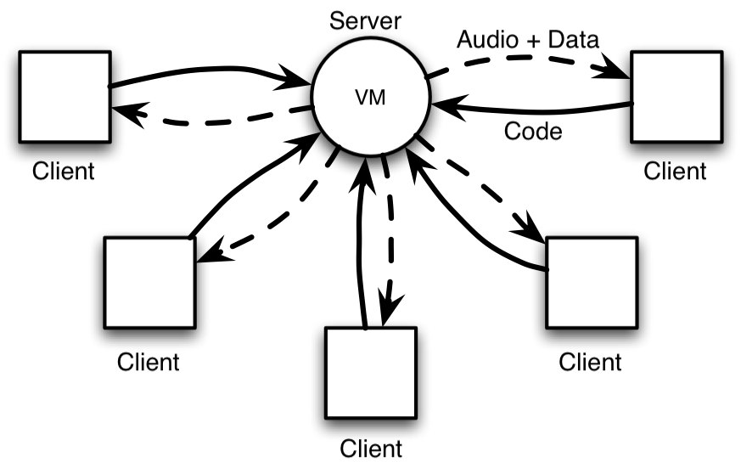

Slide 13
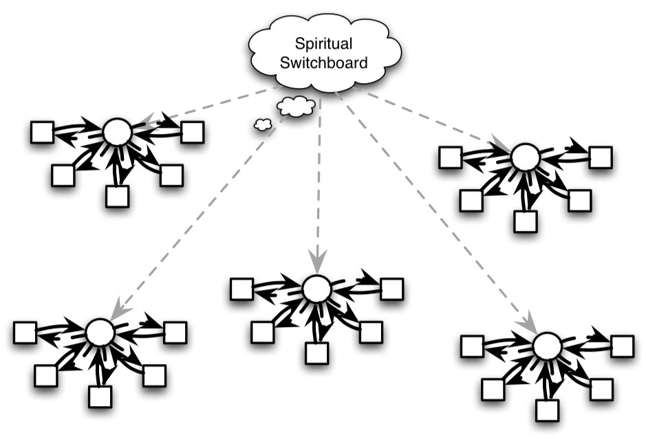

Slide 14
Client/Server Group
one group server
  can be instantiated by any user, who becomes the administrator or moderator
  register with Spiritual Switchboard
  audio computations happen at the server, and sent to clients in real-time
  maintains group state
  public space for coding, chatting
many clients
  semi-dumb terminal
    rendering
    edit management
Notes:
Precisely – get rid of
Synchronize by audio device

Slide 15
Peer-to-Peer
many symmetrical nodes
no audio is transferred, only code
consistency
  maintained by chuck
  multi-environment shred syndicate
    black box unit, only interface is time
synchronization
  clock skew is a problem
security
Notes:
Precisely – get rid of
Synchronize by audio device

Slide 16
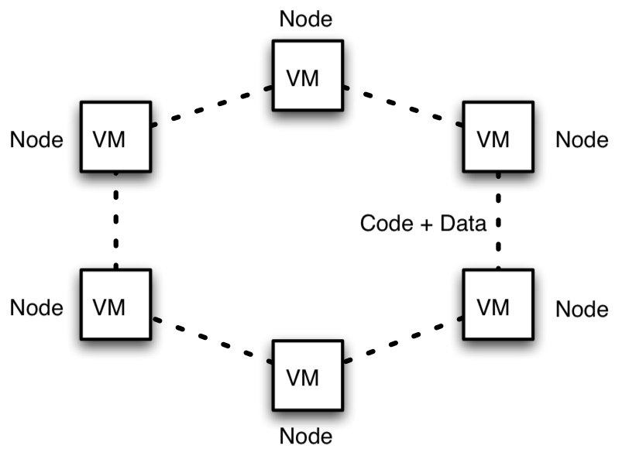

Slide 17
Users
users can:
  read each other’s code
  contribute code as participants
  observe (and listen)
  communicate via chat
  move from room to room
  persist state and objects in his/her bindle

Slide 18
Co-Audicle Client/Server
Architecture
Notes:
Precisely – get rid of
Synchronize by audio device

Slide 19
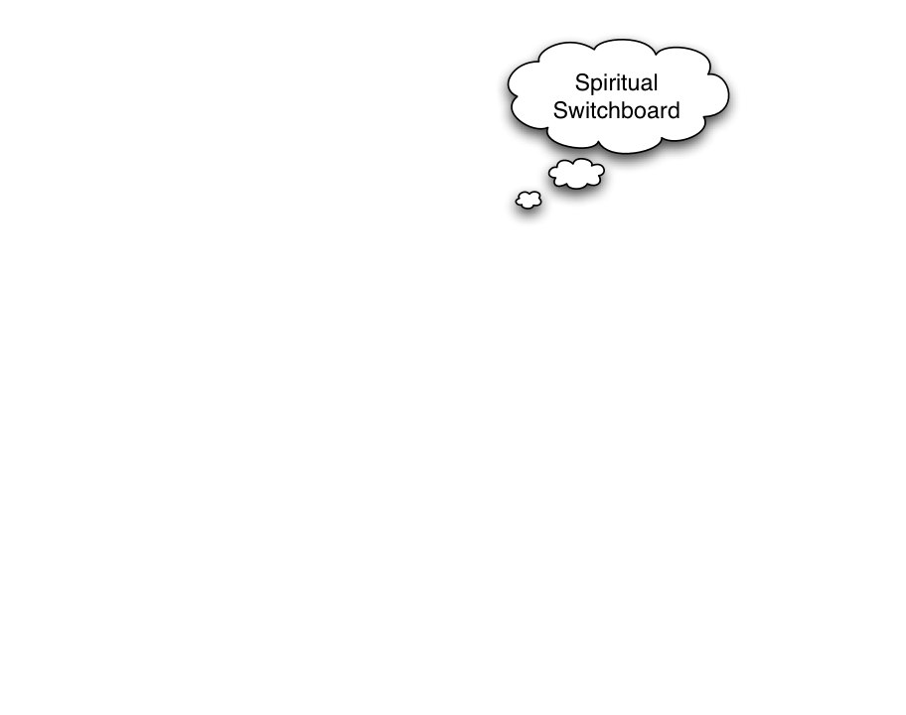

Slide 20
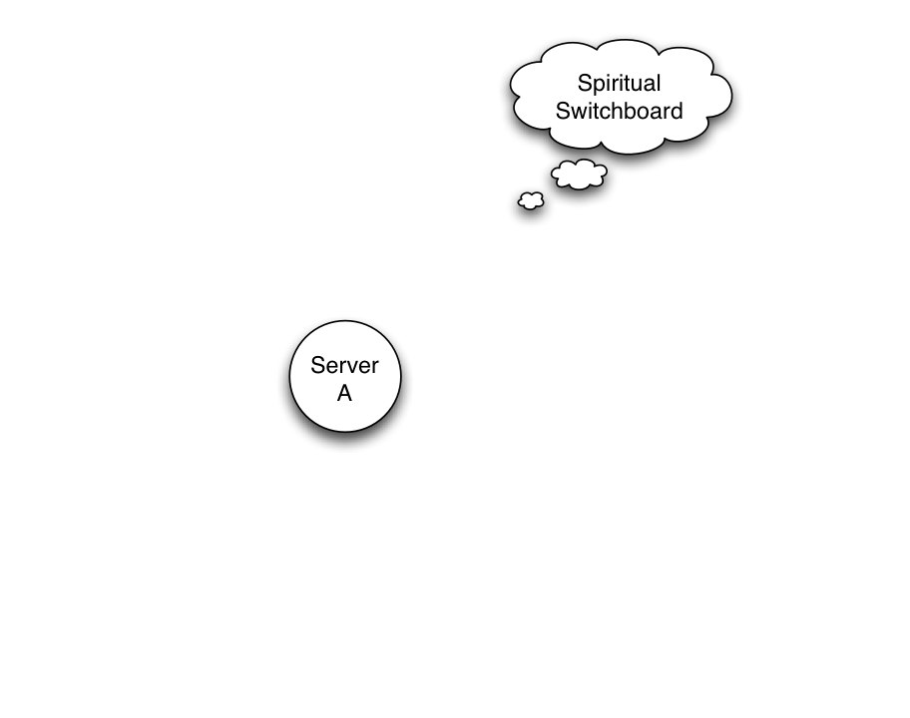

Slide 21
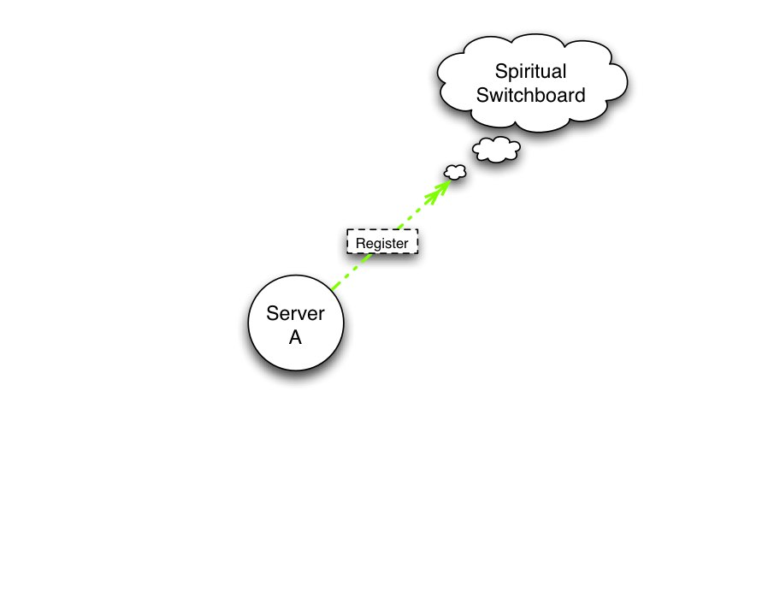

Slide 22
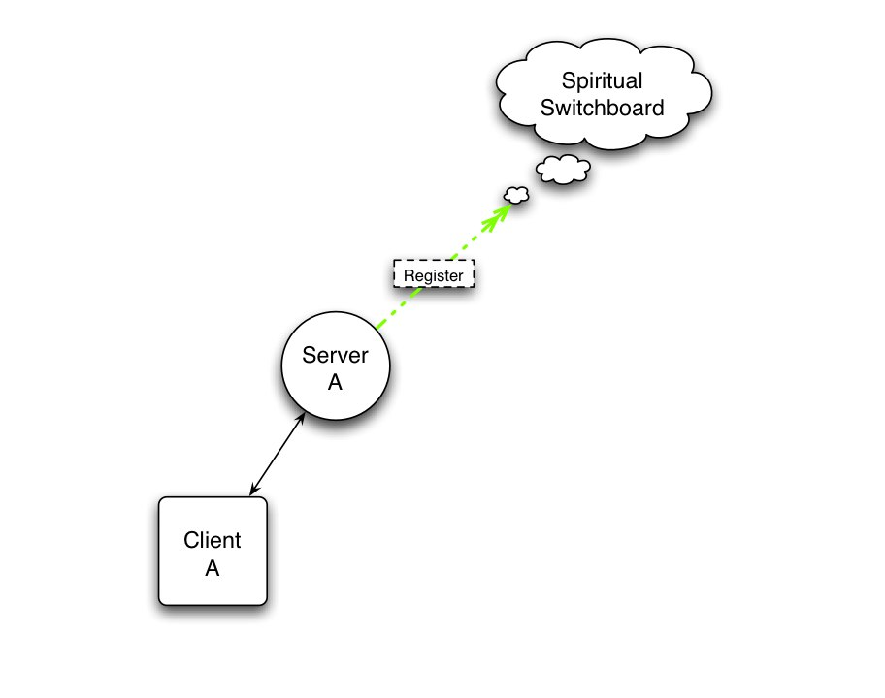

Slide 23
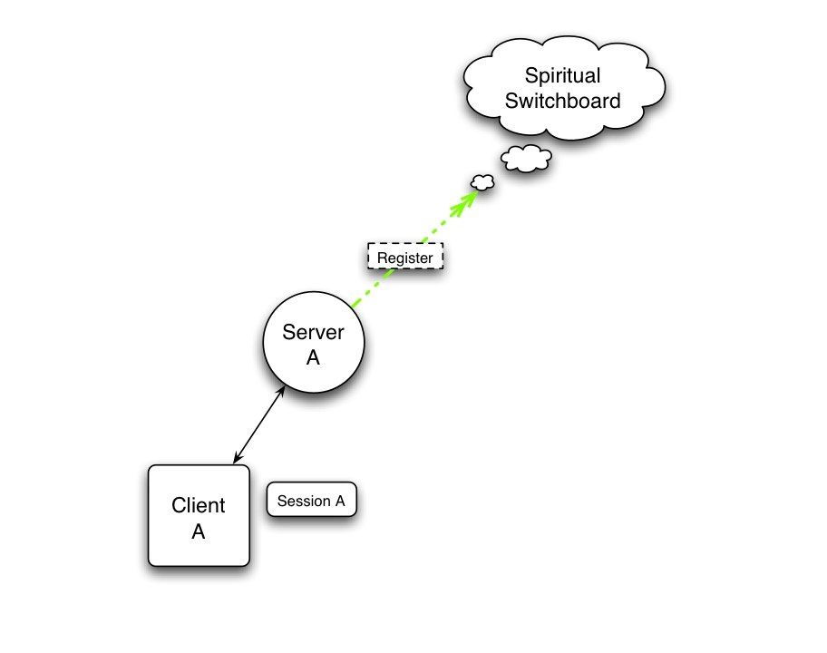

Slide 24
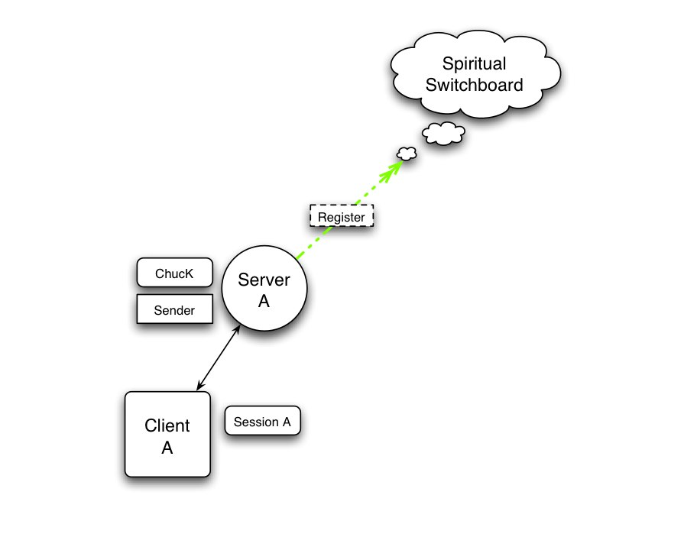

Slide 25
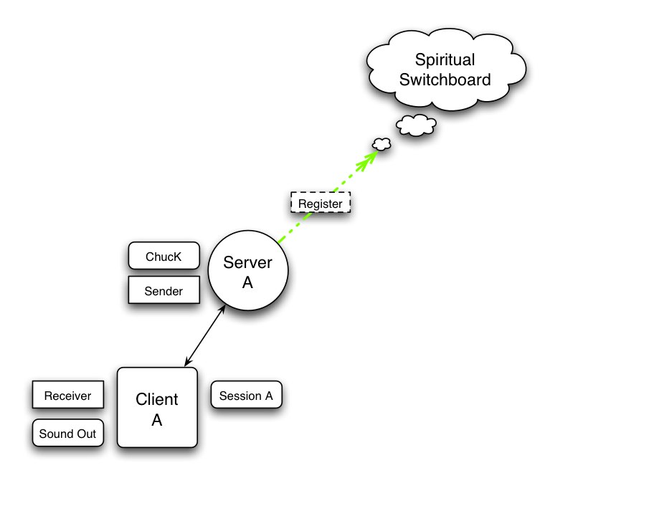

Slide 26
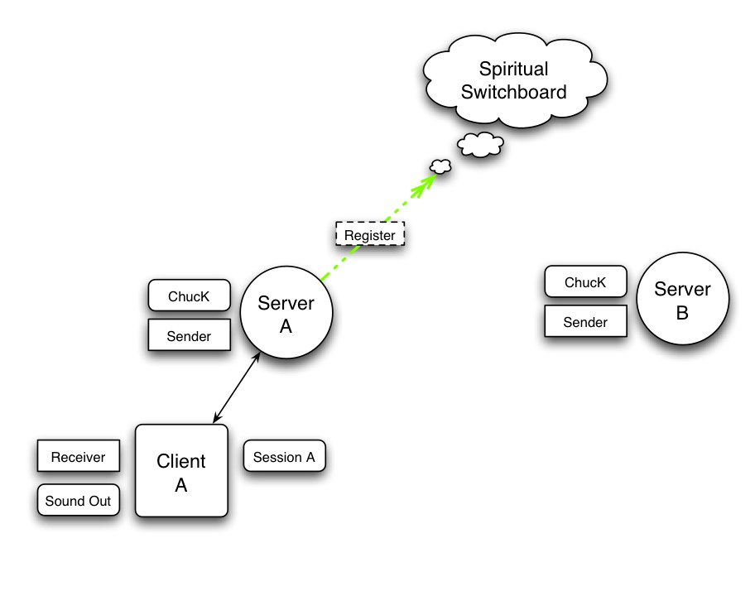

Slide 27
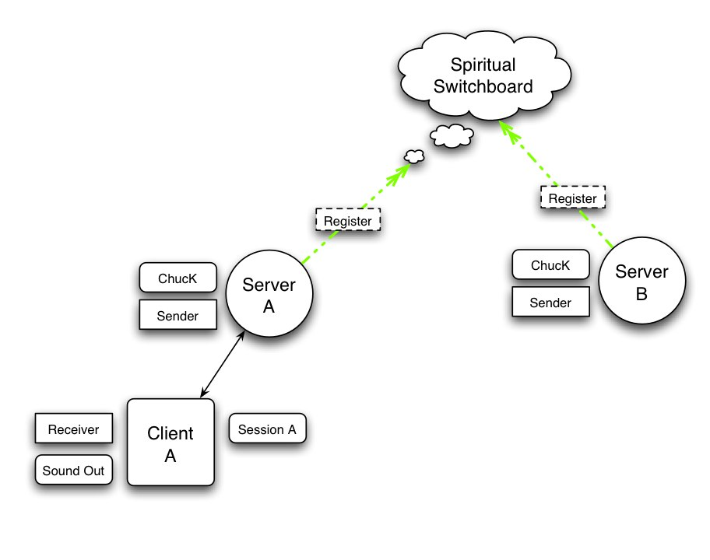

Slide 28
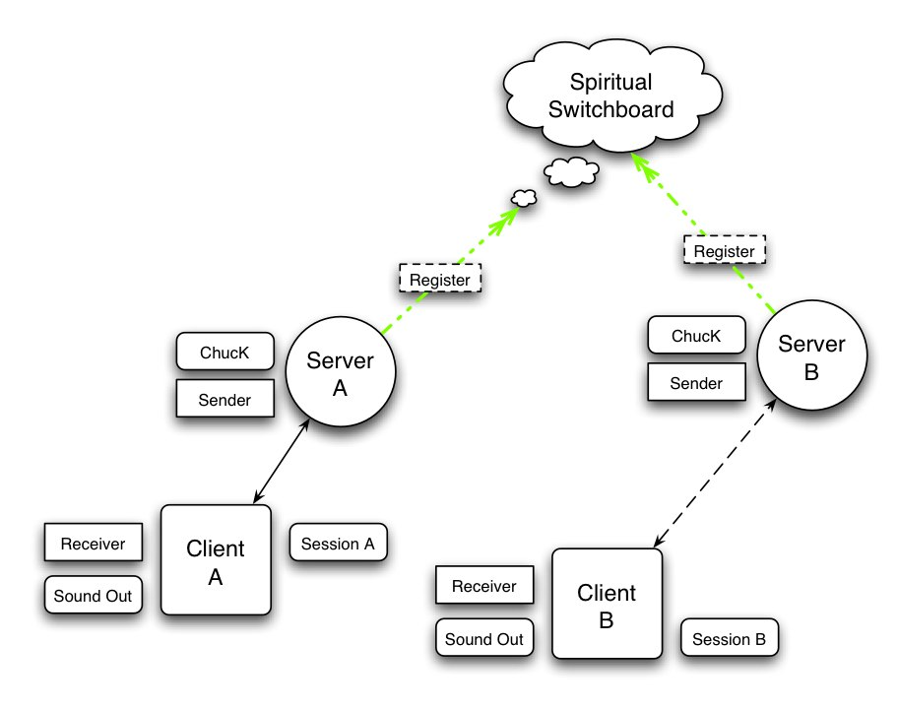

Slide 29
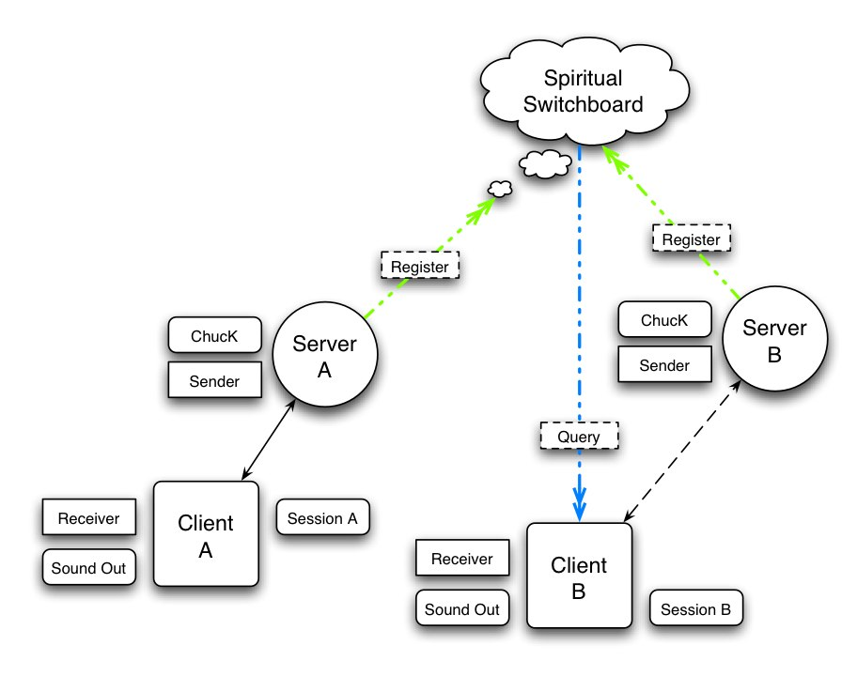

Slide 30
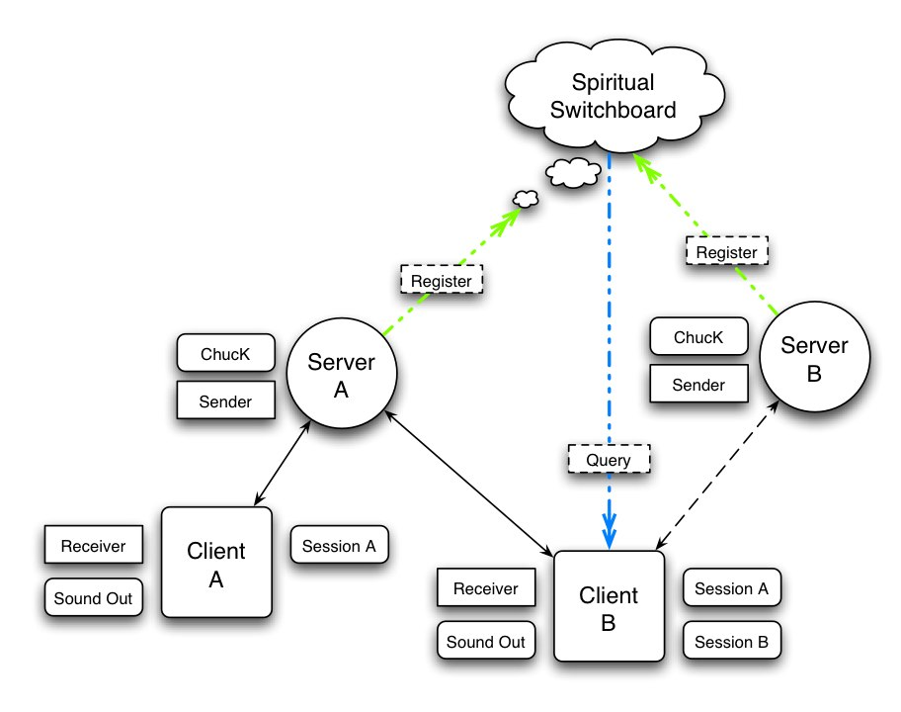

Slide 31
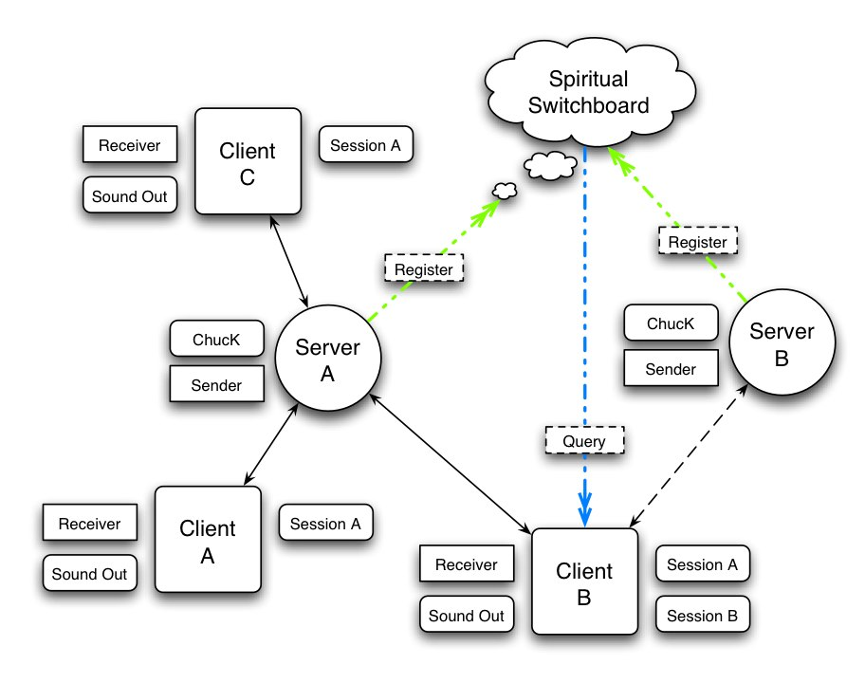

Slide 32
Demo
Notes:
Precisely – get rid of
Synchronize by audio device

Slide 33
Princeton Sound Lab:
http://soundlab.cs.princeton.edu/
(Co-)Audicle:
http://audicle.cs.princeton.edu/

