Slide 1
ChucK => A Concurrent, On-the-fly
Audio Programming Language
Ge Wang *Perry R. Cook
Department of Computer Science
(*Also Music)
Princeton University
ICMC 2003

Slide 2
What is ChucK?
General-purpose Audio Programming Language
  Strongly typed and strongly timed
  Object oriented
  Platform independent
  Designed from the ground up
    Not based on a single existing language
A new programming model
Solves a number of problems

Slide 3
Audio Programming
Considerations
  Development
    Flexibility & Programmability
    Elegant mapping of audio concepts to language
    Levels of abstraction
    Timing (and Concurrency?)

Slide 4
Audio Programming
Considerations
  Development
    Flexibility & Programmability
    Elegant mapping of audio concepts to language
    Levels of abstraction
    Timing (and Concurrency?)
  Run-time
    Real-time
    Usability / Control
    Performance

Slide 5
Audio Programming
Considerations
  Development
    Flexibility & Programmability
    Elegant mapping of audio concepts to language
    Levels of abstraction
    Timing (and Concurrency?)
  Run-time
    Real-time
    Usability / Control
    Performance
Problem:
  Difficult to incorporate into a single language

Slide 6
Question: Can we design one language that supports:
Representation of audio concepts
  Reason about flow from code
Both high and low levels of abstraction
  Data and time
  Reason about time directly from code
Concurrency
  Can be useful (but hard!)
    Timing
    Synchronization
    Performance

Slide 7
Problem 1: Representation
MIDI
Input
center freq
note on
White
Noise
A D S R
BiQuad
Filter
DAC
dacOut.tick(biQuad.tick(adsr.tick() * noise.tick()));
if( timeCount % 44 == 0 )
{
if( midi.nextMessage() == __SK_NoteOn_ )
{
(midi.getByteThree() ? adsr.noteOn() : adsr.noteOff());
biQuad.setFreq( MD2Freq(midi.getByteTwo()) );
}
}
Notes:
Chuck operator useful for the rest of the talk, keep it in mind

Slide 8
Solution 1: Representation
MIDI
Input
center freq
note on
White
Noise
A D S R
BiQuad
Filter
DAC
noise3
=> ADSR
=> biquad1
=> dac;
midi => ( ADSR, biquad1 );
Notes:
Chuck operator useful for the rest of the talk, keep it in mind

Slide 9
Solution 1: Representation
=>
Notes:
Chuck operator useful for the rest of the talk, keep it in mind

Slide 10
=> Syntax
Simple chuck: x => y;
Chain chuck: w => x => y => z;
Nested chuck: w => ( x => y ) => z;
Cross chuck: w => (x, y);
(w, v) => (x, y, z);
Un-chuck: x =< y =< z;
Re-chuck: x =<> y;

Slide 11
=> Semantics
Action-oriented
Overloaded on types
  Defined for primitives
  Unit generators
  System mechanisms
Chuck operator helps represent flow

Slide 12
Problem 2: Level of Control
What is the appropriate level of control for…
  Data? (bits, bytes, objects, …)
  Time & control rate? (sample, ms, …)
Solution: provide many levels of control!
  Work at multiple levels of abstraction for both data and time
Notes:
Chuck operator useful for the rest of the talk, keep it in mind

Slide 13
Problem 2: Level of Control
noise => env => biQuad => dac;
    while( true )
    {
    500 + (300 * sin(now*FC)) => biQuad.freq;
    100:ms => now;
    }
Demo 1
Notes:
Chuck operator useful for the rest of the talk, keep it in mind

Slide 14
ChucK Timing Constructs
dur is a native type
  Units:
    samp, ms, second, minute, hour, day, week
  Arithmetic:
    3:second + 100:ms => dur quarter;
time is a native type
  now keyword holds current chuck time
  Arithmetic:
    5:second + now => time later;
Notes:
Time does not move!

Slide 15
Time Example
    4:second + now => time later;
    while( now < later )
    {
    now => stdout;
    1:second => now;
    }
  > chuck foo.ck
  0
  1
  2
  3

Slide 16
Advancing Time
Time stands still until you “advance” it
Two semantics for advancing time
  Chuck to now
  1:second => now;
  Wait on event
  midi_event => midi_handler;
You are responsible for keeping up with time
Timing embedded in program flow
Notes:
Explain event better (example)
Say garbage collection
Run other concurrent entities – what does this mean

Slide 17
How It Works
(running)
Execution
Unit
Process
(waiting)
Audio
Engine
Scheduler
Process
now
DAC
future

Slide 18
How It Works
(running)
Execution
Unit
Process
Audio
Engine
Scheduler
now
DAC
future

Slide 19
Dynamic Control Rate
"snare" => sndbuf sbuf => dac;
50 => int r;
0 => float a;
while( true )
{
0 => sbuf;
70 + (30 * sin(a)) => r;
.1 +=> a;
r::ms => now;
}
Demo 2

Slide 20
Consequences of
Timing Mechanism
Consistent, deterministic notion of time
Strong correspondence of program flow and timing
Control rate
  Arbitrary
  Dynamic
  Sample-Synchronous
Timing model makes chuck more powerful by
allowing deterministic concurrency…
Notes:
Amortize – take out
Consistent – what does it mean – change it definitely

Slide 21
Problem 3: Concurrent
audio programming
noise => env => biQuad => dac;
    0.0 => float v;
    while( true )
    {
    sin(v*FC) => biQuad.freq;
    1.0 +=> v;
    100:ms => now;
    }
while( true )
{
if( midiin.noteOn() )
midiin.vel => env;
13:ms => now;
}

Slide 22
Concurrency is hard!
Synchronization and timing
Overhead
Programming model
  expressing concurrency in code
Notes:
Contributions after this
Get rid of time is ripe
Get rid of type

Slide 23
Programming with Shreds
Threads
  Preemptive / non-deterministic
  Use a fork()
  No timing guarantees
Shreds
  Deterministic shred of computation
  Use a spork()
  Sample-synchronous precision
Notes:
Simpler story about shreds
User level
Timing granularity is sample based
Two shred conflict – deterministic within vm

Slide 24
Properties of Shreds
Resemble non-preemptive threads
User-level constructs (no kernel interaction)
  High-performance
    Context switch
    Synchronization / shreduling
Automatically synchronized by time!
Managed by the ChucK shreduler
Deterministic execution
Notes:
Precisely – get rid of
Synchronize by audio device

Slide 25
How it Works
(running)
Execution
Unit
Shred
(waiting)
(waiting)
Audio
Engine
Shreduler
Shred
Shred
…
now
DAC
future

Slide 26
CONTROL RATES and SHREDS
Determined by programmer per shred
ChucK control rates are:
  Arbitrary
  Dynamic
  Simultaneous
Demo 3
3-shred example:
500::ms => now;
"bass" => sndbuf sb => dac;
while( 1 )
{
0 => sb;
500::ms => now;
}
750::ms => now;
"snare" => sndbuf sb => dac;
while( 1 )
{
0 => sb;
500::ms => now;
}
625::ms => now;
"hatcl" => sndbuf sb => dac;
while( 1 )
{
0 => sb;
250::ms => now;
}
Notes:
Possible to create unit generators in the language!

Slide 27
Consequences of
Concurrency with timing
Possible to write truly parallel, sample-synchronous audio code
Can work at low and high level
  Fine granularity == power and control
  Arbitrary granularity == flexibility and efficiency
Program on-the-fly…
Notes:
Line end
Correspondence – what does it mean

Slide 28
On-the-fly Programming
Goal: add/modify/remove parts of the program as it is running
Experimentation & performance possibilities
Use the shred mechanism
  Add and remove shreds from the virtual machine
  Use networking, GUI, or command line

Slide 29
ChucK Virtual Machine
Code (“foo.ck”)
Code (“foo.ck”, “bar.ck”)
Process
shred
shred
shred
Chuck
Virtual
Machine
On-the-fly compiler
Shreduler
Execution Unit
Audio Engine
I/O Manager
Notes:
Talk about interactive programming

Slide 30
Acknowledgements
Thanks => ( Andrew Appel, David August, Brian Kernighan, Kai Li, David Walker, Dan Trueman, Amal Ahmed, Lujo Bauer, Limin Jia, Jared Ligatti, Kedar Swadi, Spyros Triantafyllis, Ari Lazier );
ChucK is free from the authors:
http://chuck.cs.princeton.edu/
http://soundlab.cs.princeton.edu/

Slide 31
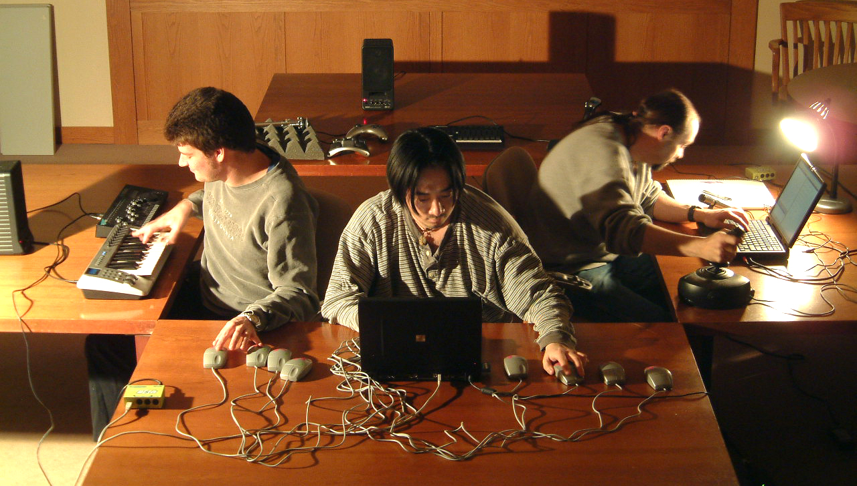
Questions?
http://chuck.cs.princeton.edu/
http://soundlab.cs.princeton.edu/

