Slide 1
The Database Environment and Development Process
Modern Database Management 12th Edition
Stanford Online Intro To Databases
Stanford Intro To Databases
Udemy Intro To Databases
Washington State Intro To Databases

Slide 2
Objectives
Define terms
Name limitations of conventional file processing
Explain advantages of databases
Identify costs and risks of databases
List components of database environment
Identify categories of database applications
Explain roles of individuals
Explain the three-schema architecture for databases

Slide 3
Definitions
Database: organized collection of logically related data
Data: stored representations of meaningful objects and events
Structured: numbers, text, dates
Unstructured: images, video, documents
Information: data processed to increase knowledge in the person using the data
Metadata: data that describes the properties and context of user data

Slide 4
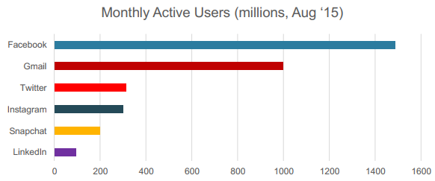
Rate of data generation
Record 20KB per page view/request
200 requests per session
1 month of data in LinkedIn(100M/mo) = 400 Terabytes
1 month of data in Facebook (1500M/mo) = 6000 Terabytes
Notes:
Here we see summaries of the data. Rather than individual data units, the data has been processed into aggregates and categories. Sums and averages are typical forms of aggregated data, and this is another way of turning raw data into useful and actionable information.

Slide 5
Data in context
What about modeling a university?
Entities
Students
Courses
Professors
Relations
Students enrolled in courses
Professors teaching courses
Notes:
Data by itself is not very useful. It is only after the data has been processed, summarized, and organized that it becomes useful for decision makers and knowledge workers. Processed data becomes information, which is often made available to users in the form of reports or graphical displays.
Metadata really pertains to the underlying structure of the data. When you design a database, you are specifying its metadata. When you populate the database, you are putting data into it.

Slide 6
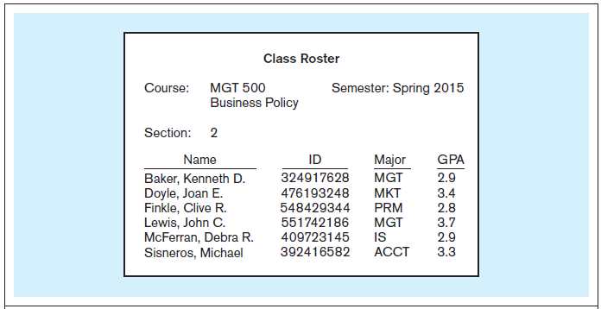
Figure 1-1a Data in context
Context helps users understand data
Notes:
Here we see a report that indicates several types of data entities. We have courses and sections of these courses, and we also have the students that are enrolled in a section. Thus, we have gone from just raw data to some type of useful information by organizing the data.
The concept of an entity is something we will discuss in detail later on.

Slide 7
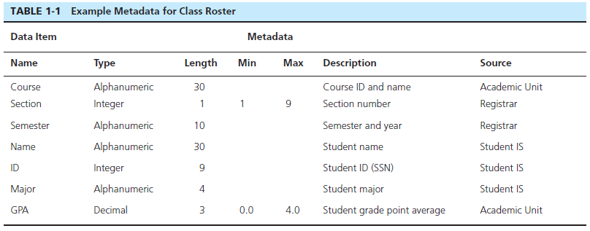
Descriptions of the properties or characteristics of the data, including data types, field sizes, allowable values, and data context
Notes:
Metadata is not data per se. Instead it is a description of how data is to be stored and organized into a database.

Slide 8

Figure 1-1b Summarized data
Graphical displays turn data into useful information that managers can use for decision making and interpretation
Notes:
Here we see summaries of the data. Rather than individual data units, the data has been processed into aggregates and categories. Sums and averages are typical forms of aggregated data, and this is another way of turning raw data into useful and actionable information.

Slide 9
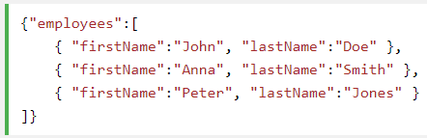
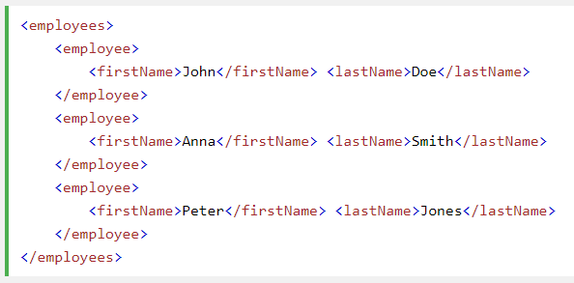
Data model examples
Can be relational – will see next
Can be JSON
Can be XML

Slide 10
Disadvantages of File Processing
Program-Data Dependence
All programs maintain metadata for each file they use
Duplication of Data
Different systems/programs have separate copies of the same data
Limited Data Sharing
No centralized control of data
Lengthy Development Times
Programmers must design their own file formats
Excessive Program Maintenance
80% of information systems budget
Notes:
Prior to the advent of databases, data was stored in individual files, each being used by a separate program. This was the traditional file processing approach to data storage. As business applications became more complex, it became evident that traditional file processing systems had a number of shortcomings and limitations. Database systems were developed to overcome these shortcomings. However, there is still a lot of data that is stored in traditional file systems. Legacy systems still abound with traditional files. Even Excel spreadsheets, which are relatively modern, would be considered to fall within the same category as file systems. Many companies store their important data in myriad spreadsheets, and as their businesses become more complex they run up against the limitations of these storage methods.

Slide 11
Problems with Data Dependency
Each application programmer must maintain his/her own data
Each application program needs to include code for the metadata of each file
Each application program must have its own processing routines for reading, inserting, updating, and deleting data
Lack of coordination and central control
Non-standard file formats

Slide 12
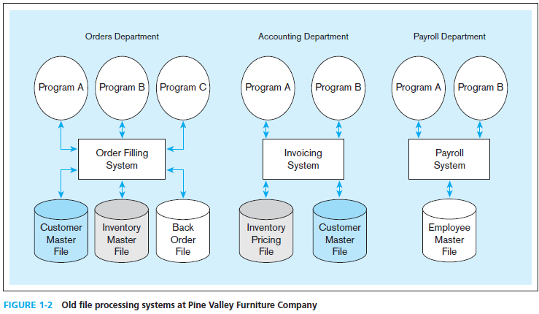
Duplicate Data
Notes:
If the invoicing system and the order filing system each have their own copy of customer data, then this could lead to inconsistencies. What if one file changes the address or account valance of a customer, but the other one does not? In this case, we would have inconsistent data, which is not good for the organization. Data duplication is one of the biggest problems in data management, and databases are designed to eliminate or reduce duplication.
The Pine Valley Furniture (PVF) company will be an ongoing case in this textbook. You will become very familiar with PVF over time.

Slide 13
Problems with Data Redundancy
Waste of space to have duplicate data
Causes more maintenance headaches
The biggest problem:
Data changes in one file could cause inconsistencies
Compromises in data integrity
Notes:
Although wasted space is an issue with data redundancy, it has become less of a problem over time. Storage media is increasingly becoming less and less expensive.
The real problem, as mentioned earlier, is with data inconsistencies. The term “data integrity” refers to ensuring the validity, security, and availability of a company’s data. Traditional file processing systems have a difficult time ensuring data integrity.

Slide 14
SOLUTION: The DATABASE Approach
Central repository of shared data
Data is managed by a controlling agent
Stored in a standardized, convenient form
Requires a Database Management System (DBMS)

Slide 15
Advantages of THE DatabaSE APPROACH
Program-data independence
Planned data redundancy
Improved data consistency
Improved data sharing
Increased application development productivity
Enforcement of standards
Improved data quality
Improved data accessibility and responsiveness
Reduced program maintenance
Improved decision support
Notes:
There are many advantages of databases of traditional files.

Slide 16
Database Management System
A software system that is used to create, maintain, and provide controlled access to user databases
Order Filing
System
Central database
Contains employee,
order, inventory,
pricing, and
customer data
Invoicing
System
DBMS
Payroll
System
DBMS manages data resources like an operating system manages hardware resources
Notes:
The database management system (DBMS) is a software system that is used to create, maintain, and provide controlled access to user databases.
Most current DBMSs are in the form of relational databases, which represent data as a collection of tables in which all data relationships are represented by common values in related tables. We will explore relational databases in detail throughout this course.
Note that because all the data is shared in a central database, there is no longer the need for separate systems and programs to maintain their own copy of the data. This reduces duplication and increases integrity.
Point out the Client/Server aspect of this – left side can be clients or can have even further left side that is web browser….DBMS is the server.

Slide 17
REQUIRED FUNCTIONALITY FOR DBMS
Massive Data
Tera and Peta bytes level of data storage
Persistent
Safe
Multi-User
Admins, developers, end-users
Concurrent users
Convenient
Describe real-world entities in terms of stored data
Easily change structure (e.g., add attributes)
Efficient
query & update – Must handle complex questions about data – Must handle sophisticated updates – Performance matters (users can feel 200ms latency)
Enable simultaneous updates
Reliable
Crash recovery
Security and integrity
Notes:
M – must handle data at the Terabyte and Petabyte levels and beyond.
P – must be available after our applications or website is gone, data has to be available 24/7
S – the data can never disappear, your database needs to be resilient to power outages, user error, hardware failure, software/OS failure
MU – this has 2 real requirements, we need multiple levels of users, such as admins to run the box, developers to write the applications, end-users to get data out. But we also need it to support multiple users at the same time. It doesn’t do us any good if only one user can get or update or insert data at a time
C – need to be able to conveniently describe the world in terms of entities. Need to also be able to change these entities at will, and to get data into and out of them with a simple/easy language
E – Queries and Updates need to be fast, for millions+ rows. 200ms will be noticed by a user. Can handle thousands of queries a second.
R – data is available 24/7, data will not change unexpectedly

Slide 18
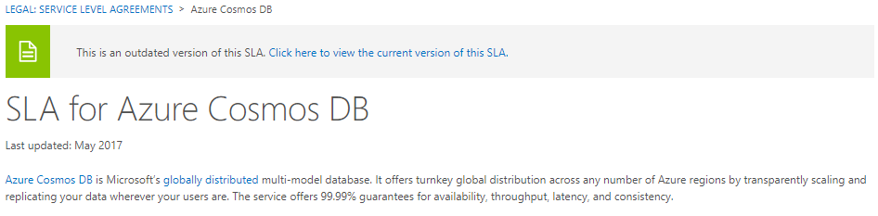
24/7 uptime
Databases (and most systems) have a guaranteed uptime SLA
Most of these are listed as >99%
Let’s look at this SLA for a single week
60 secs/min 60 mins/hr 24 hrs/day 86,400 seconds/day 604,800 seconds/week
99.99% uptime Meaning we can have 0.01% downtime 604,800 * 0.0001 = 60.48 seconds
In a single week, that database can only be down for 1 minute or it is considered a breach in your contract
How long does it take your computer to boot up?
How long does it take if you notice your computer is frozen to shut it down, then boot back up?
How long does it take for the internet company to come out if you lose your internet? How long does it take to microwave a bag of popcorn in the break room? (about 4 times longer)
Notes:
Any system that you are dependant on, even if that system is in house will have an uptime SLA
What is the guaranteed amount of time that server will be available to you
Example, Microsoft Azure Cosmos Database is guaranteed SLA of 99.99% uptime
But what does that mean?

Slide 19
Elements of the Database Approach
Data models
Graphical diagram capturing nature and relationship of data
Enterprise Data Model–high-level entities and relationships for the organization
Project Data Model–more detailed view, matching data structure in database or data warehouse
Shows Schema – not data
Entities – schema
Noun form describing a person, place, object, event, or concept
Composed of attributes
Relationships – schema
Between entities
Usually one-to-many (1:M) or many-to-many (M:N), but could also be one-to-one (1:1)
Notes:
Data model is just a representation of how data is going to be stored.
This could be an XML schema, a graphical view of your tables and their relationships. The goal of this is to be able to clearly articulate how your data is stored and what relationship exists between other sets of data.

Slide 20
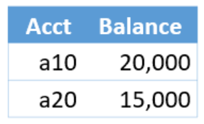
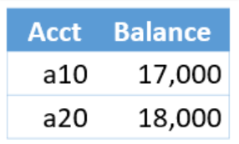
How do you ensure reliability?
The key to an DBMS are transactions
An atomic sequence of reads/writes
Atomic action means it either completes 100% or not at all
Cancelled or Failed transactions leave data as it was (Or Consistent)
For example
We have 2 bank accounts
Want to transfer3000 from A10 to A20
STEP 1 – withdraw 3000 from A10
STEP 2 – deposit 3000 to A20
An atomic transactions means that both step 1 and 2 must complete
If step 1 fails – nothing has changed
If step 2 fails – step 1 has to be rolled back or the change abandoned
If something after step 2 fails – the transaction is done, keep the changes

Slide 21
Costs and Risks of the Database Approach
New, specialized personnel
Installation and management cost and complexity
Conversion costs
Need for explicit backup and recovery
Organizational conflict
Notes:
But there are also costs and risks. It is not an easy thing to convert from traditional file processing systems to databases. Although the end result is usually beneficial to the organization, the costs of converting are significant, especially for a large company.

Slide 22
Evolution of Database Systems
Driven by four main objectives:
Need for program-data independence ➔ reduced maintenance
Desire to manage more complex data types and structures
Ease of data access for less technical personnel
Need for more powerful decision support platforms
Notes:
Here are some of the motivations that led to the evolution of database systems.

Slide 23
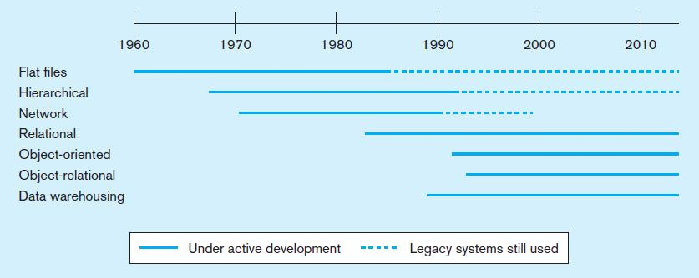
Figure 1-10a Evolution of database technologies
Notes:
Over the years since the advent of computer data processing systems in business, there have been many approaches to database technology. We already discussed flat files and their problems. Early attempts to solve these problems led to hierarchical and network databases. Legacy systems, those initially created in the 1950s and 1960s sometimes still use these earlier technologies.
The relational database is the most common form, especially for business applications. However, others also exist, including object-oriented and object-relational. Data warehousing is commonly used for managerial decision making.

Slide 24
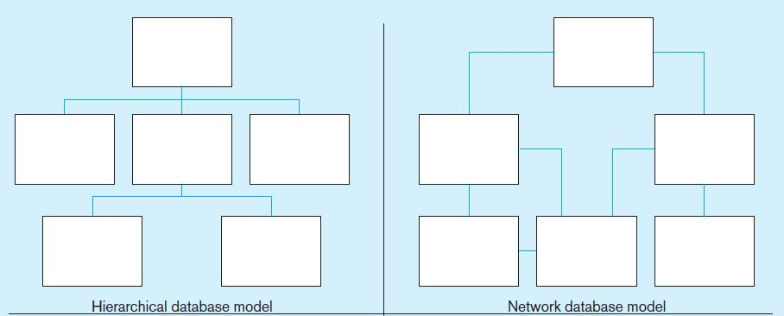
Figure 1-10b Database architectures
Notes:
The hierarchical and network database models was the first attempt to structure data according to relationships between entities. But they fell short because they were very inflexible. For example, many-to-many relationships are impossible in hierarchical databases, and although they are possible in network models they are difficult to modify in these structures.

Slide 25
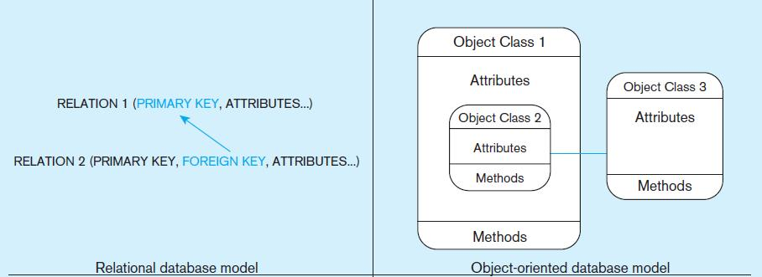
Figure 1-10b Database architectures (cont.)
Notes:
The relational model is the most ubiquitous, and represents relationships as primary-to-foreign key associations in different “relations”. Here we see some confusing terminology. There is the concept of “relationship”, which was shown as lines between boxes in figure 1-3. And there is another concept of “relation”, which is really like a database table. We’ll see this distinction later in the semester.
Object-oriented databases are interesting in that they allow for a sort of inheritance between classes and subclasses. Also, unlike relations (tables) in relational databases, objects in object-oriented databases are capable of behaviors (program code) in the form of “methods”. If you take a course in Java or another object-oriented language, you will become familiar with these ideas.

Slide 26
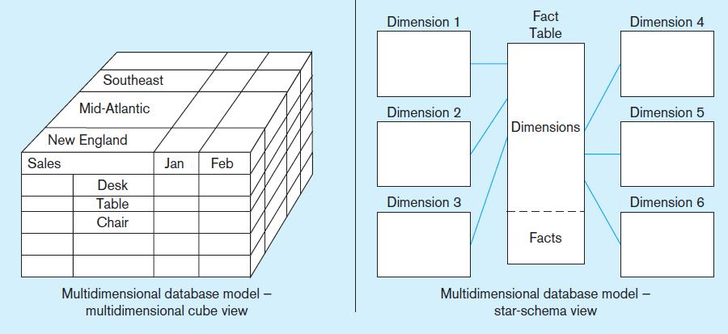
Figure 1-10b Database architectures (cont.)
Notes:
Multidimensional models are typically based on data warehouses, and are used for decision support purposes. The term Online Analytical Processing (OLAP) refers to the types of systems that use multidimensional data.

Slide 27
Components of the Database Environment
Data modeling and design tools -- automated tools used to design databases and application programs
Repository–centralized storehouse of metadata
Database Management System (DBMS) –software for managing the database
Database–storehouse of the data
Application Programs–software using the data
User Interface–text, graphical displays, menus, etc. for user
Data/Database Administrators–personnel responsible for maintaining the database
System Developers–personnel responsible for designing databases and software
End Users–people who use the applications and databases

Slide 28
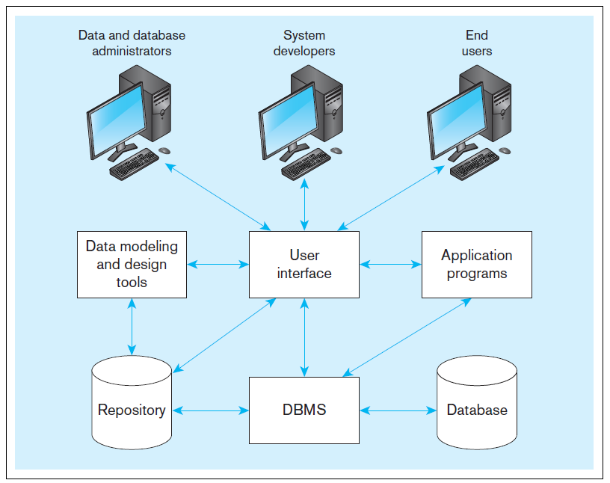
Figure 1-5 Components of the database environment
Notes:
Data modeling and design tools are automated tools used to design databases and application programs. These tools help with creation of data models and in some cases can also help automatically generate the “code” needed to create the database.
A repository is a centralized knowledge base for all data definitions, data relationships, screen and report formats, and other system components. In other words, the metadata resides in the repository.
DBMS is a software system that is used to create, maintain, and provide controlled access to databases. A database is an organized collection of logically related data, usually designed to meet the information needs of multiple users in an organization. A database is not the same as a repository. The database contains data, whereas the repository contains metadata. In other words, the repository defines the structure of the data.
Application programs interact with the database to provide functionality of use for the company. Relating this to figure 1-2, the application programs fulfill the order processing, invoicing, and payroll functions.
The user interface includes languages, menus, and other facilities by which users interact with various system components. Most application programs will involve user interfaces, because they will be directly used by people (users). However, not all applications involve user interfaces; some are run as batch programs in the background. For example, a program that prints paychecks may not include a user interface.
Different types of users include data and database administrators, system developers, and end users. The data administrators manage the data and database. The developers create the application programs. The end users are peope who use the systems for various business functions. These can include accountants, sales people, managers, etc. Database administrators and system developers are IT people, and their principal clientele involve end users.

Slide 29
Database Schema
External Schema
User Views
Subsets of Conceptual Schema
Can be determined from business-function/data entity matrices
DBA determines schema for different users
Conceptual Schema
E-R models–covered in Chapters 2 and 3
Internal Schema
Logical structures–covered in Chapter 4
Physical structures–covered in Chapter 5
Notes:
The term “schema” here refers to the view you have of the system being developed. Users of a system have one view, based on the reports, forms, and interactions they have with the system. Designers have s view of the entities, attributes, and relationships involved in the world being modeled (the conceptual schema), as well as a view of tables, fields, primary and foreign keys, together with an understanding of what makes a database well structured and efficient (the internal schema).

Slide 30
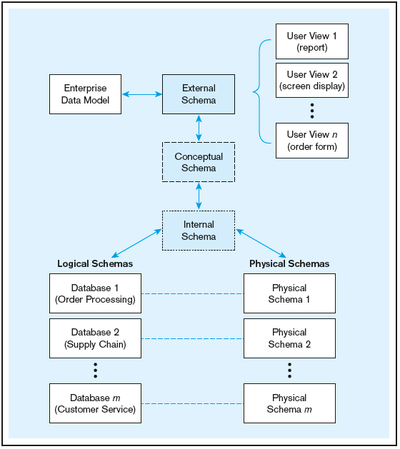
Figure 1-9 Three-schema architecture
Different people have different views of the database…these are the external schema
The internal schema is the underlying design and implementation
Notes:
If you are a database designer, you will be extensively involved in the conceptual schema logical and physical pieces of the internal schema. You will be particularly involved in the physical schema if you are a database administrator (DBA). If you are a user, these schemas don’t matter much to you; rather you will be involved in the external schema.

Slide 31

Enterprise Data Model
First step in the database development process
Specifies scope and general content
Overall picture of organizational data at high level of abstraction
Entity-relationship diagram
Descriptions of entity types
Relationships between entities
Business rules

Slide 32
Project level Data Model
Builds on top of the Enterprise data model
Will contain more information about each Entity
Attributes to be included
Will not necessarily be the best way to represent the data in the DBMS itself
Usually has more detail than the CTO or directors want and is a good starting point for developers and dbas
Devs/DBAs will create a more detailed document called an ER diagram (covered later)

Slide 33
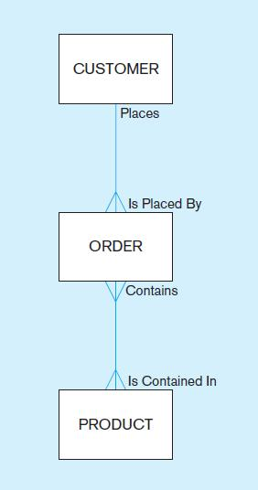
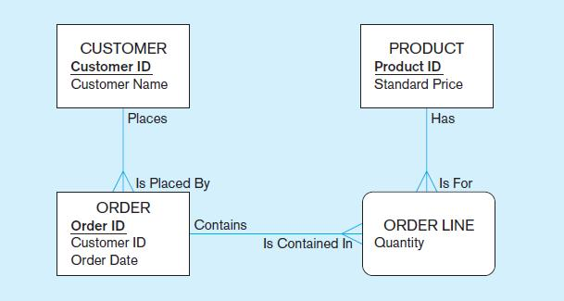
Figure 1-3 Comparison of enterprise and project level data models
Segment of an enterprise data model
Segment of a project-level data model
Notes:
Here we see the distinction between an enterprise data model and a project data model. The enterprise-level model is more of a bird’s eye view, and less detailed than a project-level model.
Entities are represented by boxes. Relationships are represented by lines between the boxes. Attributes, which describe the important characteristics of an entity, are represented by the verbiage within the boxes.

Slide 34
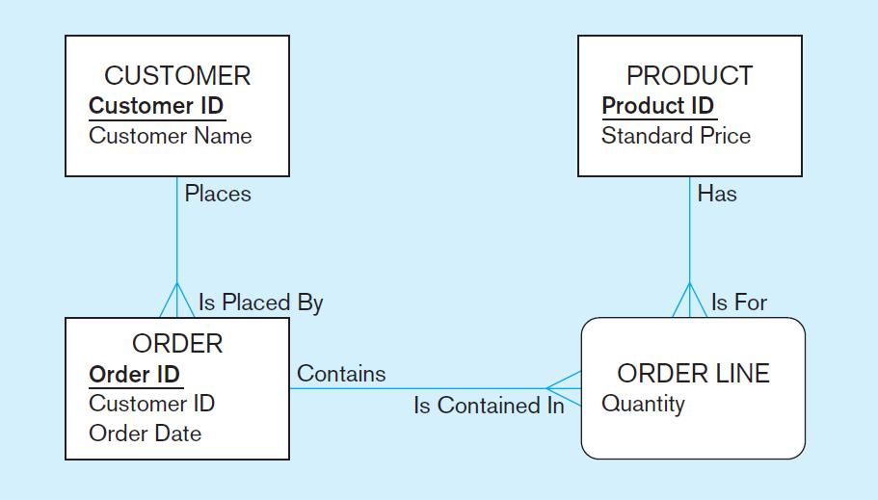
One customer may place many orders, but each order is placed by a single customer
→ One-to-many relationship
Notes:
The relationship between customers and orders is one-to-many. The crows feet of the relationship line indicates the many side of the relationship.

Slide 35
One order has many order lines; each order line is associated with a single order
→ One-to-many relationship
Notes:
Here we see another one-to-many relationship, this time between orders and order lines.
Note that some of the attributes are underlined and in bold. This typically represents an identifier attribute, which is a unique identifier of the entity. For example, only one customer can have a particular customer ID.

Slide 36
One product can be in many order lines, each order line refers to a single product
→ One-to-many relationship
Notes:
Another one-to-many (M:N) relationship. There may be several order line for the same product. But each order line belongs is associated with only one product.

Slide 37
Therefore, one order involves many products and one product is involved in many orders
→ Many-to-many relationship
Notes:
Notice that the Order Line entity has curved corners. This is the symbol of an “associative entity”, so called because it’s main purpose is to represent an association between two other entities. A particular order can involve purchase of many products. Also, a particular product could be involved in many orders. In a sense an associative entity could be thought of as a combination entity/relationship.
We will discuss many of these concepts in detail when we get to chapter 2.

Slide 38
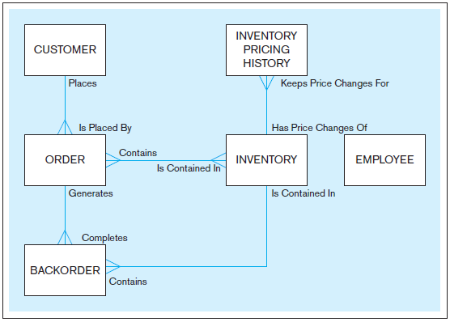

Notes:
Note that the enterprise model doesn’t contain some details, including the attributes of the entities, as well as the associative entities. In this sense it is a more summarized view, and simpler to look at. This is in contrast to the project-level model which is much more detailed.

Slide 39
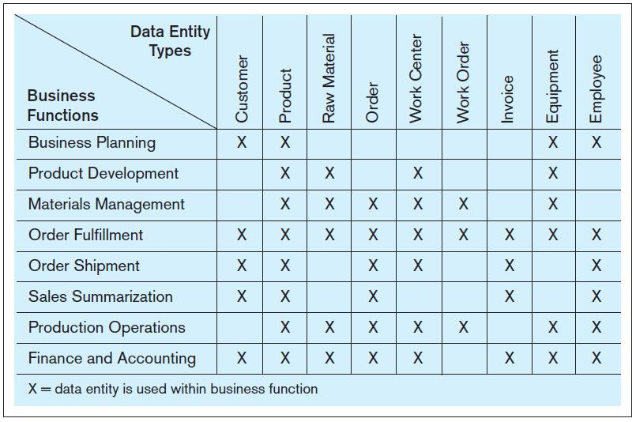
FIGURE 1-6 Example business function-to-data entity matrix
Notes:
How do we determine the type of data that is required and who within the organization needs what data? Often this is done using matrixes. One type of matrix matches business functions with the data entity types they need; this is called a function-to-data-entity matrix.

Slide 40
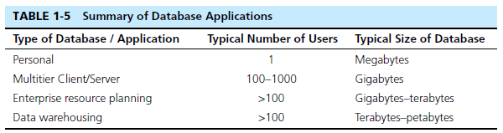
The Range of Database Applications
Personal databases
Two-tier and N-tier Client/Server databases
Enterprise applications
Enterprise resource planning (ERP) systems
Data warehousing implementations
Notes:
Here are some size ranges of typical database applications. Personal databases are often done in Microsoft Access. Multitier client/server and ERP systems are typical for the normal operational activities of most companies. Data warehouses tend to be large because they collect and maintain historical data over time.

Slide 41
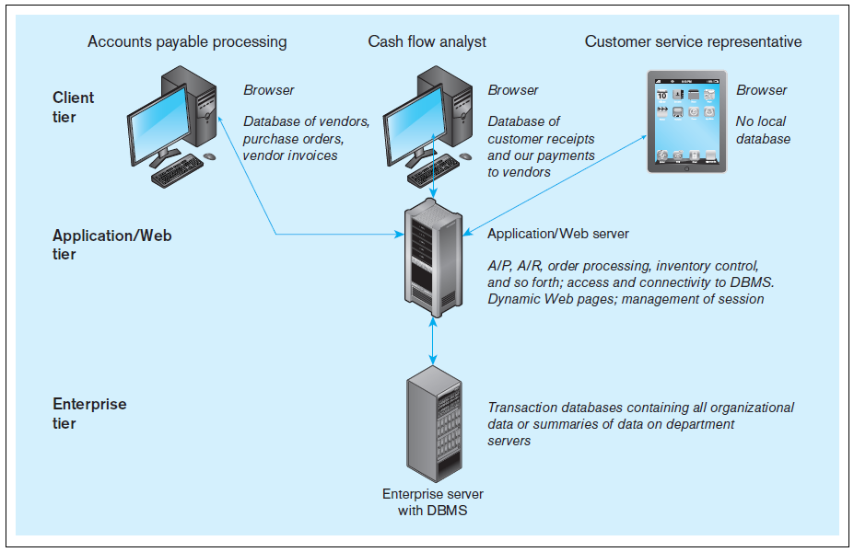
Figure 1-11 Multi-tiered client/server database architecture
Notes:
When we get to chapter 8, we will see how databases are used in applications. Most web applications follow the 3-tier approach. Databases are typically at an enterprise tier, application program code is at an application/Web tier, and user interfaces for different users are at the client tier.

Slide 42
Enterprise Database Applications
Enterprise Resource Planning (ERP)
Integrate all enterprise functions (manufacturing, finance, sales, marketing, inventory, accounting, human resources)
Data Warehouse
Integrated decision support system derived from various operational databases

Slide 43
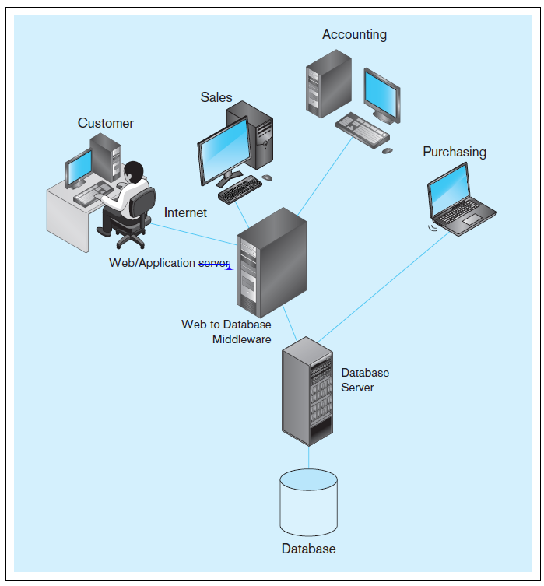
FIGURE 1-13 Computer
System for Pine Valley
Furniture Company
Notes:
Throughout the textbook, you will see many descriptions of Pine Valley Furniture. This figure shows a typical system configuration. Note the 3-tier architecture, with a database server, an application server, and client workstations for customers and employees in different departments.

Slide 44
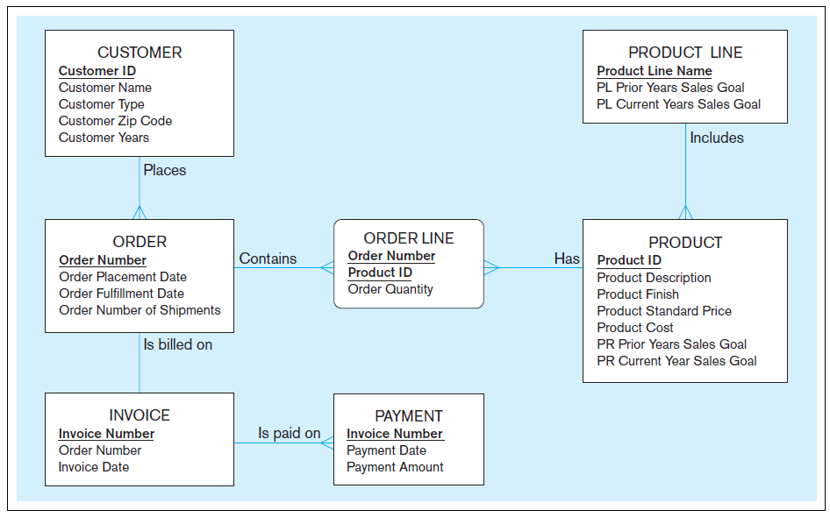
FIGURE 1-15 Project data model for Home Office product line marketing support system
Notes:
This data model shows some of the main entities for PVF, as well as their attributes and relationships. Over time you will see many other diagrams and descriptions of PVF.

Slide 45
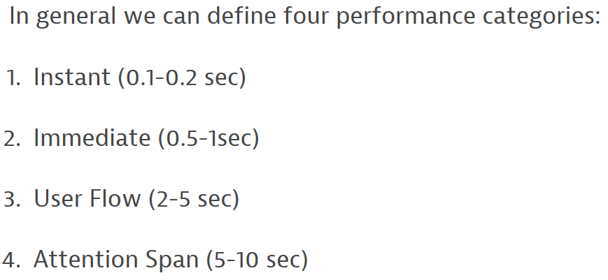
User response expectations
As we mentioned before – response time is important
Let’s assume we can’t take longer than average attention span (5-10 secs)
Our entire application has to run (assume 2-5 seconds)
Database is but a small piece
Estimate a minimum amount of transfer time at 1.5seconds
Leaves 0.5-3.5 seconds for database work (we’ve missed Instant and Immediate)
Rule of thumb – keep database as fast as possible and <1 sec
1-Request 100ms
7-Response 100ms
2-Receive and query
500ms
6-Form
Response
500ms
3-Request 10ms
5-Response (depends on amount of data)
250ms
4-Total Time?
https://www.dynatrace.com/blog/what-is-the-expected-response-time-for-a-good-user-experience/
Notes:
We spoke before about a database needing to be efficient
We have seen an example of how an application may be set up, so let’s talk about how our database response time can affect that
With a bit of

Slide 46
Lab - homework
Problems and Exercises p44-45
https://sqlite.org/download.html
Precompiled Binaries for Windows: 32 or 64 bit
Precompiled Binaries for Windows: sqlite-tools
http://www.sqlitetutorial.net/
Download a sample database

