Slide 1
Chapter 5: Physical Database Design and Performance
Modern Database Management
12th Edition
Jeff Hoffer, Ramesh Venkataraman,
Heikki Topi

Slide 2
Objectives
Define terms
Describe the physical database design process
Choose storage formats for attributes
Select appropriate file organizations
Describe three types of file organization
Describe indexes and their appropriate use
Translate a database model into efficient structures
Know when and how to use denormalization

Slide 3
Physical Database Design
Purpose–translate the logical description of data into the technical specifications for storing and retrieving data
Goal–create a design for storing data that will provide adequate performance and ensure database integrity, security, and recoverability

Slide 4
Physical Design Process
Inputs
Decisions
Normalized relations
Volume estimates
Attribute definitions
Response time expectations
Data security needs
Backup/recovery needs
Integrity expectations
DBMS technology used
Attribute data types
Physical record descriptions (doesn’t always match logical design)
File organizations
Indexes and database architectures
Query optimization
Leads to
Notes:
Much of the input to the physical design comes from outputs from requirements analysis and logical design. Others stem from business security concerns and regulatory compliance, while still others stem from predictions of demand and performance analysis. The primary goal of physical database design is data processing efficiency.

Slide 5
Physical Design for regulatory compliance
Sarbanes- Oxley Act (SOX) – protect investors by improving accuracy and reliability
Committee of Sponsoring Organizations (COSO) of the Treadway Commission
IT Infrastructure Library (ITIL)
Control Objectives for Information and Related Technology (COBIT)
Regulations and standards that impact physical design decisions
Notes:
Physical database design forms a foundation for compliance with national and international regulations on financial reporting. Without careful physical design, an organization cannot demonstrate that its data are accurate and well protected. These listed standards, guidelines, and rules focus on corporate governance, risk assessment, and security and controls of data. For full compliance, all data integrity controls must be thoroughly documented and undergo well-documented change control procedures.

Slide 6
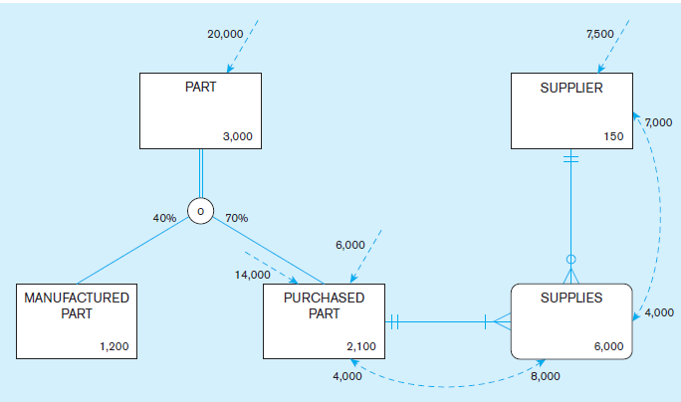
Figure 5-1 Composite usage map
(Pine Valley Furniture Company)
Notes:
The next few slides illustrate the process of usage analysis and data volume. We create usage maps by modifying EER diagrams to include information regarding sizes of entities (e.g. numbers of instances) as well as frequencies of use of these entities. In this way, we come to an understanding of the storage needs, as well as the computational demand of the system. Usage analysis should be an ongoing activity.

Slide 7
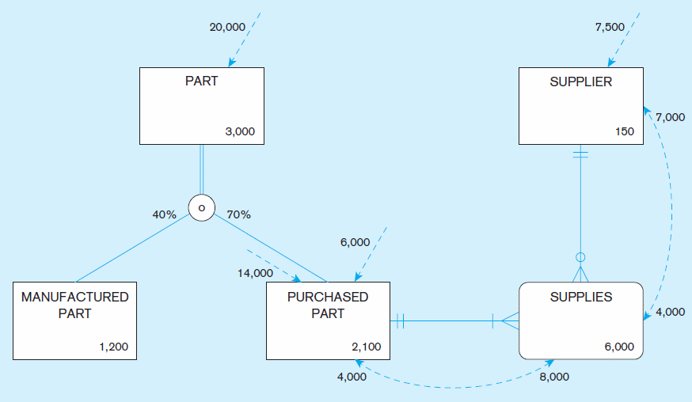
Figure 5-1 Composite usage map
(Pine Valley Furniture Company) (cont.)
Data volumes
Notes:
Here we see an expectation of 3000 parts, subdivided into manufactured and purchased. We also see 150 suppliers, and we see 6000 associations, each of which describe a particular supplier providing a particular purchased part (referred to in the next slides as a quotation). In essence, you can think of each entity as a table containing that number of rows (records).

Slide 8
Figure 5-1 Composite usage map
(Pine Valley Furniture Company) (cont.)
Access Frequencies (per hour)
Notes:
The volume and frequency statistics are generated during the systems analysis phase of the systems development process when systems analysts are studying current and proposed data processing and business activities. The data volume statistics represent the size of the business and should be calculated assuming business growth over a period of at least several years. The access frequencies are estimated from the timing of events, transaction volumes, the number of concurrent users, and reporting and querying activities.

Slide 9
Figure 5-1 Composite usage map
(Pine Valley Furniture Company) (cont.)
Usage analysis:
14,000 purchased parts accessed per hour ➔
8000 supplies accessed from these 14,000 purchased part accesses ➔
7000 suppliers accessed from these 8000 supplies accesses
Notes:
Note that the access of data from one table may trigger the need for further accesses in other tables. Usage analysis includes providing a representation of this expected flow of access requests.

Slide 10
Figure 5-1 Composite usage map
(Pine Valley Furniture Company) (cont.)
Usage analysis:
7500 suppliers accessed per hour ➔
4000 supplies accessed from these 7500 supplier accesses ➔
4000 purchased parts accessed from these 4000 supplies accesses
Notes:
The flow can go in different directions. In the previous slide the flow was triggered by accesses to parts and flowed through purchased part, supplies (associations), and finally suppliers. In this slide we see a flow in the opposite direction, triggered by initial access requests for suppliers.
These access requests could be queries which retrieve data or updates which manipulate the data. Each of these imposes some demand on computing resources, so this type of modeling helps to express that demand.

Slide 11
Designing Fields
Field: smallest unit of application data recognized by system software
Field design
Choosing data type
Coding, compression, encryption
Controlling data integrity
Notes:
In relational database terms, the word field is synonymous with column. Fields correspond roughly with attributes in ER and EER models.
During conceptual modeling, you identified the attributes for each entity type. During logical design, you converted the entities and attributes of the ER model to relations (tables) and columns (fields). Now, during physical design you give details of the fields. In actuality, some of these things could be part of logical design.
In some respects, logical design and physical design blend together. In other respects physical design blends with implementation. There are not always hard-and-fast boundaries between these phases of the SDLC.

Slide 12
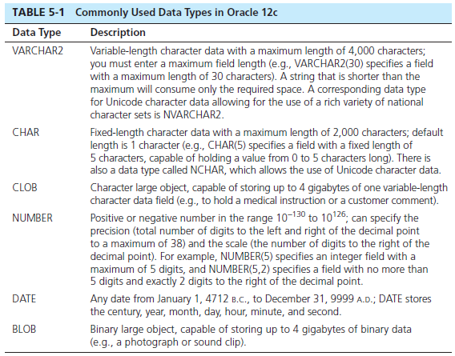
Choosing Data Types
Notes:
A data type is a detailed coding scheme recognized by system software, such as a DBMS, for representing organizational data. The data type specifies the bit pattern of data stored in that coding scheme. There are many ways in which data could be physically represented. For data used in mathematical calculations, numeric fields should be used. For text displays, there are a variety of character based representations, some of which are fixed length and some of variable length. Other data types include dates, binary representations for images or audio, and even specialized types for XML and other representations.

Slide 13
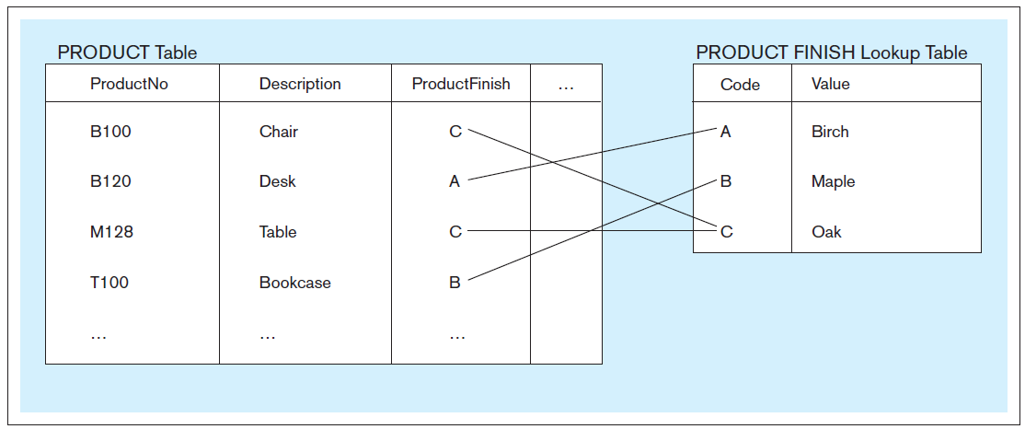
Figure 5-2 Example of a code look-up table
(Pine Valley Furniture Company)
Code saves space, but costs an additional lookup to obtain actual value
Notes:
Some attributes have a sparse set of values or are so large that, given data volumes, considerable storage space will be consumed. A field with a limited number of possible values can be translated into a code that requires less space. A code table would not appear in the conceptual or logical model. The code table is a physical construct to achieve data processing performance improvements, not a set of data with business value.
So, in this case you probably would not see the PRODUCT FINISH table in either the conceptual model or the logical design.

Slide 14
Field Data Integrity
Default value–assumed value if no explicit value
Range control–allowable value limitations (constraints or validation rules)
Null value control–allowing or prohibiting empty fields
Referential integrity–range control (and null value allowances) for foreign-key to primary-key match-ups
Sarbanes-Oxley Act (SOX) legislates importance of financial data integrity
Notes:
In most DBMSs, data integrity controls can be built into the physical structure of the fields and controls enforced by the DBMS on those fields. SQL has constructs to enforce these rules, as we will see in chapter 6.
The data type enforces one form of data integrity control because it may limit the type of data (numeric or character) and the length of a field value. Others include default values, allowable ranges of values, whether or not a value is required (null value controls), and enforcing relationships and their cardinality constraints via primary-to-foreign key matchups.

Slide 15
Handling Missing Data
Substitute an estimate of the missing value (e.g., using a formula)
Construct a report listing missing values
In programs, ignore missing data unless the value is significant (sensitivity testing)
Triggers can be used to perform these operations.
Notes:
Of the three, sensitivity testing is the most complex, requiring the most sophisticated programming. This programming can be done within the capabilities of a DBMS, without requiring external applications to do the programming. Modern DBMSs have sophisticated programming capabilities, such as case expressions, user-defined functions, and triggers through which complex logic can be performed. These will be discussed in future chapters.

Slide 16
Denormalization
Transforming normalized relations into non-normalized physical record specifications
Benefits:
Can improve performance (speed) by reducing number of table lookups (i.e. reduce number of necessary join queries)
Costs (due to data duplication)
Wasted storage space
Data integrity/consistency threats
Common denormalization opportunities
One-to-one relationship (Fig. 5-3)
Many-to-many relationship with non-key attributes (associative entity) (Fig. 5-4)
Reference data (1:N relationship where 1-side has data not used in any other relationship) (Fig. 5-5)
Notes:
It might seem counterintuitive that a database designer would want to denormalize a previously normalized (well structured) set or relations. After all, we spent considerable effort towards conceptual modeling (ER/ EER) in order to ensure well-structured logical design. And, when faced with poorly structured relations, we normalized them in our logical design. Why denormalize now?
The answer is performance. When you normalize, you split data into separate tables in order to eliminate or at least reduce data duplication. This helps to ensure data integrity. But, it comes at a cost. It is much more computationally efficient to query a single table than to query multiple tables.
Therefore, it makes sense to, an a controlled way, back off from perfect normalization. In the next few slides we’ll see some examples.

Slide 17
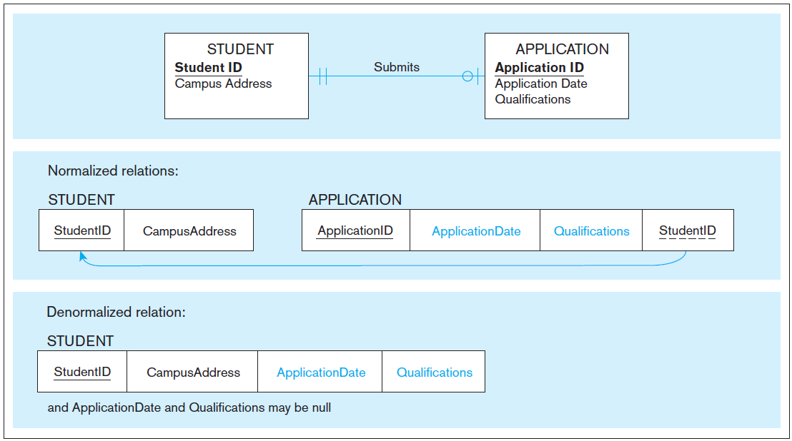
Figure 5-3 A possible denormalization situation: two entities with one-to-one relationship
Notes:
One-to-one relationships are good candidates for denormalization, such as this example of students with applications.
Note that from this diagram we know that not all students have applications. Question: how do we know this?
Answer: the optional on the application side of the Submits relationship.
Therefore, many students may not have applications, so the application date and qualifications fields of the denormalized relation may not be used. This wastes space. But, as mentioned earlier, space is cheap these days.
Denormalizing in the 1:1 case does not, however, threaten data integrity. Why?
Answer: it’s a 1:1 relationship, so there won’t be multiple records with the same student id and campus address.

Slide 18
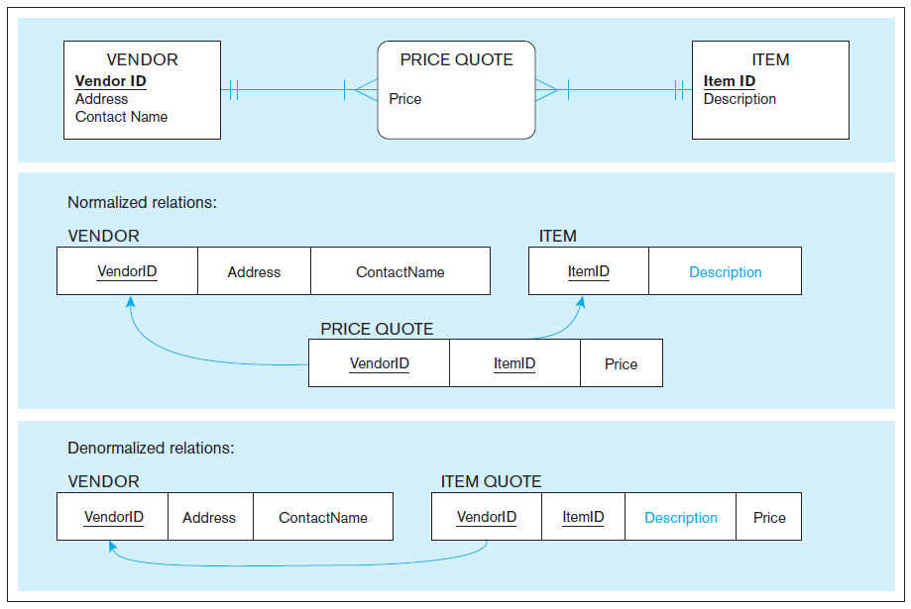
Figure 5-4 A possible denormalization situation: a many-to-many relationship with nonkey attributes
Extra table access required
Duplicate description possible
Notes:
Here is the case of a many-to-many relationship between vendors and items, which results in three tables (relations). Denormalizing combines the Item and Price Quote tables into a single table called Item Quote.
Question: which attribute will wind up being duplicated in this case?
Answer: the item description. This means that any time the description changes, the change must be done to all item quotes unless you’re willing to tolerate inconsistencies in the item descriptions. So, in this case, there is some compromising of data integrity guarantees. Again, we do this for the sake of performance. A query involving two tables is more efficient than a query involving three.
Note that the composite usage map can illustrate the demand on the extra table, and therefore can be used to justify whether or not denormalization should take place.

Slide 19
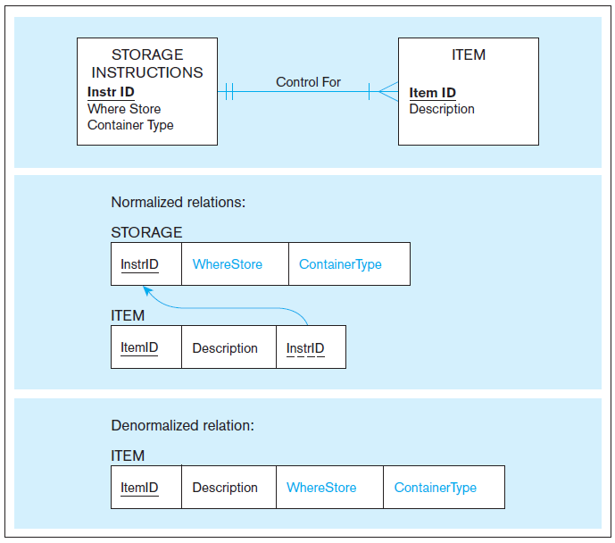
Figure 5-5
A possible denormalization situation:
reference data
Extra table access required
Data duplication
Notes:
Here again we see denormalization, this time combing two relations with 1:N relationship into a single one. Again, we improve query performance at the cost of data duplication.

Slide 20
Denormalize with caution
Denormalization can
Increase chance of errors and inconsistencies
Reintroduce anomalies
Force reprogramming when business rules change
Perhaps other methods could be used to improve performance of joins
Organization of tables in the database (file organization and clustering)
Proper query design and optimization
Notes:
Note that denormalization is most beneficial and least harmful in relations where there is a minimal amount of updates that would occur to the duplicated attributes. In chapter 9 we will discuss the concept of “data warehouses”. A data warehouse is generally for the sole purpose of performing complex queries to assist with managerial decision making. These are never updated, except at specified intervals of data integration. Therefore, data warehouses are often non-normalized.

Slide 21
Partitioning
Horizontal Partitioning: Distributing the rows of a logical relation into several separate tables
Useful for situations where different users need access to different rows
Three types: Key Range Partitioning, Hash Partitioning, or Composite Partitioning
Vertical Partitioning: Distributing the columns of a logical relation into several separate physical tables
Useful for situations where different users need access to different columns
The primary key must be repeated in each file
Combinations of Horizontal and Vertical
Notes:
The previous denormalization examples all deal with combining tables to avoid doing joins. Another form of denormalization involves the creation of more tables by partitioning a relation into multiple physical tables.
In other words, we purposely duplicate (copy) relations or portions of relations and store these copies in multiple storage locations.

Slide 22
Partitioning pros and cons
Advantages of Partitioning:
Efficiency: Records used together are grouped together
Local optimization: Each partition can be optimized for performance
Security: data not relevant to users are segregated
Recovery and uptime: smaller files take less time to back up
Load balancing: Partitions stored on different disks, reduces contention
Disadvantages of Partitioning:
Inconsistent access speed: Slow retrievals across partitions
Complexity: Non-transparent partitioning
Extra space or update time: Duplicate data; access from multiple partitions
Notes:
As with all physical design decisions, partitioning has its advantages and disadvantages.

Slide 23
Oracle’s Horizontal Partitioning
Range partitioning
Partitions defined by range of field values
Could result in unbalanced distribution of rows
Like-valued fields share partitions
Hash partitioning
Partitions defined via hash functions
Will guarantee balanced distribution of rows
Partition could contain widely varying valued fields
List partitioning
Based on predefined lists of values for the partitioning key
Composite partitioning
Combination of the other approaches
Notes:
Each enterprise DBMS vendor provides some form of partitioning. Here are Oracle’s types of horizontal partitioning, which can be combined if desired.

Slide 24
Vertical Partitioning
Distribution of the columns of a logical relation into several separate physical tables.
Example:
One PART table involving accounting, engineering, and sales attributes.
Split into three, each with the same Product ID, one for each user group.
This reduces demand on individual relations.
When combinations of data are required, perform join queries for all needed relations.
Notes:
Databases could be partitioned both horizontally and vertically. Decisions about partitioning, like all denormalization decisions, are done during physical design, and these decisions are based on observed and anticipated resource demand.

Slide 25
Designing Physical database Files
Physical File:
A named portion of secondary memory allocated for the purpose of storing physical records
Tablespace–named logical storage unit in which data from multiple tables/views/objects can be stored
Tablespace components
Segment – a table, index, or partition
Extent–contiguous section of disk space
Data block – smallest unit of storage
Notes:
We’ve been talking about relational database structures, involving tables, columns, primary and foreign keys, as if this is in fact the way data is actually stored on disk. But it is not. At the operating system level, we are always talking about files. Databases are just one kind of file. The table/column/key idea is really an abstraction. At a lower implementation level, these database files (like all physical files) are actually constructed via different file formats, which will be discussed in the next few slides.
Most database management systems store many different kinds of data in one operating system file. By an operating system file, we mean a named file that would appear on a disk directory listing (e.g., a listing of the files in a folder on the C: drive of your personal computer).

Slide 26
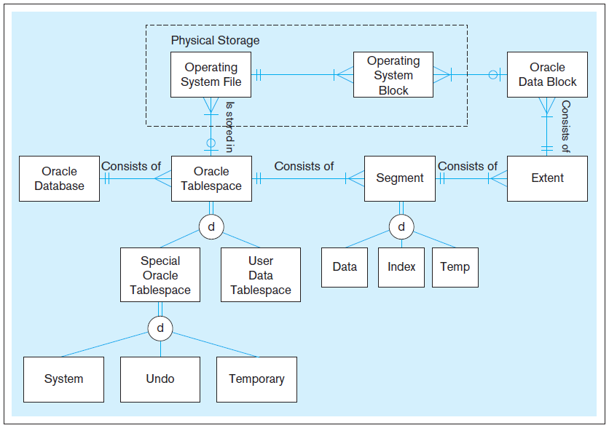
Figure 5-6 DBMS terminology in an Oracle 12c environment
Notes:
An instance of Oracle 12c includes many tablespaces—for example, two (SYSTEM and SYSAUX) for system data (data dictionary or data about data), one (TEMP) for temporary work space, one (UNDOTBS1) for undo operations, and one or several to hold user business data. So, much of the data that is actually stored in Oracle databases is for the purpose of the Oracle DBMS to mange its data. Only a subset of all the data stored is actual business-related data for a company or user.
Because an instance of Oracle typically supports many databases for many users, a database administrator usually will create many user tablespaces. This helps achieve database security because the administrator can give each user selected rights to access each tablespace.
An Oracle database consists of tablespaces. Each tablespace consists of segments (consisting of one table, index, or partition), which in turn are divided into extents, each of which consist of a number of contiguous data blocks, the smallest unit of storage in Oracles database management scheme.
But even these concepts are abstractions, higher than the operating system level of a computer. It’s only when these Oracle data blocks are expressed as operating system blocks that we get down to the operating system level, which is the level that Windows or Linux or the Mac OS use when managing disk storage. But even at the operating system level, you’re dealing in abstractions. Ultimately everything boils down to bits, which are individual electronic circuits in a chip or magnetic polarities on a magnetic disk or laser-generated pits in an optical storage medium like a DVD. At that point we’ve left the realm of software/data and entered the world of hardware.

Slide 27
File Organizations
Technique for physically arranging records of a file on secondary storage
Factors for selecting file organization:
Fast data retrieval and throughput
Efficient storage space utilization
Protection from failure and data loss
Minimizing need for reorganization
Accommodating growth
Security from unauthorized use
Types of file organizations
Heap – no particular order
Sequential
Indexed
Hashed
Notes:
A file organization is a technique for physically arranging the records of a file on secondary storage devices. Typical file organizations include sequential, indexed, and hashed, which we will see in the next few slides. Another possibility is something called a “heap”, but this has no order and is not ideal for quick access. Imagine a telephone book where people were in no particular order. You’d potentially have to search through each and every name before finding what you need. The other file organizations are designed to bring quick access and/or optimize insertion, modification, and removal of data items.
With modern relational DBMSs, you don’t need to design file organizations, but you may be allowed to select an organization and its parameters for a table or physical file. Here are some factors to consider.

Slide 28
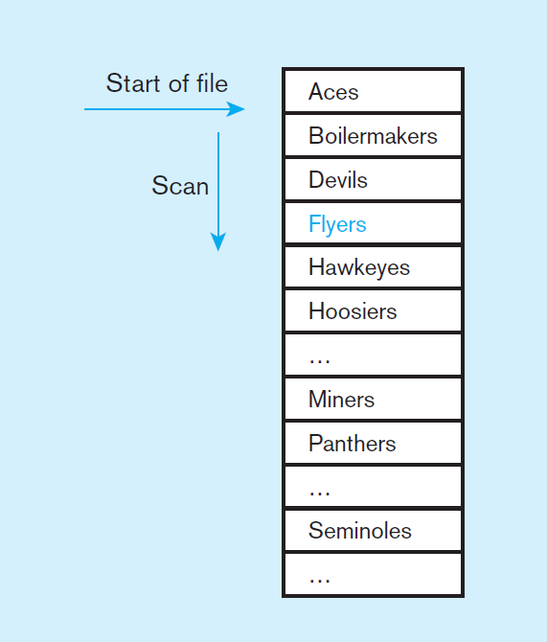
Figure 5-7a Sequential file organization
Records of the file are stored in sequence by the primary key field values.
Sequential storage:
Average time to find desired record = log₂n
If this were a heap,
Average time to find desired record = n/2
Notes:
In essence, when data is arranged sequentially, you can cut the search space in half each time you look. For example, suppose you wanted to find the Flyers? First, look at the middle item the list (suppose it was Hoosiers). Since Flyers come before Hoosiers, you know it has to be in the group before Hoosiers. So, then look in the middle of that group (suppose this item was Devils. At this point, you know it has to be between Devils and Hoosiers.
So, the speed of accessing a desired record (knowing the primary key) in a sequential file is much, much faster than accessing it in an unordered file (heap).
But, sequential file organization always requires data to be sorted. Therefore, such a file must be resorted every time new items are inserted, or if any existing items are changed. So, the speed of access comes with a significant maintenance cost.

Slide 29
Indexed File Organizations
Storage of records sequentially or nonsequentially with an index that allows software to locate individual records
Index: a table or other data structure used to determine in a file the location of records that satisfy some condition
Primary keys are automatically indexed
Other fields or combinations of fields can also be indexed; these are called secondary keys (or nonunique keys)
Notes:
In an indexed file organization, the records are stored either sequentially or nonsequentially, and an index is created that allows the application software to locate individual records (see Figure 5-7b). Like a card catalog in a library, an index is a table that is used to determine in a file the location of records that satisfy some condition. Each index entry matches a key value with one or more records. An index can point to unique records (a primary key index, such as on the ProductID field of a product record) or to potentially more
than one record. An index that allows each entry to point to more than one record is called a secondary key index.

Slide 30
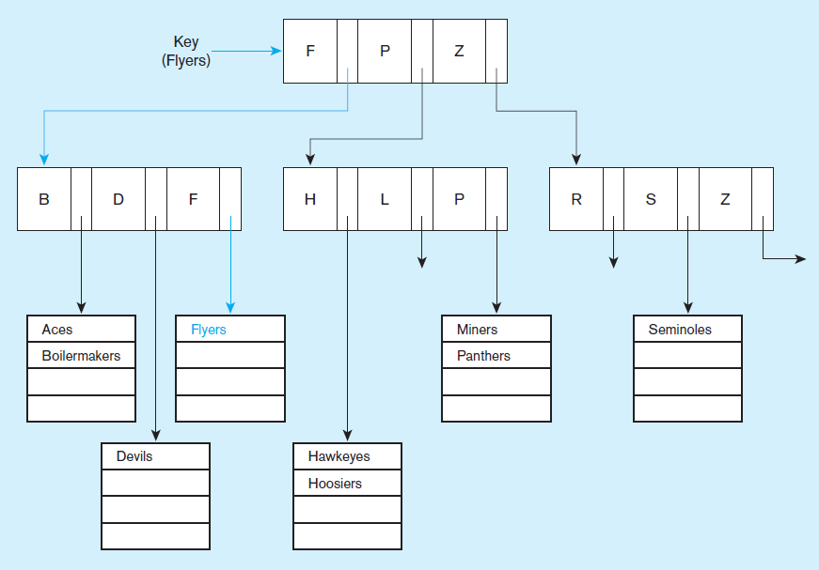
Figure 5-7b Indexed file organization
uses a tree search
Average time to find desired record based on depth of the tree and length of the list
Notes:
An advantage of the indexed file organization over the sequential is that it is easier to insert and delete data. Because the index is composed of many smaller lists of actual data items (seen in the bottom of the tree), then sorting an individual cluster is much less costly than sorting the whole file. Also, if you keep the individual lists small enough, then even if they are unsorted, the search time is not so bad.
The trick is indexing, and specifically keeping an optimal number of levels within the index. In this case we see two levels of indexing, below which are the sublists of data items.
The index organization in this figure splits at the top level into three groups. Any team name starting with A-F goes in the first group, those with G-P in the second, and those with Q-Z in the third. Within each group there is a second split into three subgroups each.
Indexed file organization is often used with attributes that are likely to be frequently used in queries. Part of the physical design process involves choosing which columns of a table to index, as we’ll see later.

Slide 31
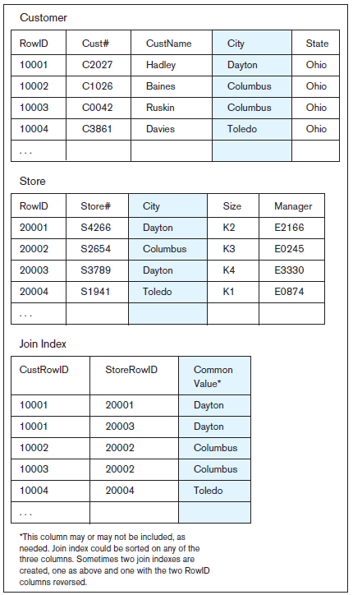
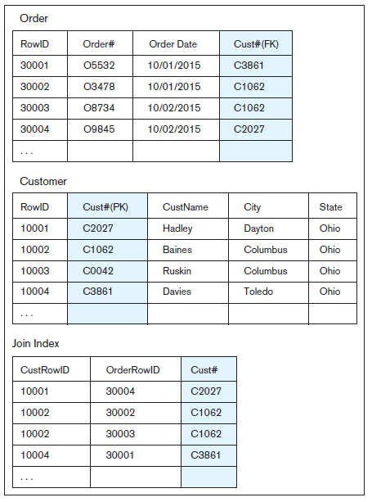
Figure 5-8 Join Indexes – to speed up join operations
b) Join index for matching foreign key (FK) and primary key (PK)
a) Join index for common non-key columns
Notes:
A join is a SQL query that involves multiple tables, usually connected via primary-key to foreign-key matchups. As we discussed earlier when talking about denormalization, joins are costly. A join index is a type of index that helps to optimize these queries.
Join indexes are especially popular in data warehouses, which is covered in chapter 9.

Slide 32
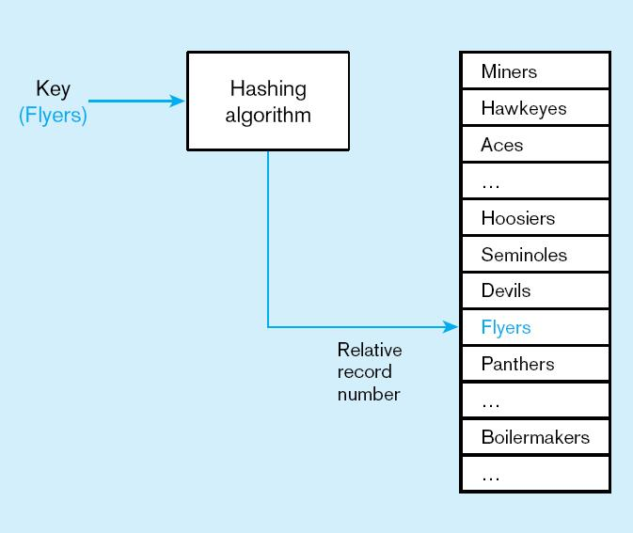
Figure 5-7c
Hashed file organization
Hash algorithm
Usually uses division-remainder to determine record position. Records with same position are grouped in lists.
Notes:
A hashing algorithm is a routine that converts a primary key value into a record address. Although there are several variations of hashed files, in most cases the records are
located nonsequentially, as dictated by the hashing algorithm. Thus, sequential data processing is impractical.
A typical hashing algorithm uses the technique of dividing each primary key value by a suitable prime number and then using the remainder of the division as the relative storage location. For example, suppose that an organization has a set of approximately 1,000 employee records to be stored on magnetic disk. A suitable prime number would be 997, because it is close to 1,000. Now consider the record for employee ID 12396. When we divide this number by 997, the remainder is 432. Thus, this record is stored at location 432 in the file.
Hashing algorithms could potentially map two different primary keys to the same location. If that happens, there will be a list at that location, similar to the lists in the indexed file organization described earlier.

Slide 33
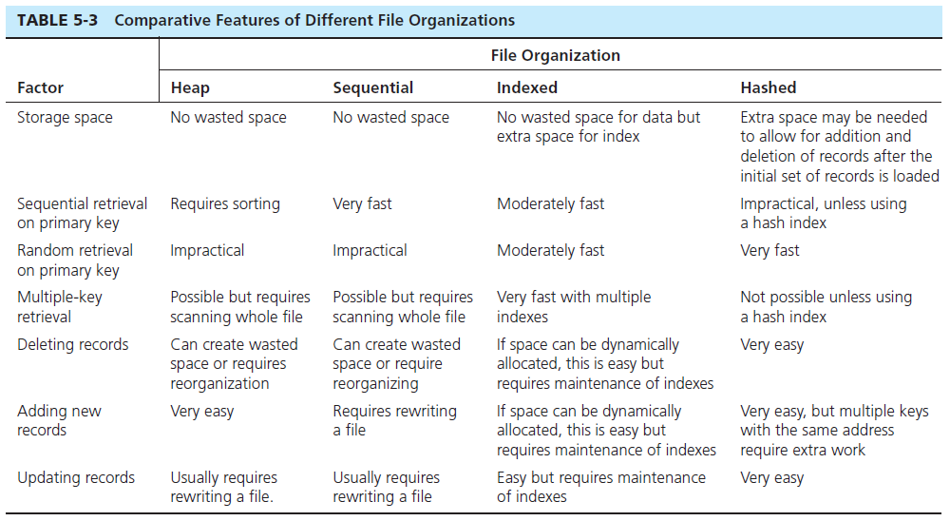
Notes:
As this figure shows, each file organization has its advantages and disadvantages. Thus, choosing the correct file organization requires an understanding of the factors that apply to the problem of database implementation.
As a database designer, it is important to understand the properties of different file organizations so that you can choose the most appropriate one for the type of database processing required in the database and application you are designing. Also, understanding the properties of the file organizations used by the DBMS can help a query designer write a query in a way that takes advantage of the file organization’s properties.

Slide 34
Clustering Files
In some relational DBMSs, related records from different tables can be stored together in the same disk area
Useful for improving performance of join operations
Primary key records of the main table are stored adjacent to associated foreign key records of the dependent table
e.g. Oracle has a CREATE CLUSTER command
Notes:
Clustering records is best used when the records are fairly static, as in a data warehouse. When records are frequently added, deleted, and changed, wasted space can arise, and it may be difficult to locate related records close to one another after the initial loading of records, which defines the clusters. Clustering is, however, one option a file designer has to improve the performance of tables that are frequently used together in the same queries and reports.
So, clustering and join indexes are both done for the purpose of optimizing join queries.

Slide 35

Unique and Nonunique Indexes
Unique (primary) Index
Typically done for primary keys, but could also apply to other unique fields
Nonunique (secondary) index
Done for fields that are often used to group individual entities (e.g. zip code, product category)
Notes:
Part of the physical design process is to decide which fields need indexing. Primary keys are normally indexed by default. The database designer typically chooses which other fields to index, based on expected usage of those fields in queries and inserts. It the fields are used a lot as conditions in queries, this increases the importance of indexing. But indexing comes at a cost, which involves maintaining the index. Indexes are costly for fields that get updated a lot.

Slide 36
Rules for Using Indexes
Use on larger tables
Index the primary key of each table
Index search fields (fields frequently in WHERE clause)
Fields in SQL ORDER BY and GROUP BY commands
When there are >100 values but not when there are <30 values

Slide 37
Rules for Using Indexes (cont.)
Avoid use of indexes for fields with long values; perhaps compress values first
If key to index is used to determine location of record, use surrogate (like sequence number) to allow even spread in storage area
DBMS may have limit on number of indexes per table and number of bytes per indexed field(s)
Be careful of indexing attributes with null values; many DBMSs will not recognize null values in an index search

Slide 38
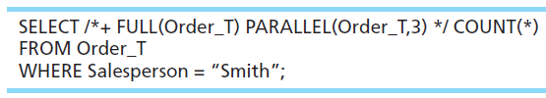
Query Optimization
Parallel query processing–possible when working in multiprocessor systems
Overriding automatic query optimization–allows for query writers to preempt the automated optimization
Oracle example:
/* */ clause is a hint to override Oracle’s default query plan

Slide 39


