Slide 1
Chapter 7: advanced sql
Modern Database Management
12th Edition
Jeff Hoffer, Ramesh Venkataraman,
Heikki Topi

Slide 2
Objectives
Define terms
Write single and multiple table SQL queries
Define and use three types of joins
Write noncorrelated and correlated subqueries
Understand and use SQL in procedural languages (e.g. PHP, PL/SQL)
Understand triggers and stored procedures
Discuss SQL:2011 standard and its enhancements and extensions

Slide 3
Processing Multiple Tables
Join–a relational operation that causes two or more tables with a common domain to be combined into a single table or view
Equi-join–a join in which the joining condition is based on equality between values in the common columns; common columns appear redundantly in the result table
Natural join–an equi-join in which one of the duplicate columns is eliminated in the result table
The common columns in joined tables are usually the primary key of the dominant table and the foreign key of the dependent table in 1:M relationships.
Notes:
Very often the data we want to see from a query needs to come from multiple tables. Most of the time these tables are linked in relationships via primary and foreign keys. The vast majority of joins involve matching primary and foreign keys, but there can also be other kinds of joins as well.

Slide 4
Processing Multiple Tables
Outer join–a join in which rows that do not have matching values in common columns are nonetheless included in the result table (as opposed to inner join, in which rows must have matching values in order to appear in the result table)
Union join–includes all data from each table that was joined
Notes:
Unions are not literally joins, and the syntax for expressing a union is not the same as the syntax for expressing a join. Nevertheless, unions also combine data from different tables.

Slide 5
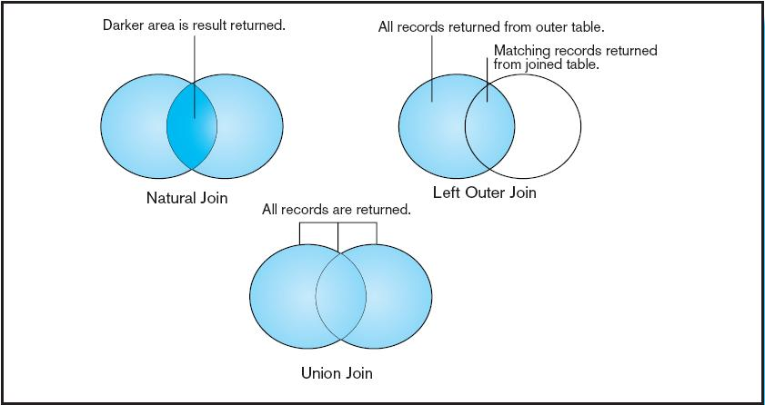
Figure 7-2 Visualization of different join types with results returned in shaded area
Notes:
In this Venn diagram, the data from each table is represented as a circle. Natural joins will only return the records from each table that have a match in the join condition with the other table. This is also called an inner join. By contrast, with an outer join, the records from one table will be included even if there are no corresponding records from the other. With a union join, all records from both tables are returned. This can also be accomplished via a full outer join.

Slide 6
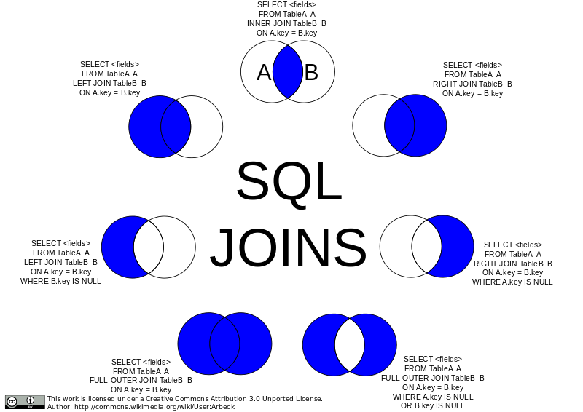
SQL JOINs

Slide 7
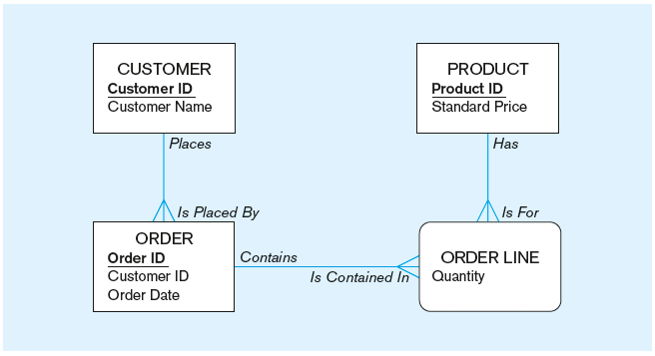
The following slides Involve queries operating on tables from this enterprise data model
(from Chapter 1, Figure 1-3)
Notes:
We’ve looked at these entities several times throughout the course. Each of these entities is implemented in a table. A customer may have several orders, each of which contains one or more order lines. Each order line is associated with a product. Of course, each product could be associated with several orders (through the order line associative entity).
We’ll look at several examples involving tables generated from these entities.

Slide 8
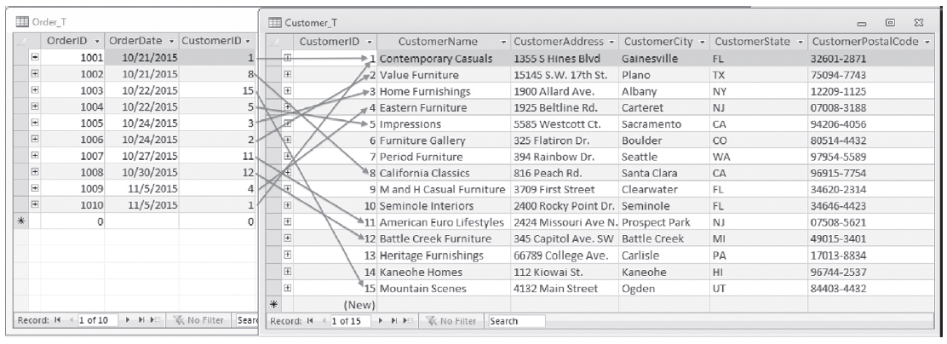
Figure 7-1 Pine Valley Furniture Company Customer_T and Order_T tables with pointers from customers to their orders
These tables are used in queries that follow
Notes:
Customer_T and Order_T have a 1:N relationship, as you can see from the CustomerID foreign key in Order_T. These are two of the tables; the others are OrderLine_T and Product_T.

Slide 9
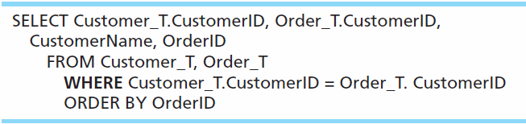
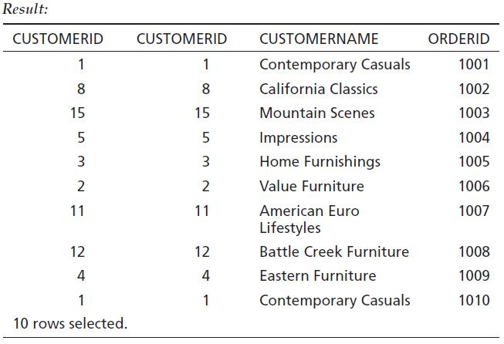
Equi-Join Example
For each customer who placed an order, what is the customer’s name and order number?
Customer ID appears twice in the result
Notes:
This is an equi-join. Notice that the CustomerID is showing from both tables. It’s probably not necessary to see this, because they are always matched.
Notice also that 10 rows are returned in this query. There are 10 rows in the Order_T table, and only those rows from the Customer_T table with corresponding orders will be included. That’s because equi-joins are inner join by default.

Slide 10
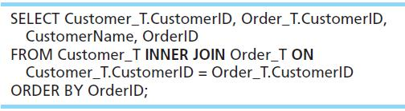
Equi-Join Example – alternative syntax
INNER JOIN clause is an alternative to WHERE clause, and is used to match primary and foreign keys.
An INNER join will only return rows from each table that have matching rows in the other.
This query produces same results as previous equi-join example.
Notes:
For join conditions, sometimes this syntax is used instead of the WHERE clause. This way you can distinguish between conditions that are used for matching records between tables vs. conditions used for selecting which rows to return (as we learned about in Chapter 6).

Slide 11
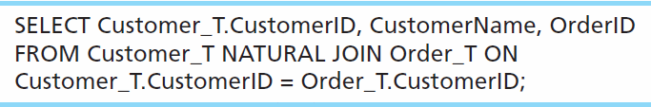
Natural Join Example
For each customer who placed an order, what is the customer’s name and order number?
Join involves multiple tables in FROM clause
ON clause performs the equality check for common columns of the two tables
Note: From Fig. 7-1, you see that only 10 Customers have links with orders.
➔ Only 10 rows will be returned from this INNER join

Slide 12
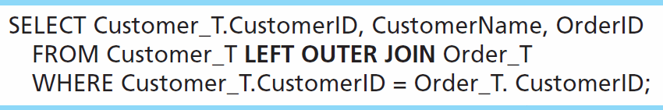
Outer Join Example
List the customer name, ID number, and order number for all customers. Include customer information even for customers that do have an order.
LEFT OUTER JOIN clause causes customer data to appear even if there is no corresponding order data
Unlike INNER join, this will include customer rows with no matching order rows

Slide 13
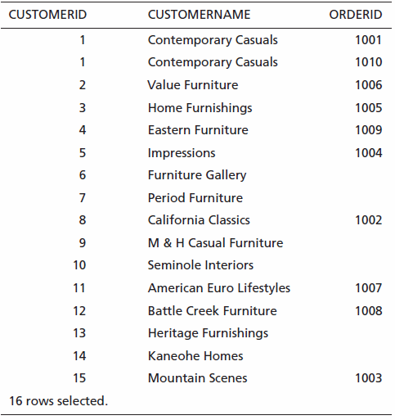
Outer Join Results
Unlike INNER join, this will include customer rows with no matching order rows
Notes:
There are 15 records in the Customer_T table, so all of these are returned, even if there are no matching records in the Order_T table. Also, one of the customers has two orders, as you can see. Therefore there are total of 16 rows returned here. That’s one for each order, plus one for each unmatched customer.
This is what distinguishes an outer join from an inner join.

Slide 14
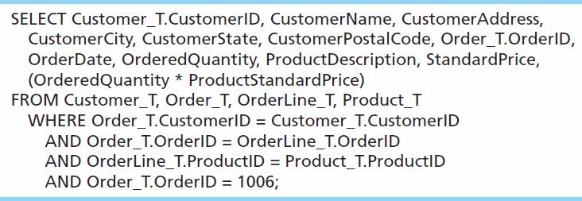
Multiple Table Join Example
Assemble all information necessary to create an invoice for order number 1006
Four tables involved in this join
Each pair of tables requires an equality-check condition in the WHERE clause, matching primary keys against foreign keys.
Notes:
There are four tables involved in this join. Therefore there are three join conditions. In general, if there are n tables, there will be n-1 join conditions.
The final condition (OrderID = 1006) is not a join condition. This is a condition that restricts the number of rows returned, not one that connects tables.

Slide 15
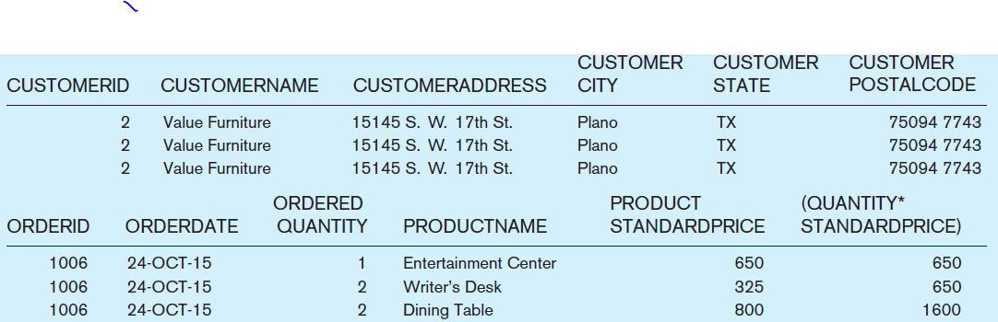
Figure 7-4 Results from a four-table join (edited for readability)
From CUSTOMER_T table
From PRODUCT_T table
From ORDER_T table
From ORDERLINE_T table
Notes:
Obviously, all rows returned from this query will pertain to OrderID 1006.
Note that the full query results include columns from four different tables.

Slide 16
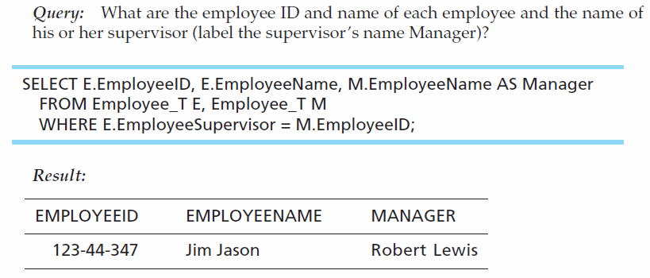
Self-Join Example
The same table is used on both sides of the join; distinguished using table aliases
Self-joins are usually used on tables with unary relationships.

Slide 17
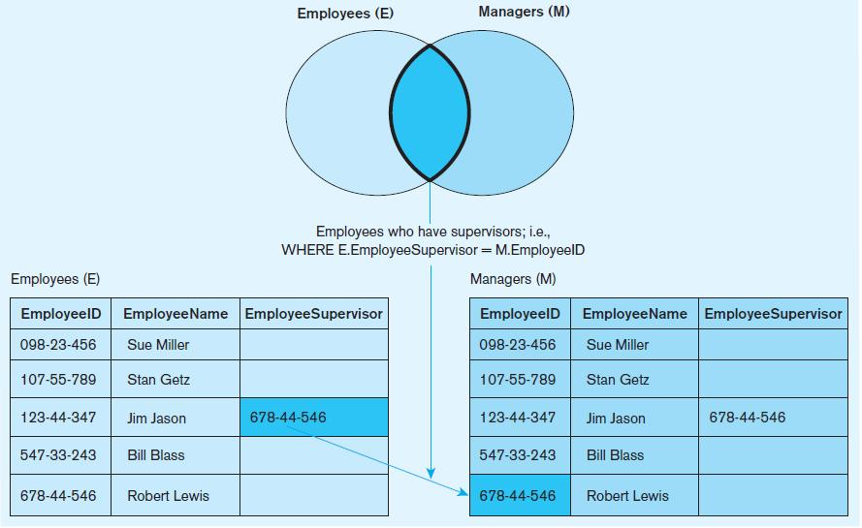
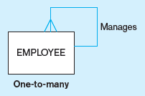
Figure 7-5 Example of a self-join
From Chapter 2
Unary 1:N
Notes:
Suppose you have a table of five employees as shown here. Only one of these employees has a supervisor. The EmployeeSupervisor column would be a foreign key in the Employees table which is associated the primary key EmployeeID. We saw an ER diagram showing the same sort of thing in chapter 2. So, a self join is associated with a unary relationship.

Slide 18
Processing Multiple Tables Using Subqueries
Subquery–placing an inner query (SELECT statement) inside an outer query
Options:
In a condition of the WHERE clause
As a “table” of the FROM clause
Within the HAVING clause
Subqueries can be:
Noncorrelated–executed once for the entire outer query
Correlated–executed once for each row returned by the outer query
Notes:
Subqueries are usually placed in the WHERE or HAVING clause of the outer query, and its results are often used as conditions for the WHERE or HAVING. It is also possible to put subqueries into the FROM clause.
When using multiple tables, sometimes you need a subquery, sometimes you need a join. Other times, the problem can be solved by either a subquery or a join. It is also possible to combine joins and subqueries together.

Slide 19
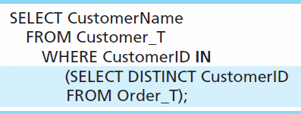
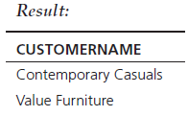
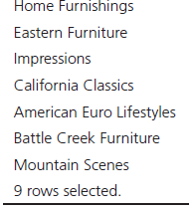
Subquery Example
Show all customers who have placed an order
The IN operator will test to see if the CUSTOMER_ID value of a row is included in the list returned from the subquery
Subquery is embedded in parentheses. In this case it returns a list that will be used in the WHERE clause of the outer query
Notes:
Here, the subquery returns all the DISTINCT customer IDs. In other words, if the same customer ID appears twice in the Order_T table, the DISTINCT operator ensures that it only appears once in the final result. This is often useful in queries.
This could also have been accomplished using an inner join.

Slide 20
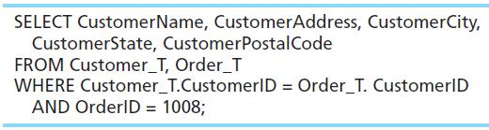
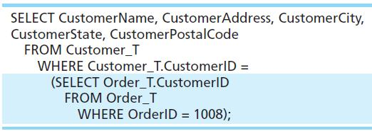
Join vs. Subquery
Some queries could be accomplished by either a join or a subquery
Join version
Subquery version
Notes:
Here is another example where either a join or a subquery would work.
But the subquery would not work if you needed to display data from the Order table. The results from the subquery are not actually displayed to the user; rather they are only used by the outer query. So, none of the data from the query looking at ORDER_T will be displayed.

Slide 21
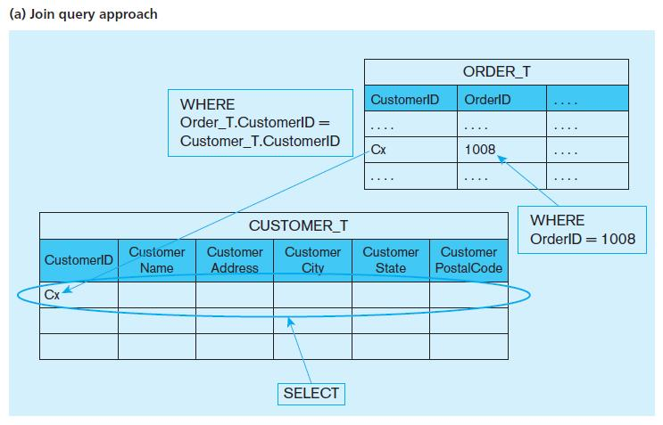
Figure 7-6 Graphical depiction of two ways to answer a query with different types of joins
Notes:
The joining technique is useful when data from several relations are to be retrieved and displayed, and the relationships are not necessarily nested, whereas the subquery technique allows you to display data from only the tables mentioned in the outer query. For example with the join we could see the Oder ID, but not with the subquery.
A join involves a cross product which combines all combinations of rows from each of the tables, followed by removing the rows that don’t match according to the conditions of the join.

Slide 22
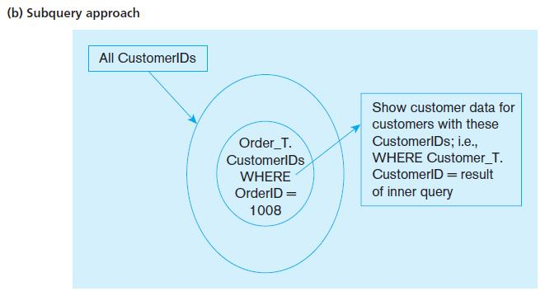
Figure 7-6 Graphical depiction of two ways to answer a query with different types of joins
Notes:
A subquery operates differently from a join. First, the subquery executes, which returns a result. Then that result is used in the outer query.
So, for these examples, although the results are the same, the execution that gave the results are quite different.

Slide 23
Correlated vs. Noncorrelated Subqueries
Noncorrelated subqueries:
Do not depend on data from the outer query
Execute once for the entire outer query
Correlated subqueries:
Make use of data from the outer query
Execute once for each row of the outer query
Can use the EXISTS operator
Notes:
Correlated subqueries use the result of the outer query to determine the processing of the inner query. That is, the inner query is somewhat different for each row referenced in the outer query. In this case, the inner query must be computed for each outer row, whereas in the earlier examples, the inner query was computed only once for all rows processed in the outer query.

Slide 24
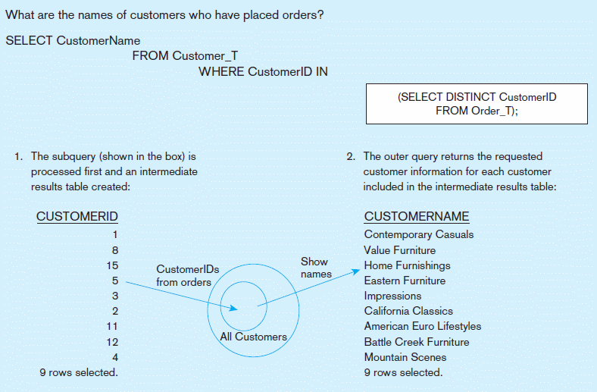
Figure 7-8a Processing a noncorrelated subquery
A noncorrelated subquery processes completely before the outer query begins.
Notes:
This is a non-correlated subquery. In this case all customer IDs are obtained from the Order_T table. Then this list is applied to the IN clause in the outer query. So, in this case we executed the inner query once, and then the outer query once.

Slide 25
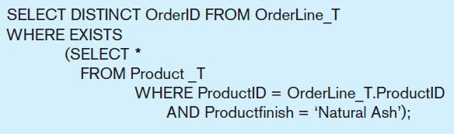
Correlated Subquery Example
Show all orders that include furniture finished in natural ash.
The EXISTS operator will return a TRUE value if the subquery resulted in a non-empty set, otherwise it returns a FALSE
➔ A correlated subquery always refers to an attribute from a table referenced in the outer query
The subquery is testing for a value that comes from the outer query
Notes:
The key feature that identifies a correlated subquery is the fact that the subquery makes reference to a column from the outer query. Note that OrderLine_T is a table used in the FROM clause of the outer query, but is not a table in the FROM clause of the inner query. Yet, the WHERE clause of the inner query does refer to a column from OrderLine_T, specifically the product ID.
If your subquery has a reference to a table in the outer query, that makes it a correlated subquery. If it does not have such a reference, then it is a noncorrelated subquery.

Slide 26
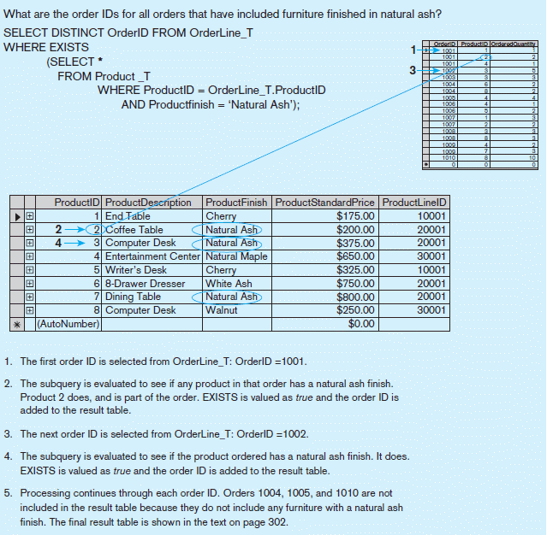
Figure 7-8b Processing a correlated subquery
Subquery refers to outer-query data, so executes once for each row of outer query
Note: Only the orders that involve products with Natural Ash will be included in the final results.
Notes:
So, in this case the subquery will execute once for each row of the outer query. In this example, the outer query goes through each row of the OrderLine_T table. Each time it gets to a row, that particular row’s product ID is used in the subquery to get the product of that particular order line. There are 17 order line records, so the subquery will execute 17 times, one for each order line record.
So, you can see the difference in behaviors of correlated vs. noncorrelated queries. With a non-correlated query, the inner query executes once, and then the outer query executes. For a correlated subquery, the outer query executes, and for each row of the outer query the inner query will execute once.

Slide 27
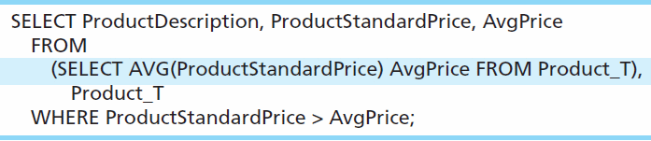
Another Subquery Example /(Derived Table)
Show all products whose standard price is higher than the average price
One column of the subquery is an aggregate function that has an alias name. That alias can then be referred to in the outer query.
Subquery forms the derived table used in the FROM clause of the outer query
The WHERE clause normally cannot include aggregate functions, but because the aggregate is performed in the subquery its result can be used in the outer query’s WHERE clause.
Notes:
Here we have a case where the subquery is in the FROM clause of the outer query. This is often called a “derived table”, because normally you see tables in the FROM clause. Derived tables are discussed in chapter 6.
Because aggregate functions cannot be done in the WHERE clause, it is often useful to use subqueries when you want your conditions to include aggregate results.
For example, this query would not have worked, so instead we do what the slide is showing:
SELECT ProductDescription, ProductStandardPrice FROM Product_T
WHERE ProductStandardPrice > AVG(ProductStandardPrice);

Slide 28
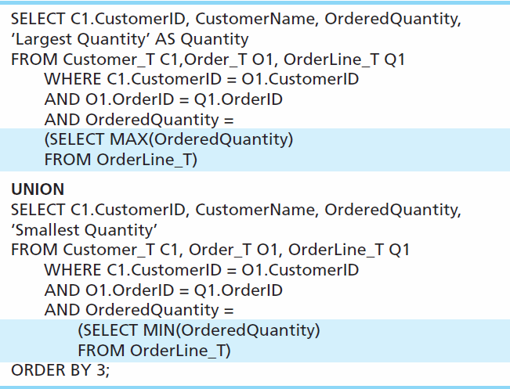
Union Queries
Combine the output (union of multiple queries) together into a single result table
First query
Combine
Second query
Notes:
This query determines the customer(s) who has in a given line item purchased the largest quantity of any Pine Valley product and the customer(s) who has in a given line item purchased the smallest quantity and returns the results in one table.
To use the UNION clause, each query involved must output the same number of columns, and they must be UNION compatible. This means that the output from each query for each column should be of compatible data types.
Note: although these queries involve subqueries, this is not necessary for unions. It just so happens we’re doing it in this example.
In general a UNION is structured like this:
SELECT statement
UNION
SELECT statement
It is possible to UNION many different SELECT statements together. He we perform a single UNION operation combining two of them.

Slide 29
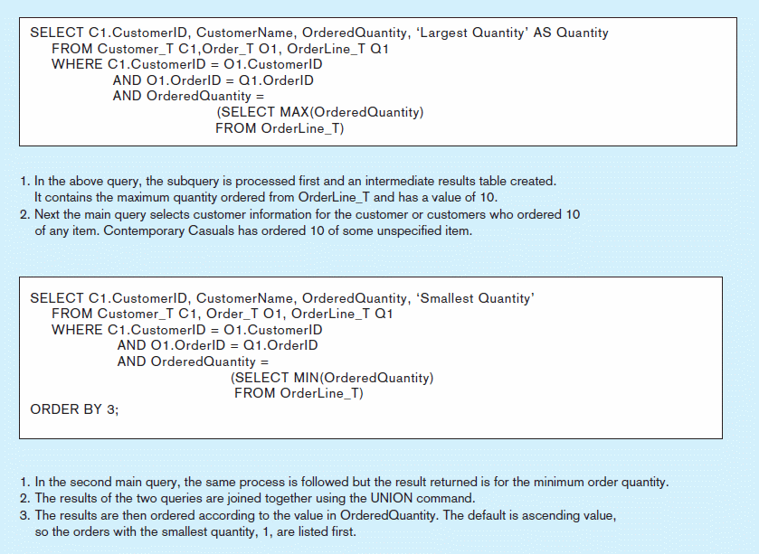
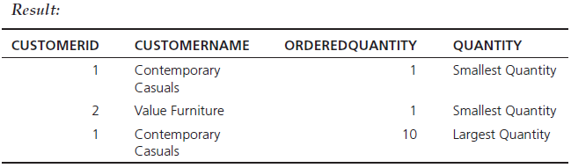
Figure 7-9 Combining queries using UNION
Note: With UNION queries, the quantity and data types of the attributes in the SELECT clauses of both queries must be identical.
Notes:
This figure explains the processing of this UNION query.
Note another feature of this example. It is possible for the SELECT clause to include literal values in its returned column list. See the words ‘Smallest Quantity’ and ‘Largest Quantity’. These are not values in the tables, but can still be shown in the results.

Slide 30
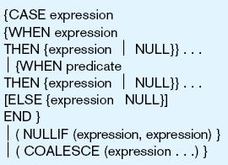
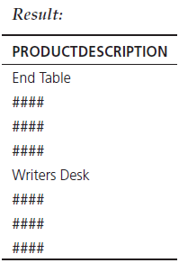
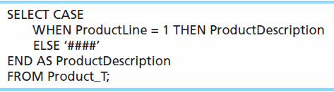
Conditional Expressions Using Case Keyword
This is available with newer versions of SQL, previously not part of the standard
Figure 7-10
Notes:
SQL does not include an IF-ELSE statement, unlike procedural programming languages. The CASE keyword was introduced to accommodate this need.
The CASE syntax has four possible forms.
The CASE form can be constructed using either an expression that equates to a value or a predicate. The predicate form is based on threevalue logic (true, false, don’t know) but allows for more complex operations. The value expression form requires a match to the value expression. So, these are the first two forms.
NULLIF and COALESCE are the keywords associated with the other two forms of the CASE expression.

Slide 31
More Complicated SQL Queries
Production databases contain hundreds or even thousands of tables, and tables could include hundreds of columns.
So, sometimes query requirements can be very complex.
Sometimes it’s useful to combine queries, through the use of Views.
If you use a view (which is a query), you could have another query that uses the view as if it were a table.
Notes:
Views were discussed in Chapter 6. These are objects stored in the database, like tables. But they are dynamically generated “virtual” tables, which are really implemented as queries. So, you could have a query that uses the view, which is another query.

Slide 32
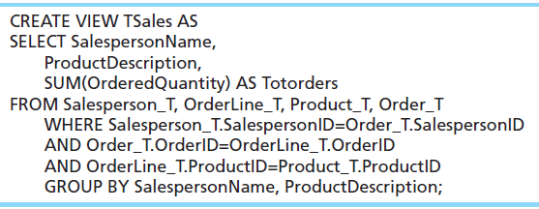
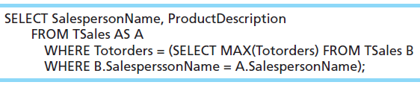
Example of Query Using a View
Notes:
The view is called TSales, and consists of an aggregate query involving a join of three tables. TSales, returns the total sales of each product sold by each salesperson.
The query below it uses TSales as if it were a table. Note that this query involves a correlated subquery. What this query does is show the biggest selling product for each salesperson.

Slide 33
Tips for Developing Queries
Be familiar with the data model (entities and relationships)
Understand the desired results
Know the attributes desired in results
Identify the entities that contain desired attributes
Review ERD
Construct a WHERE equality for each link
Fine tune with GROUP BY and HAVING clauses if needed
Consider the effect on unusual data
Notes:
It is important to test your query against a set of test data that includes unusual data, missing data, impossible values, etc.

Slide 34
Query Efficiency Considerations
Instead of SELECT *, identify the specific attributes in the SELECT clause; this helps reduce network traffic of result set
Limit the number of subqueries; try to make everything done in a single query if possible
If data is to be used many times, make a separate query and store it as a view
Notes:
Subqueries can be very useful, but can also cause computational overload. This is especially true for correlated subqueries. Suppose for example, you had a correlated subquery where the outer query was processing through 10,000 rows. This means the subquery would execute 10,000 times! So, in effect, that one overall query involves 10,001 real queries.
This is another reason it is important to test your queries. Not only must they be able to execute, but they should produce valid results and also do it in a reasonable amount of time.

Slide 35
Guidelines for Better Query Design
Understand how indexes are used in query processing
Keep optimizer statistics up-to-date
Use compatible data types for fields and literals
Write simple queries
Break complex queries into multiple simple parts
Don’t nest one query inside another query
Don’t combine a query with itself (if possible avoid self-joins)
Notes:
Note that if you have indexed fields and want to take advantage of them, the WHERE clause should test for equality. For example, in the Product_T table, suppose Finish is indexed. If so, the query will run more efficiently if you are doing something like this: WHERE Finish = ‘Birch’ OR ‘Walnut’ instead of this: WHERE Finish NOT = ‘Walnut’.

Slide 36
Guidelines for Better Query Design (cont.)
Create temporary tables for groups of queries
Combine update operations
Retrieve only the data you need
Don’t have the DBMS sort without an index
Learn!
Consider the total query processing time for ad hoc queries
Notes:
All options are not available with every DBMS, and each DBMS has unique options due to its underlying design. You should refer to reference manuals for your DBMS to know which specific tuning options are available to you.

Slide 37
Ensuring Transaction Integrity
Transaction = A discrete unit of work that must be completely processed or not processed at all
May involve multiple updates
If any update fails, then all other updates must be cancelled
SQL commands for transactions
BEGIN TRANSACTION/END TRANSACTION
Marks boundaries of a transaction
COMMIT
Makes all updates permanent
ROLLBACK
Cancels updates since the last COMMIT
Notes:
Transactions should be atomic. This means that either the entire transaction should complete, or none of it should complete.
Atomicity is discussed in more detail in chapter 12 (database administration). DBMSs are supposed to guarantee ACID (atomic, consistent, isolated, durable) transactions.
For example, consider processing a customer’s sales order in the Pine Valley Furniture database. This requires creating an Order_T record, and a few OrderLine_T records. .
If the Product_T table also includes inventory on hand attribute, it could also mean changing this value. So, several updates need to be done. If any of these fail, then all the others should be cancelled.

Slide 38
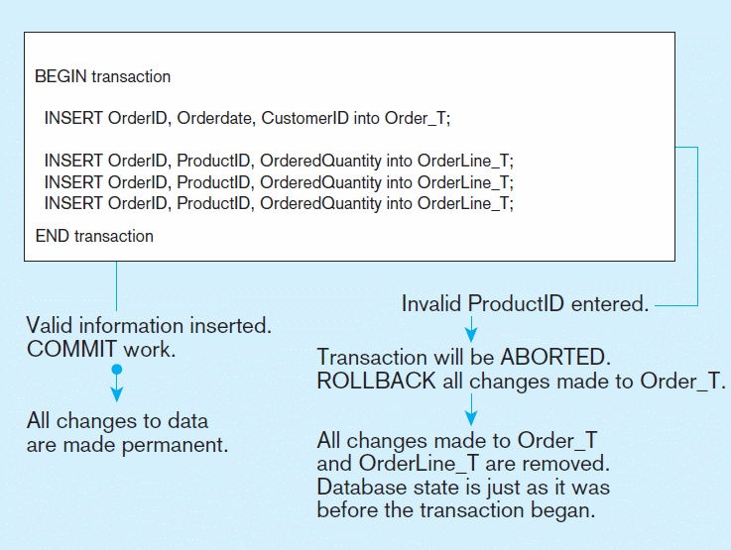
Figure 7-12 An SQL Transaction sequence (in pseudocode)
Notes:
So, none of the inserts actually take place until the transaction have been COMMITTED. If there is any error, then all previous updates will be ROLLED BACK.
This helps to ensure that the transaction is atomic. Either the whole thing happens, or none of it happens.

Slide 39
Data Dictionary Facilities
System tables that store metadata
Users usually can view some of these tables
Users are restricted from updating them
Some examples in Oracle 12c
DBA_TABLES – descriptions of tables
DBA_CONSTRAINTS – description of constraints
DBA_USERS – information about the users of the system
Examples in Microsoft SQL Server 2014
sys.columns – table and column definitions
sys.indexes – table index information
sys.foreign_key_columns – details about columns in foreign key constraints
Notes:
All of these tables and views are used internally by the DBMS. But you can also query them. For example, you could find the owners of a company’s tables. Here is an example if PVF’s database was stored in an Oracle DBMS:
SELECT OWNER, TABLE_NAME FROM DBA_TABLES WHERE TABLE_NAME = ‘PRODUCT_T’;

Slide 40
SQL:2008 Enhancements/Extensions
User-defined data types (UDT)
Subclasses of standard types or an object type
Analytical functions (for OLAP)
CEILING, FLOOR, SQRT, RANK, DENSE_RANK, ROLLUP, CUBE, SAMPLE,
WINDOW–improved numerical analysis capabilities
New Data Types
BIGINT, MULTISET (collection), XML
CREATE TABLE LIKE–create a new table similar to an existing one
MERGE
Notes:
The SQL standard is constantly being enhanced and updated.
SQL:1999 added more programming capabilities. SQL:2008 added statistical functions, new data types, XML processing capabilities. SQL:2011 introduced further refinements and temporal features.

Slide 41
SQL:2008 Enhancements (cont)
Programming extensions
Persistent Stored Modules (SQL/PSM)
Capability to create and drop code modules
New statements:
CASE, IF, LOOP, FOR, WHILE, etc.
Makes SQL into a procedural language
Oracle has propriety version called PL/SQL, and Microsoft SQL Server has Transact/SQL

Slide 42
Routines and Triggers
Routines
Program modules that execute on demand
Functions–routines that return values and take input parameters
Procedures–routines that do not return values and can take input or output parameters
Triggers–routines that execute in response to a database event (INSERT, UPDATE, or DELETE)

Slide 43
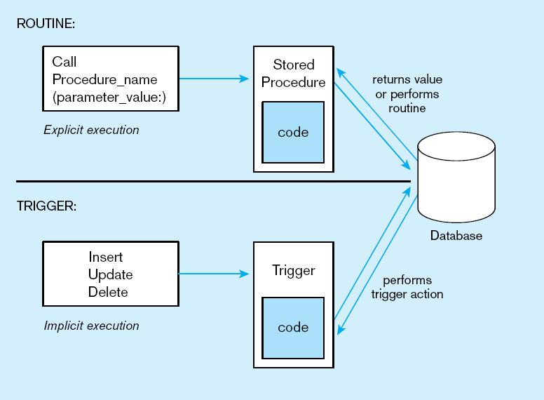
Figure7-13 Triggers contrasted with stored procedures (based on Mullins 1995)
Procedures are called explicitly
Triggers are event-driven
Source: adapted from Mullins, 1995.
Notes:
Procedures and Functions are called explicitly by the user of the database (for example an application program). When calling a procedure or function, you may pass it parameters. Functions, unlike procedures, will actually return a value. In both cases, there could be several queries or updates done to the database.
Triggers are not called explicitly. Instead, they are invoked as a result of some sort of database action, such as inserting a new record, modifying an existing record, or deleting a record. They could also be invoked as a result of a DDL statement to ALTER a table.

Slide 44
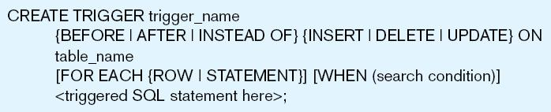
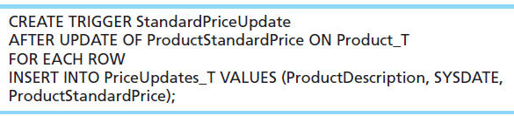
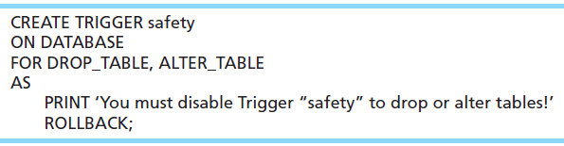
Figure 7-14 Simplified trigger syntax, SQL:2008
Example DML Trigger
Example DDL Trigger
Notes:
Triggers may occur either before, after, or instead of the statement that aroused the trigger is executed. DML triggers may occur on INSERT, UPDATE, or DELETE commands.
Question: Remember what DML stands for?
Answer: Data Manipulation Language.
Question: Remember what DDL stands for?
Answer: Data Definition Language
SQL = DDL + DML
This sample DML trigger will execute after an update of the ProductStandardPrice column of the Product_T table. It will add a new row to the PriceUpdates_T table, and use the new values of the product description and price (from the update) for this new row.
DDL triggers are generally most useful to database administrators.

Slide 45
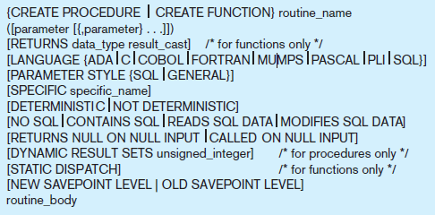
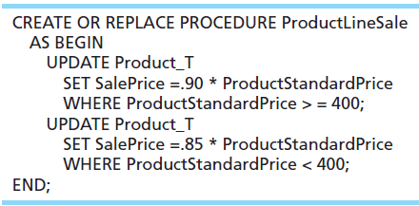

Figure 7-15 Syntax for creating a routine, SQL:2011
Example stored procedure
Calling the procedure
Notes:
As we said earlier, routines, which can be either Procedures or Functions, are explicitly called and can take parameters. In this sense they are a lot like the types of program modules you find in procedural programming languages like Java or C. These will often make use of SQL extensions that enable flow control, such as IF-THEN statements or loops. These extensions are called Persistent Stored Modules.

Slide 46
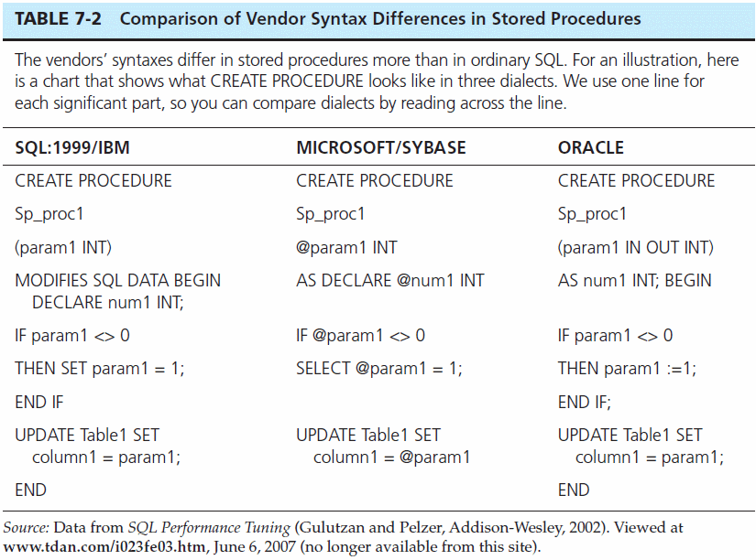

Slide 47
Embedded and Dynamic SQL
Embedded SQL
Including hard-coded SQL statements in a program written in another language such as C or Java
Dynamic SQL
Ability for an application program to generate SQL code on the fly, as the application is running
Notes:
We’ll learn more about embedded and dynamic SQL in chapter 8, when we talk about database applications.

Slide 48
Reasons to Embed SQL in 3GL
Can create a more flexible, accessible interface for the user
Possible performance improvement
Database security improvement; grant access only to the application instead of users

Slide 49


