Slide 1
Chapter 8: database application development
Modern Database Management
12th Edition
Jeff Hoffer, Ramesh Venkataraman,
Heikki Topi

Slide 2
Objectives
Define terms
Explain three components of client/server systems: presentation, processing, and storage
Distinguish between two-tier and three-tier architectures
Describe how to connect to databases in 2-tier systems using VB.NET and Java
Describe key components and information flow in Web applications
Describe how to connect to databases in 3-tier applications using JSP, PHP, and ASP .NET
Explain the purpose of XML
See how XQuery can be used to query XML documents
Explain how XML fosters Web services and SOAs

Slide 3
Client/Server architectures
Networked computing model
Processes distributed between clients and servers
Client–Workstation (PC, smartphone, tablet) that requests and uses a service
Server– Powerful computer (PC/mini/mainframe) that provides a service
For DBMS, server is a database server
For the Internet, server is a web server
Notes:
Client/server applications began with the advent of networked computing, and are the dominant paradigm for computing applications for the past 25 years. Prior to that, mainframe computers with “dumb terminals” (and later “smart terminals”) was the dominant mode. These still exist, but they are usually also somehow connected C/S networks.
Every time you use the Web you are operating in a client/server environment. The idea is that the requests some sort of resource, and the server provides it. Each server will service many clients, maybe even millions (for example Amazon’s web servers.
Servers can be file servers, print servers, database servers, web servers, or in general servers providing any shared resource to clients in the network. For example, your school’s computer lab has a shared printer that you can use, and this is done by a print server in a client/server environment. The computer you work on is a client in that network. This is typically called a local area network (LAN).
Web servers operate in the Internet, which is a wide are network (WAN).
Advances in personal computing, smartphone, and tablet technology and the corresponding rapid evolution of graphical user interfaces (GUIs), networking, and communications have changed the way businesses use computing systems to meet ever more demanding business needs. Electronic commerce requires that clients (PCs or smartphones) be able to access dynamic Web pages attached to databases that provide real-time information. Mainframe applications have been rewritten to run in client/server environments and take advantage of the greater cost-effectiveness of advances in networking, personal computers, smartphones, and tablets.

Slide 4
Application Logic in C/S Systems
Presentation Logic
Input–keyboard/mouse
Output–monitor/printer
GUI Interface
Processing Logic
I/O processing
Business rules
Data management
Procedures, functions,
programs
Storage Logic
Data storage/retrieval
DBMS activities
Notes:
As you can see here, there are three main layers in an application, and they serve different purposes. The presentation layer is what you the user directly interact with. The processing logic involves the software doing all the computation for the application. And the storage logic involves the activities of the DBMS. Different types of C/S systems will distribute these three in different ways.

Slide 5
Application Partitioning
Placing portions of the application code in different locations (client vs. server) after it is written
Advantages
Improved performance
Improved interoperability
Balanced workloads
Notes:
We’re going to see different types of application partitioning. This involves distributing the presentation, processing and storage logic to different computers in the client server network. Of course, presentation is always at the client.

Slide 6
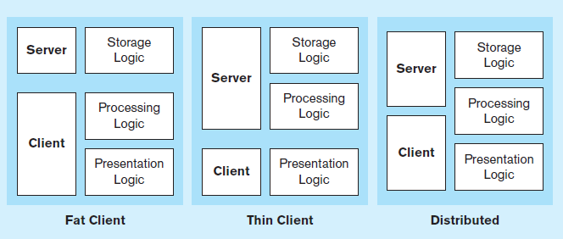
Figure 8-2 Common Logic Distributions
a) Two-tier client-server environments
Processing logic could be at client (fat client), server (thin client), or both (distributed environment).
Notes:
Local area networks are typically implemented as a 2-tier system. Here, the presentation layer always does presentation logic, and the server always does storage logic. Processing logic could take place in either. This is what you are using when you work within an office’s local network, or your school’s computer lab’s.

Slide 7
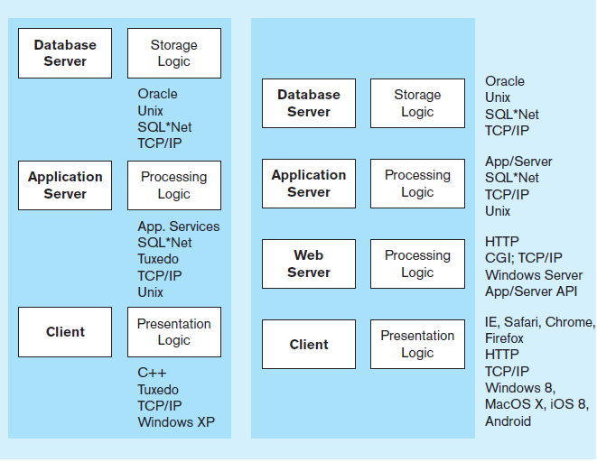
Figure 8-2 Common Logic Distributions
b) Three-tier and n-tier client-server environments
Processing logic will be at application server or Web server.
Notes:
This is how it’s done on the web. There are at least three tiers, with each tier doing one of the three logics. The client is you on your PC or mobile device. Application logic takes place on the application server and the DBMS is on the database server. We’ll see in later slides some code you’ll typically see in application logic.
Notice that sometimes the processing logic is split. The underlying business logic is done on one server and the control of Internet processing is done on the web server.

Slide 8
Two-Tier Database Server Architectures
Client workstation is responsible for
Presentation logic
Data processing logic
Business rules logic
Server performs all data storage, access, and processing
Typically called a database server
➔ DBMS is only on server

Slide 9
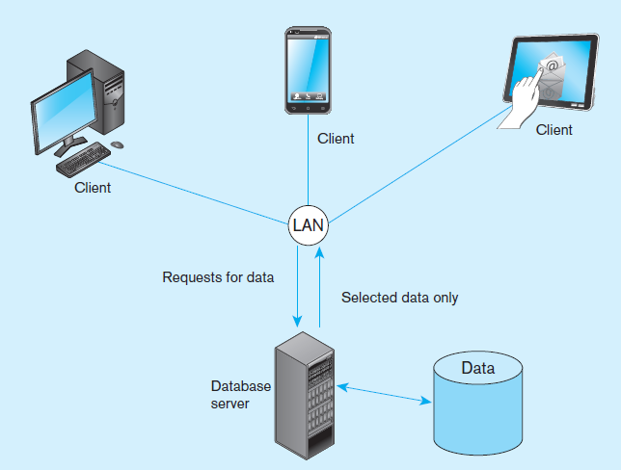
Figure 8-3 Database server architecture (two-tier architecture)
Front-end programs
Back-end functions
Notes:
Here is a picture of a 2-tier system with a database server and clients. LANs tend to be small without a huge amount of network traffic. The server is in charge of all control to the database, and also handles all the DBMS activities like user authorization, integrity checking, data dictionary maintenance, and query and update processing.
The only people directly using the server are typical system administrators and database administrators. We talk about database administration in chapter 12.

Slide 10
Characteristics of Two-Tier Client/Server Systems
Departmental in scope (few users)
Not mission-critical
Low transaction volumes
Common programming languages:
Java, VB .NET, C#
Interface database via middleware, APIs
Notes:
As you can see, this is very different from the scope of the Web. It’s also different from the scope of a large enterprise. So, 2-tier systems don’t work for enterprise-wide applications in large corporations.
But they are relatively simple and work well for smaller groups.

Slide 11
Middleware and APIs
Middleware – software that allows an application to interoperate with other software without requiring user to understand and code low-level operations
Application Program Interface (API) – routines that an application uses to direct the performance of procedures by the computer’s operating system
Common database APIs – ODBC, ADO .NET, JDBC
Notes:
No matter what C/S architecture you use, you will encounter middleware and APIs. There are many kinds of APIs, and database APIs is only one type. For example, there are API’s for the presentation layer stuff (forms, buttons, list boxes, and all the user interface processing). There are also APIs for working with different web services; often these are in the form of REST and XML.
Computer programmers and application developers will use APIs for interacting with the database, and these APIs invoke middleware to provide the connection to the DBMS.
ODBC and ADO .NET are the most common database APIs for the Microsoft platform. ODBC is older, and ADO .NET is more modern. ADO .NET is the most common database API in web applications.

Slide 12
Steps for Using Databases via Middleware APIs
Identify and register a database driver.
Open a connection to a database.
Execute a query against the database.
Process the results of the query.
Repeat steps 3–4 as necessary.
Close the connection to the database.
Notes:
When you’re writing a program that interacts with a database, you will need to do all these things in the code. Different programming languages have different syntax and we’ll see a couple examples.

Slide 13
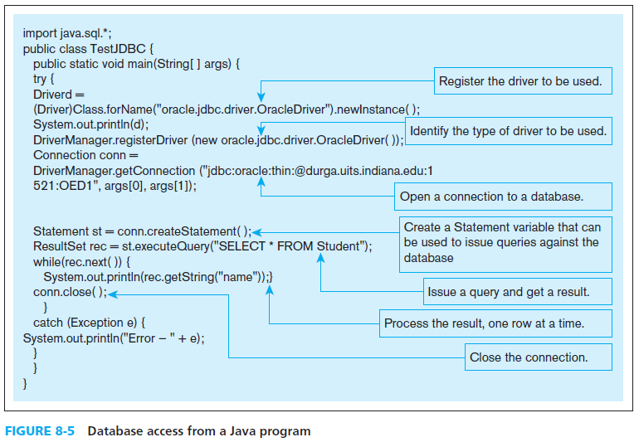
Notes:
Here’s the Java code for doing these steps. The “driver” is the middleware program that provides the link to the DBMS. At the “open a connection” step you can see the connection string. And further down, you see the query. The data returned from the query is in a “result set”, and your program can loop through this result set to obtain that data.
The three JDBC classes that you will likely use in a Java database program are DriverManager, Connection, Statement, and ResultSet. Each of these are classes in the Java JDBC API.
The textbook also shows a VB .NET example, which you’d typically have in a Microsoft operating system. There are similar classes in the .NET API (for establishing connections, creating commands and queries, and processing the results of queries).

Slide 14
Three-Tier Architectures
GUI interface
(I/O processing)
Browser, Mobile App
Client
Application server
Web Server
Business rules
Database server
Data storage
DBMS
Thin Client
PC just for user interface and a little application processing. Limited or no data storage (sometimes no hard drive)
Notes:
We’ve been talking about 2-tier client server architectures, and now we’ll start talking about three-tier and n-tier systems. In these types of C/S architectures, the client is typically a browser like Internet Explorer or Google Chrome sitting on your desktop, or perhaps a mobile app. These interact with a Web server, which includes in addition to HTTP processing, the application framework like ASP .NET, PHP, or JSP. At this level, programs written in these languages interact with DBMSs such as Oracle, SQL Server, or mySql through a variety of middleware components via the APIs of these particular frameworks.

Slide 15
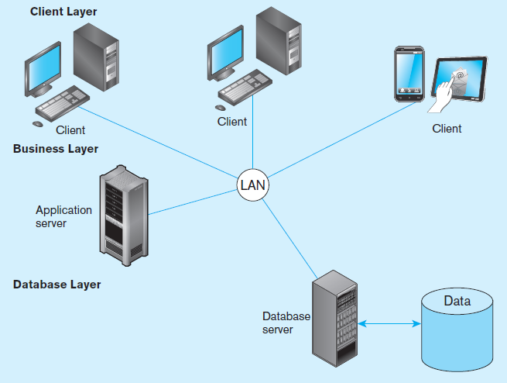
Figure 8-6a Generic three-tier architecture
Thin clients
DBMS only on DB server
Business rules on application
server
Notes:
Here, notice the separation of the two different servers. That’s why it’s 3-tier.
This distributes the processing demand across servers, increasing performance and scalability. Also, experts at different levels concentrate on the code on different tiers. For example, user interface designers concentrate on the code of the presentation layer. Applications developers’ code resides on the application server. And database designers and administrators concentrate on the database server.

Slide 16
Thin Client
An application where the client accessing the application primarily provides the user interfaces and some application processing, usually with no or limited local data storage.
Usually, thin client application is a Web browser and the 3-tier architecture involves a Web application.
Notes:
Your browser is a good example of a thin client. This displays HTML and responds to users’ menu choices and button clicks. It also includes a little more processing in the form of JavaScript and JSON. But the deep application processing is done at the server level. This is where the .NET, PHP, or JSP code resides and executes. Clients will typically store very little permanent data, which usually goes to a database server. Often the permanent client-saved data is in the form of cookies.

Slide 17
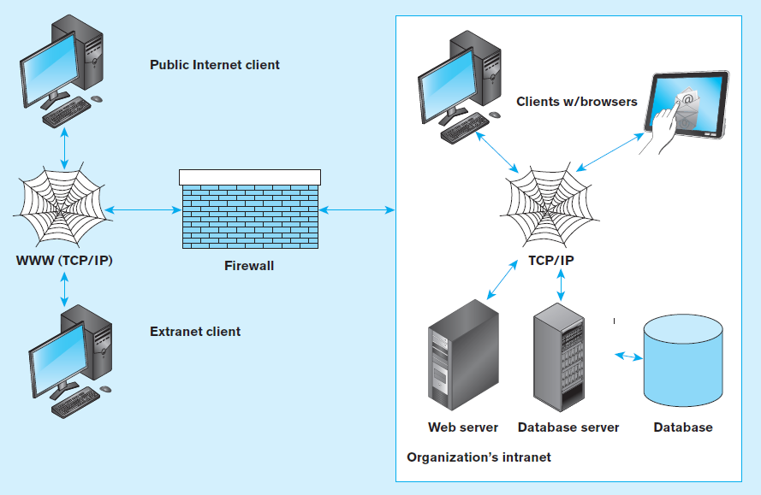
Figure 8-7 A database-enabled intranet/Internet environment
Notes:
The network protocol for Internet-bound traffic is TCP/IP, which stands for Transmission Control Protocol – Internet Protocol. The notion of an extranet is what we usually think of when we use a Web site like Amazon. Companies interact with the public via extranets. An intranet also uses 3-tier internet technology (web servers, TCP/IP protocol) but is limited to access from within an organizations control. This is hidden from the external internet by a firewall, providing security for the organization’s resources.

Slide 18
Web Application Components
Database server – hosts the DBMS
e.g. Oracle, SQL Server, Informix, MS Access, MySql
Web server – receives and responds to browser requests using HTTP protocol
e.g. Apache, Internet Information Services (IIS)
Application server – software building blocks for creating dynamic web sites
e.g. MS ASP .NET framework, Java EE, ColdFusion, PHP
Web browser – client program that sends web requests and receives web pages
e.g. Internet Explorer, Firefox, Safari, Google Chrome

Slide 19
Languages for Creating Web Pages
Hypertext Markup Language (HTML)
Markup language specifically for Web pages
Standard Generalized Markup Language (SGML)
Markup language standard
Extensible Markup Language (XML)
Markup language allowing customized tags
XHTML
XML-compliant extension of HTML
JavaScript/VBScript
Scripting languages that enable interactivity in HTML documents
Cascading Style Sheets (CSS)
Control appearance of Web elements in an HML document
XSL and XSLT
XMS style sheet and transformation to HTML
Standards and Web conventions established by
World Wide Web Consortium (W3C)

Slide 20
Processing in 3-Tier Applications
Static page requests
.htm or .html requests handled by the Web server
Dynamic page requests
.jsp, .aspx, and .php requests are routed to the application server
Server-side processing by JSP servlet (Java), ASP .NET application (C# or VB), ColdFusion, or PHP
Database access via JDBC, ADO .NET, or other database middleware

Slide 21
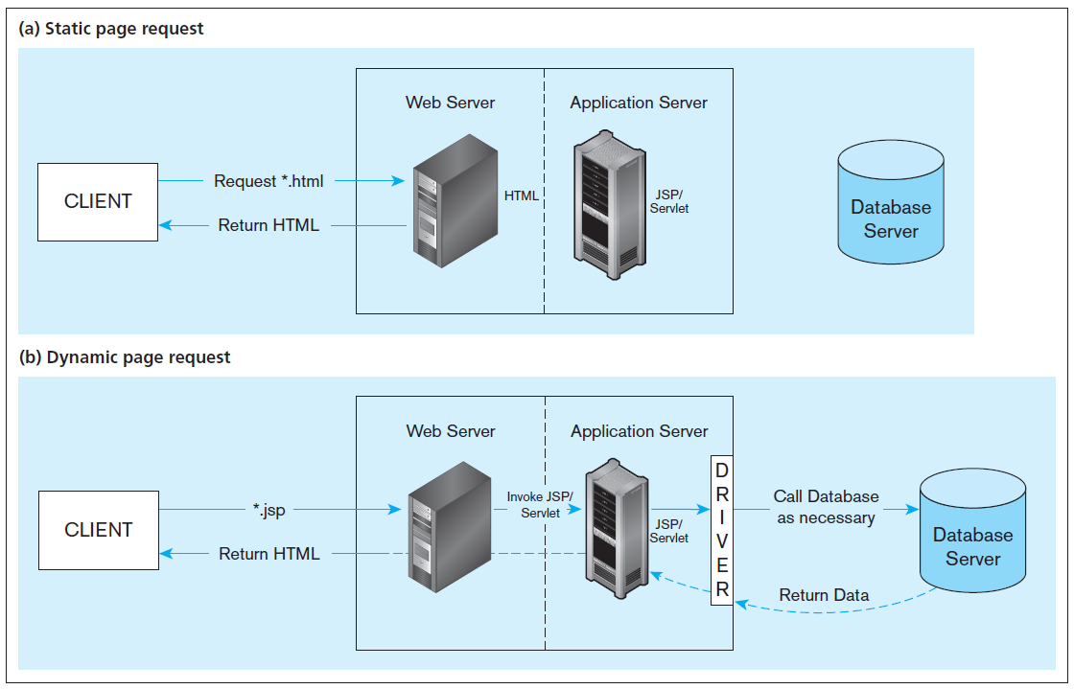
Figure 8-9 Information flow in a three-tier architecture
No server side processing, just a page return
Server side processing, including database access
…also *.aspx or *.php
Notes:
This shows the difference between static and dynamic page requests. Any web request to a .html or .shtml file is a static request. No application processing takes place on the application server. Basically, the file retrieved has all the HTML, CSS, and JavaScript code in it.
URLs with .jsp, .php, and .aspx are dynamic page requests. Here, the application server is invoked and interacts with the database to dynamically generate the HTML, CSS, and JavaScript that gets sent to the browser.

Slide 22
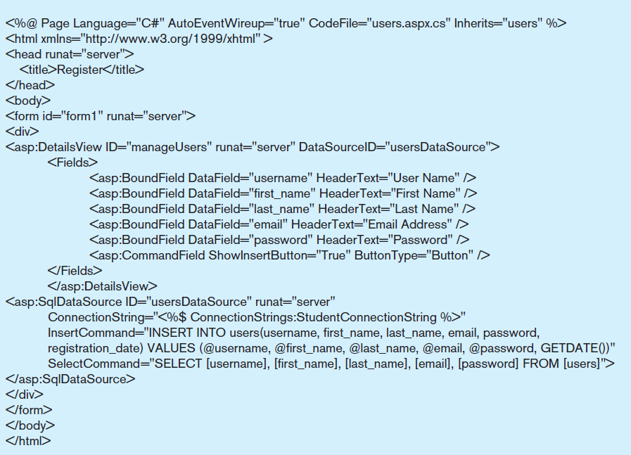
Figure 8-12 A registration page written in ASP .NET
a) Sample ASP .NET code for user registration
A DetailsView is a type of Web control
Web controls can be databound to data sources, including SqlDataSource.
Notes:
The textbook also shows PHP and JSP examples, but we’ll focus on an ASP .NET example here. This is an example Web page that you would see in a .aspx file. You see some HTML, but you also see some special asp tags. These are the objects that are part of the ASP .NET API.
Web controls are often databound to query results from the SqlDataSource web control. There are lots of different web controls in ASP .NET, including FormViews, ListBoxes, GridViews, Charts, to name a few.
The <asp:> tags run at the server to create Web controls that dynamically generate HTML which gets sent to the browser.
Note that this Page has a C# as its underlying procedural code. But code you see here is all markup language (HTML with .ASP NET extensions).

Slide 23
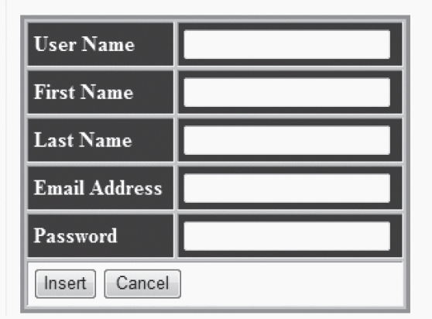
Figure 8-12 A registration page written in ASP .NET
b) Form for the ASP .NET application
Notes:
This web page has a DetailsView. A DetailsView displays as a table consisting of two columns. The first column consists of the field name of the bound field in the .aspx file. The second column will contain the values of these fields from the query results. A DetailsView can also allow for update, insert, or delete.
Remember the earlier Java example. In that example, setting up connections and doing queries and updates is coded in the procedural language. But in this case, we did it in the markup HTML. This is often much simpler. However, you can’t do everything in the markup language. Sometimes you need procedural code for database processing. In this case you’d do that in the C# or VB procedural code associated with the .aspx file.

Slide 24
Considerations in 3-Tier Applications
Stored procedures
Code logic embedded in DBMS
Improve performance, but proprietary
Transactions
Involve many database updates
Either all must succeed, or none should occur
Database connections
Maintaining an open connection is resource-intensive
Use of connection pooling
Notes:
We looked at stored procedures in chapter 7. A stored procedure is actually a database object, like a table or a view. With the stored procedure, application logic is taking place on the database server.
Transactions are discussed in chapter 12. The idea here is that a transaction should be atomic. That means either the whole thing is done or none of it is done. So, updates within a transaction aren’t finalized until the transaction commits. If an error occurs any time along the way, then the data is rolled back, canceling previous updates in the transaction.
As you can see, developers of web applications need to be careful about how they establish database connections.

Slide 25
Advantages And Disadvantages of Stored Procedures
Advantages
Performance improves for compiled SQL statements
Reduced network traffic
Improved security
Improved data integrity
Thinner clients
Disadvantages
Programming takes more time
Proprietary, so algorithms are not portable

Slide 26
Benefits of Three-Tier Architectures
Scalability
Technological flexibility
Long-term cost reduction
Better match of systems to business needs
Improved customer service
Competitive advantage
Reduced risk
Notes:
The three tier architecture makes it easy do distribute computational burden across many different computers. This increases scalability, and impacts all the factors in this list.

Slide 27
Cloud computing
A model for creating ubiquitous, convenient, on-demand access to network services
Characteristics: on-demand, broad network access, resource pooling, rapid elasticity, measured service
Types of cloud computing:
Infrastructure-as-a-service (IaaS)
Platform-as-a-service (PaaS)
Software-as-a-service (SaaS)
Notes:
Cloud computing and 3-tier architectures go hand in hand.

Slide 28
Extensible Markup Language (XML)
A text-based markup language (like HTML)
Uses elements, tags, attributes
Includes document type declarations (DTDs), XML schemas, comments, and entity references
Revolutionizes the way data are exchanged over the Internet
Document Structure Declarations (DSD), XML Schema (XSD) and Relax NG replacing DTDs for validating XML document structure
XSD – language for defining XML databases, recommended by the W3C.
Notes:
Actually, XML is not a language per se. It’s more of a meta-language, or a format for creating your own XML-based language. This is different from HTML. With HTML, there are specific types of elements, such as <body>, <head>, <table>, etc. With XML, there are not predefined elements; rather you create your own for your own purpose.
You can think of DSD, XSD, DTD, etc. as a way to express the metadata of the XML language you create.

Slide 29
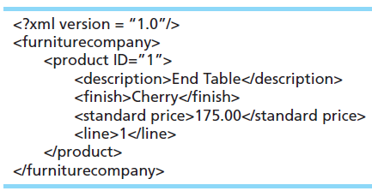
Simple SML Example
Notes:
XML is hierarchical; it consists of elements, sub-elements, sub-sub-elements, etc. In the markup language, elements are expressed as <tags>.
Here we see a <furniturecompany> element, composed of one subelement called <product> which in turn has sub-elements <description>, <finish>, <standard price>, and <line>.
Some elements have attributes. For example, the <product> element has an ID attribute.
At the lowest level of the hierarchy are simple text data values. For example, the value of the <description> element of product ID #1 is “End Table”.
Data is also found in the values of the attributes. For example, the <product> element shown here has an ID of “1”.
Keep in mind that XML is just text. You can read an XML file with a program like Notepad.

Slide 30
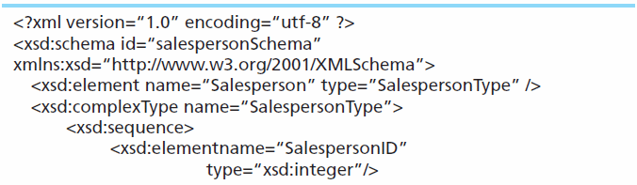
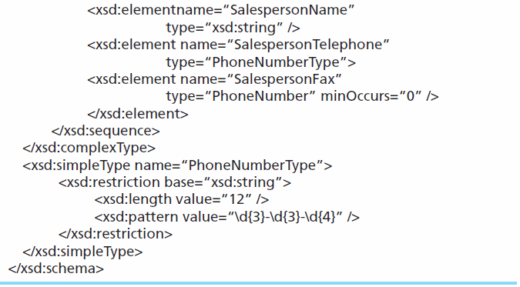
Sample XML Schema (XSD)
Schema is a record definition, analogous to the Create SQL statement, and therefore provides metadata.
Notes:
This XSD describes that defines a complex data type. You can see that it ascribes names and data types for various elements in the XML-based language. So, you can see that this is describing metadata.
Note that even the XSD is in XML format. Everything you see here is elements and attributes, hierarchically arranged.

Slide 31
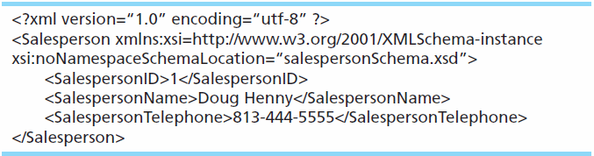
Sample XML Document Data
This XML data conforms to the XML schema of the previous slide, and involves elements and attributes defined in the schema.
This is analogous to a record in a database.
Notes:
It’s not absolutely necessary to have an XSD. But if you have the XSD, the XML engine will be able to verify the validity of the XML data.
Otherwise the XML engine will only apply the general rules of XML when parsing the XML document.

Slide 32
Storing XML Documents
Storing as files introduces the same file processing problems stated in Ch 1
Four common options:
Store XML data in a relational database by shredding the XML document
Store entire XML document in a large field (BLOB or CLOB)
Store the XML document using special XML columns
Store the XML document using a native XML database (non-relational)
Notes:
Some DBMSs include a special XML data type. Fields of this type are expected to have valid XML data, and that data can be processed using XQuery and XPath.

Slide 33
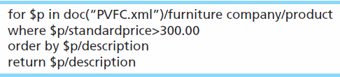
Retrieving XML Documents
XPath – One of a set of XML technologies supporting XQuery development, locating data in XML documents
XQuery – An XML transformation language that allows applications to query both relational databases and XML data
Sample XQuery expression:
Notes:
XPath is to XML documents as the SQL Select statement is to relational databases. In other words, XPath provides the basic query functionality for XML documents. XQuery adds functionality to XPath in much the same way that T-SQL and PL-SQL add to core SQL. For example, loops, as we see in this example.

Slide 34
Displaying XML Data
Extensible Stylesheet Language Transformation (XSLT) – A language used to transform complex XML documents and also used to create HTML pages from XML documents
XSLT can translate a single XML document into both standard HTML and WAP/WML for cell phones without the necessity for two different pages

Slide 35
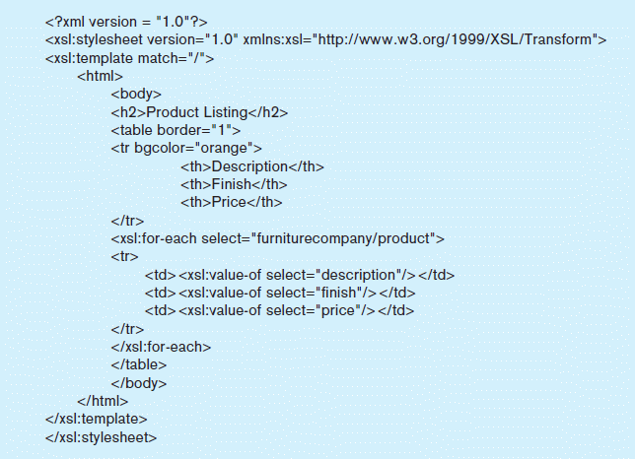
Figure 8-15b – XSLT Code
Notes:
Notice that XSLT is itself based on XML. Can you see why we call XML a meta-language?
Here we see a loop expressed in XSLT. What this says is that each time we come to a product element directly under a furniture company element, we will generate an HTML table row with cells containing the values of the description, finish, and prices sub-elements.

Slide 36
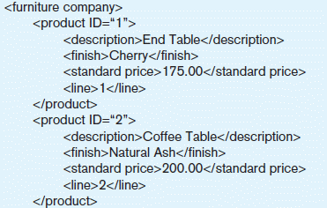
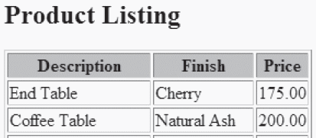
Extracted from Figures 8-15a and 8-15c
When applied to the above XML data, the XSLT code from Figure 8-15b produces the display on the right.
Notes:
So, based on the previous XSLT code, the XML data shown here is transformed to the HTML for this display in a browser.

Slide 37
XML and Web Services
Web Services – a set of emerging XML-based standards that define protocols for automatic communication between software programs over the Web
Universal Description, Discovery, and Integration (UDDI) – standard for creating a distributed registry of Web services
Web Services Description Language (WSDL) – XML-based grammar for describing a Web Service and specifying its public interface
Simple Object Access Protocol (SOAP) – XML-based communication protocol for sending messages between applications over the Internet

Slide 38
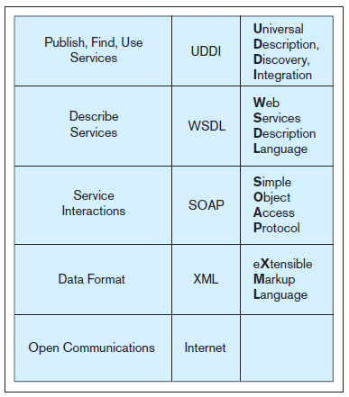
Figure 8-17 Web Services protocol stack
Notes:
With the exception of the Internet layer (the lowest level) of this stack, everything you see is XML based. Again, this shows how XML is a metalanguage.
The Internet level is based on the TCP/IP protocol.

Slide 39
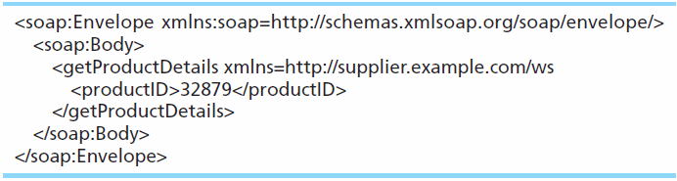
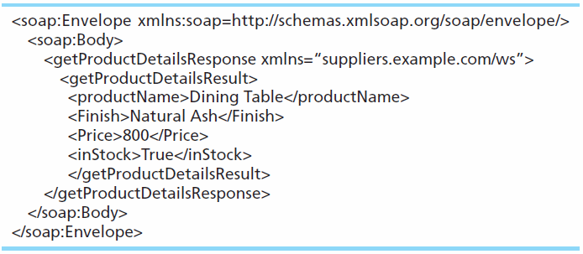
SOAP request sent from customer to supplier
SOAP response sent from supplier to customer
Notes:
SOAP is a very rich language for communication in a web services environment. But often your needs will be much simpler. In this case, requests are often sent in the form of URL parameters; this is often called a REST query.

Slide 40
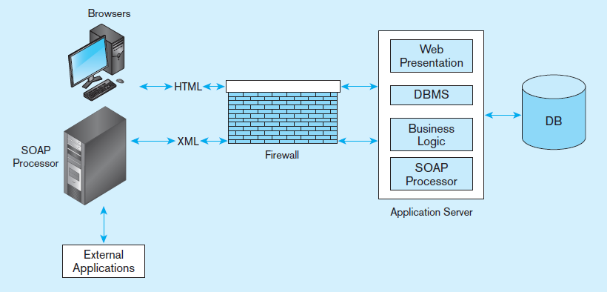
Figure 8-18 Web services deployment
Source: Based on Newcomer (2002).
Notes:
As a transaction flows from one business to another or from a customer to a business, a SOAP processor creates a message envelope that allows the exchange of formatted XML data across the Web. Note that within a company’s 3-tier architecture, the SOAP processor logic is housed in the application server. Note also that this exchange of XML data is happening between SOAP processors.

Slide 41
Service Oriented Architecture (SOA)
A collection of services that communicate with each other, usually by passing data or coordinating a business activity
A new paradigm for IT application development, based mostly on Web services
Loosely coupled, highly interoperable components
Leads to flexibility and shorter development time
Notes:
Service-oriented architectures are useful for application integration. Application integration will be discussed in more detail in chapter 10.

Slide 42
