Slide 1
Chapter 10: data Quality and Integration
Modern Database Management
12th Edition
Jeff Hoffer, Ramesh Venkataraman,
Heikki Topi

Slide 2
Objectives
Define terms
Describe importance and goals of data governance
Describe importance and measures of data quality
Define characteristics of quality data
Describe reasons for poor data quality in organizations
Describe a program for improving data quality and data stewardship
Describe the purpose and role of master data management
Describe three types of data integration approaches
Describe four steps and activities of ETL for data integration for a data warehouse
Explain various forms of data transformation for data warehouses
Notes:
This chapter covers two main topics. The first is data quality, which refers to ensuring the accuracy, timeliness, consistency, completeness, and integrity of the data. This can be difficult if your company has a wide variety of databases and data sources.
The second has to do with data integration, which is widely used for creating data warehouses. In this section, we discuss the ETL process and other means of integrating data from multiple data sources.

Slide 3
Data Governance
Data governance
High-level organizational groups and processes overseeing data stewardship across the organization
Data steward
A person responsible for ensuring that organizational applications properly support the organization’s data quality goals

Slide 4
Requirements for Data Governance
Sponsorship from both senior management and business units
A data steward manager to support, train, and coordinate data stewards
Data stewards for different business units, subjects, and/or source systems
A governance committee to provide data management guidelines and standards
Notes:
The goals of data governance are transparency—both within the organization and for external regulators. Ultimately we want to ensure and increase the value of the organization’s data.
Data governance involves measuring data quality and availability, as well as identifying targets for quality and availability.
This process directs efforts to overcome risks associated with bad or unsecured data, and reviews the results of data audit processes.
Data governance is best chartered by the most senior leadership in the organization.

Slide 5
Importance of Data Quality
If the data are bad, the business fails. Period.
GIGO – garbage in, garbage out
Sarbanes-Oxley (SOX) compliance by law sets data and metadata quality standards
Purposes of data quality
Minimize IT project risk
Make timely business decisions
Ensure regulatory compliance
Expand customer base
Notes:
The Sarbanes-Oxley Act of 2002 has made it imperative that organizations undertake actions to ensure data accuracy, timeliness, and consistency. This U.S. federal law is named after Senator Paul Sarbanes and Representative Michael Oxley.
Several high-profile scandals of major corporations (including Enron, Tyco, and WorldCom) led the U.S. Congress to create this legislation, which attempts to increase corporate public disclosure and transparency and reduce conflicts of interest. It’s had a tremendous impact on IT is is very relevant for database design, use, and maintenance.

Slide 6
Characteristics of Quality Data
Uniqueness
Accuracy
Consistency
Completeness
Timeliness
Currency
Conformance
Referential integrity
Notes:
Uniqueness means that each entity exists no more than once within the database, and there is a key that can be used to uniquely access each entity. That’s one of the reasons we have primary keys in database tables.
Accuracy means the degree to which data correctly represents the real-life objects it models. Data must be both accurate and precise enough for their intended use.
Consistency means that values for data in one data set (database) are in agreement with the values for related data in another data set (database). This is aided within a single database through sound logical design of well-structured normalized databases, such as what we discussed in chapter 4. But remember that a company may have many databases, so consistency between databases is also important.
Completeness refers to data having assigned values if they need to have values. The NOT NULL domain constraints help to ensure this.
Timeliness means meeting the expectation for the time between when data are expected and when they are readily available for use. In other words, the data should be available when it is needed without excessive delays.
Currency is the degree to which data are recent enough to be useful. For example, we may require that customers’ phone numbers be up-to-date so we can call them at any time. Outdated data is not of much use.
Conformance refers to whether data are stored, exchanged, or presented in a format that is as specified by their metadata. This includes both domain constraints of allowable values, as well as proper formatting of displayed data.
We’ve discussed referential integrity already, and this is ensured via primary/foreign key relationships as well as the referential integrity rules that we discussed in chapter 4.

Slide 7
Causes of poor data quality
External data sources
Lack of control over data quality
Redundant data storage and inconsistent metadata
Proliferation of databases with uncontrolled redundancy and metadata
Data entry
Poor data capture controls
Lack of organizational commitment
Not recognizing poor data quality as an organizational issue
Notes:
There are many factors that can result in poor quality data. Some data comes from external sources, and if these are not pre-screened you can get the GIGO effect.
Recall also that the old, traditional file processing approach resulted in duplication of data and loss of integrity.
Even with well-designed databases, bad data can be entered by users. So applications should include validation checks.
For a variety of reasons, many organizations simply have not made the commitment or invested the resources to improve their data quality. Some organizations are simply in denial about having problems with data quality. Others realize they have a problem but fear that the solution will be too costly or that they cannot quantify the return on investment. The situation is getting better but there’s still lots of improvement needed.

Slide 8
Steps in Data quality improvement
Get business buy-in
Perform data quality audit
Establish data stewardship program
Improve data capture processes
Apply modern data management principles and technology
Apply total quality management (TQM) practices

Slide 9
Business Buy-in
Executive sponsorship
Building a business case
Prove a return on investment (ROI)
Avoidance of cost
Avoidance of opportunity loss
Notes:
In order to get top-level executive buy-in for data quality improvement, you need to convince decision makers of the negative impacts of poor quality data. These include increased costs, decreased revenues, decreased confidence, and increased risks. In other words, executives need to be convinced that a data quality program will yield a sufficient return on investment (ROI).
Emphasize that costs includes both direct costs and opportunity costs. Direct costs involve the costs of correcting and dealing with the fallout that could occur. Opportunity costs refer to loss of potential business because pf lowered reputation.

Slide 10
Data Quality Audit
Statistically profile all data files
Document the set of values for all fields
Analyze data patterns (distribution, outliers, frequencies)
Verify whether controls and business rules are enforced
Use specialized data profiling tools
Notes:
An audit will thoroughly review all process controls on data entry and maintenance. Procedures for changing sensitive data should likely involve actions by at least two people with separated duties and responsibilities. Primary keys and important financial data fall into this category. Proper edit checks should be defined and implemented for all fields.

Slide 11
Data Stewardship Program
Roles:
Oversight of data stewardship program
Manage data subject area
Oversee data definitions
Oversee production of data
Oversee use of data
Report to: business unit vs. IT organization?
Notes:
Data stewardship is a role, not a job; as such, data stewards do not own the data, and data stewards usually have other duties inside and usually outside the data administration area.
However, many businesses are beginning to establish a new role, sometimes called chief data officer (CDO). This is an executive-level position accountable for all data-related activities in the enterprise.

Slide 12
Improving Data Capture Processes
Automate data entry as much as possible
Manual data entry should be selected from preset options
Use trained operators when possible
Follow good user interface design principles
Immediate data validation for entered data
Notes:
Lax data entry is a major source of poor data quality, so improving data capture processes is a fundamental step in a data quality improvement program.
According to Inmon, there are three critical data entry points to consider. First is the original capture location (typically an end user with an entry screen). Second is the data pulled in through data integration (such as ETL for data warehousing). And third is data loaded into the data warehouse. Quality checks should be done for each of these steps.

Slide 13
Apply modern data management principles and technology
Software tools for analyzing and correcting data quality problems:
Pattern matching
Fuzzy logic
Expert systems
Sound data modeling and database design
Notes:
The data modeling and design principles we learned in chapters 2 through 5 are particularly relevant here.

Slide 14
TQM Principles and Practices
TQM – Total Quality Management
TQM Principles:
Defect prevention
Continuous improvement
Use of enterprise data standards
Balanced focus
Customer
Product/Service
Strong foundation of measurement
Notes:
TQM balances a focus on the customer satisfaction and the data resource (which is the product or service of concern). TQM results in decreased costs, increased profits, and reduced risks.
Recall the seven characteristics of data quality: uniqueness, accuracy, consistency, completeness, timeliness, currency, conformance, and referential integrity. Data quality is in the eye of the beholder, so the right mix of these seven characteristics will depend on data users of a particular organization.

Slide 15
Master Data Management (MDM)
Disciplines, technologies, and methods to ensure the currency, meaning, and quality of reference data within and across various subject areas
Three main architectures
Identity registry – master data remains in source systems; registry provides applications with location
Integration hub – data changes broadcast through central service to subscribing databases
Persistent – central “golden record” maintained; all applications have access. Requires applications to push data. Prone to data duplication.
Notes:
Certain categories of data are referenced more frequently than others across the enterprise in operational and analytical systems. The challenge for an organization is to ensure that all applications that use common data from these areas, such as customer, product, or employee, have a “single source of truth” they can use. Sometimes this is called a “golden record”, but no one source system contains the golden record of ALL relevant facts about the particular subject.
For example, customer data could be spread across CRM, billing, ERP, and sales tables or databases. MDM determines the best source for each piece of data (e.g., customer address or name) and makes sure that all applications reference the same virtual “golden record.”
These three main architectures are the most common means of accomplishing MDM.

Slide 16
Data Integration
Data integration creates a unified view of business data
Other possibilities:
Application integration
Business process integration
User interaction integration
Any approach requires changed data capture (CDC)
Indicates which data have changed since previous data integration activity
Notes:
In Chapter 9 we learned about data warehouses. Recall that one of the main characteristics about data warehouses is that they are integrated. In other words, data comes from a wide variety of data sources and are combined into the data warehouses. These data sources can be databases, spreadsheet files, XML sources, web services, legacy files, or other types of data.
Application integration involves coordinating the flow of event information, between business applications, often via a service-oriented architecture (recall Chapter 8’s discussion of SOA).
Business process integration involves tighter coordination of activities across business processes (e.g., selling and billing) so that applications can be shared and more application integration can occur. ERP systems facilitate this; these systems also require cross-enterprise data to be integrated.
User interaction integration involves creating fewer user interfaces that feed different data systems. This is often done using an enterprise portal to interact with different data reporting and business intelligence systems.

Slide 17
Techniques for Data Integration
Consolidation (ETL)
Consolidating all data into a centralized database (like a data warehouse)
Data federation (EII)
Provides a virtual view of data without actually creating one centralized database
Data propagation (EAI and EDR)
Duplicate data across databases, with near real-time delay
Notes:
ETL stands for extract-transform-load. This is the traditional approach for building physical data warehouses.
EII stands for enterprise information integration. In this case there is no physical data warehouse; rather the data warehouse is “virtual”, composed of dynamic queries and views that operate directly on the source data.
EAI stands for enterprise application integration, and EDR stands for enterprise data replication. In both cases, data are pushed to duplicate sites as updates occur. Sometimes this is called event-driven propagation; the events are the updates themselves. Triggers (which we learned in chapter 7) help to facilitate this.

Slide 18
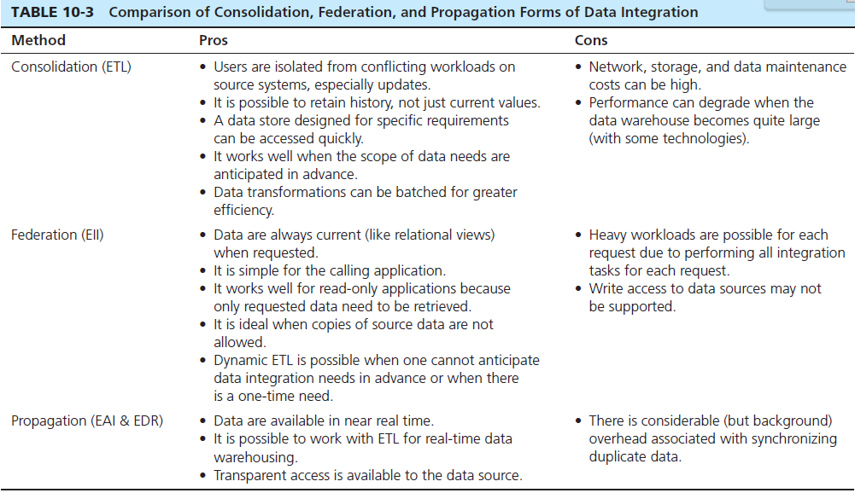
Notes:
Each approach has its set of pros and cons. If you always need the most current data, EII or EAI/EDR are the best approaches. If you need to maintain historical data, ETL is your best approach. If you want to avoid too much computational load on the transaction databases, ETL is better than EII or EAI/EDR.
Often, companies will combine these approaches.

Slide 19
The Reconciled Data Layer
Typical operational data is:
Transient–not historical
Not normalized (perhaps due to denormalization for performance)
Restricted in scope–not comprehensive
Sometimes poor quality–inconsistencies and errors
Notes:
Recall in chapter 9 we discussed reconciled data, which is placed in the operational data store. Prior to getting “reconciled”, we need to deal with issues in the operational data. This is done via ETL.

Slide 20
The Reconciled Data Layer
After ETL, data should be:
Detailed–not summarized yet
Historical–periodic
Normalized–3rd normal form or higher
Comprehensive–enterprise-wide perspective
Timely–data should be current enough to assist decision-making
Quality controlled–accurate with full integrity
Notes:
This reconciled data in the ODS becomes the integrated source that gets further transformed and loaded into the final data warehouse or mart.
Actually, data warehouses are not always perfectly normalized, and data marts are almost never perfectly normalized. They don’t need to be because they are nonvolatile. And it’s useful to have duplicate data if that simplifies and speeds up complex query processing.
But it is useful for the ODS to be well normalized, because this helps to ensure the integrity of the data. Also note that the final data warehouse may wind up having only summarized data. But the ODS will be detailed.

Slide 21
The ETL Process
Capture/Extract
Scrub or data cleansing
Transform
Load and Index
ETL = Extract, transform, and load
During initial load of Enterprise Data Warehouse (EDW)
During subsequent periodic updates to EDW
Notes:
Actually, ETL might better have been named ESTL (scrub) or ECTL (clean). Cleaning or scrubbing the data is an important part of this process. But the commonly used term is ETL.
Again, recall the importance of the operational data store (ODS). This is the “work space” of the ETL process, and serves as, among other things, a staging area.

Slide 22
Mapping and Metadata Management
A design step prior to performing ETL
Required data are mapped to data sources
Graphical or matrix representations
Explanations of reformatting, transformations, and cleansing actions to be done
Process flow involving tasks and jobs
Metadata that:
Identifies data sources
recognizes same data in different systems
represents process flow steps
Notes:
Before you can use the data warehouse, you need to design it. And before you can run the ETL process, you have to design that as well. There are many commercial tools for designing ETL processes.

Slide 23
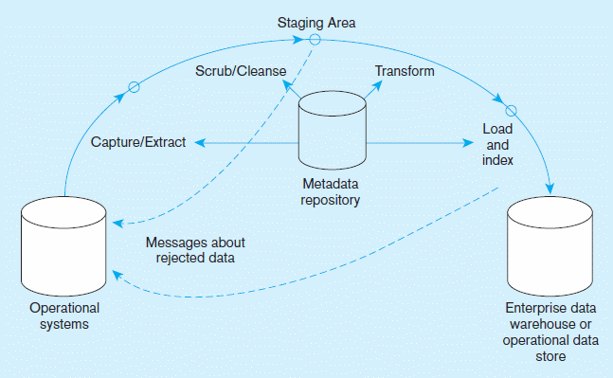
Capture/Extract…obtaining a snapshot of a chosen subset of the source data for loading into the data warehouse
Figure 10-1 Steps in data reconciliation
Static extract = capturing a snapshot of the source data at a point in time
Incremental extract = capturing changes that have occurred since the last static extract
Notes:
This figure actually simplifies ETL considerably. Each of these steps are composed of multiple subsystems.
Note that the capture/extract and scrub/clean are used for generating the data that goes into the staging area, whereas the transformations take place on reconciled data in order to populate the data warehouse or reconciled ODS.
First comes capture and extract.

Slide 24
Scrub/Cleanse…uses pattern recognition and AI techniques to upgrade data quality
Figure 10-1 Steps in data reconciliation
(cont.)
Fixing errors: misspellings, erroneous dates, incorrect field usage, mismatched addresses, missing data, duplicate data, inconsistencies
Also: decoding, reformatting, time stamping, conversion, key generation, merging, error detection/logging, locating missing data
Notes:
Next comes the cleaning process.
Poor data quality is the bane of ETL. In fact, it is the bane of all information systems (“garbage in, garbage out”). But the fact is that it exists. Also, different source systems may have different standards for what constitutes good data quality.
Cleansing also helps to alert source system owners of errors so that processes can be fixed in the source systems.

Slide 25
Transform … convert data from format of operational system to format of data warehouse
Figure 10-1 Steps in data reconciliation
(cont.)
Record-level:
Selection–data partitioning
Joining–data combining
Aggregation–data summarization
Field-level:
single-field–from one field to one field
multi-field–from many fields to one, or one field to many
Notes:
Once the data has been cleansed, we can do various transformations. These transformations result in the final data warehouse or data mart contents. Remember that data warehouses are composed of fact and dimension tables, and that their data may be at various levels of granularity. And the information stored is expressed in terms that are useful to the decision makers who use the DW. So, operational (and reconciled) data are now transformed into these final results.

Slide 26
Load/Index…place transformed data into the warehouse and create indexes
Figure 10-1 Steps in data reconciliation
(cont.)
Refresh mode: bulk rewriting of target data at periodic intervals
Update mode: only changes in source data are written to data warehouse
Notes:
As a final step, the transformed data is finally loaded into the data warehouse. This also involves creating indexes, using approaches we learned about in chapter 5.
Note that all these steps are represented in the metadata repository. This is a highly automated process. A data integration tool is essentially an automated sequence of tasks operating on data sources and performing extraction, cleaning, transformation operations, and sending this transformed data to data destinations such as an EDW.

Slide 27
Record Level Transformation Functions
Selection – the process of partitioning data according to predefined criteria
Joining – the process of combining data from various sources into a single table or view
Normalization – the process of decomposing relations with anomalies to produce smaller, well-structured relations
Aggregation – the process of transforming data from detailed to summary level
Notes:
In the next few slides we’ll look at some sample transformations. Here, we see the types of transformation that happen at the record level. All of these should be familiar to you.

Slide 28
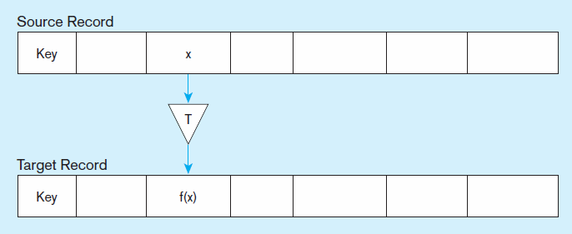
Figure 10-2 Single-field transformation
a) Basic Representation
In general, some transformation function translates data from old form to new form
Notes:
Oftentimes, transformations are done on a single field. This is especially done for situations like needing a common format (for example, always representing a middle initial, even though some data sources use the whole middle name).

Slide 29
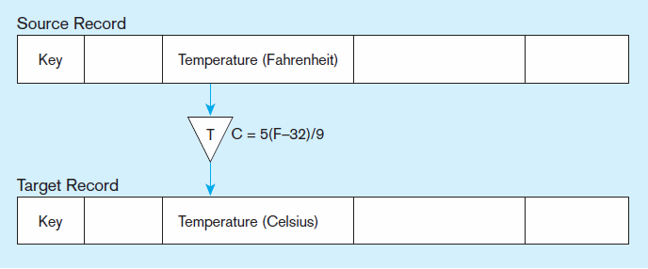
Figure 10-2 Single-field transformation (cont.)
b) Algorithmic
Algorithmic transformation uses a formula or logical expression
Notes:
Some transformations are based on formulas or other algorithmic expressions. These can be very simple, as in this example, or quite complex.

Slide 30
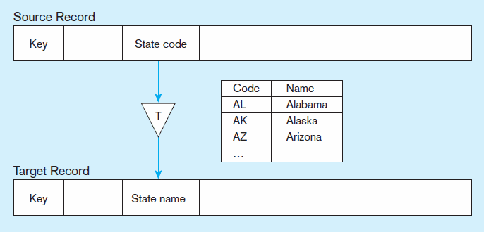
Figure 10-2 Single-field transformation (cont.)
c) Table lookup
Table lookup uses a separate table keyed by source record code
Notes:
Others are based on table lookups. Here, we are given a state code and look up the corresponding name. Another example would be to look up a month name and get the month abbreviation. Again, this is generally done to ensure that data from all data sources are represented the same in the data warehouse, even if they were different in the different data sources.

Slide 31
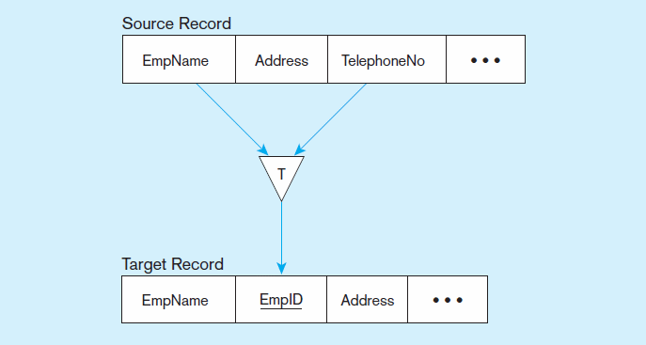
Figure 10-3 Multi-field transformation
a) Many sources to one target
Notes:
Sometimes, you will take data from multiple fields of a source record in order to create a single field of the target. Here, we see a transformation from the employee name and phone number to the employee ID. This was probably done via a table lookup.
Another example would be to generate a full name by combining the first and last names.
Note that a particular multi-field transformation could involve getting fields from different data sources and combining them into a single field.

Slide 32
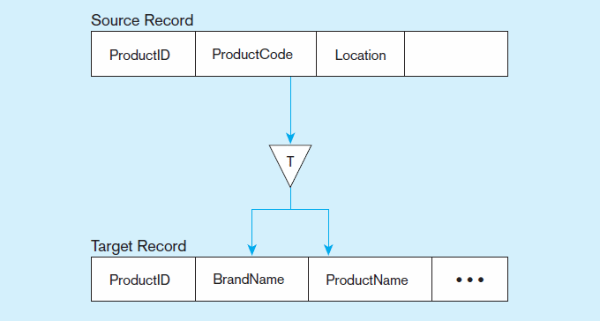
Figure 10-3 Multi-field transformation (cont.)
b) One source to many targets
Notes:
Here we see a multi-field transformation going in reverse. From the product code, we get the brand name and product name. This is also probably done via table a lookup. But multi-field transformations could also be done via algorithmic functions.
So, both table lookups and algorithmic transformations could be applied to either single field or multi-field transformations.

Slide 33


