Slide 1
Chapter 12: data and Database Administration
Modern Database Management
12th Edition
Jeff Hoffer, Ramesh Venkataraman,
Heikki Topi

Slide 2
Objectives
Define terms
List functions and roles of data/database administration
Describe role of data dictionaries and information repositories
Compare optimistic and pessimistic concurrency control
Describe problems and techniques for data security
Understand role of databases in Sarbanes-Oxley compliance
Describe problems and facilities for data recovery
Describe database tuning issues and list areas where changes can be done to tune the database
Describe importance and measures of data availability

Slide 3
Ineffective data administration ➔ poor data quality
Multiple data definitions, causing data integration problems
Missing data elements, causing reduction in data value
Inappropriate data sources and timing, causing lowered reliability
Inadequate familiarity, causing ineffective use of data for planning and strategy
Poor response time and excessive downtime
Damaged, sabotaged, and stolen data
Unauthorized access, leading to ….
Embarrassment to organization
Notes:
Many of these conditions put an organization at risk for failing to comply with regulations, such as the Sarbanes-Oxley Act (SOX), the Health Insurance Portability and Accountability Act (HIPAA), and the Gramm-Leach-Bliley Act for adequate internal controls and procedures in support of financial control, data transparency, and data privacy. We talked about these issues in chapter 10.

Slide 4
Traditional Administration Definitions
Data Administration: A high-level function that is responsible for the overall management of data resources in an organization, including maintaining corporate-wide definitions and standards
Database Administration: A technical function that is responsible for physical database design and for dealing with technical issues such as security enforcement, database performance, and backup and recovery
Notes:
These are two different roles. One is more managerial and the other is more technical.

Slide 5
Traditional Data Administration Functions
Data policies, procedures, standards
Planning
Data conflict (ownership) resolution
Managing the information repository
Internal marketing of DA concepts
Notes:
Many of these have to do with tasks related to governance.

Slide 6
Traditional Database Administration Functions
Analyzing and designing databases
Selecting DBMS and software tools
Installing/upgrading DBMS
Tuning database performance
Improving query processing performance
Managing data security, privacy, and integrity
Data backup and recovery
Notes:
A database administrator will typically use database administration tools for tuning, security management, and backup/recovery. These tools are also useful for logical and physical database design.

Slide 7
Data Warehouse Administration
New role, coming with growth in data warehouses
Similar to DA/DBA roles
Emphasis on integration and coordination of metadata/data across many data sources
Specific roles:
Support decision support applications
Build a stable architecture – corporate information factory
Establish service level agreements regarding data warehouses and data marts
Notes:
Similar to DA and DBA roles, DWAs are involved in communicating with users about data needs, making performance and capacity decisions, and budgeting and planning.
The term “corporate information factory” was coined by data warehouse pioneer Bill Inmon, referring to the dependent data mart (hub-and-spoke) architecture. The DWA role tends to be an enterprise-wise role, so this implies a centralized EDW architecture.
Whether the company emphasizes this approach or Kimball’s independent data marts, the architecture should be well-understood and supported, a task for the DWA.
DWAs typically report through the IT unit of an organization but have strong relationships with other management of various business functions who need analytical decision support.
Note that organizations may combine the DA, DBA, and DWA roles.

Slide 8
Open Source DB Management
Open Source DBMS: an alternative to proprietary packages such as Oracle, Microsoft SQL Server, or DB2
Examples: MySQL, PostgreSQL
Advantages:
Pool of volunteer developers and testers
Less expensive than proprietary packages
Source code available, for modification
Disadvantages
Absence of complete documentation
Ambiguous licensing concerns
Not as feature-rich as proprietary DBMSs
Vendors may not have certification programs
Notes:
An open source DBMS is free or nearly free database software whose source code is publicly available.
Recall from chapter 8 that Java and PHP are open source web application APIs. So, not surprisingly, applications using MySQL tend to involve PHP or Java programming, whereas applications involving SQL Server tend to be done using Microsoft’s proprietary .NET API. It’s not a hard-and-fast rule, but it’s the tendency.

Slide 9
Open Source DB Management (Cont.)
Considerations when selecting an open source DBMS
Features
Support
Ease of use
Stability
Speed
Training
Licensing
Notes:
Here’s a list of things to consider. This applies to all DBMS selection, but is especially relevant for open source, where you may find gaps in functionality and ease-of-use.
Open source DBMSs are improving rapidly to include more powerful features, such as the transaction controls described later in this chapter, needed for mission-critical applications. Open source DBMSs are fully SQL compliant and run on most popular operating systems.

Slide 10
Data Security
Database Security: Protection of the data against accidental or intentional loss, destruction, or misuse
Increased difficulty due to Internet access and client/server technologies
Notes:
Data security is a critical part of any company’s IT procedures, policies, and infrastructure. This is an important task for the DA and DBA roles.
Because data are a critical resource, people in an organization must be sensitive to security threats and take measures to protect their data. Data administrators are responsible for developing overall policies and procedures to protect databases. Database administrators administer database security on a daily basis. Again, one is more managerial and the other is more technical.

Slide 11
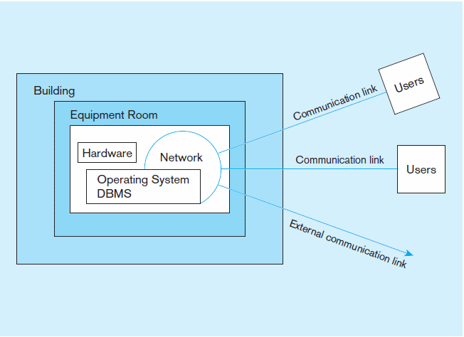
Figure 12-2 Possible locations of data security threats
Notes:
Threats to data security may be direct threats to the database. For example, those who gain unauthorized access to a database may then browse, change, or even steal the data to which they have gained access. But threats come from other places as well, so focusing on database security alone won’t ensure a secure database. All parts of the system must be secure, including the database, the applications using the database, the network, the operating system, the building(s) that house the database, and all personnel who have access to the system.

Slide 12
Threats to Data Security
Accidental losses attributable to:
Human error
Software failure
Hardware failure
Theft and fraud
Loss of privacy or confidentiality
Loss of privacy (personal data)
Loss of confidentiality (corporate data)
Loss of data integrity
Loss of availability (e.g., through sabotage)
Notes:
All of these losses can be very costly, and some can threaten the very existence of a company.

Slide 13
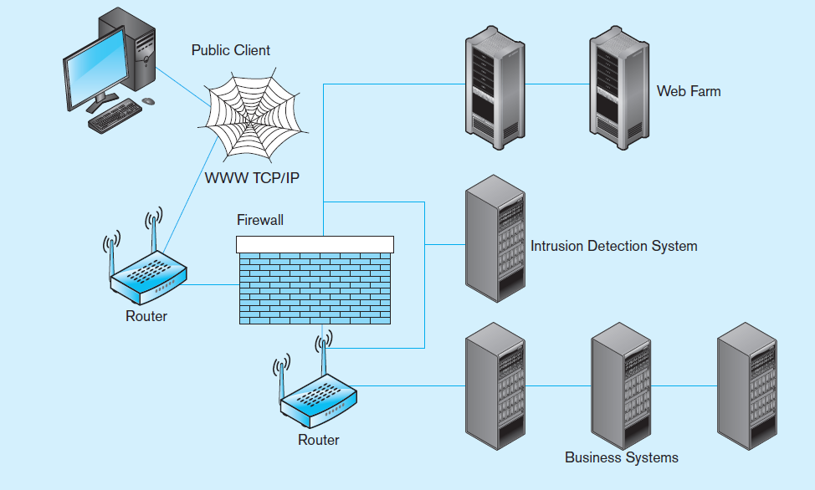
Figure 12-3 Establishing Internet Security
Notes:
For static web pages, the security concerns are on access to the html files on the server. With dynamic web pages though, there is also concern about database access.
The server that owns the database connection should be physically secure, and the execution of programs on the server
should be controlled. User input, which could embed SQL commands, also needs to be filtered so unauthorized scripts are not executed. In other words, the system needs to protect against SQL Injection, a particularly harmful data security threat in Web application environments.

Slide 14
Client – Server Application security
Static HTML files are easy to secure
Standard database access controls
Place Web files in protected directories on server
Dynamic pages are harder
User authentication
Session security
SSL for encryption
Restrict number of users and open ports
Remove unnecessary programs
Notes:
There is an interesting Web security project called OWASP at http://owasp.org. They have a lot of useful information for security of dynamic web application systems. OWASP stands for Open Web Application Security Project.

Slide 15
W3C Web Privacy Standard
Platform for Privacy Protection (P3P)
Addresses the following:
Who collects data
What data is collected and for what purpose
Who is data shared with
Can users control access to their data
How are disputes resolved
Policies for retaining data
Where are policies kept and how can they be accessed
Notes:
Privacy is an increasing concern.
E-mail, e-commerce, and other online resources allow organizations (employers, governments, and businesses) to get data about people’s Internet behavior. Applications that return individualized responses require that information be collected about the individual, but at the same time proper respect for the privacy and dignity of employees, citizens, and customers should be observed. It’s a delicate balancing act.
Information privacy legislation gives individuals the right to know what data have been collected about them and to correct any errors in those data. As the amount of data exchanged continues to grow, the need is also growing to develop
adequate data protection.
The W3C’s Platform for Privacy Preferences (P3P) standard communicates a Web site’s stated privacy policies and compare that statement with the user’s own policy preferences. P3P uses XML code on Web site servers that can be fetched automatically by any browser or plug-in equipped for P3P.

Slide 16
Database Software Security Features
Views or subschemas
Integrity controls
Authorization rules
User-defined procedures
Encryption
Authentication schemes
Backup, journalizing, and checkpointing
Notes:
All of these are DBMS features that enable a DBA to implement data security in an organization’s database. We’ll discuss these in the next few slides.

Slide 17
Views and Integrity Controls
Views
Subset of the database that is presented to one or more users
User can be given access privilege to view without allowing access privilege to underlying tables
Integrity Controls
Protect data from unauthorized use
Domains–set allowable values
Assertions–enforce database conditions
Triggers – prevent inappropriate actions, invoke special handling procedures, write to log files
Notes:
We discussed Views in chapter 7. We can set access privileges on these views to control which users get to see which aspects of the database.
As you can see, the integrity controls discussed in chapter 4 also serve a security purpose.

Slide 18
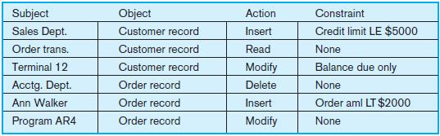
Authorization Rules
Controls incorporated in the data management system
Restrict:
access to data
actions that people can take on data
Authorization matrix for:
Subjects
Objects
Actions
Constraints
Figure 12-4 Authorization matrix
Notes:
Authorization rules grant subjects access to objects, specifying which actions and constraints govern the subjects’ access.
Subjects are users or groups of users. Objects are entities in the database. Actions are the types of DML commands permitted for a given subject on a given object (SELECT, INSERT, UPDATE, DELETE). And these actions can be further constrained, based on the authorization rule.
All of these are available to the DBA to control via the DBMS software.
Here we see these rules expressed as an authorization matrix.

Slide 19
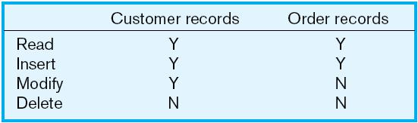
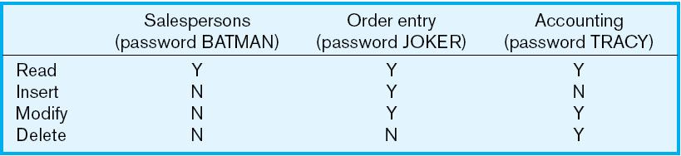
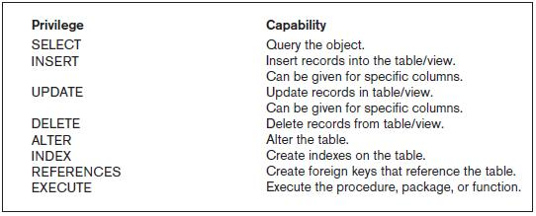
Figure 12-5a Authorization table for subjects (salespersons)
Implementing authorization rules
Figure 12-5b Authorization table for objects (orders)
Figure 11-6 Oracle privileges
Some DBMSs also provide capabilities for user-defined procedures to customize the authorization process.
Notes:
These authorization tables are simplified representations of authorization rules. One is for subjects and the other is for objects.
The key idea in both authorization matrices and authorization tables is that you are controlling who gets what kind of access to which data elements.

Slide 20
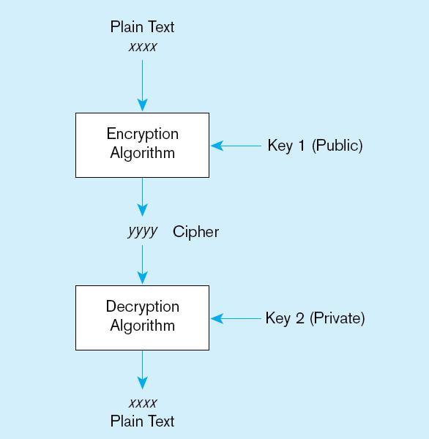
Figure 11-7 Basic two-key encryption
Encryption – the coding or scrambling of data so that humans cannot read them
Secure Sockets Layer (SSL) is a popular encryption scheme for TCP/IP connections.
Notes:
Some DBMS products include encryption routines that automatically encode sensitive data when they are stored or transmitted over communications channels. For example, encryption is commonly used in electronic funds transfer (EFT) systems. Other DBMS products provide exits that allow users to code their own encryption routines

Slide 21
Authentication Schemes
Goal – obtain a positive identification of the user
Passwords: First line of defense
Should be at least 8 characters long
Should combine alphabetic and numeric data
Should not be complete words or personal information
Should be changed frequently
Notes:
Authentication is not the same as authorization. Authorization rules specify who has what access rights to what data elements. Authentication schemes are means of ensuring that a user is who he or she claims to be.
Obviously passwords are the first line of defense, but these are imperfect. It’s hard to remember multiple complex passwords, so people tend to simplify them, or worse, write them down.

Slide 22
Authentication Schemes (cont.)
Strong Authentication
Passwords are flawed:
Users share them with each other
They get written down, could be copied
Automatic logon scripts remove need to explicitly type them in
Unencrypted passwords travel the Internet
Possible solutions:
Two factor–e.g., smart card plus PIN
Three factor–e.g., smart card, biometric, PIN
Notes:
Smart cards, biometric, and combinations are some current means of improving authentication.

Slide 23
Sarbanes-Oxley (SOX)
Requires companies to audit the access to sensitive data
Designed to ensure integrity of public companies’ financial statements
SOX audit involves:
IT change management
Logical access to data
IT operations
Notes:
In chapter 10, we discussed Sarbanes-Oxley in terms of data quality (accuracy, timeliness, and consistency). SOX is also highly relevant for security-related compliance.
The DA and DBA roles are important in this effort.

Slide 24
IT Change Management
The process by which changes to operational systems and databases are authorized
For database, changes to: schema, database configuration, updates to DBMS software
Segregation of duties: development, test, production
Notes:
Segregation of duties helps to ensure that no one person has inordinate authority and power over the system.

Slide 25
Logical Access to Data
Personnel controls
Hiring practices, employee monitoring, security training, separation of duties
Physical access controls
Swipe cards, equipment locking, check-out procedures, screen placement, laptop protection
Notes:
Security requires the cooperation of employees, so training and smart hiring is important. Physical access is the means by which employees interact with the system, so these means must also be protected.

Slide 26
IT Operations
Policies and procedures for day-to-day management of infrastructure, applications, and databases in an organization
Also involves vendor management
Review external maintenance agreements
Access source code? (if vendor goes out of business)

Slide 27
Database Recovery
Mechanism for restoring a database quickly and accurately after loss or damage
Recovery facilities:
Backup Facilities
Journalizing Facilities
Checkpoint Facility
Recovery Manager
Notes:
Sometimes data is lost or damaged, so DBMS systems include facilities for recovering from this lost. Generally this involves backing data up and allowing it to be restored.

Slide 28
Back-up Facilities
DBMS copy utility that produces backup copy of the entire database or subset
Periodic backup (e.g. nightly, weekly)
Cold backup–database is shut down during backup
Hot backup–selected portion is shut down and backed up at a given time
Backups stored in secure, off-site location
Notes:
We’ll talk more about the mechanics of backup-and-recovery shortly.

Slide 29
Journalizing Facilities
Audit trail of transactions and database updates
Transaction log–record of essential data for each transaction processed against the database
Database change log–images of updated data
Before-image–copy before modification
After-image–copy after modification
Produces an audit trail
Notes:
Actually, the recover process requires both the backup snapshot and the change log, as we’ll see shortly.

Slide 30
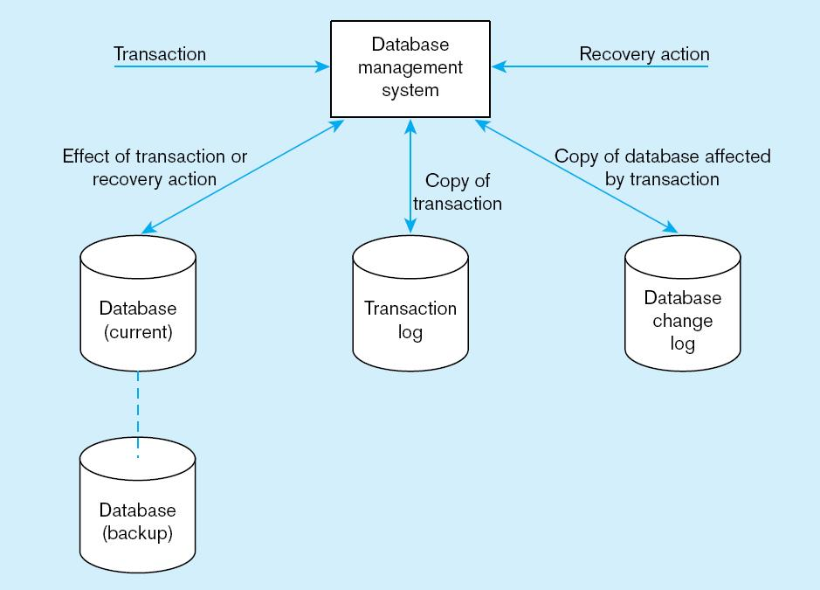
Figure 12-8 Database audit trail
From the backup and logs, databases can be restored in case of damage or loss
Notes:
Imagine that the database was last backed up on Sunday at midnight. This means the we need all transaction/change log entries since Sunday at midnight in order to bring it up to date. We start with the backup and then repeat the database changes.
Note the difference between the transaction log and the database change log. We will see that transaction logs are use for one form of recovery (restore/rerun) and database change logs are used for another (forward recovery).

Slide 31
Checkpoint Facilities
DBMS periodically refuses to accept new transactions
➔ system is in a quiet state
Database and transaction logs are synchronized
This allows recovery manager to resume processing from short period, instead of repeating entire day
Notes:
The database needs to be in a quiet state in order for backup to occur.
A DBMS may perform checkpoints automatically (which is preferred) or in response to commands in user application programs. Checkpoints should be taken frequently (say, several times an hour).

Slide 32
Recover Manager
Recovery Manager – DBMS module that restores the database to a correct condition when a failure occurs and then resumes processing user requests
Recovery and Restart Procedures
Disk Mirroring–switch between identical copies of databases
Restore/Rerun–reprocess transactions against the backup (only done as a last resort)
Transaction Integrity–commit or abort all transaction changes
Backward Recovery (Rollback)–apply before images
Forward Recovery (Roll Forward)–apply after images (preferable to restore/rerun)

Slide 33
Transaction ACID Properties
Atomic
Transaction cannot be subdivided
Consistent
Constraints don’t change from before transaction to after transaction
Isolated
Database changes not revealed to users until after transaction has completed
Durable
Database changes are permanent
Notes:
ACID is kind of a mantra when it comes to relational database management. This isn’t true for all data sources, however. For example, most XML data that is exchanged over the internet is not ACID compliant. For ensuring data integrity in transaction processing systems, though, ACID is essential.

Slide 34
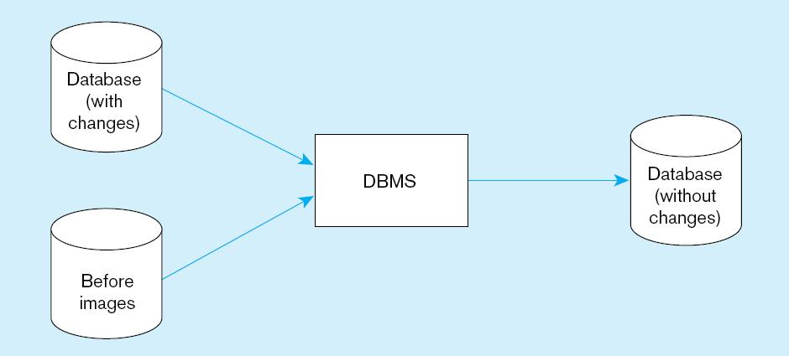
Figure 12-9 Basic recovery techniques
a) Rollback (backward recovery)
The backout, or undo, of unwanted changes to a database. Before images of the records that have been changed are applied to the database, and the database is returned to an earlier state. Rollback is used to reverse the changes made by transactions that have been aborted, or terminated abnormally.
Notes:
Rollback is the typical means of cancelling transactions when there is an error in the insert/update/deletes. Recall that we talked about atomic transactions in chapter 7. At that time, we encountered the ROLLBACK SQL command.

Slide 35
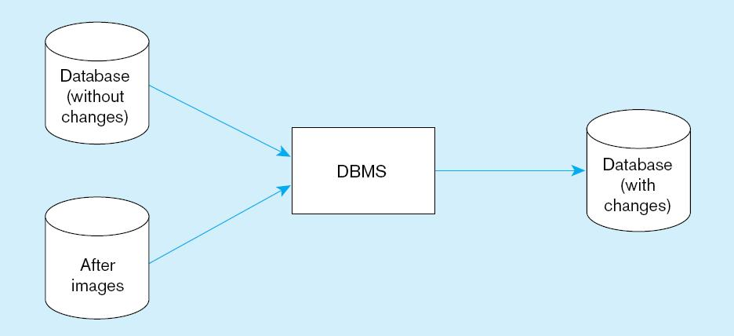
Figure 12-9 Basic recovery techniques (cont.)
b) Rollforward (forward recovery)
A technique that starts with an earlier copy of a database. After images (the results of good transactions) are applied to the database, and the database is quickly moved forward to a later state.
Notes:
This approach is an alternative to restore/rerun. It is much faster and doesn’t require the use of the transaction log and repetition of transactions. Instead, it makes use of database change log. Of course, this requires more up-front activity (maintaining the database change log in addition to the transaction log). But the actual recovery itself, if needed, runs much faster and with more accuracy.

Slide 36
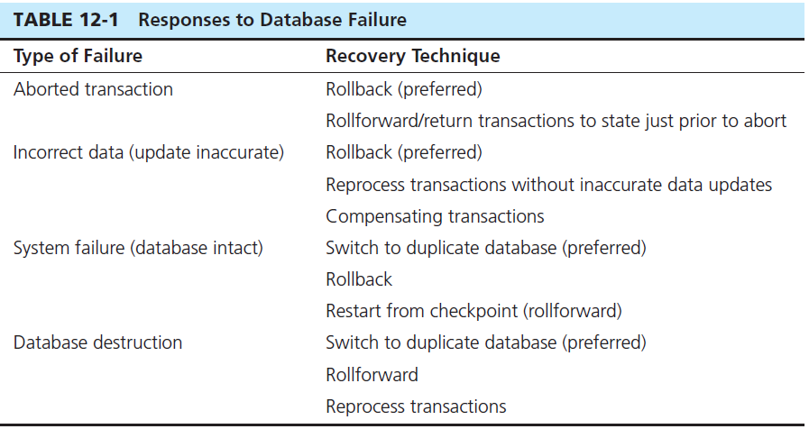
Notes:
This table shows several types of failures and the best recovery techniques to use. Notice that reprocessing transactions is never a preferred option. Notice also all these are possible because of disk mirroring, backups, and the maintenance of transaction and database change logs. All of these are techniques to make the database “fault tolerant”.

Slide 37
Control concurrent Access
Problem–in a multi-user environment, simultaneous access to data can result in interference and data loss (lost update problem)
Solution–Concurrency Control
The process of managing simultaneous operations against a database so that data integrity is maintained and the operations do not interfere with each other in a multi-user environment
Notes:
We’re going to see that multi-user environments add some complexity. The lost update problem is one reason. But, as we’ll see, solving the lost update problem could lead to another problem, called deadlock. We’ll explore these in the next few slides.

Slide 38
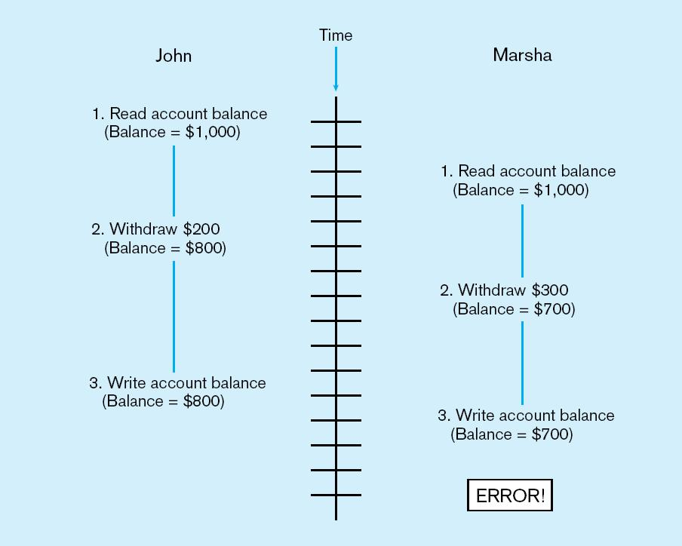
Figure 12-10 Lost update (no concurrency control in effect)
Simultaneous access causes updates to cancel each other.
A similar problem is the inconsistent read problem.
Notes:
So, the idea here is that if two programs can read and write to the same record at the same time, then one may “step on the other”, thereby negating the effect of one program.
How do we prevent this? Through locking. Let’s talk about that next.

Slide 39
Concurrency Control Techniques
Serializability
Finish one transaction before starting another
Locking Mechanisms
The most common way of achieving serialization
Data that is retrieved for the purpose of updating is locked for the updater
No other user can perform update until unlocked
Notes:
The idea here is to accomplish serializability. This is usually done via locking.

Slide 40
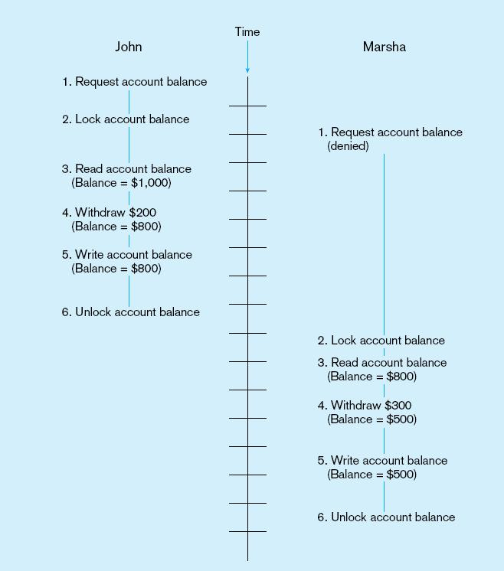
Figure 12-11: Updates with locking (concurrency control)
This prevents the lost update problem
Notes:
As you can see from this figure, locking helps to alleviate the lost update problem. You can lock at the table level or at the record level, and you can lock for updates only or updates plus queries. There are SQL commands for locking, and most DBMSs adopt a default locking (e.g. record level for updates) mechanism.

Slide 41
Locking Mechanisms
Locking level:
Database–used during database updates
Table–used for bulk updates
Block or page–very commonly used
Record–only requested row; fairly commonly used
Field–requires significant overhead; impractical
Types of locks:
Shared lock–Read but no update permitted. Used when just reading to prevent another user from placing an exclusive lock on the record
Exclusive lock–No access permitted. Used when preparing to update
Notes:
So, here we see details of the types and levels of locks.

Slide 42
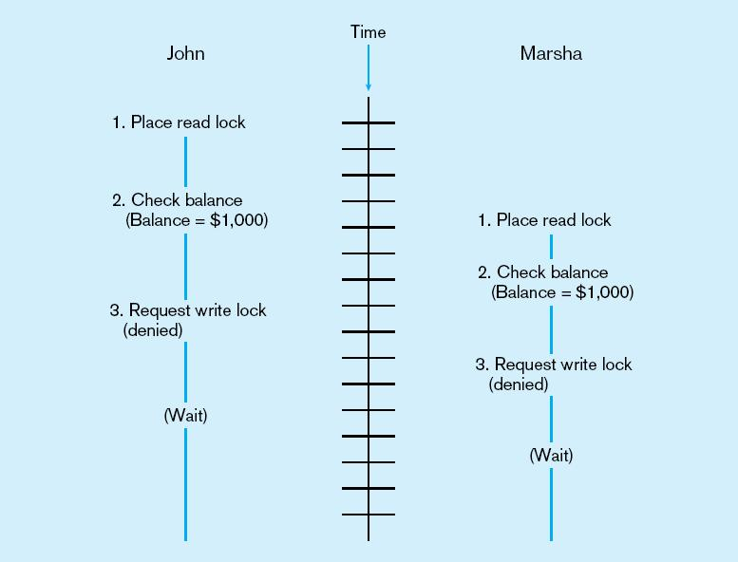
Deadlock
An impasse that results when two or more transactions have locked common resources, and each waits for the other to unlock their resources
Figure 12-12
The problem of deadlock
John and Marsha will wait forever for each other to release their locked resources!
Notes:
The problem with locking is that it can lead to a situation called “deadlock”. If one program has resource A locked and wants resource B, while at the same time another program has resource B locked and wants resource A, you have a deadlock. Neither can proceed until the other releases the resource it wants. So, they are both stuck.

Slide 43
Managing Deadlock
Deadlock prevention:
Lock all records required at the beginning of a transaction
Two-phase locking protocol
Growing phase
Shrinking phase
May be difficult to determine all needed resources in advance
Deadlock Resolution:
Allow deadlocks to occur
Mechanisms for detecting and breaking them
Resource usage matrix
Notes:
There are two main approaches to dealing with deadlock. One is to try and prevent it from happening in the first place, and this can get pretty complications.
A second is to just deal with it when it happens. Deadlock is not a very frequent occurrence, so if you can quickly resolve it, this is as good as preventing it in the first place.

Slide 44
Versioning
Optimistic approach to concurrency control
Instead of locking
Assumption is that simultaneous updates will be infrequent
Each transaction can attempt an update as it wishes
The system will create a new version of a record instead of replacing the old one
When a conflict occurs, accept one user’s update and inform the other user that its update needs to be tried again.
Use of rollback and commit for this
Notes:
Versioning is an alternative to locking. You won’t have deadlock, but you may require an application to redo its transaction.
The assumption here is that simultaneous updates aren’t going to happen that often. There versioning could be considered to be “optimistic” concurrency control, whereas locking is “pessimistic” concurrency control.

Slide 45
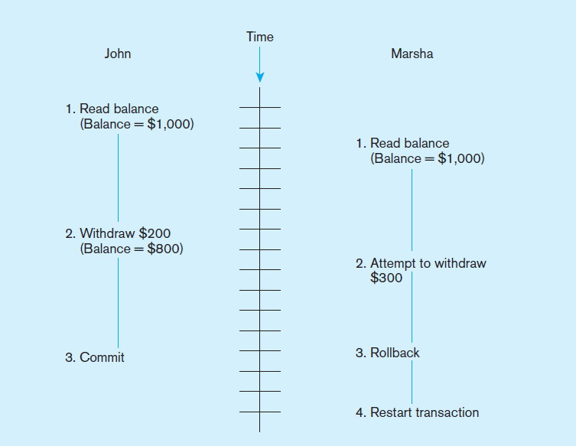
Figure 12-14 The use of versioning
Better performance than locking
Notes:
Here we see the result of versioning. If John’s transaction begins before Marsha’s transaction, then Marsha needs to redo hers.
Note that with versioning, you’re not going to encounter deadlock.

Slide 46
Data Dictionaries and Repositories
Data dictionary
Documents data elements of a database
System catalog
System-created database that describes all database objects
Information Repository
Stores metadata describing data and data processing resources
Notes:
“Data dictionary” is an older term. “Repository” is a newer term.
All of this is about the representation and maintenance of metadata. This is another important task for DAs and DBAs.

Slide 47
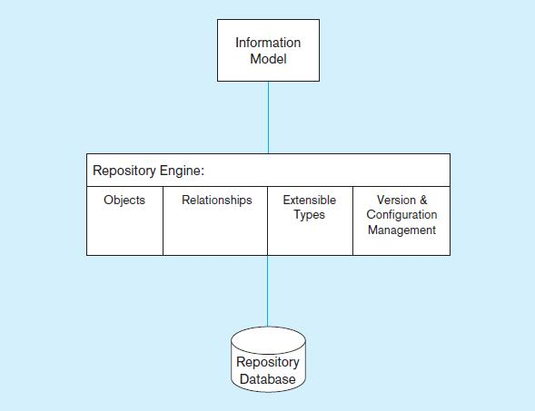
Figure 12-15 Three components of the repository system architecture
A schema of the repository information
Software that manages the repository objects
Where repository objects are stored
Source: based on Bernstein, 1996.
Notes:
Everything has an architecture, including metadata management. DBAs and DWAs use Repository Engine tools to administer the organization’s metadata.

Slide 48
Database Performance Tuning
DBMS Installation
Setting installation parameters
Memory and Storage Space Usage
Set cache levels
Choose background processes
Data archiving
Input/output (I/O) Contention
Use striping
Distribution of heavily accessed files
CPU Usage – Monitor CPU load
Application tuning
Modification of SQL code in applications
Use of heartbeat queries
Notes:
This is another technical task performed by DBAs (and other system administrators).
Data archiving is the process of moving inactive data to another storage location where it can be accessed when needed.
Striping helps to reduce I/O contention and improve performance.

Slide 49
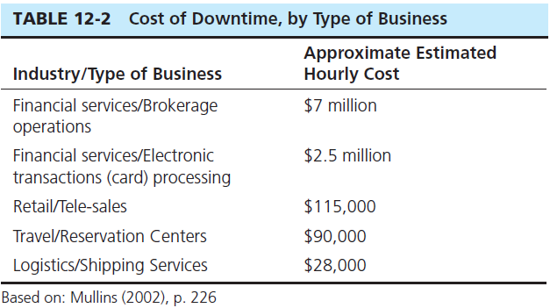
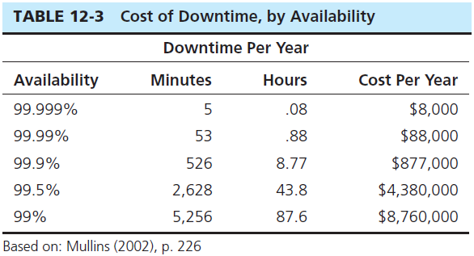
Cost of Downtime
Downtime is expensive
Notes:
A big mission of system administrators is to prevent downtime. Here’s why.

Slide 50
Data Availability
How to ensure availability
Hardware failures–provide redundancy for fault tolerance
Loss of data–database mirroring
Human error–standard operating procedures, training, documentation
Maintenance downtime–automated and non-disruptive maintenance utilities
Network problems–careful traffic monitoring, firewalls, and routers
Notes:
System administrators are responsible for maximizing availability. Here are some of the things that they do to accomplish this.

Slide 51


