Slide 1
Chapter 13 (Online): Distributed Databases
Modern Database Management
12th Edition
Jeff Hoffer, Ramesh Venkataraman,
Heikki Topi

Slide 2
Objectives
Define terms
Explain business conditions driving distributed databases
Describe salient characteristics of distributed database environments
Explain advantages and risks of distributed databases
Explain strategies and options for distributed database design
Discuss synchronous and asynchronous data replication and partitioning
Discuss optimized query processing in distributed databases

Slide 3
Definitions
Distributed Database: A single logical database spread physically across computers in multiple locations that are connected by a data communications link
Decentralized Database: A collection of independent databases on non-networked computers
They are NOT the same thing!
Notes:
With a distributed database, users at different locations can share data. Not so with a decentralized database.

Slide 4
Business Reasons for Distributed Database
Business unit autonomy and distribution
Data sharing
Data communication reliability and costs
Multiple application vendors
Database recovery
Transaction and analytic processing
Notes:
In large global corporations, where business units are geographically dispersed and may have different application software and DBMSs, there is still a need for some sort of cohesive view of corporate data available to all. This is a compelling reason to implement a distributed database. Distribution also leads to fault tolerance, where failures in one location can be mitigated, particularly if you replicate data. We’ll discuss data replication shortly.
Distributed databases have been around since the 1980s.

Slide 5
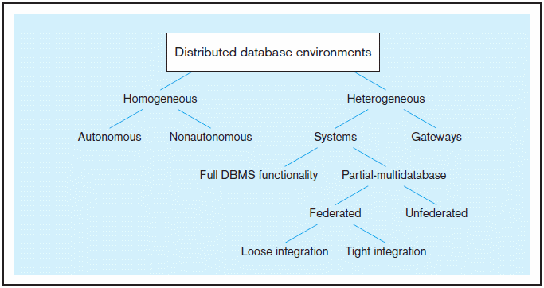
Figure 13-1 Distributed database environments (based on Bell and Grimson, 1992)
Notes:
This figure shows that there are many different possible types of distributed database environments. We’ll talk about a few of these in the next few slides.

Slide 6
Distributed Database Options
Homogeneous–same DBMS at each node
Autonomous–independent DBMSs
Non-autonomous–central, coordinating DBMS
Easy to manage, difficult to enforce
Heterogeneous–different DBMSs at different nodes
Systems–with full or partial DBMS functionality
Gateways–simple paths are created to other databases without the benefits of one logical database
Difficult to manage, preferred by independent organizations

Slide 7
Distributed Database Options (cont.)
Systems (Heterogeneous)–supports some or all functionality of one logical database
Full DBMS Functionality–all distributed DB functions
Partial-multidatabase–some distributed DB functions
Federated–supports local databases for unique data requests
Loose Integration–local databases have own schemas
Tight Integration–local databases use common schema
Un-federated–requires all access to go through a central, coordinating module

Slide 8
Homogeneous, Non-Autonomous Database
Data is distributed across all the nodes
Same DBMS at each node
All data is managed by the distributed DBMS (no exclusively local data)
All access is through one, global schema
The global schema is the union of all the local schema
Notes:
The homogeneous environment is much easier to implement than a heterogeneous environment. But doing so requires you to enforce a common standard across the whole organization, and this can be very difficult. Imagine, for example, if two companies merge. Each of their original databases may have completely different architectures. Is one of the firms going to impose its architecture on the other?

Slide 9
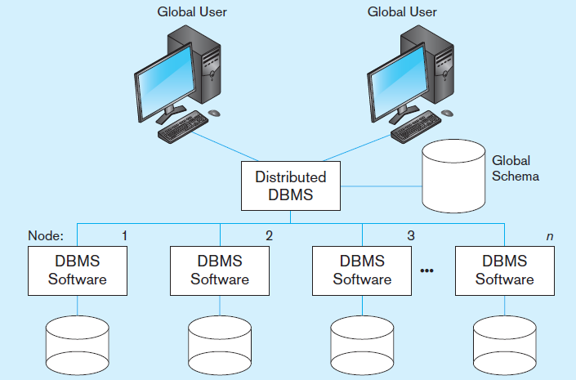
Figure 13-2 Homogeneous Distributed Database Environment
Identical DBMSs
Source: Based on Bell and Grimson, 1992.
Notes:
The central DBMS software and global schema are characteristic of the non-autonomous variety of homogeneous databases. In the autonomous variety, you would have more independent nodes passing messages back and forth.
Each database contains its own data, but this is accessible all throughout the network through the distributed DBMS.

Slide 10
Typical Heterogeneous Environment
Data distributed across all the nodes
Different DBMSs may be used at each node
Local access is done using the local DBMS and schema
Remote access is done using the global schema
Notes:
As you can see the heterogeneous environment differs from the homogeneous in a three main ways. First, you can have Oracle at one node, SQL Server at another, and MySQL at a third.
Second, you can have each DBMS operate independently. Actually, this is not unique to heterogeneous environments, because autonomous homogeneous environments also allow this.
Third, in addition to global users, you also can have local databases for users, in addition to the global distributed database.
The next slide’s figure illustrates this.

Slide 11
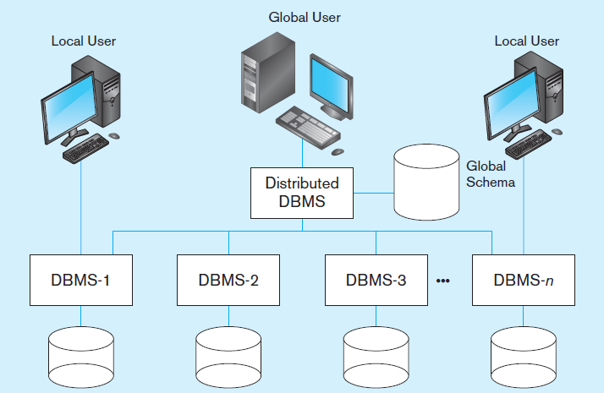
Figure 13-3 Heterogeneous Distributed Database Environment
Non-identical DBMSs
Source: Based on Bell and Grimson, 1992.
Notes:
As you can see here, the local users does not need to interact with the distributed DBMS in order to access data on their own local database.

Slide 12
Major Objectives
Location Transparency
User does not have to know the location of the data
Data requests automatically forwarded to appropriate sites
Local Autonomy
Local site can operate with its database when network connections fail
Each site controls its own data, security, logging, recovery
Notes:
Ease of access is important in distributed databases. Users should not need to worry about where the data is; all they should need to worry about is what data they want. Also, administrators at each site should be able to use their own controls and rules. So, both users and DBAs should be able to work with the distributed database as if it is a local database.
This is a design challenge at the global distributed level, and there are various approaches for doing this.

Slide 13
Significant Trade-Offs
Synchronous Distributed Database
All copies of the same data are always identical
Data updates are immediately applied to all copies throughout network
Good for data integrity
High overhead ➔ slow response times
Asynchronous Distributed Database
Some data inconsistency is tolerated
Data update propagation is delayed
Lower data integrity
Less overhead ➔ faster response time
NOTE: all this assumes replicated data (to be discussed later)

Slide 14
Advantages of Distributed Database over Centralized Databases
Increased reliability/availability
Local control over data
Modular growth
Lower communication costs
Faster response for certain queries
Notes:
You can see that there are a lot of advantages of disturbed databases. For many companies, this makes the extra effort and cost worthwhile.
But there are also disadvantages, as we will see in the next slide.

Slide 15
Disadvantages of Distributed Database Compared to Centralized Databases
Software cost and complexity
Processing overhead
Data integrity exposure
Slower response for certain queries
Notes:
Distributed DBMSs are considerably more complex to implement than centralized ones. And, the extra work of ensuring consistency in replicated and partitioned data adds to the computational load. With replication (like any data duplication as we discussed in chapter 4), there are problems with ensuring data integrity.
And, if you query on data that is actually distributed in many places, the extra network time can be problematic.
What do I mean by replication and partitioning? We will see in the next few slides.

Slide 16
Options for Distributing a Database
Data replication
Copies of data distributed to different sites
Horizontal partitioning
Different rows of a table distributed to different sites
Vertical partitioning
Different columns of a table distributed to different sites
Combinations of the above
Notes:
Replication simply means copying. Of course this means data duplication, which implies that extra work needs to be done to ensure integrity and consistency.
Partitioning means dividing the data between different DBMS nodes on the network. Essentially, a distributed database involves some combination of replication and partitioning.

Slide 17
Data Replication Advantages
Reliability
Fast response
May avoid complicated distributed transaction integrity routines (if replicated data is refreshed at scheduled intervals)
Decouples nodes (transactions proceed even if some nodes are down)
Reduced network traffic at prime time (if updates can be delayed)
Notes:
One advantage of data replication, as we discussed earlier, is that you have extra copies of the data in case a DBMS node crashes on the network. This is where reliability and fault tolerance comes into play.
Another obvious advantage is performance. If data is copied then there is less contention on any one node for a particular segment of the database.

Slide 18
Data Replication Disadvantages
Additional requirements for storage space
Additional time for update operations
Complexity and cost of updating
Integrity exposure of getting incorrect data if replicated data is not updated simultaneously
Therefore, better when used for non-volatile
(read-only) data
Notes:
Remember the data duplication issues we talked about when we were discussing well structured and normalized databases earlier (in chapter 4)? The same issues can occur in distributed databases.
The storage space requirements aren’t that problematic when you consider the ever-increasing reduction of storage costs.

Slide 19
Types of Data Replication
Push Replication–
updating site sends changes to other sites
Pull Replication–
receiving sites control when update messages will be processed
Notes:
Remember when we talked about data integration in chapter 10? EAI refers to “push” and traditional ETL refers to “pull”. So, the same sorts of factors that influence choices of data integration also apply to data distribution.

Slide 20
Types of Push Replication
Snapshot Replication–
Changes periodically sent to master site
Master collects updates in log
Full or differential (incremental) snapshots
Dynamic vs. shared update ownership
Near Real-Time Replication–
Broadcast update orders w/out requiring confirmation
Done through use of triggers
Update messages stored in message queue until processed by receiving site
Notes:
The cost to perform a snapshot refresh may depend on whether the snapshot is simple or complex. A simple snapshot is one that references all or a portion of only one table. A complex snapshot involves multiple tables, usually from transactions that involve joins. Some distributed DBMSs support only simple snapshots.
In near real-time replication using triggers, each database update event can be handled individually and transparently to programs and users. If network connections to a node are down or the node is busy, these messages informing the node to update its database are held in a queue to be processed when possible.
Synchronization is less disruptive with pull replication than with push replication.

Slide 21
Issues for Data Replication
Data timeliness–high tolerance for out-of-date data may be required
DBMS capabilities–if DBMS cannot support multi-node queries, replication may be necessary
Performance implications–refreshing may cause performance problems for busy nodes
Network heterogeneity–complicates replication
Network communication capabilities–complete refreshes place heavy demand on telecommunications
Notes:
As mentioned before, data replication has its costs, which are listed here.

Slide 22
Horizontal Partitioning
Different rows of a table at different sites
Advantages
Data stored close to where it is used ➔ efficiency
Local access optimization ➔ better performance
Only relevant data is available ➔ security
Unions across partitions ➔ ease of query
Disadvantages
Accessing data across partitions ➔ inconsistent access speed
No data replication ➔ backup vulnerability
Notes:
Table partitioning was discussed in chapter 5.
One reason for horizontal partitioning would be to divide the table so that rows relevant to a particular location are stored at that location’s site. Thus, the most relevant data for a particular location would be available through local access, not requiring global access through the distributed DBMS.

Slide 23
Vertical Partitioning
Different columns of a table at different sites
Advantages and disadvantages are the same as for horizontal partitioning except that combining data across partitions is more difficult because it requires joins (instead of unions)

Slide 24
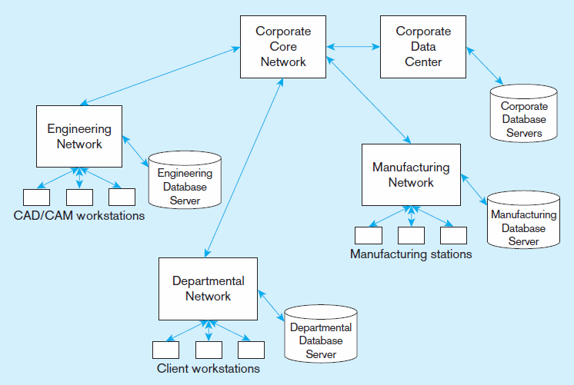
Figure 13-6
Distributed processing system for a manufacturing company
Notes:
If different business functions are located at different sites, then it makes sense to partition the data so that the most relevant data for a particular function is stored local to that function’s site. So, in general, the idea with partitioning is to make data as local as possible while still being accessible globally if needed.

Slide 25
Five Distributed Database Strategies
Centralized database, distributed access
Replication with periodic snapshot update
Replication with near real-time synchronization of updates
Partitioned, one logical database
Partitioned, independent, nonintegrated segments

Slide 26
Factors in Choice of Distributed Strategy
Organizational forces – funding, autonomy, security
Frequency and locality or clustering of reference to data
Growth and expansion needs
Technological capabilities
Costs of managing complex technologies
Need for reliable service

Slide 27
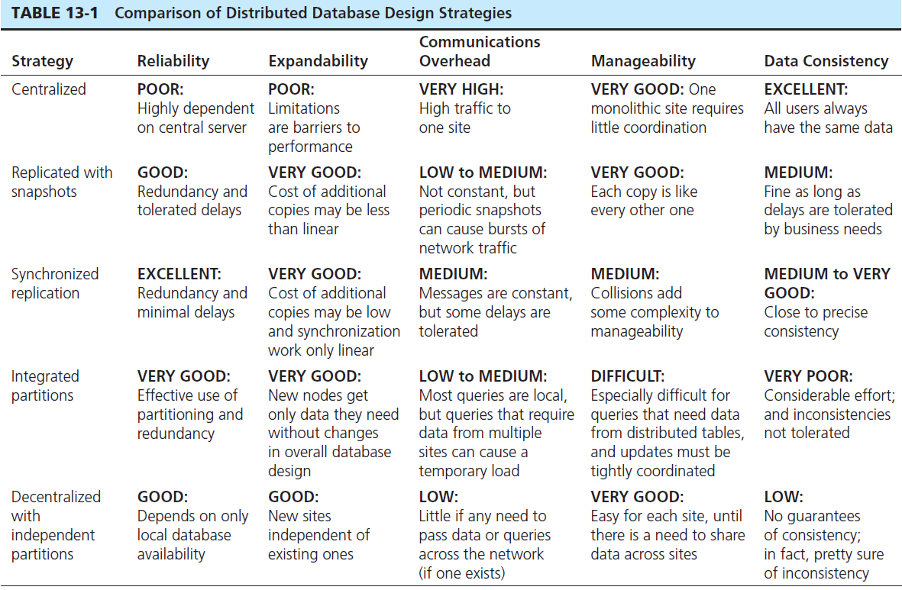
Notes:
As with all design alternatives, each distributed DBMS strategy has its advantages and disadvantages.
Question: which strategy would you use is you wanted an easily managed and expandable database?
Answer: probably replication with snapshots.
Question: If data consistency is a major concern for you, what is the worst choice?
Answer: Integrated partitions

Slide 28
Functions of a Distributed DBMS
Locate data with a distributed data dictionary
Determine location from which to retrieve data and process query components
Translate between nodes with different local DBMSs
Provide data management functions: security, concurrency, deadlock control, query optimization, failure recovery
Provide data consistency (via multiphase commit protocols)

Slide 29
Functions of a Distributed DBMS (cont.)
Provide a single logical database, physically distributed → Global primary key control
Be scalable
Replicate data and stored procedure
Transparently use residual computing power to improve database processing performance
Permit different nodes to run different DBMSs
Allow different versions of application code to reside on different nodes

Slide 30
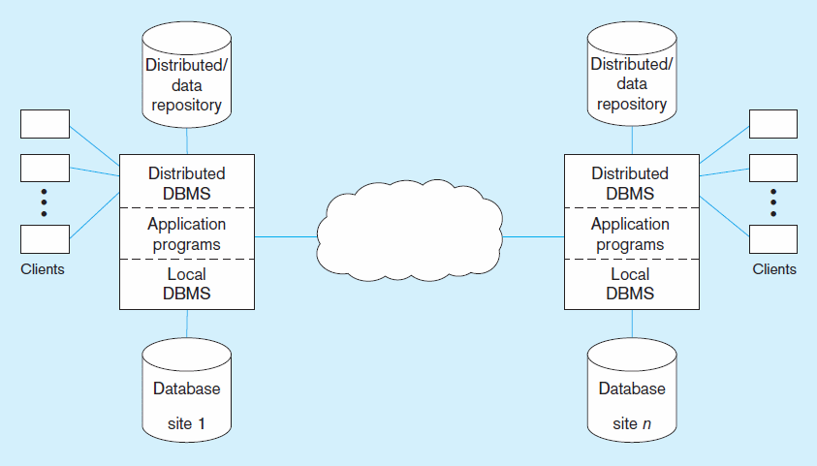
Figure 13-10 Distributed DBMS architecture
Notes:
Distributed DBMS processing is very complex compared to local DBMS processing, as we’ll see in the next few slides.

Slide 31
Local Transaction Steps
Application makes request to distributed DBMS.
Distributed DBMS checks distributed data repository for location of data. Finds that it is local.
Distributed DBMS sends request to local DBMS.
Local DBMS processes request.
Local DBMS sends results to application.
Notes:
Here are the steps for local transactions. Let’s see a pictorial representation of these steps in the next slide.

Slide 32
Figure 13-10 Distributed DBMS Architecture (showing local transaction steps)
2
1
3
5
4
Local transaction–all data stored locally
Notes:
All steps are happening in one place. As soon as the distributed DBMS recognizes (by looking at the distributed data repository) that the desired data resides locally, it lets the local DBMS handle the request.

Slide 33
Global Transaction Steps
Application makes request to distributed DBMS.
Distributed DBMS checks distributed data repository for location of data. Finds that it is remote.
Distributed DBMS routes request to remote site.
Distributed DBMS at remote site translates request for its local DBMS if necessary, and sends request to local DBMS.
Local DBMS at remote site processes request.
Local DBMS at remote site sends results to distributed DBMS at remote site.
Remote distributed DBMS sends results back to originating site.
Distributed DBMS at originating site sends results to application.
Notes:
With global transactions, as you can see, there are more steps. Of course, requests are going to be sent across the Internet. We’ll see this in the next slide.

Slide 34
Figure 13-10 Distributed DBMS architecture (showing global transaction steps)
2
3
1
6
7
8
4
5
Global transaction–some data is at remote site(s)
Notes:
In this case, the node’s distributed DBMS found (via the distributed data repository) that the desired data resides on another node in the network. So it sends the request to the distributed DBMS of the other node, which in turn sends it to that nodes local DBMS. When the result is returned to that node’s distributed DBMS, it sends the results back to the first node’s DBMS for final processing with the application program.

Slide 35
Distributed DBMS Transparency Objectives
Location Transparency
User/application does not need to know where data resides
Replication Transparency
User/application does not need to know about duplication
Failure Transparency
Either all or none of the actions of a transaction are committed
Each site has a transaction manager
Logs transactions and before and after images
Concurrency control scheme to ensure data integrity
Requires special commit protocol
Notes:
Transparence means the user doesn’t need to know or care where the data is. Al l of that is handled by the distributed DBMS.

Slide 36
Two-Phase Commit
Prepare Phase
A message is broadcast to every participating site, asking whether that site is willing to commit its portion of the transaction at that site. Each site returns an “OK” or “not OK” message.
An “OK” says that the remote site promises to allow the initiating request to govern the transaction at the remote database.
Notes:
Recall from chapter 12 the notion of “committing” a transaction. This becomes more complicated in a distributed environment, because different database updates of the transaction could occur at different sites.
Remember the reason for “committing”. It was to ensure that the transaction is atomic. Either all the updates occur or none of them. So if one of the nodes fails, then all other nodes must be informed to roll back their updates.

Slide 37
Two-Phase Commit (cont.)
Commit Phase
The originating site collects the messages from all sites.
If all are “OK,” it broadcasts a message to all sites to commit the portion of the transaction handled at each site.
If one or more responses are “not OK,” it broadcasts a message to all sites to abort the transaction.
If the transaction fails during the commit phase it is in limbo.
A limbo transaction can be identified by a timeout or polling.

Slide 38
Concurrency Control
Concurrency Transparency
Design goal for distributed database
Appearance of serial transactions, even though simultaneous transactions are occurring
Time stamping
Concurrency control mechanism
Assign globally unique timestamp to each transaction
Alternative to locks in distributed databases
Notes:
Concurrency control was also discussed in chapter 12. Issues here were the lost update problem (solved by locking) and the possibility of deadlock.

Slide 39
Query Optimization
Query optimization plan: for a multi-site join the distributed DBMS must decide where to access the data and how to proceed with the join. Three step process:
Query decomposition
Data localization
Global optimization
Semijoin operation: only the joining attribute of the query is sent from one site to the other, rather than all selected attributes
Notes:
Query optimization was discussed in chapter 5 and again in chapter 7. During those discussions, the assumption was that we’re working with a centralized database. With a distributed database, optimization involves more factors.
Query decomposition, the query is simplified into a structured, relational algebra form. This is followed by data localization, the query is fragmented into multiple queries, each operating locally on the data on a local node. Finally, the global optimization involves the order of query fragment execution and movement of data between sites.

Slide 40
Evolution of Distributed DBMS
“Unit of Work”–All of a transaction’s steps
Remote Unit of Work
SQL statements originated at one location can be executed as a single unit of work on a single remote DBMS

Slide 41
Evolution of Distributed DBMS (cont.)
Distributed Unit of Work
Different statements in a unit of work may refer to different remote sites
All databases in a single SQL statement must be at a single site
Distributed Request
A single SQL statement may refer to tables in more than one remote site
May not support replication transparency or failure transparency

Slide 42


