Slide 1
Chapter 14 (Online): Object-Oriented Data Modeling
Modern Database Management
12th Edition
Jeff Hoffer, Ramesh Venkataraman,
Heikki Topi

Slide 2
Objectives
Define terms
Describe phases of object-oriented development life cycle
State advantages of object-oriented modeling
Compare object-oriented model with E-R and EER models
Model real-world application using UML class diagram
Provide UML snapshot of a system state
Recognize when to use generalization, aggregation, and composition
Specify types of business rules in a class diagram
Notes:
For this chapter you are going to see that there are a LOT of similarities between object oriented modeling and entity relationship modeling. The key distinction between the two is that objects in UML, unlike entities in E-R, include behaviors.

Slide 3
What Is Object-Oriented Data Modeling?
Centers around objects and classes
Involves inheritance
Encapsulates both data and behavior
Benefits of Object-Oriented Modeling
Ability to tackle challenging problems
Improved communication between users, analysts, developers
Increased consistency in analysis, design, and programming
Explicitly represents commonality among system components
System robustness
Reusability of analysis, design, and programming results
Notes:
In other modeling approaches, such as structured analysis and design, the models that are developed lack a common underlying representation and, therefore, are very weakly connected.
Traditional structured analysis and design lack a common underlying representation. They suffer from disjoint model transitions.
What does “structured analysis and design” mean? The idea of the structured design method is to take a problem and divide it into tasks and subtasks. This is a process-oriented approach and was the standard software design method prior to the advent of object orientation. It is a modular approach, and an improvement over the “spaghetti code” mess that can occur in unplanned coding. But the current paradigm is an object approach, which is more modular yet, and centers on objects relating to each other rather than task decomposition.
Objects can be used in many applications, whereas tasks tend to be more limited to the application for which they were created.

Slide 4
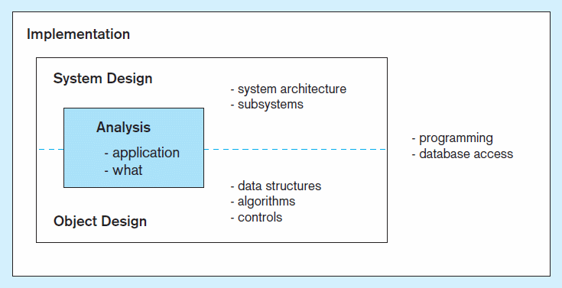
Figure 14-1 Phases of object-oriented systems development cycle
Progressive and iterative development process
Notes:
Iterative development means you design objects, do some coding, then do more design. It’s a bit related to the prototyping design methodology we discussed in chapter 1.

Slide 5
OO vs. EER Data Modeling
Object Oriented (OO)
EER
Class
Entity type
Object
Entity instance
Association
Relationship
Inheritance of attributes
Inheritance of attributes
Inheritance of behavior
No representation of behavior
Object-oriented modeling is typically represented using Unified Modeling Language (UML)
Notes:
Here, we see that objects are a lot like entities. Associations are essentially the same thing as relationships. The main difference is the existence of behaviors in the OO approach. There is no such thing as behaviors in the EER model.
Unified modeling language (UML) is the standard approach for analyzing, designing, and representing object-oriented software systems.

Slide 6
Classes and Objects
Class: An entity that has a well-defined role in the application domain, as well as state, behavior, and identity
Tangible: person, place or thing
Concept or Event: department, performance, marriage, registration
Artifact of the Design Process: user interface, controller, scheduler
Object: a particular instance of a class
Objects exhibit BEHAVIOR as well as attributes
➔ Different from entities

Slide 7
State, Behavior, Identity
State: attribute types and values
Behavior: how an object acts and reacts
Behavior is expressed through operations that can be performed on it
Identity: every object has a unique identity, even if all of its attribute values are the same
Notes:
Every program contains some variables that contain data in memory. The current value at any given step in a program’s algorithm is called its state.
In an ER model, an entity has an identifier. Similarly, in a relational database, a row of a table is uniquely identified by its primary key. The same idea is true for objects, which contain their own unique identity.

Slide 8
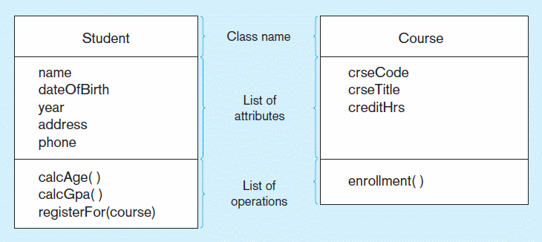
Figure 14-2 UML class and object diagram
a) Class diagram showing two classes
Class diagram shows the static structure of an object-oriented model: object classes, internal structure, relationships
Notes:
Note that a the box representing a class is similar to the box representing an entity that we saw in chapters 2 and 3. Each has a name, and each has a set of attributes. But classes also include behaviors, which are implemented in methods when coded in an object oriented language like Java or C++.

Slide 9
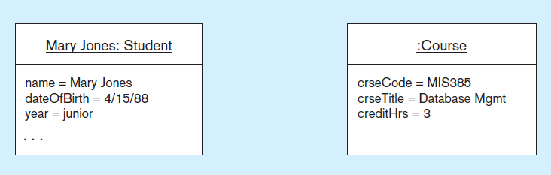
Figure 14-2 UML class and object diagram (cont.)
b) Object diagram with two instances
Object diagram shows instances that are compatible with a given class diagram
Notes:
This is the syntax for object diagrams. An instance is an object, which is a particular instantiation of a class. If you take an object oriented programming class you will see plenty of examples of object instantiation.

Slide 10
Operation
A function or service provided by all instances of a class
Encapsulation – hiding internal implementation details
Types of operations:
Constructor: creates a new instance of a class
Query: accesses but does not change an object’s state
Update: alters the state of an object
Class-Scope: operation applies to the class instead of an instance
Operations implement the object’s behavior
Notes:
Operations are implemented as methods in object oriented programming language. Methods are sometimes called functions or procedures. Functions return values, whereas procedures only do desired behaviors.
When an object is instantiated, a constructor is invoked to set initial values for the object’s attributes. Query operations are sometimes called “accessors” and update operations are sometimes called “mutators”.
Most operations (methods) of a class are applied to a specific instance, but it is also possible to have a method that applies to all the instances of a class.

Slide 11
Associations
Association
Named relationship among object classes
Association Role
Role of an object in an association
The end of an association where it connects to a class
Multiplicity
How many objects participate in an association. Lower-bound...Upper-bound (cardinality)
Notes:
Associations in UML are essentially the same thing as relationships in ER. Multiplicity and cardinality are synonymous.

Slide 12
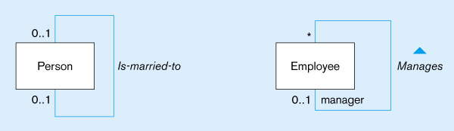
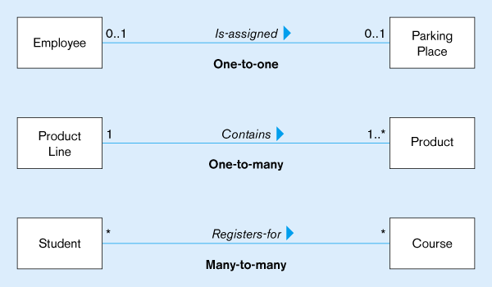
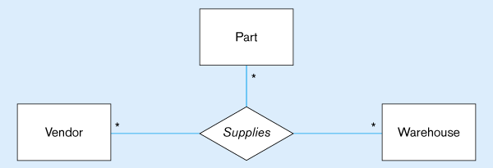
Figure 14-3
Examples of association relationships of different degrees
Unary
Lower-bound – upper-bound
Represented as:
0..1, 0..*, 1..1, 1..*
Similar to minimum/maximum cardinality rules in EER
Binary
Ternary
Notes:
Can you see the similarities between UML “associations” and ER “relationships”? Both have degrees and cardinalities (multiplicities).

Slide 13
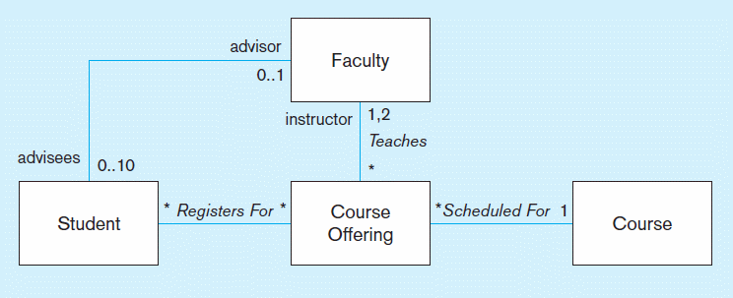
Figure 14-4 Examples of binary association relationships
a) University example
Alternative multiplicity representation: specifying the two possible values in a list instead of a range
Notes:
Here we see a UML diagram showing associations between classes, and multiplicities for these associations. The associations can include labels indicating their purpose, and the roles of each class in the association.

Slide 14
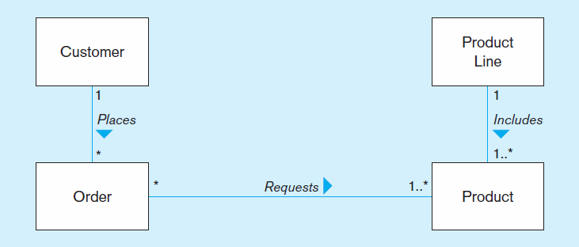
Figure 14-4 Examples of binary association relationships (cont.)
b) Customer order example

Slide 15
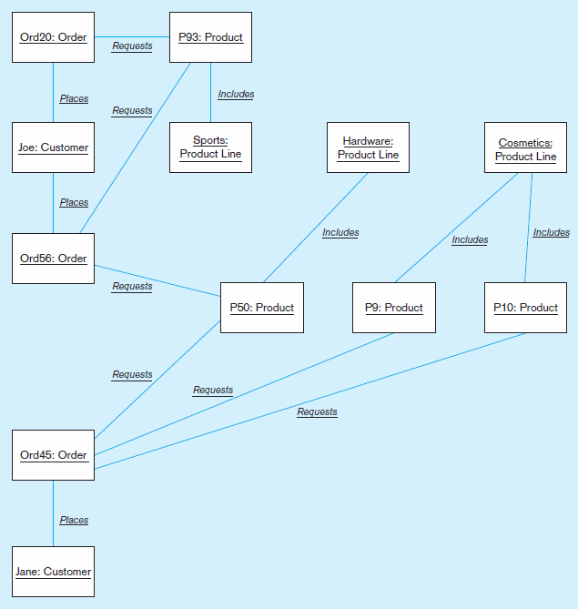
Figure 14-5
Object diagram for customer order example
Object diagram shows associations between specific object instances
Notes:
If you recall from chapter 2, there was a distinction between diagrams for entity types and diagrams for entity instances. The object diagram in UML is analogous to the entity instance diagram in E-R modeling.

Slide 16
Association Class
An association that has attributes or operations of its own or that participates in relationships with other classes
Like an associative entity in E-R model

Slide 17
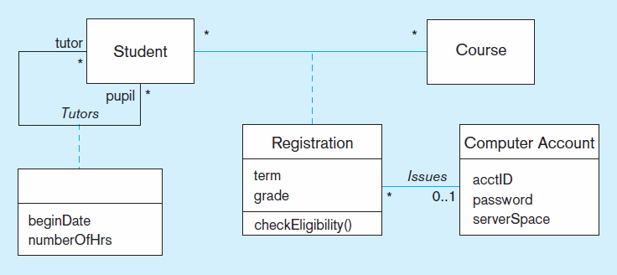
Figure 14-6 Association class and link object
a) Class diagram showing association classes
Binary association class with attributes and behavior
Unary association with attributes but no behavior
Notes:
Again, you see so much similarity between the ER model and the UML model. Association classes are essentially the same idea as “associative entities”.

Slide 18
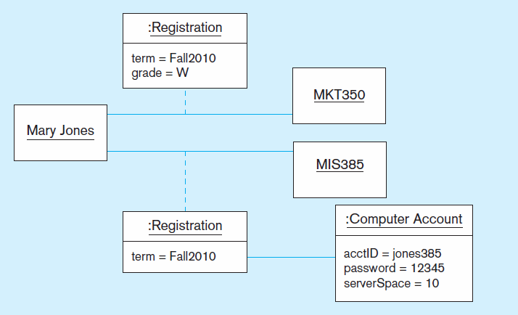
Figure 14-6 Association class and link object (cont.)
b) Object diagram showing link objects
Association class
instances
Notes:
Mary Jones is registered for MKT 350 and MIS 385 in fall 2010, but withdrew from MKT 350.

Slide 19
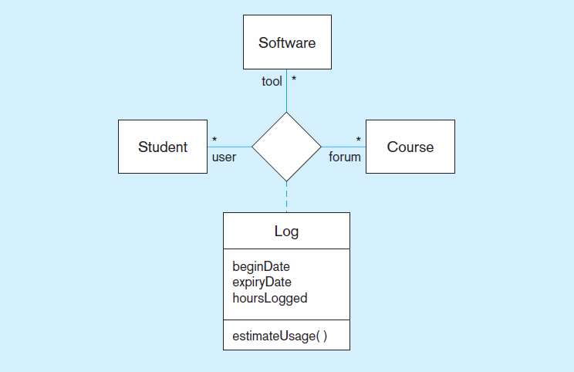
Figure 14-7 Ternary relationship with association class

Slide 20
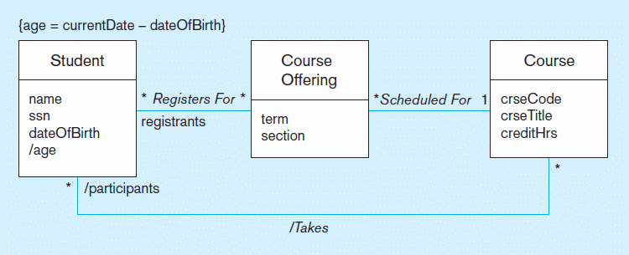
Figure 14-8 Derived attribute, association, and role
Constraint expression for derived attribute
Derived attribute
Derived relationship (from Registers-for and Scheduled-for)
Derived attributes and relationships shown with / in front of the name
Notes:
Derived attributes are calculated, not stored explicitly in a variable. When a coder takes a diagram like this and writes the program, the student’s age will be calculated based on the specified formula.

Slide 21
Generalization/Specialization
Subclass, Superclass
similar to subtype/supertype in EER
Common attributes, relationships, and operations
Disjoint vs. Overlapping
Complete (total specialization) vs. incomplete (partial specialization)
Abstract Class: no direct instances possible, but subclasses may have direct instances
Concrete Class: direct instances possible

Slide 22
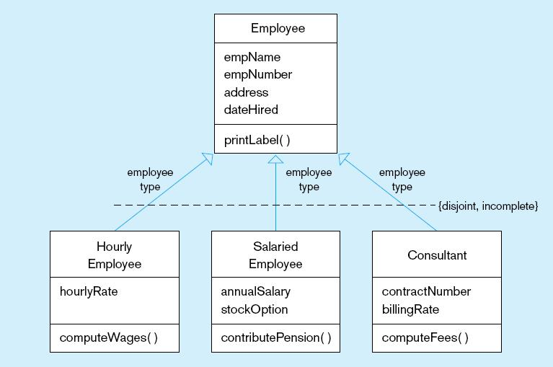
Figure 14-9 Examples of generalization, inheritance, and constraints
a) Employee superclass with three subclasses
An employee can only be one of these subclasses
Shared attributes and operations
An employee may be none of them
Specialized attributes and operations

Slide 23
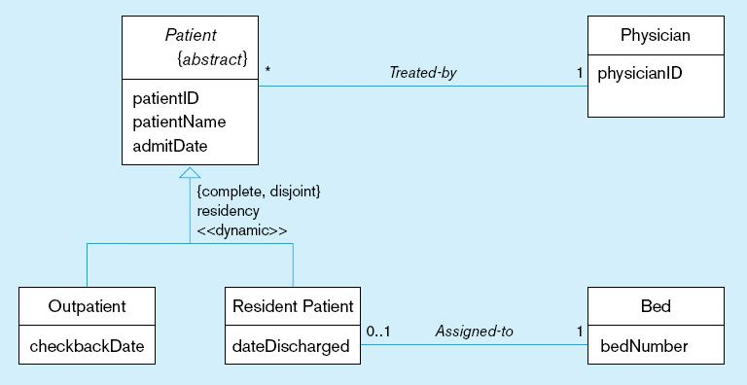
Figure 14-9 Examples of generalization, inheritance, and constraints
b) Abstract Patient class with two concrete subclasses
Abstract indicated by italics
A patient MUST be EXACTLY one of the subtypes
Dynamic means a
patient can change from one subclass to another over time.
Notes:
In an object oriented system, you can instantiate some classes but not others. Abstract classes are not instantiated, but they do define certain attributes and behaviors that are shared across all instantiable subclasses. It’s a useful design construct and used a lot in object oriented languages.

Slide 24
Class-Scope Attribute
Specifies a value common to an entire class, rather than a specific value for an instance
Represented by underlining
“=”is initial, default value
Notes:
Here is one difference between object-oriented modeling and E-R modeling. The notion of a class-scope attribute is not found in E-R modeling.
Actually, class-scope attributes (and behaviors) are similar to the concepts you would see in a structured programming language. In structured programming, these are sometimes called “global” variables or attributes.

Slide 25
Polymorphism
Abstract Operation: Defines the form or protocol of the operation, but not its implementation
Method: The implementation of an operation
Polymorphism: The same operation may apply to two or more different classes in different ways
Notes:
Polymorphism refers to behaviors, so here is another difference from E-R.

Slide 26
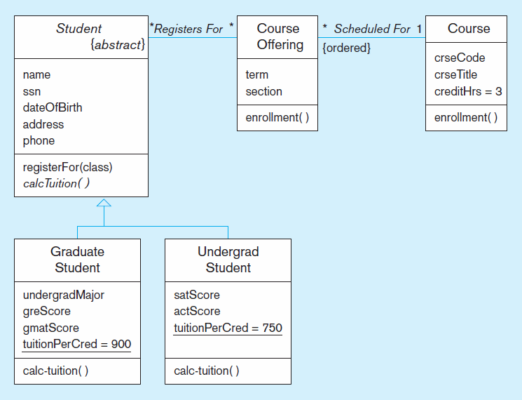
Figure 14-11 Polymorphism, abstract operation, class-scope attribute, and ordering
This operation is abstract…it has no method at Student level.
Class-scope attributes–only one value common to all instances of these classes (includes default values)
Methods defined at subclass level
Notes:
Note the calcTuition method. In the superclass student, it is abstract, without an actual implementation of behavior. It is overridden in each of the subclasses and in these classes there is a specific implementation.
The tuitionPerCred attribute of the Undergrad Student class is shared across all instances. By contrast, each undergrad student has its own satScore and actScore. That’s the difference between class-scope attributes and “instance-specific” attributes.

Slide 27
Overriding Inheritance
Overriding: The process of replacing a method inherited from a superclass by a more specific implementation of that method in a subclass
For Extension: add code
For Restriction: limit the method
For Optimization: improve code by exploiting restrictions imposed by the subclass

Slide 28
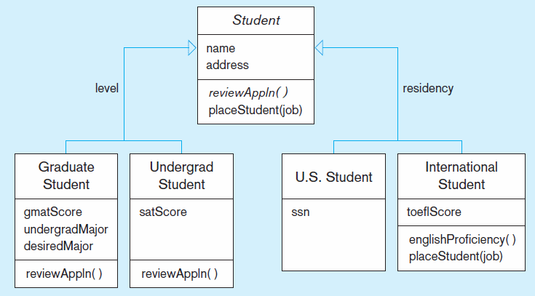
Figure 14-12 Overriding inheritance
Subclasses that do not override placeStudent use the default behavior.
Restrict job placement
Notes:
Overriding is a powerful feature of object oriented programming languages, and this is the way that polymorphism is enables. In this example, the Graduate, Undergrad, and US student classes simply rely on the inherited behavior of the Student’s placeStudent method. But, the International Student class overrides this method to provide specialized behavior for placing this type of student.

Slide 29
Multiple Inheritance
Multiple Classification: An object is an instance of more than one class
Multiple Inheritance: A class inherits features from more than one superclass

Slide 30
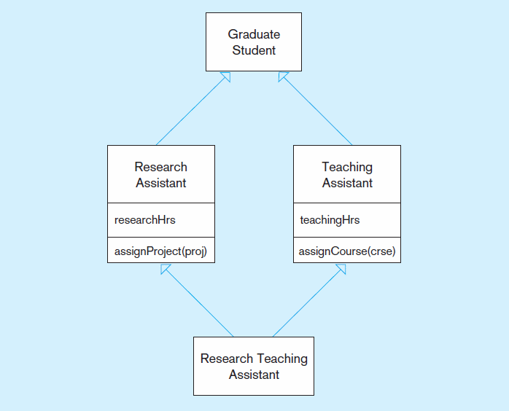
Figure 14-13 Multiple inheritance
An instance includes both researchHrs and teachingHrs.
An instance includes both assignProject and assignCourse.
Notes:
Some languages allow multiple inheritance. In these cases, a particular class can inherit attributes from multiple other classes. C++ is an example of a language that allows multiple inheritance. But not all object oriented languages support this. For example, in Java, a class can be a subclass of only one parent class.
Also, notice that we didn’t see any multiple inheritance examples in the EER model. This is not a feature of EER.

Slide 31
Aggregation
Aggregation: A part-of relationship between a component object and an aggregate object
Composition: A stronger form of aggregation in which a part object belongs to only one whole object and exists only as part of the whole object
Recursive Aggregation: Composition where component object is an instance of the same class as the aggregate object

Slide 32
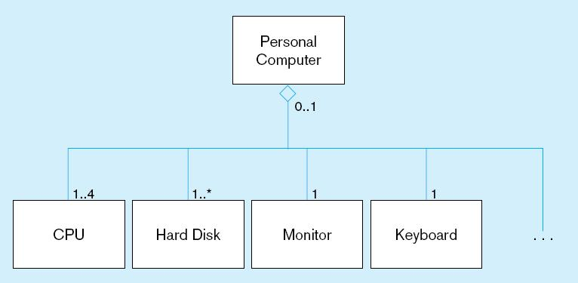
Figure 14-14 Example of aggregation
A Personal Computer includes CPU, Hard Disk, Monitor, and Keyboard as parts. But, these parts can exist without being installed into a computer. The open diamond indicates aggregation, but not composition.
Notes:
What this diagram is showing is that a PC will contain at least one CPU and at least one hard drive. It will also contain a monitor and keyboard.
This diagram also implies that the CPU, hard drive, monitor, and keyboard can exist without being part of the PC. That’s because these are aggregation associations, represented with the open diamond. If they were composition relationships represented with closed diamonds, then this would imply that the CPU does not exist on its own.
In this sense, a composition association is a lot like an identifying relationship, and implies a mandatory one in the 1:N relationship. A simple aggregation could very well be the same as an optional one in a 1:N relationship.

Slide 33
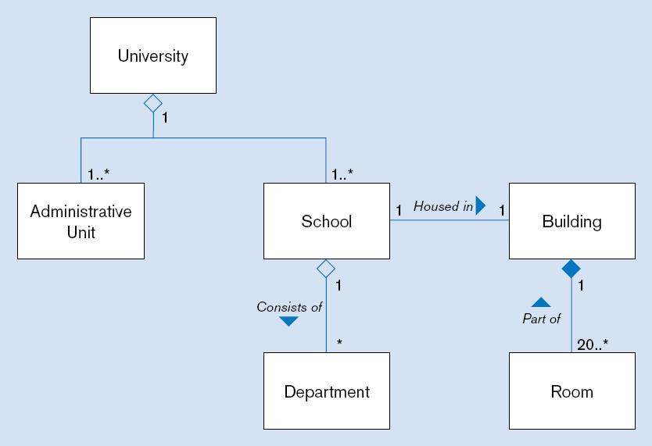
Figure 14-15 Aggregation and Composition
(a) Class diagram
Closed diamond indicates composition. The room cannot exist without the building.
Notes:
In this case, the room cannot exist without the building. If this were represented by an ER diagram, then Room would be a weak entity and the Part of relationship would be an identifying relationship. Recall that weak entities and identifying relationships were represented with double lines in chapter 2.

Slide 34
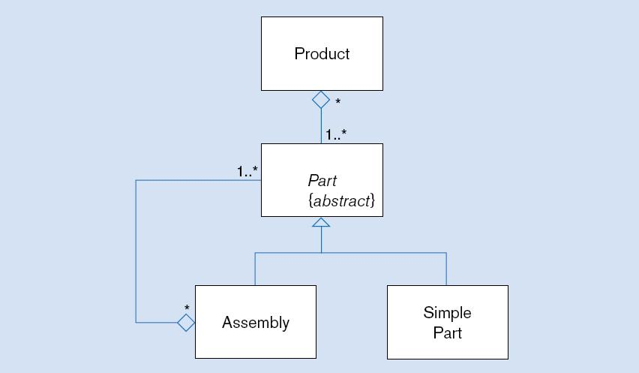
Figure 14-16 Recursive aggregation
Notes:
Recall the bill of material relationship we saw in chapter 2. This is essentially the same thing represented in UML.

Slide 35
Business Rules
See Chapters 2 and 3
Implicit and explicit constraints on objects – for example:
cardinality constraints on association roles
ordering constraints on association roles
Business rules involving two graphical symbols:
labeled dashed arrow from one to the other
Business rules involving three or more graphical symbols:
note with dashed lines to each symbol

Slide 36
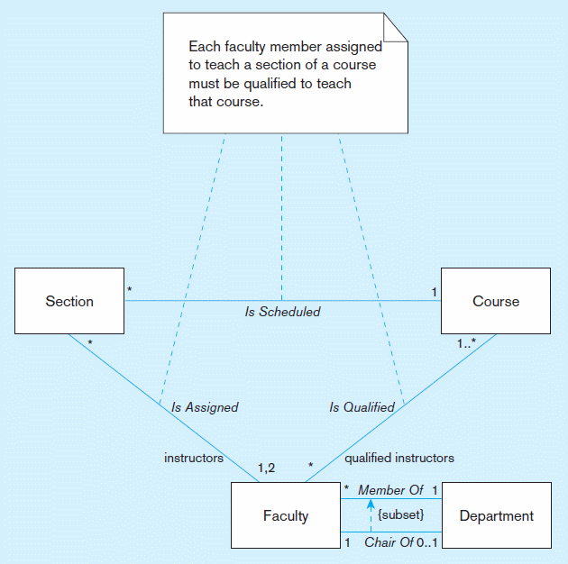
Figure 14-17 Representing business rules
Three-symbol constraint
Two-symbol constraint
Notes:
It’s possible to model similar business rules in ER diagrams.

Slide 37
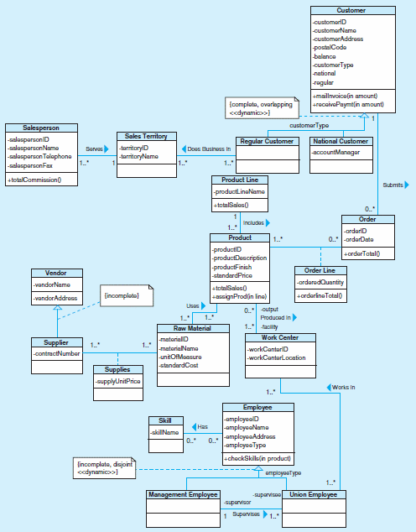
Figure 14-18 Class diagram for Pine Valley Furniture Company
Notes:
This is a Visio representation.

Slide 38
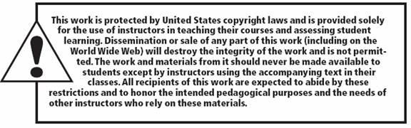
38

