Slide 1
WROX–Pro ASP.NET MVC 5 Chapter 1
Introduction

Slide 2
What is MVC (Model-View-Controller)
Model
Objects to hold all needed data
Functions to retrieve data (data access layer DAL – such as EF, NH, etc)
Holds Business Logic
View
Generates HTML
Displayed to the users
Controller
Ties Model and View together
Has logic for reacting to user input
Has logic for manipulating data from/to the data layer

Slide 3
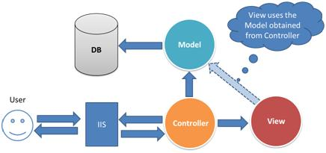

Slide 4
New to MVC 5
Built in display modes for things like mobile views
Bundling/Minification
Allow bundling of JS files into a single file
Minification will remove spaces and shorten code to make smaller for transmit
Bootstrap templating
Scaffolding
Quickly setting up boiler plate logic around data models
Attribute Routing
Improved Identity/Membership/Authentication systems
Supports Single Page Applications (SPA)
NuGet

Slide 5
MVC 6 is coming (is mostly here)
Extends MVC 5
If you know MVC 5, it’s easy to pick up
Adds things like Gulp/Grunt/Bower/NPM
Is based on .NetCore which removes dependencies on installed CLR framework

Slide 6
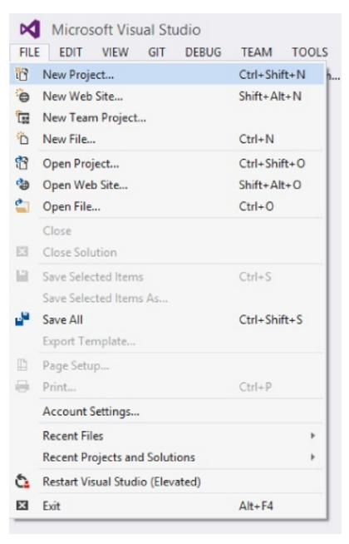
How to start?
Visual Studio 2015 or later
File -> New Project

Slide 7
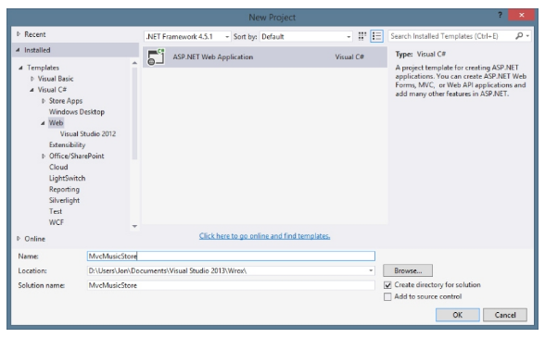
How to start?
->Installed Templats
->Visual C#
->Web

Slide 8
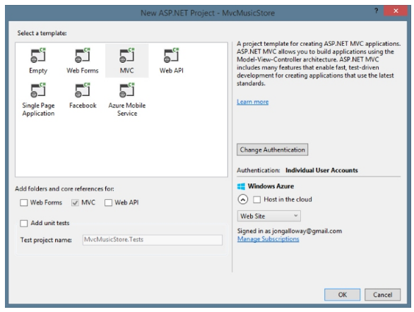
How to start?
Select MVC
Add WebAPI or UnitTests
Add Authentiation
Host on Azure

Slide 9
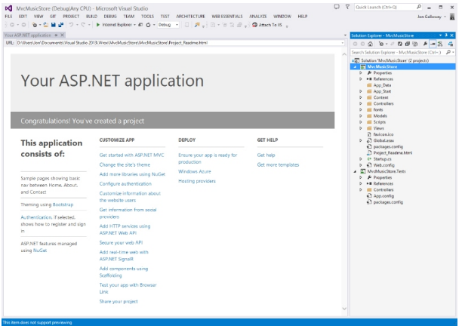
How to start?

Slide 10
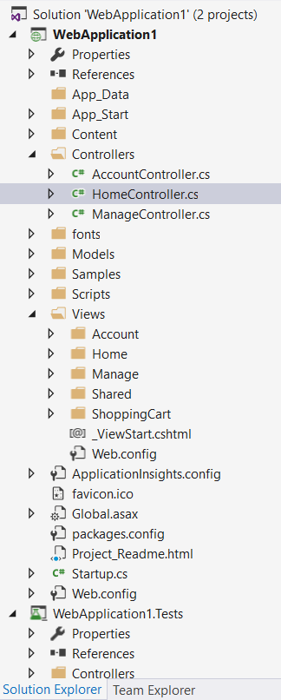
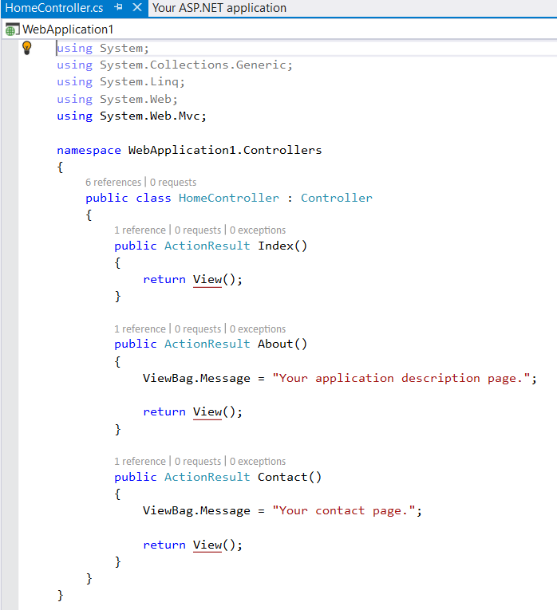
What you should see now

Slide 11
Things to be aware of as you start
Each controller’s class name ends with Controller: ProductionController, HomeController, and so on, and lives in the Controllers directory
There is a single Views directory for all the views of your application
Views that controllers use live in a subdirectory of the Views main directory and are named according to the controller name (minus the ‘Controller’ suffix). For example, the views for the ProductController discussed earlier would live /Views/Product/.

Slide 12


