Slide 1
WROX–Pro ASP.NET MVC 5 Chapter 2
Controllers

Slide 2
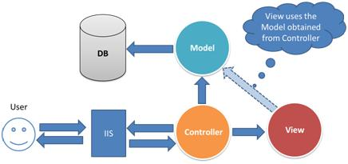

Slide 3
What is a controller?
Responsible for responding to user input
From the VIEW layer
Often changes values in the MODEL layer
MODEL would be responsible for persisting these if needed
Concerned with the flow of the application
How input is used to determine what the output is
Work relative to the VIEW layer
MVC pattern is responsible for serving up responses to web calls
Normal web server is meant to just serve pages with or without dynamic content
Web calls could be API or web pages

Slide 4
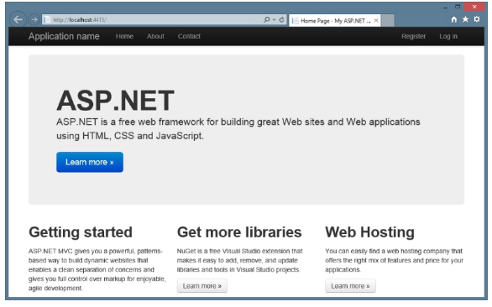
Controller code in Visual Studio
Sample ASP page from the empty project created in chapter 1.
Notice: 3 links at top

Slide 5
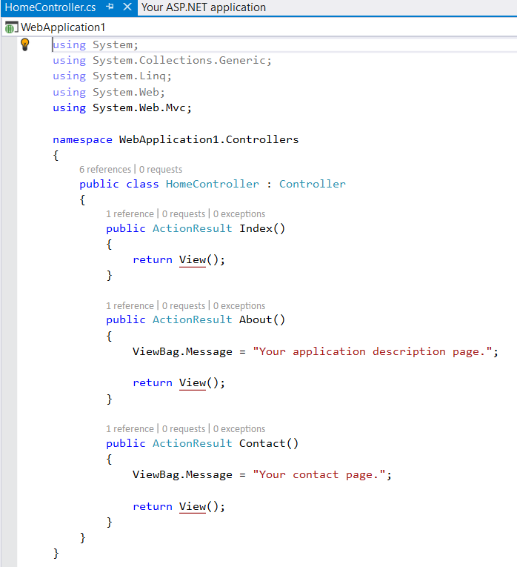
Controller code in Visual Studio
Visual Studio 2015 or later
Index
What is done when first browsing to this page
About/Contact are the links we saw previously
These would be considered an action of this page
Would show as site.com/About

Slide 6
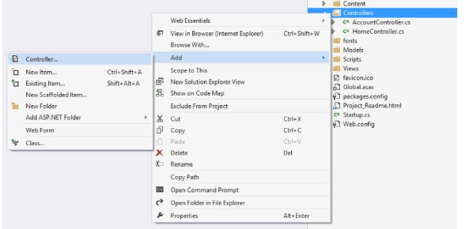
How to start?
Visual Studio 2015 or later
Right click ‘Controller’ folder
->Add
-->Controller

Slide 7
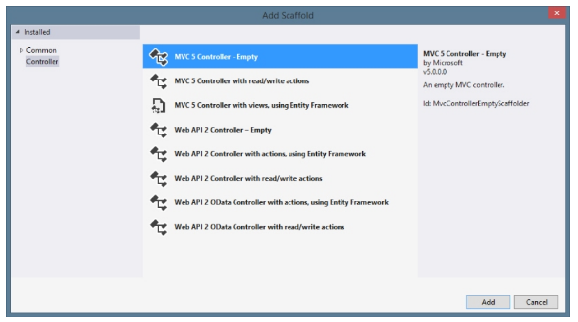
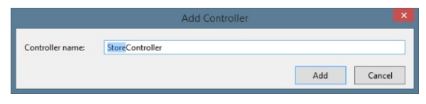
How to start?
Visual Studio 2015 or later
Choose an Empty Controller
Name the controller ‘Store’

Slide 8
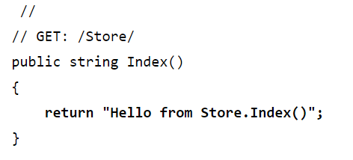
How to start?
Let’s test the index function
Add the following code
Now run the site
http://localhost/Store

Slide 9
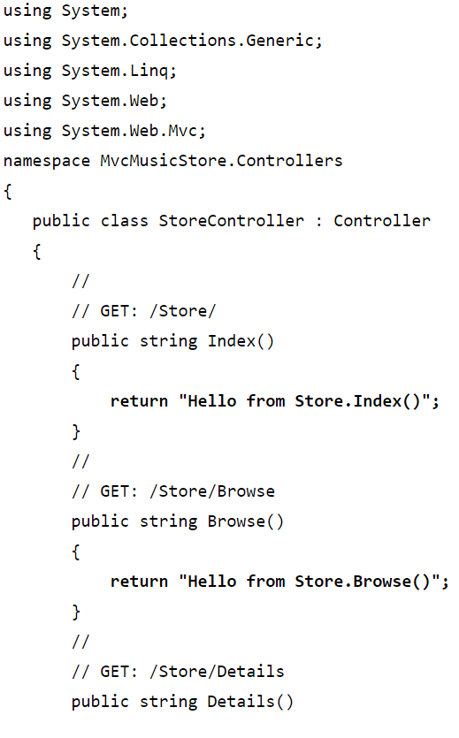
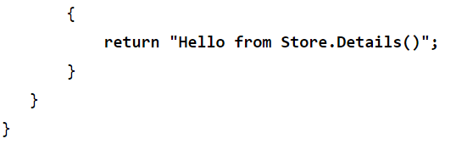
How to start?
Let’s test actions on this page
Add the following code
Now run the site
http://localhost/Store/Browse
http://localhost/Store/Details

Slide 10
A few notes about the code so far
Browsing to /Store/Details caused the Details method of the StoreController class to be executed, without any additional configuration. This is routing in action. We’ll talk more about routing later in this chapter and chapter 9.
Though we used Visual Studio tooling to create the controller class, it’s a very simple class. The only way you would know from looking that it was a controller class was that in inherits from System.Web.Mvc.Controller
We’ve put text in a browser with just a controller – we didn’t use a model or a view. Although models and views are incredibly useful within ASP.NET MVC, controllers are really at the heart. Every request goes through a controller, whereas some will not need to make use of models and views.

Slide 11
Extending the Controller
Next step is allow parameters through the controller
Pass parameters through URL
Want to add code to allow for
GET: /Store/Browse?genre=?Disco
Want to add code to allow for
Get: /Store/Details/5

Slide 12
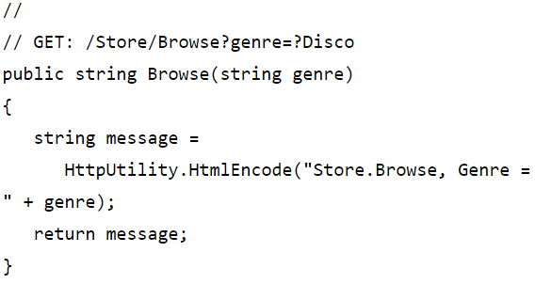
Extending the Controller
Let’s change the Browse function
Change the Browse code
Now run the site
http://localhost/Store/Browse?Genre=Disco

Slide 13
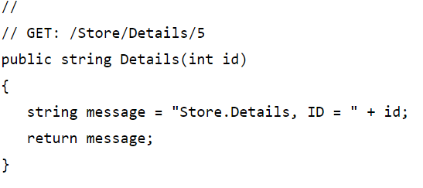
Extending the Controller
Let’s change the Browse function
Change the Details code
Now run the site
http://localhost/Store/Details/5

Slide 14


