Slide 1
WROX-Pro ASP.NET MVC 5 Chapter 3
Views

Slide 2
What is a View
What is responsible for actually displaying content to the user
Can be static HTML
What good is that? We need it to be dynamic
Driven by Controller, populated through Models
Controller responsible for calling returning a View
Convention – Controller/View names the same
Configuration – can manually assign relations
Dynamic through passing data
Strongly typed View
ViewBag
ViewData

Slide 3
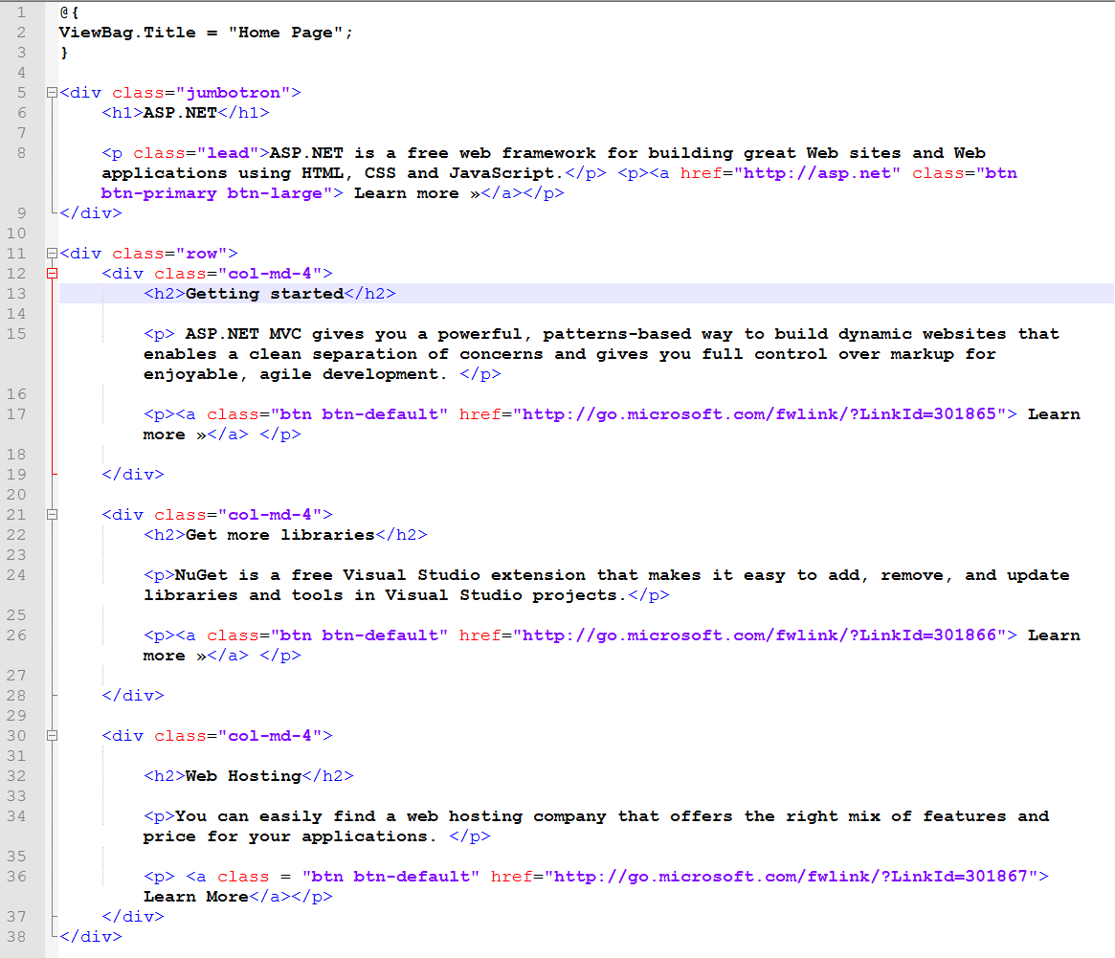
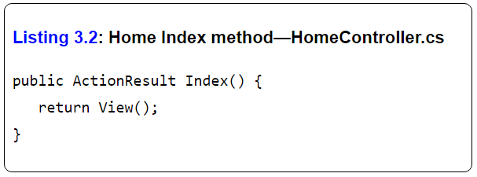
What is a View

Slide 4
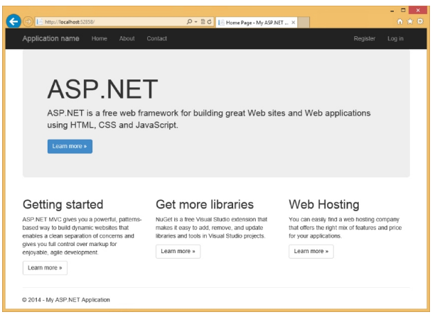
What is a View

Slide 5
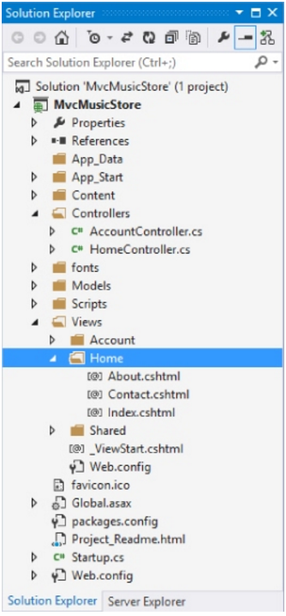
View-to-Controller mapping
By Default, MVC finds a View with the same name as your Controller.
Index function will call that found View
Additional methods that return View will find a view in that same folder
About(){return View();} will return About.cshtml
Can also return View(“~/Views/SomeFolder/SomePage.cshtml”) to point to another page

Slide 6
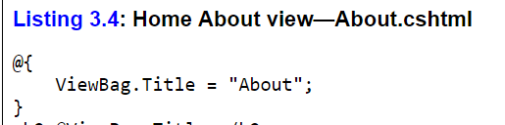
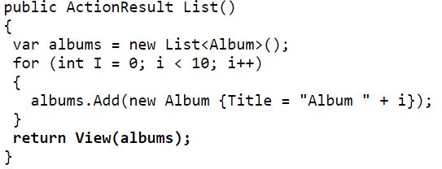

Passing data from Controller to View
Controller has to get/work on data and pass it to a View
Two ways to do this (up to this point)
ViewBag
Can add data dynamically
Essentially Key Value pair (dictionary)
Strong typed Views
Tie controller to a single model (class)

Slide 7
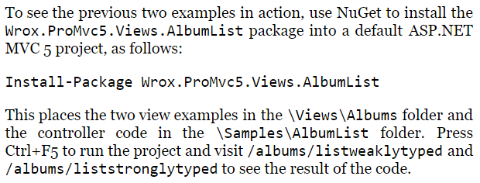
Code examples

Slide 8
The story behind View data
We showed two methods of passing data
ViewBag
Strongly typed View
SURPRISE!
They leverage the same mechanism
They are both ViewDataDictionaries

Slide 9
Well what is ViewDataDicitonary
ViewData is the backing property for passing data
It is used as a normal dictionary
Can use them all interchangeably

Slide 10
More on different ways of passing data
Strongly typed Views take advantage of ViewData.Model
This restricts to passing only ONE instance of an object
What if we need extra data?
In the music album example, how do we show a list of genres to choose from when we are looking at a specific album?
DO NOT pollute your data model
Keeps separation of concerns
Use View Models (Not the same as ViewModel in MVVM)
Let’s call them ‘View Specific Models’

Slide 11
What are these View Specific Models?!?
Don’t worry, these aren’t all that different
Just a new term for a class that holds other classes
Specifically:
A model that holds extra information that our View will need to enhance user experience
PLUS the normal model that you need to display the pertinent data
Using the album example:

Slide 12
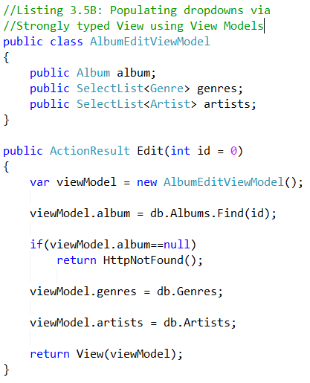
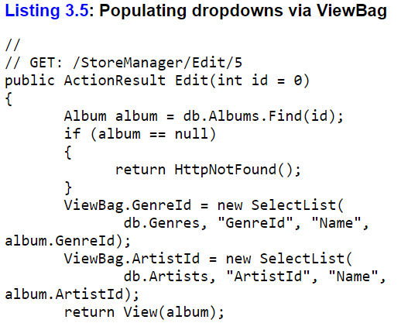
ViewBag vs View Specific Model

Slide 13

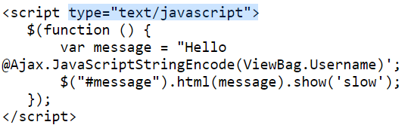
Who to write Views? RAZOR!
The engine that renders views for asp mvc
Allows injecting C# code into HTML code
Inline - @Variable.Property
Code blocks - @{ …. }
Can also be injected into javascript

Slide 14
Razor Layouts
To keep a consistent look and minimize the code in individual pages
Layouts structure the page, rely on Razor method calls to fill out content

Slide 15
Partial Views and ViewStart
Partial Views will not have an HTML or HEAD tag
Partial Views are meant to be used across multiple views
ViewStart is a file in your view folder that houses any code meant to run before the rest of the Views in its folder/subfolders

Slide 16


