Slide 1
WROX-Pro ASP.NET MVC 5 Chapter 4
Models

Slide 2
What is a Model
Final piece of the puzzle
What contains your underlying data
Often use scaffolding when you set up a model
Can be backed by anything
SQL
Text file
ORM (Entity Framework, Nhibernate,etc)

Slide 3
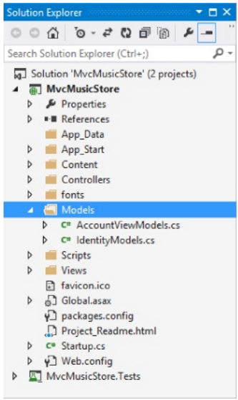
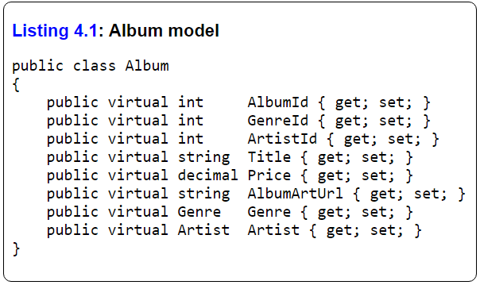
Model – continuing MusicStore

Slide 4
Model – MusicStore
Artist is a class and field under Album
Artist field is called ‘Navigational Property’
The database would save this as a foreign key id
Entity Framework (or other ORM/boilerplate sql access) would replace it with an instance of the class
The ArtistId is the ‘Foreign Key Property’
All of these are virtual . Why?

Slide 5
Model - Scaffolding
Quick way to set up CRUD operations on a pre-defined model
Create, Read, Update, Delete
Not the only way to access data
Repository and Unit of Work design patterns are often used
Can also choose different scaffolding generators from NuGet
Can access this in VisualStudio
MVC Empty
MVC w R/W access
Web API
MVC with EF

Slide 6
Model – Scaffolding - EntityFramework
Will use EntityFramework in class for homework and project
Two ways to get data into your code
Code First – write you models and EF figures out how to save it into SQL
Database First – write your tables and relations, EF will import and generate code
Virtual properties allow for EF to hook in
Track if changes occur to underlying data

Slide 7
Model – Scaffolding - EntityFramework
Still Convention VS Configuration
Class name = table name
Field name of ‘ID’ means primary key with Auto Increment
Field name of TableID + ‘ID’ means foreign key
Will default to a local database and schema and will create it if missing

Slide 8
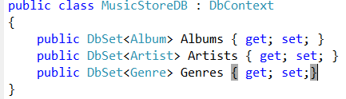
Model – EntityFramework - DbContext
DbContext is the way to access any data
Must have a class to inherit from this
Will contain all the classes/tables that represent your data
Will be of type DbSet<T>
DbSet is the base collection that all EF data will be stored
Tracks changes and allows for updates/inserts

Slide 9
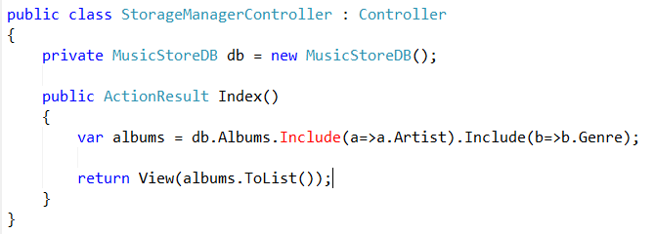
Model – EntityFramework - DbContext
DbContext allows access to any single collection of data
EX: Artist OR Genre OR Album
Will ‘Lazy Load’ data
Won’t call DB until needed
Won’t access related data unless specifically told
Use .Include(…) to force EF to get related data as well

Slide 10
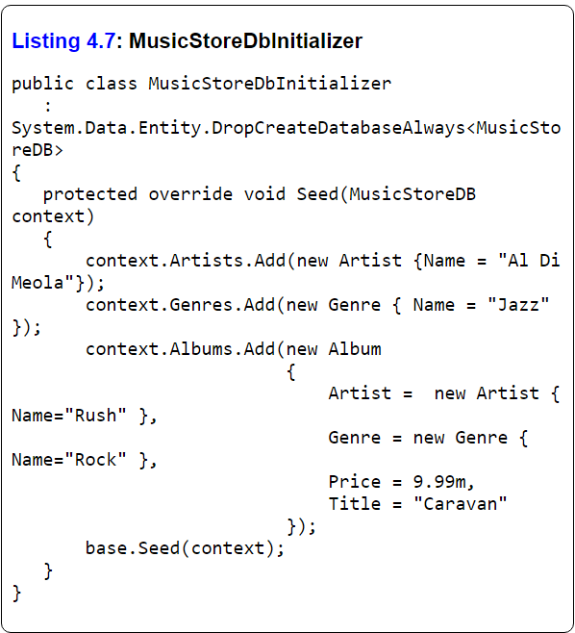
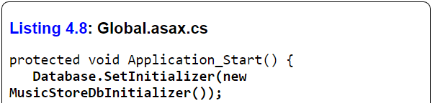
Model – EntityFramework – DB Init
Will often want to seed data to a new application
Database Initializer allows for this
Create and populate new instances of models and save them to the underlying database

Slide 11
Model – EntityFramework – ModelBinder
Have an issue of validating input from user or changes to underlying model
ModelBinder can help
Can determine what fields are being passed and map them into your class or value type
Can also explicitly update/bind through TryUpdateModel and UpdateModel

Slide 12


