Slide 1
Basics of UnitTesting

Slide 2
What are UnitTests?
How do you know code is right?
Run through scenarios and sample input
Can’t manually run through every scenario each time you make a code change
UnitTest frameworks exist so that you can code test scenarios
Ensures that every code change behaves correctly
Also makes it easy to code complex, hard to replicate states

Slide 3
Part of Test Driven Development (short version)
Test Drive Development
Frame the expectations of your overall piece of the application
Break it down into code-able steps
Each code-able step (function) has several means of being used
Write a unit test scenario to mock this situation
Now, write the function so that it satisfies this unit test
Repeat
CircularBuffer example
UnitTest - Has to have way to add objects to the collection
UnitTest – Add function has to know when to stop allowing additions to collection
UnitTest – Has to have a way to remove objects from the colletion
UnitTest – Has to know when to stop removing when collection is empty
UnitTest – Should allow adding a new item after removing an old one
UnitTest – Should allow for adding a new item, after collection hits its limit, and an item is removed
ETC

Slide 4
Part of Test Driven Development (short version)
You will have a lot of unit tests per function
UnitTests only apply to functions
Integration tests will include multiple steps of you code
CircularBuffer code doesn’t have anything that would qualify for integration testing
MVC Music Store website does
Integration test would be creating a new album, receiving an ID back, then querying to get the values pulled from the data store
Integration tests aren’t usually automated on build since they require actual implementations

Slide 5
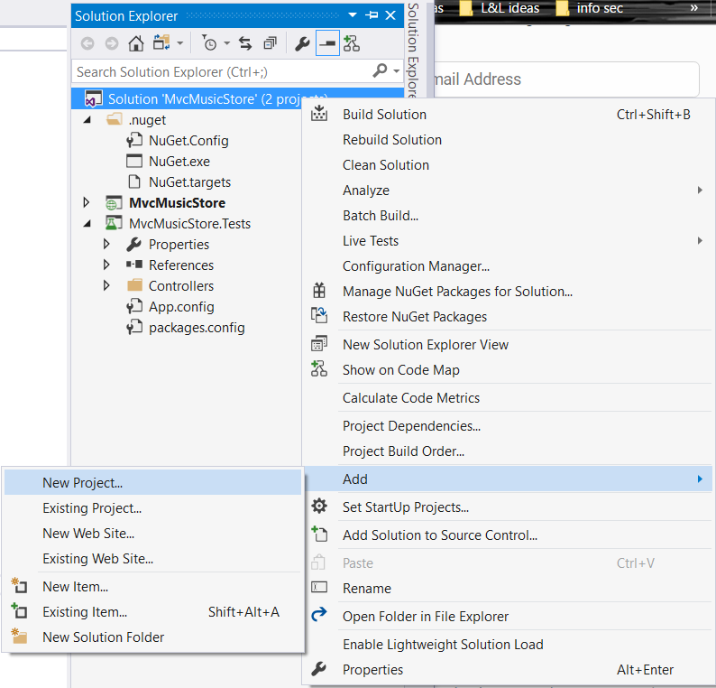
Unit Test and Visual Studio
Right click on solution
Go to Add
New Project

Slide 6
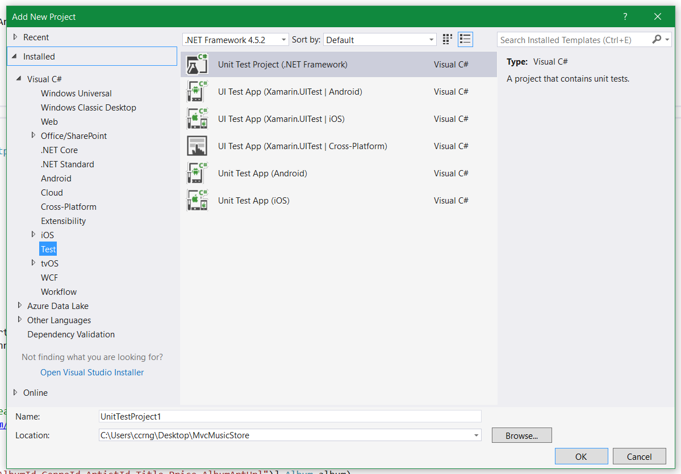
Unit Test and Visual Studio
Choose ‘Unit Test Project’
Want the (.NET Framework)
Other options are for different platforms
Give it a name

Slide 7
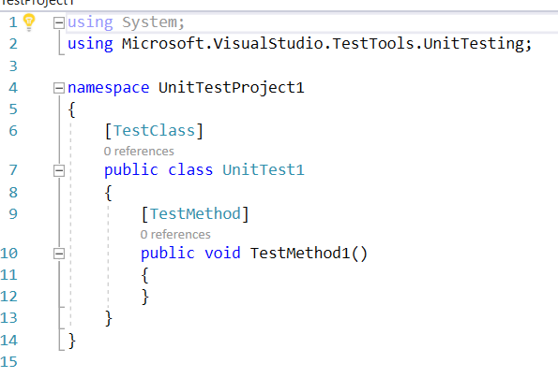
Unit Test and Visual Studio
Now you will be presented with this
[TestClass] – marks your class as testable
[TestMethod] – individual unit test
Can be run independently
Will pass/fail

Slide 8
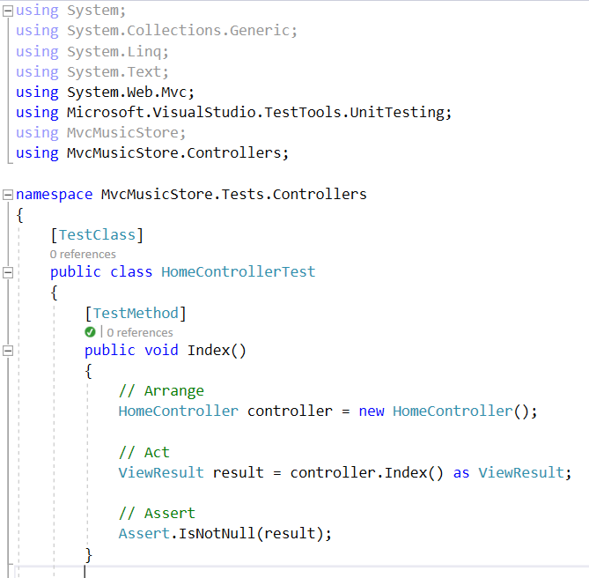
Unit Test and Visual Studio
Sample unit test from the music store web site
Assert is how you check the values you expect
If the assert condition does not match it will throw an exception and ‘Fail’

Slide 9
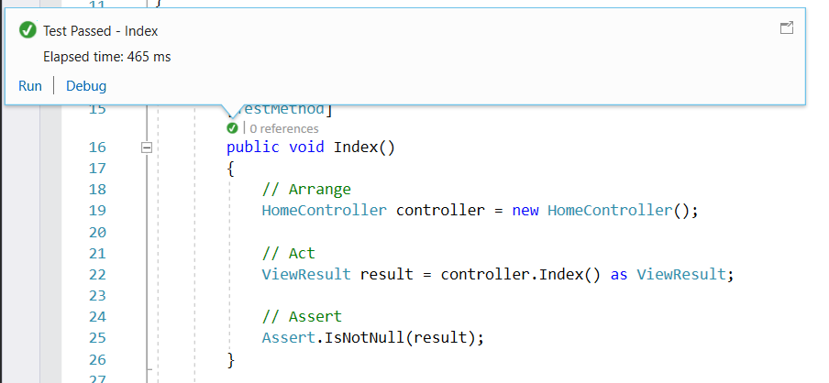
Unit Test and Visual Studio
Can run single test
Click the icon above the function name
Click Debug to step through Click Run to run as release

Slide 10
Title and Content Layout with Chart

Slide 11
Two Content Layout with Table
First bullet point here
Second bullet point here
Third bullet point here
Class | Group A | Group B
Class 1 | 82 | 95
Class 2 | 76 | 88
Class 3 | 84 | 90

Slide 12
Two Content Layout with SmartArt
Group A
Task 1
Task 2
Group B
Task 1
Task 2
Group C
Task 1
First bullet point here
Second bullet point here
Third bullet point here

Slide 13
Add a Slide Title - 1

Slide 14
Add a Slide Title - 2

Slide 15
Add a Slide Title - 3

Slide 17
Add a Slide Title - 4

Slide 18
Add a Slide Title - 5

