Slide 1
WROX-Pro ASP.NET MVC 5 Chapter 5
Forms and HTML Helpers

Slide 2
Why do we need HTML helpers?
Make sure to get URLs correct and make it easier to re-structure files
Elements have proper names/value binding
Display appropriate validation errors
Coordinate view and runtime components
Provide more intelisense and type checking

Slide 3
HTML Forms
Contain for input elements
Common controls
Button
Checkbox
Text input
Label
Radio button
Makes use of helpers to surface extra information, validations, strong typing

Slide 4

HTML Forms – Action and Method
Action
Attribute tells where to send information in Form
Is relative to some server/web directory
Can be absolute for external resources
Method
Attribute tells how to send information
GET or POST
Default is GET

Slide 5
HTML forms – Method – GET vs POST
GET
POST
Will pass parameters in the URL
Allows for bookmarking of a specific page with specific parameters
Should not be expected to change server state (can re-run the same request and the same result returns)
For READ operations
Hides parameters in HTTP request
Should be assumed it will alter server state (re-run the same request and it be different – may re-submit online order, may not work)
For WRITE operations

Slide 6
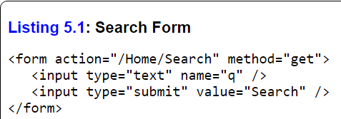
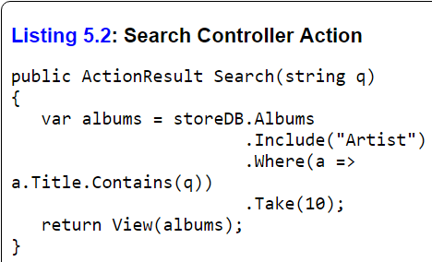

HTML forms – Method – GET example
GET URL has ?q=work
Search function accepts parameter ‘q’ which is a string
MVC maps the passed parameters to a function that can handle it

Slide 7
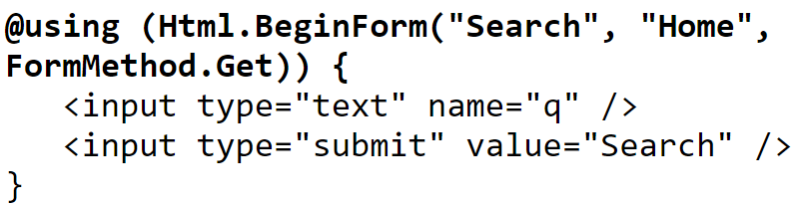
HTML forms – Method – GET example
Alternate way of writing the view
HTML.BeginForm will determine where the Seach page is on its own
If page is moved, MVC will fix it

Slide 8
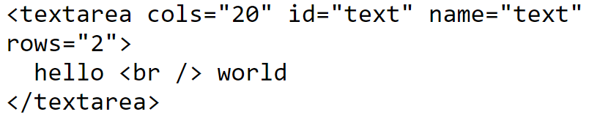
HTML helpers
These also automatically encoding your text
If you allow content to go from your GET parameters into your content, there exists the possibility of cross site scripting.
We could inject a malicious address, javascript, or anything we want
MVC encodes the text in such a way we don’t have to worry about it

Slide 9
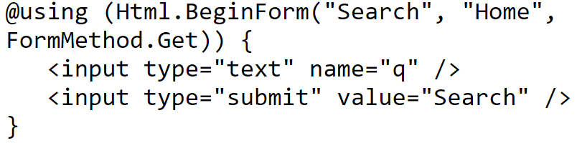
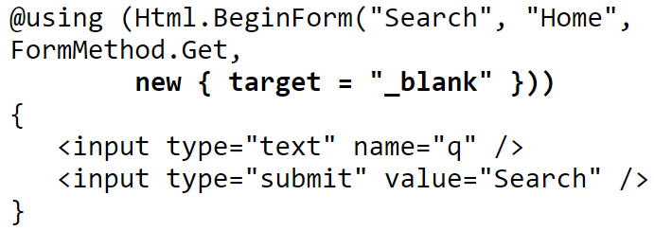

HTML helpers – Overloads
Can make additional key-value entries
These will be treated as attributes and values
Some oddities
Can’t use reserved keywords (ie class – can use @class instead)
Can’t use ‘-’ (dash) (ie data-validation – can use data_validation instead)
MVC will remove @ and replace ‘_’ for ‘-’

Slide 10
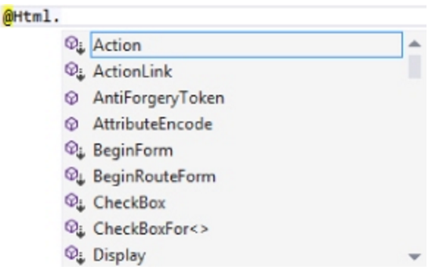
HTML helpers – deeper look
Every Razor view inherits an ‘HTML’ property from base
Most of the things available are extension methods

Slide 11
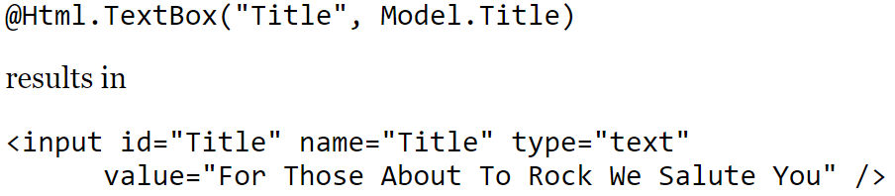
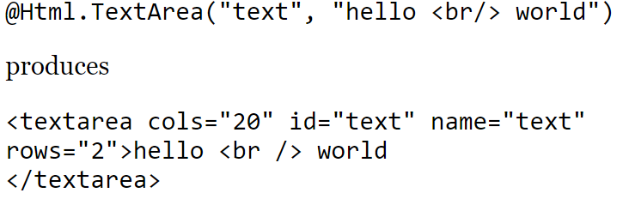
HTML helpers – example controls
TextBox
Normal way to accept user input, free form text
TextArea
Larger free form text box

Slide 12
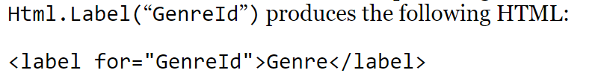
HTML helpers – example controls
Label
Provides information for associated element
‘for’ attribute points to backing element

Slide 13
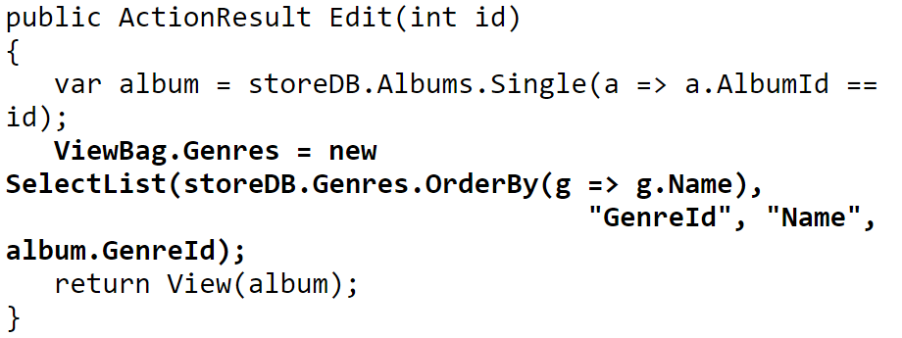
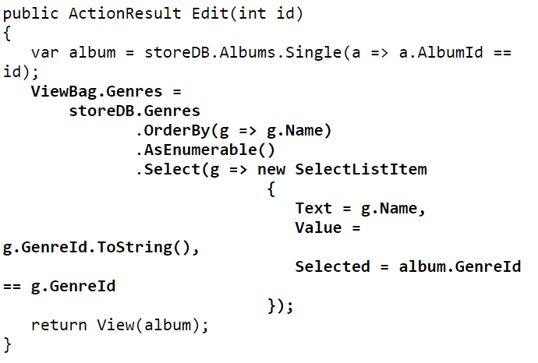
HTML helpers – example controls
Dropdown List
Provides a list of choices for user
Can only choose 1 item
Require SelectListItem
ListBox
Another option for displaying a list for users
Can choose multiple items
Must use ‘multiple’ attribute
Also require SelectListItem

Slide 14
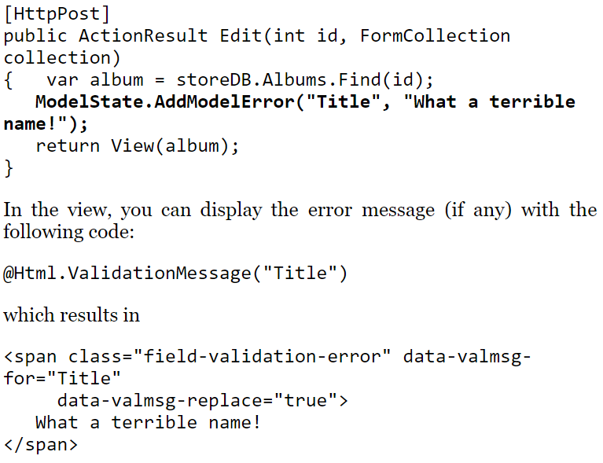
HTML helpers – example controls
ValidationMessage
Allows for displaying errors in validation
Can be Model level or Property level

Slide 15
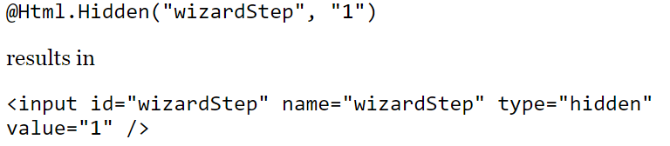
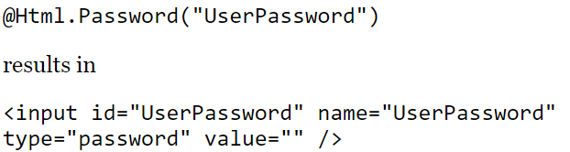
HTML helpers – example controls
Hidden
A field that contains some data that is not visible to the user
Password
Special field that masks user password

Slide 16
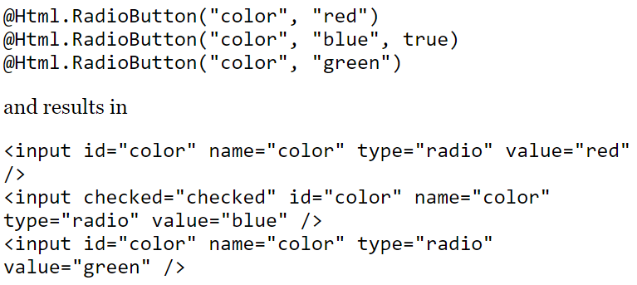
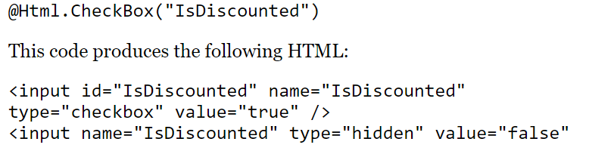
HTML helpers – example controls
RadioButton
Requires grouping, usually only 1 checked per group
CheckBox
Adds hidden input control to return a value showing both true/false
Spec requires only to return if true

Slide 17
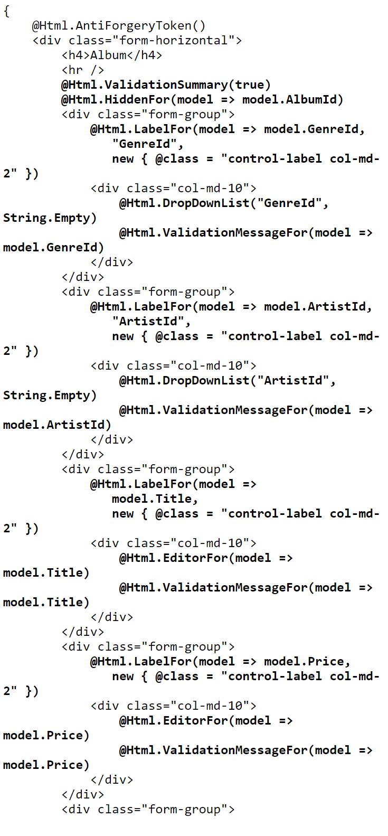
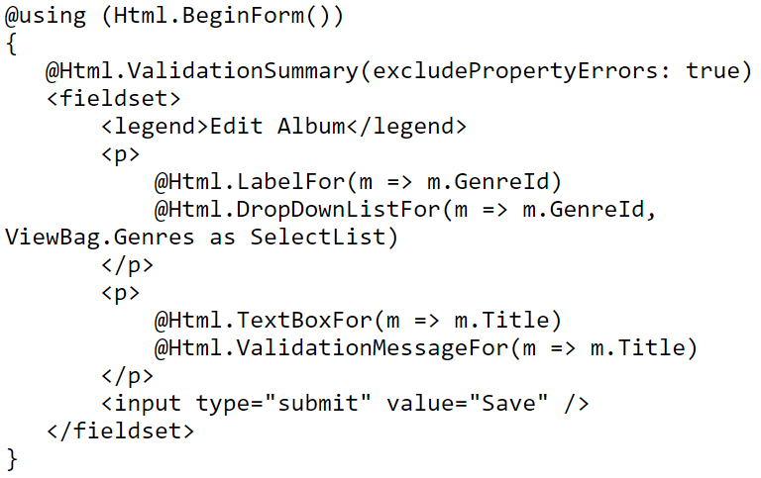
HTML helpers – strongly typed
Can use strongly typed variables
Removes need to have strings that don’t user intelisense

Slide 18
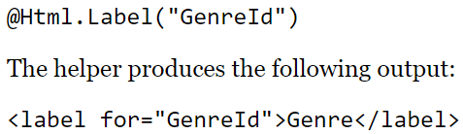

HTML helpers – model metadata
HTML helpers have built in ability to pull metadata included in model
Things like ‘Label’ relies on this metadata for screen readers and to move focus to the correct control

Slide 19
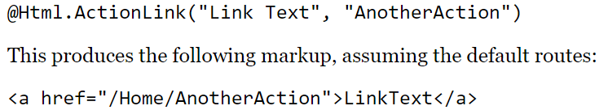


Rendering Helpers
ActionLink
Create links to controller and actions
Allow passing query parameters
RouteLink
Same as Action but does not include link to a controller

Slide 20
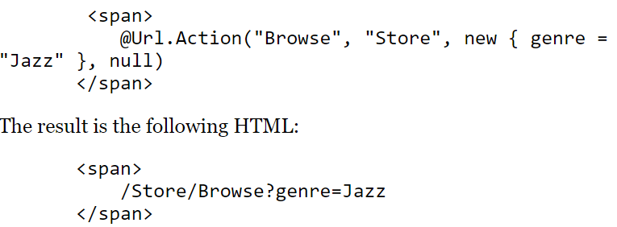


URL Helpers
Unlike most Actions and Helpers
returns a URL, not HTML
Action
Takes controller and action
Content
Takes resource files and returns absolute location
Route
Same RouteLink – will take action but no controller

Slide 21
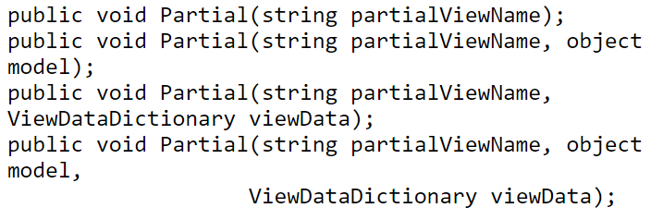

HTML Partial and RenderPartial
Views can be made partial
Do not include HTML/HEAD attributes
Allows for re-usable UI elements
This helper also does not return HTML
Writes directly to output stream

Slide 22
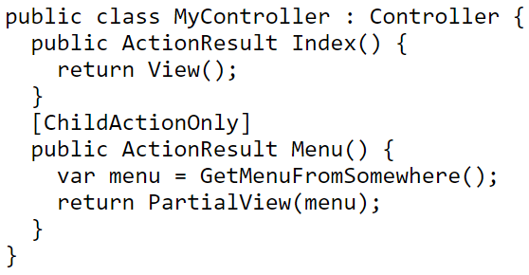
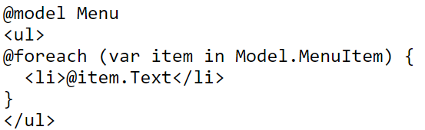
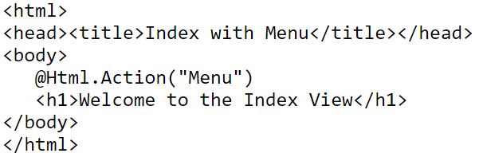
HTML Action and RenderAction
Similar to Partial and RenderPartial
Except the controller side
Offers a ChildActionOnlyAttribute
Ensures controller can’t be directly called via URL

Slide 23
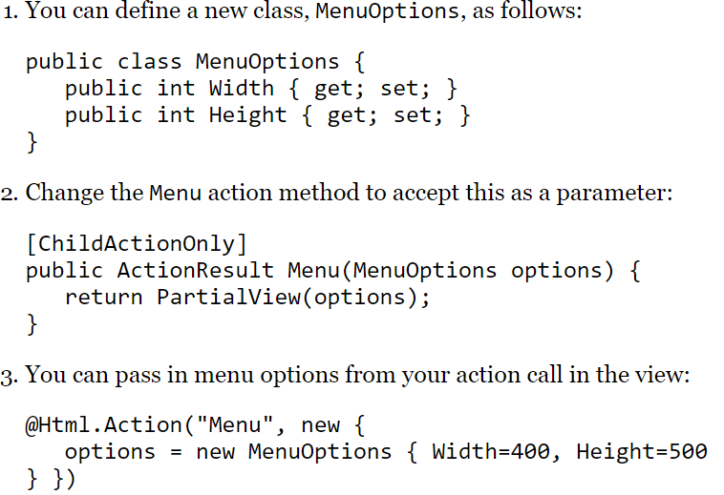
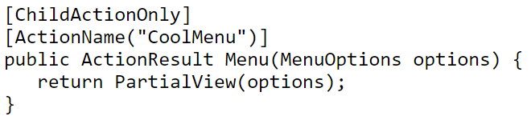
HTML Action and RenderAction
Can still pass values like a normal controller

Slide 24
Title and Content Layout with Chart

Slide 25
Two Content Layout with Table
First bullet point here
Second bullet point here
Third bullet point here
Class | Group A | Group B
Class 1 | 82 | 95
Class 2 | 76 | 88
Class 3 | 84 | 90

Slide 26
Two Content Layout with SmartArt
Group A
Task 1
Task 2
Group B
Task 1
Task 2
Group C
Task 1
First bullet point here
Second bullet point here
Third bullet point here

Slide 27
Add a Slide Title - 1

Slide 28
Add a Slide Title - 2

Slide 29
Add a Slide Title - 3

Slide 31
Add a Slide Title - 4

Slide 32
Add a Slide Title - 5

