Slide 1
WROX-Pro ASP.NET MVC 5 Chapter 9
Routing

Slide 2
Routing and usability
Want high quality URLs
Short
Easy to type
Reflective of the site structure
“Backable” – users can move higher in site structure by removing ending of URL
Persistent – URL won’t change over time
Why?
How does routing play in to this?

Slide 3
URLs, URIs, MVC
Most URLs represent the physical location of a resource on disk
Example.com/Albums/list.aspx actually means
//…webroot…/albums/list.aspx file on your host machine
MVC technically uses URI instead of URL
Universal Resource Indicator
All URLs are URIs but a URI is not necessarily a URL
Does not tell you where in a system a file is physically stored like URL may

Slide 4
Routing
2 main purposes
Match incoming requests that don’t match a file on disk
Instead point to something that can handle the request (controller and action)
Constructs outgoing URLs (URIs) that correspond to controller/action
Is not URL rewriting
Both can be used to make pretty URLs
Both separate incoming URL and what it actually points to/does
Rewriting is essentially mapping one URL to another, not treating a URI as a pointer to a work handler

Slide 5
Routing
2 Types of routing in MVC
Traditional – config setting and framework does the mapping
Attribute – config setting and developer decorates classes/methods for mapping
Both require some input from the dev
Both allow for massive alteration/override/configuration
Can be used together

Slide 6

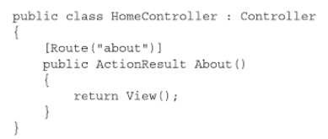
Attribute Routing
First step:
Alter Routeonfig.cs
Can now use attribute routing on controllers

Slide 7
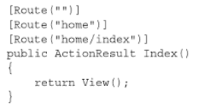
More Routing
You can declare multiple routes for a given action or controller
This is routing for your main landing page
Example.com
Example.com/home
Example.com/home/index

Slide 8
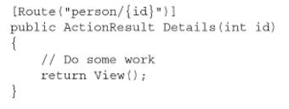
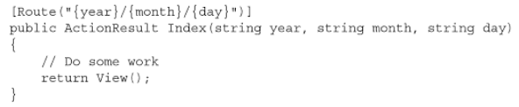
More Routing
You can parameterize your routes
Example.com/person/5
Exampel.com/2015/12/30

Slide 9
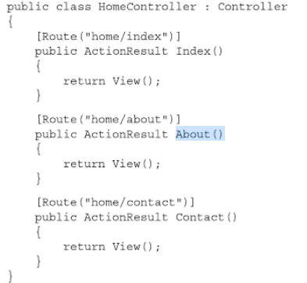
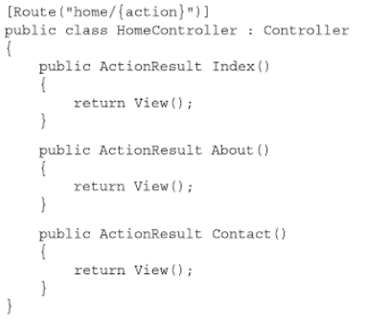
More Routing - Controllers
Put routing on your controller to set a common route for all your actions
Note {Action} is declared as a parameter
Can still override or extend with action attributes

Slide 10
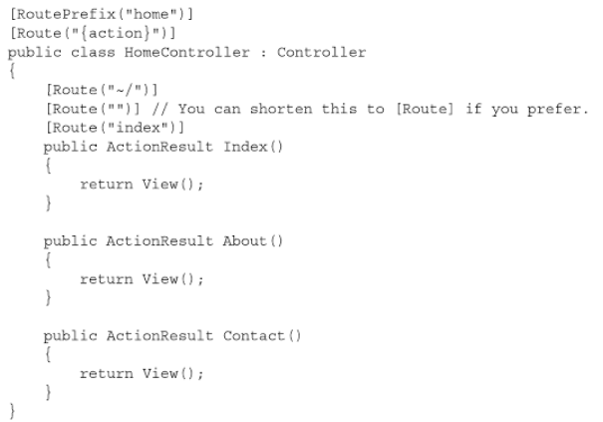
More Routing
RoutePrefix allows for adding just the prefix of route
Can still get to root route using ‘~/’

Slide 11
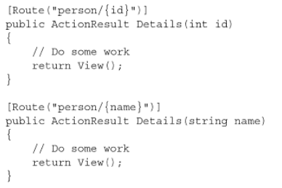
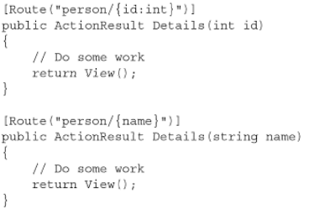
Route constraints
Can have constraints on your parameters
How could you determine this route
Example.com/person/5

Slide 12
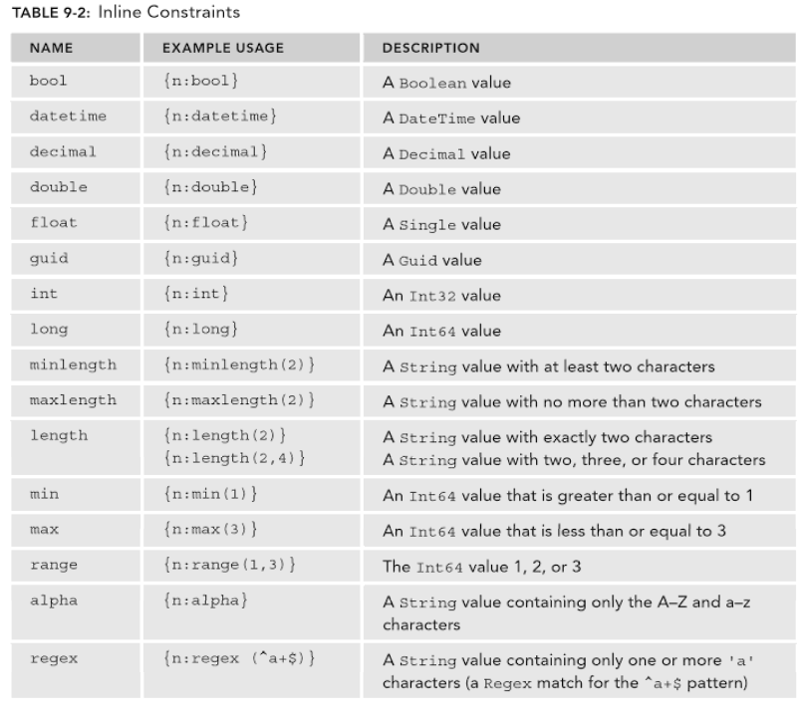
Routing Constraints – reference

Slide 13
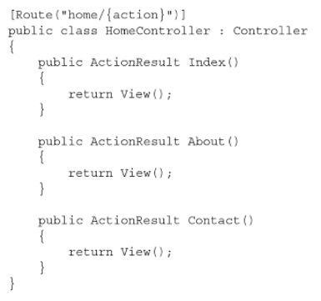
Route defaults
When you specify a route, URLs are matched via pattern
This can be a problem
Example.com/home – does this work?

Slide 14
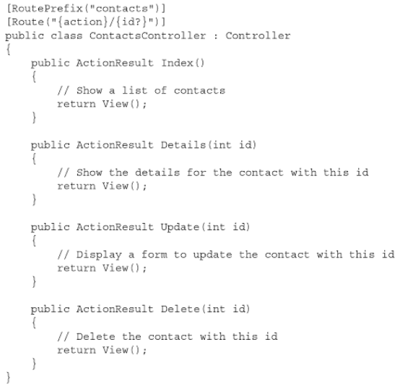
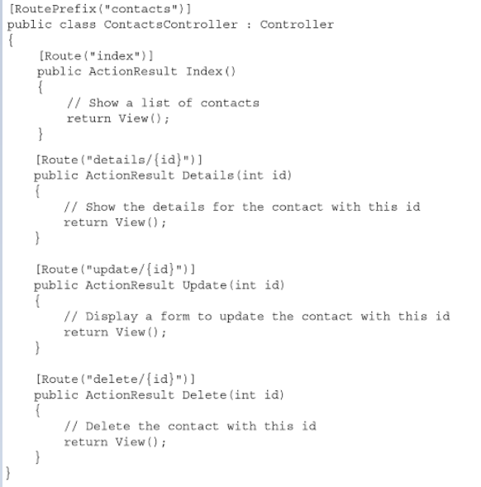
Route optional parameters
Optional allows you to drop off parameters if you don’t always need them instead of creating new functions
This example allows index to not take id, might show all contacts listed

Slide 15

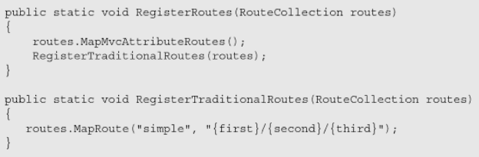
Traditional Routes
To get started
Alter RouteConfig.cs
This way allows for unit testing by registering different routes
If both attribute and traditional are wanted, list attribute first

Slide 16

Routes
Can still have optional parameters
And default parameters

Slide 17
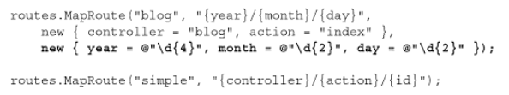
Route - Constraints
Can still introduce constraints to your Routes
These will be new routes you configure

Slide 18
Routes – Traditional and Attribute
Define Attribute first
When framework searches, first pattern match wins
Attribute tends to be more specific, that is why you want it first
Traditional tends to be very widely defined
Why Traditional
Want centralized config
Can use custom constraint objects
Working in a legacy app
Why Attribute
Keep routes with your action code
Working on a new app or drastically changing legacy

Slide 19

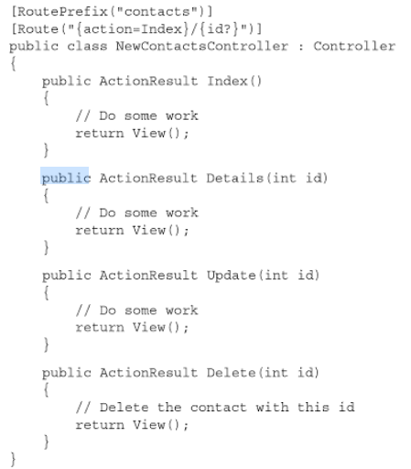
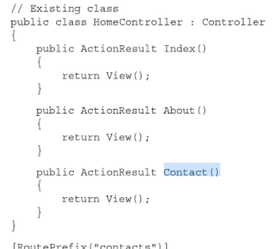
Route – Traditional and Attribute

Slide 20

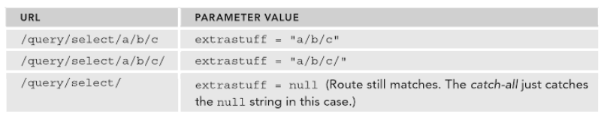
Routes – catch all
Catch all routes ensure your urls go somewhere or map to something
Defined as attribute or traditional

