Slide 1
WROX-Pro ASP.NET MVC 5 Chapter 11
Web API

Slide 2
Web API
Programmatic way to call code over the web
Very similar to MVC controllers and structure
Several design methodologies to follow (IE RESTful, Statetful)
Term ‘Web API’ tends to be used in MVC/ASP only
Comes in 3 flavors
ASP.NET
WCF self hosted
OWIN self hosted

Slide 3
Web API vs MVC Controllers
Do not return HTML code
Return strings or generic objects that represent your output
Inherit from ‘ApiController’ base class
Conventions is to tie controller to HTTP verbs
GET, PUT, POST, DELETE
In System.Web.Http instead of System.Web.MVC
Share some terms/classes such as Controller context, ModelState, RouteDate, Url helper, User
Request is HttpRequestMessage instead of HttpRequestBase
Missing some classes – like Response
Is Asynchronous by default

Slide 4
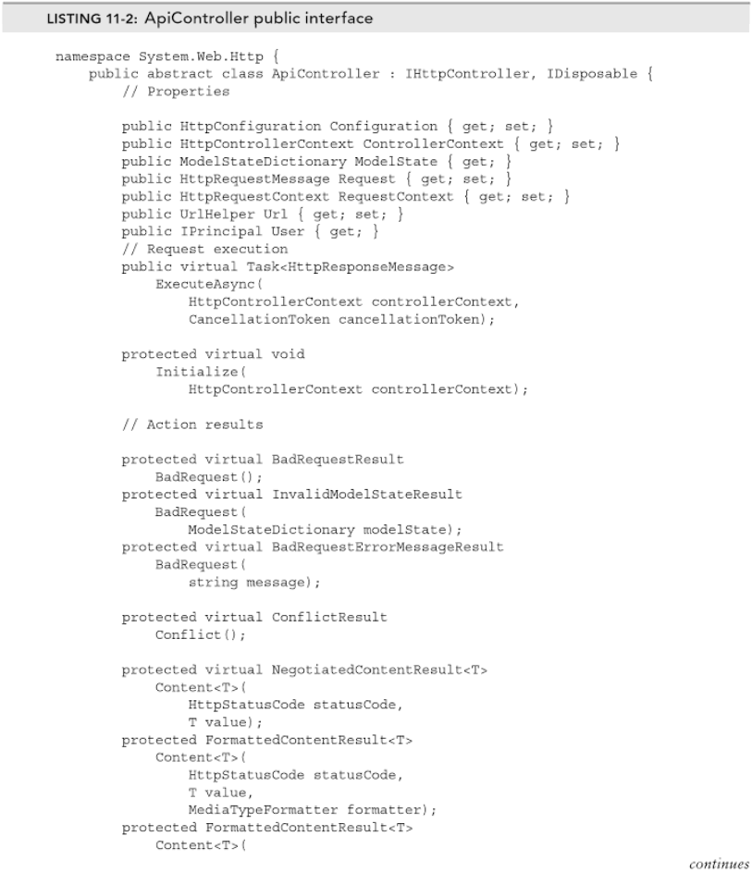
ApiController

Slide 5
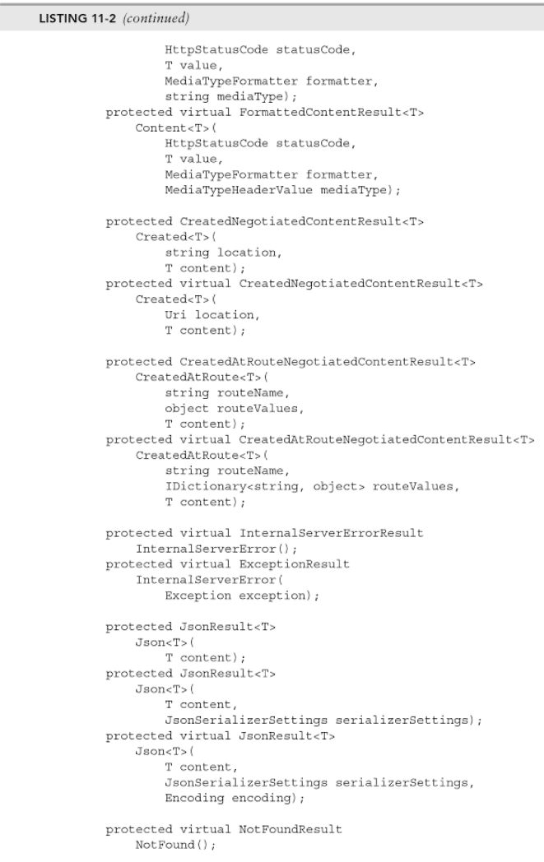
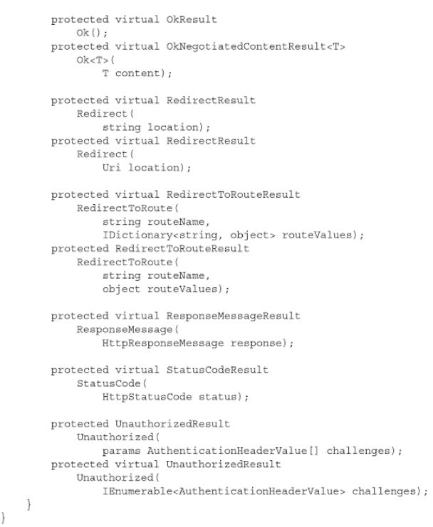

Slide 6
Inputs and Outputs
Can add parameters to actions/methods – same as MVC controllers
Base types are mapped directly – similar system as MVC
Custom types are passed through the body element of the http request
Handled by new formatter system
Returns Version 1
Basic object types
Can also be strings that would house your serialized data
This didn’t allow for errors but can throw HttpResponseException
Returns Version 2
Now returns an IHttpActionResult
Are asynchronous

Slide 7
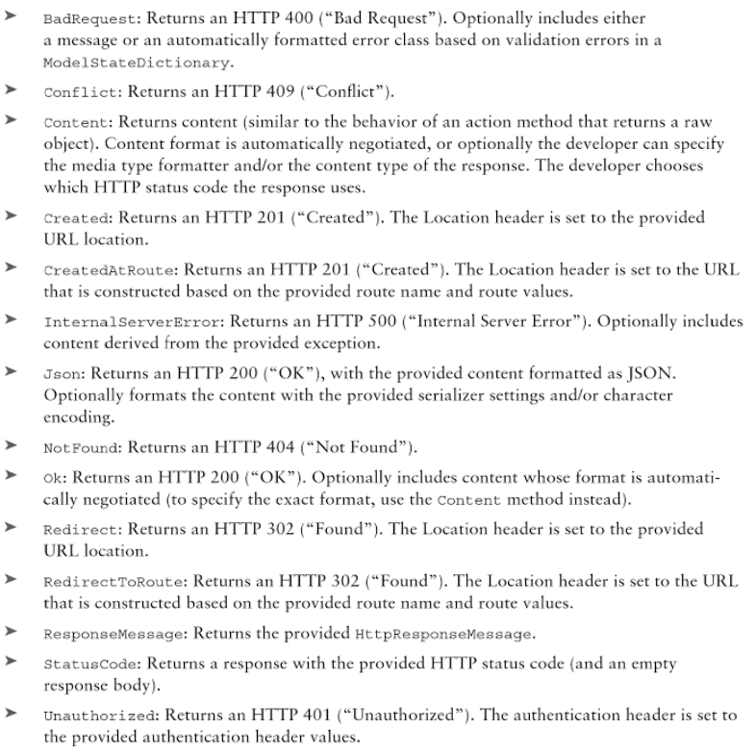
IHttpActionResult
Action Results and associated behaviors

Slide 8
Async, await, threading…
New version of the Web API is built to accommodate async/await keywords
Async means a task will be offloaded and run at a slightly later time
Await means the caller knows it is waiting for a specific function
Framework can sometimes finish other code after ‘AWAIT’ if nothing depends on it

Slide 9
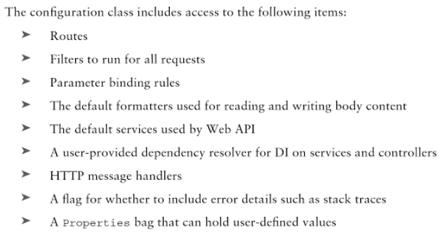
Configuration
No entries in Global.asax
Set everything in the HttpConfiguration class
Allows for running multiple web api servers in some application
Run unit tests and end-to-end tests more easily

Slide 10
Configuration
No entries in Global.asax
Set everything in the HttpConfiguration class
Allows for running multiple web api servers in some application
Run unit tests and end-to-end tests more easily
Comes in 3 versions
ASP.NET
WCF self hosted
OWIN self hosted

Slide 11
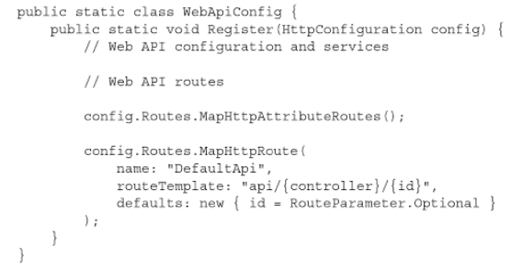
Configuration – ASP.NET (Default)
WebApiConfig.cs file

Slide 12
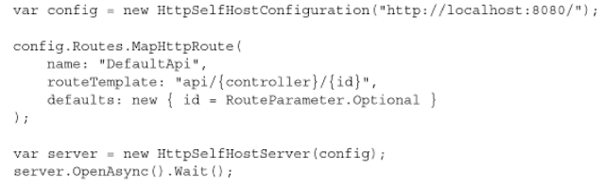
Configuration – WCF self hosted
Create an instance of HttpSelfHostFromService
Pass in configuration

Slide 13
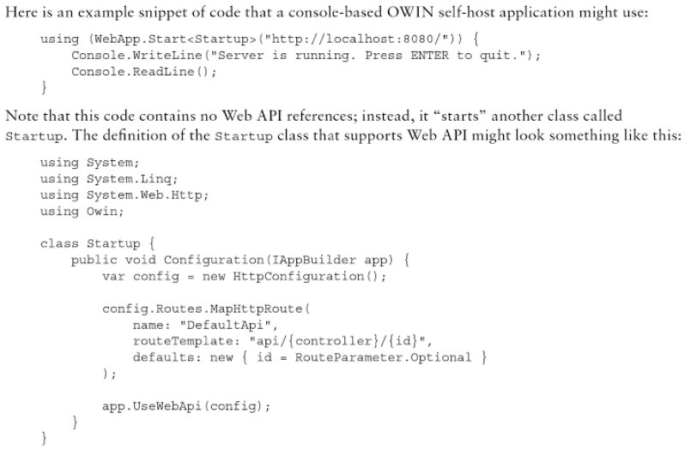
Configuration – OWIN self hosted
Requires nuget Microsoft.AspNet. WebApi. OwinSelfHost
Must start your own server
Must define a processing class that will do your work

