Slide 1
C#/.NET Refresher

Slide 2
What is .NET
An application development framework from Microsoft
Runs inside a virtual machine (making it architecture independent)
Includes extensive tooling
Supports several languages
Microsoft also created an IDE specifically for these languages
Mono project and open source clr tools allow for more ways to write and compile code
Full support for OOP and Functional
Supports multiple levels of the dev stack
Desktop
Web pages
Restful API
Windows Services
Self hosted web resources

Slide 3
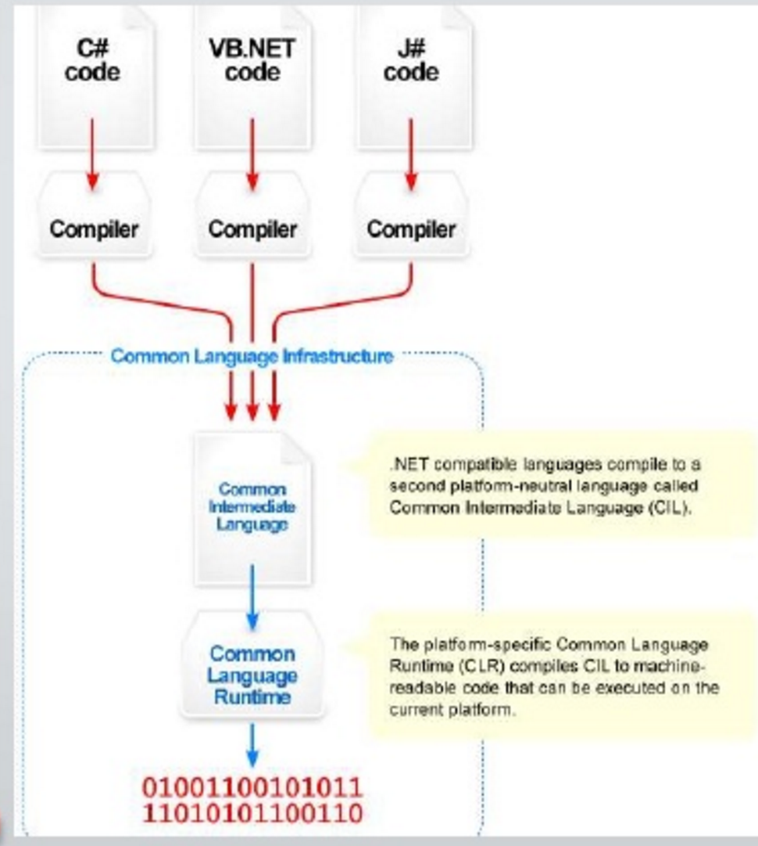
What is .NET
Language independent
All languages translate to CLR
Common Language Runtime
This translated code is called MSIL
MS Intermediate Language

Slide 4
Introducing C#
C# is very similar to languages you have used so far
Java
C++
Nearly identical
Declarations (‘bool isTrue;’)
Expressions (‘isTrue == false’)
Assignment (‘isTrue = false;’)
Control (if..else, for, while)
Similar
Class
Functions
Polymorphism/Inheritance/Encapsulation/Abstraction

Slide 5
Representing data
Class
Object
Defines abstract characteristics of a thing
Customer
Employee
Car
Think of it as a template or blueprint
Is the most generic form to enable re-use
Can utilize/build on top of other classes
This description also includes struct
Covered later
Instance of a class
“Car” class has an instance to represent all cars in your application

Slide 6
A few terms to help us talk about C#
Properties
Changeable features of a specific object
Class ‘Car’ has a ‘Color’ that will be different between each instance
Methods/Functions
Actions on an a specific object
Class ‘Car’ has can ‘Accelerate’
Can also be independent of a specific instance of a class
These are defined as ‘Static’
Events
Let other objects know about an action
Class ‘Car’ can have a ‘DoorOpened’ that other classes/objects may need to know about when they occur

Slide 7
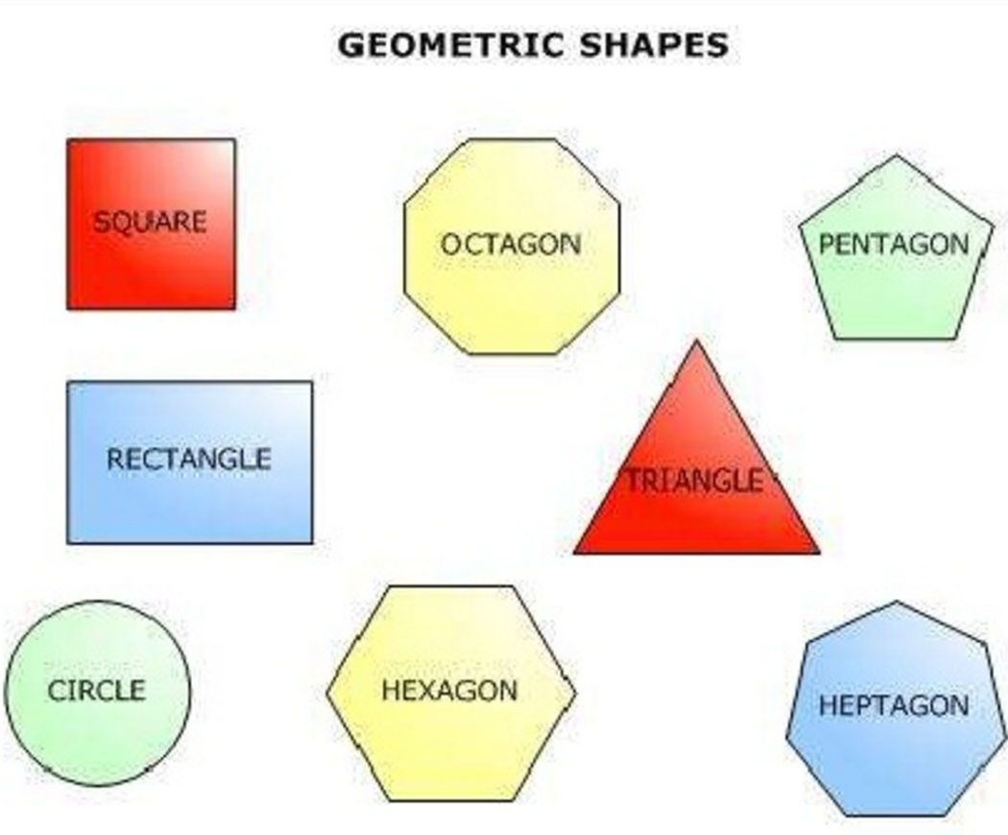
Object Oriented Refresh
Inheritance
Each of these objects are shapes
All of these specific shapes share qualities just because they are shapes

Slide 8
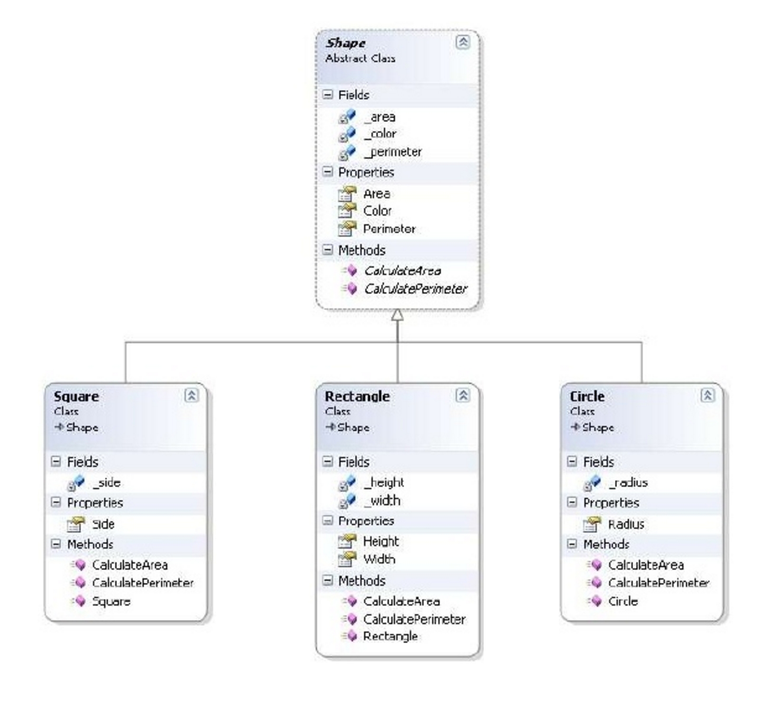
Object Oriented Refresh
Every shape has an Area, Color, and Perimeter
These are in the shape class
Square has extra properties and methods that aren’t the same as a general shape
CalculateArea – area calc is different for the different type of shape
Same for rectangle and circle
Circle has a radius
Rectangle would have height and width

Slide 9


Object Oriented Refresh
Inheritance (more)
Can also inherit from ‘Interface’
Interfaces can contain no code inside methods
Abstract classes can house some code that will run as default if it is not overridden
Can inherit multiple interfaces
Can only inherit 1 class

Slide 10
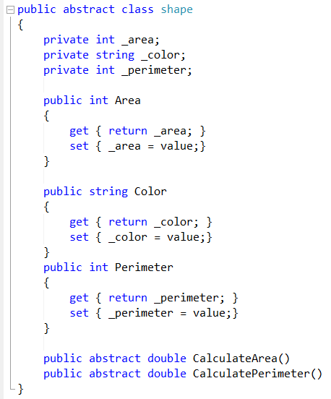
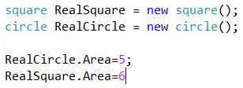
Object Oriented Refresh

Slide 11
Object Oriented Refresh
Encapsulation
Information hiding
Each shape have fields that are private and can only be accessed through methods/properties

Slide 12
Object Oriented Refresh
Shape has ‘_area’, ‘_color’, ‘_perimeter’ and these are all private.
Also has accessor properties ‘Area’, ‘Color’, and ‘Perimeter’
Square has ‘_size’
Can not access ‘_area’ even thought they it inherits shape because it is private
Can access ‘Area’

Slide 13
Object Oriented Refresh
Polymorphism
An object that looks/acts like a different object
Classes that inherit from a base can still be treated like that base class

Slide 14
Object Oriented Refresh
Shape has ‘_area’, ‘_color’, ‘_perimeter’ and these are all private.
Also has accessor properties ‘Area’, ‘Color’, and ‘Perimeter’
Square has ‘_size’
Can not access ‘_area’ even thought they it inherits shape because it is private
Can access ‘Area’

Slide 15
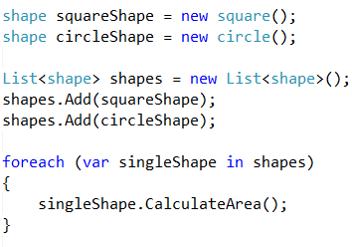
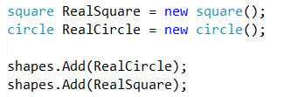
Object Oriented Refresh

Slide 16
Object Oriented Refresh
Abstraction
Hide details of an implementation while exposing how the generic object should behave
We know shapes have Areas and perimeters but how to find that depends on the specific shape

Slide 17
Object Oriented Refresh
Shape is marked ‘abstract’
CAN NOT do ‘new Shape()’
It has 2 methods but those methods won’t have any code in them
Each specific class has to define how to do these actions

Slide 18
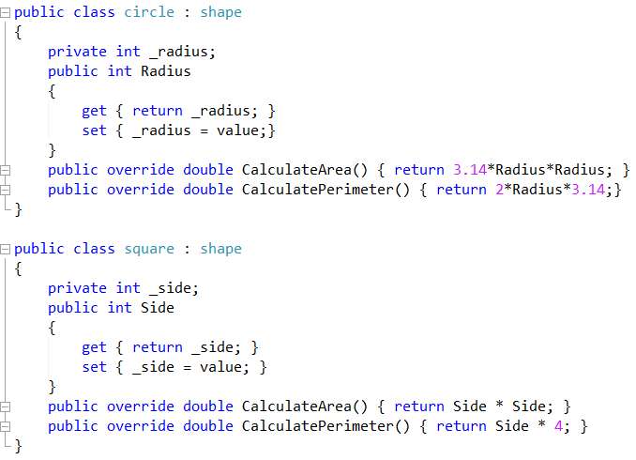


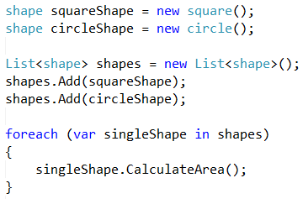
Object Oriented Refresh

Slide 19
More topics…
Namespaces
Type system
Enums
Exceptions
Generics
Collections

Slide 20
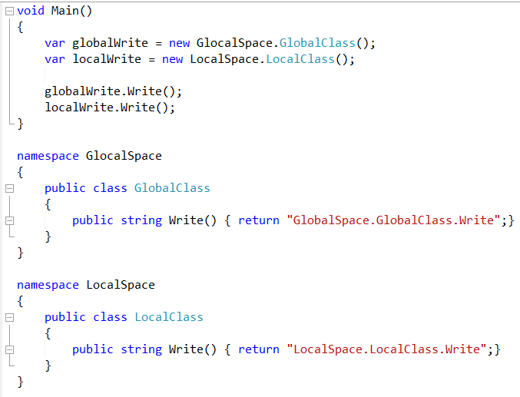
Namespaces
Namespaces allow for splitting code up into logical groups
Namespaces can exist in multiple files and house multiple classes
Different namespaces allow for the same names of classes/functions
Should be fully qualified
Full namespace + class name

Slide 21
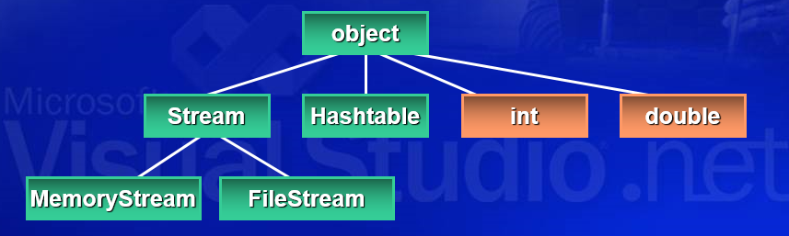
Type System
All types derive from System.Object
System.Object provides 4 methods
Bool Equals
Int GetHashCode
Type GetType
String ToString
These can be overridden or a default version will run

Slide 22
Type System
What was this about ‘structs’
A type can be either ‘class’ or ‘struct’
It is because there are ‘reference’ types and ‘value’ types
Reference type
Variable is a reference to a memory address
Reference is stored on stack
Value is stored on heap
Heat type
Variable is the actual value
Value is stored on stack

Slide 23
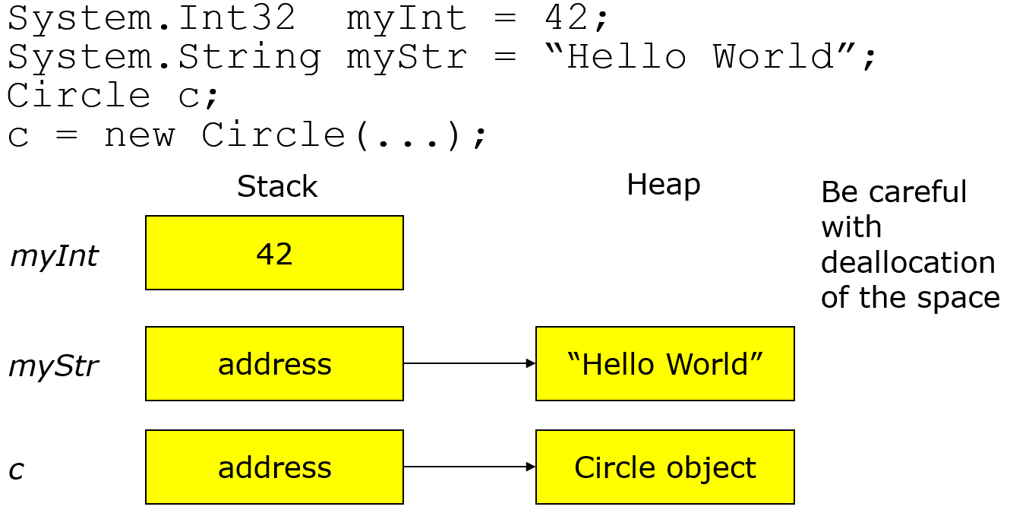
Type System

Slide 24
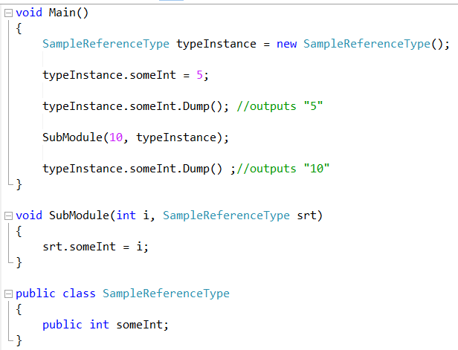
Type System
WARNING!
Reference types can be tricky
Only have a memory address
Changes affect what ever is located at your memory address
Passing a reference type around as parameter means anything can change that instance

Slide 25
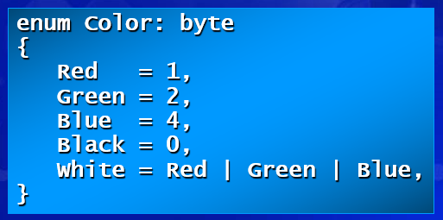
Enums
Strongly typed
Limited selection that is enforced
Can specific underlying type
Byte
Short
Long
Int (default)
Always want to give a starting value
Normally want to list in order

Slide 26
Exceptions
Exceptions are everywhere
They exist as a means to handle errors in code
Else the program would just stop
Handled via Try/Catch/Finally
Catch is able to catch specific exceptions (NullReferenceException, FileException, etc)
Can also catch Exception (the base that all other exceptions inherit from)
Code should always have exception handling code
If not, program ends with no information as to why

Slide 27
Generics
With OOP and Inheritance comes the idea of ‘Generics’
When you write code, you may want it to work with any class or a certain set of classes
Or use ‘generic’ classes
The most common need for these are collections of a specific object

Slide 28
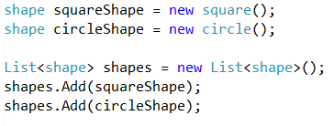


Collections
In the old days there were arrays….
Int[] someInt = {0,1,2,3};
How do I add to this?
It’s not fun
Then there were collections
Are generic
Are essentially very fancy arrays
Can apply to only specific classes

Slide 29
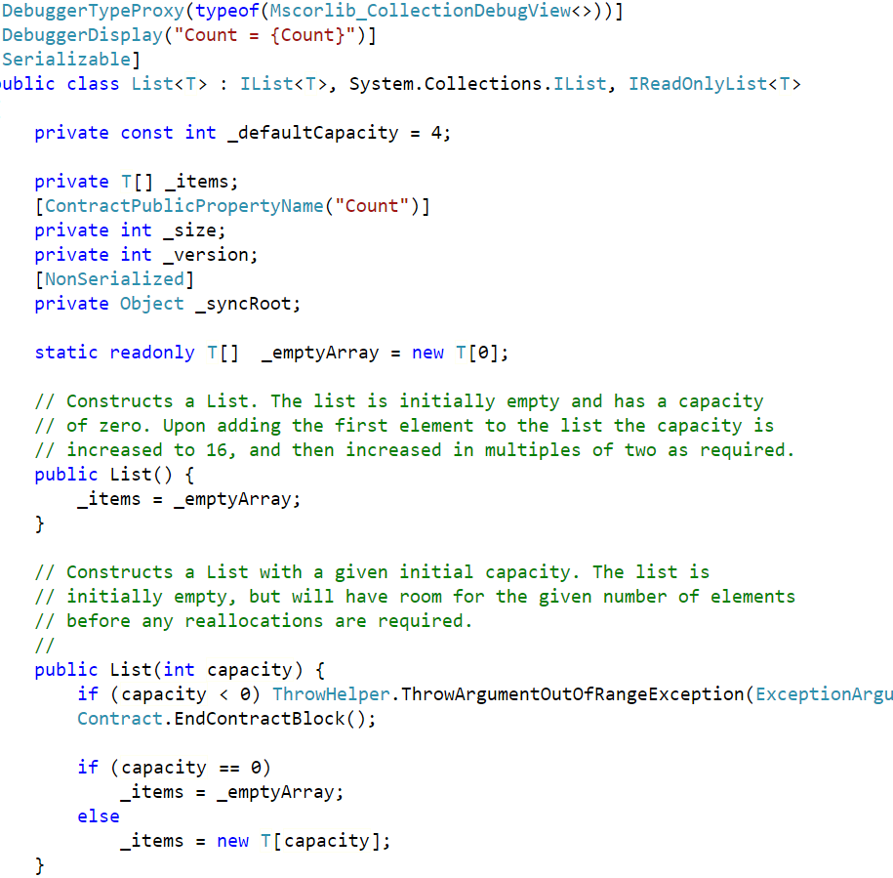
Collections
Lets look at the actual List class in C#
https://referencesource.microsoft.com/#mscorlib/system/collections/generic/list.cs,cf7f4095e4de7646

Slide 30
Additional Resources
The C# tutorial http://www.csharp-station.com/Tutorial.aspx
Online videos and training http://channel9.msdn.com/learn/courses/VS2010/
Nice video to OOP http://msdn.microsoft.com/en-us/beginner/cc963989.aspx
More on OOP http://en.wikipedia.org/wiki/Object-oriented_programming
Design patterns in C# http://www.dofactory.com/Patterns/Patterns.aspx
Beginner Developer Learning Center http://msdn.microsoft.com/en-us/beginner/default.aspx
http://www.learncs.org/
https://mva.microsoft.com/en-us/training-courses/c-fundamentals-for-absolute-beginners-16169?l=Lvld4EQIC_2706218949
http://csharp.net-tutorials.com/
https://referencesource.microsoft.com/
CodeProject for C# https://www.codeproject.com/?cat=3
CodeProject for WEB https://www.codeproject.com/?cat=23
StackOverflow http://stackoverflow.com/tags (click on which tag you want, C#, ASP, javascript, etc)

Slide 31


