Slide 1
WROX-Pro ASP.NET MVC 5 Chapter 6
Data Annotations and Validation

Slide 2

Validation Logic
Constant and difficult battle to validate everything into your application
Front End needs it for quickly informing users
Back End needs it to keep your code and data safe from attack or corruption
Never trust data from any source, even if it you assume it comes from another piece of your own code

Slide 3
In MVC
Validation occurs against the Model
Default way to do this is ‘Data Annotations’
Validation is extensible
Can create validation at most points
Can create new data annotations
We will focus on 2 ways
Data Annotations
Self-validating model

Slide 4
Data Annotations
These are attributes placed on the Model and its fields
These provide server side validations by default
Can be used on client-side or client-side with server callback
Uses JavaScript mainly, which can be bypassed by user settings
Several annotations provided by default

Slide 5
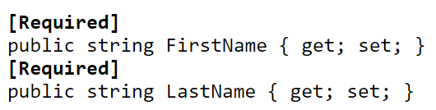
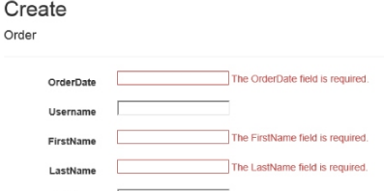
Data Annotations - REQUIRED
Raises validation if value is ‘NULL’ or empty (‘’, “”)

Slide 6
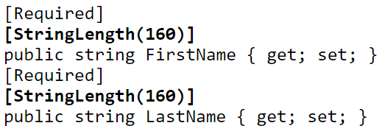

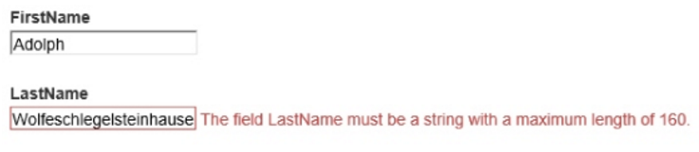
Data Annotations – STRING LENGTH
Upper limit of string length
Allows for override of MinimumLength

Slide 7
Data Annotations – REGULAR EXPRESSION
Run against a regular expression (reg ex) to check overall format of data
Regular expression are hard, they are messy, they are powerful
Expression below is a generic check for an email address

Slide 8


Data Annotations – RANGE
Specify minimum and maximum for a numeric value

Slide 9
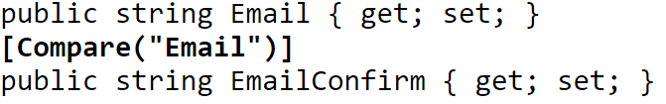
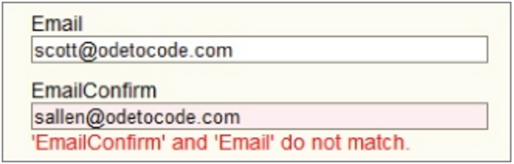
Data Annotations – COMPARE
Allows for comparing against another field value

Slide 10

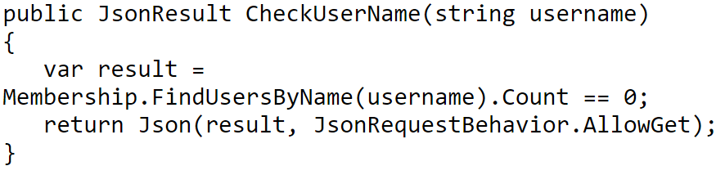
Data Annotations – REMOTE
Allows for client side checking via server callback
Sometimes need to validate data against a database or other external resource
Can’t do this from the client side, have to request a resource to do it for you

Slide 11
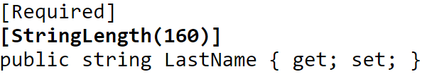
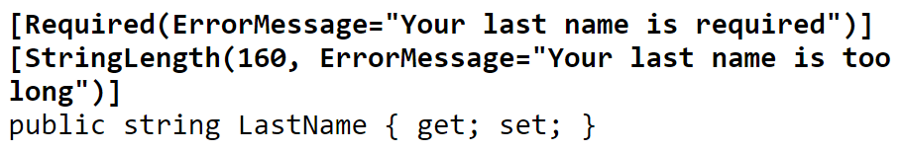
Data Annotations – Custom Error Messages
Every validation attribute allow for option custom error messages

Slide 12

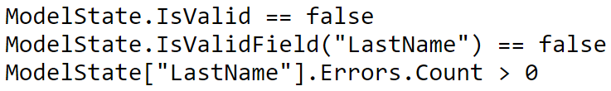
Data Annotations – Behind the Curtain
Validation and Model binding
Validation occurs on the model at binding
Implicitly on ActionResult Func that accepts a specific type
Explicitly by calling TryUpdateModle()
Uses MetaData and ModelState
Side effect of model binding
Contains Values, errors, way to track updates

Slide 13
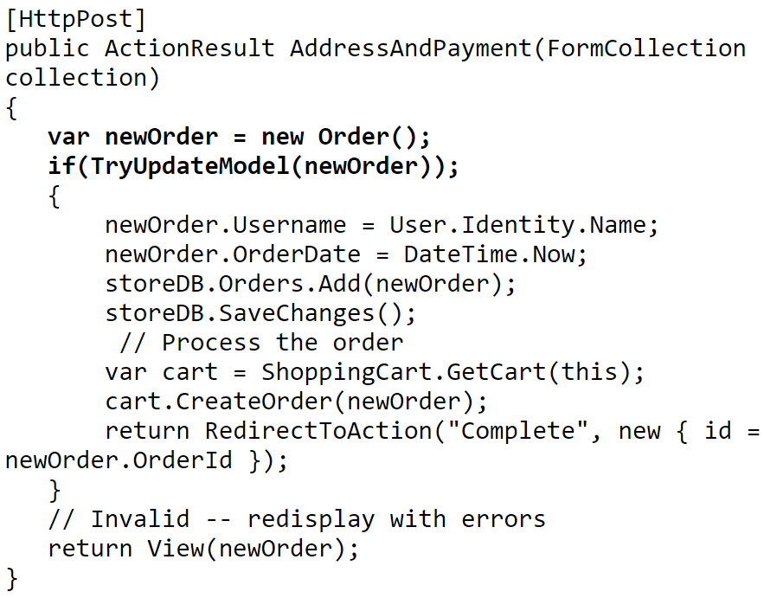
Controller Actions and Validation errors
Controllers decide what to do with success or failure
Success – usually results in saving of model
Failure – results in re-render of the view for fixing by the user

Slide 14
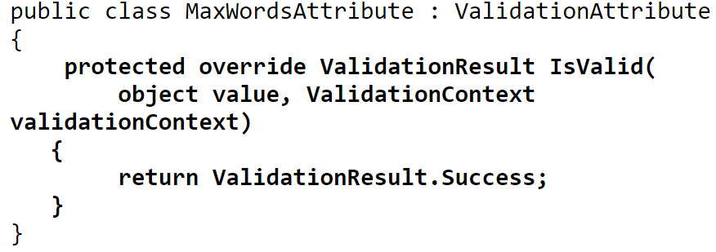
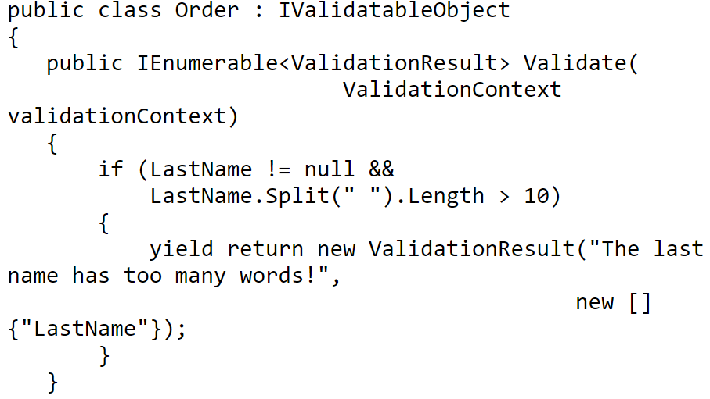
Custom Validation Logic
2 ways we will cover
Custom Data Annotations
All derive from ‘ValidationAttribute’
Must override ‘IsValid’
Constructor can be used for passing values
Self-Validating Model
Implements IValidationObject
Must have Ienumverion<ValidationResults> Validate
Note this uses ‘yield’ keywork

Slide 15
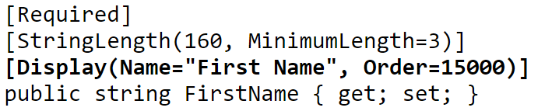
Controller Actions – Display and Annotations
Want to automatically display names on UI
Don’t want to constantly re-type meta data
Display
Changes name displayed
Order
What order fields are rendered in UI

Slide 16
Controller Actions – MORE!
ScaffoldColumn
Hides property from UI
DisplayFormat
Allow formatting of value
ReadOnly
Only allow reading
DataType
Give additional info about your field
Password, Currency, Date, Time, MultilineText

