Slide 1
WROX-Pro ASP.NET MVC 5 Chapter 7
Security

Slide 2
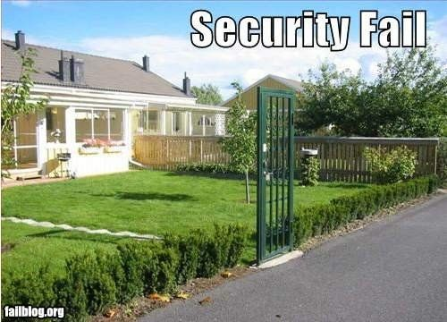
Security topics to cover
Authorization
Authentication
HTML/URL Encoding
Roles/Permissions
User Identities
OAuth/OpenID
Security Vectors
Cross Site Scripting
Cross Site Request Forgery
Cookie hijacking
Over Posting
Open Re-direction

Slide 3

Why is this important?
Never trust users
Most aren’t looking to break your site
Even some of those may accidentally break something
There are some people who just want to break it because they can
Never trust any external data
User to web
Web to backend
External API calls/files

Slide 4
Basics to keep in mind
HTML/URL encode everything coming into your system
Begin by requiring Authorization for everything
Prune down restrictions from there (Ex Index, Register, Login, About,etc. Whatever pages that should be available for navigation, even if some content is suppressed)
Use HTTPOnly cookies
DO NOT DO YOUR OWN SECURITY!
EVER!
SERSIOUSLY, you will do it wrong, and your system will break.

Slide 5
Authentication VS Authorization
Authentication
Authorization
Sole purpose is to verify a user is who they say they are
Can use external services to authenticate users
Don’t always want to keep that data yourself
Is responsible for restricting what a user can do
Relies on Authenticated user so it can apply appropriate permissions
Don’t want anonymous users to do much on a big site
Make sure you don’t lock users out of important things (Login, Register, etc)

Slide 6

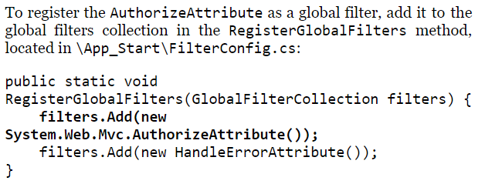
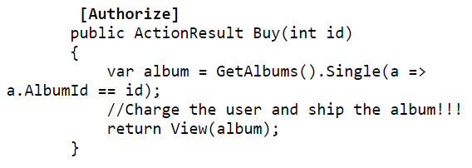
Authorization
AuthorizationAttribute restricts what user can access
Can apply at multiple levels
Controller
Method
Globally

Slide 7
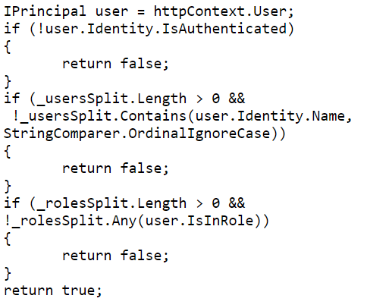

Authorization – Behind the scenes
Un-authorized requests return an HTTP 401
Often converted to a HTTP302 – redirect to login
MVC does this conversion automatically
Allows you to specify the login form
Future will be entirely handled by OWIN
Open Web Interfaces for .Net
Old way used web.config solely
https://brockallen.com/2013/08/07/owin-authentication-=middleware-architecture/

Slide 8
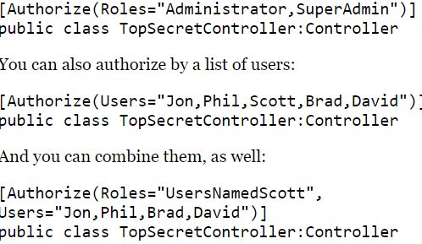
Authorization - Permissions
AuthorizeAttribute allows for specifying a user or role
Much better to assign Users to roles and grant roles permissions through the AuthorizeAttribute
It gets too hard to maintain users permission

Slide 9
Authentication
Can ask/require users to register for just your site
Requires you to have database schema to house/maintain/protect user login credentials
Can ask user to authenticate with a larger entity that will vouch for them
OAuth and OpenID both provide this
Allow Google, Facebook, Microsoft, Twitter, etc to sign in to their service
They then provide a token back to you, stating the user has been verified
Much less maintenance work for you, less information that could leak

Slide 10
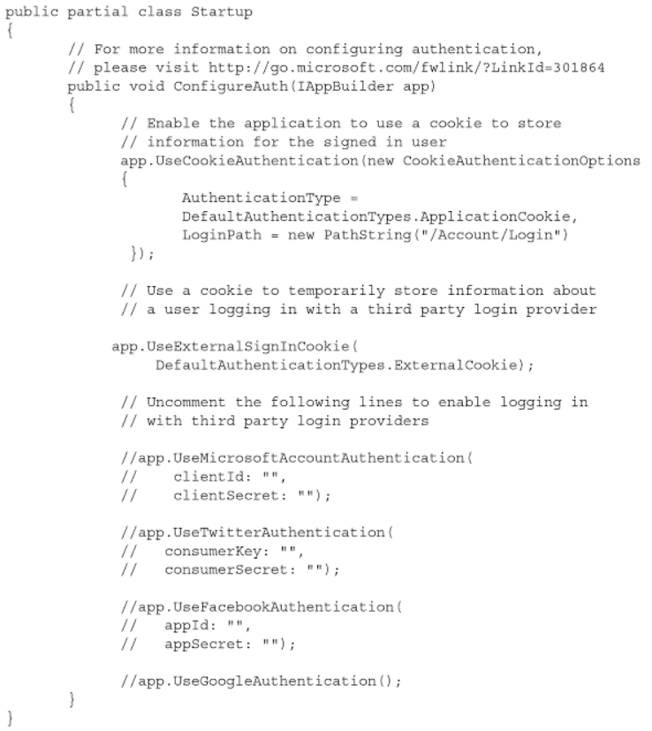
Authentication
OAuth
Configured in AppStart\StartupAuth.cs
Must register your site with OAuth providers and receive an API key

Slide 11
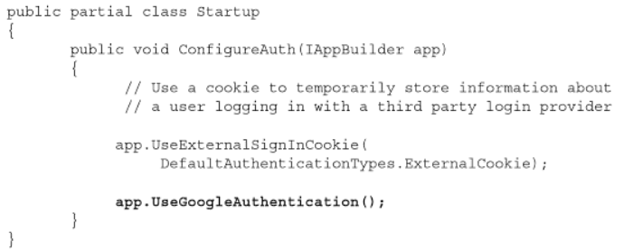
Authentication
OpenID
Configure in the same location
Code is in place, just uncomment to use
Will show google login button on your project

Slide 12
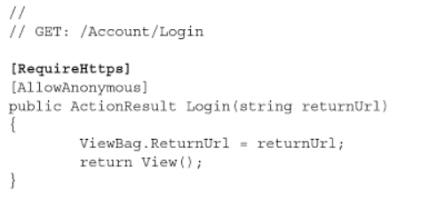
Authentication
For any login always require SSL
If you get information back from external source (OAuth, OpenID), they can contain sensitive data that you don’t want transmitted in clear text
RequireHttps attribute allows this

Slide 13
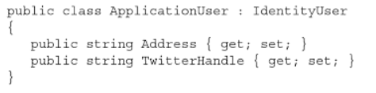
Authentication – Extending User Identities
Once a user is authenticated, you may need/want to persist some additional information about them
This used to be very difficult in previous ASP/MVC versions
Your user identity model will extend IdentityUser
By default, MVC will handle this models persistence through EF

Slide 14
Security Vectors – Cross Site Scripting XSS
XSS occurs when users input code to un-sanitized input fields and the value is then used by your app
Passive – input is saved and re-displayed later
Active – input is immediately shown back to the user
Prevention
HTML encode everything
Any external source, User, database, API call, anything passed around should be encoded and sanitized
Treat everyone like they are out to get you
JavaScript can also be affected
JS Encoding via Ajax.JavaScriptStringEncode function in C#

Slide 15

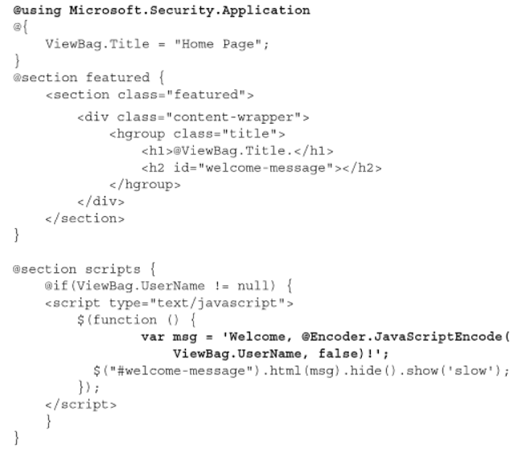
Security Vectors – Cross Site Scripting XSS
AnitXSS framework is the best solution
Its entire focus is to make sure data is secure instead of displayed properly
Once imported, it will replace your html encode with a version that is html/js safe
Provides additional encoders
Installed via nuget

Slide 16


Security Vectors – Cross Site Request Forgery – CSRF/Csurf/XSRF
Relies on XSS vulnerability and also a ‘confused deputy’
Confused deputy is a privilege escalation exploit
Relies on the server executing code as itself, when it should not
Prevention
AntiForgery
HtmlAntiForgeryToken as a hidden form field
ValidateAntiForgeryToken attribute on a controller function
Idempotent GETs
Idempotent - denoting an element of a set that is unchanged in value when multiplied or otherwise operated on by itself.
GET function should always return the same thing, no matter how many times you run it
HttpReferer validation
Ensure the post is from your site

Slide 17
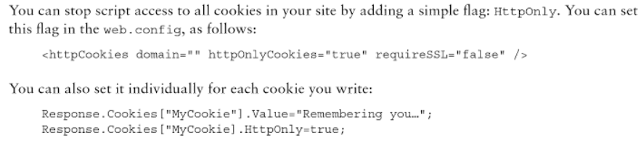
Security Vectors – Cookies
Session
Stored in browser memory
Transmitted in headers with each request
Persistent
Saved in a file on the client machine
Transmitted once in header
If an attacker steals a cookie with authentication information, they can impersonate the user
Prevention
Set HttpOnly for cookies

Slide 18
Security Vectors – OverPosting
User can set fields that were not exposed through form or are hidden
Can often do this by adding fields to the query string
Prevention
Use Bind attribute to declare what fields can be bound to
Overload UpdateModel to pass only parameters you want from that view
BEST OPTION – create a new special model ‘ViewModel’ that only has the fields that specific control can set
Notes:
On whiteboard example of VIewModel based on album order

Slide 19
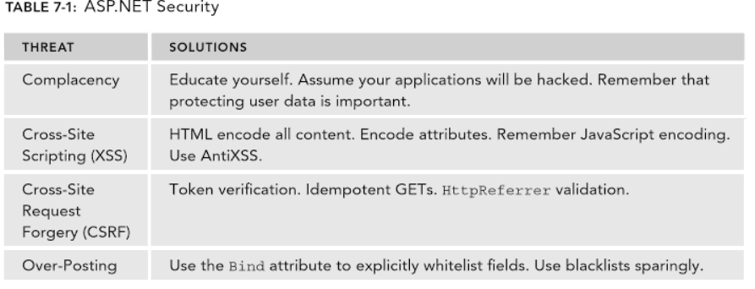
Security Vectors – Thread summary
Notes:
On whiteboard diagram of user/role permissions

Slide 20
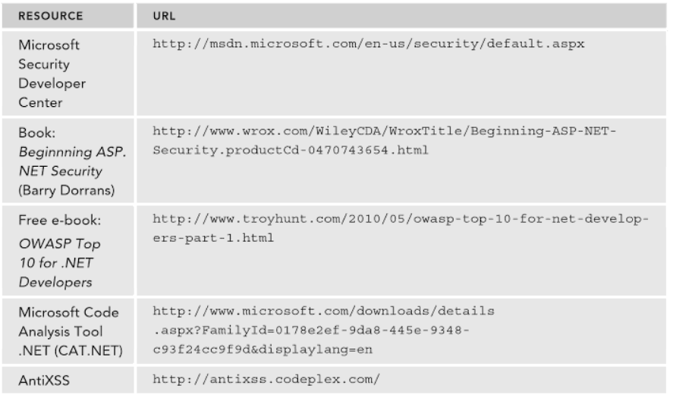
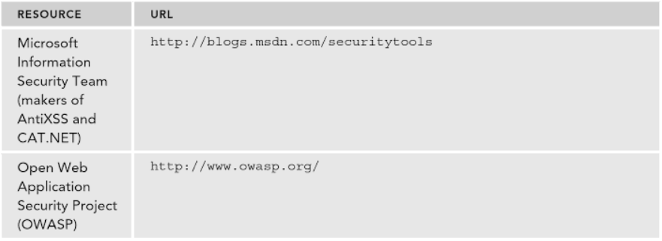
Security Vectors – Thread summary
Notes:
On whiteboard diagram of user/role permissions

