Slide 1

Ruse Cruise Stocks
Sprint 1 Presentation
CSI 480
Cox, Bernero, Mi, Croke
Notes:
Caroline

Slide 2
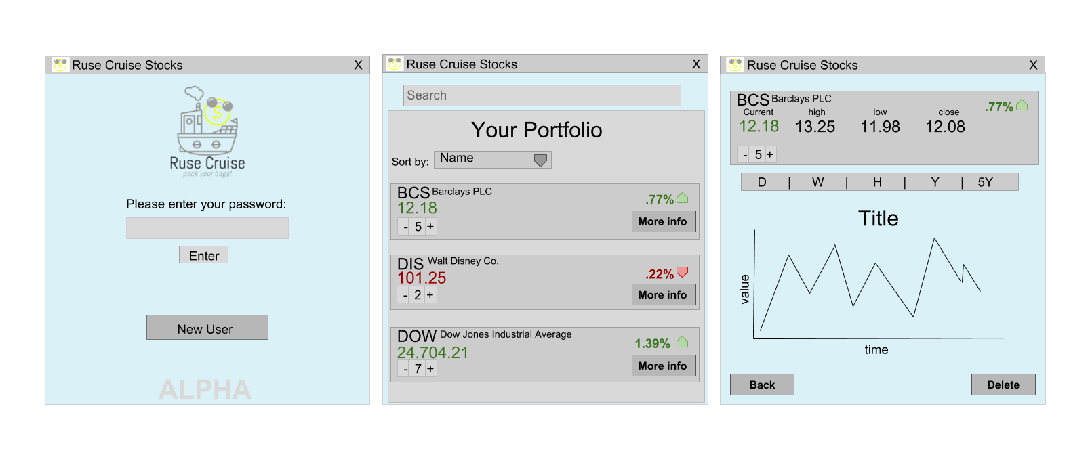
User Interface Mockups
Notes:
Caroline

Slide 3
Open Screen
Allows for password protection to your data.
Allows for a new password through the “New User” button.
Includes a pop up window
Notes:
Cailtin

Slide 4
Portfolio View
Ability to search for stock to add them to portfolio
Sortable list of added stocks
Number you own
Percent change from last close
Current value
“More Info” button switches to next screen
Notes:
Damien

Slide 5
More Info
Expands the information of one stock
Includes:
Current value
Today’s high
Today’s low
Previous Close
Percent change
Historical graph with time period options
Ability to delete this stock from your portfolio
Notes:
Matt

Slide 6
Technical Overview
Alpha Vantage API
Parses JSON
Can only store one portfolio/user
Will store the most recent data for your portfolio to show in the case that the API doesn’t respond
Uses Apache Maven with Java for build automation
Using the Java Card layout to switch between screens
Notes:
Caroline

Slide 7
Sprint Overview
Implemented API (16 Story Points)
Batch stock retrieval
Single stock retrieval
Daily History retrieval
Calculation of percent change
Planned UI and system design
Began UI (8 Story Points)
Basic login screen
Switch between screens
List stocks on portfolio screen
Began the implementation of the search button
Sprint 2
Display historical data
Visual indicators on portfolio
Searching stocks to add to portfolio
keep API updated automatically
Notes:
Caroline

Slide 8
DEMO
Notes:
Matt

