Slide 1

Ruse Cruise Stocks
Sprint 2 Presentation
CSI 480
Cox, Bernero, Mi, Croke
Notes:
Matt

Slide 2
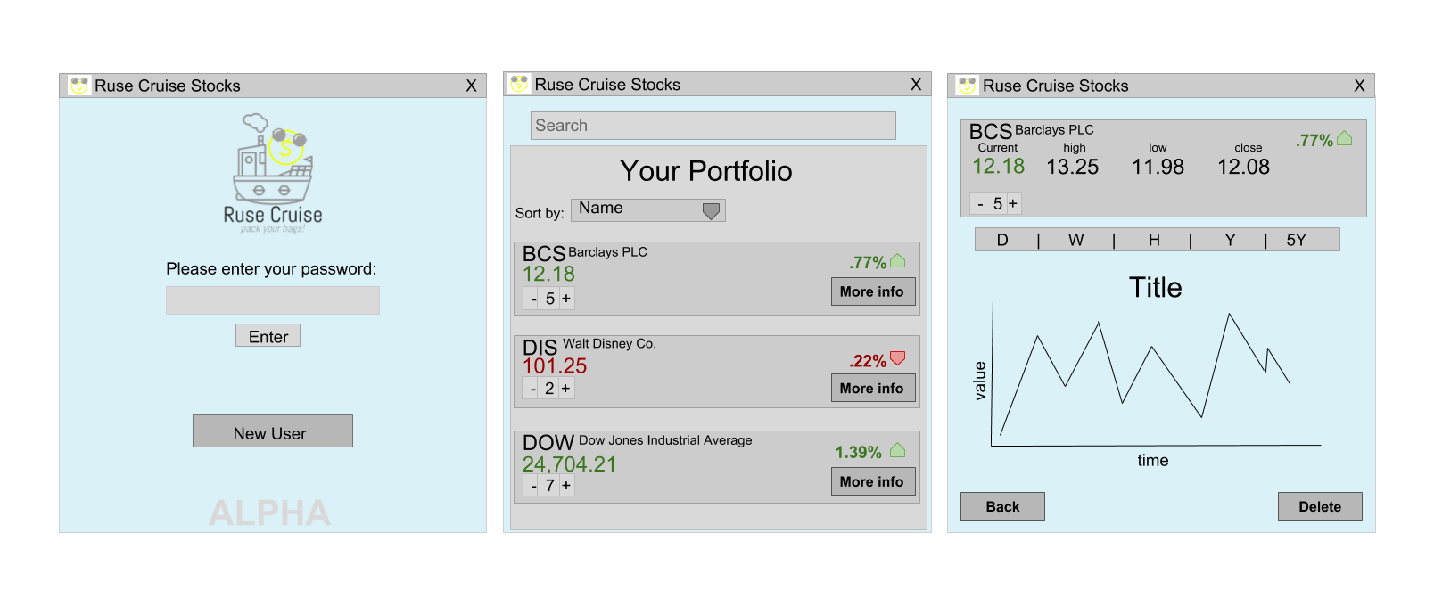
User Interface Mockups
Notes:
Matt

Slide 3
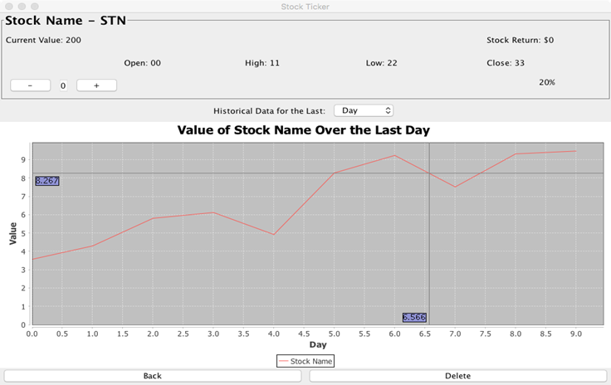
Current User Interface
Notes:
Matt

Slide 4
Sprint Overview
API Optimizations
Began Work on Database
SQL Database stores financial data
Java Application accesses data via DriverManager
Created Info Screen
J Free Chart shows historical data
Lists the financial values of interest
Started Implementation of Search Bar
Notes:
Matt

Slide 5
API Updates
The API is the main source of data
Retrieves and stores current information in database at launch
Pulls data from the database if API fails
Reduced number of duplicate calls, and sped up the calls
Notes:
Caroline

Slide 6
Portfolio Updates
Ability to search for stock to add them to portfolio
More Info button leads to the info screen
Notes:
Damien

Slide 7
Info View
Displays:
Current value
Today’s high
Today’s low
Previous Close
Percent change
J Free Chart displays historical data
“Delete” removes the stock from the portfolio
Notes:
Caitlin

Slide 8
DEMO
Notes:
Matt

