Slide 1

Ruse Cruise Stocks
Sprint 3 Presentation
CSI 480
Bernero, Cox, Croke, Mi
Notes:
Caitlin

Slide 2
Sprint Overview
API Optimizations
GUI Refinement
Stock status visualizations
Honed user experience
Implemented a user portfolio
Stores information of saved stocks
Sortable and updatable display
Notes:
Caitlin

Slide 3
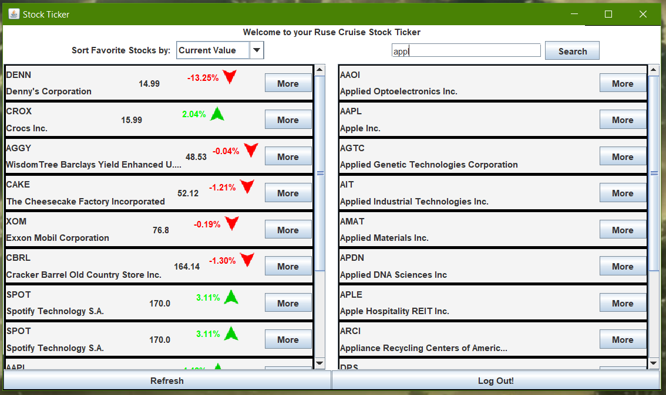
GUI Refinement
Stock search result panels
Favorited stock panels
Login and Loading Screen
Notes:
Caitlin

Slide 4
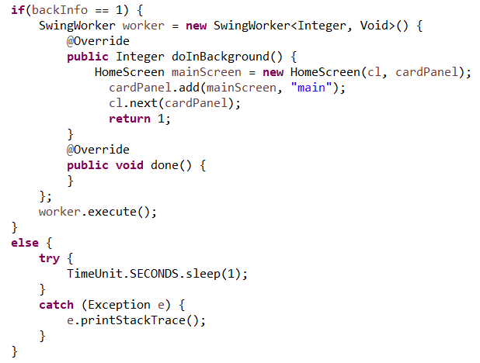
API Updates
Changing the API
AlphaVantage -> IEX
Refreshing data
Loading Screen
Notes:
Caroline

Slide 5
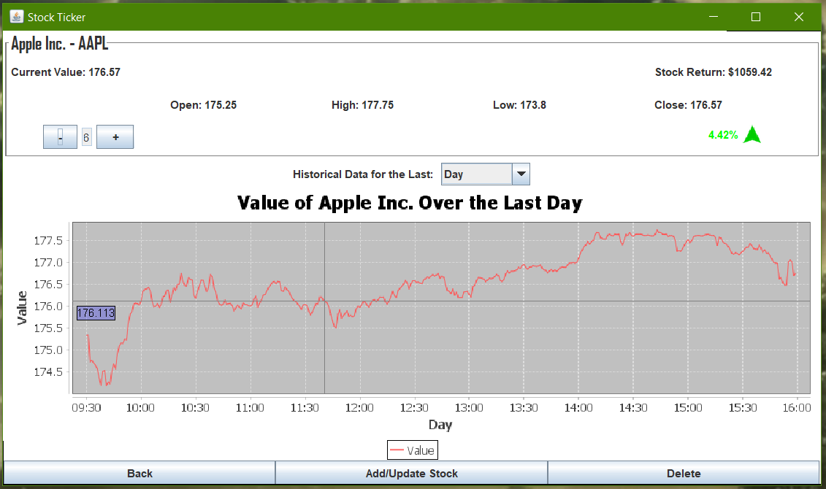
Visualizations
Info Screen and Home Screen
Increase in green
Decrease in red
Corresponding arrow
Notes:
Damien

Slide 6
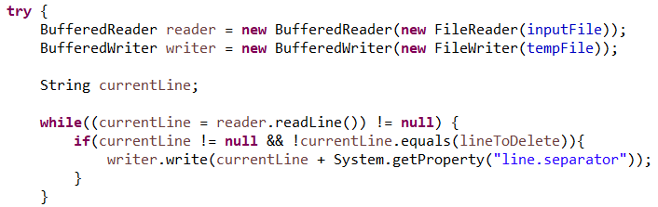
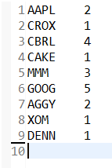
Stock Portfolio
Writes to text file
Number of shares can be updated
Update and delete stock
Notes:
Matt

Slide 7
What we learned
Communication and teamwork are key
Consistently meeting
Constant communication
Clearly defined tasks
Assigning tasks based on skill sets
Debugging and optimization
Notes:
Caitlin

Slide 8
DEMO
Notes:
Matt

