Slide 1
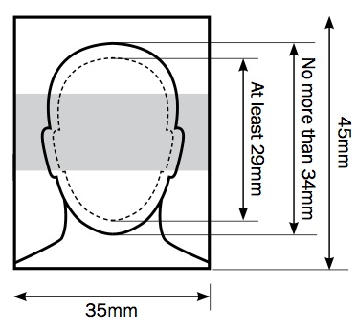
計算機組織學生資料
姓名：
年級：大二/大三/大四/研究所
班別：甲/乙
學號：
興趣或值得一提的事：
Photo Requirement:
Minimum Image Size: 600x750
Photo taken within one year
You can be easily recognized

Slide 2
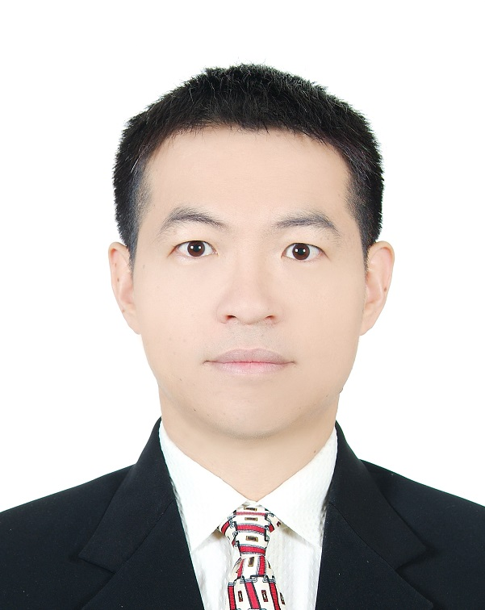
計算機組織學生資料
姓名：林英超
年級：大二
班別：乙
學號：F741234567
興趣或值得一提的事：
I like to play ping pong and badminton
I am father of two cute girls
I enjoy doing research about computer architecture and IC Design

Slide 3
Background Survey
What programming languages you are good at?
Verilog : □ Yes □ No
Other: _______________
C : □ Yes □ No
C++ : □ Yes □ No
Have you taken “Introduction to digital system”
□ Yes □ No
Have you taken “Introduction to circuits theory and digital electronics” ?
□ Yes □ No
Write any thing that you want Prof. Lin Know:

