Slide 1
Soft Case-Based Reasoning Thanks to Dr. Simon C. K. Shiu

Slide 2
Content
What is Case-based Reasoning (CBR)
CBR Life Cycle:
Case Representation and Indexing
Similarity Assessment
Adaptation
Case-base Maintenance
CBR advantages
Applications

Slide 3
What is Case-Based Reasoning?

Slide 4
What is CBR?
Reasoning by remembering past solutions
Solve new problems by adapting solutions that were used to solve similar old problems
CBR is the ways people use cases to solve problems and the ways we can make machines use them

Slide 5
What is CBR?
A methodology to model human reasoning and thinking
A methodology for building intelligent computer systems

Slide 6
What is CBR methodology?
Store previous experience (cases) in memory
To solve new problems:
retrieve similar experience about similar situations from the memory
reuse the experience in the context of the new situation: complete or partial reuse, or adapt according to differences
store new experience in memory (learning)

Slide 7
CBR LIFE CYCLE
RETRIEVE the most similar case or cases to the problem description
REUSE the information and knowledge in that case to solve the problem
REVISE or adapt that solution to better fit the new problem if necessary
RETAIN the new solution once it has been confirmed or validated

Slide 8
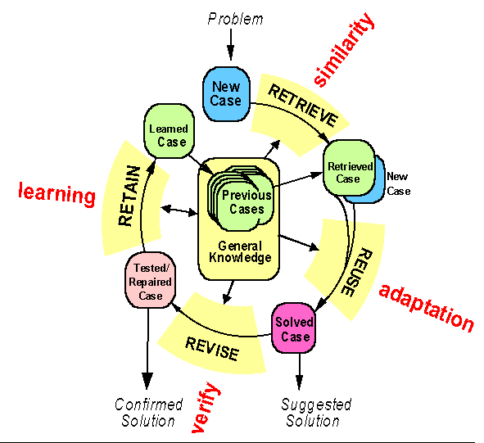
The CBR cycle

Slide 9
GUIDELINES OF USING CBR
Does the domain have an underlying model?
Are there exceptions and novel cases?
Do cases recur?
Is there significant benefit in adapting past solutions?
Are relevant previous cases obtainable?

Slide 10
Merits of Using CBR
Reduce the knowledge acquisition task
Avoid repeating mistakes made in the past
Provide flexibility in knowledge modeling
Reason in domains that have not been fully understood, defined or modeled
Make predictions of the probable success of a proffered solution
Learn over time
Reason in a domain with a small body of knowledge
Reason with incomplete or imprecise data and concept
Avoid repeating all the steps that need to be taken to arrive at a solution
Provide a means of explanation
Can be used in many different ways
Can be applied to a broad range of domains
Reflect human reasoning

Slide 11
CBR Life Cycle: Representation & Indexing Case Retrieval Adaptation Case-base Maintenance

Slide 12
Case Representation and Indexing
The structure and representation of the cases
The memory model used for organizing the entire case base
The selection of indexes, which are used to identify each case

Slide 13
Representing Cases
Many different case representations are used:
Depend on requirements of domain and task
Structure of already available case data

Slide 14
Representing Cases
Flat feature-value list
Simple case structure is sometimes sufficient for problem solving
Easy to store and retrieve in a CBR system
Object-oriented representations
Case: collection of objects (instances of classes) in the sense of OO
Required for complex and structured objects
For special tasks
Graph representations: Case = set of nodes and arcs
Plans: Case = (partially) ordered set of actions
Predicate logic: Case =set of atomic formulas

Slide 15
Object-Oriented Representations
A case consists of a set of objects
An object represents a closed part of the situation
Objects described by a set of features
Relations between objects (e.g. Part-Of)
Each Object belongs to an object-class
Object classes are organized in an inheritance hierarchy - (e.g. Kappa PC)

Slide 16
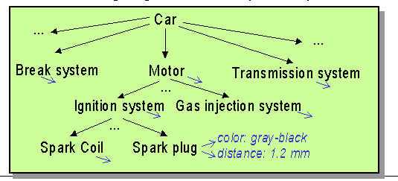
Object Oriented Representation

Slide 17
CASE INDEXING
Assigning indexes to cases for future retrieval and comparisons
Indexes should reflect the important features of the case
Indexes should be abstract enough to allow retrieval in all the circumstances in which a case will be useful

Slide 18
CBR Life Cycle: Representation & Indexing Case Retrieval Adaptation Case-base Maintenance

Slide 19
CASE RETRIEVAL
Closest to query case (k-Nearest Neighbors (k-NN)), inductive approach (decision tree induction), knowledge guided approach
Adaptations possible
Number of cases search, retrieve

Slide 20
Retrieve: What is Similarity
Purpose of similarity
Select cases that can be adapted easily to the current problem
Select cases that can "solve" the current problem
Basic assumption
similar problems have similar solutions

Slide 21
Retrieve: What is Similarity
Degree of similarity = utility / reusability of solution
Similarity is an a-priori approximation of utility / reusability
Goal of similarity modeling: provide a good approximation
close to real reusability
easy to compute

Slide 22
Retrieve: Modeling Similarity
Different approaches depending on case representation
Similarity measures:
function to compare two cases
local similarity: similarity on feature level
global similarity: similarity on case or object level
combine local similarity and importance of features

Slide 23
How to measure similarity?
The meaning of similarity always depends on the underlying context of a particular application, and it does not convey a fixed characteristic that applies to any comparative context

Slide 24
Based on Weighted Euclidian Distance
based on the location of objects in the Euclidian space (i.e., an ordered set of real numbers), where the distance is calculated as the square root of the sum of the squares of the arithmetical differences between the corresponding coordinates of the two objects.

Slide 25
Based on Weighted Euclidian Distance

Slide 26
Based on the no. of common/ different features
where common and different represent the number of attributes that are similar or dissimilar respectively between a new query case and a stored case, and e_{p} and e_{q} are two cases.

Slide 27
Based on the no. of rules satisfied
where (r_{i}) represents the rules that are learned from the case base, and w is the weight assigned

Slide 28
Based on Hamming distance
defined as the number of bits that are different between two bit vectors. For example, d(0,1) = 1, d(001,011) = 1, d(000,111) = 3, d(111,111) = 0.
Hamming distance is represented by a state-space graph

Slide 29
Based on feature contrast
where e_{p} represents a new query case and e_{q} represents a stored case. The intersection (e_{p} ∩ e_{q}) describes those attributes that are common to e_{p} and e_{q}, and the complement sets (e_{p} - e_{q}) and (e_{q} - e_{p}) describe those attributes that are observed only in the query case and in the stored case, respectively.

Slide 30
Vector Space with Term Weights and Cosine Matching
D_{i}=(d_{i1},w_{di1};d_{i2}, w_{di2};…;d_{it}, w_{dit})
Q =(q_{i1},w_{qi1};q_{i2}, w_{qi2};…;q_{it}, w_{qit})
Term B
1.0
Q = (0.4,0.8)
D1=(0.8,0.3)
D2=(0.2,0.7)
D₂
Q
0.8
0.6
0.4
D₁
0.2
0
0.2
0.4
0.6
0.8
1.0
Term A

Slide 31
Based on distances in a abstract hierarchy
Using an abstraction hierarchy
In an object tree, what are their common parents
Animal
Bird
Fish
Mammal
Sparrow
Robin
Cat
Dog
Siamese
Alley

Slide 32
Based on Fuzzy Sets
Qualitative Distance (fuzzy similarity)
Concept mapping (using qualitative descriptors such as “good customer”, “bad customer”, “poor repayment history,”
Sometime based on quantitative measures, and map to an qualitative scale

Slide 33
How to determine weights?
Which fields (or combination of fields) are important?
By human experts (good at relative ranking, not at determining the actual weight scores)
Using data mining methods (which field(s) can predict the outcomes better statistically)

Slide 34
How to determine weights?
Using classification and clustering methods (more weights to a particular class)
Using machine learning methods
Training
Samples
Search
Algorithms
Performance
Algorithms
Selected
Feature
Weights
Feature Weights
Evaluation
Evaluation
Function

Slide 35
Feature Weights Learning
Must be based on past data (availability of cases)
Mode of training
Supervised (correct result is known before hand and feedback to the training method as “errors”)
Un-supervised (correct result is not-known, based on some hypothesis, and their maximization)

Slide 36
Retrieve, but Efficiently
Efficient case retrieval is essential for large case bases
Different approaches depending
on the case representation
size of the case base

Slide 37
CBR Life Cycle: Representation & Indexing Case Retrieval Adaptation Case-base Maintenance

Slide 38
CASE ADAPTATION
The solution returned used as a solution to the current problem without modification, or with modifications
The steps or processes that were followed to obtain the previous solution could be re-run without modifications, or with modifications
Where more than one case has been retrieved, a solution could be derived from multiple cases or alternatively several alternative solutions could be presented.

Slide 39
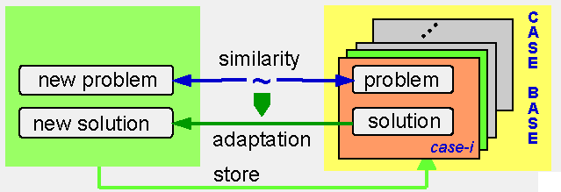
Case Adaptation

Slide 40
How to Adapt the Solution
No modification of the solution: Just copy
Manual/interactive solution adaptation by the user
Automatic solution adaptation

Slide 41
Automatic solution adaptation
Transformational Analogy
Transformation of the solution
Rules or operators to adjust solution w.r.t. differences in the problems
Knowledge required about the impact of difference

Slide 42
Automatic solution adaptation
Derivational Analogy:
replay of the problem solving trace
Complete generative problem solver
Knowledge required about how to solve the problem in principle
Compositional adaptation:
combine several cases to a single solution

Slide 43
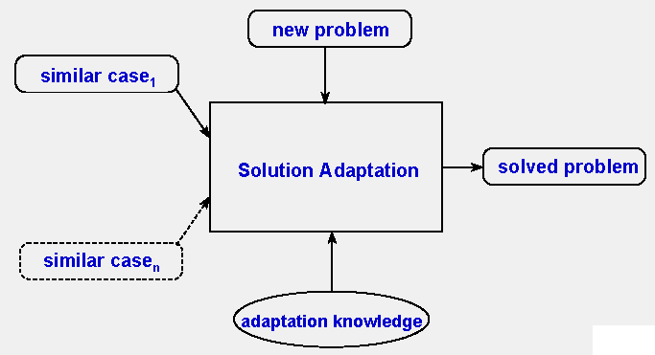
Adaptation Knowledge Needed

Slide 44
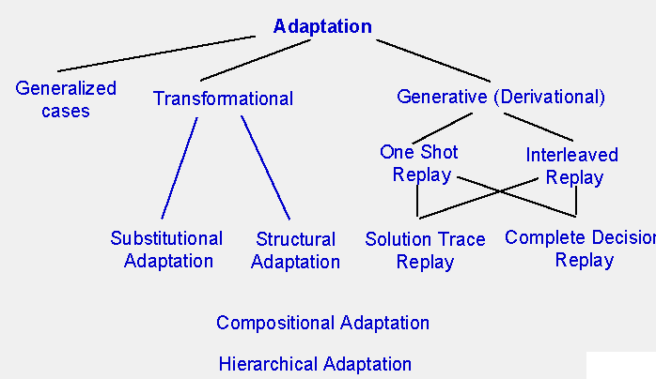
Different Approaches

Slide 45
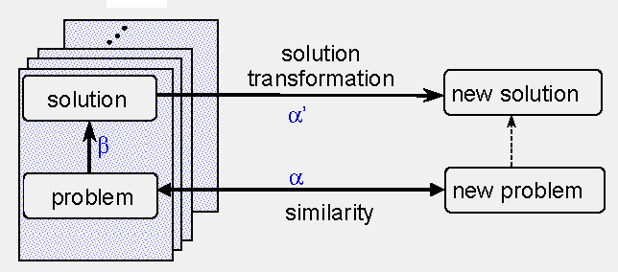
Transformational Adaptation

Slide 46
Transformational Adaptation
Representation of adaptation knowledge
Adaptation Rules
Adaptation operators (e.g. requirements, variables, formulas, models)

Slide 47
Transformation Adaptation
Kinds of Transformational Adaptation
Substitutional Adaptation
Modify, insert, delete solution components or parameters
Structural Adaptation
Reorganization (re-structuring) of the solution
Inserting or deleting of objects

Slide 48
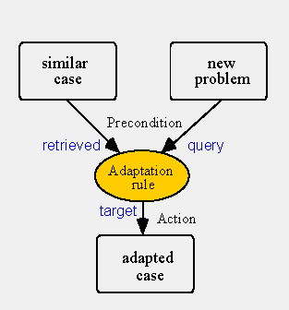
Adaptation Rules of OO Representations
Rules defined for object classes
Precondition – test of attributes
Every attribute reference mentions to which case it belongs: query, retrieved, target
Actions: change, insert, delete attribute values or objects
Inheritance of object classes to sub-objects
Several rules may be applied together for the adaptation of one case

Slide 49
Example (Substitutional Adaptation)
Car Diagnosis
Adaptation rule:
IF query.problem = light X doesn’t_work AND retrieved.problem = front_light_doesn’t_work
THEN
target.diagosis:=REPLACE (retrieved.diagnosis, front_light, X)
target.repair:=REPLACE (retrieved.repair, front_light, X).

Slide 50
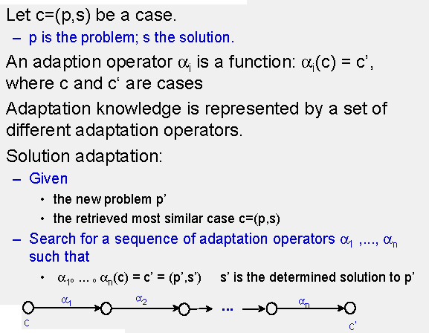
Adaptation Operators

Slide 51
Generative (Derivational Adaptation)
Main assumption: for the problem to be solved, there exists a generative problem solver that is able to solve each problem without cases
Example “planning”: Means-End Analysis is such a generative problem solver (a problem solving techniques in which the current state is compared to the goal state, and the difference between them is divided up into subgoals in order to achieve the goal state by the use of the available operators).

Slide 52
Generative (Derivational Adaptation)
Finding solutions faster (remember high complexity in planning problems)
Finding solutions similar to previous solutions
Find solutions that require only little modifications

Slide 53
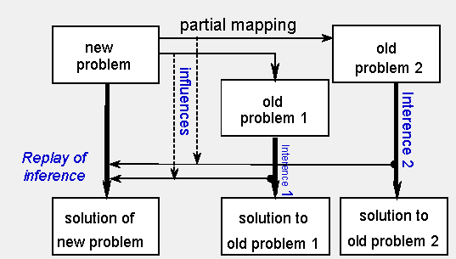
Derivational Analogy

Slide 54
Derivational Analogy
Case = problem + solution + inference (solution trace)
Transfer (replay) solution trace

Slide 55
Cases and Generative Problem Solving
Transfer parts of the solution trace that are applicable
Combine solution traces from different cases
Solve remaining solution gaps by the generative problem solver
Hence, the case-base and the generative problem solver work tightly together
One shot Replay: FIRST apply all solution steps from the case(s) and then start the generative problem solver.
Interleaved Replay: cases and generative problem solver alternate during problem solving

Slide 56
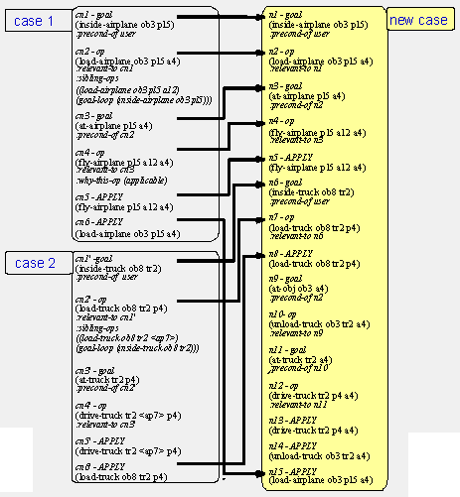
Derivational
Analogy

Slide 57
Transformation vs Generative Adaptation
Generative
Generative problem solver required, including domain knowledge for problem solving
Cases must contain the solution trace
If problem solver creates only correct solutions, the result of the adaptation is correct
Cases are primarily used for improved speed
Transformation based
No generative problem solver required
Knowledge about adaptation is necessary
Solution trace NOT required in the case
Solution correctness usually can not be guaranteed
Cases and adaptation knowledge represent knowledge of the domain

Slide 58
Adaptation with Generalized Cases
In transformational and generative adaptation, the adaptation knowledge is global and independent from the individual cases
Generalized cases: different approach
Encode adaptation knowledge within the individual case
Every case contains the knowledge to what extend it can be adapted

Slide 59
Adaptation with Generalized Cases
Definition generalized case: A generalized case is a triple (P,S,C)
P: set of problems
S: set of solutions
C: constraints (relations) between the problems of P and solutions of S

Slide 60
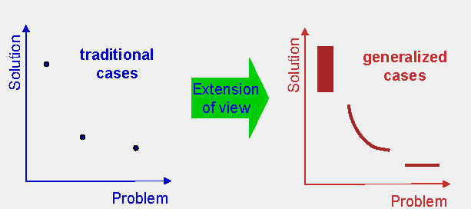
Applying Generalized Cases

Slide 61
Applying Generalized Cases
A traditional case describes ONE problem and ONE solution to this problem
A generalized case describes SEVERAL problems and SEVERAL solutions and how they related to each other

Slide 62
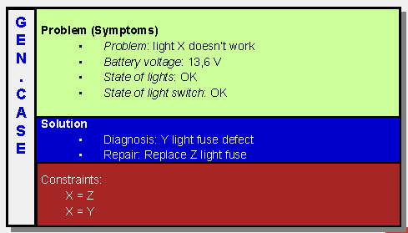
Example: Car Diagnosis
All kinds of “light not working” problems caused by a defect fuse

Slide 63
Relationship between Adaptation and Retrieval
Purpose of similarity: selection of solutions that can be transferred to solve the current problem
Hence, similarity should estimate the effort for solution adaptation
High similarity: solution is easily adaptable to the new problem
Low similarity: solution cannot be adapted at all, or only with much effort

Slide 64
Relationship between Adaptation and Retrieval
Adaptability is a posteriori criterion: only after we have tried, we know
Similarity is an a priori criterion: the selection must be done in advance
Hence: similarity must approximate adaptability

Slide 65
CBR Life Cycle: Representation & Indexing Case Retrieval Adaptation Case-base Maintenance

Slide 66
CASE LEARNING
In which situations should a case be added to the case base, and in which situations should it be discarded?
If a case is to be added to the case base, the indexes of the new case must be determined and also how that case is to be added to the case base.

Slide 67
CASE-BASE MAINTENANCE
Trade off between no. of cases and efficiency
Removing redundant case, conflicting cases, subsume cases,
Case base competence
Size, distribution and density of case
Coverage of case
Similarity and adaptation knowledge

Slide 68
Case-Base Maintenance
Policies and techniques of
Adding cases
Deleting cases
Updating cases
Re-organizing Indexes and
other knowledge (e.g. similarity and adaptation)
to guarantee the ongoing effectiveness and performance of a CBR system

Slide 69
Qualitative Maintenance
Assurance of the
Correctness
Consistency
Completeness

Slide 70
Qualitative - Correctness
A case is considered as correct if the given solution component, after adaptation, really "solves" the input query problem.
How to define correctness is application and domain dependent
Correct classification
Error tolerance level
Creativity (in synthesizing tasks, develop a new recipe)

Slide 71
Qualitative - Consistency
Redundant cases
two cases are equal (case duplication) or if one case subsumes another, the subsumed case can be removed from the case-base without affecting the overall competence of the CBR system
Conflicting cases
two or more cases match on every attribute, yet propose conflicting solutions
due to the erroneous input of case attributes or may be due to the changes of the "correct" solution over time

Slide 72
Qualitative - Consistency
Alternative cases
offering alternative solutions to the same problem is very useful (e.g. recommending different holiday packages to the tourists)
trade-off between similarity and diversity, i.e. maximally improving diversity and minimally compromising similarity
Erroneous cases
inconsistent with the background knowledge of the system (an attribute value, or the solution does not make sense, e.g. age is 2002)

Slide 73
Qualitative - Consistency
Dead cases
a case could not be retrieved at all from the case-base due to the missing of some important attributes,
or erroneous values such that the similarity score is always zero

Slide 74
Qualitative - Completeness
Completeness of a case-base refers to its problem and solution coverage of the task domain
In the process of building CBR systems, cases are collected incrementally, and the completeness of a case-base is also evolving over time.
addition of cases may not necessarily improve the completeness of the case-base.
"missing knowledge
Coverage of cases
Reachiability of cases

Slide 75
CASE ORGANIZATION
Flat Memory, serial search
Shared feature network (or hierarchy), breath-first graph search
Discrimination network, node=discrimination question
Redundant discrimination networks
Flat library, parallel search
Hierarchical memory, parallel search

Slide 76
EXAMPLES 1

Slide 77
A Simple Example
Technical Diagnosis of Car Faults
Symptoms are observed (e.g. engine doesn’t start) and values are measured (e.g. battery voltage = 6.3V)
Goal: Find the cause for the failure (e.g. battery empty) and a repair strategy (e.g. charge battery)

Slide 78
A Simple Example
Case-based Diagnosis
A case describes a diagnostic situation and contains
description of the symptoms
description of the failure and the cause
description of a repair strategy
Store a collection of cases in a case base
Find case similar to current problem and reuse repair strategy

Slide 79
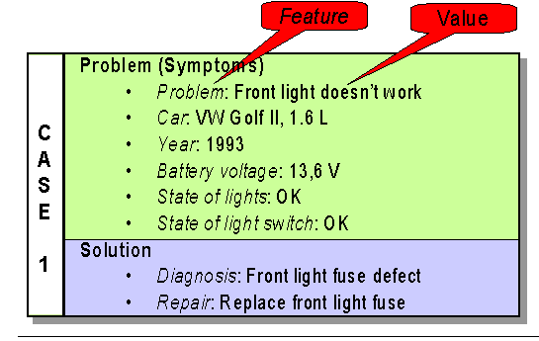
What is a Case?

Slide 80
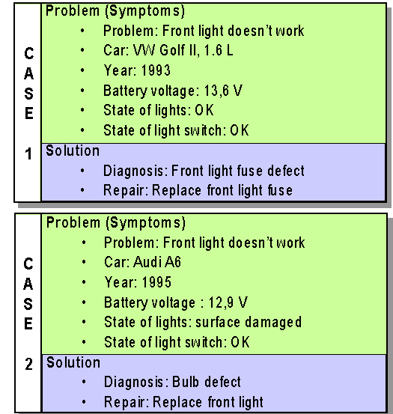

Slide 81
Solving a New Diagnostic Problem
A new problem must be solved
We make several observations in the current situation, and define a new problem
Not all feature values must be known
The new problem is a case without solution part

Slide 82
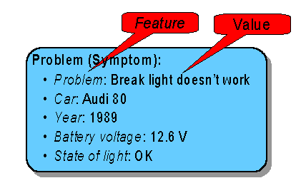
A New Problem

Slide 83
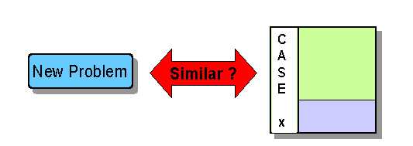
Similarity comparison

Slide 84
Similarity
Similarity is the most important concept in CBR
When are two cases similar?
How to rank the cases according to their similarity?
Can we assess similarity based on the similarity of each feature (Simple SUM?)

Slide 85
Similarity
Similarity of each feature depends on the feature value
BUT: Importance of different features may be different!
The concepts of feature weighting

Slide 86
Similarity Computation
Assignment of similarities for features values
Express degree of similarity by a real number between 0 and 1
0 means not similar, and 1 means very similar

Slide 87
Similarity Computation
Feature: Problem
Case 1: Front light doesn’t work
Case 2: Break light doesn’t work
Similarity is 0.8
Case 1: Front light doesn’t work
Case 2: Engine doesn’t start
Similarity is 0.4

Slide 88
Feature weighting
Different features have different importance (weights)!
High importance:
Problem. Battery voltage. State of light. ..etc.
Low importance:
Car Model. Year. Colour, Owner’s Name…etc.

Slide 89
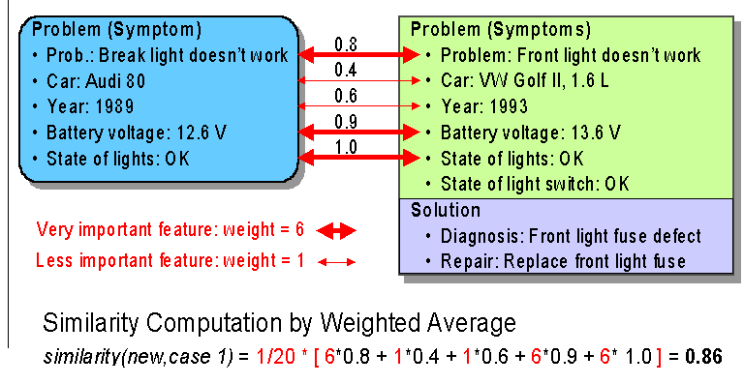
Compare New Problem and Case 1

Slide 90
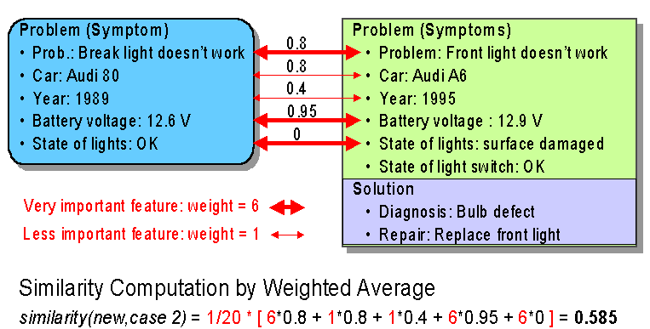
Compare New Problem and Case 2

Slide 91
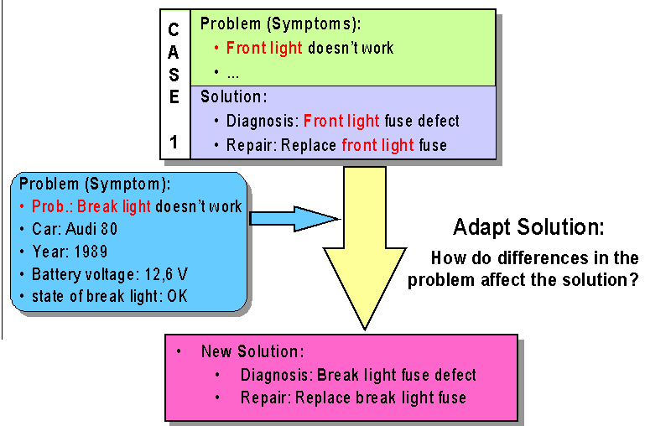
Reuse the Solution of Case 1

Slide 92
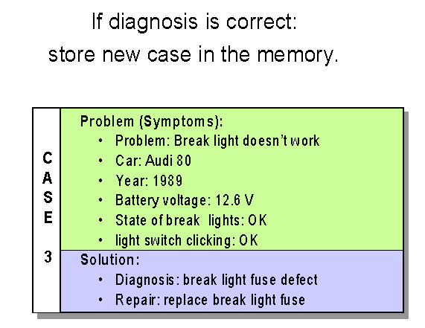
Store the New Experience

Slide 93
EXAMPLES 2

Slide 94
Another application of CBR in Hong Kong An Object Oriented Case-Based Expert System for Awarding Punishment for Serious Discipline Cases

Slide 95
Content
Introduction
Design of Case-based Expert System
Implementation
Testing and Evaluation
Future Enhancement

Slide 96
Introduction
A postal officer left the counter at public hall without locking up his cash box. When he returned to the counter, it was discovered that $4,000 was found missing. A further check by Internal Audit Section revealed a further shortage of $1,000 in the counter sub-stock.

Slide 97
Introduction
A nurse, while working at the Gynecological section of South Kwai Chung Polyclinic, neglected her duty by failing to properly handle a vaginal swab contained in a test tube; hence the same swab was used for a second time on another patient.

Slide 98
Introduction
1,500 serious discipline cases in HKCS, such as negligence of duty, conflict of interest, misbehavior, fraud and dishonesty.
an officer may be required to retrieve all the previous cases and study them thoroughly before he is able to find the relevant portion for drawing the analogy.

Slide 99
Design of the CBR Expert System
knowledge acquisition stage
searching the existing documents,
Government Manual on Discipline, Labor Laws, Staff Contract information
conducting interviews
20 officers were interviewed
real life experience
the knowledge engineer tries to do several cases himself with the aid of experience officer

Slide 100
Design of the CBR Expert System
four major categories of information:
general data about the staff and the offence
nature of the offence, and detail breakdown of the severity of offence into sub-categories
considerations for punishment, e.g., the severity of offence, the offender's attitude towards the case and
the punishment itself

Slide 101
Design of the CBR Expert System
cases are classified into a structural hierarchy
cases within the same category share some common features
in criminal cases, more detail information is stored in each case, whist in non-criminal cases, less information is required.

Slide 102
Design of the CBR Expert System
5 classes and 12 sub-classes of objects have been created, each with 20 to 30 slots.
The user interface consists of 30 individual screens

Slide 103
Design of the CBR Expert System
Compare primary features
job-relatedness, office hours, abuse of position, isolated or recurrence offence, consequence to Government
Compare secondary features
The method used is the nearest neighbor algorithm

Slide 104
Design of the CBR Expert System
Production rules are used to derive the adapted solution for the new case. A typical rule is:
IF Punishment_awarded = Reprimand
THEN debar_from_promotion
OR appointment_for X years
value X depends on the current policy being enforced

Slide 105
Implementation
Matching and evaluation algorithms were written using the KAL language interpreter provided by KAPPA-PC

Slide 106
Testing and Evaluation
Evaluated by 15 officers
19 questions were asked, and also invite comments
Results
useful aid
assist in understanding the scenario
acceptability of ES increased with degree of computer literacy
slight variation of experienced and inexperienced officers

Slide 107
EXAMPLES 3

Slide 108

Another example in China - Case-Based Reasoning
Finding the rent of apartments in Shanghai

Slide 109
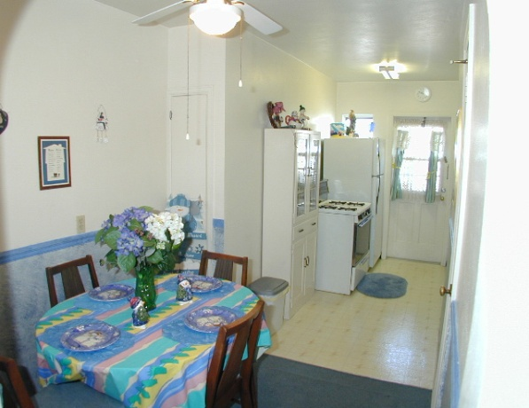
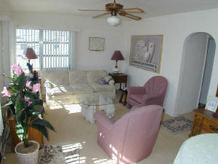
請問上海浦東蓮花路有冇單位出租? 租金多少?
Searching the Web?
Ask the agents?
Browse through all records?
Fails (or time consuming)
Exact match
No records available on the web
No apartments are available
Search agent could not locate the information

Slide 110
Why Case-based Reasoning (CBR)
Based on degree of similarity
No exact match is required -> perform adaptation
CBR cycle
Case Representation (what features are used to represent a case?)
Case Indexing (how cases are organized in computers?)
Case Similarity assessment (how to compare cases?)
Case Adaptation (how to adapt the old solution to suit the new problem?)
Case-Base Maintenance (how to update and maintain the CBR system?)

Slide 111
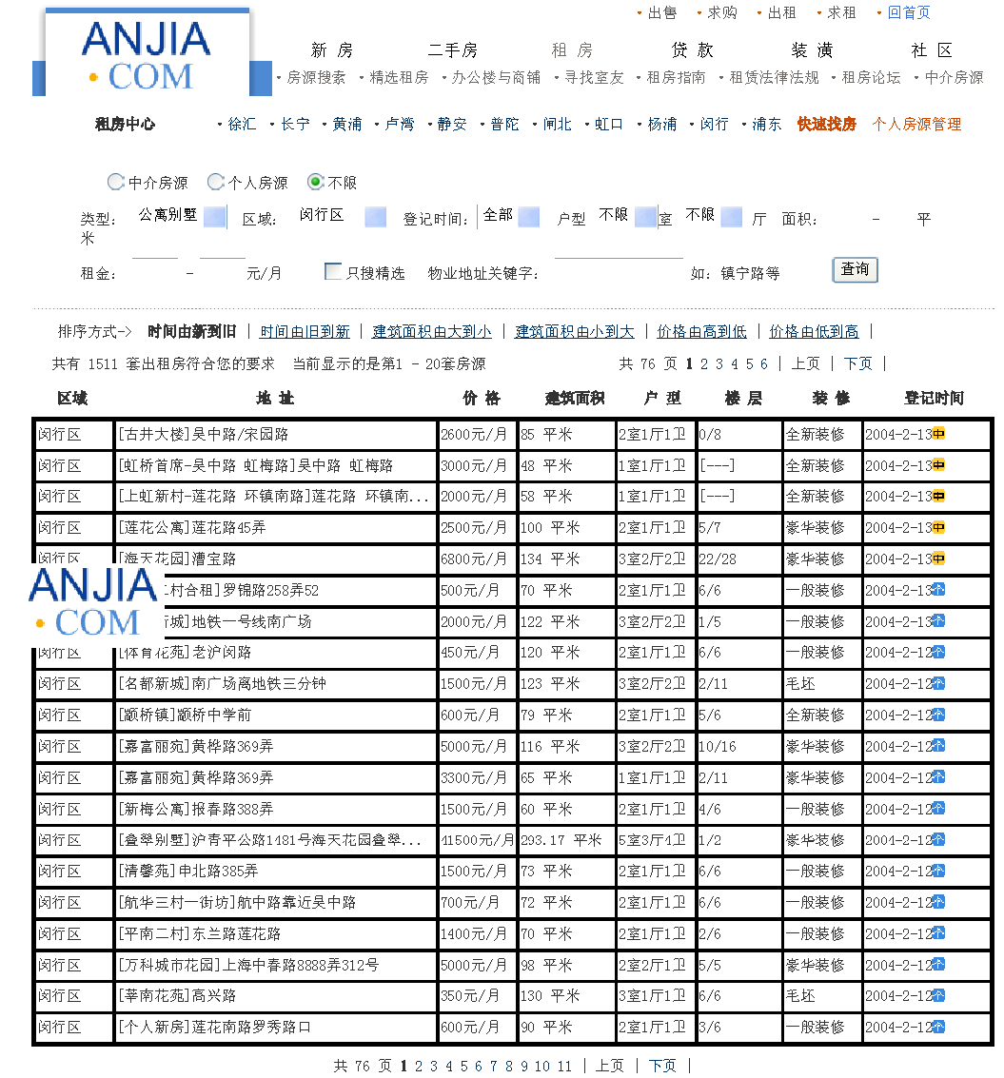
Collect cases

Slide 112
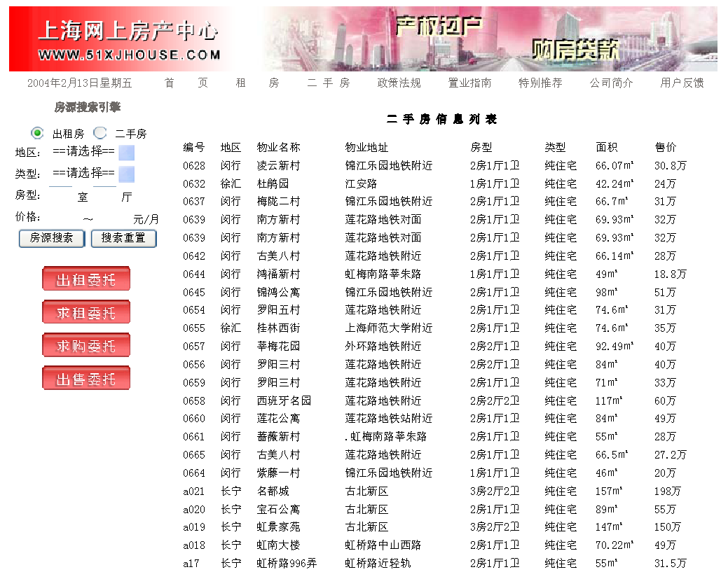
Collect cases (different sources)

Slide 113
Case Representation
Minghang District
閔行區
蓮花路
One bedroom and one sitting room
Information from Landlord
Rent
Features Selection and Representation

Slide 114
Construction of Case-Base

Slide 115
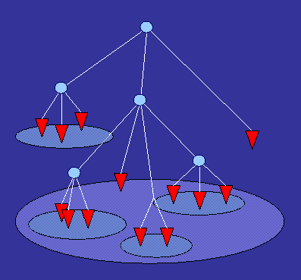
Case Indexing
Select a method to store these cases in computer memory.
Organize the cases in a hierarchy so that only a small subset of them needs to be searched during retrieval
Using the most important feature attribute, i.e., City District as an index
Shanghai
Hong Qiao (虹橋)
Pudong (浦東)

Slide 116
Case Retrieval
A process of finding within the case base the case(s) that are closest to the current case
Given a new case ê = (Mh, Lz, 11, indi, θ), we want to find the value of θ(rent)
Step 1 : Find which class ê belongs to
Step 2 : Calculate the degree of similarity by

Slide 117
Case Retrieval - Continue
Step 3 : Rank the cases by similarity measure
Result: Four cases are retrieved
SM(ê , e₁) = SM(ê , e₂) = SM(ê , e₄) = SM(ê , e₅) = 0.75

Slide 118
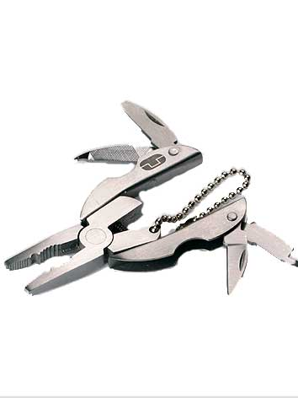
Case Adaptation
After a matching case is retrieved, its solution needs to be modified to fulfill the needs of the current case
Step 1 : Group the retrieved cases based on their solution values
Step 2 : Choose the group with the highest no. of cases
Step 3 : Use this solution as the solution of the new case
C₁ = {e₁, e₄}
C₂ = {e₂}
C₃ = {e₅}
C₁ has two records, therefore, its solution, 500 Yuan is chosen as the solution

Slide 119
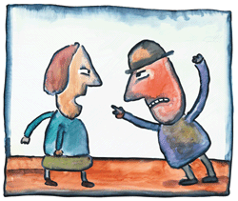
Case-Base Maintenance
Correctness – e.g., wrong case
Consistency – e.g., conflicting cases
Completeness – e.g., missing cases
My case is better than your case!

Slide 120
Case-Base Maintenance
Reduce the size of the case base by removing the redundant (duplications) cases
Step 1 : Classify all cases into groups according to their addresses
Step 2 : For each group, compare each feature value of these cases pairwise
Step 3 : If some cases have identical values for all features, retain one of these cases and remove the rest

Slide 121
Relevance of Soft Computing: Representation & Indexing Similarity Assessment Adaptation Case-base Maintenance

Slide 122
Relevance of Soft Computing
Case Indexing and Representation
fuzzy indexing
connectionist indexing
fuzzy clustering and classification of cases for indexing
neural network, probability and/or Bayesian models for representative case selection for indexing

Slide 123
Relevance of Soft Computing
Case similarity computation and Retrieval
neural fuzzy techniques for similarity assessment
genetic algorithms for leaning cases similarity
rough set based methods for case retrieval
case-based similarity inference using fuzzy rules
fuzzy techniques for feature weights learning (similarity)

Slide 124
Relevance of Soft Computing
Reuse
adaptation of cases using neural networks
evolutionary approaches for tuning adaptation parameters
mining adaptation rules using rough set approach
learning fuzzy adaptation knowledge from cases
neural-fuzzy hybrid approaches for reuse
reusing cases by interactive and conversational fuzzy reasoning
learning reusable case knowledge

Slide 125
Relevance of Soft Computing
Revise
Still largely a human intensive process involving the verification of the adapted solution in the REAL WORLD

Slide 126
Relevance of Soft Computing
Retain (Case-Base Maintenance)
validations and verifications of CBR systems' internal structure and knowledge, e.g. completeness, consistency and correctness
size, indexing structure, performance statistics, irrelevant/ obsolete cases, noisy data or filling in missing data, user feedbacks and comments, and house keeping tasks.

Slide 127
Advantage of CBR

Slide 128
Advantage of CBR
High Flexibility
Knowledge can be distributed between the four containers (cases, representation and indexing, similarity, adaptation) according to application needs
Focus on knowledge in the case base
Knowledge in the case base can be updated and maintained very easily

Slide 129
Advantages of CBR over others
Reduces the knowledge acquisition effort
Requires less maintenance effort
Improve problem solving performance through reuse
Makes use of existing data, e.g. databases
Improve over time and adapt to changes in the environment
High user acceptance
No commercial expert shells are needed, any languages will serve the purpose, C++, Java, etc

Slide 130
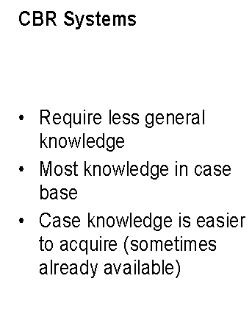
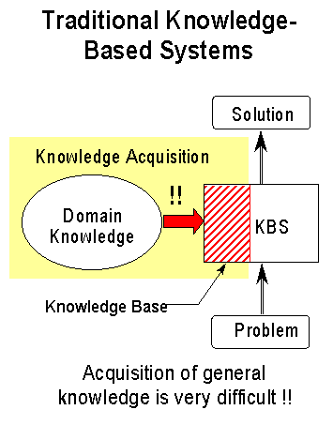
Avoid (Partially) Knowledge Acquisition Effort

Slide 131
Less Effort Required for Maintenance
What is the impact of changes of the environment?
Rule bases or models are different to maintain
many dependencies between rules
rules of KBS often difficult to understand for non AI experts
Effects of changes of the rule base are hard to predict
maintenance by the domain expert impossible

Slide 132
Less Effort Required for Maintenance
Case bases are easier to maintain
Cases are independent from each other
Domain experts and novices understand cases quite easy
Maintenance of the CBR system (partially) by adding/deleting cases

Slide 133
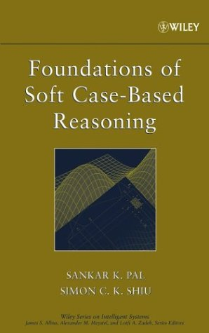
Reference BOOK
Foundations of Soft Case-Based Reasoning
Simon C. K. Shiu and Sankar K. Pal
Wiley Series on Intelligent Systems,
John Wiley and Sons
2004

Slide 134
BACKGROUND OF CASE-BASED REASONING
Cognitive Science (1977 -
how people learn a new skill, and how humans generate hypotheses about new situations based on their past experiences
Artificial Intelligence (1993 –
First European workshop on CBR (EWCBR-93), Kaiserslautern, Germany, CBR (EWCBR-94), Chantilly, France
First International Conference on CBR (ICCBR-95), Sesimbra, Portugal
(EWCBR-96), Lausanne, Switzerland, (ICCBR-97), Providence, RI, USA
(EWCBR-98), Dublin, Ireland, (ICCBR-99), Seeon Monastery, Germany
(EWCBR-00), Trento, Italy, (ICCBR-01), Vancouver, Canada
(ECCBR-02), Aberdeen, Scotland, (ICCBR-03), Trondheim, Norway
(ECCBR-04), Madrid, Spain; (ICCBR-05) Chicago, IL, USA; ECCBR-06, Turkey; (ICCBR-07), Belfast, Northern Ireland, UK; (ECCBR-08), Germany; (ICCBR-09), Seattle, WA, USA; (ICCBR-10), Alessandria, Italy; (ICCBR-11), London; (ICCBR-12), Florence, Italy.

Slide 135
Useful CBR books and references
Foundations of Soft Case-Based Reasoning, Sankar K. Pal, Simon C. K. Shiu, John Wiley, 2004.
Soft Computing in Case Based Reasoning, (Eds.) S.K. Pal, T.S. Dillon and D.S. Yeung, Springer Verlag, London, 2001
Case-Based Reasoning Research and Development, Proceedings of the Fourth International Conference on Case-based Reasoning, Springer-Verlag, Germany, 2001.
Applying Case-Based Reasoning: Techniques for Enterprise Systems, by Ian Watson, Morgan Kaufmann Publishers, Inc., 1997.
Case-Based Reasoning Experiences, Lessons and Future Directions, (Ed.) David B. Leake, AAAI Press/MIT Press, 1996.
Case-Based Reasoning, by Janet Kolodner, Morgan Kaufmann, San Mateo, CA, 1993.
David Aha at US Navy maintains a site with URL www.aic.nrl.navy.mil/~aha
Ian Watson at the University of New Zealand maintains a site with URL http://www.ai-cbr.org
Ralph Bergmann, Ivo Vollrath and Sascha Schmitt at the University of Kaiserslautern maintain a site with URL http://www.cbr-web.org

