Slide 1
Introduction to
Fuzzy Set Theory
模糊集合理论

Slide 2

Uncertainty
Information
  Meaningful data
  Knowledge get from experience
Uncertainty
  The condition in which the possibility of error exist
Complexity

Slide 3
Types of Uncertainty
Stochastic uncertainty
  E.g., rolling a dice
Linguistic uncertainty
  E.g., low price, tall people, young age
Informational uncertainty
  E.g., credit worthiness, honesty

Slide 4
Measurement and Uncertainty
Precision
  No matter how accurate our measurements are, some uncertainty always remains
  Fractional parts
Measure ?

Slide 5

Language and vagueness
Understanding of word meaning
  Full texture of cultural and personal association
  Vagueness
Heap paradox
Taking a stone from a heap, it leaves a heap

Slide 6
The emergence of fuzzy set theory
To deal with uncertainty
  Avoid
  Statistical mechanics
  Fuzzy set

Slide 7
Applications
Pattern recognition and clustering
Fuzzy control
  Automobiles, air-condition, robotics
Fuzzy decision
  Stock market, finance, investment
Expert system
  Database, information retrieval, image processing
Combined with other field
  Neural network, genetic algorithms

Slide 8

参考教材
Computational Intelligence:
An Introduction
  Andries.P.Engelbrecht
  中文版：计算智能导论
  清华大学出版社，2010

Slide 9

参考教材
Computational Intelligence:
Principles, Techniques and Applications
  Amit Konar
  Springer Verlag

Slide 10
Content
Fuzzy Sets
Set-Theoretic Operations
MF Formulation
Extension Principle
Fuzzy Relations
Linguistic Variables
Fuzzy Rules
Fuzzy Reasoning

Slide 11
Introduction to
Fuzzy Set Theory
Fuzzy Sets

Slide 12


Fuzzy and crisp
180cm
179cm
Degree of high
1
Crisp
cm
180
Degree of high
1
Fuzzy
cm
160
180
Notes:
模糊是可以用來調和對立的。譬如說：如果硬要規定180公分以上才叫高的人，那麼身高179公分的人就要抗議了。但是如果高的定義是由這樣的隸屬函數來定義的話，179公分已經相當高了！

Slide 13
Crisp or Fuzzy Logic
Crisp Logic
  A proposition can be true or false only.
    Bob is a student (true)
    Smoking is healthy (false)
  The degree of truth is 0 or 1.
Fuzzy Logic
  The degree of truth is between 0 and 1.
    William is young (0.3 truth)
    Ariel is smart (0.9 truth)

Slide 14
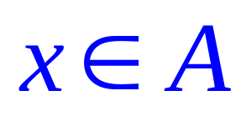
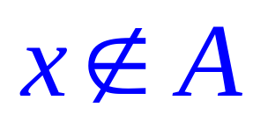
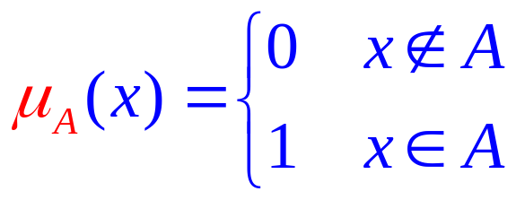
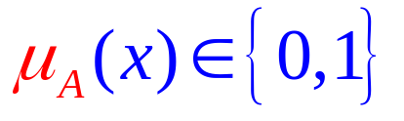
Crisp Sets
Classical sets are called crisp sets
  either an element belongs to a set or not, i.e.,
Member Function of crisp set
or

Slide 15
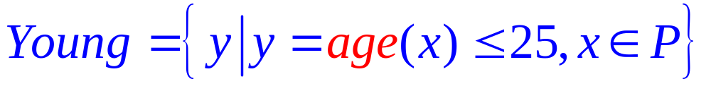
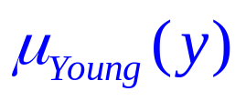
Crisp Sets
P : the set of all people.
P
Y : the set of all young people.
Y
1
25
y

Slide 16
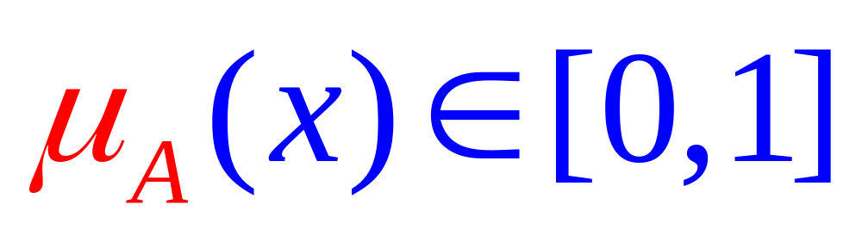
Crisp sets
Fuzzy Sets
Example
1
y

Slide 17

Fuzzy Sets
Lotfi A. Zadeh
The founder of fuzzy logic.
L. A. Zadeh, “Fuzzy sets,” Information and Control,
vol. 8, pp. 338-353, 1965.

Slide 18
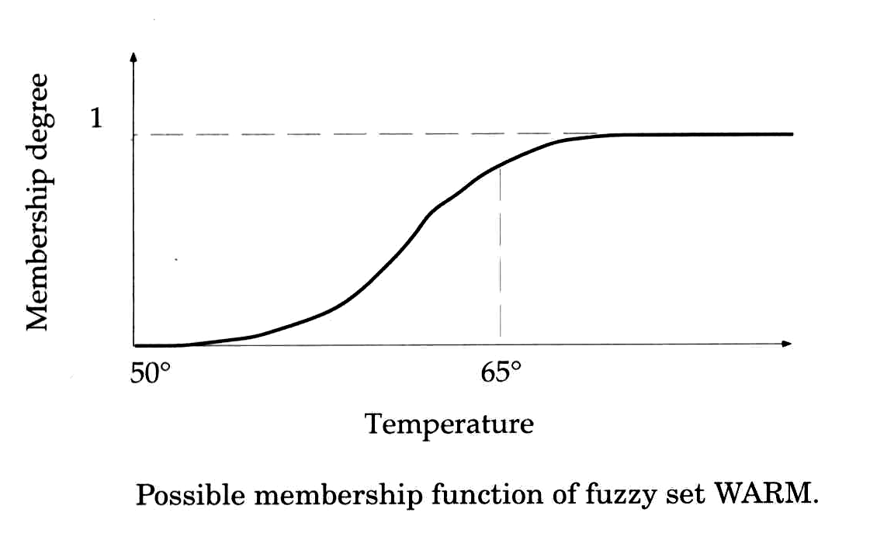
Fuzzy sets
Definition
  The pair of member and the degree of membership of the member
Membership function
MF（隶属函数）

Slide 19
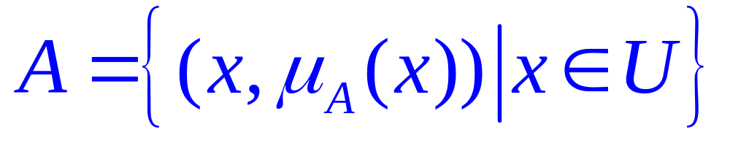
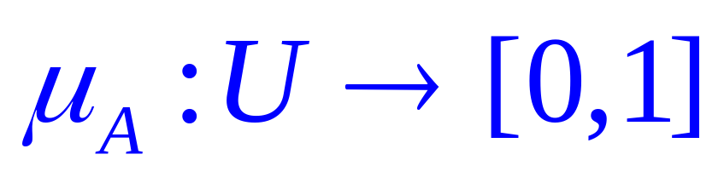
U : universe of discourse.
Definition:
Fuzzy Sets and Membership Functions
If U is a collection of objects denoted generically by x, then a fuzzy set A in U is defined as a set of ordered pairs:
membership
function

Slide 20
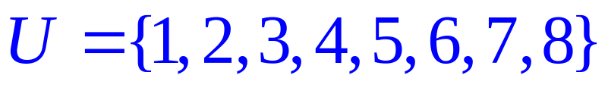
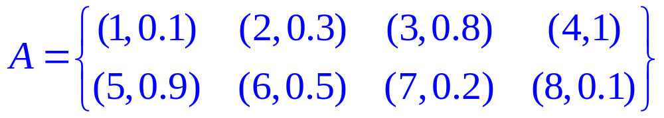

Example (Discrete Universe)
# courses a student may take in a semester.
appropriate
# courses taken
1
0.5
0
2
4
6
8
x : # courses

Slide 21
Example (Discrete Universe)
# courses a student may take in a semester.
appropriate
# courses taken
Alternative Representation:

Slide 22
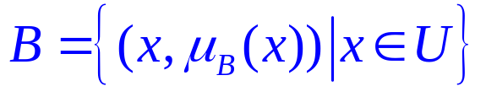
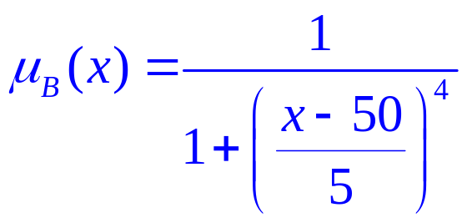
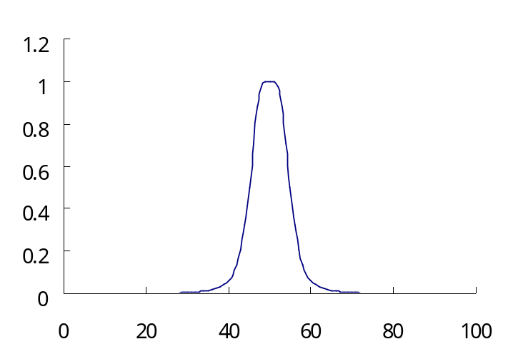

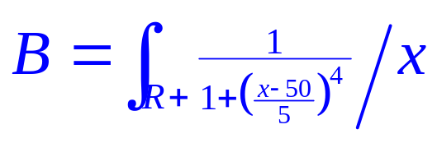
Example (Continuous Universe)
U : the set of positive real numbers
possible ages
about 50 years old
Alternative Representation:
x : age

Slide 23
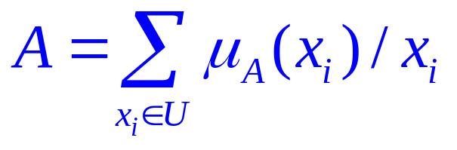
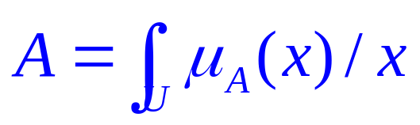
Alternative Notation
U : discrete universe
U : continuous universe
Note that ∑ and integral signs stand for the union of membership grades; “ / ” stands for a marker and does not imply division.

Slide 24
Membership Functions (MF’s)
A fuzzy set is completely characterized by a membership function.
  a subjective measure.
  not a probability measure.
“tall” in Asia
1
Membership
value
“tall” in USA
“tall” in NBA
0
5’10”
height

Slide 25
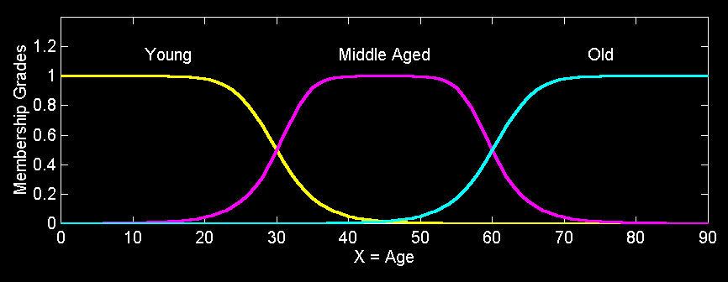
Fuzzy Partition
Fuzzy partitions formed by the linguistic values “young”, “middle aged”, and “old”:

Slide 26
MF Terminology
cross points
1
MF
0.5
α
0
x
core
核
width
宽度
α-cut
截集
support
支集

Slide 27

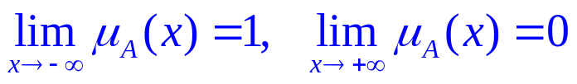
More Terminologies
Normality （正规）
  core non-empty
Fuzzy singleton（单点 ）
  support one single point
Fuzzy numbers
  fuzzy set on real line R that satisfies convexity and normality
Symmetricity
Open left or right, closed

Slide 28
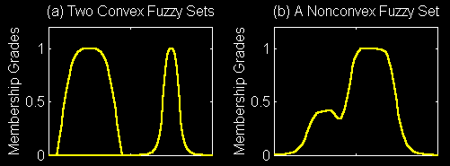
Convexity of Fuzzy Sets
A fuzzy set A is convex if for any λ in [0, 1].

Slide 29
Introduction to
Fuzzy Set Theory
Set-Theoretic Operations

Slide 30

Set-Theoretic Operations
Subset
Complement
Union
Intersection

Slide 31
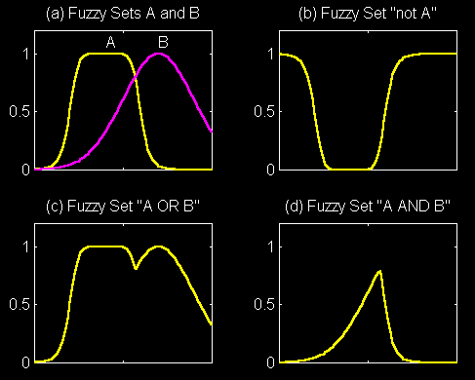


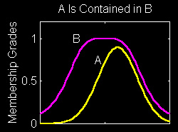


Set-Theoretic Operations

Slide 32













Properties
Involution
对偶律
De Morgan’s laws
复原律
Commutativity
交换律
Associativity
结合律
Distributivity
分配律
Idempotence
幂等律
Absorption
吸收律

Slide 33
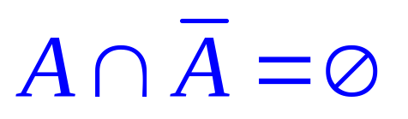

Properties
The following properties are invalid for fuzzy sets:
  The laws of contradiction 矛盾律
  The laws of exclude middle 排中律

Slide 34
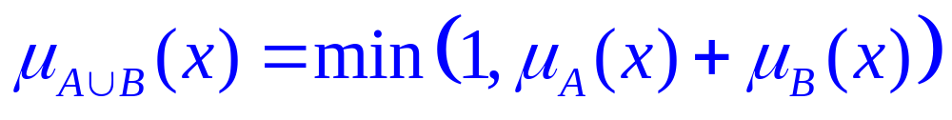
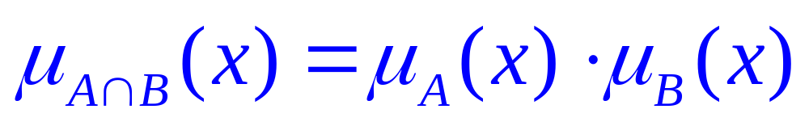
Other Definitions for Set Operations
Union
Intersection

Slide 35
Other Definitions for Set Operations
Union
Intersection

Slide 36
Generalized Union/Intersection
Generalized Intersection
Generalized Union
t-norm
t-conorm

Slide 37

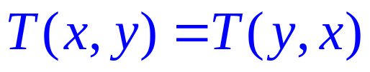
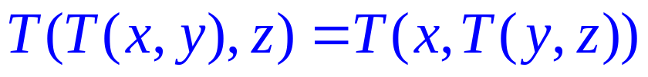
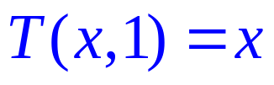
T-Norm
Or called triangular norm.
Symmetry
Associativity
Monotonicity
Border Condition

Slide 38

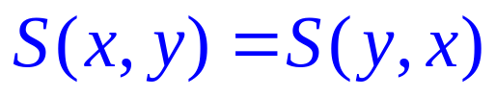
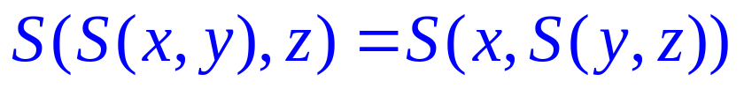
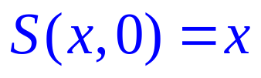
T-Conorm
Or called s-norm.
Symmetry
Associativity
Monotonicity
Border Condition

Slide 39




Examples: T-Norm & T-Conorm
Minimum/Maximum:
Lukasiewicz:
Probabilistic:

Slide 40
Introduction to
Fuzzy Set Theory
MF Formulation

Slide 41
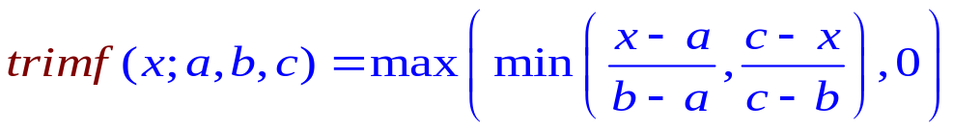
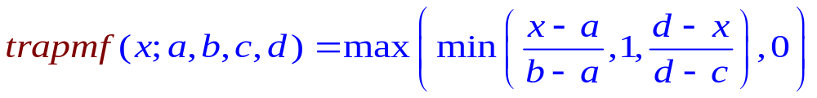
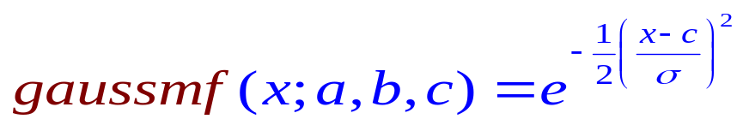
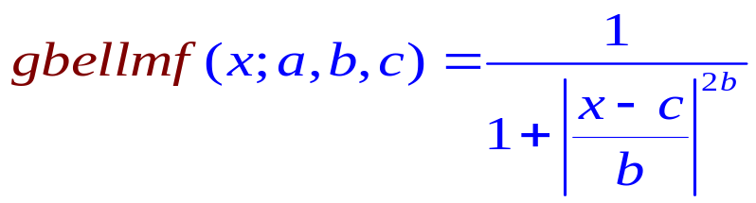
MF Formulation
Triangular MF
Trapezoidal MF
Gaussian MF
Generalized bell MF

Slide 42
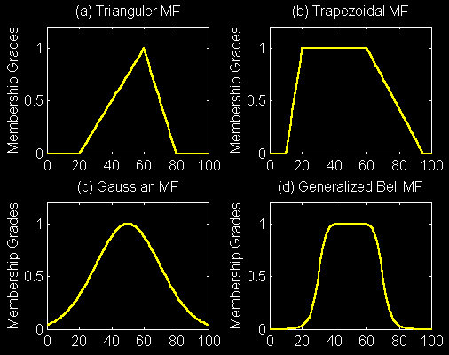
MF Formulation

Slide 43
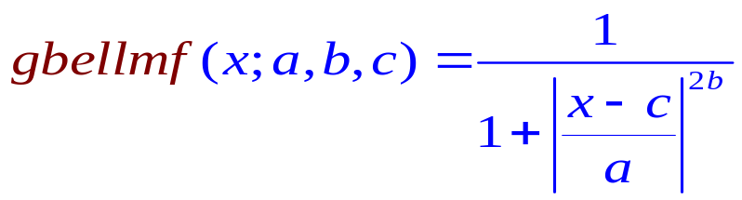
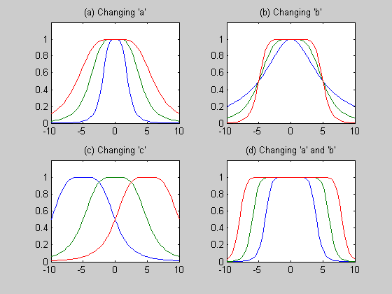
Manipulating Parameter of the
Generalized Bell Function

Slide 44
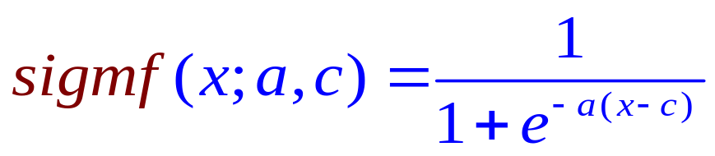
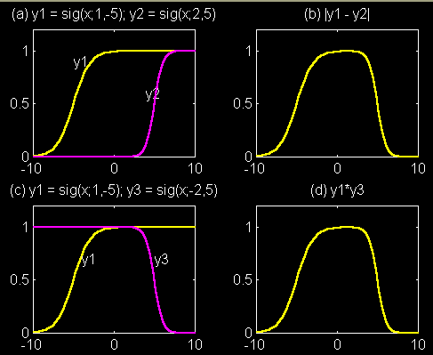
Sigmoid MF
Extensions:
  Abs. difference
  of two sig. MF
  Product
  of two sig. MF

Slide 45
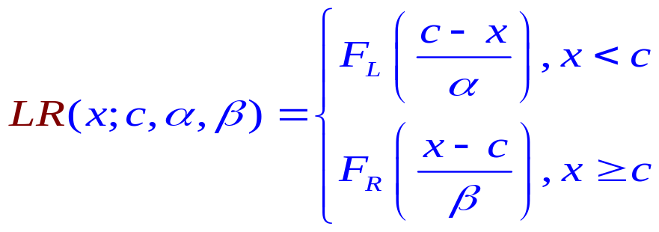
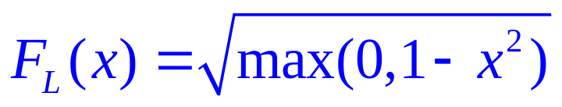
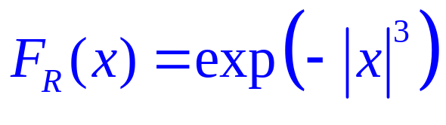
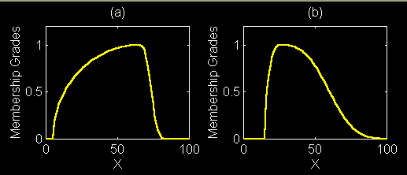
L-R MF
Example:
c=65
α=60
β=10
c=25
α=10
β=40

Slide 46
Introduction to
Fuzzy Set Theory
Extension Principle

Slide 47
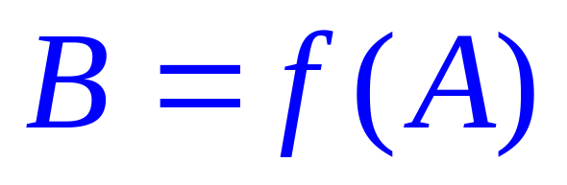
Functions Applied to Crisp Sets
y
y = f(x)
B
x
μ_{B}(y)
A
μ_{A}(x)
x

Slide 48
Assume a fuzzy set A and a function f.
How does the fuzzy set f(A) look like?
Functions Applied to Fuzzy Sets
y
y = f(x)
B
x
μ_{B}(y)
μ_{A}(x)
A
x

Slide 49
Functions Applied to Fuzzy Sets
y
y = f(x)
B
x
μ_{B}(y)
μ_{A}(x)
A
x

Slide 50
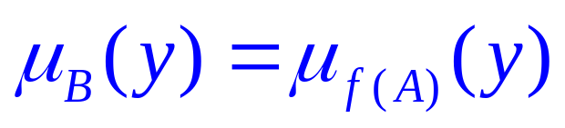
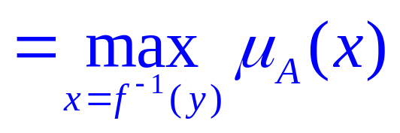
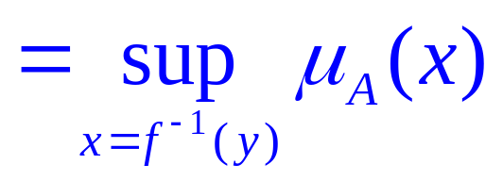
The Extension Principle
y
y = f(x)
B
x
μ_{B}(y)
μ_{A}(x)
A
x

Slide 51
Example:
  Let A = 0.1 / -2+0.4 / -1+0.8 / 0+0.9 / 1+0.3 / 2
    and f(x) = x² – 3
    Applying the extension principle, we obtain:
    B = 0.1 / 1+0.4 / -2+0.8 / -3+0.9 / -2+0.3 /1
    = 0.8 / -3+(0.4 V 0.9) / -2+(0.1 V 0.3) / 1
    = 0.8 / -3+0.9 / -2+0.3 / 1
    where “V” represents the “max” operator, Same reasoning for continuous universes

Slide 52
Introduction to
Fuzzy Set Theory
Fuzzy Relations

Slide 53

Binary Relation (R)
b₁
a₁
A
b₂
a₂
B
b₃
a₃
b₄
a₄
b₅

Slide 54
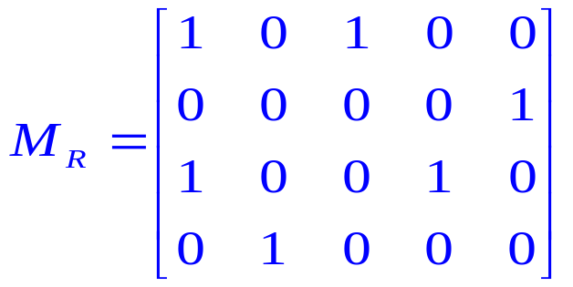







Binary Relation (R)
b₁
a₁
A
b₂
a₂
B
b₃
a₃
b₄
a₄
b₅

Slide 55
The Real-Life Relation
x is close to y
  x and y are numbers
x depends on y
  x and y are events
x and y look alike
  x and y are persons or objects
If x is large, then y is small
  x is an observed reading and y is a corresponding action

Slide 56

Fuzzy Relations
A fuzzy relation R is a 2D MF:

Slide 57



Example (Approximate Equal)

Slide 58


Max-Min Composition 合成运算
X
Y
Z
R: fuzzy relation defined on X and Y.
S: fuzzy relation defined on Y and Z.
R。S: the composition of R and S.
A fuzzy relation defined on X and Z.

Slide 59







Example
min
max

Slide 60

Max-min composition is not mathematically tractable, therefore other compositions such as max-product composition have been suggested.
Max-Product Composition
X
Y
Z
R: fuzzy relation defined on X and Y.
S: fuzzy relation defined on Y and Z.
R。S: the composition of R and S.
A fuzzy relation defined on X an Z.

Slide 61





Dimension Reduction
Projection
R

Slide 62





Dimension Reduction
Projection

Slide 63



Dimension Expansion
Cylindrical Extension
A : a fuzzy set in X.
C(A) = [A↑X×Y] : cylindrical extension of A.

Slide 64
Introduction to
Fuzzy Set Theory
Linguistic Variables

Slide 65
Linguistic Variables
Linguistic variable is “a variable whose values are words or sentences in a natural or artificial language”.
Each linguistic variable may be assigned one or more linguistic values, which are in turn connected to a numeric value through the mechanism of membership functions.

Slide 66
Motivation
Conventional techniques for system analysis are intrinsically unsuited for dealing with systems based on human judgment, perception & emotion.

Slide 67
Example
if temperature is cold and oil is cheap
then heating is high

Slide 68
Example
Linguistic
Variable
μ_{cold}
if temperature is cold and oil is cheap
then heating is high
Linguistic
Value
Linguistic
Value
Linguistic
Variable
μ_{cheap}
μ_{high}
Linguistic
Variable
Linguistic
Value

Slide 69

Definition [Zadeh 1973]
A linguistic variable is characterized by a quintuple
Name
Term Set
Universe
Syntactic Rule
Semantic Rule

Slide 70



Example
A linguistic variable is characterized by a quintuple
age
Example semantic rule:
[0, 100]

Slide 71
Example
Linguistic Variable : temperature
Linguistics Terms (Fuzzy Sets) : {cold, warm, hot}
μ(x)
μ_{cold}
μ_{warm}
μ_{hot}
1
60
x
20

Slide 72
Introduction to
Fuzzy Set Theory
Fuzzy Rules

Slide 73

Definition
    Not young and not old = ¬young ∩ ¬old
    Young but not too young = young ∩ ¬young²

Slide 74
Dienes-Rescher Implication
Classical Implication
A → B
A
B
A → B
A
B
A → B
T
T
T
1
1
1
T
F
F
1
0
0
F
T
T
0
1
1
F
F
T
0
0
1
¬A ∪ B
¬A
B
¬A ∪ B
¬A
B
¬A ∪ B
T
T
T
1
1
1
T
F
F
1
0
0
F
T
T
0
1
1
F
F
T
0
0
1

Slide 75


Classical Implication
A → B
A
B
A → B
1
1
1
1
0
0
0
1
1
0
0
1
¬A ∪ B
¬A
B
¬A ∪ B
1
1
1
1
0
0
0
1
1
0
0
1

Slide 76
A
B
A → B
1
1
1
Modus Ponens
1
0
0
0
1
1
0
0
1
A → B
¬A ∪ B
If A then B
∧
A
∧
A
∧
A is true
B
B
B is true

Slide 77
Fuzzy If-Then Rules
A → B
≡
If x is A then y is B.
antecedent
or
premise
consequence
or
conclusion

Slide 78
Examples
A → B
≡
If x is A then y is B.
    If pressure is high, then volume is small.
    If the road is slippery, then driving is dangerous.
    If a tomato is red, then it is ripe.
    If the speed is high, then apply the brake a little.

Slide 79

Fuzzy Rules as Relations
A → B
≡
R
If x is A then y is B.
Depends on how
to interpret A → B
A fuzzy rule can be defined as a binary relation with MF

Slide 80

Interpretations of A → B
A coupled with B
A entails B
y
y
B
B
x
x
x
x
A
A

Slide 81


Interpretations of A → B
A coupled with B
A coupled with B (A and B)
A entails B
y
y
B
B
t-norm
x
x
x
x
A
A

Slide 82

Interpretations of A → B
A coupled with B
A coupled with B (A and B)
A entails B
y
y
B
B
E.g.,
x
x
x
x
A
A

Slide 83




Interpretations of A → B
A entails B (not A or B)
Material implication
Propositional calculus
Extended propositional calculus
Generalization of modus ponens
A coupled with B
A entails B
y
y
B
B
x
x
x
x
A
A

Slide 84

Interpretations of A → B
A entails B (not A or B)
Material implication
Propositional calculus
Extended propositional calculus
Generalization of modus ponens

Slide 85




Fuzzy Implication Relations

Slide 86
Introduction to
Fuzzy Set Theory
Fuzzy Reasoning

Slide 87



Propositional Inference Rules
Modus Ponens：取式推理、肯定前件推理
Modus Tollens：拒式推理、否定后件推理
Hypothetical Syllogism：三段论

Slide 88

Fuzzy Modus Ponens
模糊取式推理(GMP)
B′

Slide 89

Fuzzy Modus Tollens
模糊拒式推理

Slide 90


Fuzzy Hypothetical Syllogism
模糊三段论

Slide 91
Generalized Modus Ponens (GMP)
Single rule with single antecedent
Rule:
if x is A then y is B
Fact:
x is A’
Conclusion:
y is B’

Slide 92




Fuzzy Reasoning−
Single Rule with Single Antecedent
A
A’
B
B’ = ?
x

Slide 93







Fuzzy Reasoning−
Single Rule with Single Antecedent
Max-Min Composition
Firing Strength
A
A’
B
x

Slide 94

Fuzzy Reasoning−
Single Rule with Single Antecedent
Max-Min Composition
A
A’
B
x

Slide 95
Fuzzy Reasoning−
Single Rule with Multiple Antecedents
Rule:
if x is A and y is B then z is C
Fact:
x is A and y is B
Conclusion:
z is C

Slide 96


Fuzzy Reasoning−
Single Rule with Multiple Antecedents
Rule:
if x is A and y is B then z is C
Fact:
x is A’ and y is B’
Conclusion:
z is C’
A
A’
B’
B
C
C’ = ?
x

Slide 97







Fuzzy Reasoning−
Single Rule with Multiple Antecedents
Max-Min Composition
Firing Strength
A
A’
B’
B
C
x

Slide 98

Fuzzy Reasoning−
Single Rule with Multiple Antecedents
Max-Min Composition
Firing Strength
A
A’
B’
B
C
x

Slide 99
Fuzzy Reasoning−
Multiple Rules with Multiple Antecedents
Rule1:
if x is A₁ and y is B₁ then z is C₁
Rule2:
if x is A₂ and y is B₂ then z is C₂
Fact:
x is A’ and y is B’
Conclusion:
z is C’

Slide 100

Fuzzy Reasoning−
Multiple Rules with Multiple Antecedents
A₁
B₁
B’
C₁
A’
x
y
z
A’
A₂
B₂
B’
C₂
x
y
z
C’ = ?

Slide 101







Fuzzy Reasoning−
Multiple Rules with Multiple Antecedents
Max-Min Composition
A₁
B₁
B’
C₁
A’
x
y
z
A’
A₂
B₂
B’
C₂
x
y
z
Max
z

