Slide 1
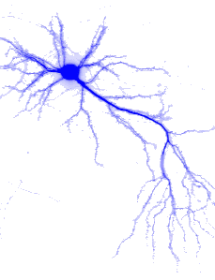
Feed-Forward Neural Networks
前馈神经网络

Slide 2
Content
Introduction
Single-Layer Perceptron Networks
Learning Rules for Single-Layer Perceptron Networks
  Perceptron Learning Rule
  Adaline Leaning Rule
  δ-Leaning Rule
Multilayer Perceptron
Back Propagation Learning algorithm

Slide 3
Feed-Forward Neural Networks
Introduction

Slide 4
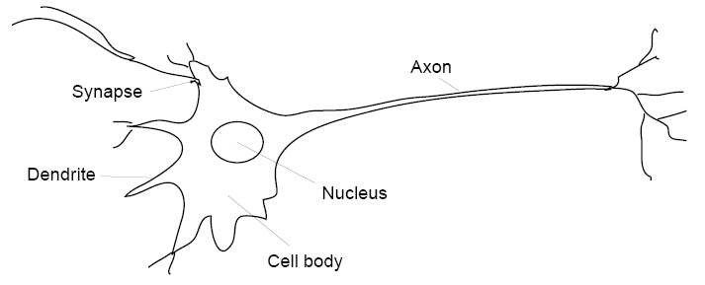
Neurons
The main purpose of neurons is to receive, analyze and transmit further the information in a form of signals (electric pulses).
When a neuron sends the information we say that a neuron “fires”.

Slide 5
A Model of Artificial Neuron
x₁
w_{i1}
x₂
∑
w_{i2}
y_{i}
.
.
.
f (.)
a (.)
w_{im} =θ_{i}
x_{m}= −1
bias

Slide 6
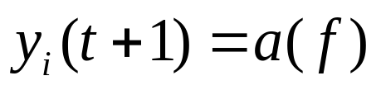
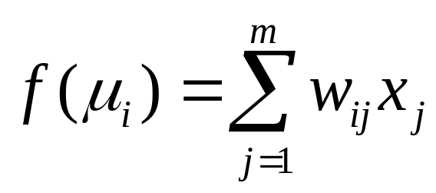
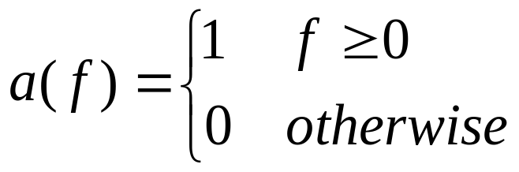
A Model of Artificial Neuron
x₁
w_{i1}
x₂
∑
w_{i2}
y_{i}
.
.
.
f (.)
a (.)
w_{im} =θ_{i}
x_{m}= −1
bias

Slide 7
Feed-Forward Neural Networks
Graph representation:
  nodes: neurons
  arrows: signal flow directions
A neural network that does not contain cycles (feedback loops) is called a feed–forward network (or perceptron).
y₁
y₂
y_{n}
. . .
. . .
. . .
. . .
x₁
x₂
x_{m}

Slide 8
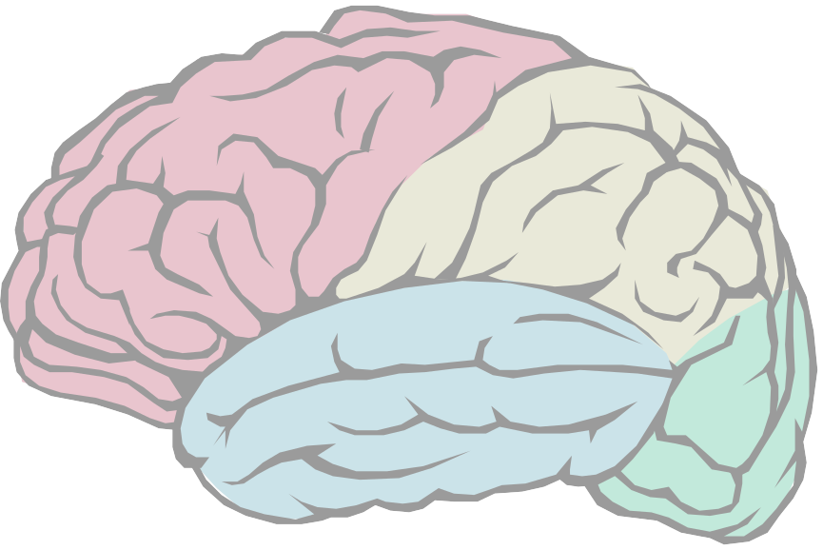
Layered Structure
y₁
y₂
y_{n}
Output Layer
. . .
Hidden Layer(s)
. . .
. . .
Input Layer
. . .
x₁
x₂
x_{m}

Slide 9
Knowledge and Memory
The output behavior of a network is determined by the weights.
Weights − the memory of an NN.
Knowledge − distributed across the network.
Large number of nodes
  increases the storage “capacity”;
  ensures that the knowledge is robust;
  fault tolerance.
Store new information by changing weights.
y₁
y₂
y_{n}
. . .
. . .
. . .
. . .
x₁
x₂
x_{m}

Slide 10
Pattern Classification
output pattern y
Function: x → y
The NN’s output is used to distinguish between and recognize different input patterns.
Different output patterns correspond to particular classes of input patterns.
Networks with hidden layers can be used for solving more complex problems then just a linear pattern classification.
y₁
y₂
y_{n}
. . .
. . .
. . .
. . .
x₁
x₂
x_{m}
input pattern x

Slide 11
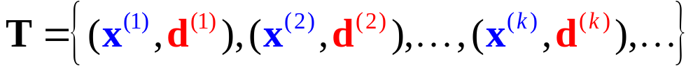
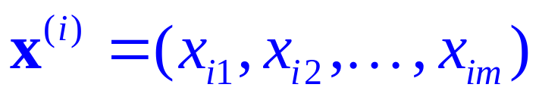
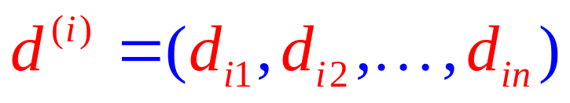
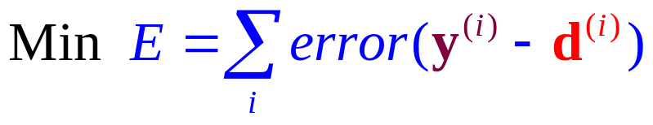
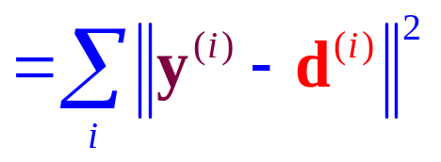
Training Set
Training
y_{i1}
y_{i2}
y_{in}
d_{i1}
d_{i2}
d_{in}
. . .
. . .
Goal:
. . .
. . .
x_{i1}
x_{i2}
x_{im}

Slide 12
Generalization
By properly training a neural network may produce reasonable answers for input patterns not seen during training (generalization).
Generalization is particularly useful for the analysis of a “noisy” data (e.g. time–series).
y₁
y₂
y_{n}
. . .
. . .
. . .
. . .
x₁
x₂
x_{m}

Slide 13
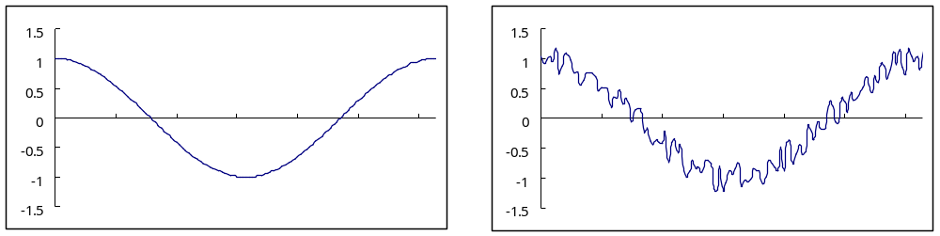
Generalization
By properly training a neural network may produce reasonable answers for input patterns not seen during training (generalization).
Generalization is particularly useful for the analysis of a “noisy” data (e.g. time–series).
y₁
y₂
y_{n}
. . .
. . .
. . .
without noise
with noise
. . .
x₁
x₂
x_{m}

Slide 14
Applications
Pattern classification
Object recognition
Function approximation
Data compression
Time series analysis and forecast
. . .

Slide 15
Feed-Forward Neural Networks
Single-Layer Perceptron Networks

Slide 16
The Single-Layered Perceptron
y₁
y₂
. . .
y_{n}
. . .
w_{1m}
w_{2m}
w_{n1}
w₁₂
w₂₂
w_{n2}
w₁₁
w₂₁
w_{nm}
. . .
x₁
x₂
x_{m-1}
x_{m}= −1

Slide 17
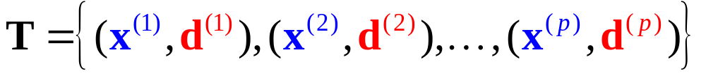


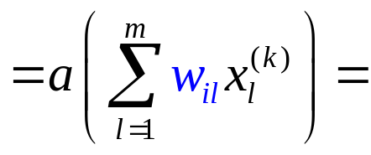

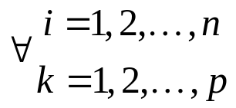
Training a Single-Layered Perceptron
Training Set
y₁
y₂
. . .
y_{n}
Goal:
d₁
d₂
d_{n}
. . .
w_{1m}
w_{2m}
w_{n1}
w₁₂
w₂₂
w_{n2}
w₁₁
w₂₁
w_{nm}
. . .
x₁
x₂
x_{m-1}
x_{m}= −1

Slide 18
Learning Rules
Linear Threshold Units (LTUs) : Perceptron Learning Rule
Linearly Graded Units (LGUs) : Widrow-Hoff learning Rule
Training Set
y₁
y₂
. . .
y_{n}
Goal:
d₁
d₂
d_{n}
. . .
w_{1m}
w_{2m}
w_{n1}
w₁₂
w₂₂
w_{n2}
w₁₁
w₂₁
w_{nm}
. . .
x₁
x₂
x_{m-1}
x_{m}= −1

Slide 19
Feed-Forward Neural Networks
Learning Rules for
Single-Layered Perceptron Networks
Perceptron Learning Rule
Adline Leaning Rule
δ-Learning Rule

Slide 20
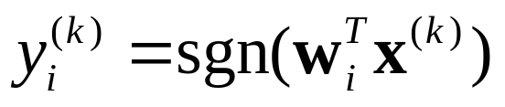
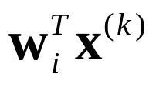
Perceptron
Linear Threshold Unit
x₁
w_{i1}
x₂
sgn
w_{i2}
∑
.
.
.
+1
−1
w_{im} =θ_{i}
x_{m}= −1

Slide 21
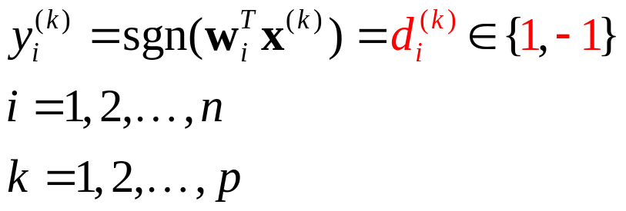
Goal:
Perceptron
Linear Threshold Unit
x₁
w_{i1}
x₂
sgn
w_{i2}
∑
.
.
.
+1
−1
w_{im} =θ_{i}
x_{m}= −1

Slide 22


Goal:
Example
Class 1 (+1)
Class 2 (−1)
x₂
y
Class 1
g(x) = −2x₁ +x₂+2=0
x₁
−2
1
−2
Class 2
x₁
x₂
x₃= −1

Slide 23
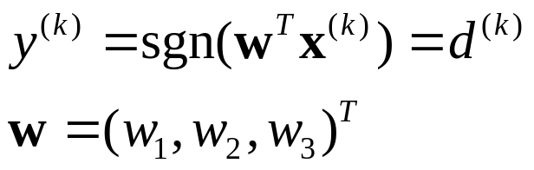
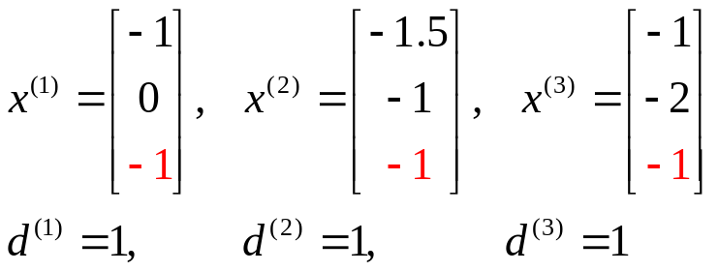
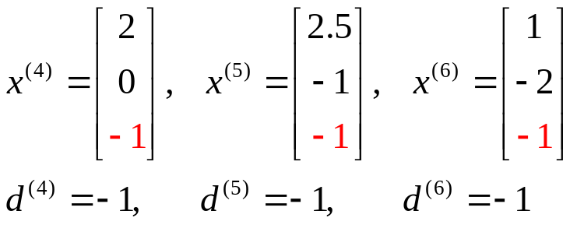
Goal:
Augmented input vector
Class 1 (+1)
Class 2 (−1)
y
Class 1 (+1)
−2
1
−2
Class 2 (−1)
x₁
x₂
x₃= −1

Slide 24


Goal:
Augmented input vector
x₃
x₂
x₁
(0,0,0)
Class 1
(−1,0, −1)
y
(−1.5, −1, −1)
(2,0, −1)
(2.5, −1, −1)
(−1, −2, −1)
(1, −2, −1)
−2
1
−2
Class 2
x₁
x₂
x₃= −1

Slide 25
Goal:
Augmented input vector
A plane passes through the origin in the augmented input space.
x₃
x₂
x₁
(0,0,0)
Class 1
(−1,0, −1)
y
(−1.5, −1, −1)
(2,0, −1)
(2.5, −1, −1)
(−1, −2, −1)
(1, −2, −1)
−2
1
−2
Class 2
x₁
x₂
x₃= −1

Slide 26
Linearly Separable vs.
Linearly Non-Separable
AND
OR
XOR
1
1
1
0
0
0
1
1
1
Linearly Separable
Linearly Separable
Linearly Non-Separable

Slide 27
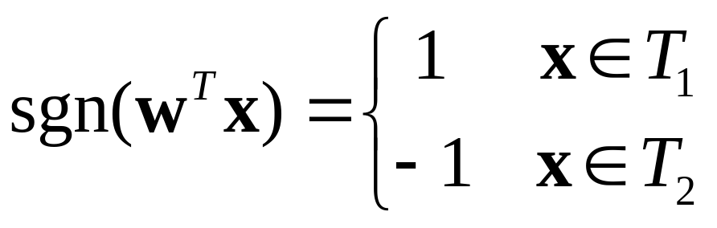
Goal
Given training sets T₁∈C₁ and T₂ ∈ C₂ with elements in form of x=(x₁, x₂ , ... , x_{m-1} , x_{m}) ^{T} , where x₁, x₂ , ... , x_{m-1} ∈R and x_{m}= −1.
Assume T₁ and T₂ are linearly separable.
Find w=(w₁, w₂ , ... , w_{m}) ^{T} such that

Slide 28
w^{T}x = 0 is a hyperplain passes through the origin of augmented input space.
Goal
Given training sets T₁∈C₁ and T₂ ∈ C₂ with elements in form of x=(x₁, x₂ , ... , x_{m-1} , x_{m}) ^{T} , where x₁, x₂ , ... , x_{m-1} ∈R and x_{m}= −1.
Assume T₁ and T₂ are linearly separable.
Find w=(w₁, w₂ , ... , w_{m}) ^{T} such that

Slide 29
d = +1
+
d = −1
Observation
−
x₂
Which w’s correctly classify x?
+
w₁
x
w₂
w₆
x₁
w₅
w₃
What trick can be used?
w₄

Slide 30
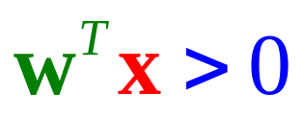
d = +1
+
d = −1
Observation
−
x₂
Is this w ok?
+
w
x
w₁x₁ +w₂x₂ = 0
x₁

Slide 31

d = +1
+
d = −1
Observation
−
x₂
w₁x₁ +w₂x₂ = 0
Is this w ok?
+
x
x₁
w

Slide 32
d = +1
+
d = −1
Observation
−
x₂
w₁x₁ +w₂x₂ = 0
Is this w ok?
+
x
How to adjust w?
?
x₁
w
?
Δw = ?

Slide 33
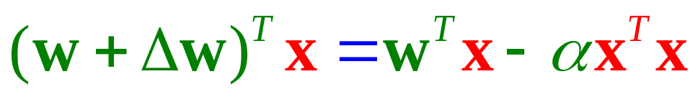
d = +1
+
d = −1
Observation
−
x₂
Is this w ok?
+
x
How to adjust w?
x₁
w
Δw = −αx
reasonable?
<0
>0

Slide 34
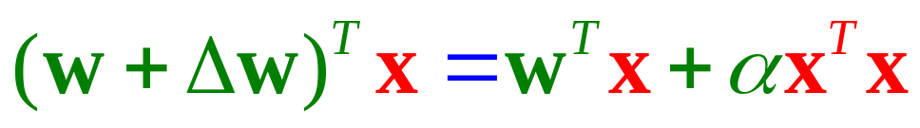
d = +1
+
d = −1
Observation
−
x₂
Is this w ok?
+
x
reasonable?
How to adjust w?
Δw = αx
x₁
w
<0
>0

Slide 35
d = +1
+
d = −1
Observation
−
x₂
Is this w ok?
−
w
x
Δw = ?
x₁
+αx
−αx
or

Slide 36
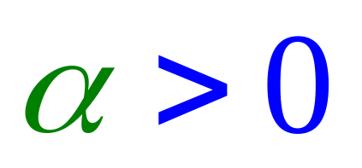


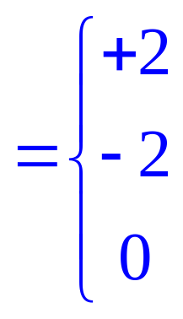
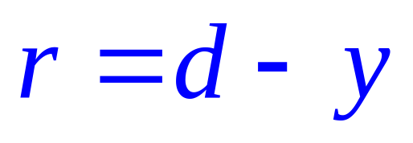
Perceptron Learning Rule
Upon misclassification on
d = +1
+
d = −1
−
Define error
+
−
−
+
No error

Slide 37

Perceptron Learning Rule
Define error
+
−
−
+
No error

Slide 38
Perceptron Learning Rule
Learning Rate
Error (d − y)
Input

Slide 39
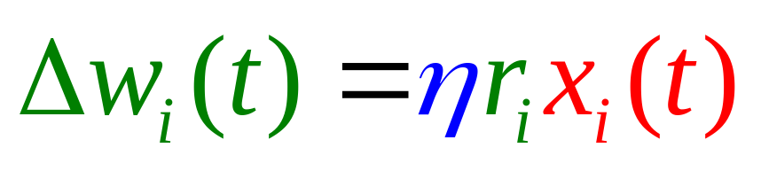
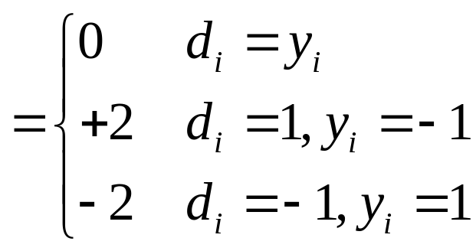
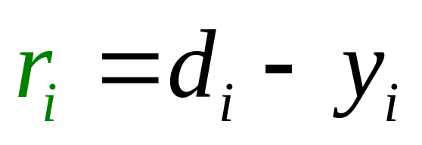
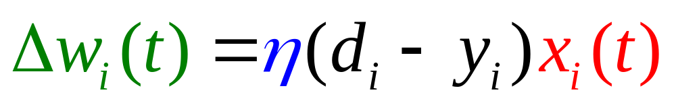
Based on the general weight learning rule.
Summary −
Perceptron Learning Rule
correct
incorrect

Slide 40


Converge?
Summary −
Perceptron Learning Rule
x
y
.
.
.
.
.
.
−
d
+
η

Slide 41
Perceptron Convergence Theorem
If the given training set is linearly separable, the learning process will converge in a finite number of steps.
x
y
.
.
.
.
.
.
−
d
+
η

Slide 42
Linearly Separable.
The Learning Scenario
x₂
x⁽¹⁾
+
x⁽²⁾
+
x₁
x⁽³⁾
−
x⁽⁴⁾
−

Slide 43
The Learning Scenario
x₂
x⁽¹⁾
+
x⁽²⁾
+
x₁
x⁽³⁾
−
x⁽⁴⁾
w₀
−

Slide 44
The Learning Scenario
x₂
x⁽¹⁾
+
x⁽²⁾
w₁
+
x₁
Δw₀
x⁽³⁾
−
x⁽⁴⁾
w₀
−

Slide 45
The Learning Scenario
x₂
x⁽¹⁾
w₂
+
Δw₁
x⁽²⁾
w₁
+
x₁
Δw₀
x⁽³⁾
−
x⁽⁴⁾
w₀
−

Slide 46
The Learning Scenario
x₂
Δw₂
x⁽¹⁾
w₃
w₂
+
Δw₁
x⁽²⁾
w₁
+
x₁
Δw₀
x⁽³⁾
−
x⁽⁴⁾
w₀
−

Slide 47
w₄ = w₃
The Learning Scenario
x₂
Δw₂
x⁽¹⁾
w₃
w₂
+
Δw₁
x⁽²⁾
w₁
+
x₁
Δw₀
x⁽³⁾
−
x⁽⁴⁾
w₀
−

Slide 48

The Learning Scenario
x₂
x⁽¹⁾
w
+
x⁽²⁾
+
x₁
x⁽³⁾
−
x⁽⁴⁾
−

Slide 49
The demonstration is in augmented space.
The Learning Scenario
x₂
x⁽¹⁾
w
+
x⁽²⁾
+
x₁
x⁽³⁾
−
x⁽⁴⁾
−
Conceptually, in augmented space, we adjust the weight vector to fit the data.

Slide 50
A weight in the shaded area will give correct classification for the positive example.
Weight Space
w₂
w
x
+
w₁

Slide 51
A weight in the shaded area will give correct classification for the positive example.
Weight Space
w₂
Δw = αx
x
w
+
w₁

Slide 52
A weight not in the shaded area will give correct classification for the negative example.
Weight Space
w₂
x
−
w₁
w

Slide 53
A weight not in the shaded area will give correct classification for the negative example.
Weight Space
w₂
w
Δw = −αx
x
−
w₁

Slide 54
The Learning Scenario in Weight Space
w₂
x⁽²⁾
x⁽¹⁾
+
+
w₁
x⁽³⁾
−
x⁽⁴⁾
−

Slide 55
To correctly classify the training set, the weight must move into the shaded area.
The Learning Scenario in Weight Space
w₂
x⁽²⁾
x⁽¹⁾
+
+
w₁
x⁽³⁾
−
x⁽⁴⁾
−

Slide 56
To correctly classify the training set, the weight must move into the shaded area.
The Learning Scenario in Weight Space
w₂
x⁽²⁾
x⁽¹⁾
+
+
w₁
w₁
x⁽³⁾
−
x⁽⁴⁾
−
w₀

Slide 57
To correctly classify the training set, the weight must move into the shaded area.
The Learning Scenario in Weight Space
w₂
x⁽²⁾
x⁽¹⁾
+
+
w₂
w₁
w₁
x⁽³⁾
−
x⁽⁴⁾
−
w₀

Slide 58
To correctly classify the training set, the weight must move into the shaded area.
The Learning Scenario in Weight Space
w₂
x⁽²⁾
x⁽¹⁾
+
+
w₂
=w₃
w₁
w₁
x⁽³⁾
−
x⁽⁴⁾
−
w₀

Slide 59
To correctly classify the training set, the weight must move into the shaded area.
The Learning Scenario in Weight Space
w₂
x⁽²⁾
x⁽¹⁾
+
+
w₄
w₂
=w₃
w₁
w₁
x⁽³⁾
−
x⁽⁴⁾
−
w₀

Slide 60
To correctly classify the training set, the weight must move into the shaded area.
The Learning Scenario in Weight Space
w₂
x⁽²⁾
x⁽¹⁾
+
+
w₄
w₂
=w₃
w₅
w₁
w₁
x⁽³⁾
−
x⁽⁴⁾
−
w₀

Slide 61
To correctly classify the training set, the weight must move into the shaded area.
The Learning Scenario in Weight Space
w₂
x⁽²⁾
x⁽¹⁾
+
+
w₄
w₂
=w₃
w₅
w₆
w₁
w₁
x⁽³⁾
−
x⁽⁴⁾
−
w₀

Slide 62
To correctly classify the training set, the weight must move into the shaded area.
The Learning Scenario in Weight Space
w₂
x⁽²⁾
w₇
x⁽¹⁾
+
+
w₄
w₂
=w₃
w₅
w₆
w₁
w₁
x⁽³⁾
−
x⁽⁴⁾
−
w₀

Slide 63
To correctly classify the training set, the weight must move into the shaded area.
The Learning Scenario in Weight Space
w₂
w₈
x⁽²⁾
w₇
x⁽¹⁾
+
+
w₄
w₂
=w₃
w₅
w₆
w₁
w₁
x⁽³⁾
−
x⁽⁴⁾
−
w₀

Slide 64
To correctly classify the training set, the weight must move into the shaded area.
The Learning Scenario in Weight Space
w₉
w₂
w₈
x⁽²⁾
w₇
x⁽¹⁾
+
+
w₄
w₂
=w₃
w₅
w₆
w₁
w₁
x⁽³⁾
−
x⁽⁴⁾
−
w₀

Slide 65
To correctly classify the training set, the weight must move into the shaded area.
The Learning Scenario in Weight Space
w₁₀
w₉
w₂
w₈
x⁽²⁾
w₇
x⁽¹⁾
+
+
w₄
w₂
=w₃
w₅
w₆
w₁
w₁
x⁽³⁾
−
x⁽⁴⁾
−
w₀

Slide 66
To correctly classify the training set, the weight must move into the shaded area.
The Learning Scenario in Weight Space
w₁₀
w₉
w₂
w₁₁
w₈
x⁽²⁾
w₇
x⁽¹⁾
+
+
w₄
w₂
=w₃
w₅
w₆
w₁
w₁
x⁽³⁾
−
x⁽⁴⁾
−
w₀

Slide 67
To correctly classify the training set, the weight must move into the shaded area.
The Learning Scenario in Weight Space
w₂
w₁₁
x⁽²⁾
x⁽¹⁾
+
+
w₁
x⁽³⁾
−
x⁽⁴⁾
−
w₀
Conceptually, in weight space, we move the weight into the feasible region.

Slide 68
Feed-Forward Neural Networks
Learning Rules for
Single-Layered Perceptron Networks
Perceptron Learning Rule
Adaline Leaning Rule
δ-Learning Rule

Slide 69
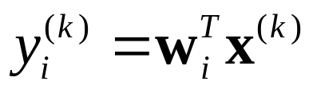
Adaline (Adaptive Linear Element)
Widrow [1962]
x₁
w_{i1}
x₂
w_{i2}
∑
.
.
.
w_{im}
x_{m}

Slide 70
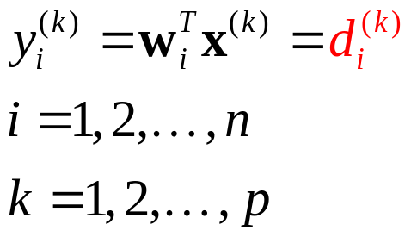
In what condition, the goal is reachable?
Adaline (Adaptive Linear Element)
Widrow [1962]
Goal:
x₁
w_{i1}
x₂
w_{i2}
∑
.
.
.
w_{im}
x_{m}

Slide 71
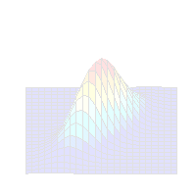
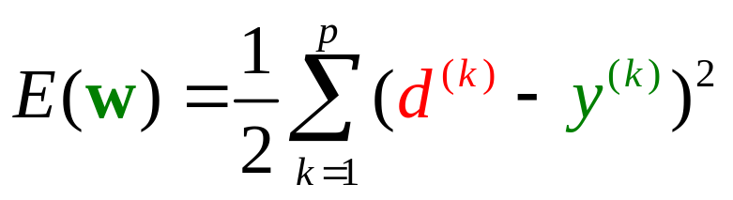
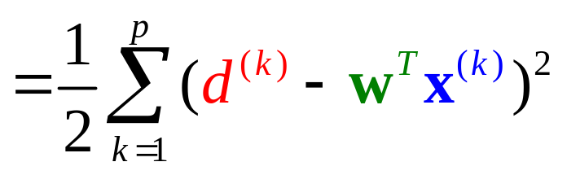
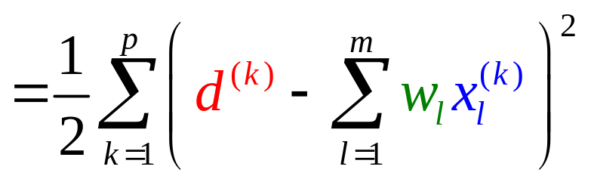
LMS (Least Mean Square)
Minimize the cost function (error function):

Slide 72
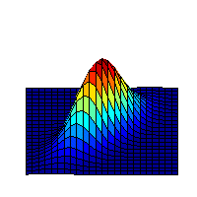
Our goal is to go downhill.
Gradient Decent Algorithm
E(w)
w₂
Contour Map
Δw
Δw₂
(w₁, w₂)
w₁
Δw₁

Slide 73
Our goal is to go downhill.
Gradient Decent Algorithm
How to find the steepest decent direction?
E(w)
w₂
Contour Map
Δw
Δw₂
(w₁, w₂)
w₁
Δw₁

Slide 74
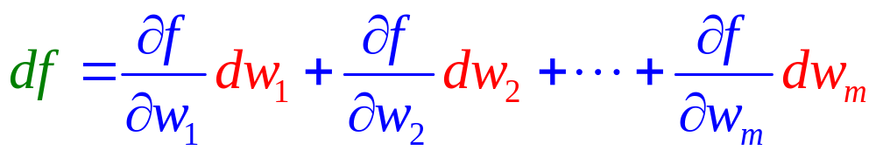
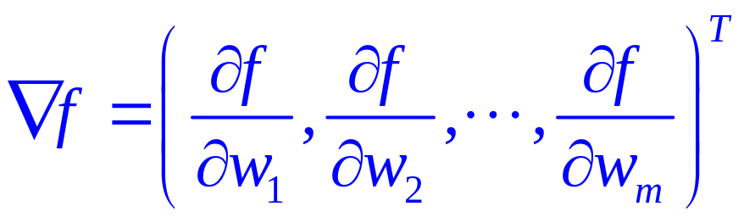
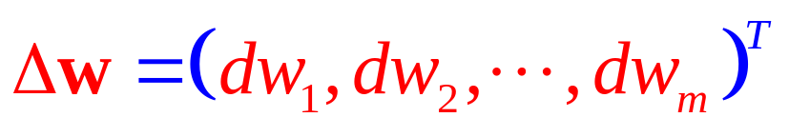
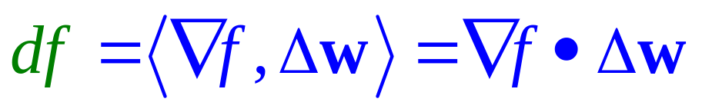
Gradient Operator
Let f(w) = f (w₁, w₂,…, w_{m}) be a function over R^{m}.
Define

Slide 75
Gradient Operator
Δw
∇f
Δw
∇f
∇f
Δw
df : positive
df : zero
df : negative
Go uphill
Plain
Go downhill

Slide 76
The Steepest Decent Direction
To minimize f , we choose
Δw = −η ∇ f
Δw
∇f
Δw
∇f
∇f
Δw
df : positive
df : zero
df : negative
Go uphill
Plain
Go downhill

Slide 77
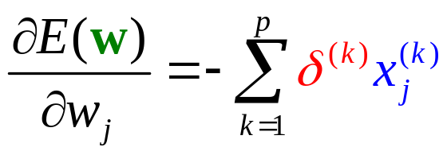

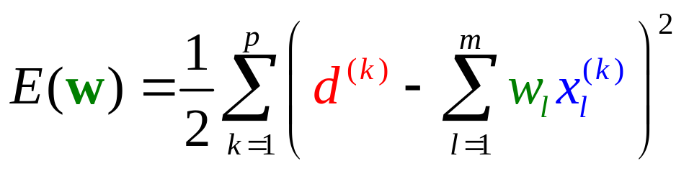
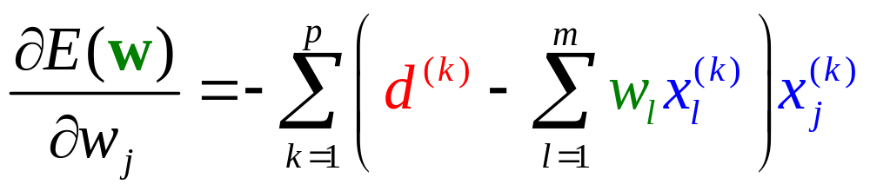
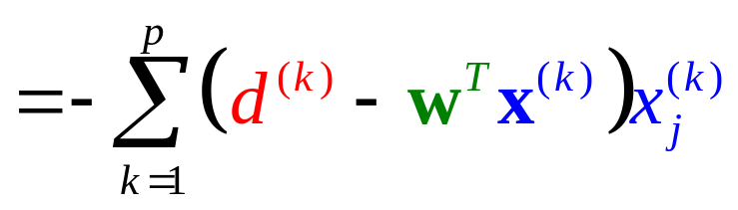
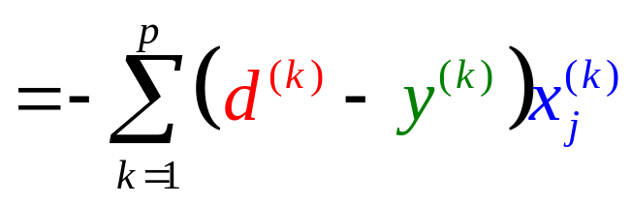
LMS (Least Mean Square)
Minimize the cost function (error function):
δ ^{(k)}

Slide 78
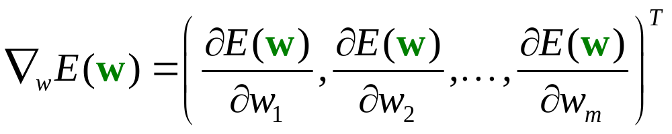

Adaline Learning Rule
Minimize the cost function (error function):
Weight Modification Rule

Slide 79
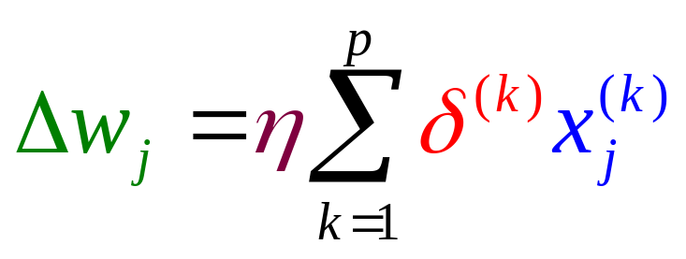

Learning Modes
Batch Learning Mode:
Incremental Learning Mode:

Slide 80

δ-Learning Rule
LMS Algorithm
Widrow-Hoff Learning Rule
Summary −
Adaline Learning Rule
Converge?
x
y
.
.
.
.
.
.
−
δ
d
+
η

Slide 81
LMS Convergence
Based on the independence theory (Widrow, 1976).
The successive input vectors are statistically independent.
At time t, the input vector x(t) is statistically independent of all previous samples of the desired response, namely d(1), d(2), …, d(t−1).
At time t, the desired response d(t) is dependent on x(t), but statistically independent of all previous values of the desired response.
The input vector x(t) and desired response d(t) are drawn from Gaussian distributed populations.

Slide 82


LMS Convergence
It can be shown that LMS is convergent if
where λ_{max} is the largest eigenvalue of the correlation matrix R_{x} for the inputs.

Slide 83

Since λ_{max} is hardly available, we commonly use
LMS Convergence
It can be shown that LMS is convergent if
where λ_{max} is the largest eigenvalue of the correlation matrix R_{x} for the inputs.

Slide 84
Comparisons
Adaline
Learning Rule
(Widrow-Hoff)
Perceptron
Learning Rule
Hebbian
Assumption
Gradient
Decent
Fundamental
Converge
Asymptotically
Convergence
In finite steps
Linearly
Separable
Linear
Independence
Constraint

Slide 85
Feed-Forward Neural Networks
Learning Rules for
Single-Layered Perceptron Networks
Perceptron Learning Rule
Adaline Leaning Rule
δ-Learning Rule

Slide 86
Adaline
x₁
w_{i1}
x₂
w_{i2}
∑
.
.
.
w_{im}
x_{m}

Slide 87


Unipolar Sigmoid
x₁
w_{i1}
x₂
w_{i2}
∑
.
.
.
w_{im}
x_{m}

Slide 88

Bipolar Sigmoid
x₁
w_{i1}
x₂
w_{i2}
∑
.
.
.
w_{im}
x_{m}

Slide 89

Goal
Minimize

Slide 90

Gradient Decent Algorithm
Minimize

Slide 91






The Gradient
Minimize
Depends on the activation function used.
?
?

Slide 92





Weight Modification Rule
Minimize
Batch
Learning Rule
Incremental

Slide 93





The Learning Efficacy
Minimize
Sigmoid
Adaline
Unipolar
Bipolar
Exercise

Slide 94



Learning Rule − Unipolar Sigmoid
Minimize
Weight Modification Rule

Slide 95





Comparisons
Batch
Adaline
Incremental
Batch
Sigmoid
Incremental

Slide 96

The Learning Efficacy
Adaline
Sigmoid
y=a(net) = net
y=a(net)
net
net
constant
depends on output

Slide 97
The Learning Efficacy
Adaline
Sigmoid
The learning efficacy of Adaline is constant meaning that the Adline will never get saturated.
y=a(net) = net
y=a(net)
a’(net)
net
1
net
y=net
constant
depends on output

Slide 98

The Learning Efficacy
The sigmoid will get saturated if its output value nears the two extremes.
Sigmoid
Adaline
y=a(net) = net
y=a(net)
a’(net)
net
net
0
1
y
depends on output
constant

Slide 99
Initialization for Sigmoid Neurons
Before training, it weight must be sufficiently small.
Why?
x₁
w_{i1}
x₂
w_{i2}
∑
.
.
.
w_{im}
x_{m}

Slide 100
Feed-Forward Neural Networks
Multilayer Perceptron

Slide 101
Multilayer Perceptron
y₁
y₂
y_{n}
Output Layer
. . .
Hidden Layer
. . .
. . .
Input Layer
. . .
x₁
x₂
x_{m}

Slide 102
How an MLP Works?
Example:
Not linearly separable.
Is a single layer perceptron workable?
XOR
x₂
1
0
x₁
1

Slide 103
How an MLP Works?
Example:
XOR
L₁
00
y₁
y₂
L₂
x₂
01
L₁
L₂
1
11
x₁
x₂
x₃= −1
0
x₁
1

Slide 104
How an MLP Works?
Example:
XOR
L₁
L₃
00
L₂
x₂
01
y₂
1
1
11
0
x₁
0
y₁
1
1

Slide 105
How an MLP Works?
Example:
XOR
L₁
L₃
00
L₂
x₂
01
y₂
1
1
11
0
x₁
0
y₁
1
1

Slide 106
How an MLP Works?
Example:
z
L₃
L₃
y₂
y₁
y₂
1
L₁
L₂
y₃= −1
0
y₁
x₁
x₂
x₃= −1
1

Slide 107
Is the problem linearly separable?
Parity Problem
x₁ x₂ x₃
x₃
000
0
001
1
010
1
011
0
100
1
x₂
101
0
110
0
111
1
x₁

Slide 108
Parity Problem
x₁ x₂ x₃
x₃
000
0
001
1
P₁
010
1
011
0
100
1
P₂
P₃
x₂
101
0
110
0
111
1
x₁

Slide 109
Parity Problem
x₁ x₂ x₃
x₃
000
0
001
1
P₁
010
1
111
011
0
100
1
P₂
P₃
x₂
101
0
011
110
0
111
1
x₁
000
001

Slide 110
Parity Problem
x₃
P₁
y₁
y₂
y₃
111
P₁
P₂
P₃
P₂
P₃
x₂
011
x₁
x₂
x₃
x₁
000
001

Slide 111
Parity Problem
y₃
x₃
P₁
111
P₄
y₂
P₂
P₃
x₂
011
y₁
x₁
000
001

Slide 112
Parity Problem
z
y₃
P₄
y₁
y₃
y₂
P₄
P₁
P₂
P₃
y₂
y₁
x₁
x₂
x₃

Slide 113
General Problem

Slide 114
General Problem

Slide 115
Hyperspace Partition
L₃
L₁
L₂

Slide 116
Region Encoding
000
001
L₃
L₁
010
100
101
110
111
L₂

Slide 117
Hyperspace Partition &
Region Encoding Layer
000
L₃
001
L₁
L₁
L₂
L₃
010
100
101
x₁
110
x₂
x₃
111
L₂

Slide 118
Region Identification Layer
101
000
L₃
001
L₁
L₁
L₂
L₃
010
100
101
x₁
110
x₂
x₃
111
L₂

Slide 119
Region Identification Layer
001
000
L₃
001
L₁
L₁
L₂
L₃
010
100
101
x₁
110
x₂
x₃
111
L₂

Slide 120
Region Identification Layer
000
000
L₃
001
L₁
L₁
L₂
L₃
010
100
101
x₁
110
x₂
x₃
111
L₂

Slide 121
Region Identification Layer
110
000
L₃
001
L₁
L₁
L₂
L₃
010
100
101
x₁
110
x₂
x₃
111
L₂

Slide 122
Region Identification Layer
010
000
L₃
001
L₁
L₁
L₂
L₃
010
100
101
x₁
110
x₂
x₃
111
L₂

Slide 123
Region Identification Layer
100
000
L₃
001
L₁
L₁
L₂
L₃
010
100
101
x₁
110
x₂
x₃
111
L₂

Slide 124
Region Identification Layer
111
000
L₃
001
L₁
L₁
L₂
L₃
010
100
101
x₁
110
x₂
x₃
111
L₂

Slide 125
Classification
0
0
−1
1
1
101
101
001
001
000
110
010
100
111
000
L₃
001
L₁
L₁
L₂
L₃
010
100
101
x₁
110
x₂
x₃
111
L₂

Slide 126
Feed-Forward Neural Networks
Back Propagation Learning algorithm

Slide 127




Activation Function — Sigmoid
1
0.5
net
0
Remember this

Slide 128
Training Set
Supervised Learning
o₁
o₂
o_{n}
d₁
d₂
d_{n}
Output Layer
. . .
Hidden Layer
. . .
. . .
Input Layer
. . .
x₁
x₂
x_{m}

Slide 129


Training Set
Supervised Learning
Sum of Squared Errors
o₁
o₂
o_{n}
d₁
d₂
d_{n}
. . .
. . .
Goal:
. . .
Minimize
. . .
x₁
x₂
x_{m}

Slide 130
Back Propagation Learning Algorithm
o₁
o₂
o_{n}
d₁
d₂
d_{n}
Learning on Output Neurons
Learning on Hidden Neurons
. . .
. . .
. . .
. . .
x₁
x₂
x_{m}

Slide 131




Learning on Output Neurons
o₁
o_{j}
o_{n}
d₁
d_{j}
d_{n}
. . .
j
. . .
w_{ji}
. . .
i
. . .
. . .
. . .
?
?
. . .
. . .

Slide 132


Learning on Output Neurons
o₁
o_{j}
o_{n}
d₁
d_{j}
d_{n}
. . .
j
. . .
w_{ji}
. . .
i
. . .
. . .
. . .
. . .
. . .
depends on the activation function

Slide 133


Learning on Output Neurons
o₁
o_{j}
o_{n}
d₁
d_{j}
d_{n}
. . .
j
. . .
w_{ji}
. . .
i
. . .
. . .
. . .
. . .
. . .
Using sigmoid,

Slide 134


Learning on Output Neurons
o₁
o_{j}
o_{n}
d₁
d_{j}
d_{n}
. . .
j
. . .
w_{ji}
. . .
i
. . .
. . .
. . .
. . .
. . .
Using sigmoid,

Slide 135



Learning on Output Neurons
o₁
o_{j}
o_{n}
d₁
d_{j}
d_{n}
. . .
j
. . .
w_{ji}
. . .
i
. . .
. . .
. . .
. . .
. . .

Slide 136


Learning on Output Neurons
o₁
o_{j}
o_{n}
d₁
d_{j}
d_{n}
. . .
j
. . .
How to train the weights connecting to output neurons?
w_{ji}
. . .
i
. . .
. . .
. . .
. . .
. . .

Slide 137


Learning on Hidden Neurons
. . .
j
. . .
w_{ji}
. . .
i
. . .
?
?
w_{ik}
. . .
k
. . .
. . .
. . .

Slide 138


Learning on Hidden Neurons
. . .
j
. . .
w_{ji}
. . .
i
. . .
w_{ik}
. . .
k
. . .
. . .
. . .

Slide 139


Learning on Hidden Neurons
. . .
j
. . .
w_{ji}
. . .
i
. . .
w_{ik}
. . .
k
. . .
?
. . .
. . .

Slide 140




Learning on Hidden Neurons
. . .
j
. . .
w_{ji}
. . .
i
. . .
w_{ik}
. . .
k
. . .
. . .
. . .

Slide 141


Learning on Hidden Neurons
. . .
j
. . .
w_{ji}
. . .
i
. . .
w_{ik}
. . .
k
. . .
. . .
. . .

Slide 142
Back Propagation
o₁
o_{j}
o_{n}
d₁
d_{j}
d_{n}
. . .
j
. . .
. . .
i
. . .
. . .
k
. . .
. . .
. . .
x₁
. . .
x_{m}

Slide 143

Back Propagation
o₁
o_{j}
o_{n}
d₁
d_{j}
d_{n}
. . .
j
. . .
. . .
i
. . .
. . .
k
. . .
. . .
. . .
x₁
. . .
x_{m}

Slide 144

Back Propagation
o₁
o_{j}
o_{n}
d₁
d_{j}
d_{n}
. . .
j
. . .
. . .
i
. . .
. . .
k
. . .
. . .
. . .
x₁
. . .
x_{m}

Slide 145
Learning Factors
Initial Weights
Learning Constant (η)
Cost Functions
Momentum
Update Rules
Training Data and Generalization
Number of Layers
Number of Hidden Nodes

Slide 146
Reading
Shi Zhong and Vladimir Cherkassky, “Factors Controlling Generalization Ability of MLP Networks.” In Proc. IEEE Int. Joint Conf. on Neural Networks, vol. 1, pp. 625-630, Washington DC. July 1999. (http://www.cse.fau.edu/~zhong/pubs.htm)
Rumelhart, D. E., Hinton, G. E., and Williams, R. J. (1986b). "Learning Internal Representations by Error Propagation," in Parallel Distributed Processing: Explorations in the Microstructure of Cognition, vol. I, D. E. Rumelhart, J. L. McClelland, and the PDP Research Group. MIT Press, Cambridge (1986).
(http://www.cnbc.cmu.edu/~plaut/85-419/papers/RumelhartETAL86.backprop.pdf).

