Slide 1
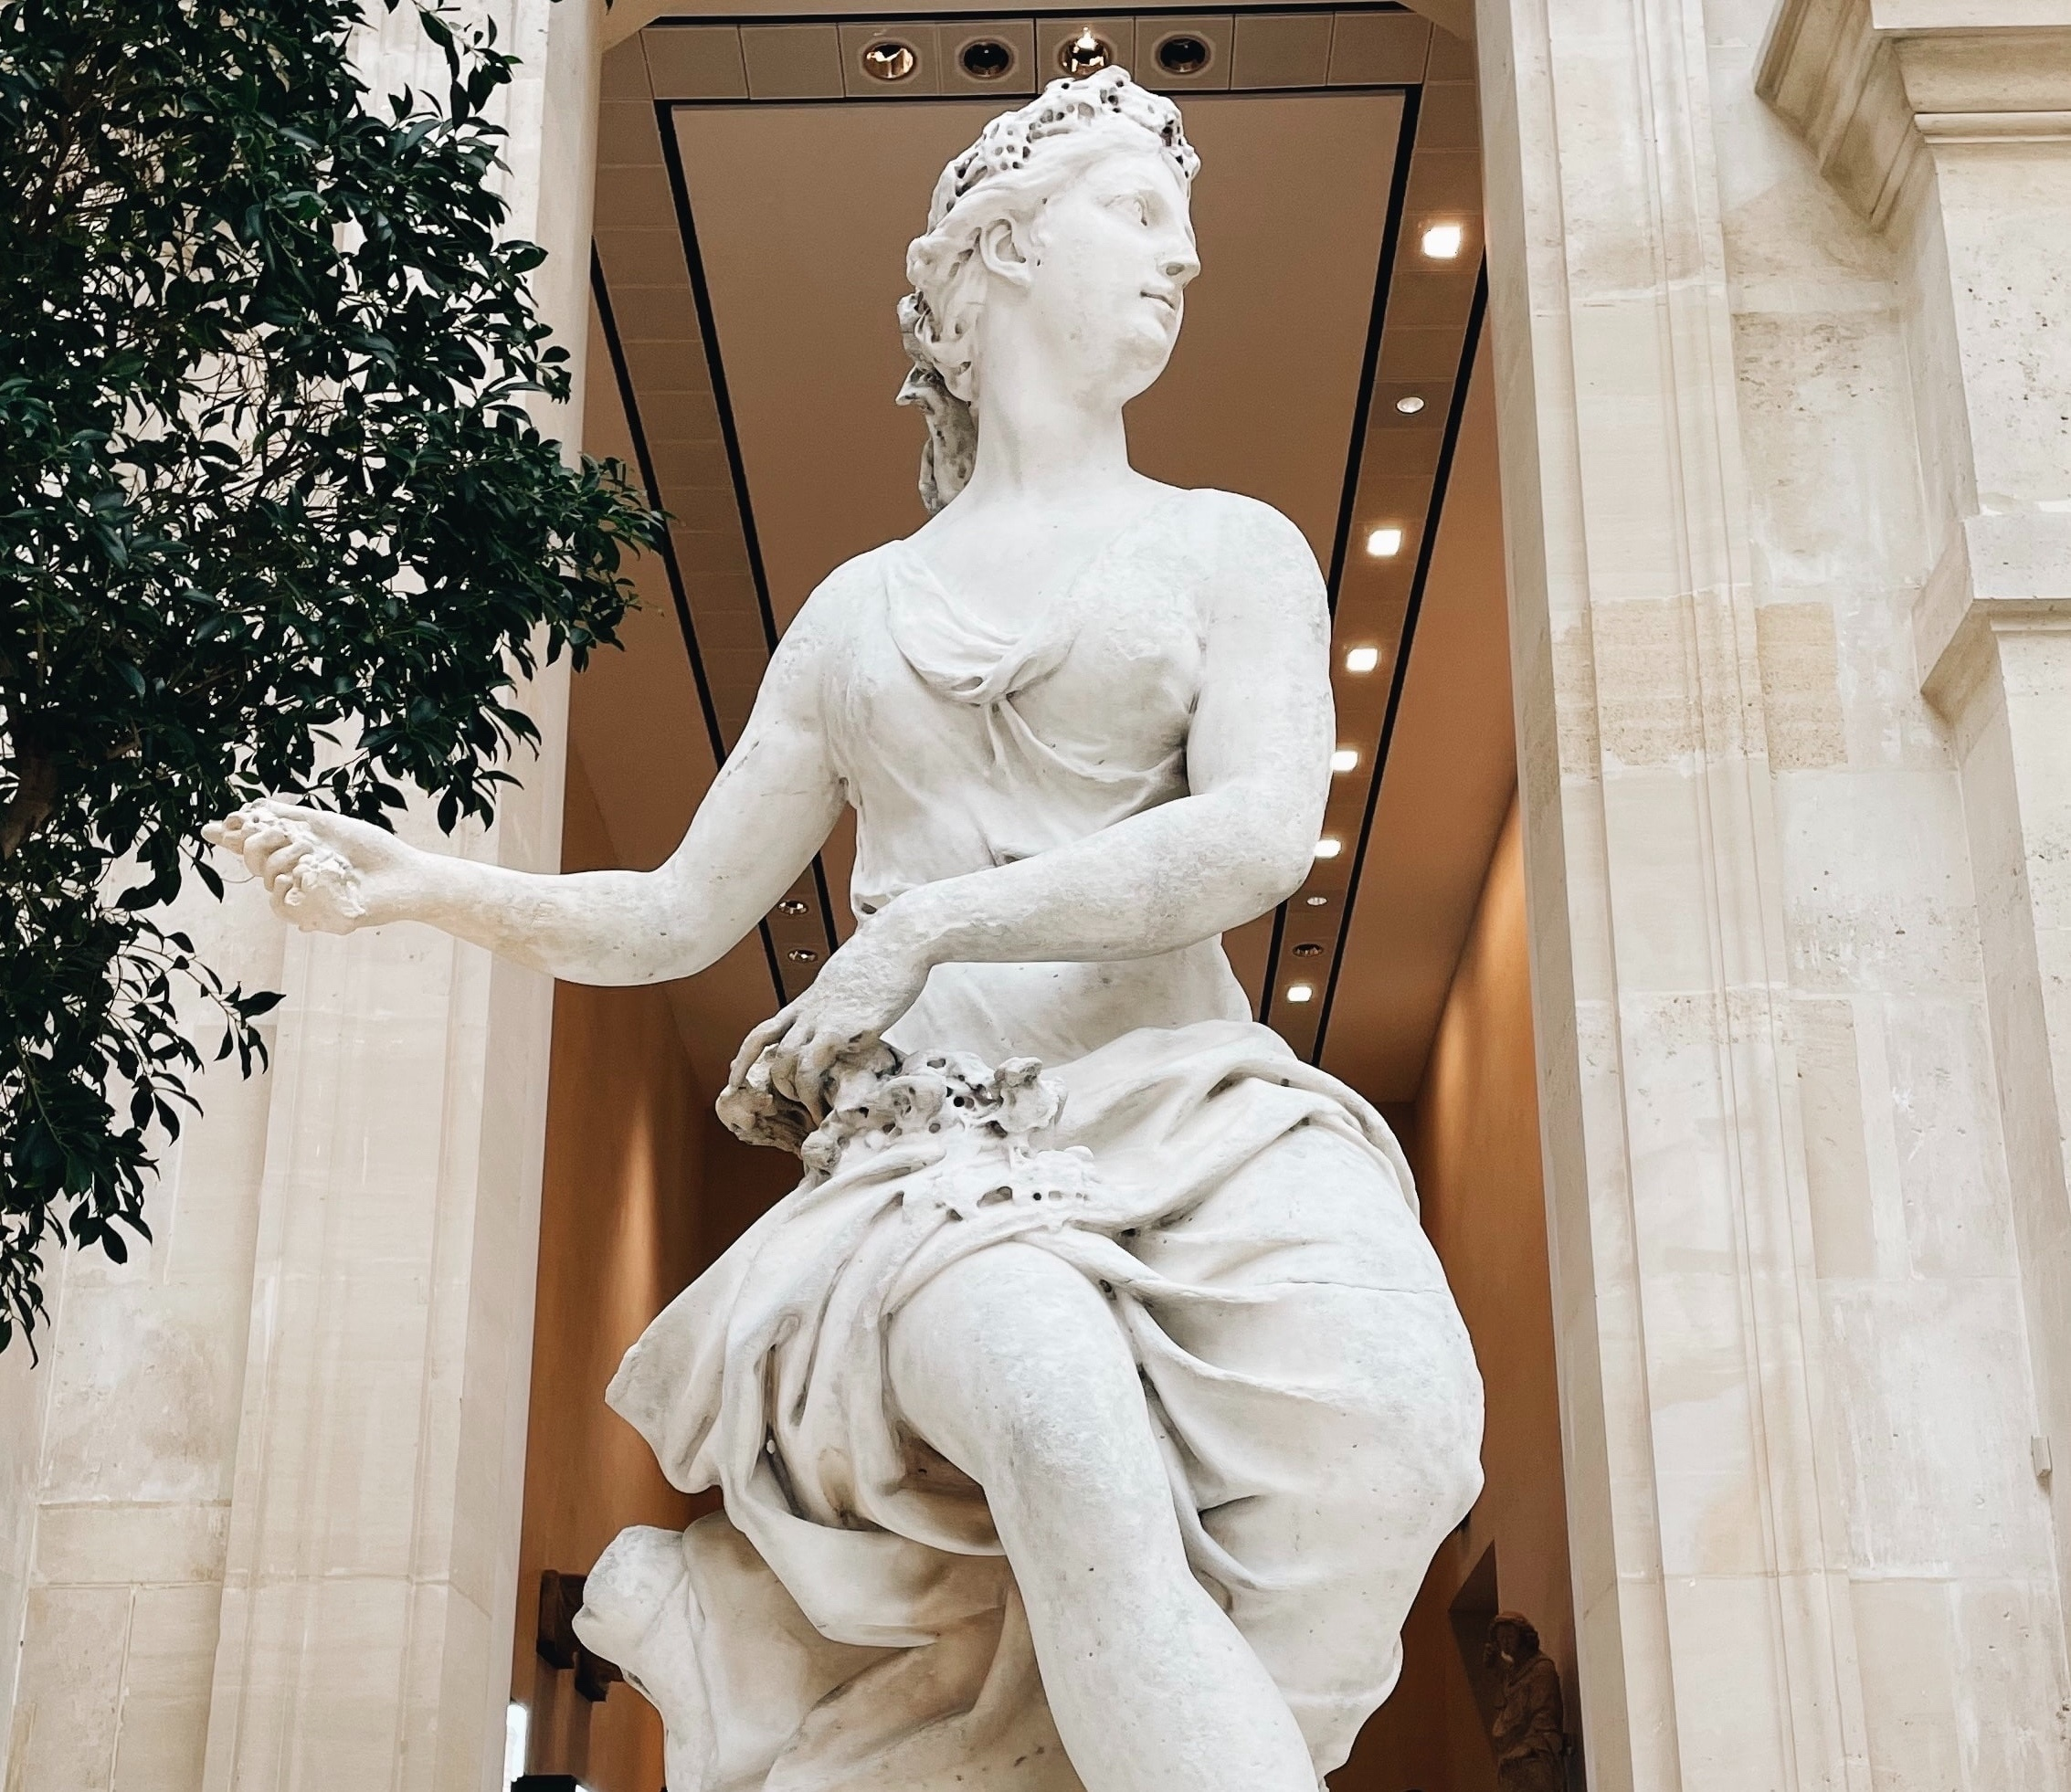
Campaign Simulation Results

