Slide 1
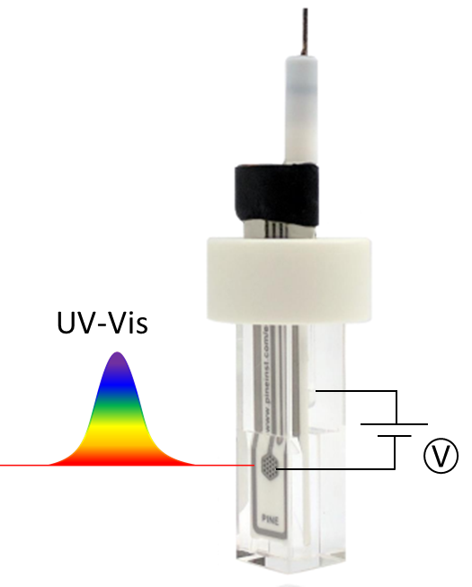
Spectroelectrochemsitry on OmcS Nanowires
02/15/2022
Sample Goes Here Solution State
Catharine Shipps
Pilar Portela

Slide 2
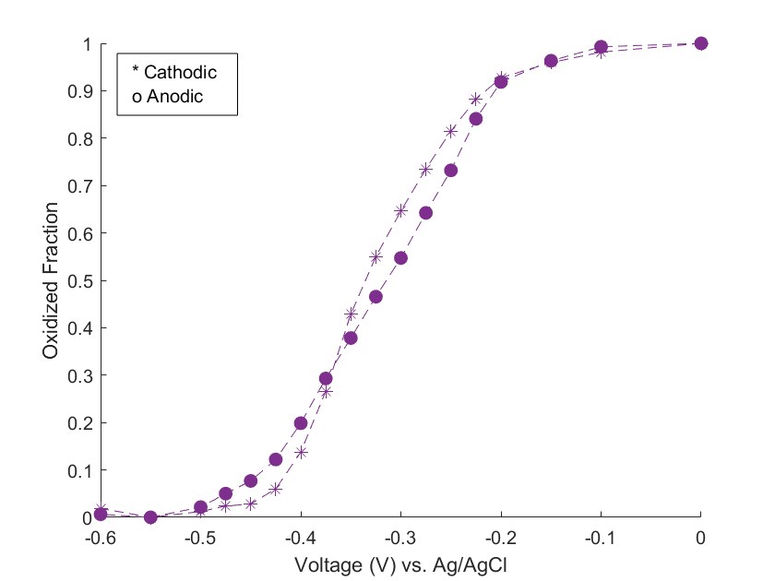
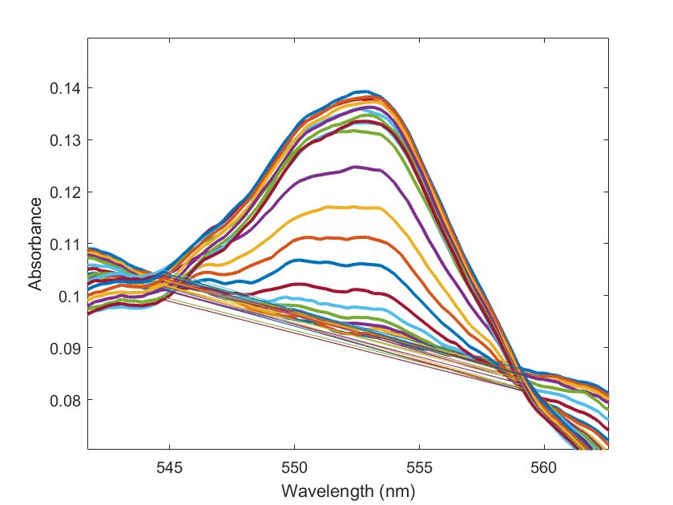
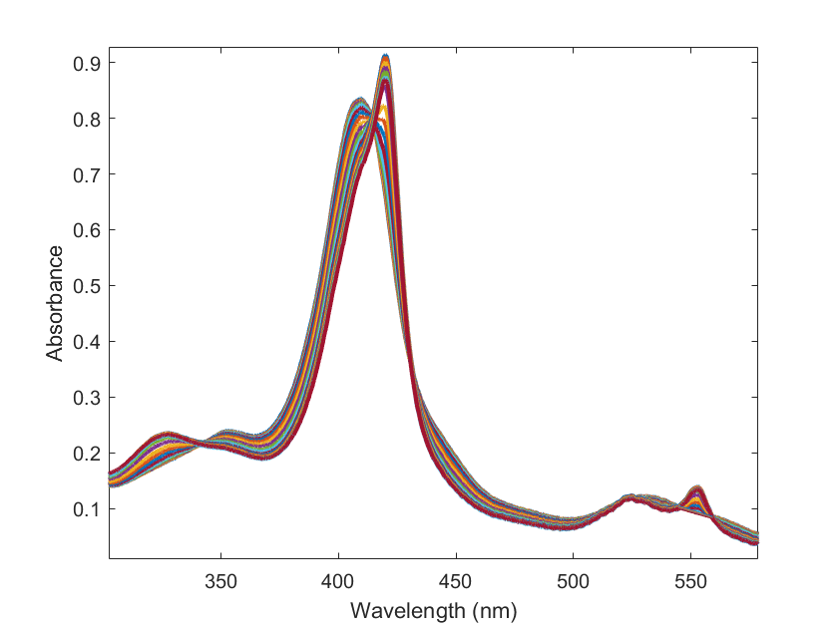
Trial 1: 33μM OmcS protein, 1uM mediators
544
559

Slide 3
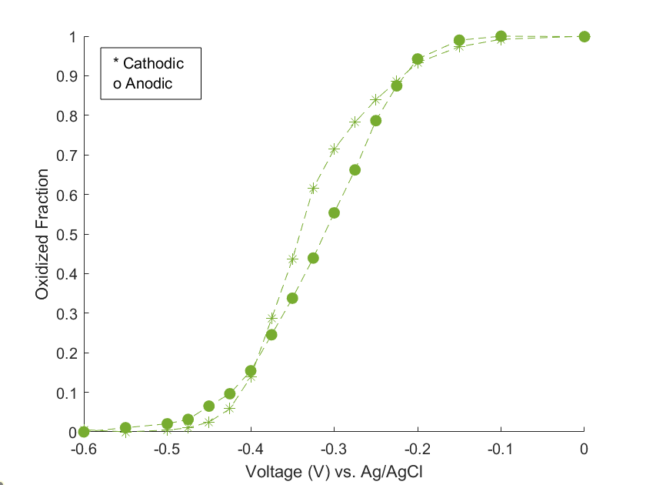
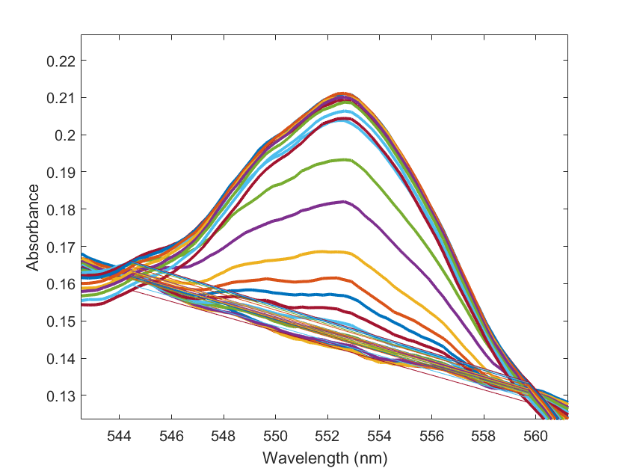
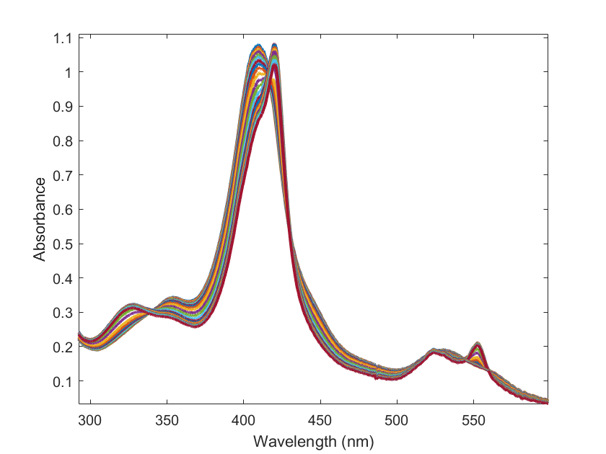
Trial 2: 45μM OmcS protein, 1 uM Mediators
544
559

Slide 4
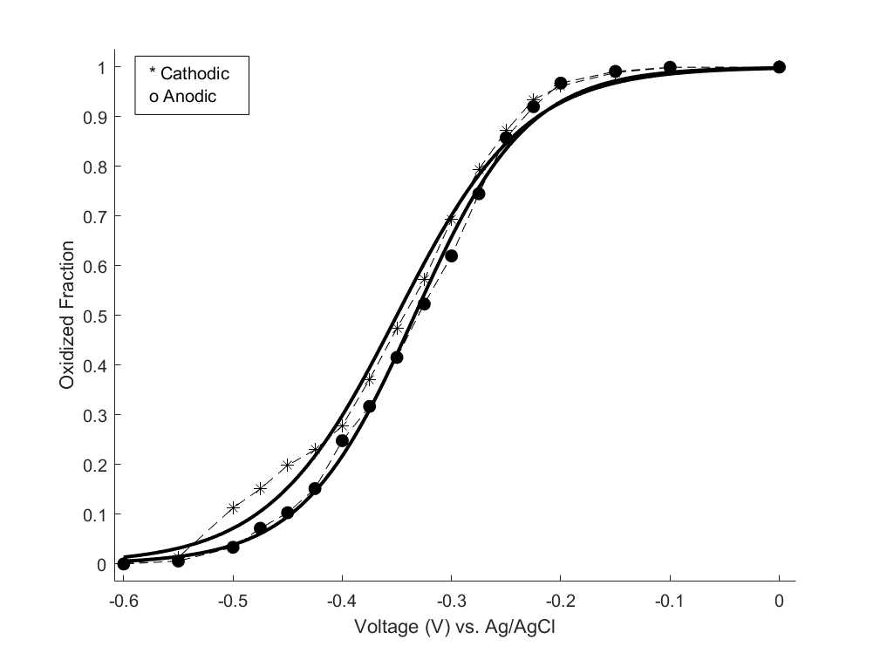
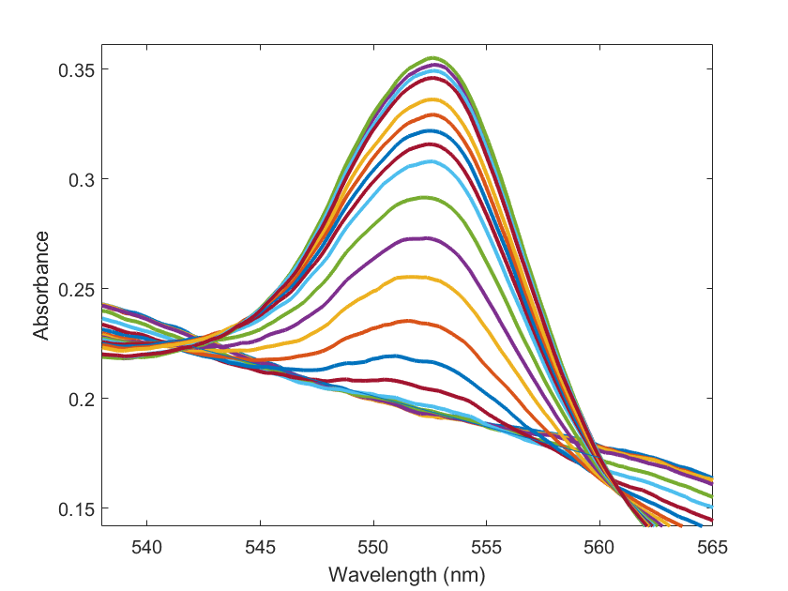
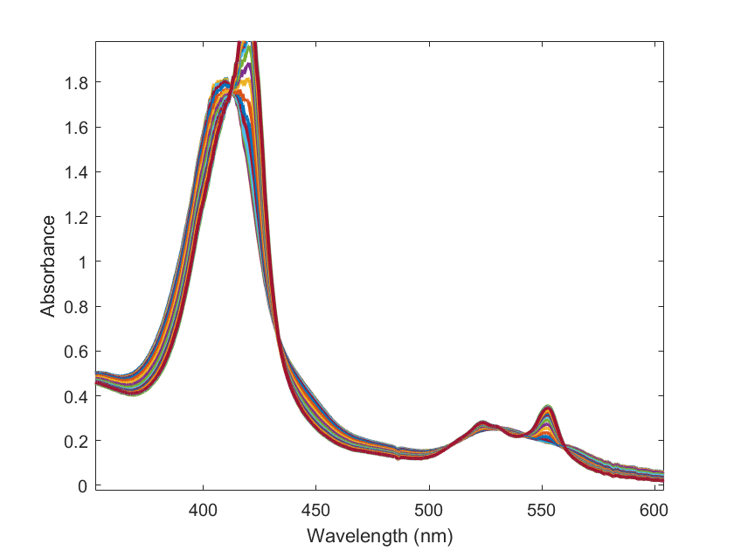
Trial 3: 60μM OmcS protein, 5uM mediators
541
559

Slide 5
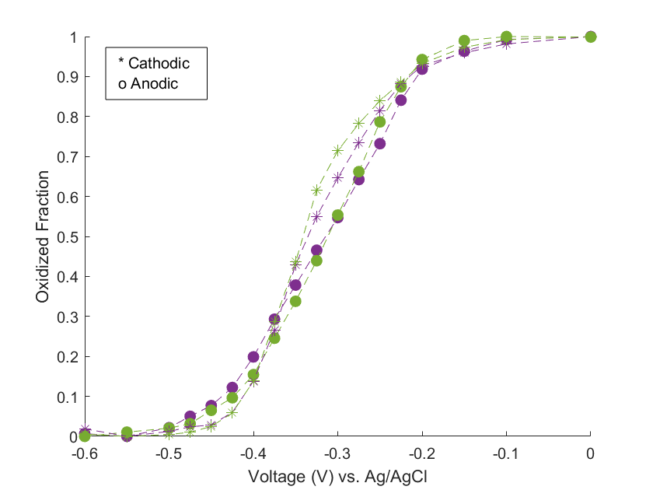
Trial 1 & 2 Overlayed
Trial 1
Trial 2

Slide 6
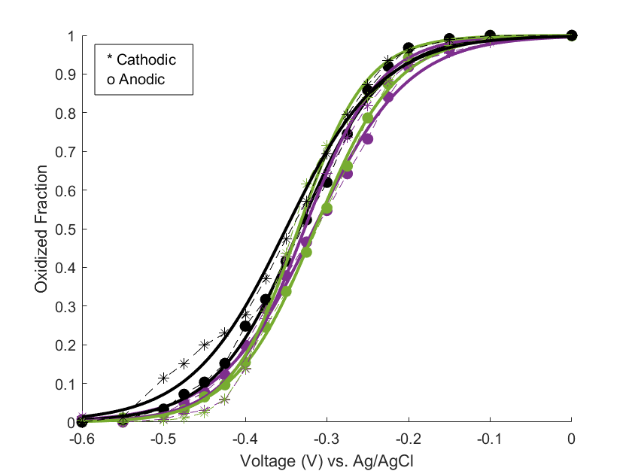
Midpoint Potentials vs Ag/AgCl
 | Anodic | Cathodic
Trial 1 | -316 mV | -327 mV
Trial 2 | -314 mV | -335 mV
Trial 3 | -334 mV | -350 mV
f(x)=exp((x-v0)*k)/(1+exp((x-v0)*k))

Slide 7
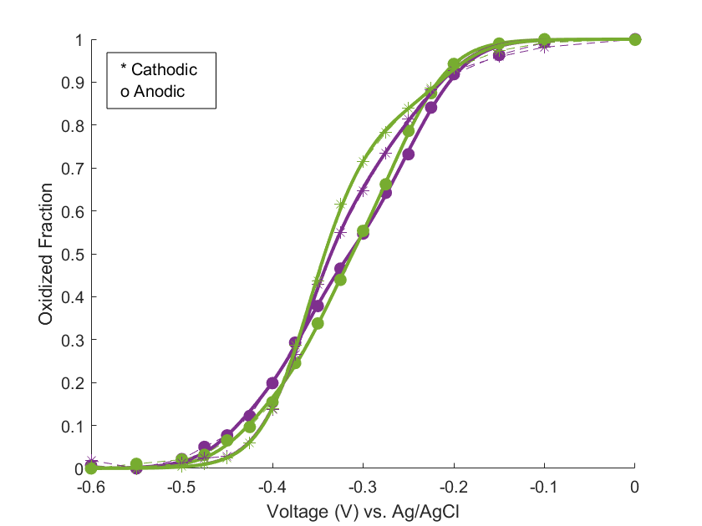
6 Independent Nernst Potentials vs Ag/AgCl
 | Anodic | Cathodic
Trial 1 | -0.439 | -0.373
 | -0.364 | -0.373
 | -0.361 | -0.373
 | -0.276 | -0.332
 | -0.252 | -0.275
 | -0.215 | -0.214
Trial 2 | -0.427 | -0.379
 | -0.353 | -0.360
 | -0.341 | -0.359
 | -0.283 | -0.359
 | -0.263 | -0.308
 | -0.232 | -0.210

Slide 8
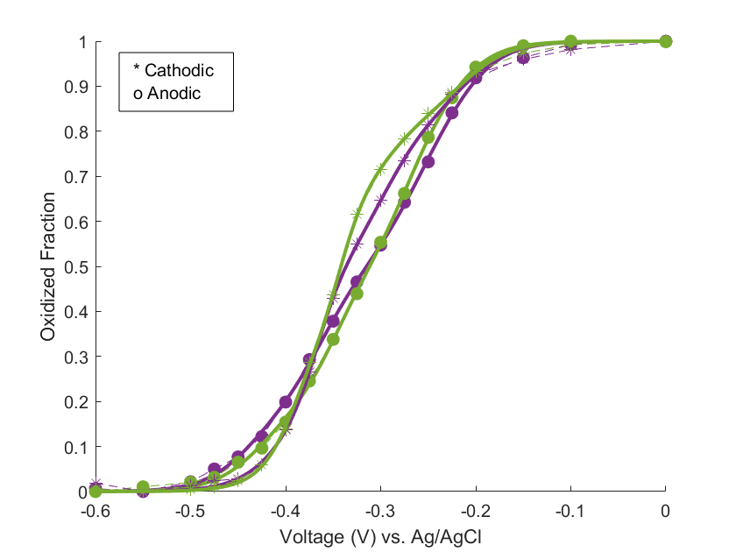
6 Sequential Nernst Potentials vs Ag/AgCl
 | Anodic | Cathodic
Trial 1 | -0.442 | -0.408
 | -0.379 | -0.373
 | -0.346 | -0.360
 | -0.284 | -0.311
 | -0.249 | -0.279
 | -0.208 | -0.209
Trial 2 | -0.431 | -0.393
 | -0.363 | -0.393
 | -0.336 | -0.354
 | -0.286 | -0.330
 | -0.262 | -0.292
 | -0.220 | -0.211

Slide 9
