Slide 1
Zeebe
Overview and demo
Notes:
Code available at https://github.com/ccso-capco/zeebe-demo

Slide 2
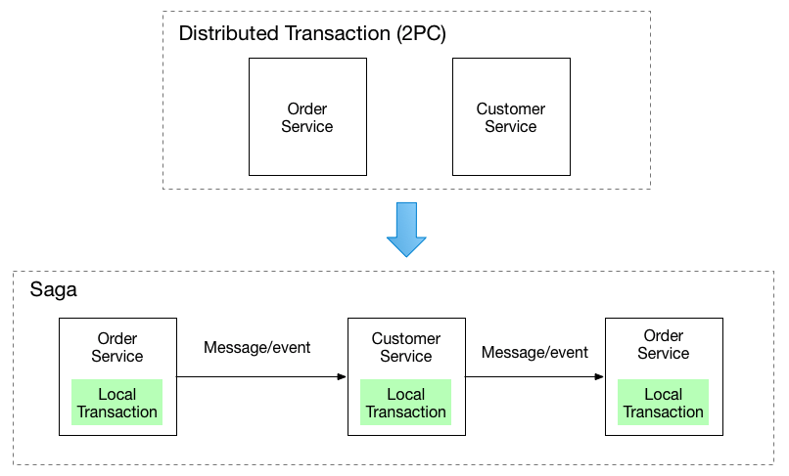
ZEEBE OVERVIEW
Saga pattern
Common pattern when business transactions span multiple services and each service has its own database.
Each local transaction updates the database and publishes a message or event to trigger the next local transaction in the Saga.
The Saga has the responsibility to either get the overall business transaction completed or to leave the system in a known termination state.
Notes:
References:
https://microservices.io/patterns/data/saga.html

Slide 3
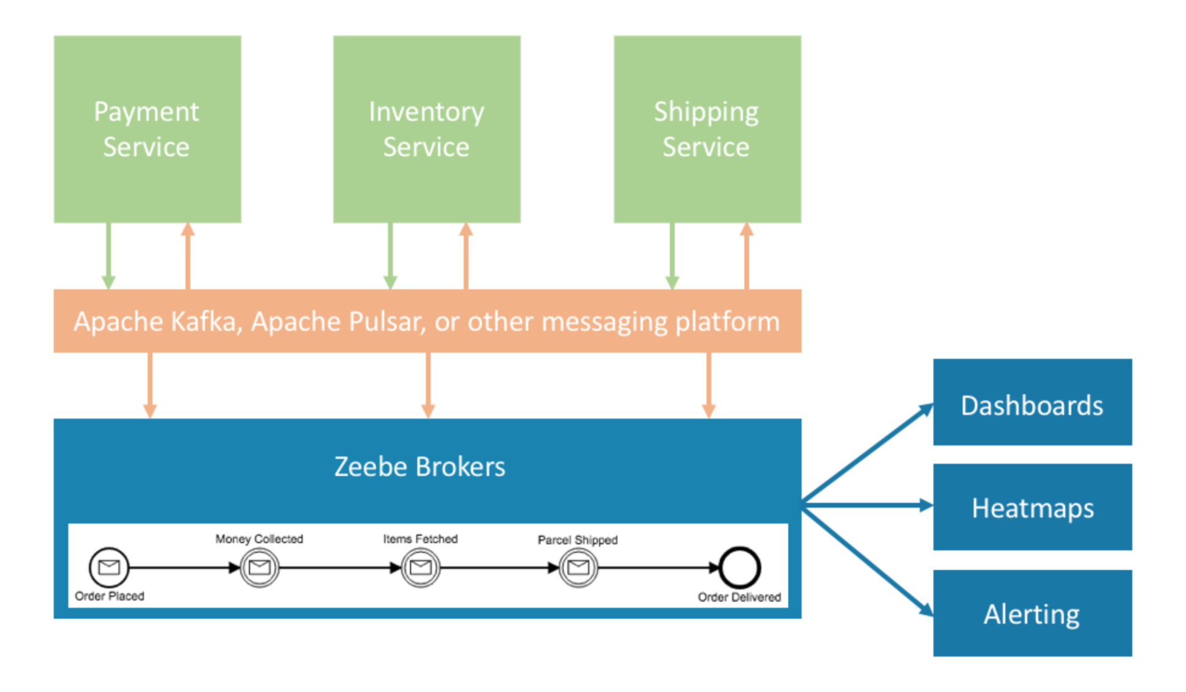
ZEEBE OVERVIEW
BPMN flow engines
Engine acts as a Saga Coordinator.
Engine does all state handling and provides features such as monitoring, timers and versioning.
There is an increased visibility of the flow during requirements gathering, development and normal business operations.
Notes:
References:
https://zeebe.io/what-is-zeebe/

Slide 4
Zeebe overview
Alternative roles of a flow engine
Asynchronous communication by commands and events
Point-to-point communication by request/response
Work distribution by workflow engine
Notes:
References:
https://blog.bernd-ruecker.com/saga-how-to-implement-complex-business-transactions-without-two-phase-commit-e00aa41a1b1b
https://blog.bernd-ruecker.com/the-microservice-workflow-automation-cheat-sheet-fc0a80dc25aa

Slide 5
Zeebe overview
Centralized vs decentralized engine
Decentralized engines
One central engine
Central engine used like decentralized ones
Notes:
References:
https://blog.bernd-ruecker.com/saga-how-to-implement-complex-business-transactions-without-two-phase-commit-e00aa41a1b1b
https://blog.bernd-ruecker.com/the-microservice-workflow-automation-cheat-sheet-fc0a80dc25aa

Slide 6
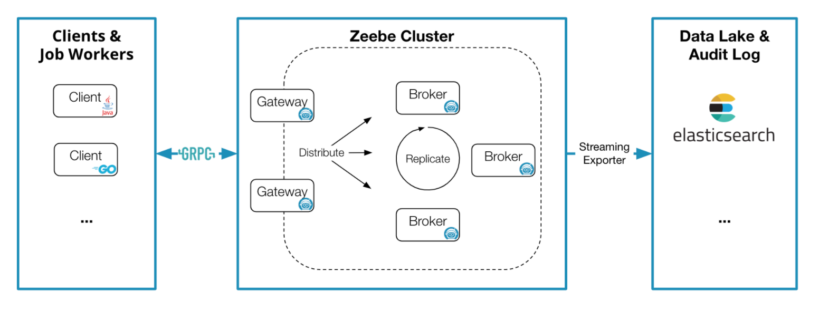
ZEEBE OVERVIEW
Architecture
Notes:
References:
https://docs.zeebe.io/basics/architecture.html

Slide 7
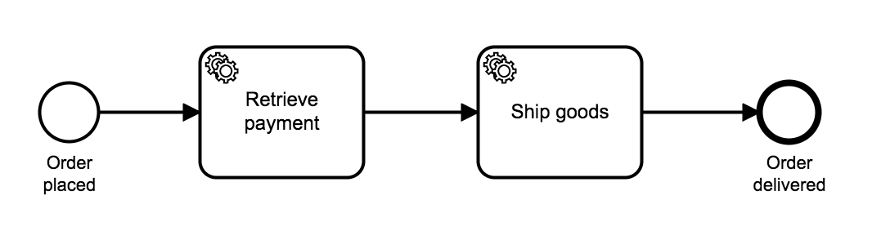
Zeebe demo
High level workflow

Slide 8
Zeebe demo
High level workflow
Order
service
Payment
service
Shipment
service

Slide 9
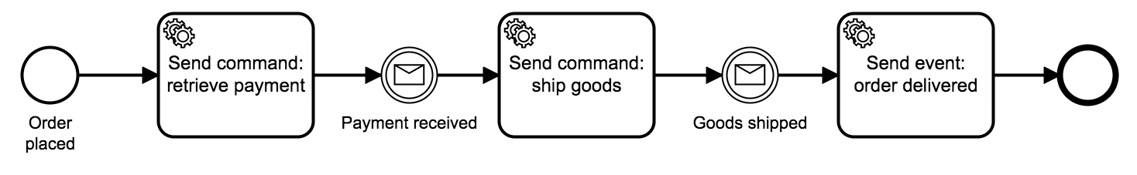
Zeebe demo
Components
Order service
Zeebe client
Kafka client
Zeebe
Kafka
Elasticsearch
Operate
Payment
service
Shipment
service
REST
Payment provider

Slide 10
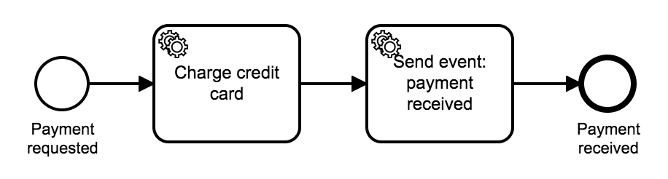
Zeebe demo
Workflow details
Zeebe
9
2
4
Order service
3
8
1 POST /orders
Kafka
5
7
Payment service
Payment provider
6
POST /card-payments
Notes:
Client calls REST endpoint from order service to start the order flow.
Order service creates a new workflow instance in Zeebe.
Zeebe triggers the next step in the flow; order service sends RetrievePaymentCommand message to Kafka.
Order service marks current step as completed in Zeebe.
Payment service receives RetrievePaymentCommand message from Kafka and triggers a new workflow instance in Zeebe.
Zeebe triggers the next step in the flow; payment service calls REST endpoint in payment provider; payment service marks current step as completed in Zeebe.
Zeebe triggers the next step in the flow; payment service sends PaymentReceivedEvent message to Kafka; payment service marks current step as completed in Zeebe.
Payment service receives PaymentReceivedEvent message from Kafka and marks current step as completed in Zeebe.

