Slide 1
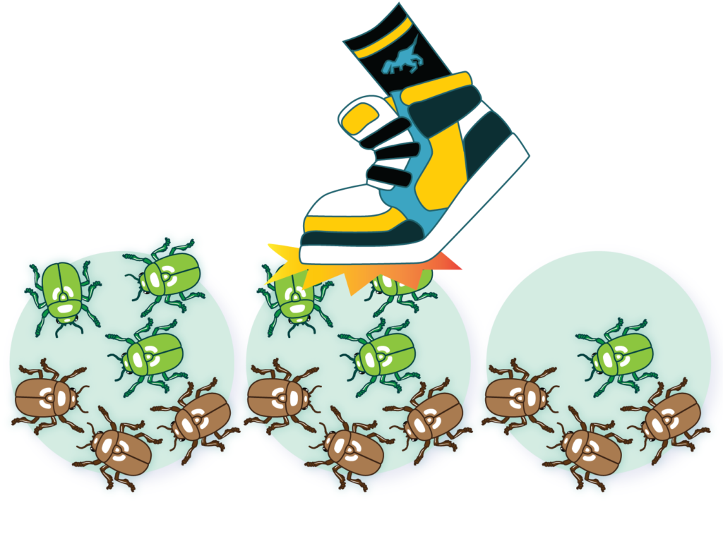
Genetic drift

Slide 2
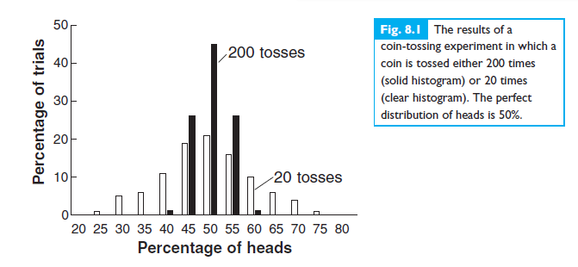
sampling error?
Constant population size
20 vs 200 times

Slide 3
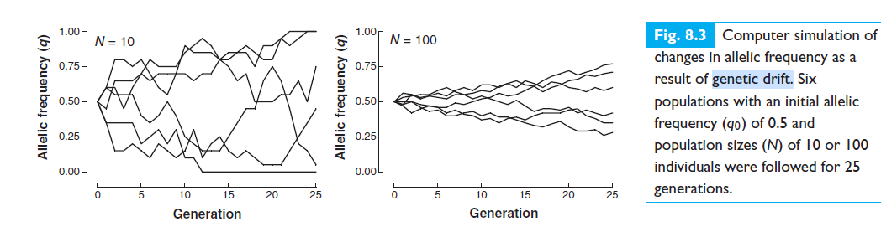
small populations showed a greater variation in allelic frequencies than the larger populations

Slide 4
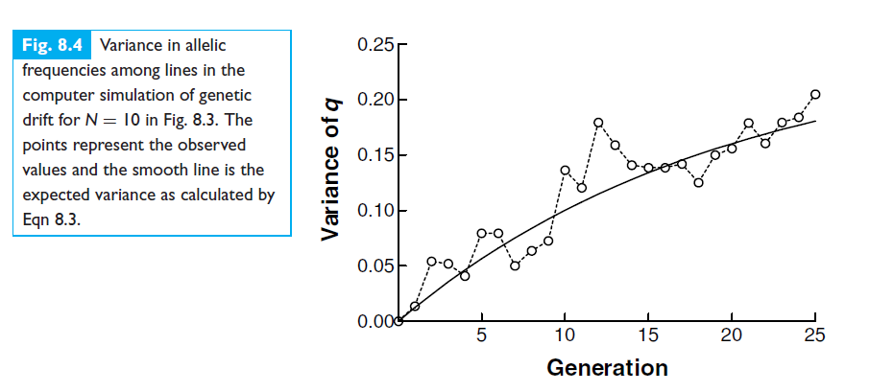
Increasing in variance

Slide 5
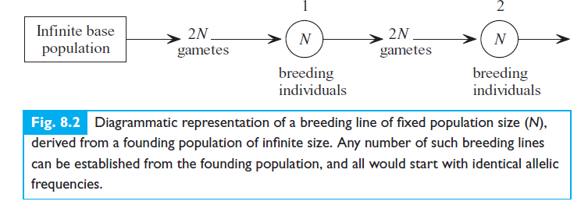

Slide 6
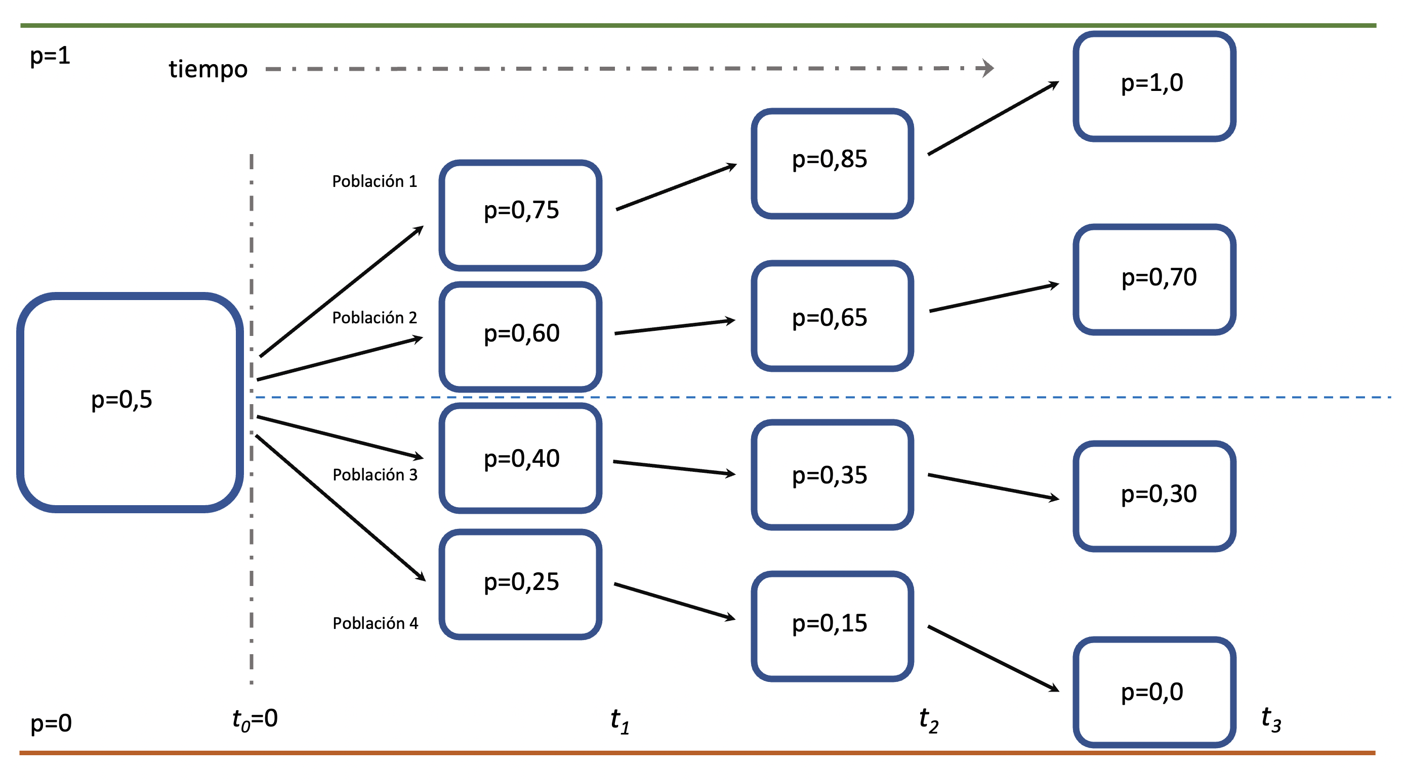
https://blakngu.github.io/libro/deriva.html

Slide 7
Biological importance
Genetic Drift: A change in the gene pool strictly by chance fixation of alleles
Acute in small populations for infrequently occurring alleles, which can suddenly increase in frequency in the population or be totally wiped out.
https://virtualbiologylab.org/NetWebHTML_FilesJan2016/GeneticDriftModel.html

Slide 8
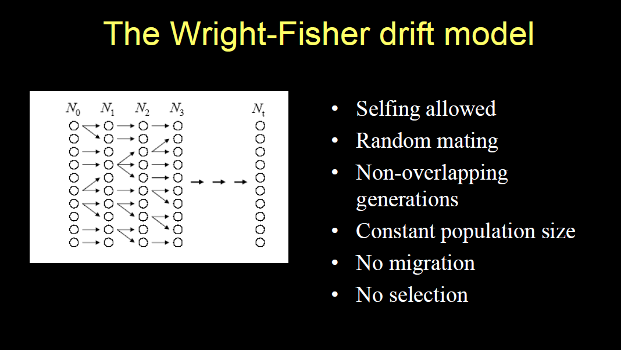

Slide 9
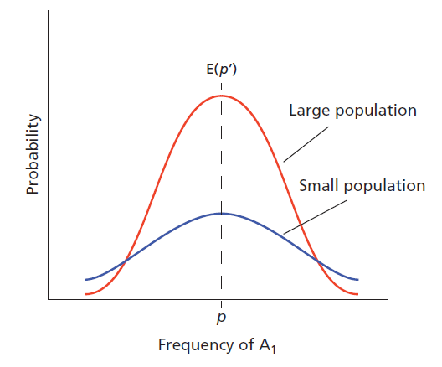

N=8
p = q = 0.5
Binomial sampling:
source of evolution by genetic drift.

Slide 10
General Properties

Slide 11

Each individual in the population produces a large number of gametes.
The allele in each gamete is an identical copy of the allele in the individual that produced it, i.e., A1 begets A1 and A2 begets A2.
The next generation is constructed by picking 2N gametes at random from the large number originally produced.
Uncertainty in next generation. Inversely proportional to pop size

Slide 12

Measure variances in next generations
variance in allelic frequencies among lines is compounded each generation, and after t generations this variance equals:
variance in allelic frequency increases at a slower and slower rate as the number of generations increases, and attains a maximum value of p0q0

Slide 13

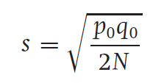
Genetic drift in idealized populations
p0 and q0
2N gametes
p0q0/2N (Binomial variance)
expected change in allelic frequency(q)

Slide 14
Mutation fixing
New mutation fixing: 1/(2N) where N individuals has 2 alleles
Fixation is faster in small populations

Slide 15
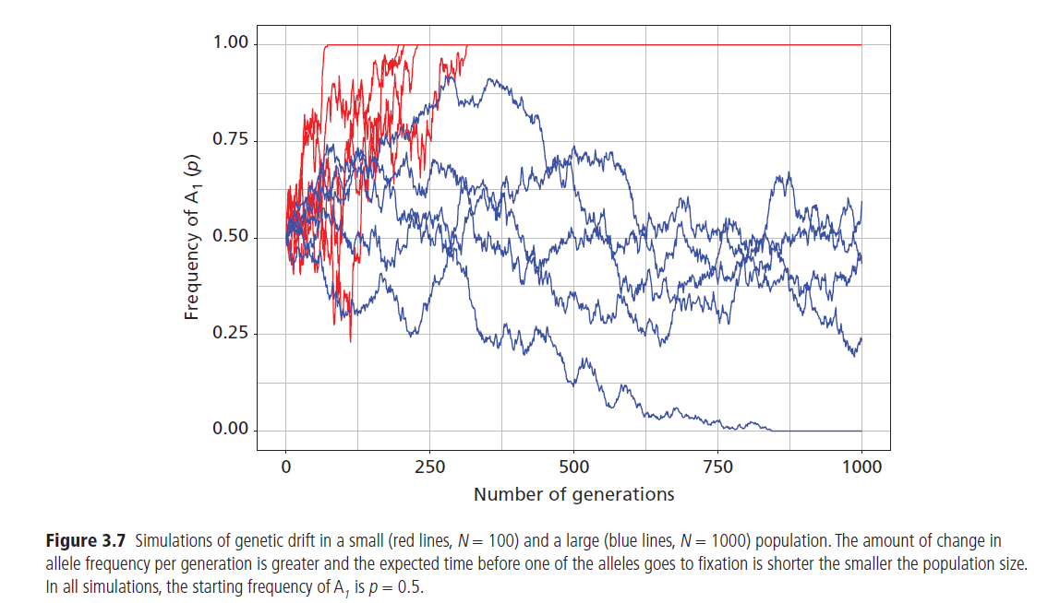

Slide 16
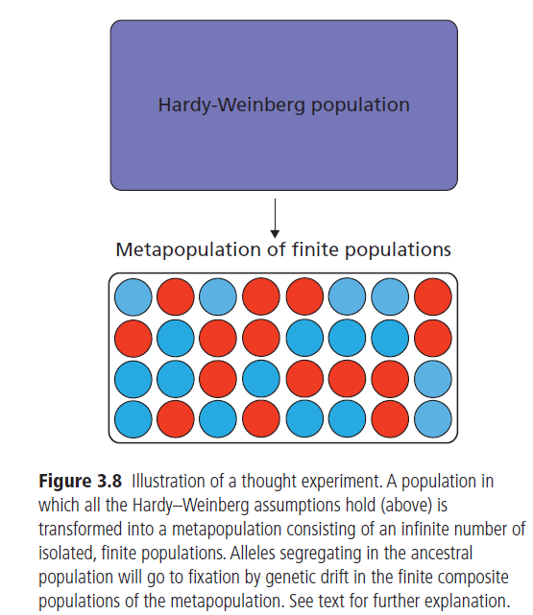
Metapopulations
Geographically separated populations constitutes a metapopulation:
Isolated
Hardy Weinberg
Finite population size
Loss of heterozygosity occurs due to local fixations.

Slide 17
Empirical example

Slide 18
Drosophila melanogaster (Buri 1956).
107 populations with eight males and eight females
heterozygousfor two alleles (bw and bw75)
P0=0.5
Frequencies changed!
Increase in homozygotes!

Slide 19
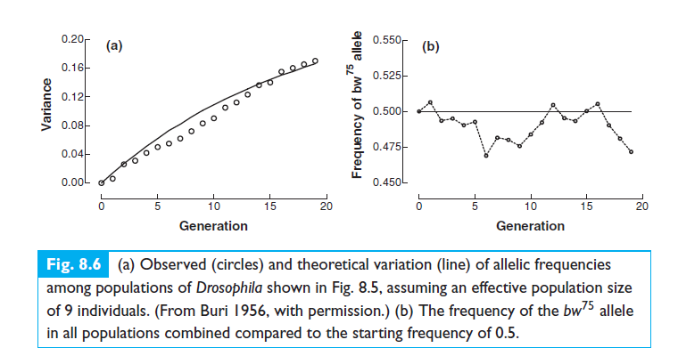
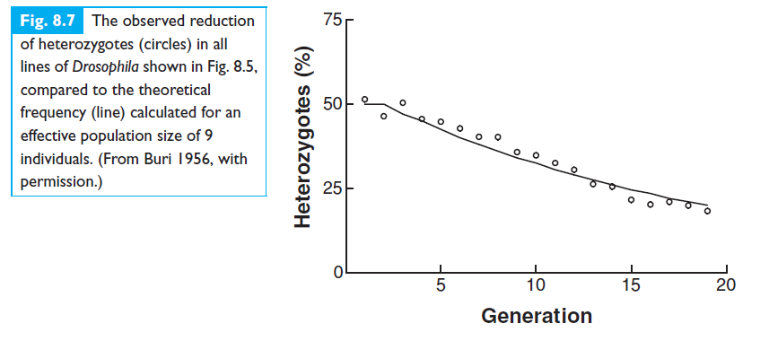
Increase in variance
Reduction of heterozygotes

Slide 20
Consequences of genetic drift

Slide 21
1
Allelic frequencies fluctuate at random, independently of one another in different populations or demes. The alleles of different loci within a population also fluctuate independently of one another, provided the loci are not linked to one another.

Slide 22
2
Different populations or demes diverge in allelic frequencies and become genetically distinct from one another. The genetic diversity of all populations combined is increased compared to the situation where all individuals could interbreed freely within a single population.

Slide 23
3
Eventually, given enough time, a single allele will become fixed at each gene locus. The probability that a specific allele will eventually become fixed is equal to the frequency of the allele.

Slide 24
4
Thus, there is a reduction of genetic variation within a population or deme. There is an increase in the proportion of homozygotes at the expense of the heterozygotes. This may lead to an increase in the incidence of deleterious recessive traits (which are only expressed in homozygous individuals), leading to a reduction in viability.

Slide 25
5
The rate at which these events occur is inversely related to population size. The smaller the population, the faster the process of genetic drift.

Slide 26
Forms of genetic drift

Slide 27
Forms of genetic drift
•Bottleneck effect
A population reaches very low numbers due to some random (non-selective) event
•Founder effect
A small number of individuals leave the original population and “found” a new one

Slide 28
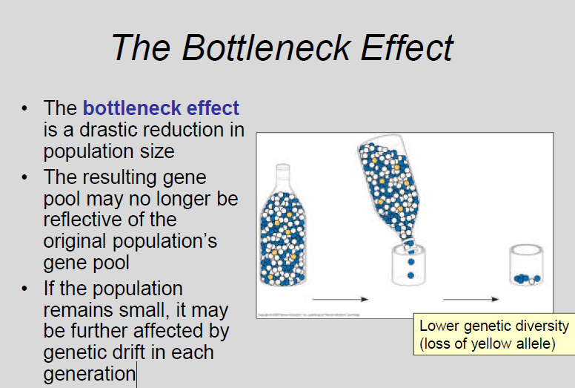

Slide 29
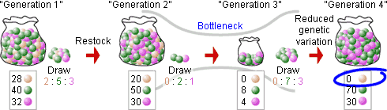
Bottlenecks!:
https://evolution.berkeley.edu/bottlenecks-and-founder-effects/

Slide 30
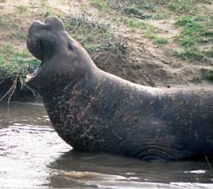
Examples
Reduced genetic variation means that the population may not be able to adapt to new selection pressures, such as climatic change or a shift in available resources, because the genetic variation that selection would act on may have already drifted out of the population.
Example: Hunting reduced Seals northern
population to 20 individuals->30000 individuals
less genetic variation than southern population

Slide 31
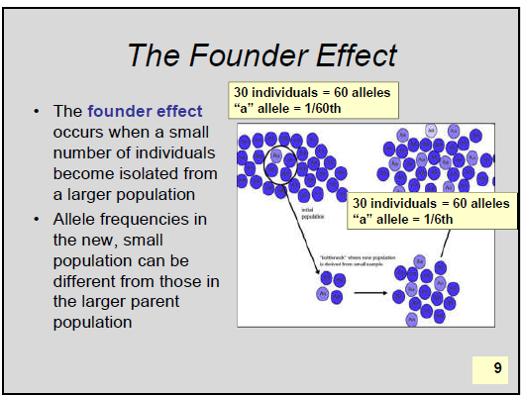
Founder effect

Slide 32
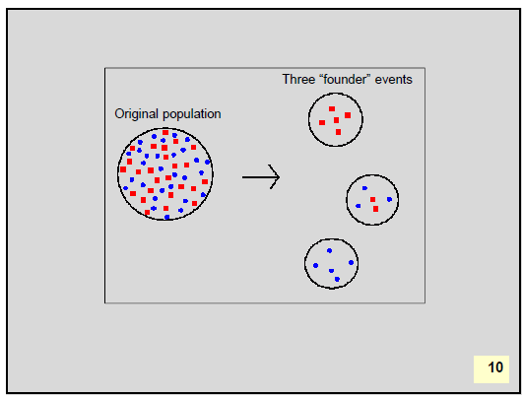

Slide 33
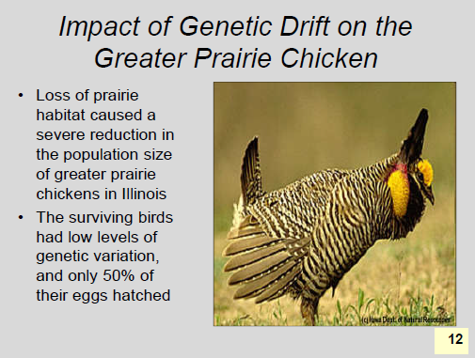

Slide 34
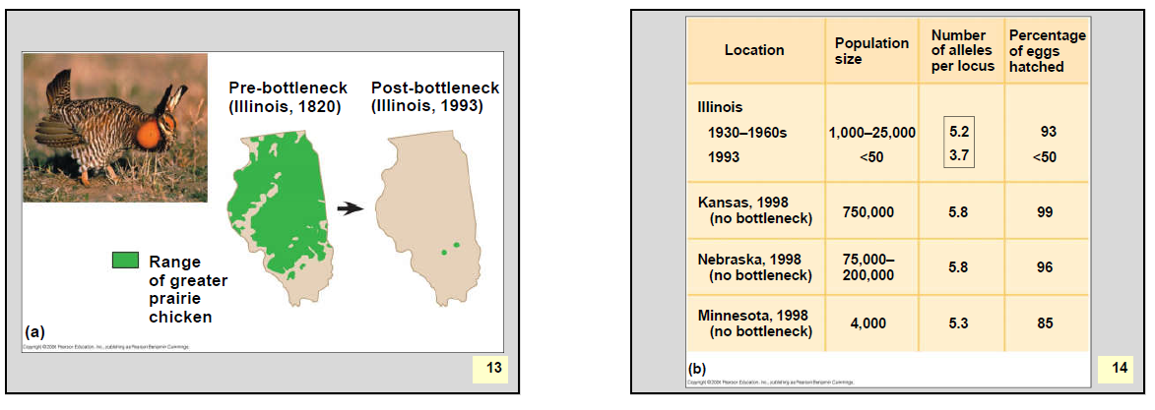

Slide 35
Practice

