Slide 1
From Mendel to molecules: A history of evolutionary genetics.
Víctor Hugo García Merchán M.Sc. Ph.D
Universidad del Quindío
Agosto, 2024

Slide 2
POPULATION GENETICS:
The study of the rules governing the maintenance and transmission of genetic variation in natural populations.

Slide 3
DARWINIAN EVOLUTION BY NATURAL SELECTION
Many more individuals are born than survive (COMPETITION).
Individuals within species are variable (VARIATION).
Some of these variations are passed on to offspring (HERITABILITY).
Survival and reproduction are not random. There must be a correlation between fitness and phenotype.

Slide 4
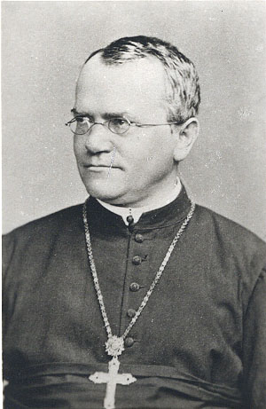
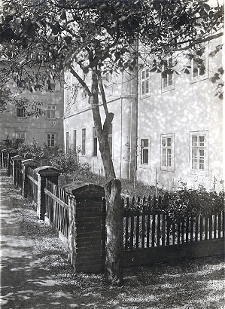
The “rediscovery” of Mendel’s genetic studies in 1902 by William Bateson completed the missing model for the inheritance of genetic factors.
Gregor Mendel
Mendel published his work in the Transactions of the Brunn Society of Natural History in 1866.

Slide 5
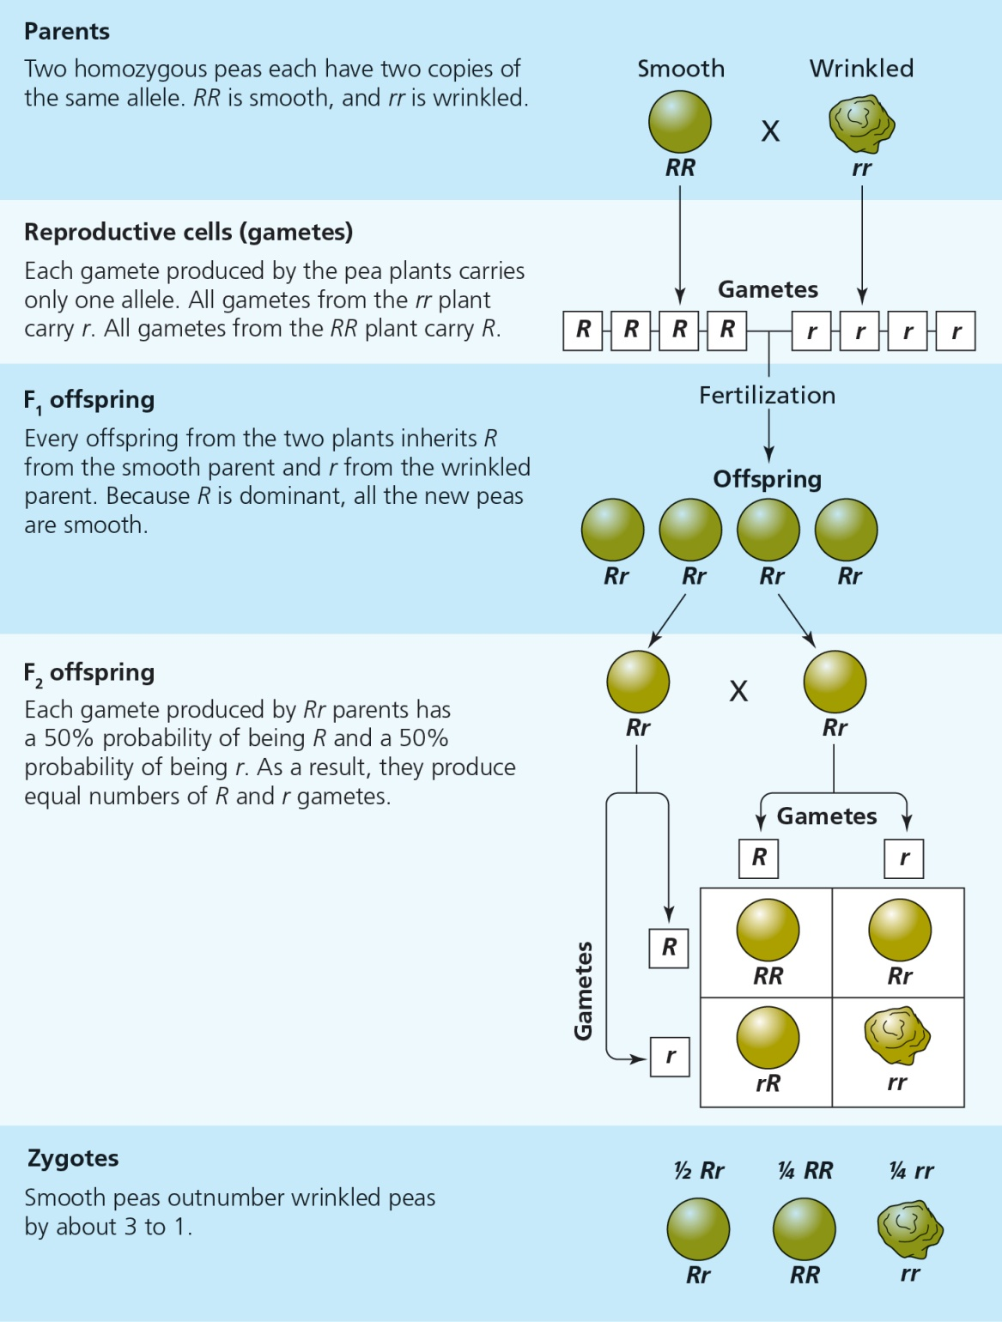
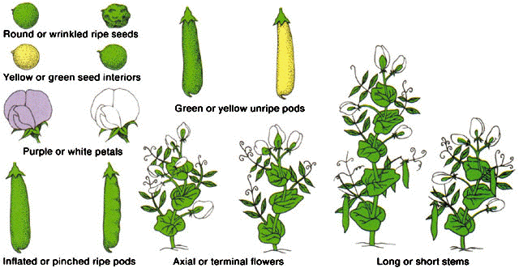
Mendel’s Laws:
Segregation
Independent assortment

Slide 6
SEXUAL REPRODUCTION CONTRIBUTES TO VARIATION
Example – A Line Cross Experiment
Consider 2 diploid individuals with 3 loci and 2 alleles,
Parents: aabbcc x AABBCC
F₁ progeny: AaBbCc
F₂ progeny:
AABBCC AABBCc AABBcc
AABbCC AABbCc AABbcc
AAbbCC AAbbCc AAbbcc
AaBBCC AaBBCc AaBBcc
AaBbCC AaBbCc AaBbcc
AabbCC AabbCc Aabbcc
aaBBCC aaBBCc aaBBcc
aaBbCC aaBbCc aaBbcc
aabbCC aabbCc aabbcc
27
COMBINATIONS

Slide 7
Mechanisms of Evolution: Mendelian Genetics in Populations
Genetic variation is the raw material of evolutionary change: how do we measure it?
What are the forces that cause genetic changes within populations? That is, what mechanisms cause evolutionary change?

Slide 8
Population Genetics
Evolution can be defined as a change in gene frequencies through time.
Population genetics tracks the fate, across generations, of Mendelian genes in populations.
Population genetics is concerned with whether a particular allele or genotype will become more or less common over time, and WHY.

Slide 9
Assumptions:
1) Diploid, autosomal locus with 2 alleles: A and a
2) Simple life cycle:
PARENTS GAMETES ZYGOTES
(DIPLOID) (HAPLOID) (DIPLOID)
These parents produce a large gamete pool (Gene Pool) containing alleles A and a.
a A A a
a A A a A a a
a A A a a A a A A
a a A A a a a
a A a a A A
A a A

Slide 10
Gamete (allele) Frequencies:
Freq(A) = p
Freq(a) = q
p + q = 1
Genotype Frequencies of 3 Possible Zygotes:
AA Aa aa
  Freq (AA) = p_{A} x p_{A} = p_{A}²
  Freq (Aa) = (p_{A} x q_{a}) + (q_{a} x p_{A}) = 2p_{A}q_{a}
  Freq (aa) = q_{a} x q_{a} = q_{a}²
p² + 2pq + q² = 1

Slide 11
General Rule for Estimating Allele Frequencies from Genotype Frequencies:
Genotypes: AA Aa aa
Frequency: p² 2pq q²
  Frequency of the A allele:
p = p² + ½ (2pq)
  Frequency of the a allele:
q = q² + ½ (2pq)

Slide 12
Sample Calculation: Allele Frequencies
Assume N = 200 indiv. in each of two populations 1 & 2
Pop 1 : 90 AA 40 Aa 70 aa
Pop 2 : 45 AA 130 Aa 25 aa
In Pop 1 :
p = p² + ½ (2pq) = 90/200 + ½ (40/200) = 0.45 + 0.10 = 0.55
q = q² + ½ (2pq) = 70/200 + ½ (40/200) = 0.35 + 0.10 = 0.45
In Pop 2 :
p = p² + ½ (2pq) = 45/200 + ½ (130/200) = 0.225 + 0.325 = 0.55
q = q² + ½ (2pq) = 25/200 + ½ (130/200) = 0.125 + 0.325 = 0.45

Slide 13
Main Points:
p + q = 1 (more generally, the sum of the allele frequencies equals one)
p² + 2pq +q² = 1 (more generally, the sum of the genotype frequencies equals one)
Two populations with markedly different genotype frequencies can have the same allele frequencies

Slide 14
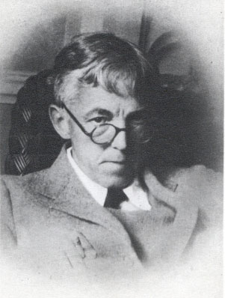
The Hardy-Weinberg Law
A single generation of random mating establishes H-W equilibrium genotype frequencies, and neither these frequencies nor the gene frequencies will change in subsequent generations.
p² + 2pq + q² = 1
Hardy

Slide 15
H-W ASSUMPTIONS:
Mating is random (with respect to the locus).
The population is infinitely large. (no sampling error – Random Genetic Drift)
Genes are not added from outside the population (no gene flow or migration).
Genes do not change from one allelic state to another (no mutation).
All individuals have equal probabilities of survival and reproduction (no selection).

Slide 16
IMPLICATIONS OF THE H-W PRINCIPLE:
A random mating population with no external forces acting on it will reach the equilibrium H-W frequencies in a single generation, and these frequencies remain constant there after.
Any perturbation of the gene frequencies leads to a new equilibrium after random mating.
The amount of heterozygosity is maximized when the gene frequencies are intermediate.
2pq has a maximum value of 0.5 when
p = q = 0.5

Slide 17
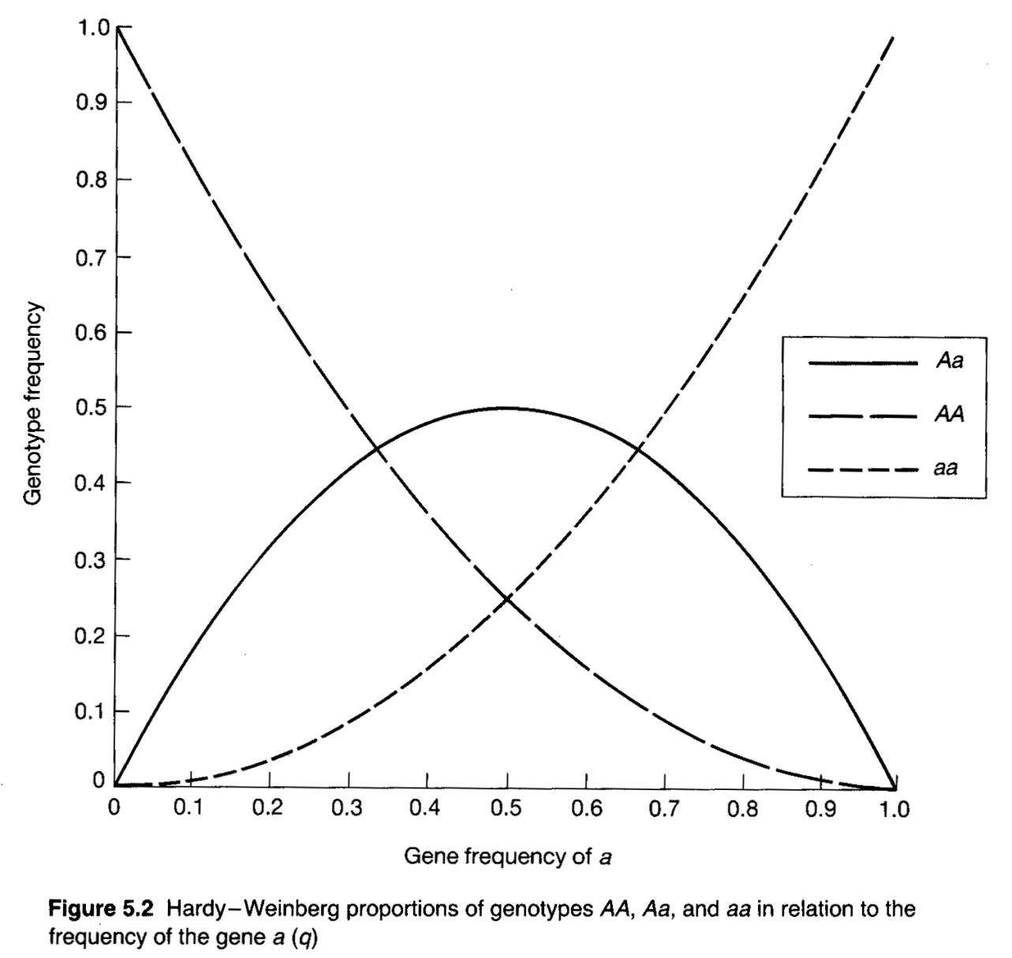
GENOTYPE VERSUS GENE FREQUENCIES
p² (AA)
q² (aa)
2pq (Aa)

Slide 18
FOUR PRIMARY USES OF THE H-W PRINCIPLE:
Enables us to compute genotype frequencies from generation to generation, even with selection.
Serves as a null model in tests for natural selection, nonrandom mating, etc., by comparing observed to expected genotype frequencies.
Forensic analysis.
Expected heterozygosity provides a useful means of summarizing the molecular genetic diversity in natural populations.

Slide 19
EVOLUTIONARY THOUGHT AFTER DARWIN
By the 1870s, most scientists accepted the historical reality of evolution (and this has been true ever since).
It would be at least 60 years after the publication of The Origin of Species before natural selection would come to be widely accepted.
People wanted life itself to be purposeful and creative, and consequently did not find natural selection appealing.
Neo-Lamarckism -- inheritance of acquired characteristics.
Orthogenesis -- variation that arises is directed toward a goal.
Mutationism -- discrete variations are all that matter.

Slide 20
MUTATIONISM AND THE IMPACT OF MENDEL
Gregor Mendel’s research was published in 1866, but was not noticed until 1900.
NOTE: Darwin knew nothing about the mechanism of inheritance when he conceived of natural selection.
MUTATIONIST THEORIES (based on Mendel’s work):
Emphasized the importance of DISCRETE VARIATION
T. H. Morgan -- the founder of Drosophila genetics.
R. Goldschmidt -- theory of “hopeful monsters”.
Mendelian genetics disproved Lamarckian and blending inheritance theories. However, the emphasis on discrete variation caused a rift between mutation and natural selection that was initially damaging to the field.

Slide 21
THE MODERN SYNTHESIS OF EVOLUTIONARY BIOLOGY
The rift between genetics and natural selection was resolved in the 1930s and 1940s.
This synthesis was forged from the contributions of geneticists, systematists, and paleontologists.

Slide 22
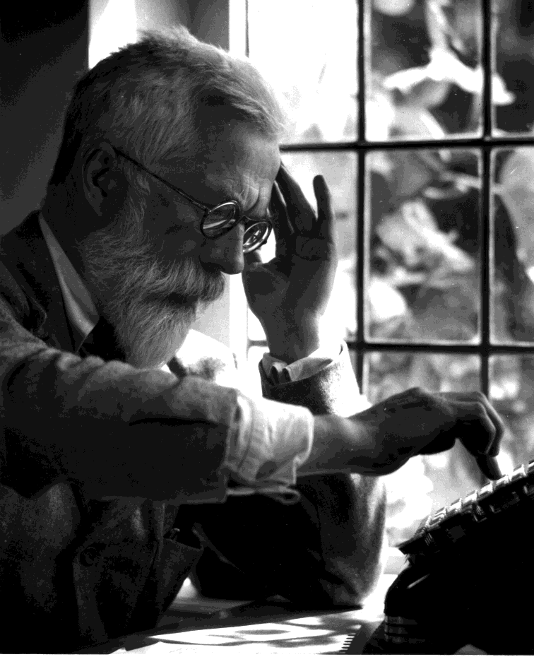
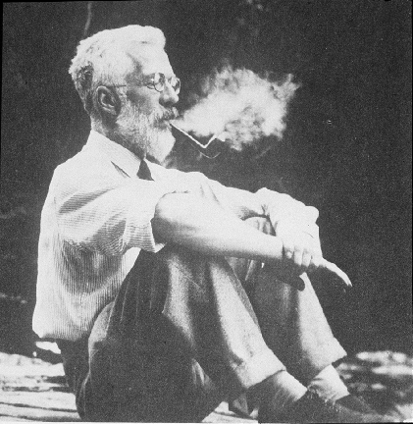
The Genetical Theory of Natural Selection
1930
Fisher united Mendelian population genetics with the inheritance of continuous traits.
"The Correlation between Relatives on the Supposition of Mendelian Inheritance" Philosophical Transactions of the Royal Society of Edinburgh in 1918, (volume 52, pages 399–433).
Sir R. A. Fisher
1890-1962

Slide 23
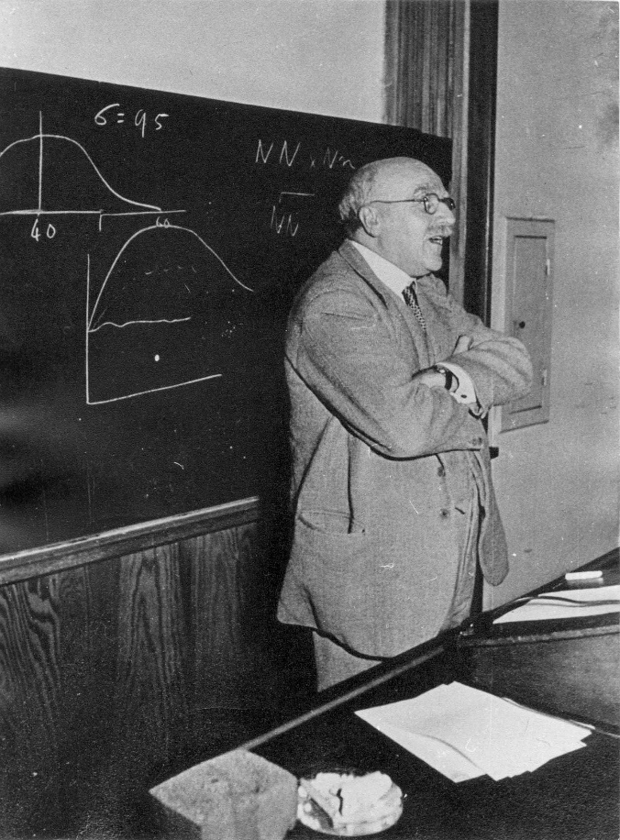
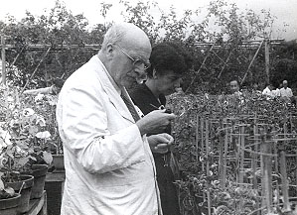
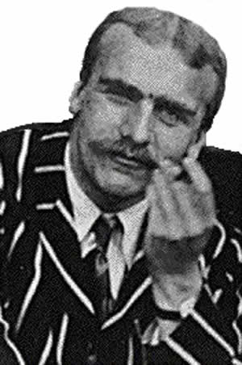
The Causes of Evolution
1932
Developed the mathematical theory of gene frequency change under selection (and many other interesting applications).
J. B. S. Haldane
1892-1964

Slide 24
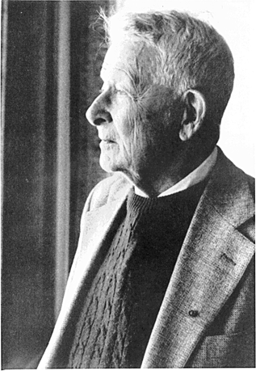
Developed the mathematical framework for understanding the genetic consequences of migration, effective population size, population subdivision, and conceived of the concept of adaptive landscapes.
Sewall Wright
On his 90th birthday
1889-1988

Slide 25
Outcomes of the “MODERN SYNTHESIS”
Populations contain genetic variation that arises by random mutation.
Populations evolve by changes in gene frequency.
Gene frequencies change through random genetic drift, gene flow, and natural selection.
Most adaptive variants have small effects on the phenotype so changes are typically gradual.
Diversification comes about through speciation.

Slide 26
MEASURING GENETIC VARIATION IN NATURAL POPULATIONS
TWO COMMONLY USED MEASURES TO QUANTIFY GENETIC VARIATION ARE:
P – the proportion of polymorphic loci (those that have 2 or
more alleles)
H – the average heterozygosity = proportion of loci at which
a randomly chosen individual is heterozygous.

Slide 27
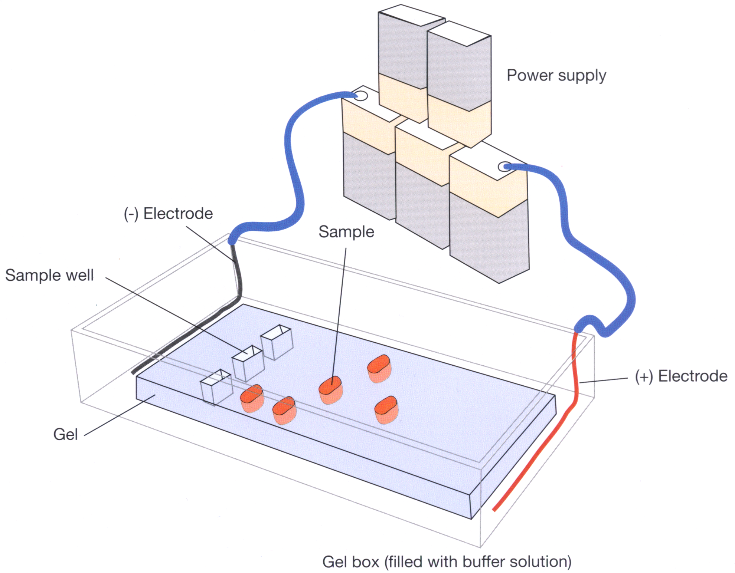
Gel electrophoresis:

Slide 28
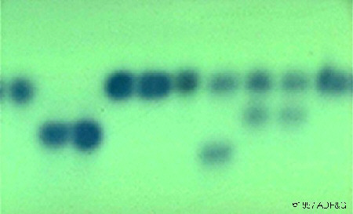
AN ALLOZYME GEL

Slide 29
Monomorphic locus: all individuals fixed for same allele
Polymorphic locus: 2 alleles
*
*
*
*
SS
FS
SS
FF
FS
FS
FF
FF
FS
SS
Frequency of F allele, p = 10 / 20 = 0.5
Frequency of S allele, q = 10 / 20 = 0.5
H = 4 /10 = 0.4

Slide 30
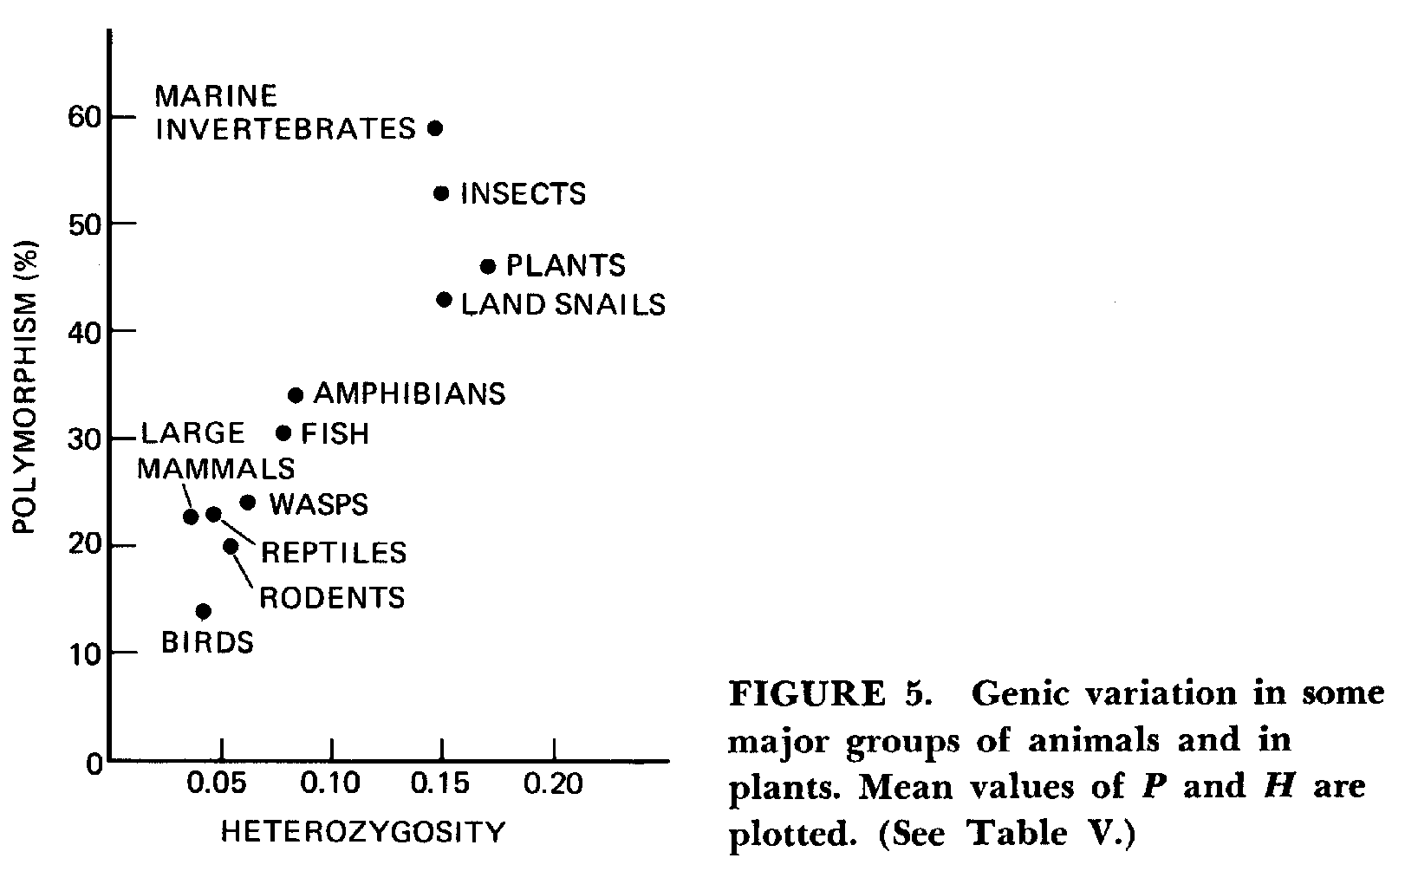
ALLOZYME VARIATION IN MAJOR TAXA
In F. J. Ayala (ed.) 1976. Molecular Evolution. Sinauer Assoc.

Slide 31
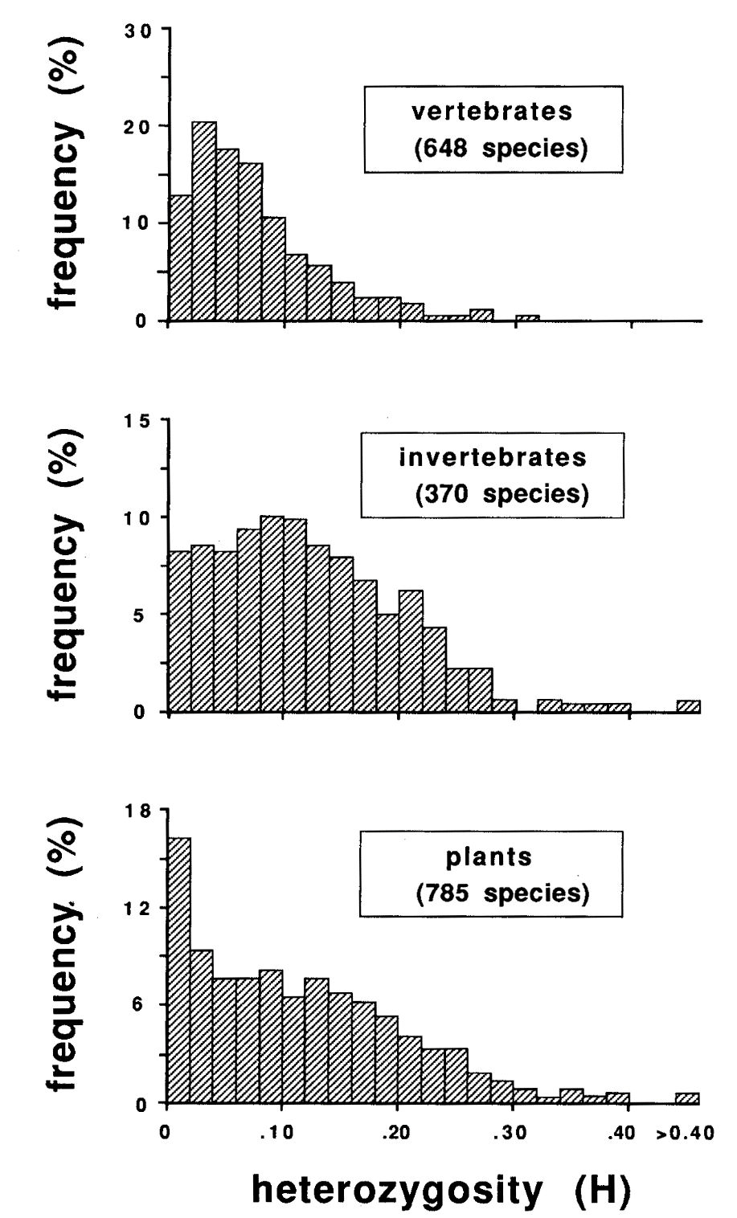
ALLOZYME VARIATION WITHIN MAJOR TAXA

Slide 32
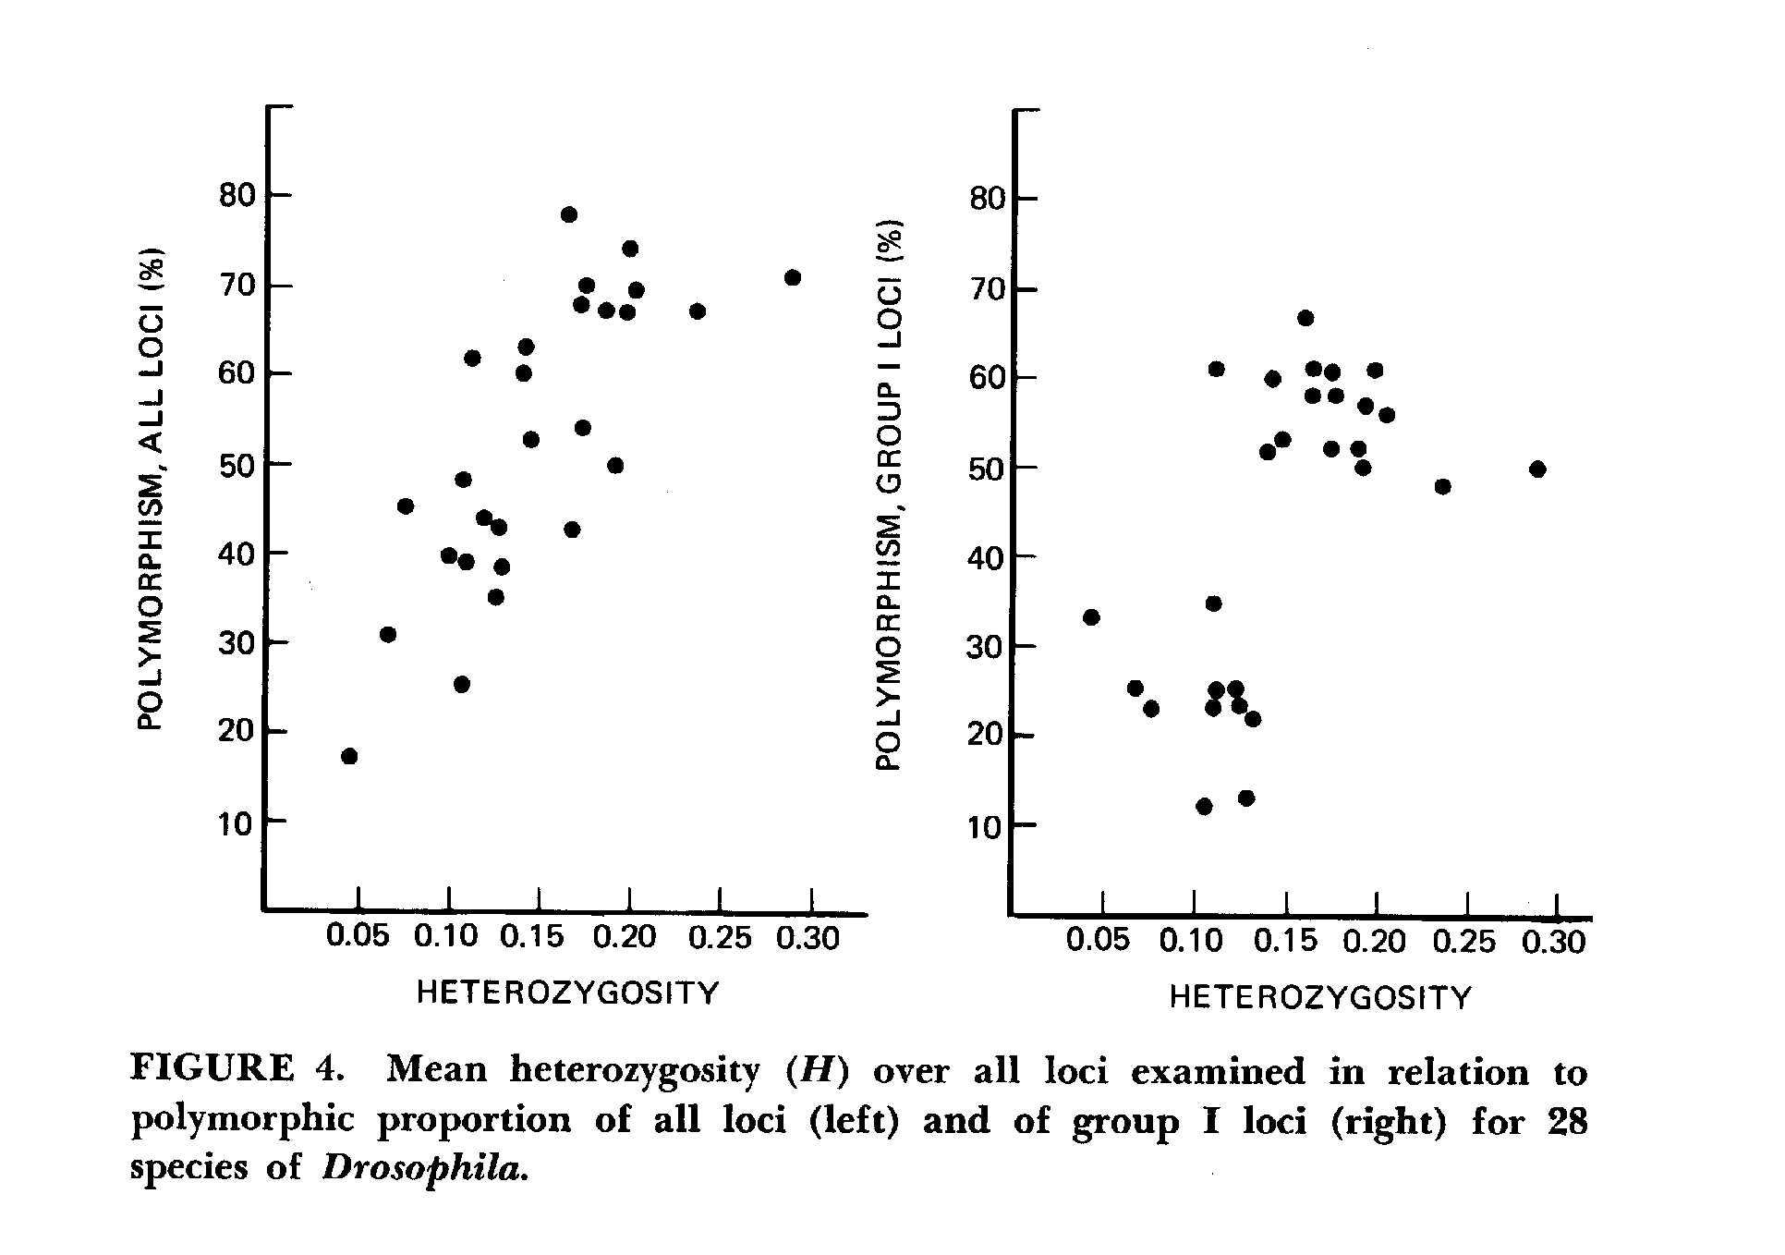
ALLOZYME VARIATION AMONG Drosophlia spp.
In F. J. Ayala (ed.) 1976. Molecular Evolution. Sinauer Assoc.

Slide 33
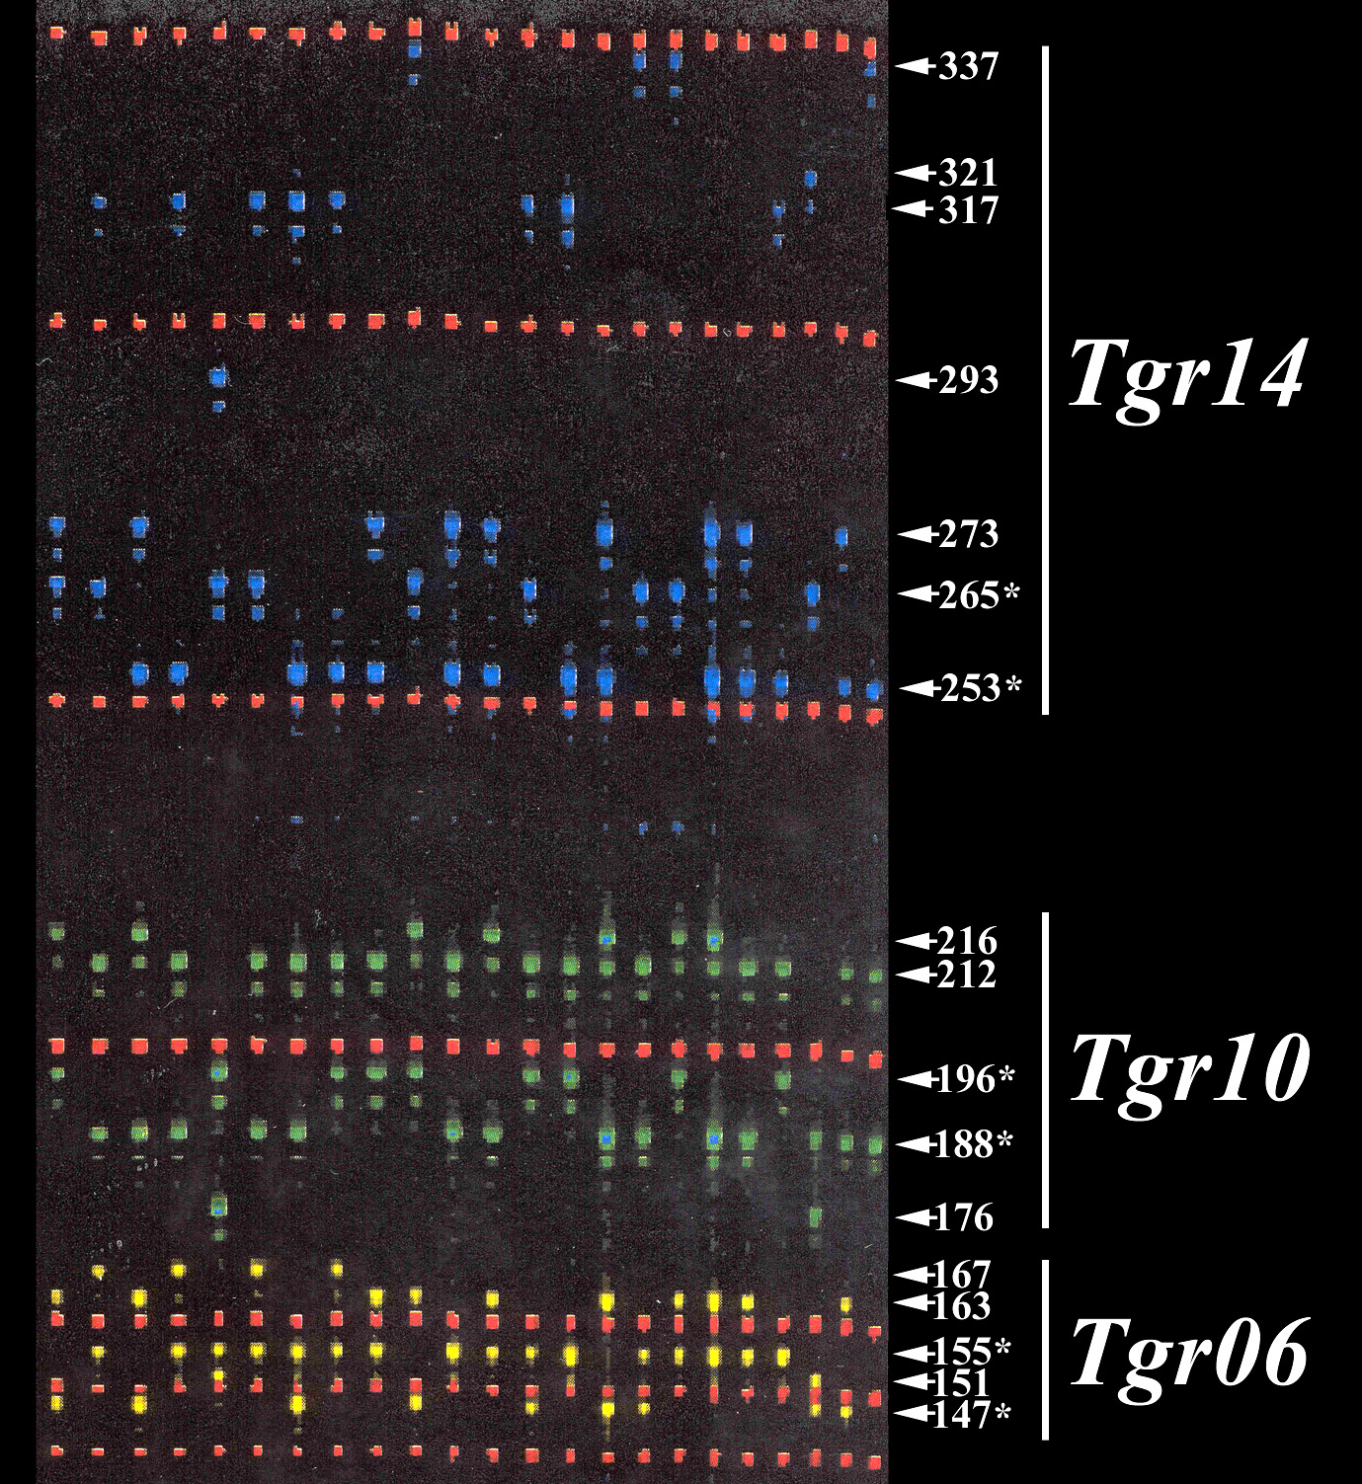
3 MICROSATELLITE
LOCI, SHOWING HIGH LEVELS OF POLYMORPHISM WITHIN A POPULATION.

Slide 34
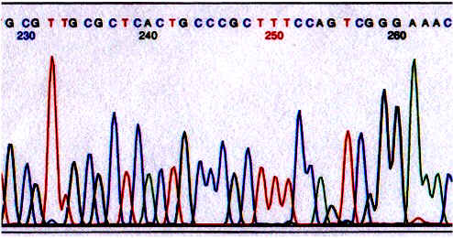
SEQUENCE DATA
The definitive source of information regarding genetic variation.
Usually obtained by PCR and direct sequencing of a particular gene of interest.
Sequence-level variation can also be assessed using restriction enzymes (RFLPs).
More on sequences when we get to “molecular evolution”.

Slide 35
THE EXTENSION OF H-W TO LOCI WITH MANY ALLELES
Regardless of the number of alleles per locus, the H-W principle still applies as long as the organisms are diploid.
Assume that you have a locus with n alleles (A₁, A₂, … , A_{n}), and the allele frequencies are given by p₁, p₂, p₃, … , p_{n}.
The expected frequency of any homozygote is just the square of the allele frequency.
F (A₁A₁) = p₁², F (A₆A₆) = p₆², etc.
The expected frequency of any heterozygote is 2 times the product of the respective allele frequencies.
F (A₁A₃) = 2p₁p₃, F (A₃A₅) = 2p₃p₅, etc.
Expected heterozygosity is 1 – Σ(p_{i}²).

Slide 36
APPLICATIONS OF H-W TO FORENSICS
Example:
Defendant Genotype Tissue Sample From Crime Scene
A₁₄A₂₇ A₁₄A₂₇
Question:
  What is the probability of this match being a false positive???
  In other words what is the probability that this match occurred simply by chance?

Slide 37
PROBABILITY OF A FALSE POSITIVE
Frequency of A₁₄ in population = p₁₄
Frequency of A₂₇ in population = p₂₇
Expected fraction of random individuals in the population with the same genotype as the defendant = 2 p₁₄ p₂₇
PRODUCT RULE:
With multiple loci, the probability of a false positive is simply equal to the product of the locus-specific probabilities.
As this probability becomes small, we become more confident that the match is real.

Slide 38
VNTR Loci:
INDIVIDUAL
A
B
C
Highly repetitive blocks of DNA ( ) found through out the genome.
DNA is cut with restriction enzymes ( ), labeled with ³²P and run through a gel to reveal a characteristic banding pattern

Slide 39
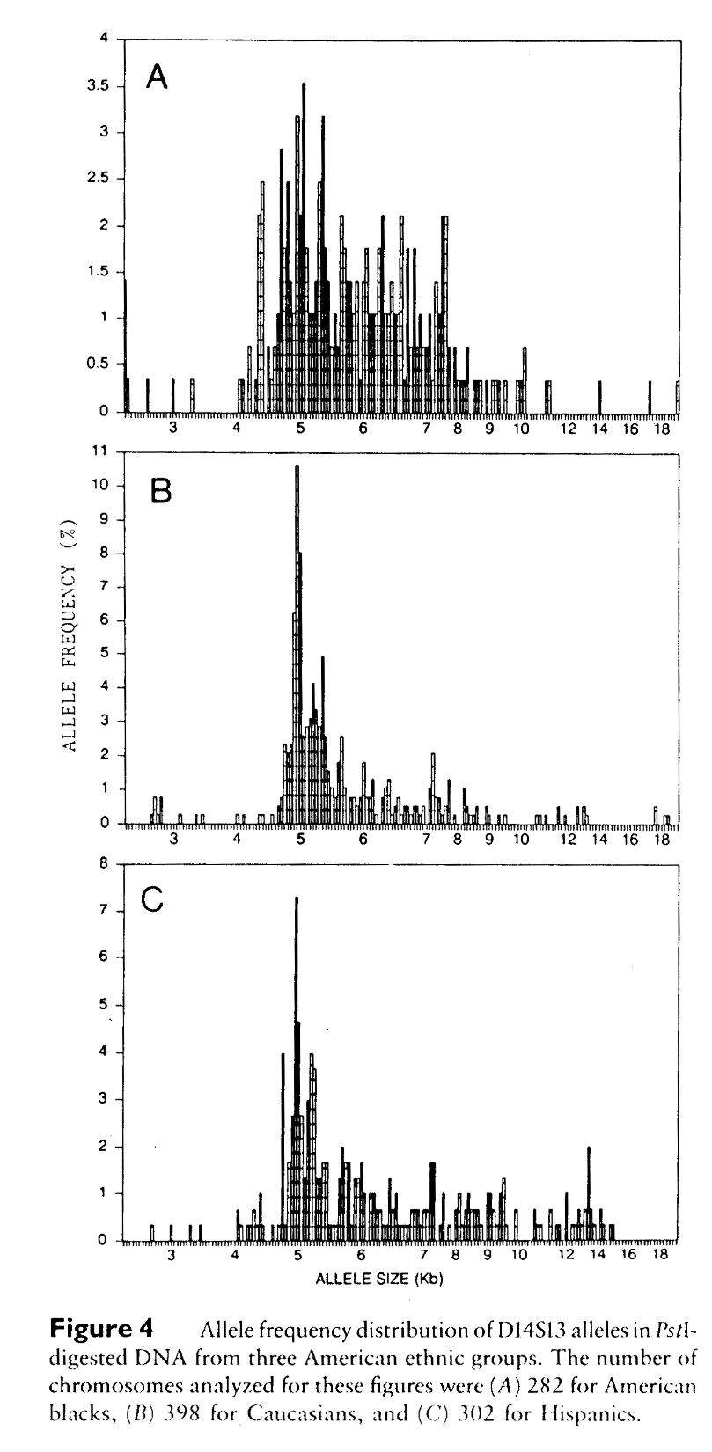
Genetic diversity of VNTR Loci in Human Populations
Average heterozygosity of 6 VNTR loci in ethnic groups:
Caucasian 0.89
Chinese 0.84
Cambodian 0.80
Melanesian 0.76
Australian aborigine 0.77
American
Blacks
Caucasians
Hispanics
FROM: Balazs et al. 1989. Am. J. Hum. Genet. 44:182-190.
Balazs et al. 1992. Genetics 131:191-198

Slide 40
Some Definitions:
Population: A freely interbreeding group of individuals.
Gene Pool: The sum total of genetic information present in a population at any given point in time.
Phenotype: A morphological, physiological, biochemical, or behavioral characteristic of an individual organism.
Genotype: The genetic constitution of an individual organism.
Locus: A site on a chromosome, or the gene that occupies the site.
Gene: A nucleic acid sequence that encodes a product with a distinct function in the organism.
Allele: A particular form of a gene.
Gene (Allele) Frequency: The relative proportion of a particular allele at a single locus in a population (a number between 0 and 1).
Genotype Frequency: The relative proportion of a particular genotype in a population (a number between 0 and 1).

