Slide 1
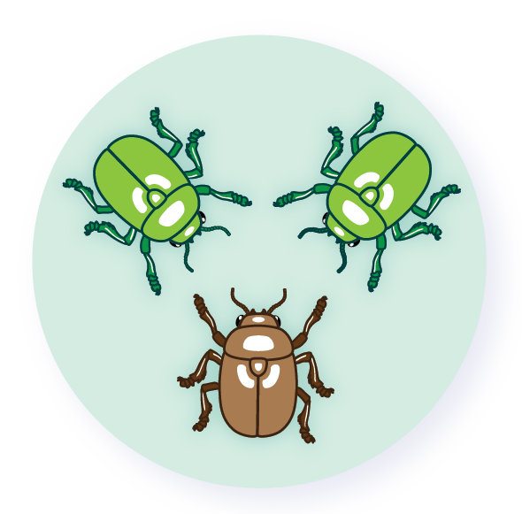
Mutations

Slide 2
Mutation
Permanent change in a nucleotide
If they are Benefitial, then natural selection increase frequency
If they are harmful they are removed by selection
Errors in DNA replication or DNA repairing

Slide 3
Different ways to produce mutations

Slide 4
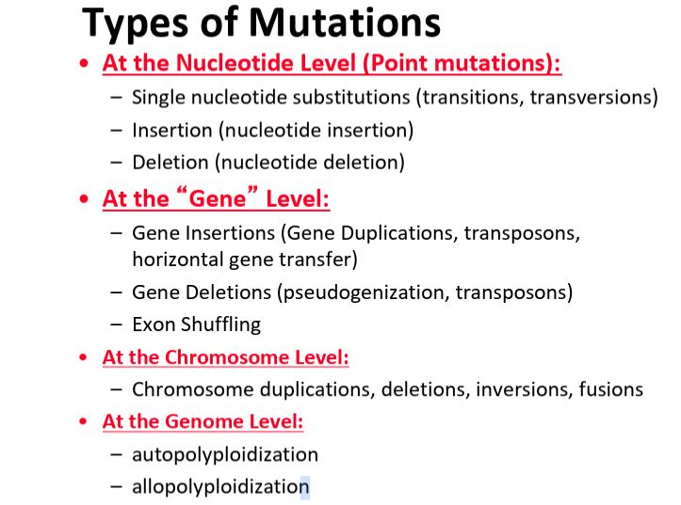

Slide 5
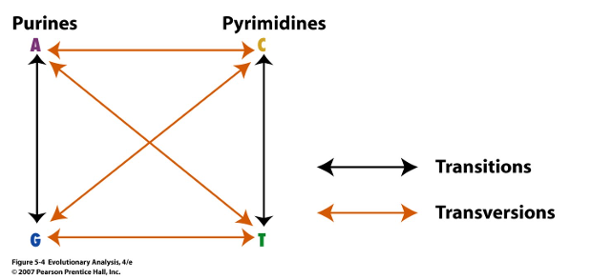
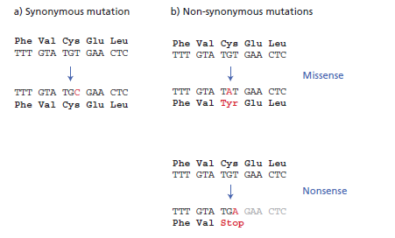
Point mutations
Simple form: Substitution
Purines: A <−> G (Transition)
Pyrimidine: C <−> T (Transversion)
synonymous mutations
What is more frequent?

Slide 6
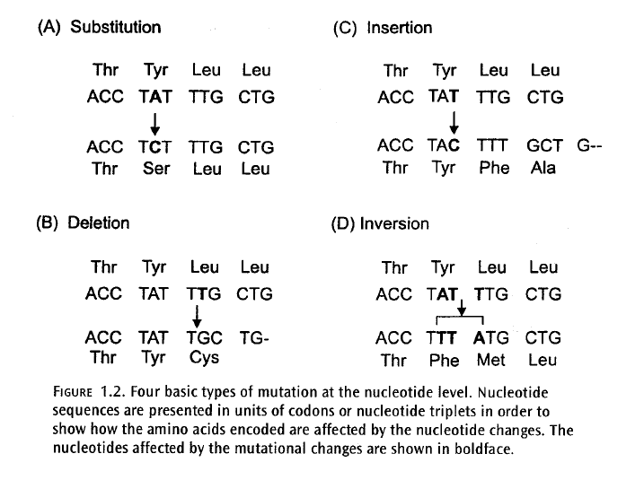

Slide 7
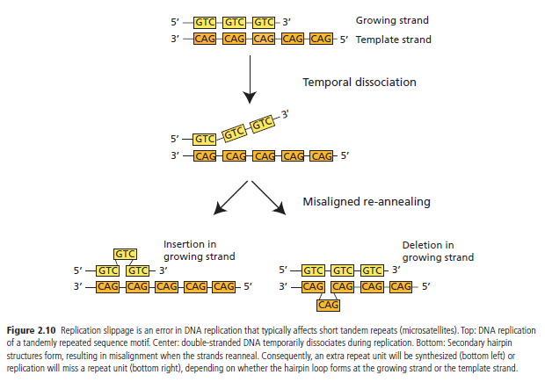
Replication slippage
Short insertions or deletions - > tandem repeats

Slide 8
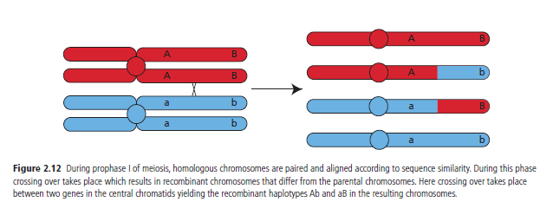
Recombination and reshuffling of alleles
During meiosis

Slide 9
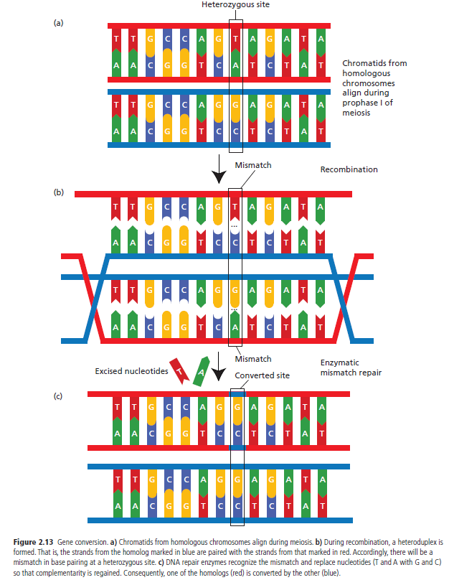
Gene conversion
Replacing of a variant

Slide 10
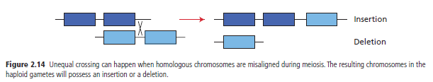
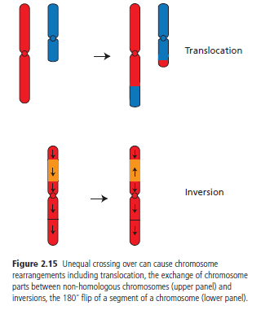
Unequal crossing over
Misalignment of homologous chromosomes during prophase I of meiosis -> insertion or deletion
Unequal crossing over can lead to gene duplication.

Slide 11
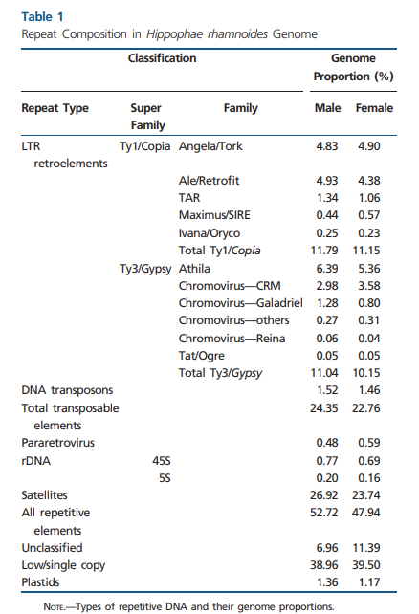
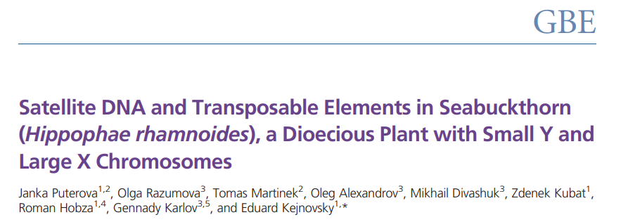
Transposable elements

Slide 12
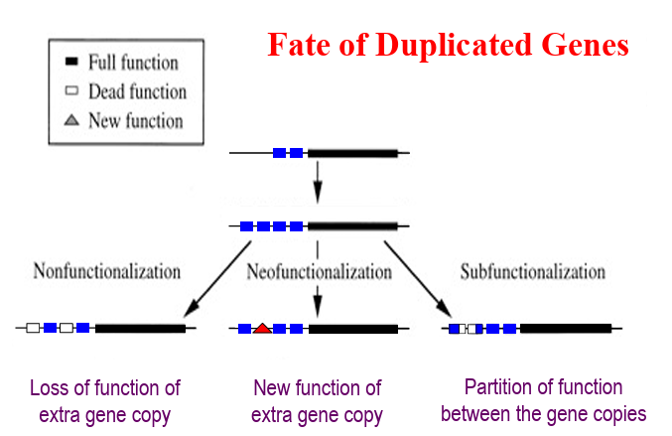
Gene Duplications

Slide 13
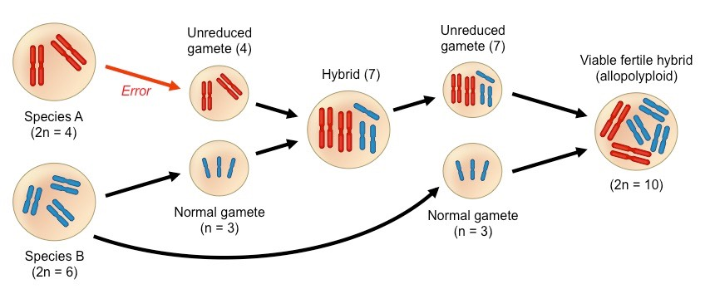
Allopolyploidy

Slide 14
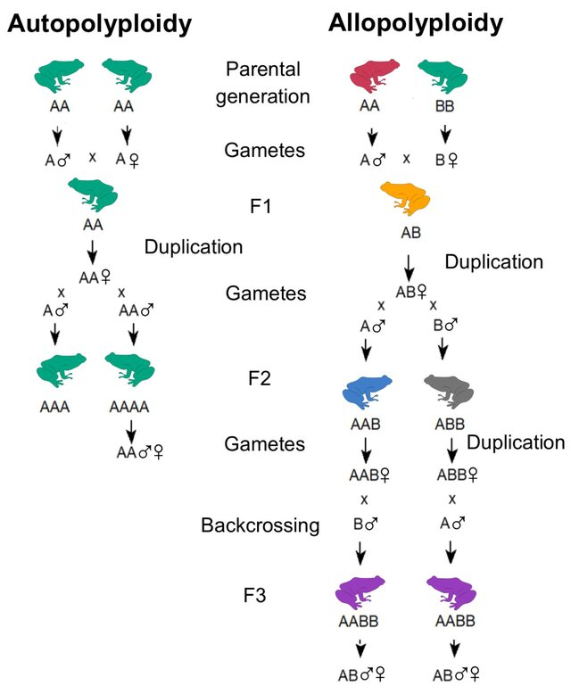
Autopolyploidy
https://www.researchgate.net/publication/369185498_Evolutionary_and_Genomic_Diversity_of_True_Polyploidy_in_Tetrapods/figures?lo=1

Slide 15
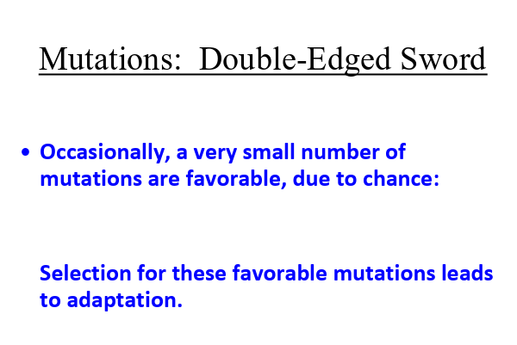
https://carollee.labs.wisc.edu/Evolution410_Reading/6.Variation-Mutation410_2023.pdf

Slide 16
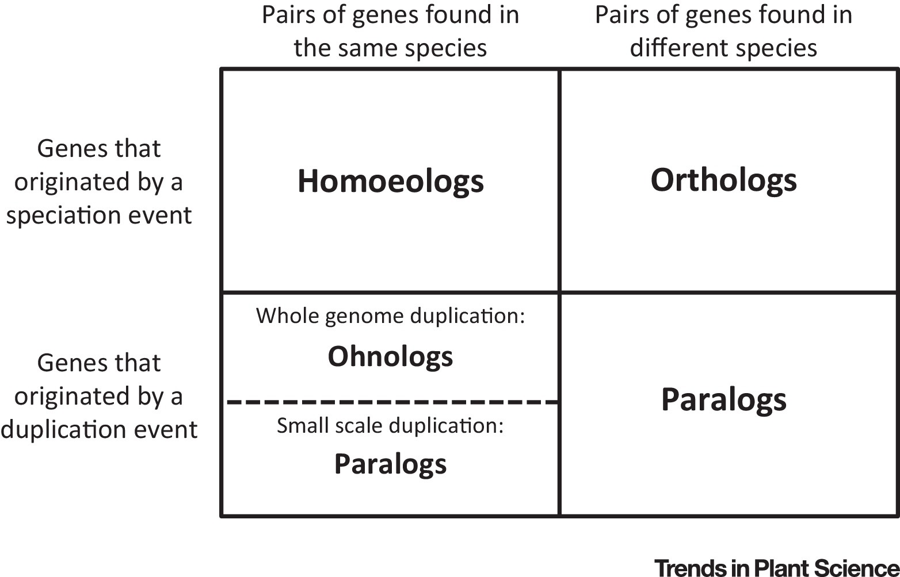
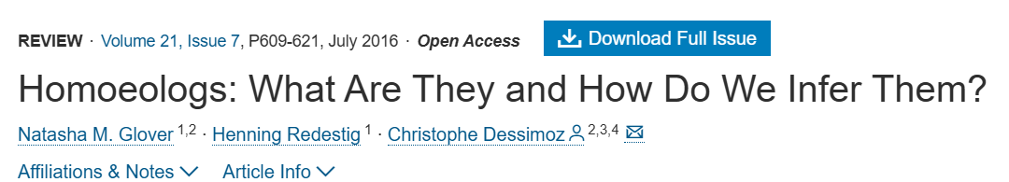

Slide 17
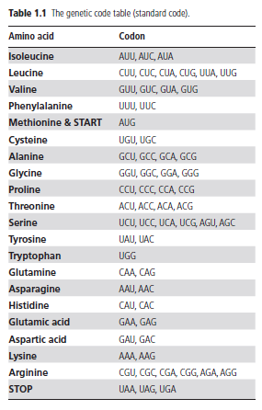
Neutral theory
Most changes due to genetic drift
Variation is neutral
Most mutations are deleterious and removed by purifying selection

Slide 18
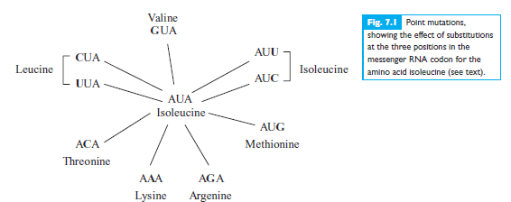

Slide 19
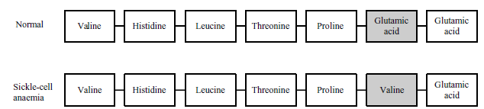
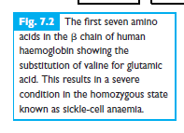

Slide 20

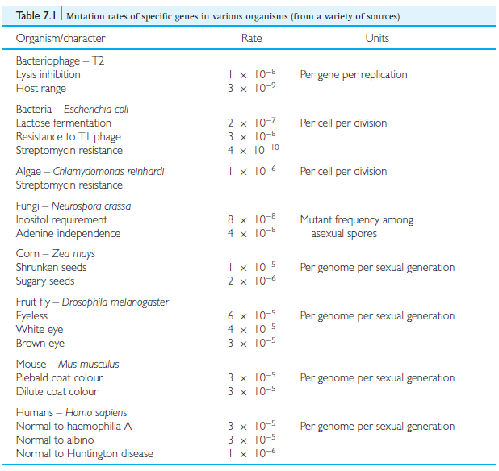
Mutation rate
mutation pressure by itself can only cause large changes in the allelic frequencies of populations over vast periods of time

Slide 21

substitution rate is the rate at which a population accumulates new fixed variants through mutation and genetic drift along a DNA sequence
Where Fixation is 1/2Ne, and the mutation rate in the population is (2Ne μ)
In the absence of selection, the substitution rate equals the mutation rate according to the neutral theory

Slide 22
Molecular clock (Zuckerkandl & Pauling 1962).
number of nucleotide differences between two species is d
substitution rate in the gene is μ per site per generation
t generations
E(d) = 2mt

Slide 23
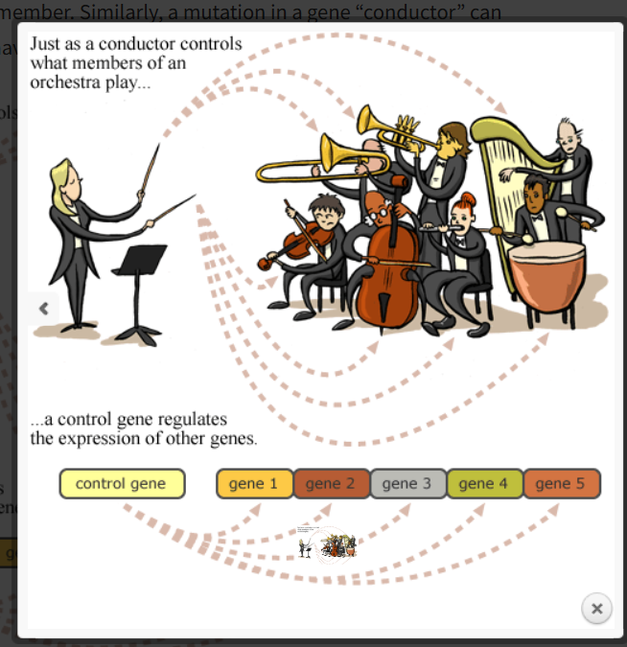

Slide 24
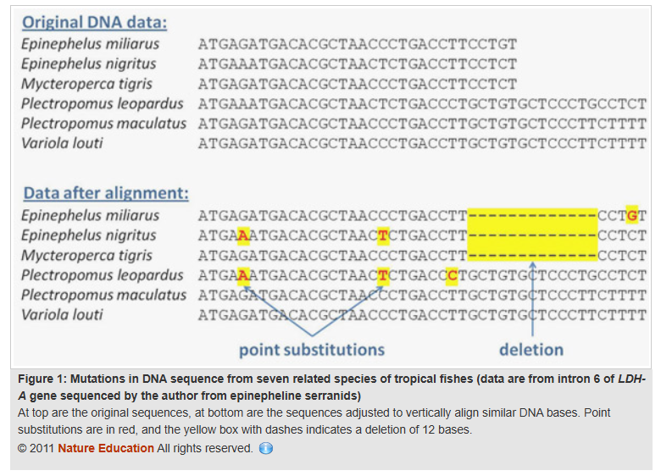

Slide 25
McDonald-Kreitman Test: Underlying Theory/Assumptions
Selection acts Nonsynonymous changes (mutations that change the protein sequence)
Synonymous (silent) mutations should be neutral
Advantageous mutations will fix more rapidly than neutral ones.
Deleterious mutations will be removed more rapidly than neutral ones.
Nonsynonymous mutations that are adaptive for a particular species will become fixed differences between species (more quickly than you would expect by chance)!
Notes:
Very simplified assumptions re: which sites are neutral or not
Makes this a very conservative test

Slide 26
McDonald-Kreitman Test: Fixed vs. Polymorphic Sites
Species 1
Species 2

Slide 27
McDonald-Kreitman Test: Fixed vs. Polymorphic Sites
A mutation here
will show up as shared b/t the 2 species
Species 1
Species 2
Outgroup
Pos. 1: Monomorphic
G
T
G
T
T
G
G
C
G
T
T
G
G
T
G
T
T
G
G
C
G
T
T
G
A
C
G
T
T
G

Slide 28
McDonald-Kreitman Test: Fixed vs. Polymorphic Sites
Mutations here will be
fixed differences between the species
Species 1
Species 2
Outgroup
Pos. 1: Monomorphic
G
T
G
T
T
G
G
T
G
T
T
G
G
C
C
T
T
G
G
C
C
T
T
G
A
C
G
T
T
G
Pos. 2: Fixed
Pos. 3: Fixed

Slide 29
McDonald-Kreitman Test: Fixed vs. Polymorphic Sites
Mutations here will be
Polymorphic within species
Species 1
Species 2
Outgroup
Pos. 1: Monomorphic
G
T
G
A
T
G
G
T
G
T
T
A
G
C
C
T
T
A
G
C
C
T
G
G
A
C
G
T
T
G
Pos. 2: Fixed
Pos. 3: Fixed
Pos. 4: Polymorphic
Pos. 5: Polymorphic

Slide 30
McDonald-Kreitman Test: Fixed vs. Polymorphic Sites
Migration, incomplete lineage sorting, or parallel mutation events can also result in polymorphic sites
Species 1
Species 2
Outgroup
Pos. 1: Monomorphic
G
T
G
A
T
G
G
T
G
T
T
A
G
C
C
T
T
A
G
C
C
T
G
G
A
C
G
T
T
G
Pos. 2: Fixed
Pos. 3: Fixed
Pos. 4: Polymorphic
Pos. 5: Polymorphic
Pos. 6: Polymorphic

Slide 31
McDonald-Kreitman Test: Fixed vs. Polymorphic Sites
1. If synonymous mutations are neutral, then they should happen with equal probability on any of the branches of the tree.
1 Monomorphic SNP
2 SNPs fixed in Species 1
2 SNPs fixed in Species 2
1 SNP polymorphic in Species 1
2 SNPs polymorphic in Species 2
Species 1
Species 2

Slide 32
McDonald-Kreitman Test: Synonymous vs. Nonsynonymous
1. If synonymous mutations are neutral, then they should happen with equal probability on any of the branches of the tree.
2. If nonsynonymous mutations are under the same selective pressure in each species, then they should also be equally likely (or unlikely) to appear on any given branch.
Synonymous
1 Monomorphic SNP
2 SNPs fixed in Species 1
2 SNPs fixed in Species 2
2 SNPs polymorphic in Species 1
2 SNPs polymorphic in Species 2
Nonynonymous
1 SNPs fixed in Species 1
1 SNP fixed in Species 2
1 SNP polymorphic in Species 1
1 SNP polymorphic in Species 2
Even though #Nonsyn < #Syn,
The relative frequency of them (1/2) is the same both within and between species
Species 1
Species 2

Slide 33
M-K Test: Synonymous vs. Nonsynonymous
1. If synonymous mutations are neutral, then they should happen with equal probability on any of the branches of the tree.
2. If nonsynonymous mutations are under the same selective pressure in each species, then they should also be equally likely (or unlikely) to appear on any given branch.
3. If a gene has been selected to have a novel functions in 1 of the 2 species, then nonsynonymous mutations are disproportionately likely to appear on only one of the branches since the species split.
Synonymous
1 Monomorphic SNP
2 SNPs fixed in Species 1
2 SNPs fixed in Species 2
2 SNPs polymorphic in Species 1
2 SNPs polymorphic in Species 2
Nonynonymous
3 SNPs fixed in Species 1
0 SNPs fixed in Species 2
0 SNPs polymorphic in Species 1
1 SNP polymorphic in Species 2
Species 1
Species 2
Notes:
Should hold true even if mutation rate is different among different genes (because silent substitution rate is essentially a control)
Also if different demographic histories affect species differently, hypothetically the synon substitution rate controls for that as well

Slide 34
McDonald-Kreitman Test
 | Nonsynonymous | Synonymous
Fixed | F_{N} | F_{S}
Polymorphic | P_{N} | P_{S}
Under Neutrality:
F_{N}/F_{S} = P_{N}/P_{S}
But, if selection is acting to fix advantageous nonsynonymous changes:
F_{N}/F_{S} > P_{N}/P_{S}
Or, if selection is working to remove deleterious nonsyn. changes:
F_{N}/F_{S} < P_{N}/P_{S}
Notes:
i.e., if rates are equal along the tree branches, then even if there are fewer (or more) nonsynonmous mutations vs. synonymous, the proportion should be equal no matter where on the tree I look

Slide 35
McDonald-Kreitman Test
 | Nonsynonymous | Synonymous
Fixed | F_{N} | F_{S}
Polymorphic | P_{N} | P_{S}
Under Neutrality:
F_{N}/F_{S} = P_{N}/P_{S} ** We test this with Chi-Square or Fisher’s Exact
Neutrality Index:
(P_{N}/P_{S})
(F_{N}/F_{S}) * If this is < 1; Nonsynonymous changes are being Fixed at a higher rate than expected by chance
* If this is >1; nonsyn changes are being removed at a higher rate than expected by chance
Notes:
In other words, under neutrality things happen at the same rate higher up the tree as they do lower down

