Slide 1
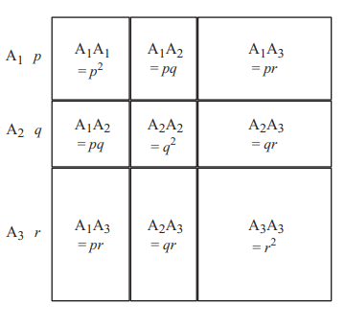
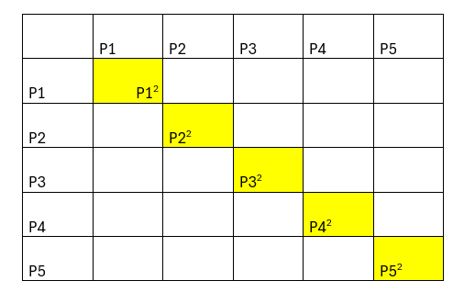
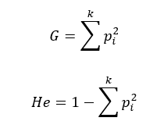
Changes in k alleles

Slide 2
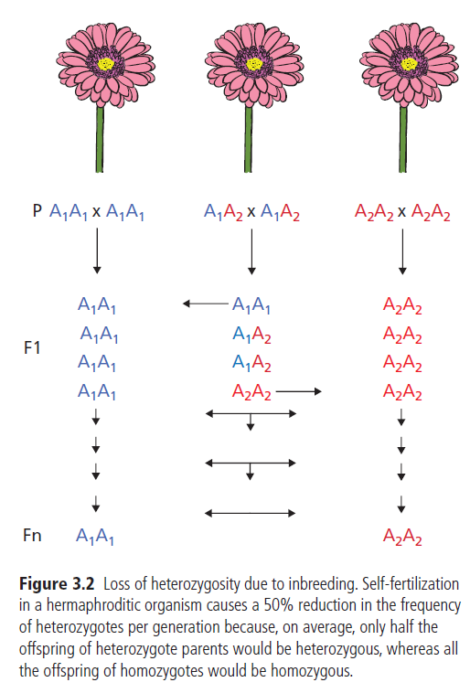

Apareamiento no aleatorio
Endogamia (Inbreeding)
Cruce con parientes cercanos
Perdida de heterocigosidad
Autofertilización

Slide 3
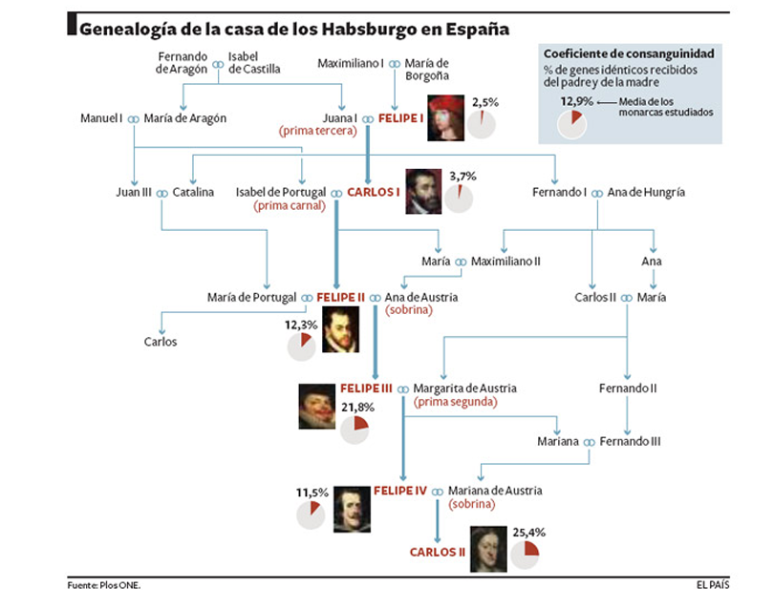
Endogamia (Inbreeding)

Slide 4
Apareamiento no aleatorio
Exogamia (Outbreeding)
Cruce con individuos no relacionados
Producción de heterocigotos

Slide 5
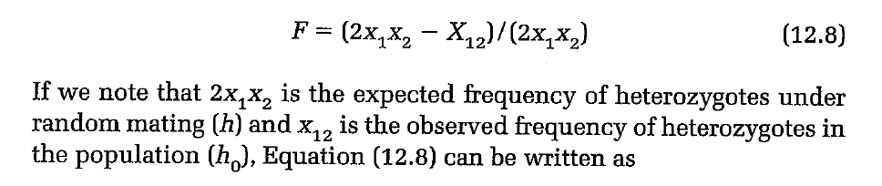
Fixation index
HW deviation can be measured by Fixation index
F=0 (HW)
F<0 heterozygotes excess
F>0 Homozygotes excess

Slide 6
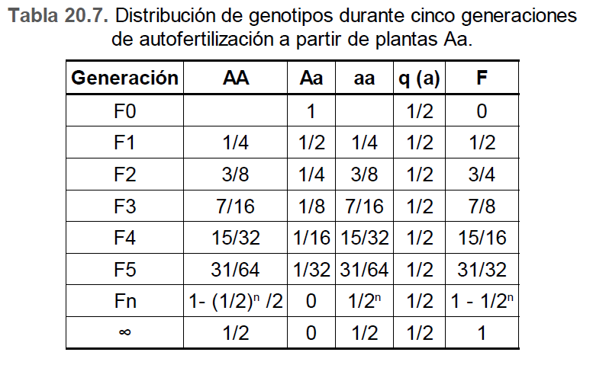
Inbreeding depression: Decreased mean of fitness

Slide 7
Migration

Slide 8
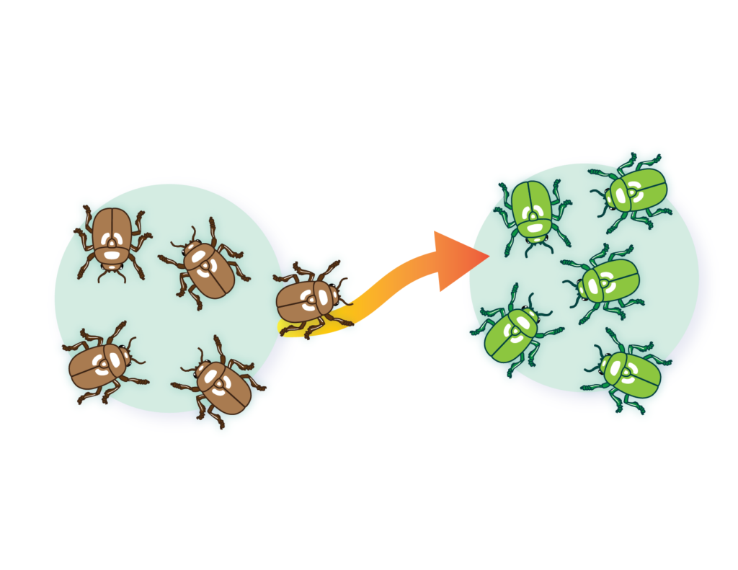
Premise: demos or subpopulations!

Slide 9
Cambios en alelos y frecuencias genotípicas
Apareamiento no aleatorio(Non-random mating)
Flujo genico (Gene Flow) o migración
Selección natural (Natural selection)
Deriva génica (Genetic drift)
Mutaciones (Mutations)
Mechanisms of microevolution

Slide 10
Original or receiving population (Po)
Neighboring or migrant population (Pm)
Changes in gene frequencies
Variant loss
Introducción de nuevas variantes-> Disminución de variabilidad genética
Increased intrapopulation variability

Slide 11
Few migrations among populations ->High genetic differentiation
Many migrations among populations ->Genetic homogenisation

Slide 12
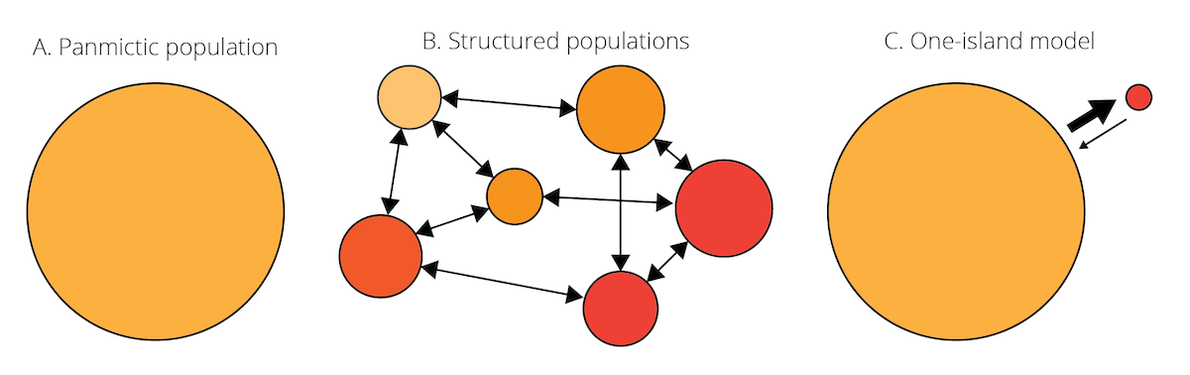
Island model
https://michitobler.github.io/primer-of-evolution/evolutionary-mechanisms-ii-mutation-genetic-drift-migration-and-non-random-mating.html

Slide 13
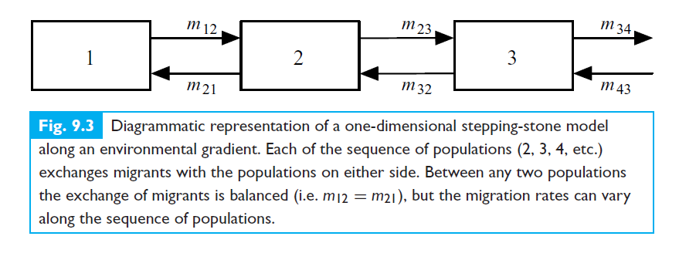
Stepping-stone model

Slide 14
Foundations

Slide 15
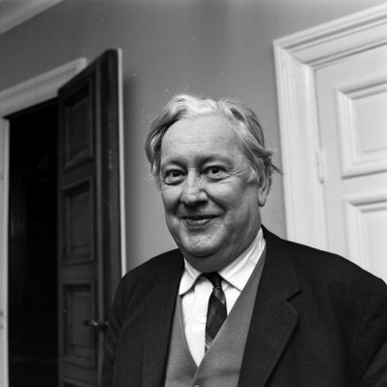
Wahlund Effect
The deficiency of heterozygosity that results from treating multiple populations as a single population.
Even if the subpopulations themselves are in H-W equilibrium.
Caused by geographic barriers + genetic drift.
Sten Wahlund, Uppsala University, Sweden – 1928

Slide 16
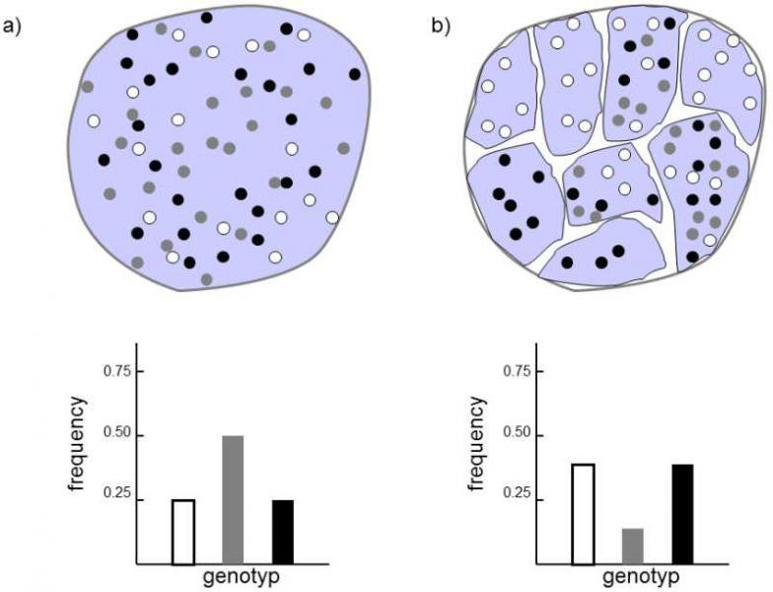
No Population
Subdivision
Population
Subdivision
Population subdivision (population structure)—allele frequencies differ between different geographic regions as a result of individuals being more likely to mate with individuals from the same region (similar to positive assortative mating)
Heterozygotes disappear from metapopulation
https://www.frozenevolution.com/v21-number-homozygotes-increases-after-large-population-splits-number-smaller-ones

Slide 17

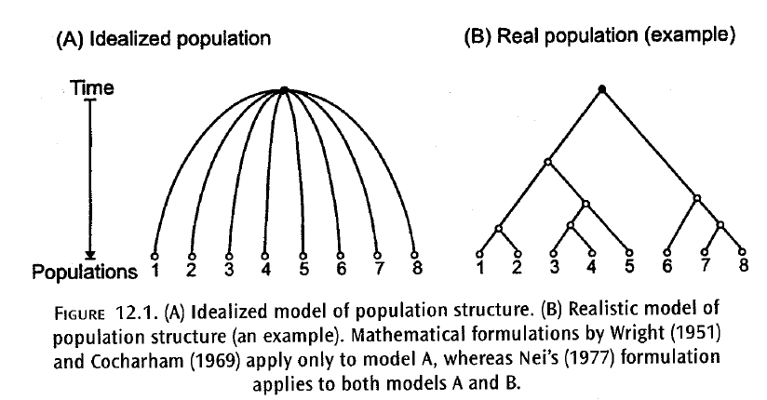

Fixation indexes! Individual -> Subpopulation -> total population

Slide 18

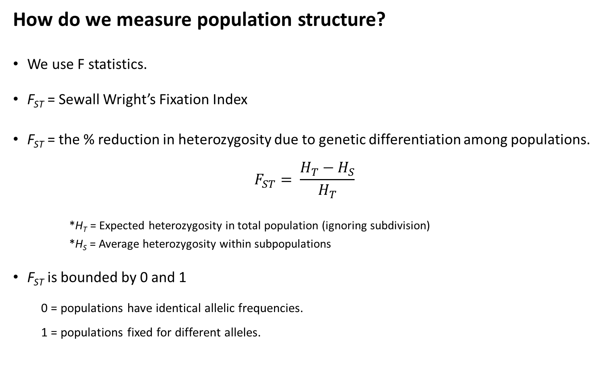
How do we measure population structure?
We use F statistics.
F_{st} = Sewall Wright’s Fixation Index
F_{st} = the % reduction in heterozygosity due to genetic differentiation among populations.
$$F_{ST}= \frac{H_{T}−H_{S}}{H_{T}}$$
*H_{T} = Expected heterozygosity in total population (ignoring subdivision)
*H_{S} = Average heterozygosity within subpopulations
F_{st} is bounded by 0 and 1
0 = populations have identical allelic frequencies.
1 = populations fixed for different alleles.
F_{st}
1.0
0.5
0.0
or

Slide 19
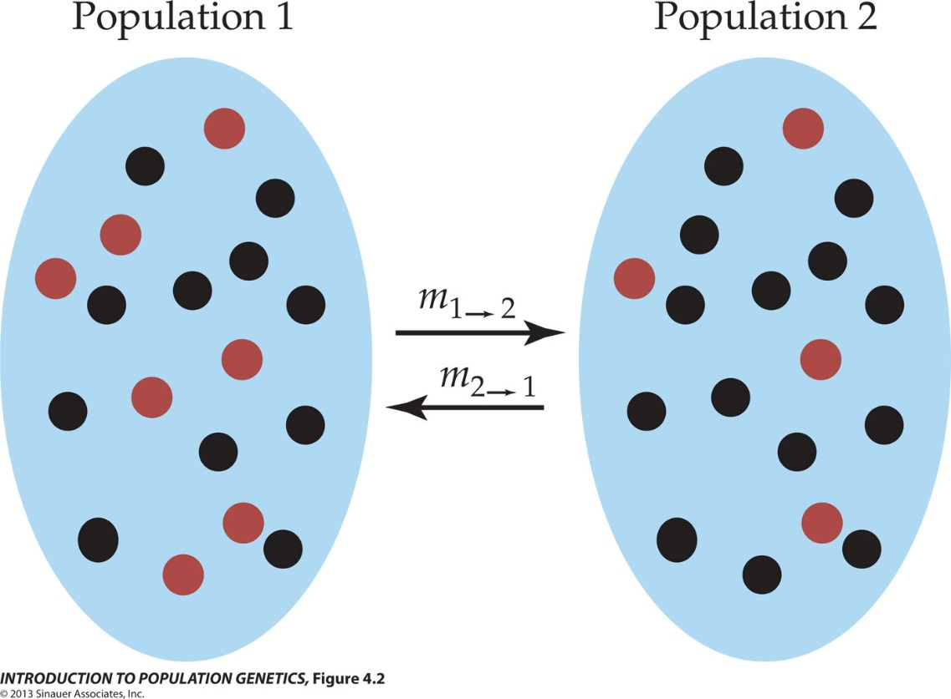

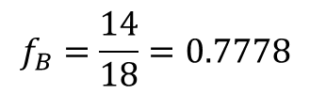



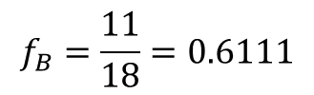



How do we measure population structure?
H_{T} = Expected heterozygosity in total population
When measuring population structure, use average allele frequencies.
$$H_{E}=1−\sum_{i=j}{f_{i}^{2}}$$
Population | f_{R} | f_{B}
1 | 0.3889 | 0.6111
2 | 0.2222 | 0.7778
Mean | 0.3056 | 0.6944
$f_{R}=\frac{7}{18}$ = 0.3889
$f_{R}=\frac{4}{18}$ = 0.2222
$$H_{T}=1−{(0.3056}^{2}+{0.6944}^{2})$$
$$f_{B}=\frac{11}{18}=0.6111$$
$$f_{B}=\frac{14}{18}=0.7778$$
$$H_{T}=1−(0.0934+0.4823)$$
$$H_{T}=1−(0.5756)$$
$$H_{T}=0.4244$$

Slide 20


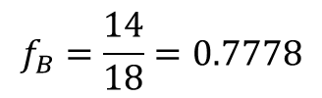






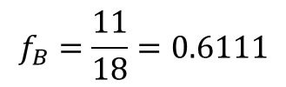





How do we measure population structure?
H_{S} = Average heterozygosity with subpopulations
$$H_{E}=1−\sum_{i=j}{f_{i}^{2}}$$
Population | f_{R} | f_{B}
1 | 0.3889 | 0.6111
2 | 0.2222 | 0.7778
Mean | 0.3056 | 0.6944
$$H_{S1}=1−{(0.3889}^{2}+{0.6111}^{2})$$
$$H_{S2}=1−{(0.2222}^{2}+{0.7778}^{2})$$
$$H_{S2}=1−(0.0494+0.6049)$$
$f_{R}=\frac{7}{18}$ = 0.3889
$f_{R}=\frac{4}{18}$ = 0.2222
$$H_{S1}=1−(0.1512+0.3735)$$
$$H_{S1}=1−(0.5247)$$
$$H_{S2}=1−(0.6543)$$
$$f_{B}=\frac{11}{18}=0.6111$$
$$f_{B}=\frac{14}{18}=0.7778$$
$$H_{S1}=0.4753$$
$$H_{S2}=0.3457$$
$$H_{S}=(0.4753+0.3457)/2$$
$$H_{S}=0.4105$$

Slide 21
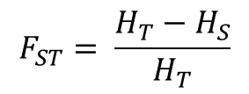


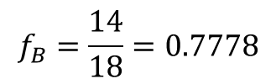


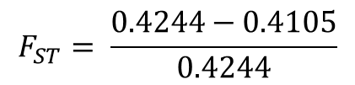
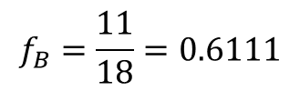

How do we measure population structure?
F_{st} = the % reduction in heterozygosity due to genetic differentiation among populations.
$$F_{ST}= \frac{H_{T}−H_{S}}{H_{T}}$$
$$H_{T}=0.4244$$
$$H_{S}=0.4105$$
$$F_{ST}= \frac{0.4244−0.4105}{0.4244}$$
$$F_{ST}=0.0327$$
$f_{R}=\frac{7}{18}$ = 0.3889
$f_{R}=\frac{4}{18}$ = 0.2222
3.3% of the total genetic variation is explained by differences between populations.
*Weak population structure
$$f_{B}=\frac{11}{18}=0.6111$$
$$f_{B}=\frac{14}{18}=0.7778$$

Slide 22
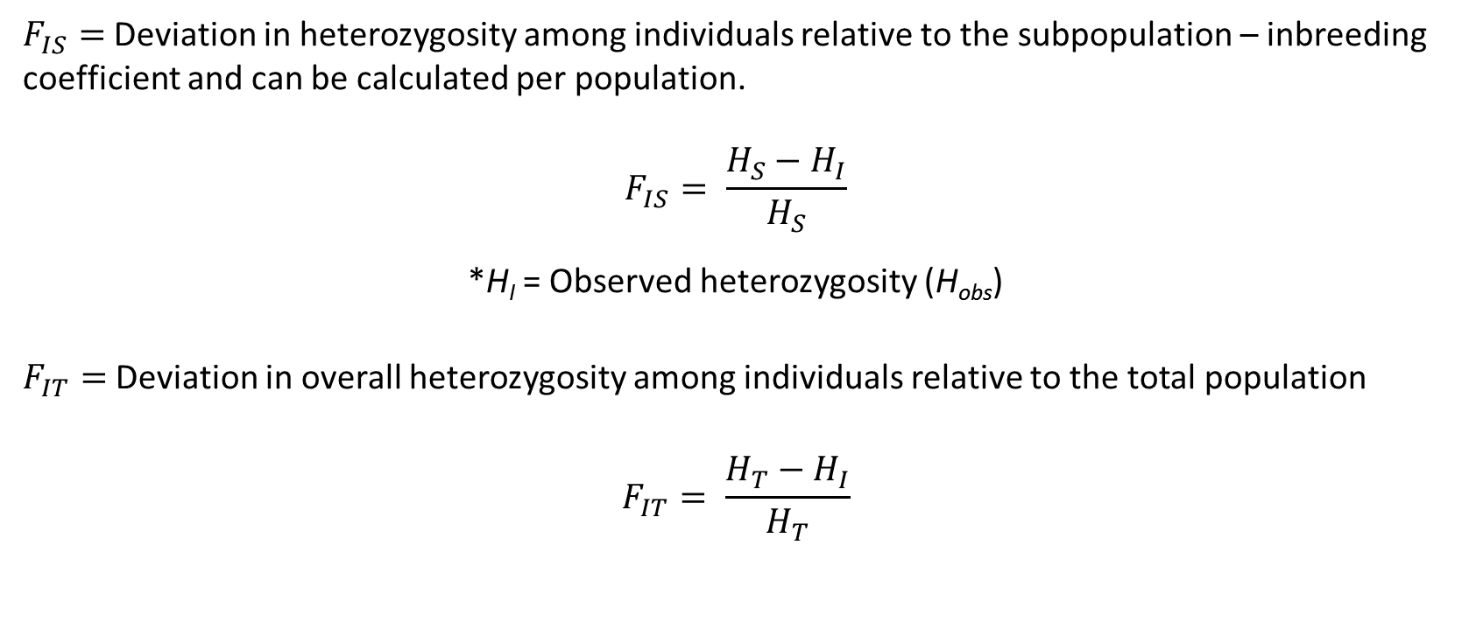
Related F coefficients
$F_{IS}=$Deviation in heterozygosity among individuals relative to the subpopulation – inbreeding coefficient and can be calculated per population.
$$F_{IS}= \frac{H_{S}−H_{I}}{H_{S}}$$
*H_{I} = Observed heterozygosity (H_{obs})
$F_{IT}=$Deviation in overall heterozygosity among individuals relative to the total population
$$F_{IT}= \frac{H_{T}−H_{I}}{H_{T}}$$

Slide 23
Observed heterozygosity within the population (ho)
Expected heterozygosity within the population (hs)
Total expected heterozygosity (hT)
Expected heterozygosity = Diversity!

Slide 24
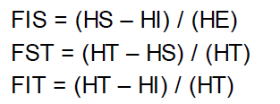
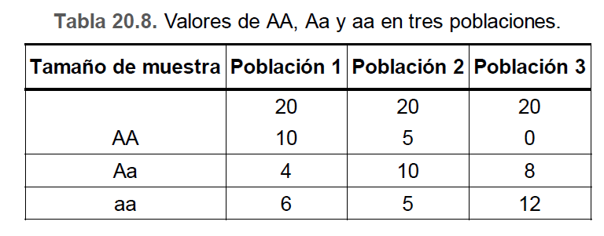
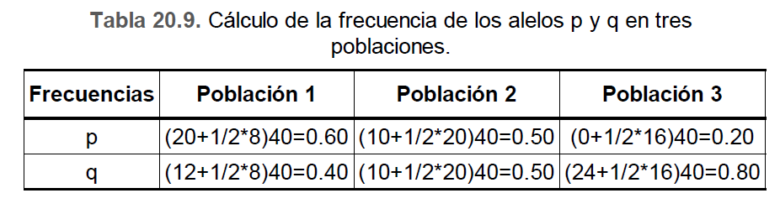

Slide 25
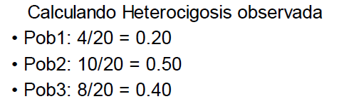
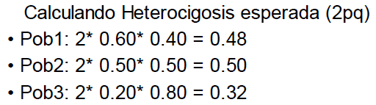
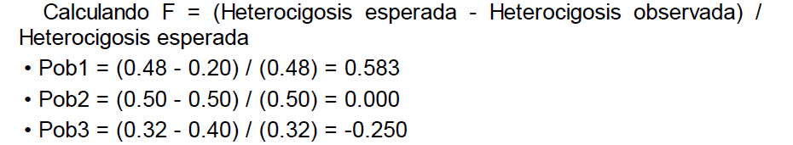
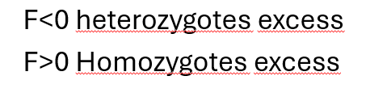

Slide 26
Island model
https://michitobler.github.io/primer-of-evolution/evolutionary-mechanisms-ii-mutation-genetic-drift-migration-and-non-random-mating.html

Slide 27


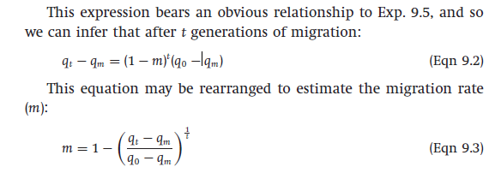
The change in gene frequency as a result of migration depends on the immigration rate (m)
m = Immigration rate
1-m = (Natives)
q0 = allelic frequency of natives
qm= allelic frequency of migrants

Slide 28
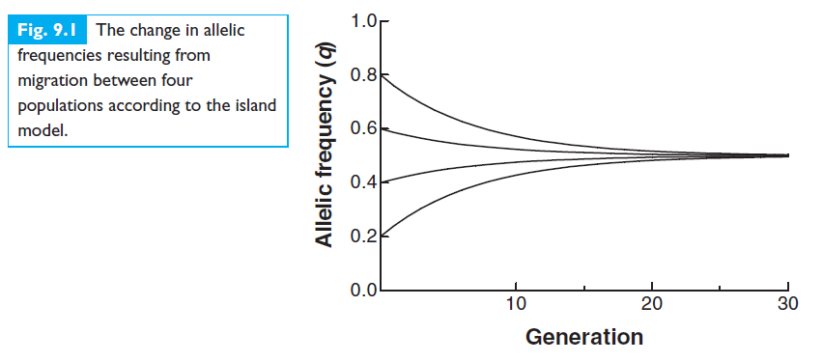
Migration homogenizes allele frequencies

Slide 29
Stepping-stone model

Slide 30
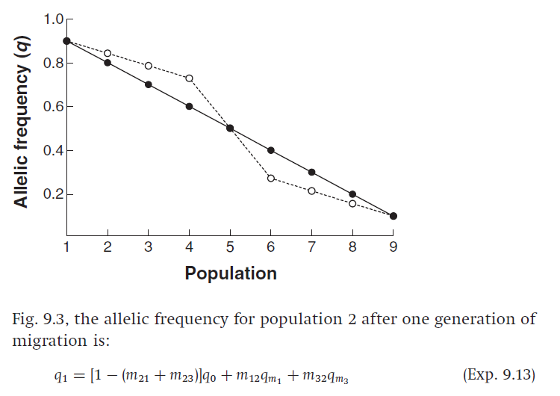
Closest populations migrate faste!

Slide 31
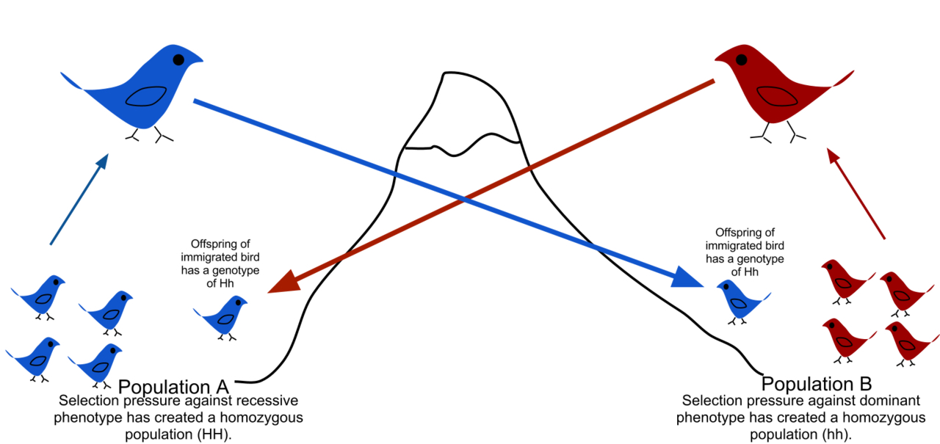
Gene flow is the transfer of alleles from one population to another.
Transfer of h allele
Transfer of H allele
Alleles are maladapted to
the opposite “non-native”
environment.
Each population has low frequency of heterozygotes due to immigrants backcrossing to other population.

Slide 32
The Wright-Fisher Model with Migration
Assumes two populations of constant size, N
Models changes in allele frequencies into future generations (forward in time)
Occasionally, an individual from one population is replaced by an individual from another population
m_{1→2} is the probability that an individual from population 1 migrates to population 2.
m_{2→1} is the probability that an individual from population 2 migrates to population 1.
Migration causes allele frequencies to become more similar between populations.
Reduces F_{st}

Slide 33
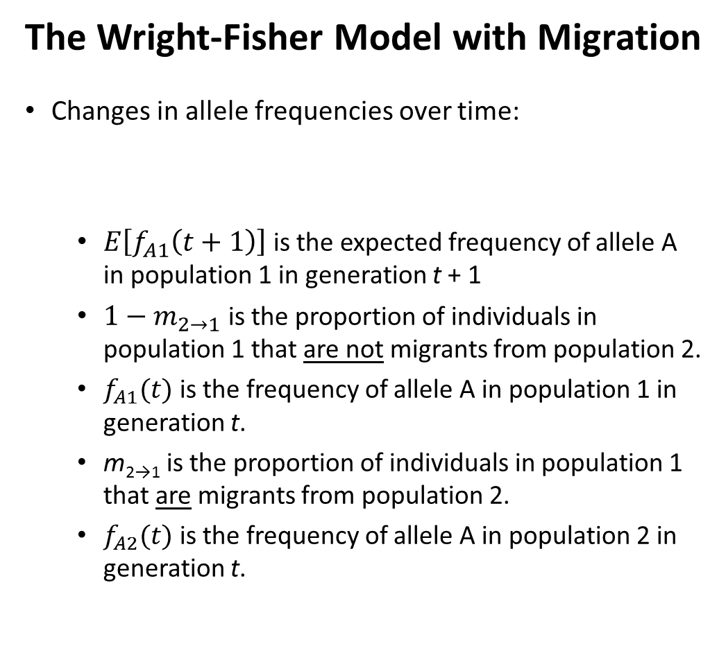
The Wright-Fisher Model with Migration
Changes in allele frequencies over time:
$E\left[f_{A1}\left(t+1\right)\right]$ is the expected frequency of allele A in population 1 in generation t + 1
$1−m_{2→1}$ is the proportion of individuals in population 1 that are not migrants from population 2.
$f_{A1}(t)$ is the frequency of allele A in population 1 in generation t.
m_{2→1} is the proportion of individuals in population 1 that are migrants from population 2.
$f_{A2}(t)$ is the frequency of allele A in population 2 in generation t.
$E\left[f_{A1}\left(t+1\right)\right]=\left(1−m_{2→1}\right)f_{A1}\left(t\right)+$ ${m_{2→1}f}_{A2}\left(t\right)$
$E\left[f_{A2}\left(t+1\right)\right]=\left(1−m_{1→2}\right)f_{A2}\left(t\right)+$ ${m_{1→2}f}_{A1}\left(t\right)$

Slide 34
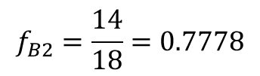

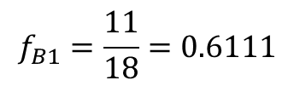


The Wright-Fisher Model with Migration
$E\left[f_{A1}\left(t+1\right)\right]=\left(1−m_{2→1}\right)f_{A1}\left(t\right)+$ ${m_{2→1}f}_{A2}\left(t\right)$
$E\left[f_{A2}\left(t+1\right)\right]=\left(1−m_{1→2}\right)f_{A2}\left(t\right)+$ ${m_{1→2}f}_{A1}\left(t\right)$
0.1111
m_{2→1} = m_{1→2} = $\frac{2}{18}$ = 0.1111
Equal migration rates in each direction (symmetrical migration)
11.11% of individuals in population 1 are migrants from population 2 each generation
Equivalent to 1 diploid migrant per generation in our model
$f_{A1}\left(t\right)=f_{R1}=0.3889$, which is the frequency of the red allele in population 1 in generation t.
$f_{A2}\left(t\right)=f_{R2}=0.2222$, which is the frequency of the red allele in population 2 in generation t.
0.1111
$f_{R1}=\frac{7}{18}$ = 0.3889
$f_{R2}=\frac{4}{18}$ = 0.2222
$$f_{B1}=\frac{11}{18}=0.6111$$
$$f_{B2}=\frac{14}{18}=0.7778$$

Slide 35



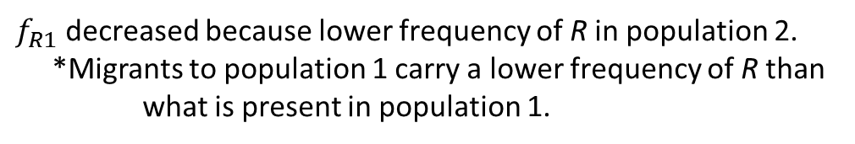


The Wright-Fisher Model with Migration
$E\left[f_{A1}\left(t+1\right)\right]=\left(1−m_{2→1}\right)f_{A1}\left(t\right)+$ ${m_{2→1}f}_{A2}\left(t\right)$
$E\left[f_{R1}\left(t+1\right)\right]=\left(1−m_{2→1}\right)f_{R1}\left(t\right)+$ ${m_{2→1}f}_{R2}\left(t\right)$
$E\left[f_{R1}\left(t+1\right)\right]=\left(1−0.1111\right)(0.3889)+$ $(0.1111)(0.2222)$
0.1111
$E\left[f_{R1}\left(t+1\right)\right]=\left(0.8889\right)(0.3889)+$ $(0.1111)(0.2222)$
$E\left[f_{R1}\left(t+1\right)\right]=(\text{0.345}7)+$ $(0.0247)$
$$E\left[f_{R1}\left(t+1\right)\right]=\text{0.370}4$$
0.1111
$f_{R1}$ decreased because lower frequency of R in population 2.
*Migrants to population 1 carry a lower frequency of R than what is present in population 1.
$f_{R1}=\frac{7}{18}$ = 0.3889
$f_{R2}=\frac{4}{18}$ = 0.2222
$E\left[f_{R2}\left(t+1\right)\right]=\left(1−m_{1→2}\right)f_{R2}\left(t\right)+$ ${m_{1→2}f}_{R1}\left(t\right)$
$E\left[f_{R2}\left(t+1\right)\right]=\left(1−0.1111\right)\left(0.2222\right)+$ $(0.1111)(0.3889)$
$$f_{B1}=\frac{11}{18}=0.6111$$
$$f_{B2}=\frac{14}{18}=0.7778$$
$E\left[f_{R2}\left(t+1\right)\right]=\left(0.1975\right)+$ $(0.0432)$
$$E\left[f_{R2}\left(t+1\right)\right]=0.2407$$
$f_{R2}$ increased because migrants to population 2 carry a higher frequency of R than what is present in population 2.

Slide 36








The Wright-Fisher Model with Migration
What will the allele frequencies be in generation t + 2?
$E\left[f_{R1}\left(t+2\right)\right]=\left(1−m_{2→1}\right)f_{R1}\left(t+1\right)+$ ${m_{2→1}f}_{R2}\left(t+1\right)$
A recursive formula always uses the preceding term to define the next term of the sequence.
0.1111
$E\left[f_{R1}\left(t+2\right)\right]=\left(1−0.1111\right)(0.3704)+$ $(0.1111)(0.2407)$
$E\left[f_{R1}\left(t+2\right)\right]=\left(0.8889\right)(0.3704)+$ $(0.1111)(0.2407)$
0.1111
$E\left[f_{R1}\left(t+2\right)\right]=(\text{0.3292})+$ $(0.0267)$
$$E\left[f_{R1}\left(t+2\right)\right]=\text{0.3559}$$
$f_{R1}$ continues to decrease.
$$E\left[f_{R1}\left(t+1\right)\right]=\text{0.370}4$$
$E\left[f_{R2}\left(t+2\right)\right]=\left(1−m_{1→2}\right)f_{R2}\left(t+1\right)+$ ${m_{1→2}f}_{R1}\left(t+1\right)$
$$E\left[f_{R2}\left(t+1\right)\right]=0.2407$$
$E\left[f_{R2}\left(t+2\right)\right]=\left(1−0.1111\right)\left(0.2407\right)+$ $(0.1111)(0.3704)$
$E\left[f_{R2}\left(t+2\right)\right]=\left(0.2140\right)+$ $(0.0411)$
$$E\left[f_{R2}\left(t+2\right)\right]=0.2551$$
$f_{R2}$ continues to increase.

Slide 37
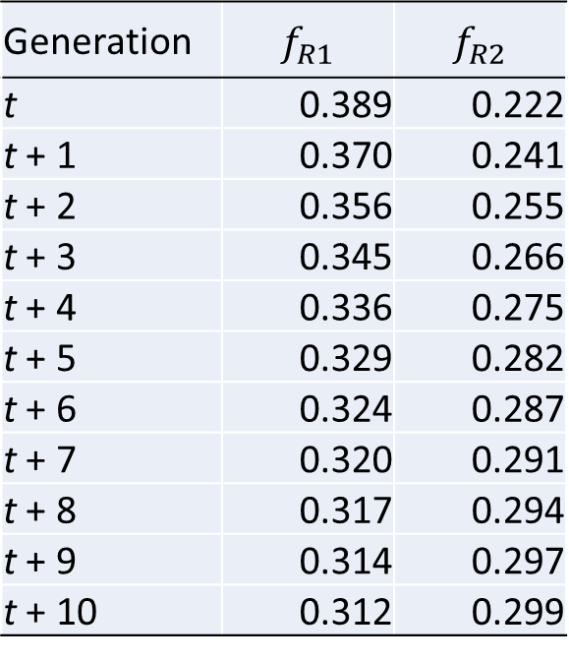
The Wright-Fisher Model with Migration
What will the allele frequencies be in generation t + n?
Generation | $$f_{R1}$$ | $$f_{R2}$$
t | 0.389 | 0.222
t + 1 | 0.370 | 0.241
t + 2 | 0.356 | 0.255
t + 3 | 0.345 | 0.266
t + 4 | 0.336 | 0.275
t + 5 | 0.329 | 0.282
t + 6 | 0.324 | 0.287
t + 7 | 0.320 | 0.291
t + 8 | 0.317 | 0.294
t + 9 | 0.314 | 0.297
t + 10 | 0.312 | 0.299
0.1111
0.1111
Note that I rounded the final values to three decimal places; however, when carrying out the math, I kept all decimal places.

Slide 38
The Wright-Fisher Model with Migration
What will the allele frequencies be in generation t + n?
0.1111
0.1111
Migration homogenizes allele frequencies

Slide 39
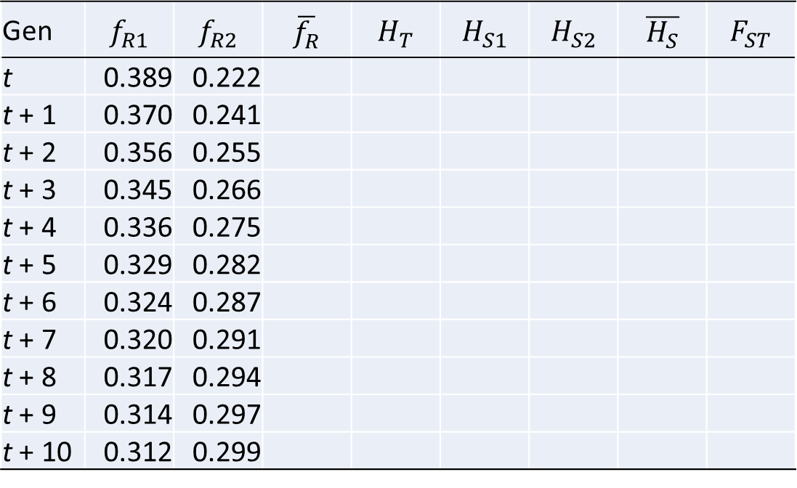
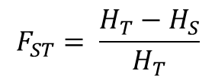
The Wright-Fisher Model with Migration
How will F_{ST} change over time?
$$F_{ST}= \frac{H_{T}−H_{S}}{H_{T}}$$
Gen | $$f_{R1}$$ | $$f_{R2}$$ | $$\overline{f_{R}}$$ | $$H_{T}$$ | $$H_{S1}$$ | $$H_{S2}$$ | $$\overline{H_{S}}$$ | $$F_{ST}$$
t | 0.389 | 0.222
t + 1 | 0.370 | 0.241
t + 2 | 0.356 | 0.255
t + 3 | 0.345 | 0.266
t + 4 | 0.336 | 0.275
t + 5 | 0.329 | 0.282
t + 6 | 0.324 | 0.287
t + 7 | 0.320 | 0.291
t + 8 | 0.317 | 0.294
t + 9 | 0.314 | 0.297
t + 10 | 0.312 | 0.299
0.1111
0.1111
Note that I rounded the final values to three decimal places; however, when carrying out the math, I kept all decimal places.

Slide 40
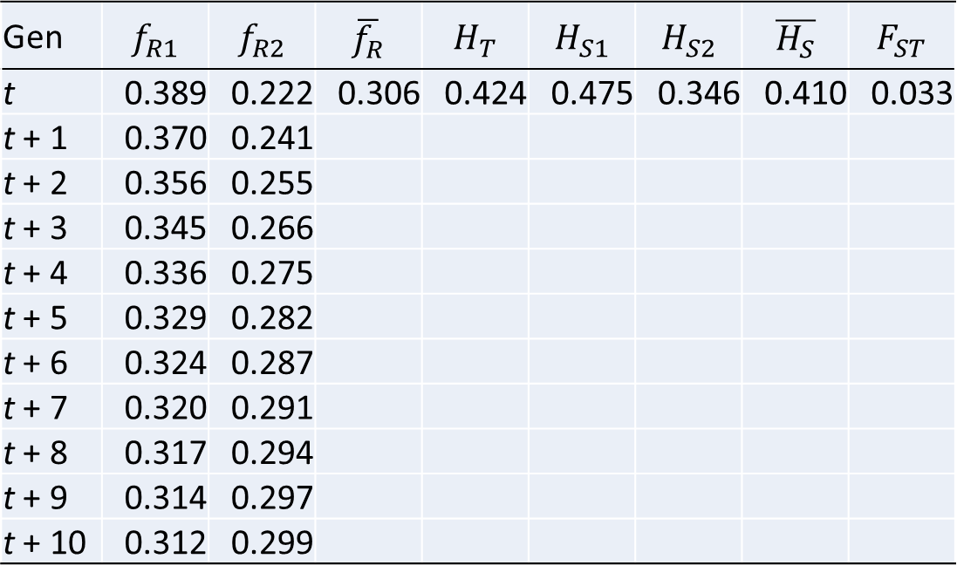
The Wright-Fisher Model with Migration
How will F_{ST} change over time?
$$F_{ST}= \frac{H_{T}−H_{S}}{H_{T}}$$
Gen | $$f_{R1}$$ | $$f_{R2}$$ | $$\overline{f_{R}}$$ | $$H_{T}$$ | $$H_{S1}$$ | $$H_{S2}$$ | $$\overline{H_{S}}$$ | $$F_{ST}$$
t | 0.389 | 0.222 | 0.306 | 0.424 | 0.475 | 0.346 | 0.410 | 0.033
t + 1 | 0.370 | 0.241
t + 2 | 0.356 | 0.255
t + 3 | 0.345 | 0.266
t + 4 | 0.336 | 0.275
t + 5 | 0.329 | 0.282
t + 6 | 0.324 | 0.287
t + 7 | 0.320 | 0.291
t + 8 | 0.317 | 0.294
t + 9 | 0.314 | 0.297
t + 10 | 0.312 | 0.299
0.1111
0.1111
Note that I rounded the final values to three decimal places; however, when carrying out the math, I kept all decimal places.

Slide 41
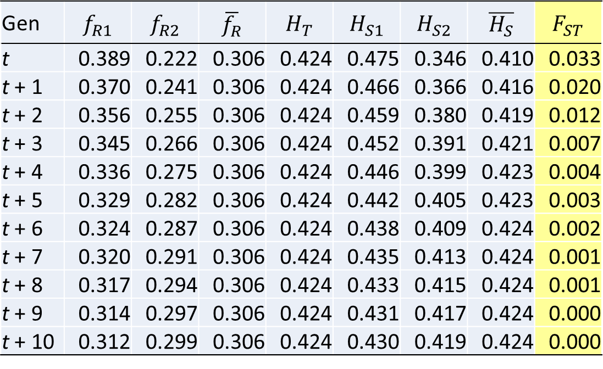
The Wright-Fisher Model with Migration
How will F_{ST} change over time?
$$F_{ST}= \frac{H_{T}−H_{S}}{H_{T}}$$
Gen | $$f_{R1}$$ | $$f_{R2}$$ | $$\overline{f_{R}}$$ | $$H_{T}$$ | $$H_{S1}$$ | $$H_{S2}$$ | $$\overline{H_{S}}$$ | $$F_{ST}$$
t | 0.389 | 0.222 | 0.306 | 0.424 | 0.475 | 0.346 | 0.410 | 0.033
t + 1 | 0.370 | 0.241 | 0.306 | 0.424 | 0.466 | 0.366 | 0.416 | 0.020
t + 2 | 0.356 | 0.255 | 0.306 | 0.424 | 0.459 | 0.380 | 0.419 | 0.012
t + 3 | 0.345 | 0.266 | 0.306 | 0.424 | 0.452 | 0.391 | 0.421 | 0.007
t + 4 | 0.336 | 0.275 | 0.306 | 0.424 | 0.446 | 0.399 | 0.423 | 0.004
t + 5 | 0.329 | 0.282 | 0.306 | 0.424 | 0.442 | 0.405 | 0.423 | 0.003
t + 6 | 0.324 | 0.287 | 0.306 | 0.424 | 0.438 | 0.409 | 0.424 | 0.002
t + 7 | 0.320 | 0.291 | 0.306 | 0.424 | 0.435 | 0.413 | 0.424 | 0.001
t + 8 | 0.317 | 0.294 | 0.306 | 0.424 | 0.433 | 0.415 | 0.424 | 0.001
t + 9 | 0.314 | 0.297 | 0.306 | 0.424 | 0.431 | 0.417 | 0.424 | 0.000
t + 10 | 0.312 | 0.299 | 0.306 | 0.424 | 0.430 | 0.419 | 0.424 | 0.000
0.1111
0.1111
Note that I rounded the final values to three decimal places; however, when carrying out the math, I kept all decimal places.
Migration homogenizes allele frequencies and causes F_{st} to decrease over time.

Slide 42
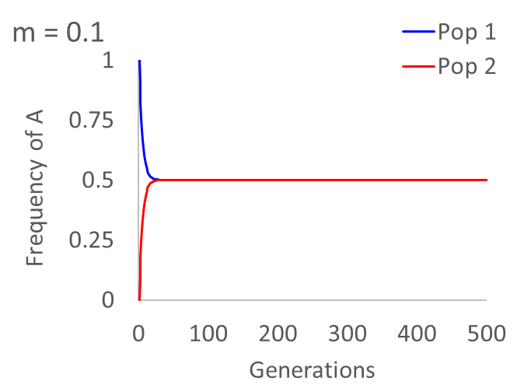
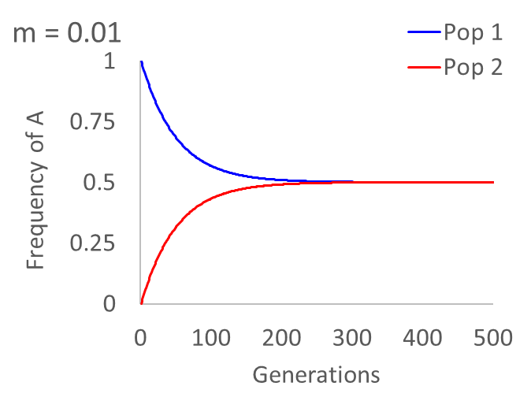
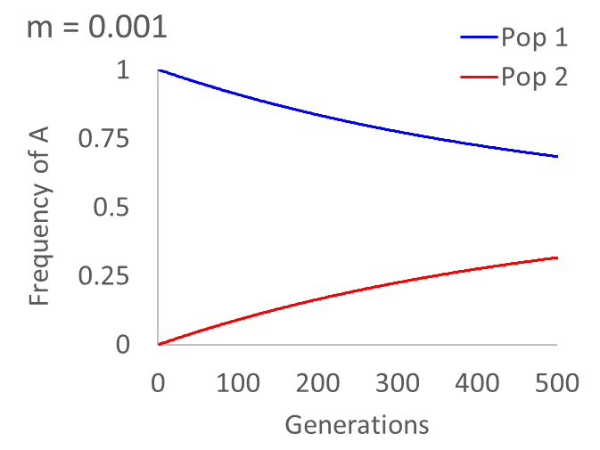
The Wright-Fisher Model with Migration
How do migration rates influence the homogenization of allele frequencies?
The lower the migration rate, the more generations that are required for allele frequencies to become the same.

Slide 43




The Wright-Fisher Model with Genetic Drift and Migration
N_{e} = 200, m = 0.0
N_{e} = 200, m = 0.0001
N_{e} = 200, m = 0.005
N_{e} = 200, m = 0.1
No migration: Allele frequencies are independent in the subpopulations.
Low migration: Allele frequencies can drift to fixation, but are reintroduced through migration.
Moderate migration: Allele frequencies are influenced by drift in the other subpopulation.
High migration: Allele frequencies are strongly dependent; behaves as if large effective population size.

