Slide 1

Molecular basis of evolution
Metrics + Phylogenetics

Slide 2
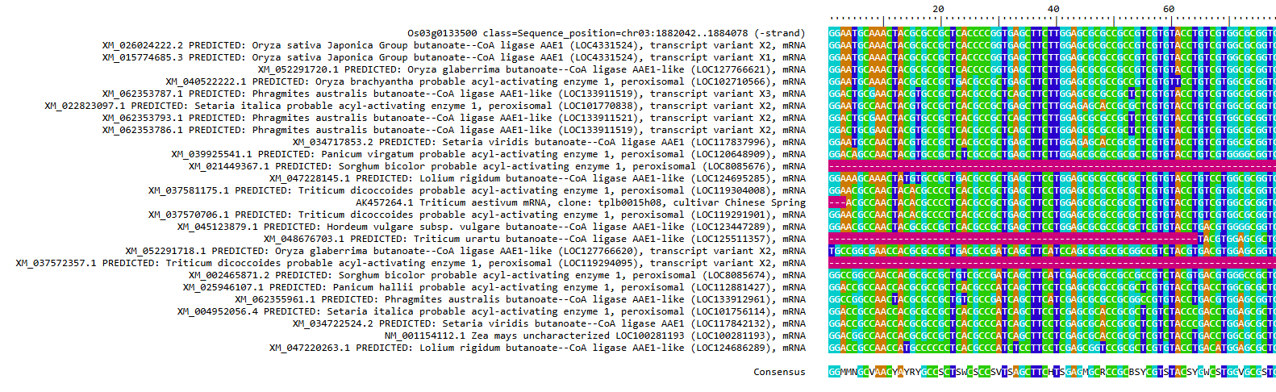

Slide 3
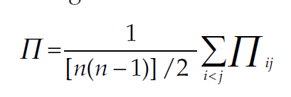
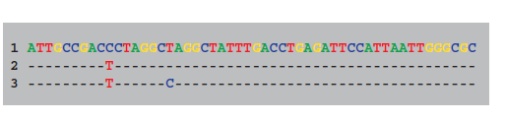
Average number of nucleotide
differences between pairs
number of nucleotide differences
between sequence i and j
number of possible sequence pairs we can make
from our sample of n sequences

Slide 4



nucleotide diversity
Π is dependent of sequence length!
nucleotide diversity

Slide 5
segregating sites
S does depend on sample size
all polymorphisms are weighted equally

Slide 6
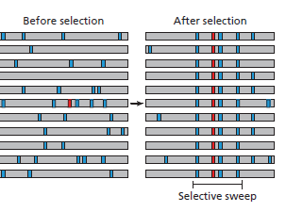
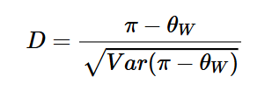
Tajima´s D
θ = K/a, donde K es igual al numero total de sitios segregativos en una muestra de secuencias dada y a = 1 + 1/2+ ... + 1/n-1 (n = numero de secuencias en la muestra; Watterson, 1975; Tajima, 1983).
π (pi) y θ (teta)
D >0 (Selección positiva)
D<0 (Selección purificadora) (Neutral)

Slide 7
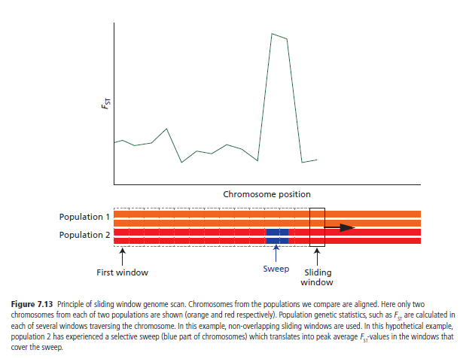
Genome scan (Sliding Windows)
Loci positions are not independent!

Slide 8
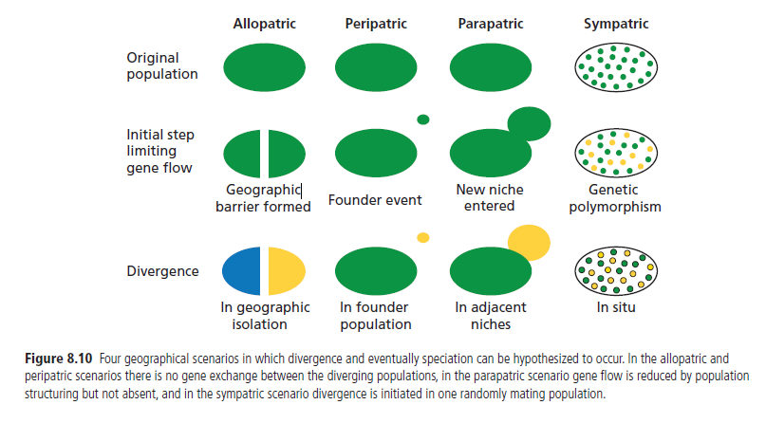
Modes of speciation

Slide 9
Molecular basis of evolution
Phylogenetics

Slide 10
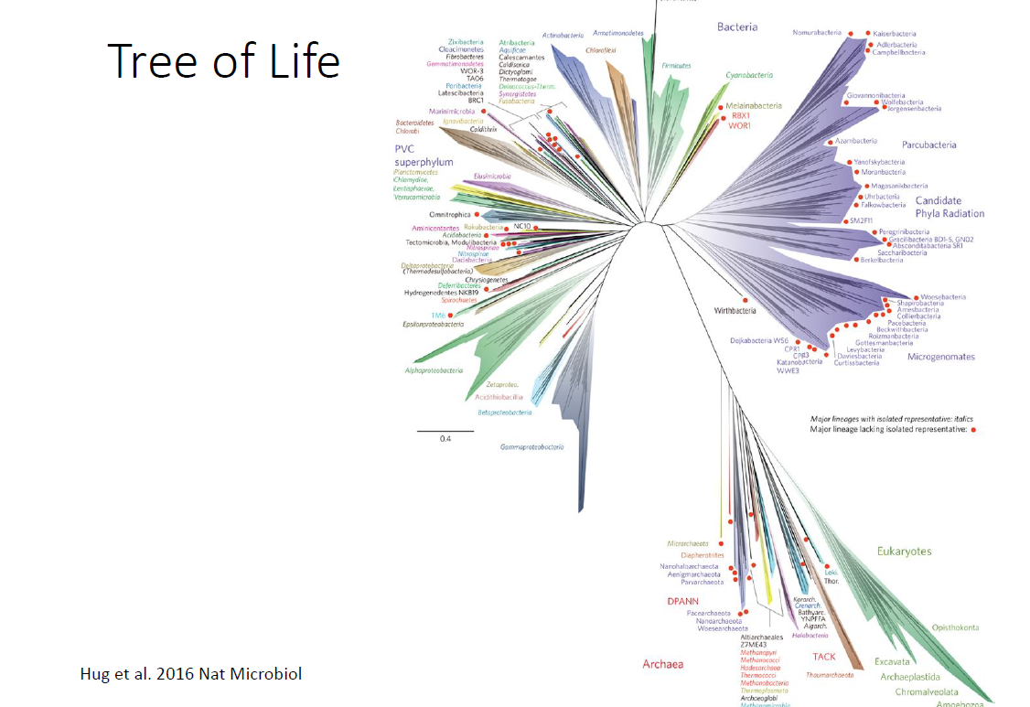

Slide 11
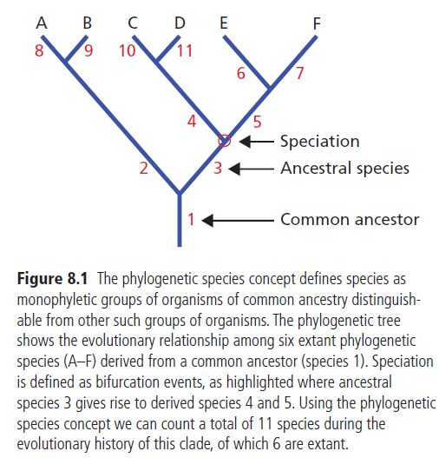
Phylogenetic species concept!

Slide 12
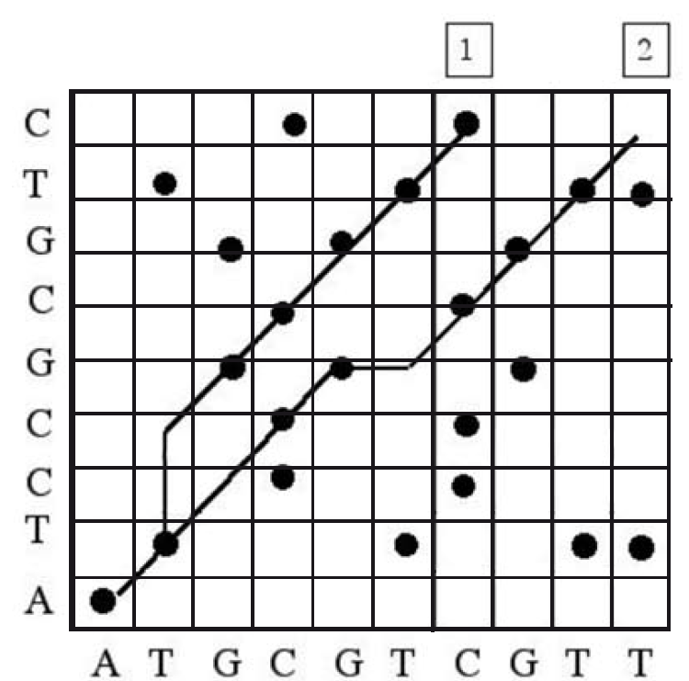
ATGCGTCGTT
ATGCGTCGT

Slide 14
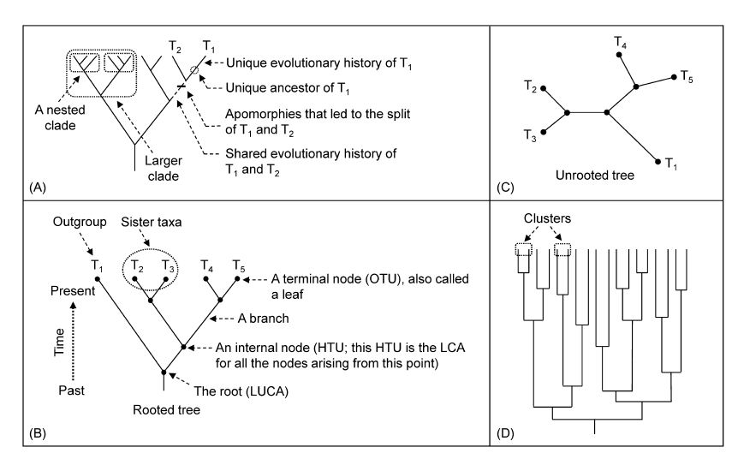
What a phylogenetic tree looks like?

Slide 15
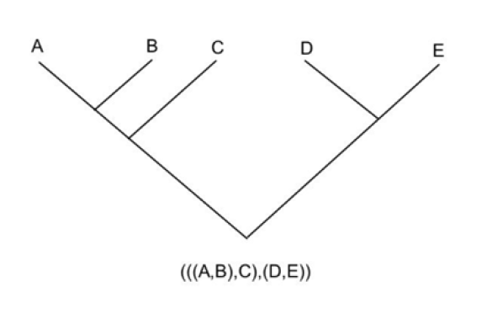
Newick format

Slide 16
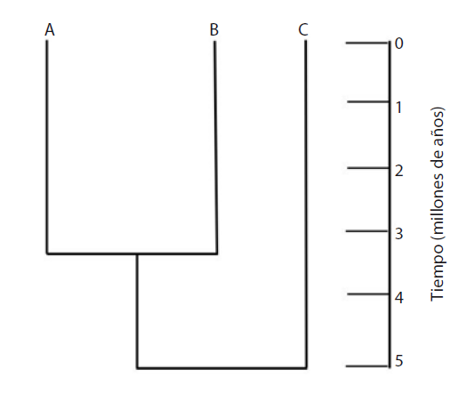
Additive tree: A tree where each branch has its own distance
Ultrametric tree: Terminal nodes have the same distance to tree root

Slide 17
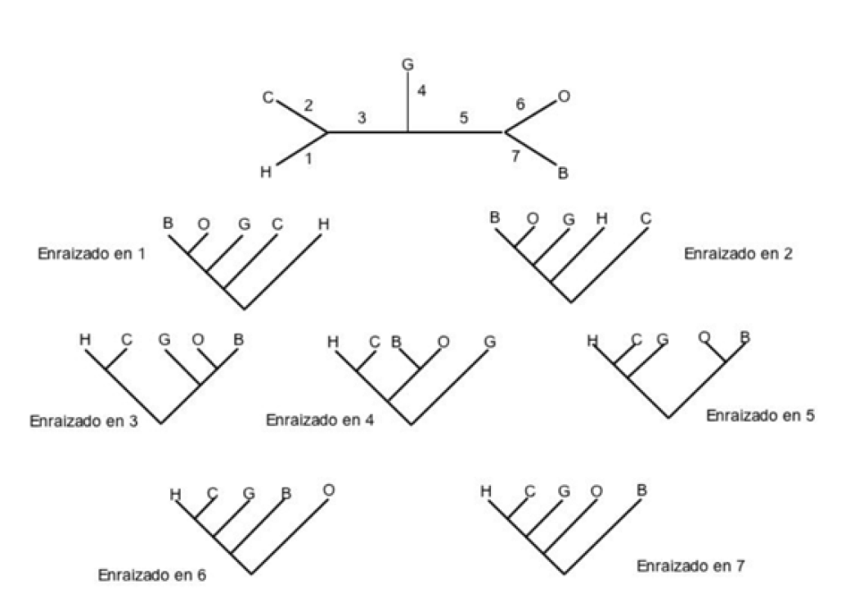
The unrooted trees issue
For 20 sequences: There could be 8 200 794 532 637 891 559 000 no rooted trees!
humano (H), el chimpance (C), el orangutan (O), el gorila (G) y el gibon (G)

Slide 18
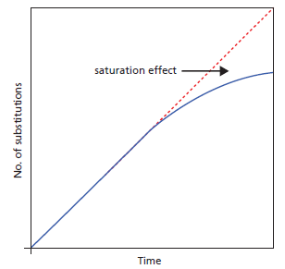
Why do you need to use a model of substitution
Saturation effect -> apply a correction

Slide 19
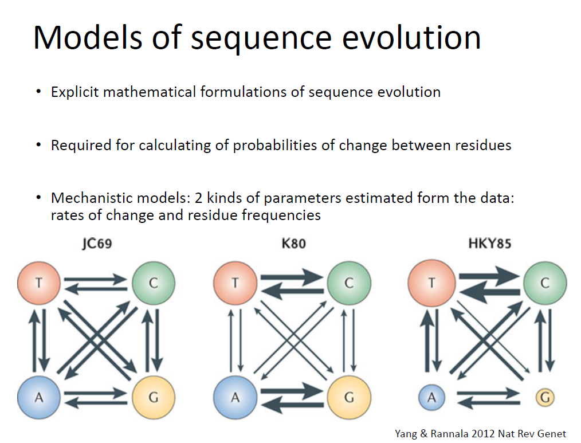

Slide 20
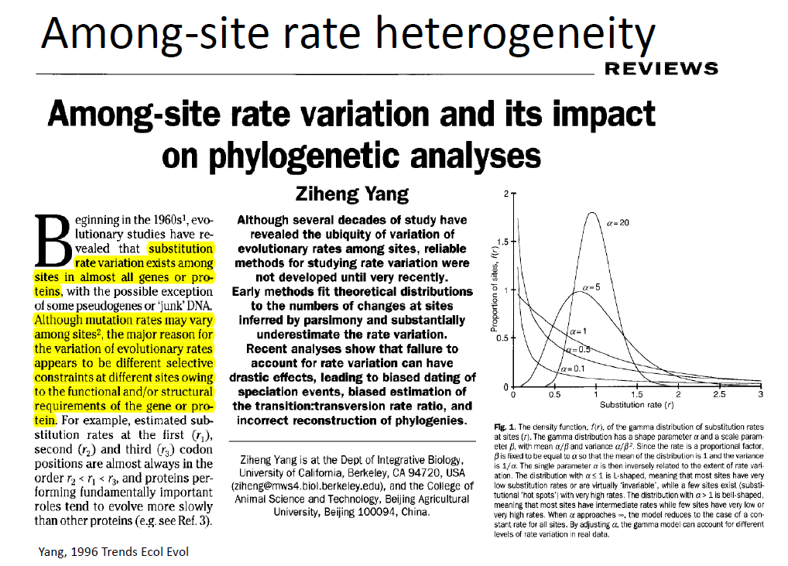

Slide 21
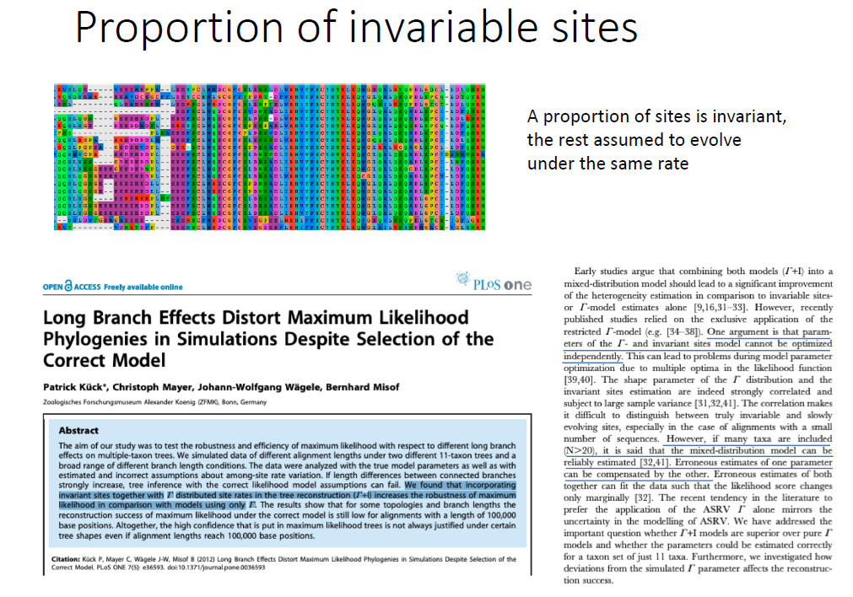

Slide 22
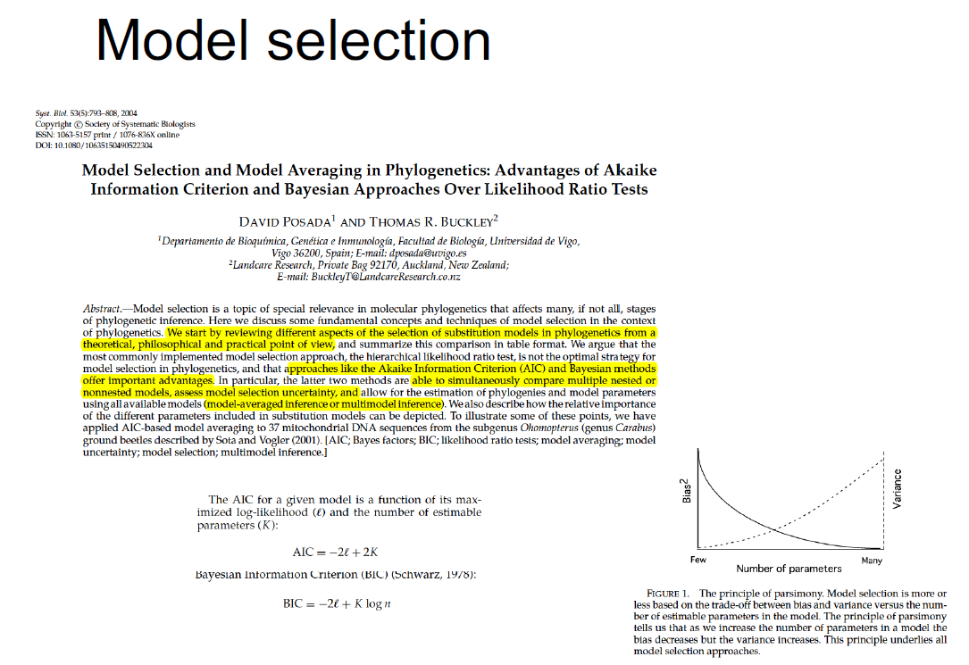

Slide 23
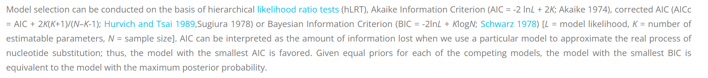
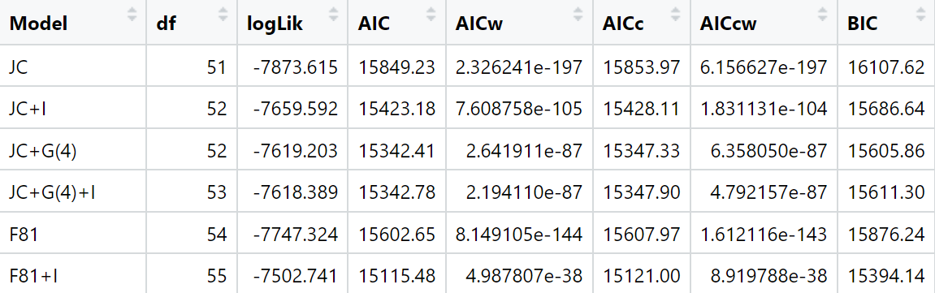

Slide 24
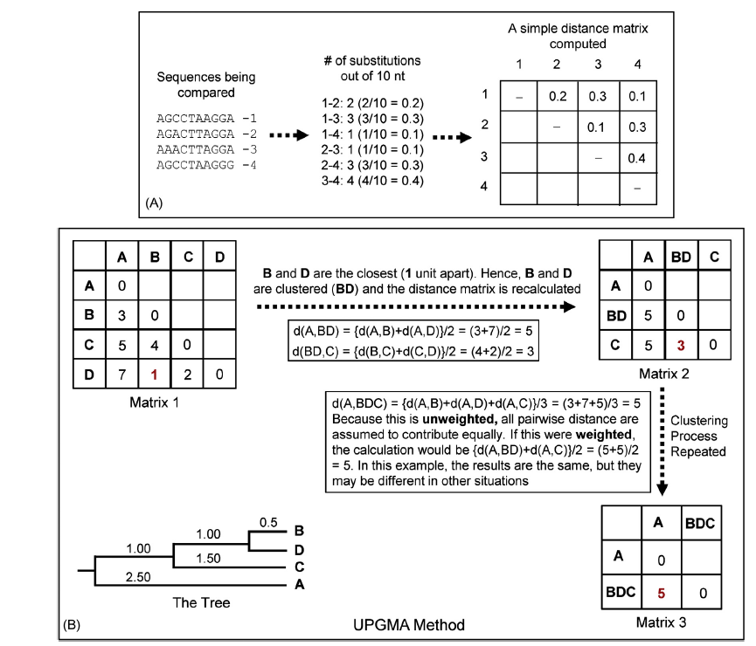
UPGMA

Slide 25
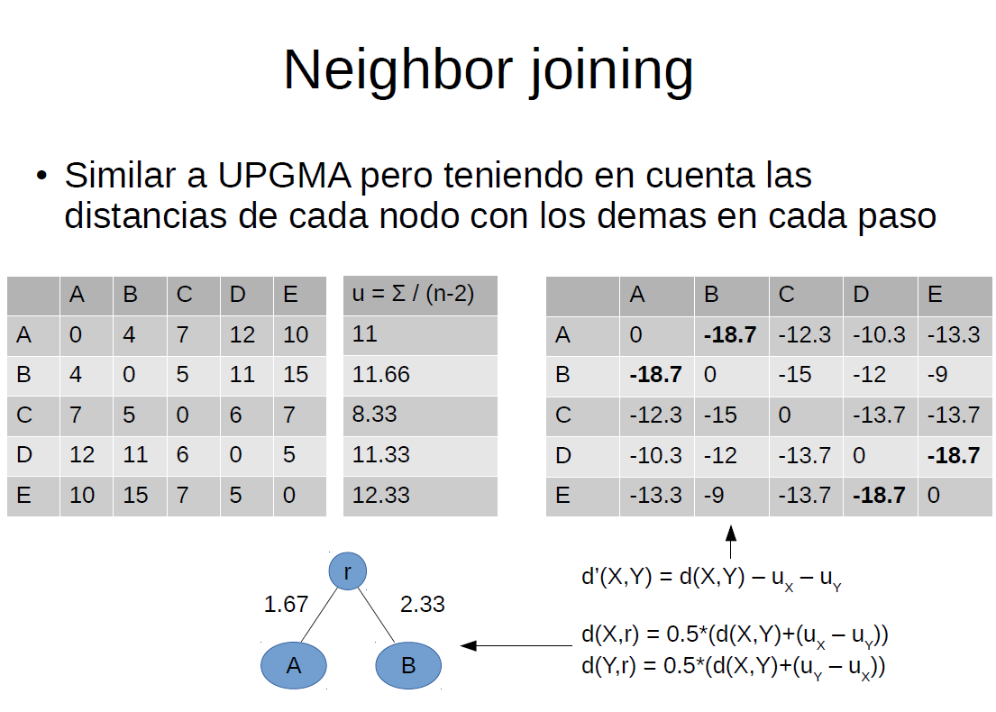

Slide 26
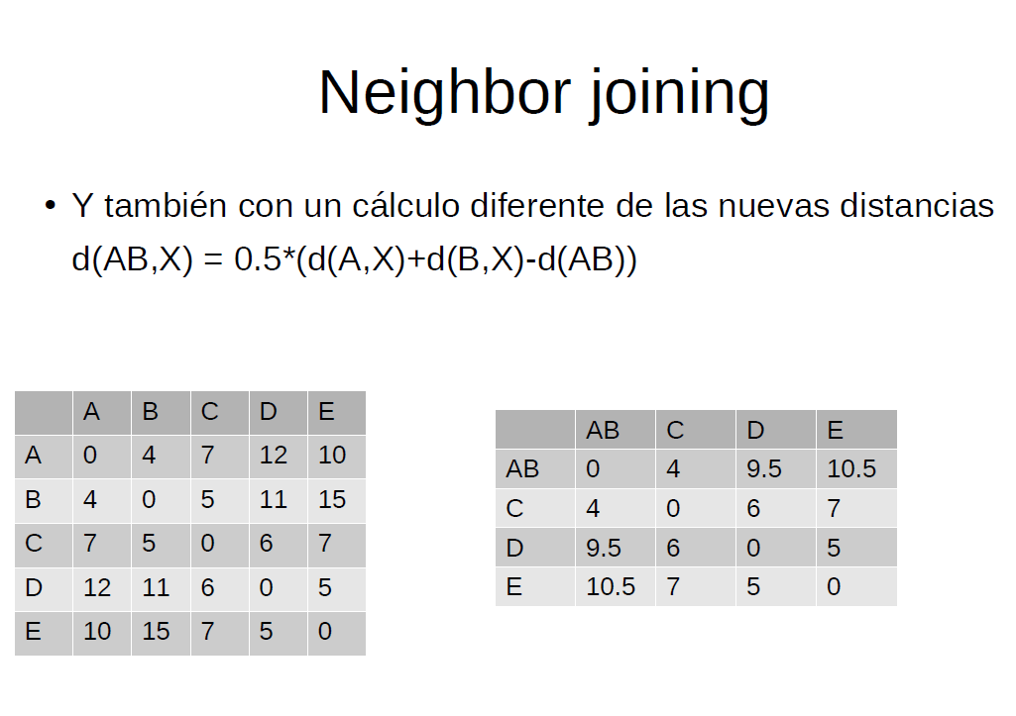
NJ

Slide 27
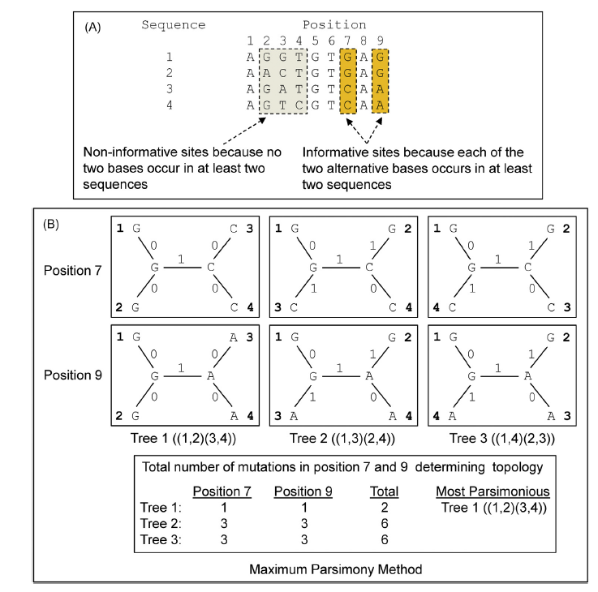
Maximum parsimony

Slide 28
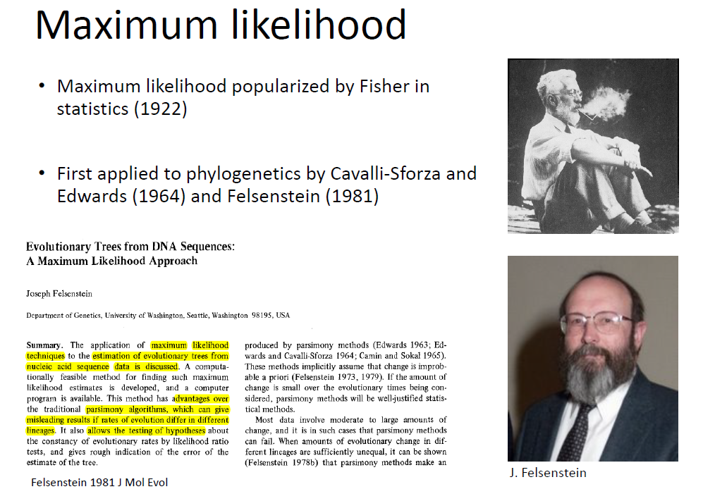

Slide 29
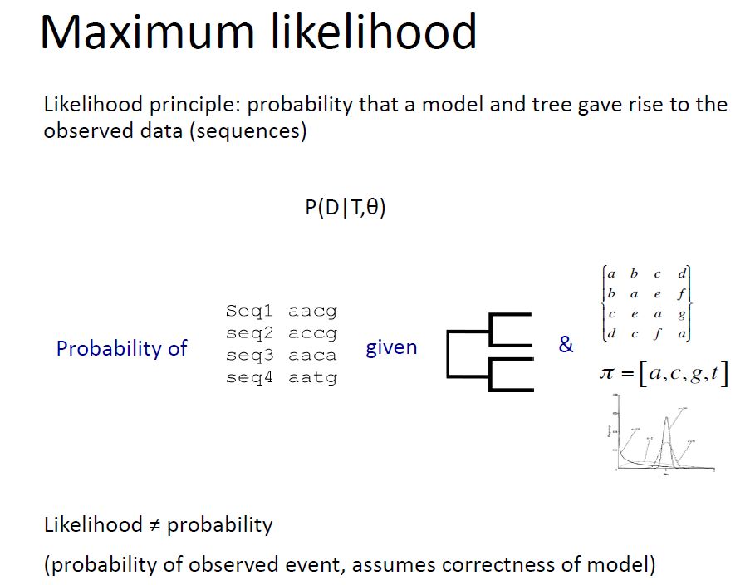

Slide 30
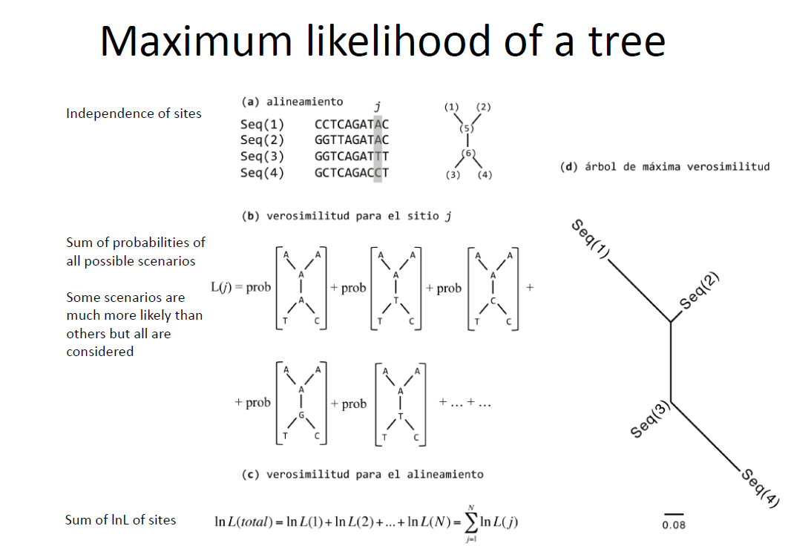

Slide 31
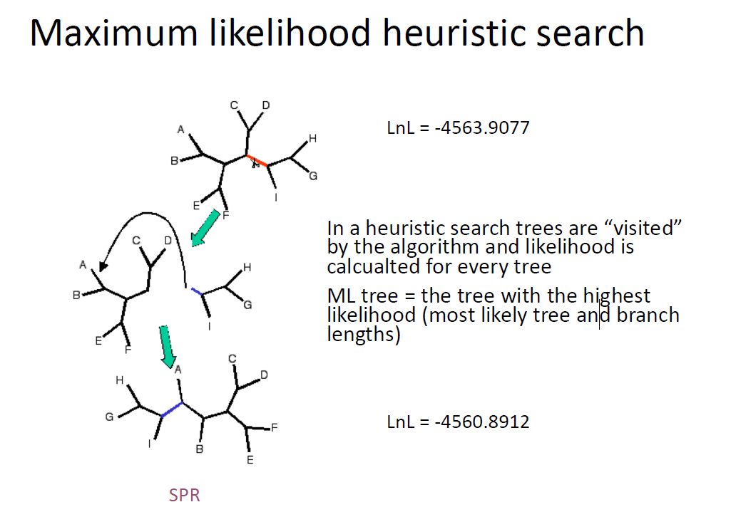

Slide 32
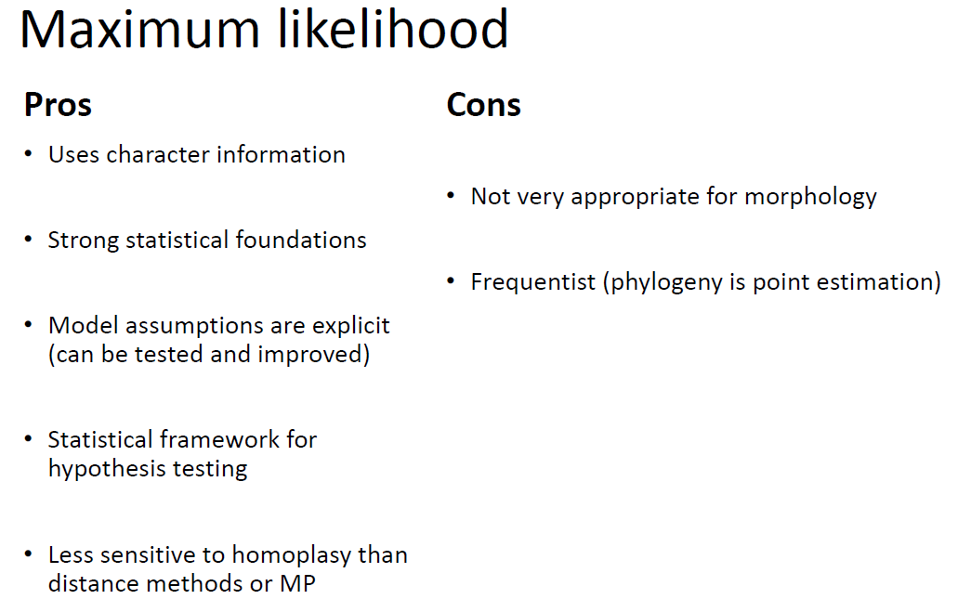

Slide 33
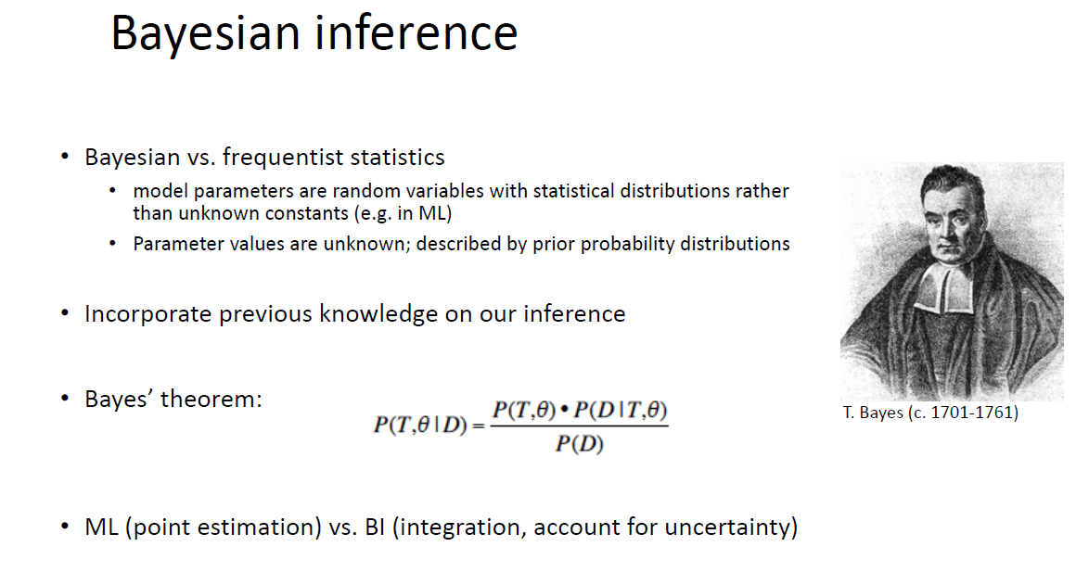

Slide 34
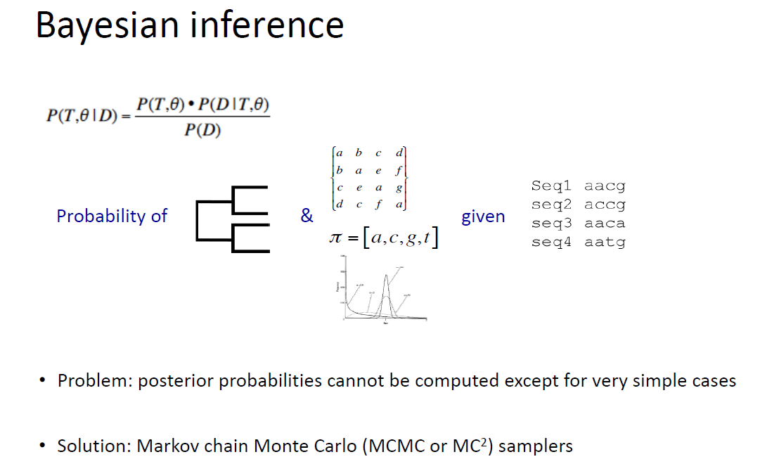

Slide 35
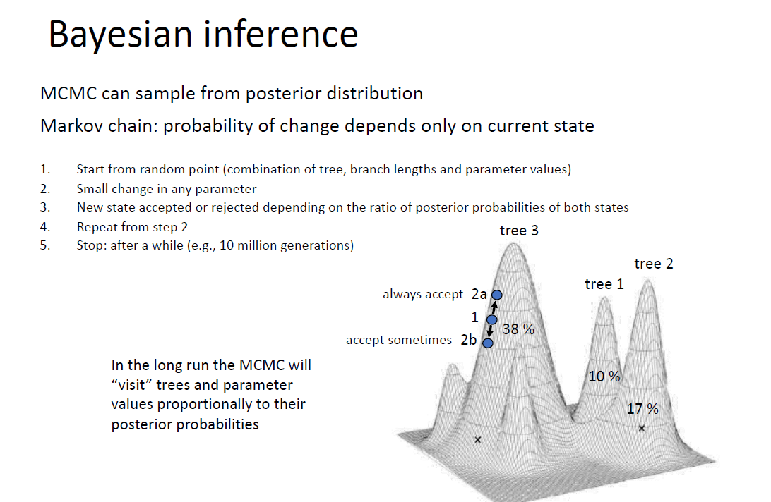

Slide 36
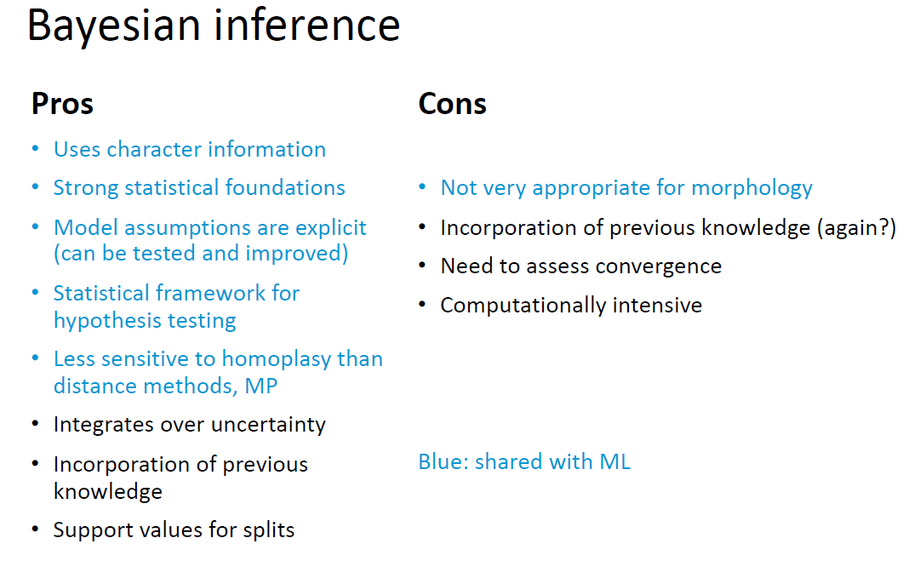

Slide 37
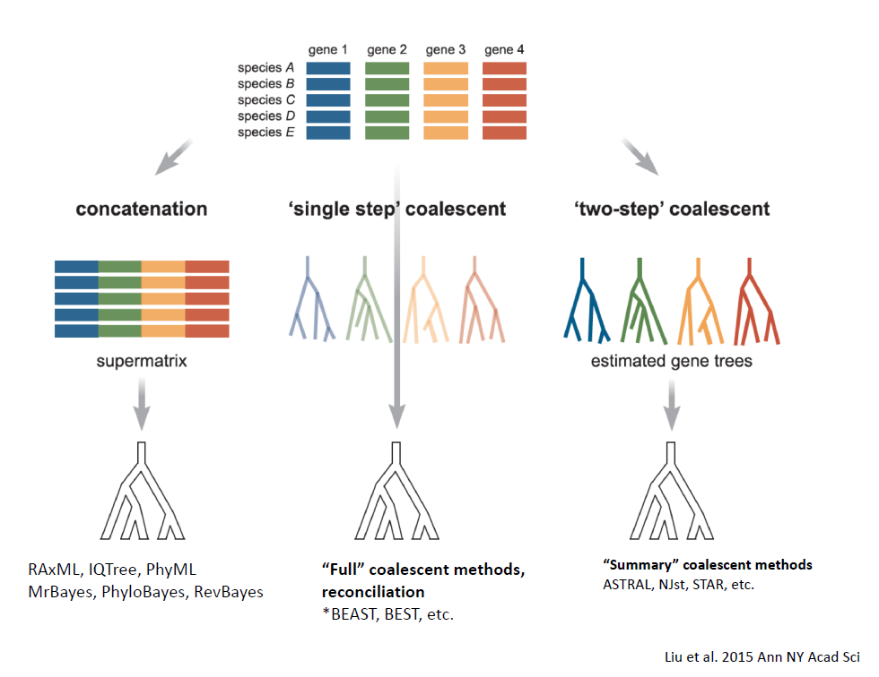

Slide 38
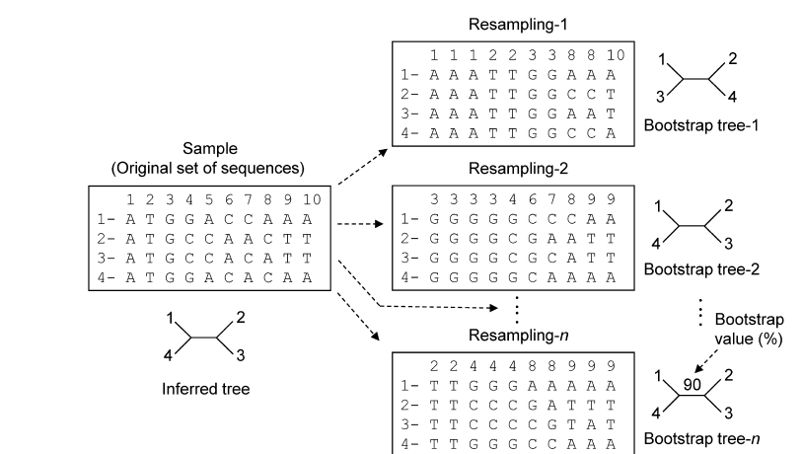
Boostraping

Slide 39
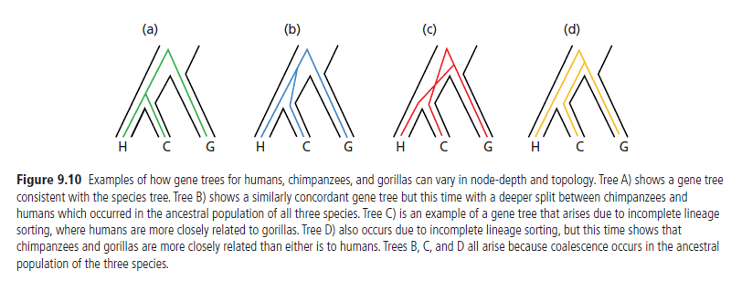
incomplete lineage sorting (ILS)

Slide 40
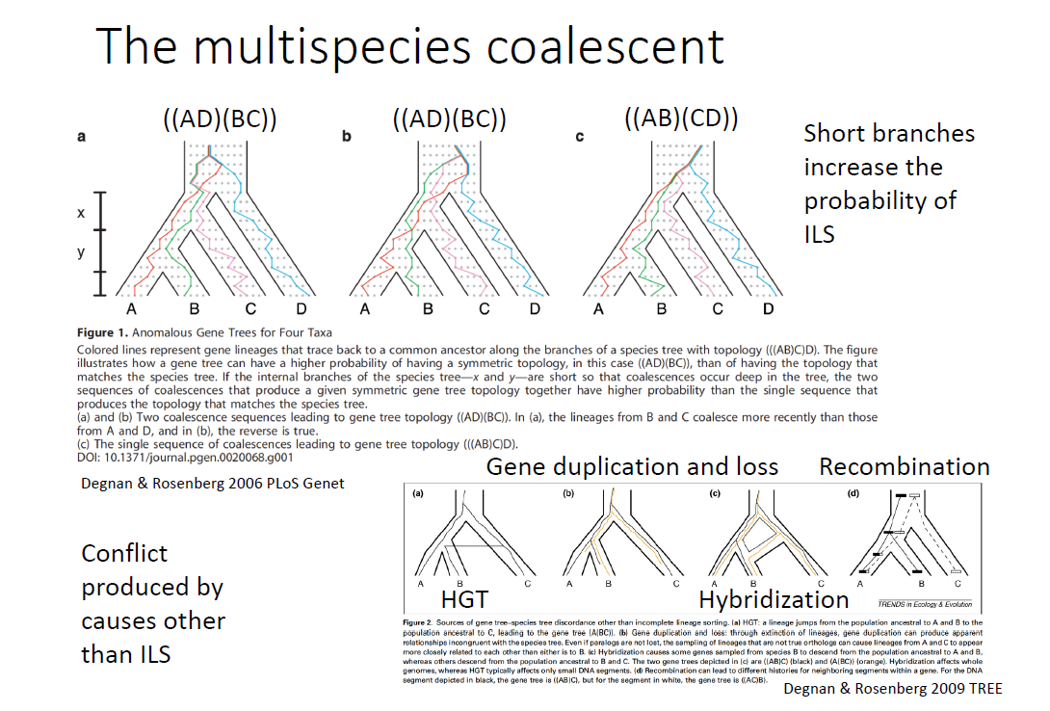

Slide 41
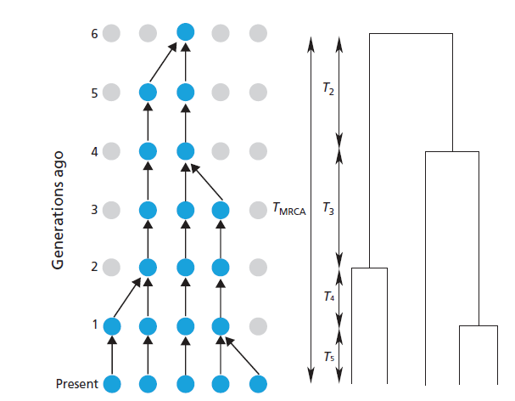

Slide 42
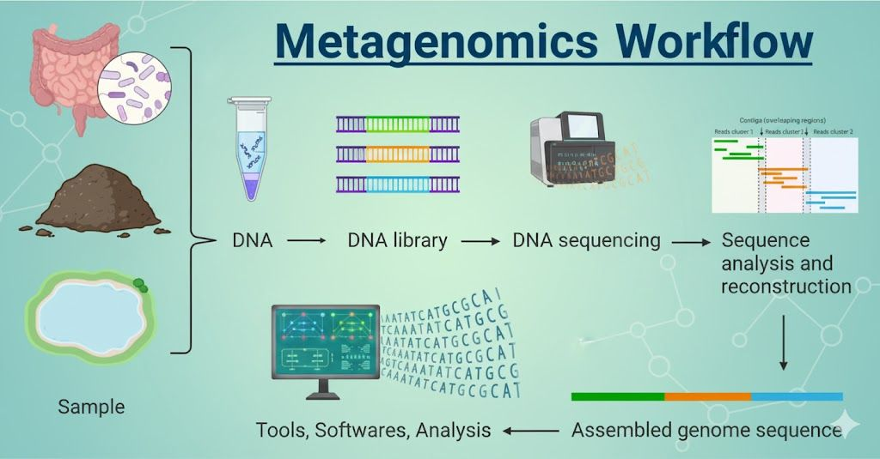
Aplications

Slide 43

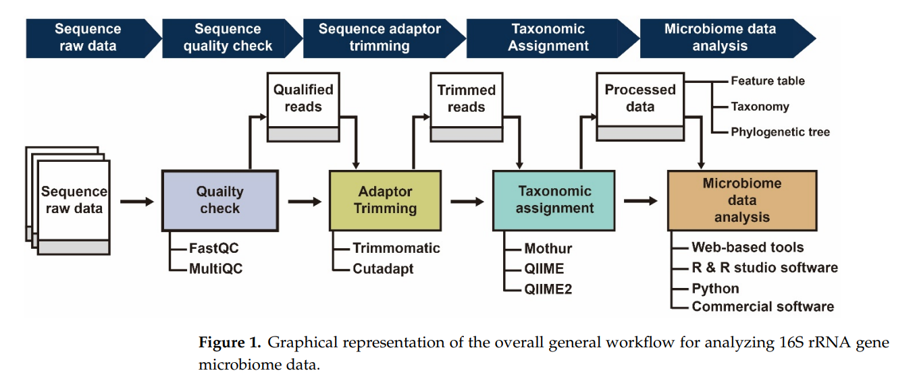

Slide 44

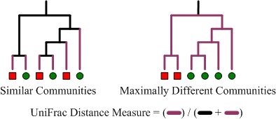
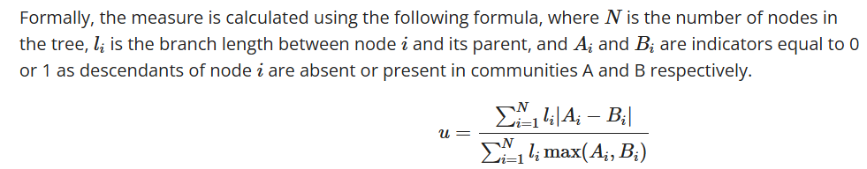

Slide 45
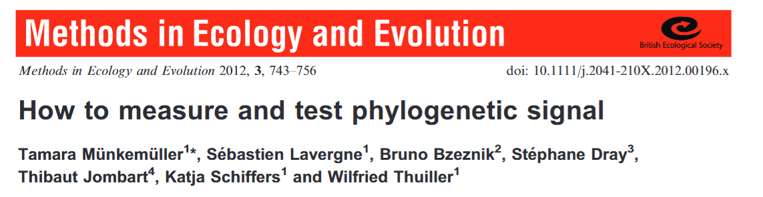

Blomberg’s K
Expresses the strength of phylogenetic signal
ratio of the mean squared error of the tip data (MSE0) measured from the phylogenetic corrected mean and the mean squared error based on the variance–covariance matrix derived from the given phylogeny under the assumption of BM

Slide 46
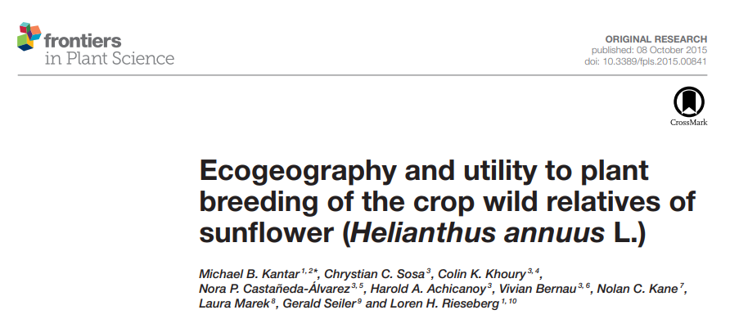
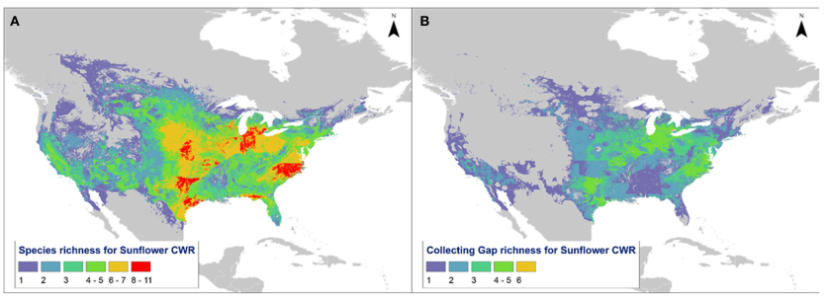

Slide 47
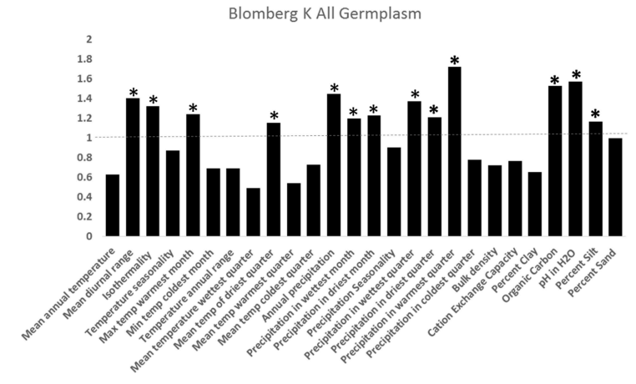
K>1 Phylogenetic conservatism
K≈0 Independent traits

