Slide 1

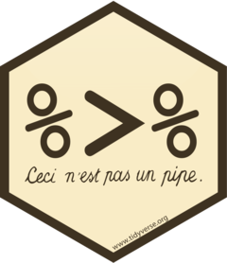


Data wrangling and analysis in R
Alliance Bioversity International and CIAT, Cali, Colombia. January, 2025

Slide 2

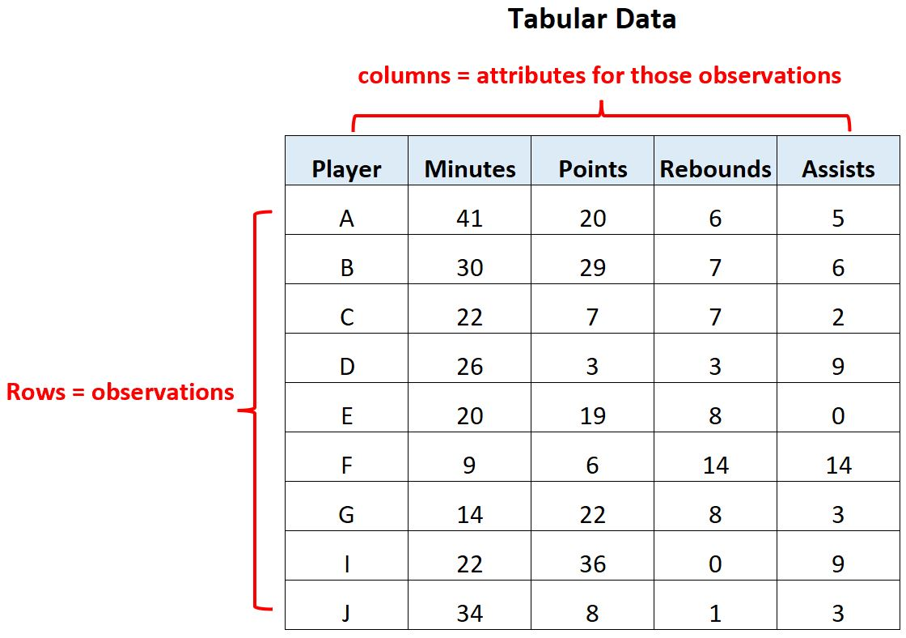
Databases and Tables
Database is a systematically organized collection of structured information, or data, typically stored electronically in a computer system. It is usually managed by a Database Management System (DBMS).
In modern databases, data is typically organized into rows and columns within a series of tables, enabling efficient processing and querying.

Slide 3

1. Read tabular data into R
Library “readr” provide a set of function dedicated to read/load tabular data to R
read_csv : read comma delimited text files
read_tsv: read tabulated delimited text files
read_delim: read separated text files
“readxl” library that provides functions to read data from any Microsoft Excel versión.
read_excel : read Microsoft excel .xlsx file

Slide 4
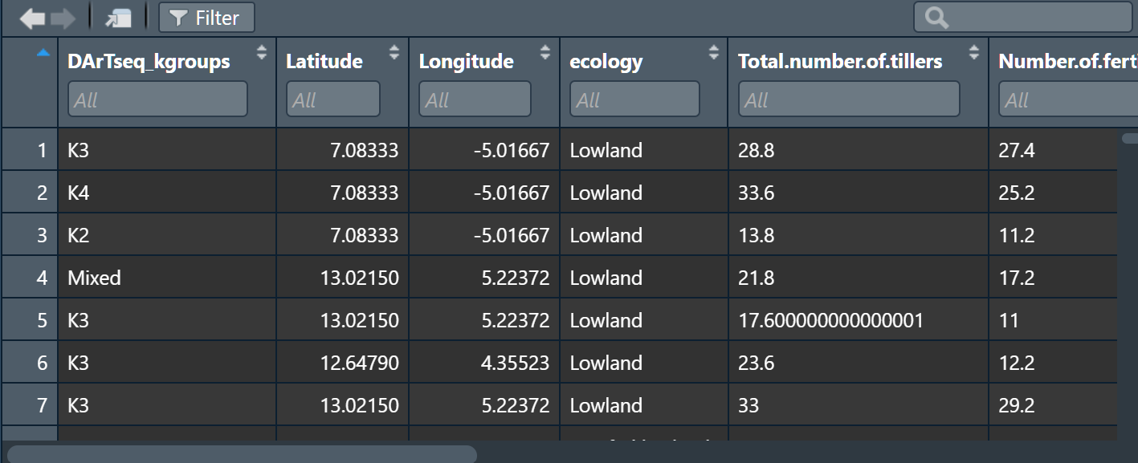
Integrated data viewer

Slide 5
Paquete dplyr
dplyr is a grammar of data manipulation, providing a consistent set of verbs that help you solve the most common data manipulation challenges:
mutate() adds new variables that are functions of existing variables
select() picks variables based on their names.
filter() picks cases based on their values.
summarise() reduces multiple values down to a single summary.
group_by() group data by factor.

Slide 6
Piping in R %>%
Piping in R is a way to make code more readable and efficient by chaining multiple operations together.
It allows you to pass the output of one function directly into the input of another, eliminating the need for intermediate variables.
The most common piping operator in R is %>%, provided by the dplyr package in the tidyverse.
Piping is especially useful when working with data manipulation tasks in the tidyverse framework!

Slide 7
Piping in R
Pipes operator %>% could be interpreted as THEN.
Dot (.) Represents the abbreviated version of the object that is being processed.
in the above example we can describe the behavior of the calculation as follows:
Define the vector of negative values THEN get the absolute value of these values (squared root can not be calculated for negative values) THEN calculate the squared root of the absolute values THEN sum the vector elements.

Slide 8
Dplyr::mutate()
Function designed to create/add new variables
Variables can be computed from existing columns in the table
It accepts variable names without quote them, this Will save a lot of lines

Slide 9
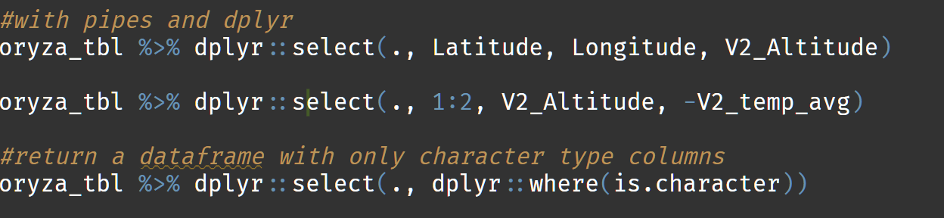
dplyr::select()
Function dplyr::select() picks or remove variables based on their names
Make easier to select a subset of variables
Accept unquoted variable names
Accepts changin name of variable when selecting
Has a set of useful capabilities to select names based on text patterns
starts_with()
ends_with()
contains()
matches()
where()

Slide 10
dplyr::filter()
Filter rows based on conditions: Select rows from a data frame where specified logical conditions are met (e.g., values greater than, equal to, or matching specific criteria).
Combine multiple conditions: Use logical operators like & (AND), | (OR), or ! (NOT) to filter rows with multiple criteria.
Use custom functions: Apply user-defined or inline functions for more complex filtering logic.

Slide 11
dplyr::group_by() and dplyr::summarise()
Create summary statistics: Compute aggregated values such as mean, sum, median, min, max, etc., for a dataset.
roup-wise summaries: Combine with group_by() to calculate summaries for each group in the data.
Handle multiple summaries simultaneously: Generate multiple summary statistics in a single call by defining multiple summary operations.

Slide 12
Exercice
Convert the variable V2_temp_avg in kelvin degrees to celsius degree (hint. use formula celcius_degree = kelvin_degree - 273.15)
Convert the character type variables to numeric (guess what is wrong with those variables).
Filter rows that are not NA in the column DArTseq_kgroups.
Calculate mean and standard deviation of V2_prec_avg grouping by DArTseq_kgroups variable.

Slide 13
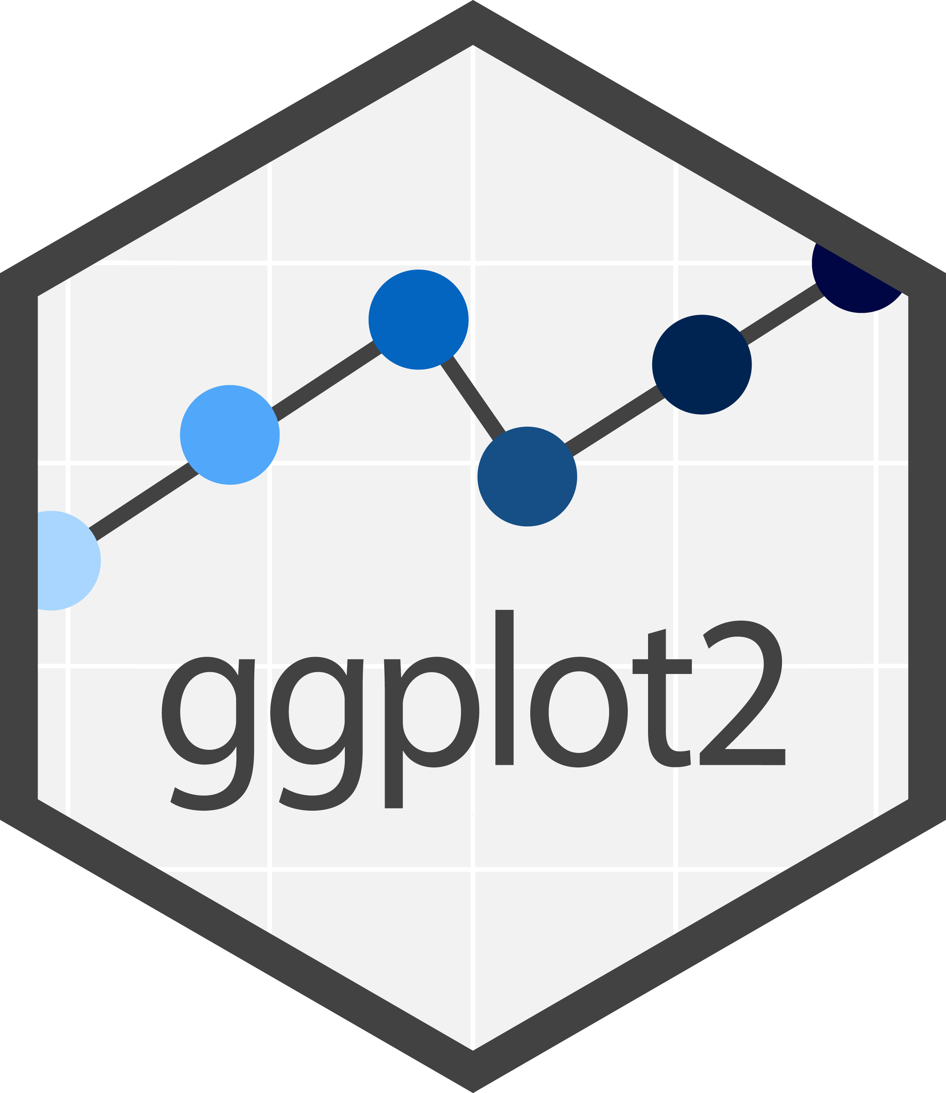

Graphs in R

Slide 14
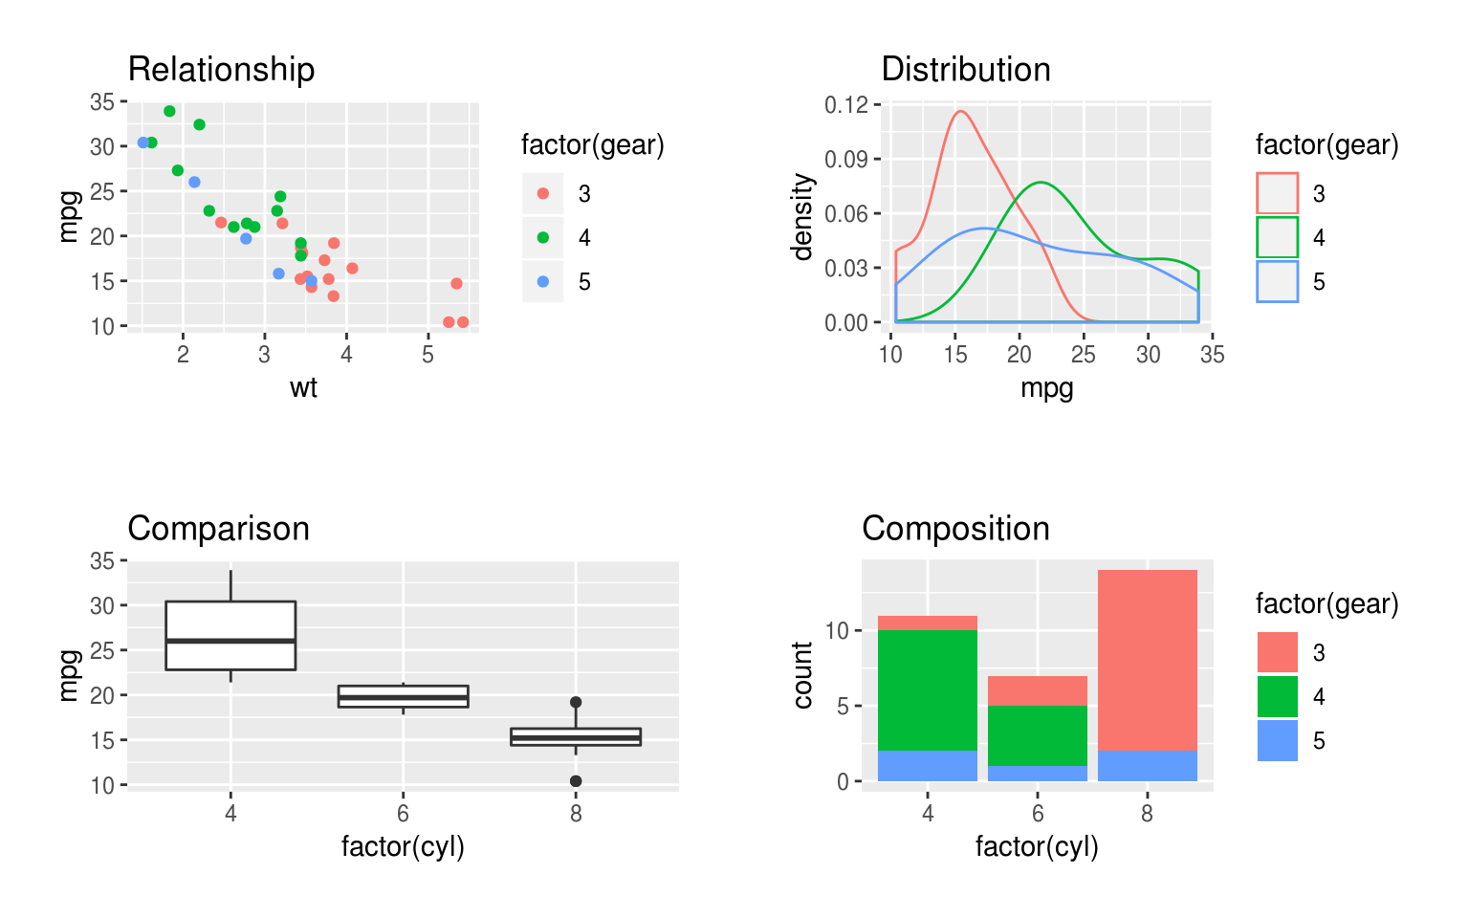
ggplot2 library
Create a wide variety of plots: Supports visualizations like scatter plots, bar charts, line graphs, histograms, boxplots, and more, with flexibility to customize aesthetics.
Layered grammar of graphics: Build plots incrementally by adding layers such as geometries , statistical transformations, and annotations, offering unparalleled flexibility.
Support for interactive extensions: Works seamlessly with extensions like plotly and ggiraph to add interactivity to plots, enhancing user experience.

Slide 15
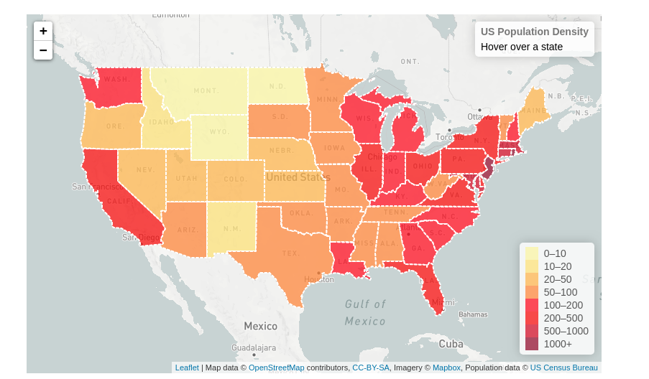
Leaflet interactive maps in R
Interactive Maps: Create interactive maps with features like zooming, panning, and tooltips for enhanced user engagement.
Add Markers and Shapes: Overlay maps with customizable markers, circles, polygons, and other shapes to highlight specific locations or areas.
Dynamic Data Mapping: Map data dynamically by binding it to visual elements, such as coloring regions or scaling markers based on data values.
Custom Tile Layers: Use a variety of map tiles from providers like OpenStreetMap, CartoDB, or Mapbox, or even custom tiles for unique visualizations.

Slide 16
Questions?

