Slide 1


Use of basic Excel and R in research

Slide 2


What is a database?
https://www.kdnuggets.com/2016/07/database-key-terms-explained.html
https://dma.org.uk/article/gdpr-data-collection

Slide 3
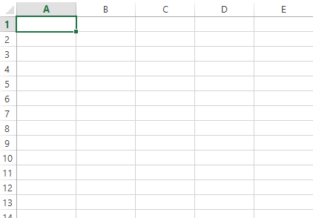
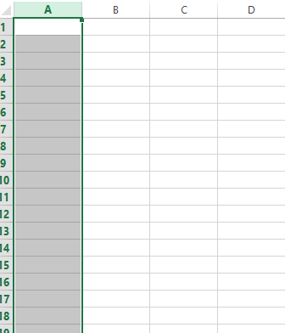
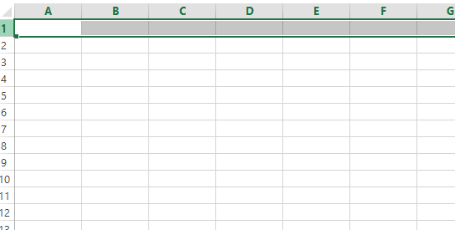
Where the statistics start: A table.
ROW: individuals
COLUMN or FIELD: variables to be used.
(Numeric or character)

Slide 4
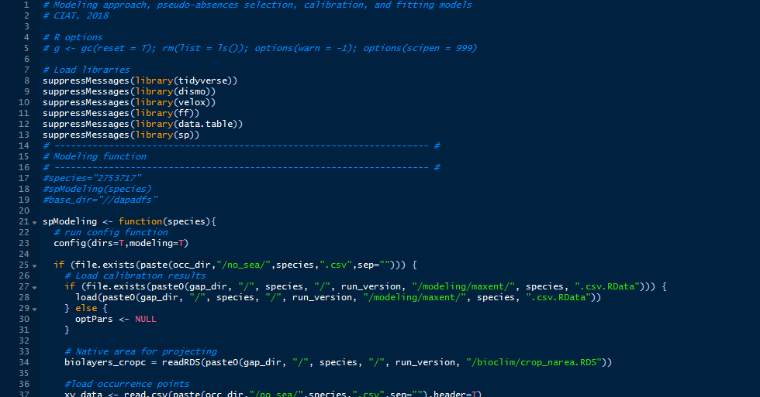
A computer is a device using language understandable for it!
Programming is translating human orders to be used by the computer.
Organize and curate data is required
Programming or using an Excel table requires time, do not expect magic in two clicks.
9 Common Reasons for Rejection: (https://hub.wiley.com/community/exchanges/discover/blog/2018/01/31/9-common-reasons-for-rejection?referrer=exchanges)
The manuscript fails the technical screening The manuscript does not fall within the journal’s Aims and Scope
The research topic isn’t of great enough significance
The research is over-ambitious
A clear hypothesis hasn’t been established The manuscript is incomplete
There are flaws in the procedures, presentation or analysis of the data
Flaws in the manuscript’s arguments and/or conclusions
Language, writing and spelling issues

Slide 5
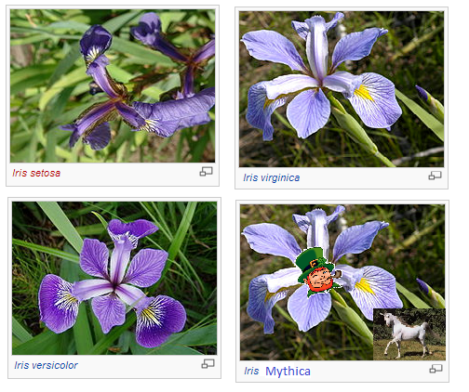
A.
Sepal.Length | Sepal.Width | Petal.Length | Petal.Width | Species
5.1 | 3.5 | 1.4 | 0.2 | setosa
4.9 | 3 | 1.4 | 0.2 | setosa
4.7 | 3.2 | 1.3 | 0.2 | setosa
4.6 | 3.1 | 1.5 | 0.2 | setosa
5 | 3.6 | 1.4 | 0.2 | setosa
5.4 | 3.9 | 1.7 | 0.4 | setosa
4.6 | 3.4 | 1.4 | 0.3 | setosa
5 | 3.4 | 1.5 | 0.2 | setosa
4.4 | 2.9 | 1.4 | 0.2 | setosa
4.9 | 3.1 | 1.5 | 0.1 | setosa
5.4 | 3.7 | 1.5 | 0.2 | setosa
4.8 | 3.4 | 1.6 | 0.2 | setosa
4.8 | 3 | 1.4 | 0.1 | setosa
4.3 | 3 | 1.1 | 0.1 | setosa
What table should I use to analyze my data, A or B?
Sepal.Length | Sepal.Width | Petal.Length | Petal.Width | Species
5.1 | 3.5 | 1.4 | 0.2 | setosa
4.9 | 3 | 1.4 | 0.2
4.7 | 3.2 | 1.3 | 0.2
4.6 | 3.1 | 1.5 | 0.2
5 | 3.6 | 1.4 | 0.2
5.4 | 3.9 | 1.7 | 0.4
4.6 | 3.4 | 1.4 | 0.3
5 | 3.4 | 1.5 | 0.2
4.4 | 2.9 | 1.4 | 0.2
4.9 | 3.1 | 1.5 | 0.1
5.4 | 3.7 | 1.5 | 0.2
4.8 | 3.4 | 1.6 | 0.2
4.8 | 3 | 1.4 | 0.1
4.3 | 3 | 1.1 | 0.1
B.
https://dreamtolearn.com/ryan/data_analytics_viz/18

Slide 6

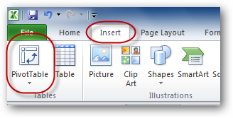
Some basic functions in Excel
Filter
Operations +, -, *, /
Average =AVERAGE(D2:D151)
Median =MEDIAN(D2:D151)
Standard deviation =STDEV.P(D2:D151)
Correlation Petal.Length and Petal.Width =PEARSON(D2:D151,E2:E151)
PivotTable
What each of these values mean?

Slide 7
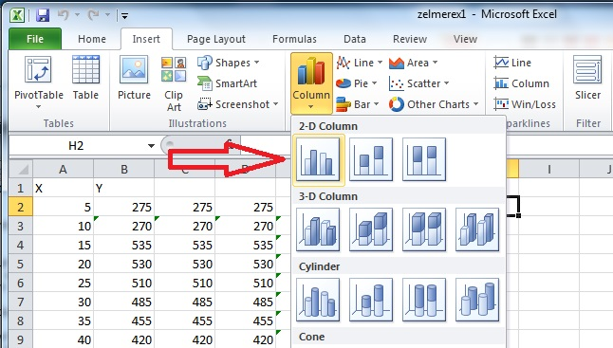
Basic plots
How is the petal length changing by species?
Is there a relationship between petal length
and sepal length?

Slide 8
Tips to use Excel
Data to analyze should be complete as possible
0 is not NA.
Use standard names (e.g: Iris is not equal to iris or Iris_) This avoid filtering problems.
Define a metadata for your data (Dictionary) to remember the variables name and procedure used.
Avoid use Excel for more than 15000 individuals.
Tables for use in analysis and paste in a manuscript are different.
Transform your Excel data in the format required for the statistical analysis

Slide 9
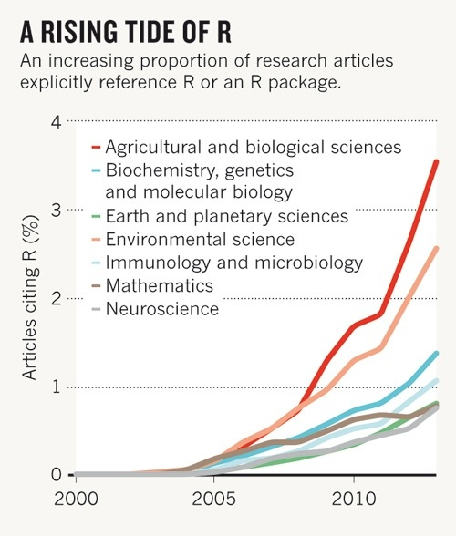
R
R is an object-based language (Encapsulating state and operation inside objects
More tan 10.000 packages!
R is for free an it is the new standard for statistics
State: In this case
a matrix of (1,2,3,4)
Object

Slide 10
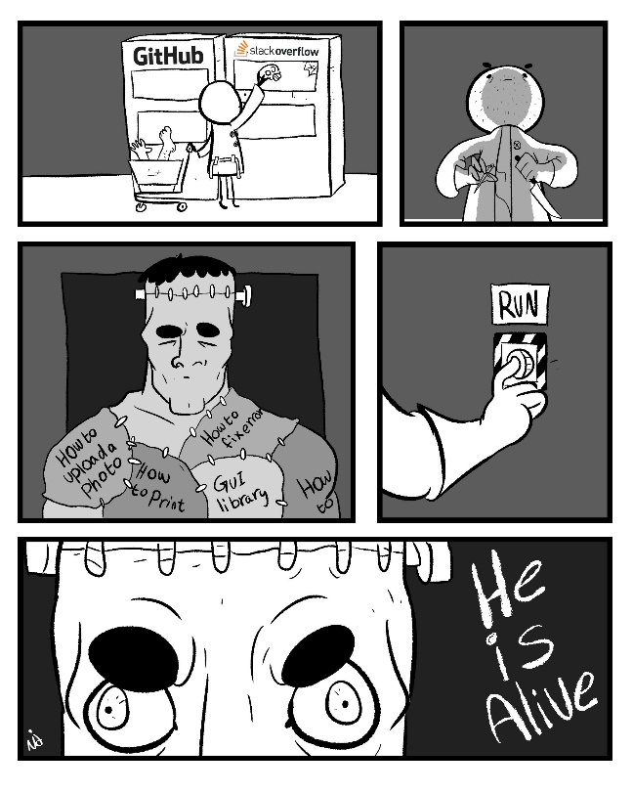
Running R
First step: Install R and Rstudio
Second step: Load libraries (Programs to be used in R)
Third step: Load your own data
Fourth step: Start running and enjoy. There are thousand of blogs and Resources online. (You are not alone!)

Slide 11
Basic functions in Excel using R.
Sepal.Length | Sepal.Width | Petal.Length | Petal.Width | Species
Filter [row,column], which(), if()
Operations +, -, *, / (SAME FUNCTIONS)
Average = mean(iris$Petal.Length,na.rm=T)
Median = median(iris$Petal.Length,na.rm=T)
Standard deviation = sd(iris$Petal.Length,na.rm=T)
Correlation= cor.test(iris$Petal.Length,iris$Petal.Width)
PivotTable summary()
What each of these values mean?

Slide 12
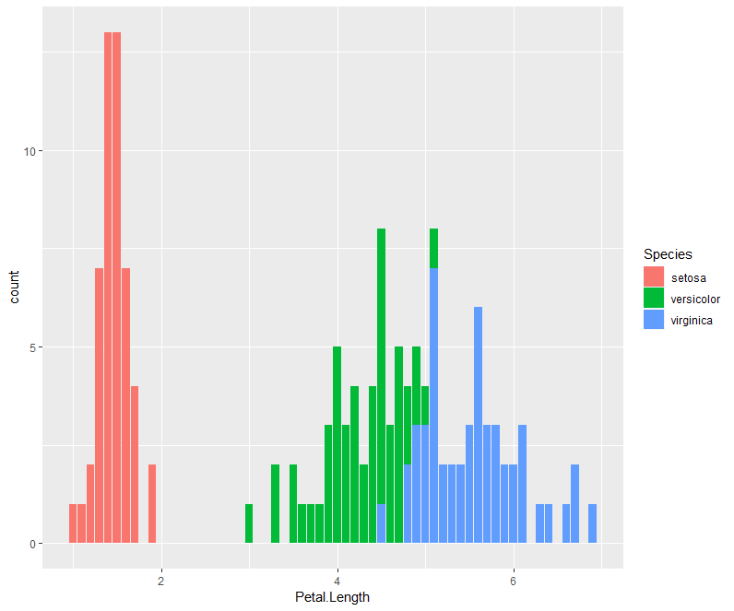
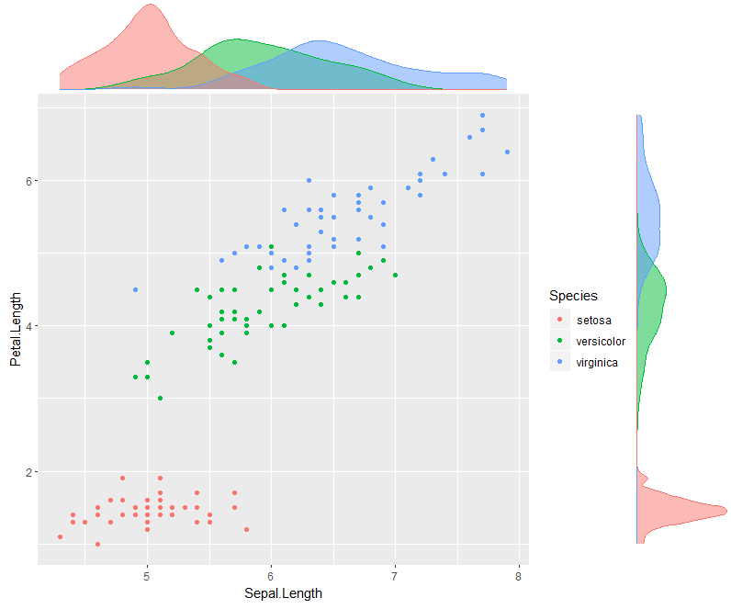
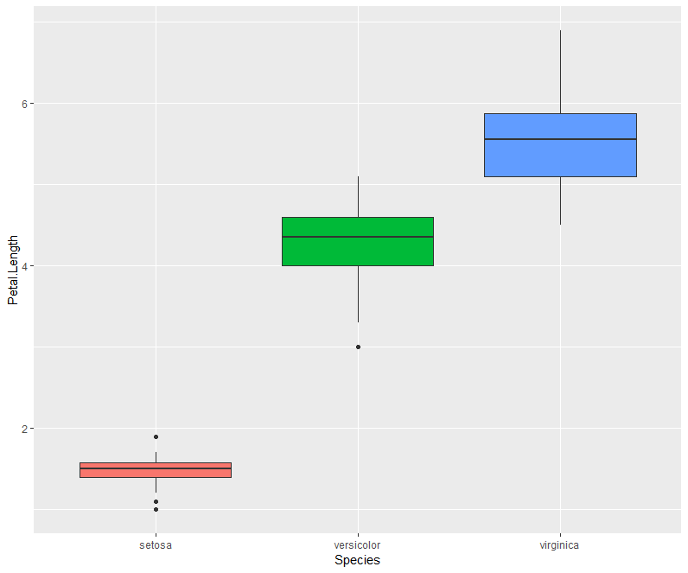
https://github.com/camocolombia/R_Examples
Is the petal length same for I. setosa and
I .Versicolor
Do you think the petal length in the three species
are equal?

Slide 13
Installing R and resources
https://cran.r-project.org/
https://www.rstudio.com/products/rstudio/download/#download
https://www.youtube.com/watch?v=imV3pPIUy1k
https://stackoverflow.com/
http://www.sthda.com/english/
https://www.coursera.org/learn/r-programming

