Slide 2
Before using the gap analysis methodologies (Summary)
Definition of a model
Niche concept
Species distribution models
Inputs curation
Examples using R

Slide 3
The workflow for a gap analysis

Slide 4
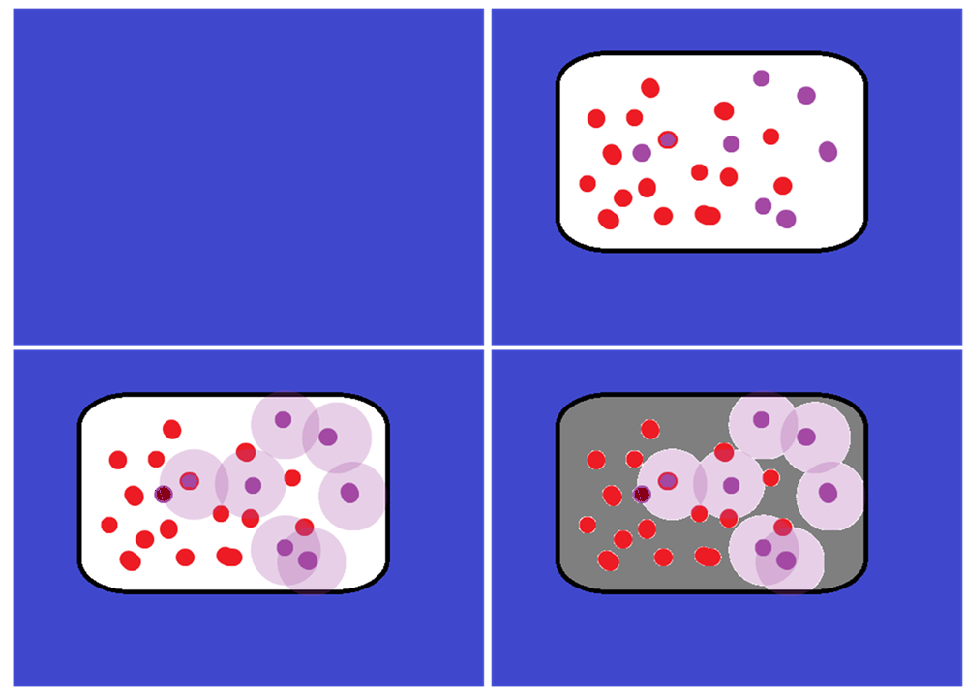




A
B

Germplasm
Other coordinates
Collected germplasm area
Species occurrences
Realized niche
Potential area to be collected
C
D
Sampled germplasm
Where to collect

Slide 5
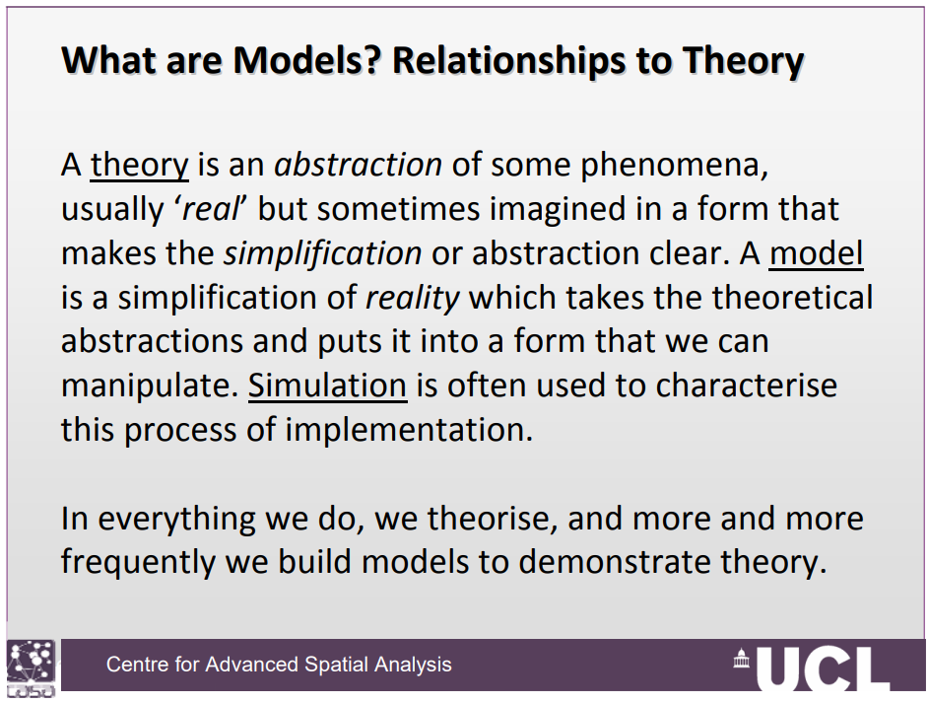

Slide 6
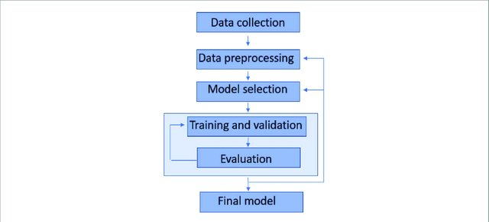
How a model workflow looks like?
https://iopscience.iop.org/article/10.1088/2633-1357/ab805d

Slide 7
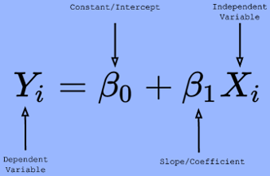
Models can be simple or complex
simple

Slide 8
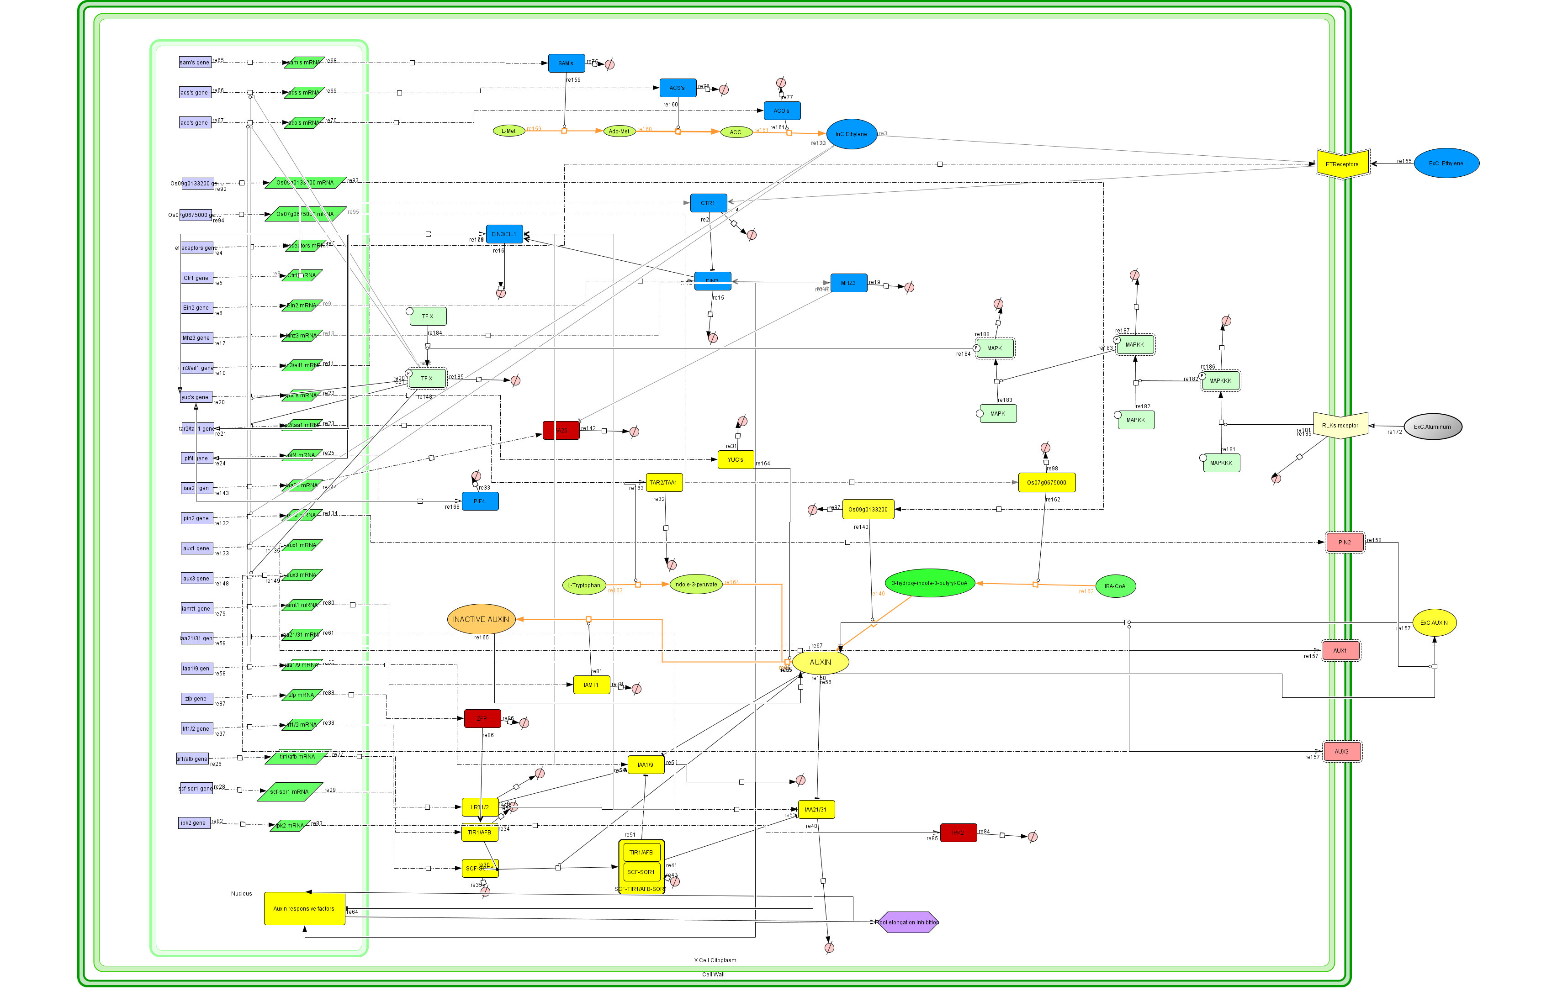
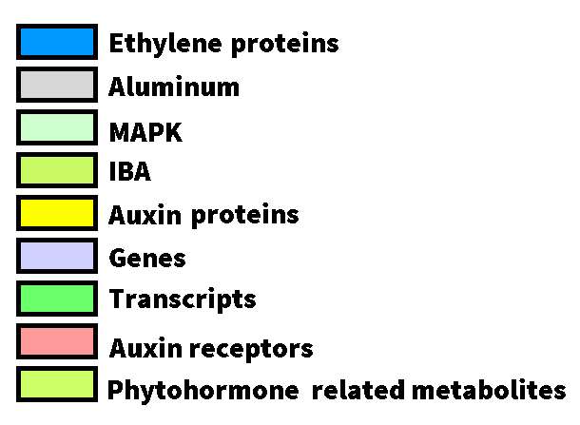
Complex
127 molecules
117 reactions

Slide 9
How can obtain the geographical distribution of a species using environmental data?

Slide 10
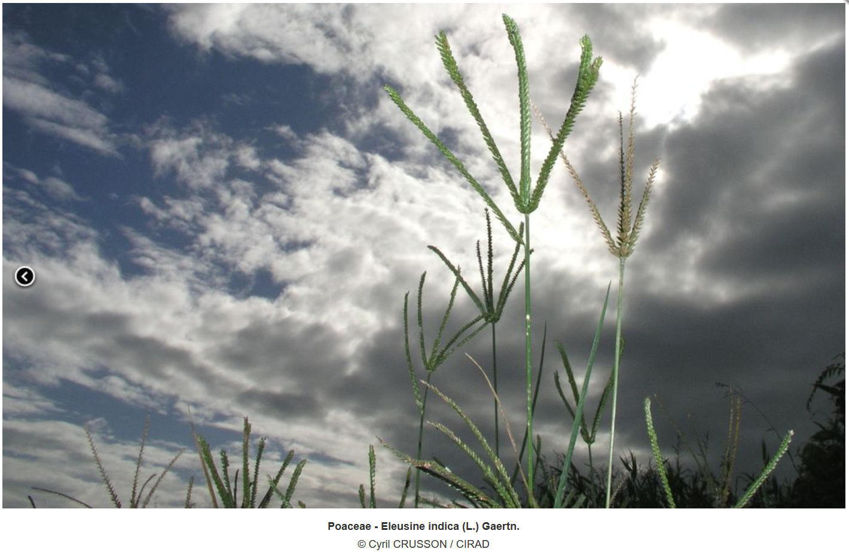
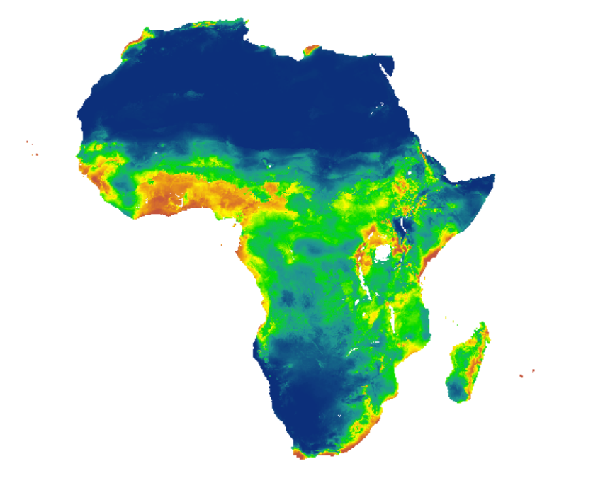
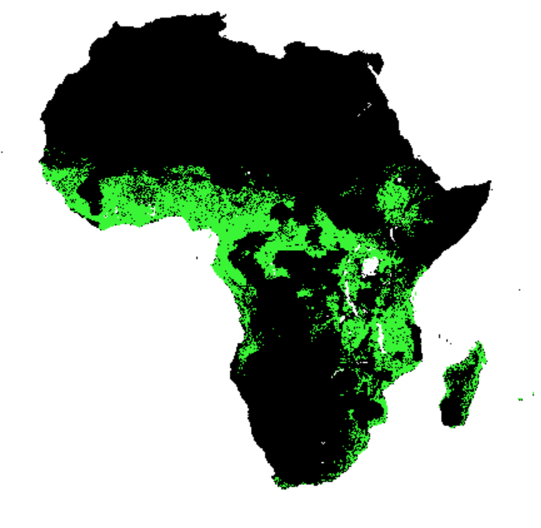
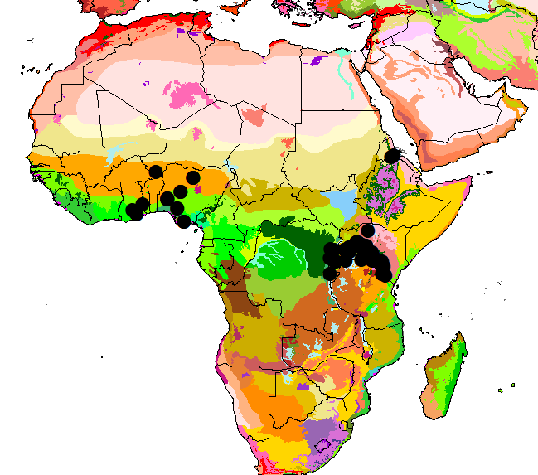
An example using E. indica

Slide 11
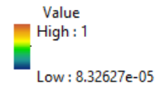
AUC | presences | absences | sensitivity | specificity | TSS | Threshold (max TSS)
0.850 | 1255 | 12550 | 0.852 | 0.664 | 0.517 | 0.357

Slide 12
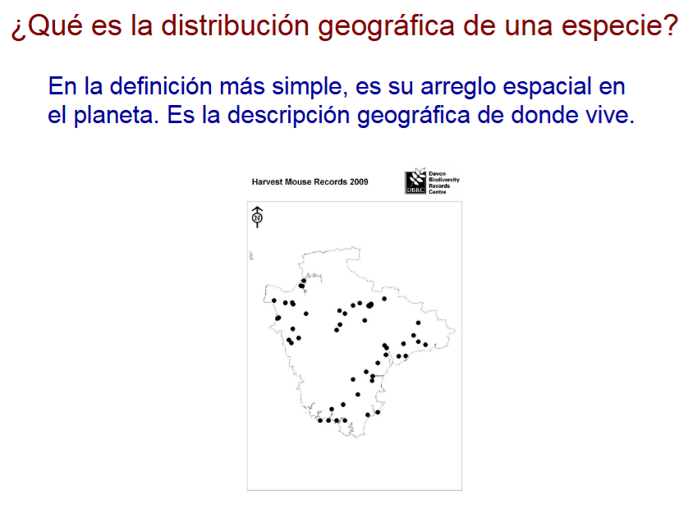
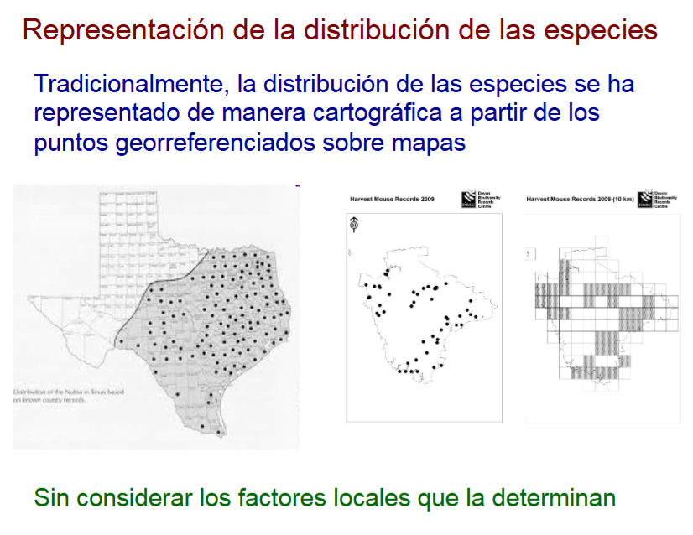
https://www.recibio.net/wp-content/uploads/2014/01/Intro-Modelado-de-nichos_EMM.pdf

Slide 13
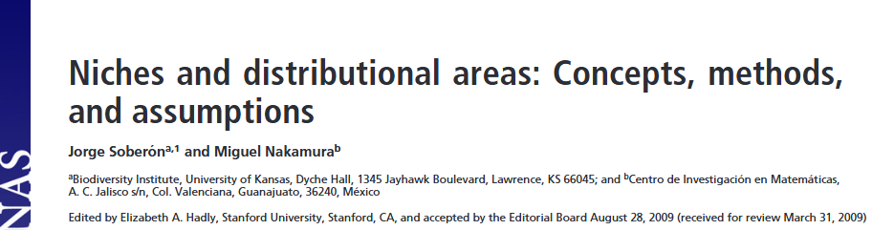
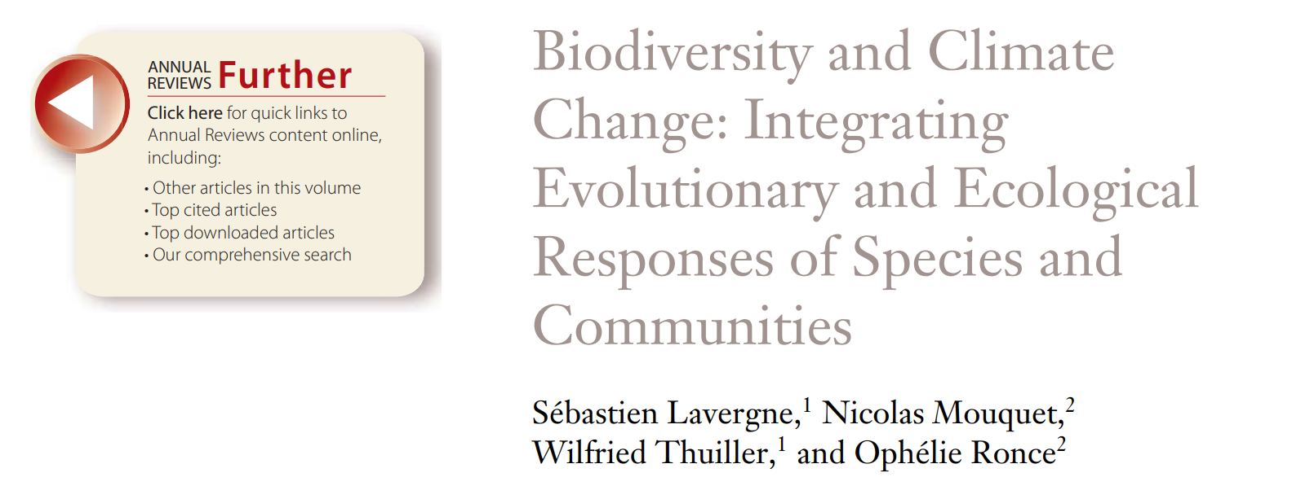
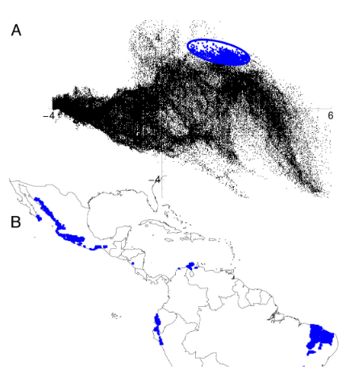
What is a niche?
Hutchinson’s concept of niche: hypervolume of the multidimensional space defined by a set of environmental variables, within which a species can maintain a viable population
Habitat suitability models: statistical models that predict species’ potential distributions by combining known occurrence records with environmental data (so-called niche-based models)
Adaptive potential: the capacity of species or populations to evolve in response to changes in environmental conditions whether biotic or abiotic

Slide 14
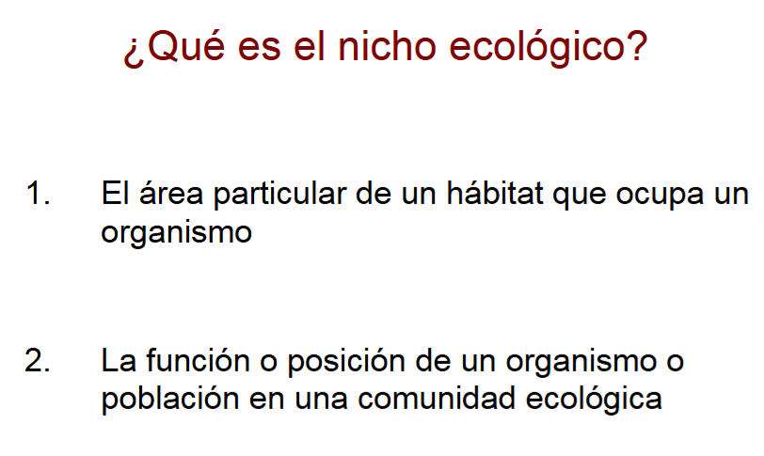
https://www.recibio.net/wp-content/uploads/2014/01/Intro-Modelado-de-nichos_EMM.pdf

Slide 15
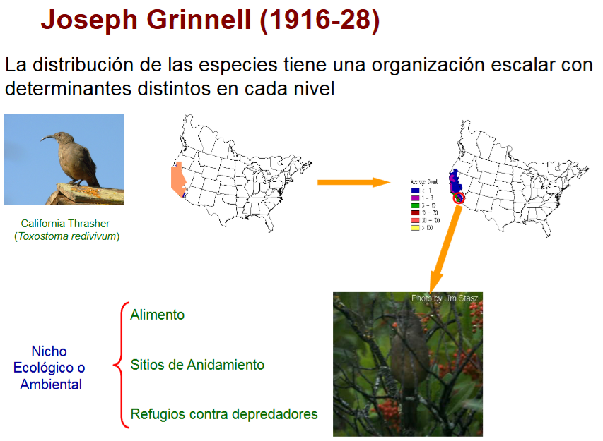

Slide 16
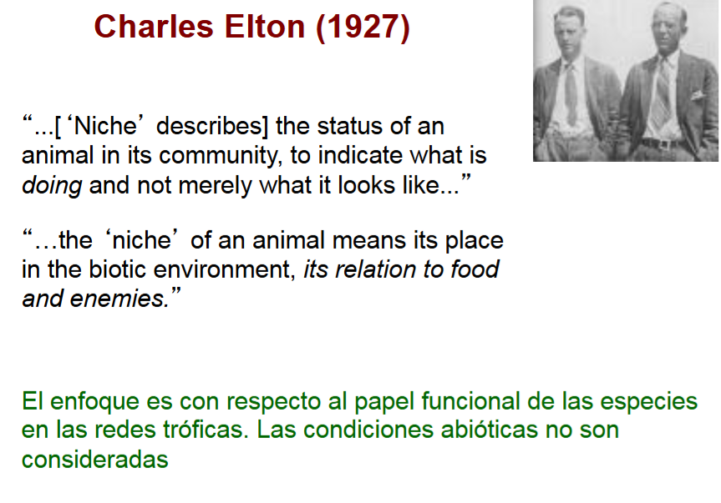
https://www.recibio.net/wp-content/uploads/2014/01/Intro-Modelado-de-nichos_EMM.pdf

Slide 17
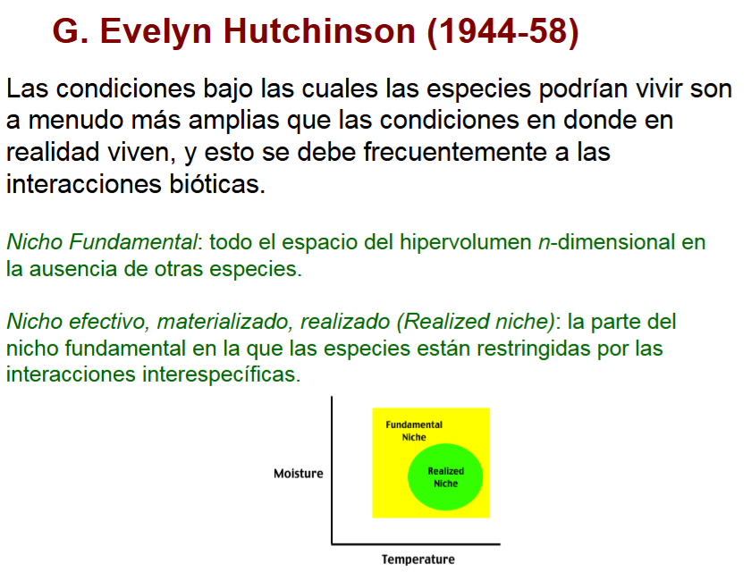
https://www.recibio.net/wp-content/uploads/2014/01/Intro-Modelado-de-nichos_EMM.pdf

Slide 18
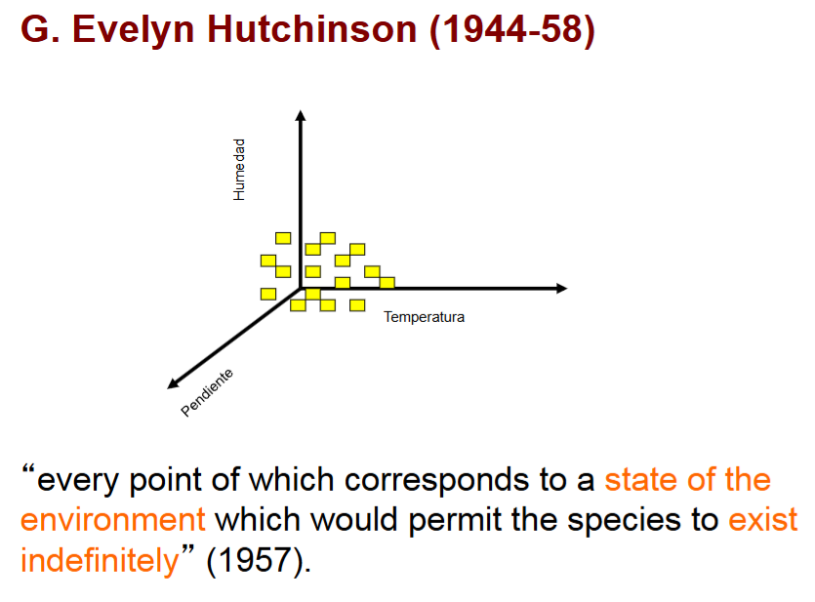
https://www.recibio.net/wp-content/uploads/2014/01/Intro-Modelado-de-nichos_EMM.pdf

Slide 19
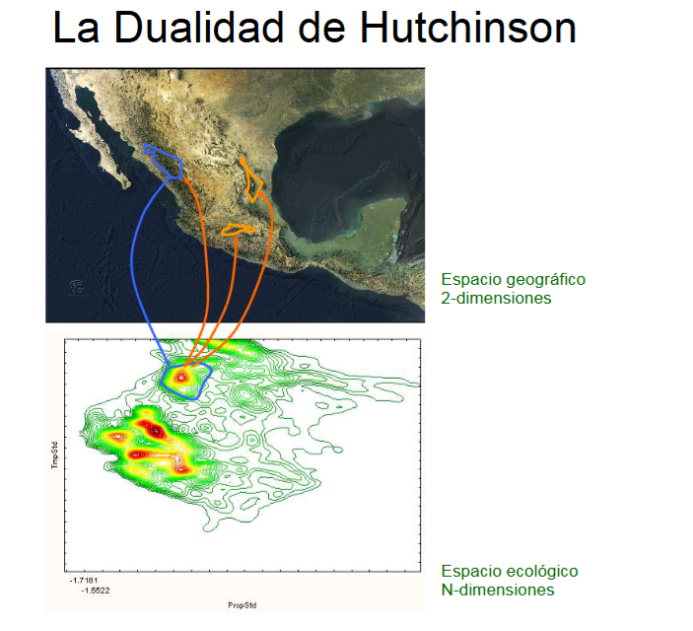
https://www.recibio.net/wp-content/uploads/2014/01/Intro-Modelado-de-nichos_EMM.pdf

Slide 20
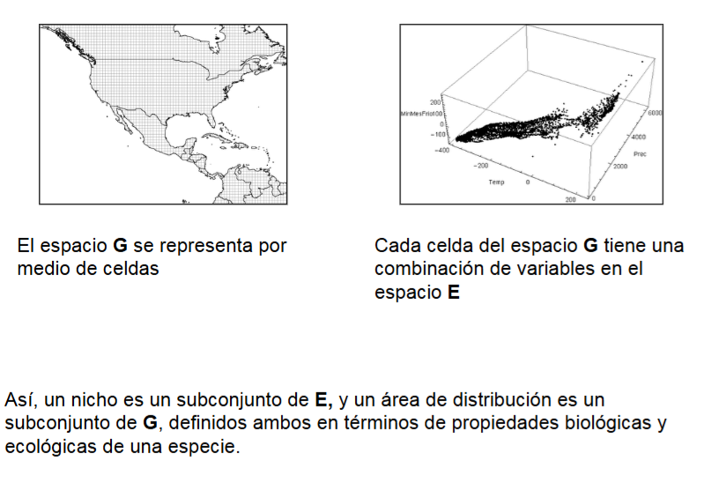
https://www.recibio.net/wp-content/uploads/2014/01/Intro-Modelado-de-nichos_EMM.pdf

Slide 21
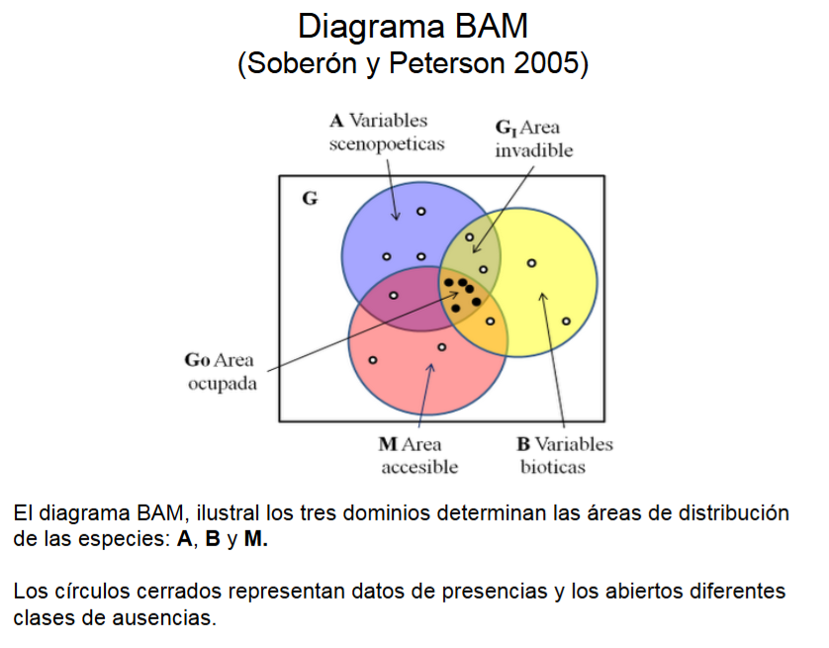
https://www.recibio.net/wp-content/uploads/2014/01/Intro-Modelado-de-nichos_EMM.pdf

Slide 22
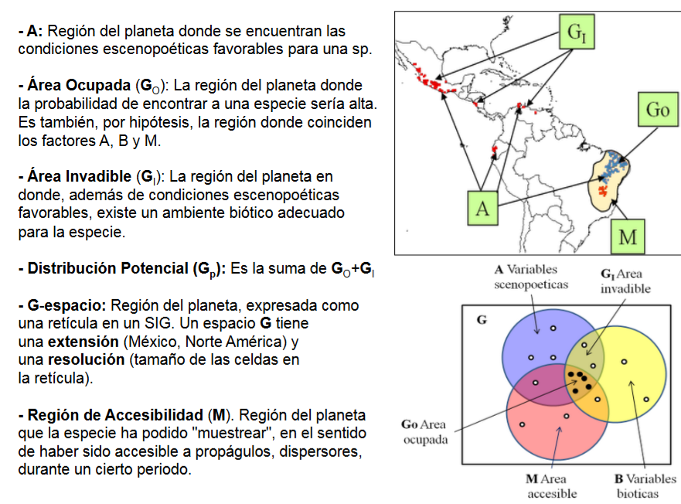
https://www.recibio.net/wp-content/uploads/2014/01/Intro-Modelado-de-nichos_EMM.pdf

Slide 23
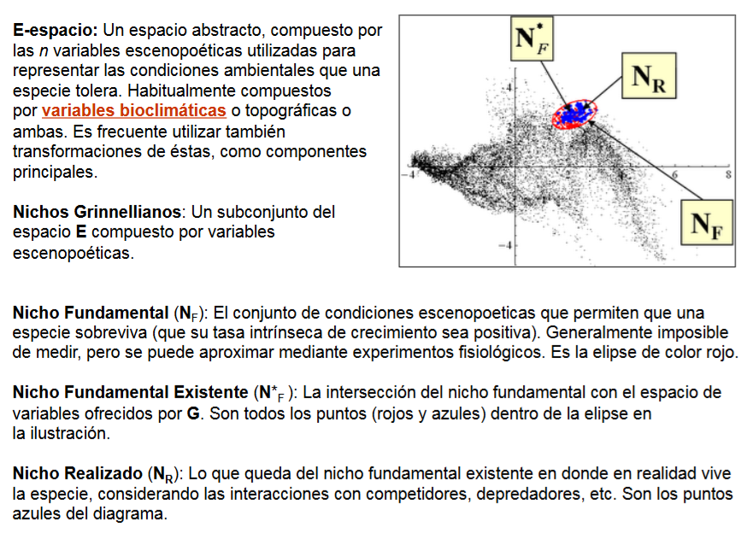
https://www.recibio.net/wp-content/uploads/2014/01/Intro-Modelado-de-nichos_EMM.pdf

Slide 24

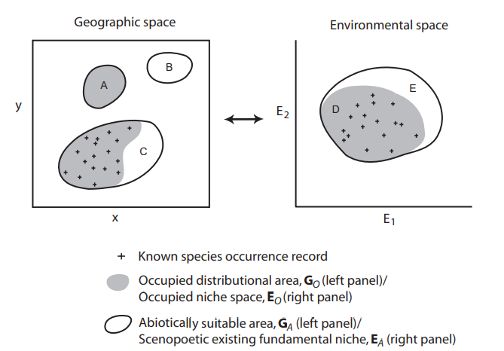
What is a niche?
If the environmental conditions encapsulated within the fundamental niche are plotted in geographical space, then we have the potential distribution
Niche and species distribution are not synonyms!
Hutchinson’s concept of niche: hypervolume of the multidimensional space defined by a set of environmental variables, within which a species can maintain a viable population

Slide 25
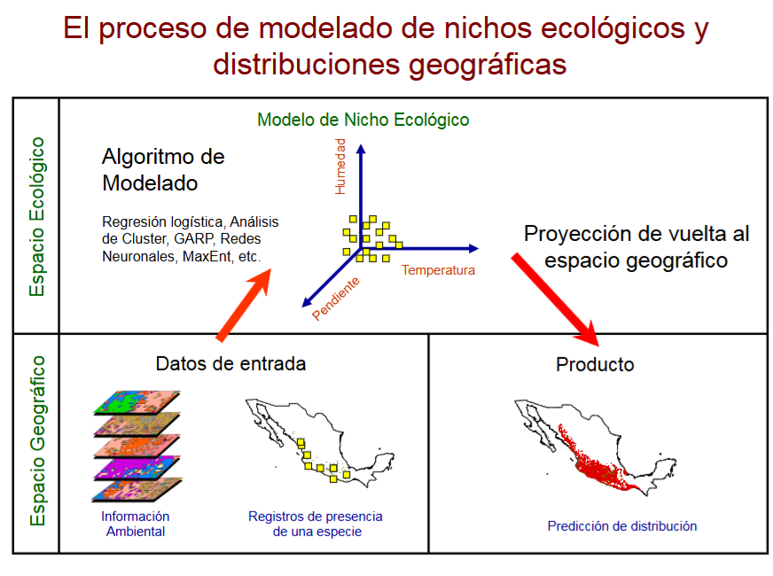
https://www.recibio.net/wp-content/uploads/2014/01/Intro-Modelado-de-nichos_EMM.pdf

Slide 26
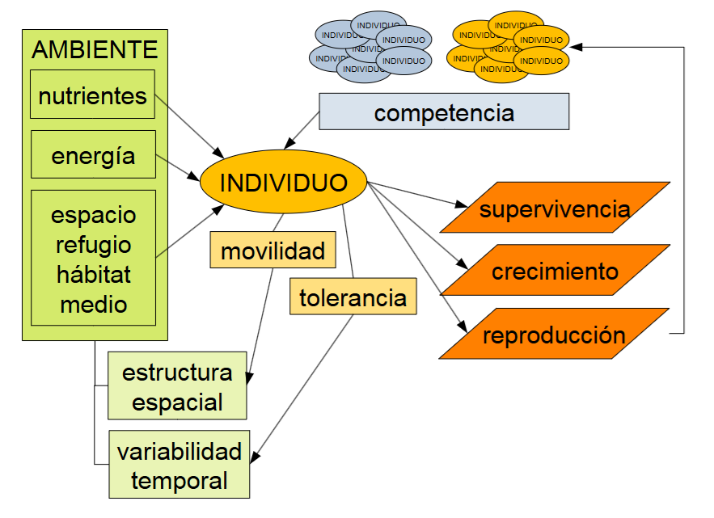
https://gbif.es/wp-content/uploads/2019/06/sesion_1.pdf

Slide 27
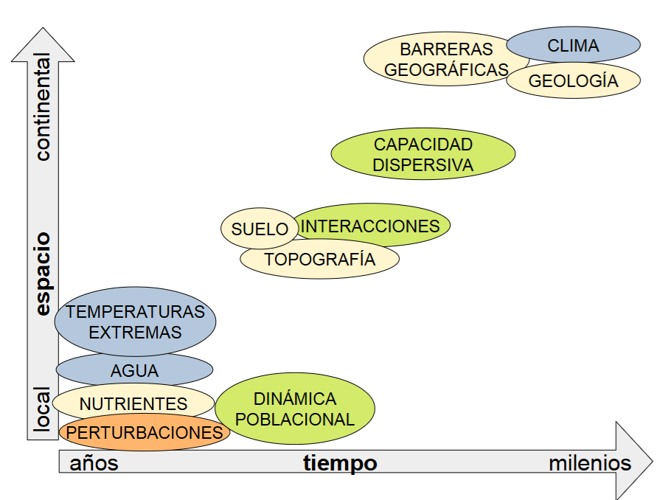
https://gbif.es/wp-content/uploads/2019/06/sesion_1.pdf

Slide 28
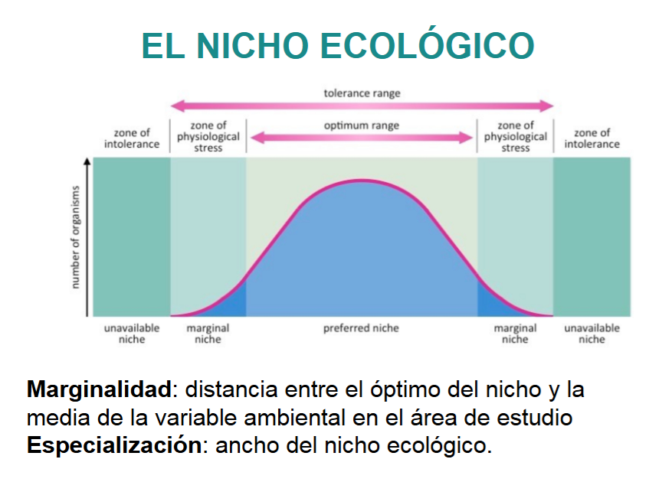
https://gbif.es/wp-content/uploads/2019/06/sesion_1.pdf

Slide 29
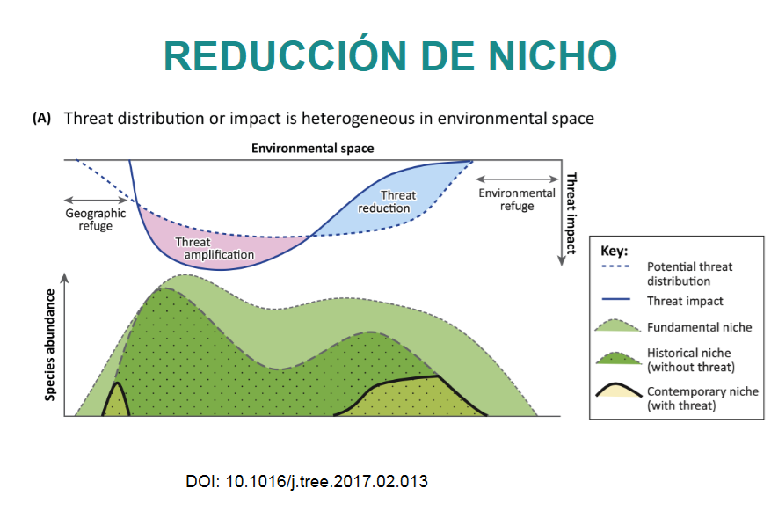
https://gbif.es/wp-content/uploads/2019/06/sesion_1.pdf

Slide 30
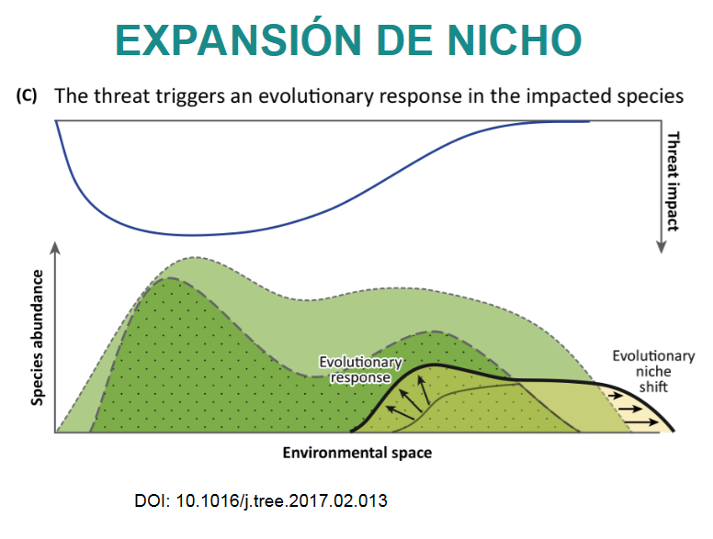
https://gbif.es/wp-content/uploads/2019/06/sesion_1.pdf

Slide 31
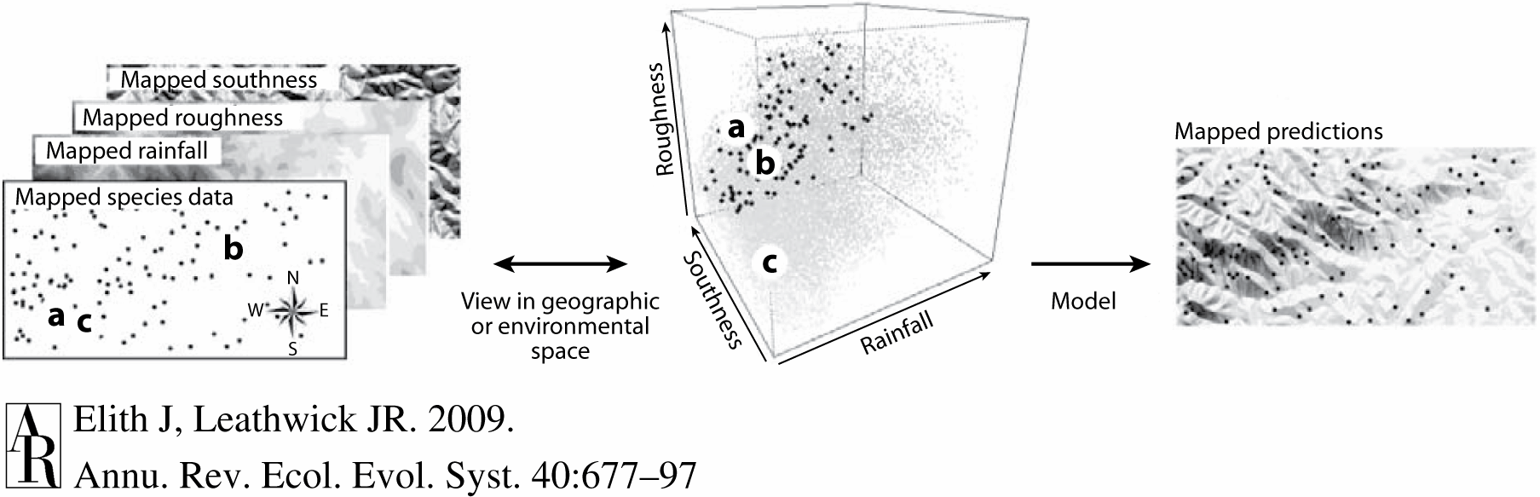
The species distribution model workflow:

Slide 32
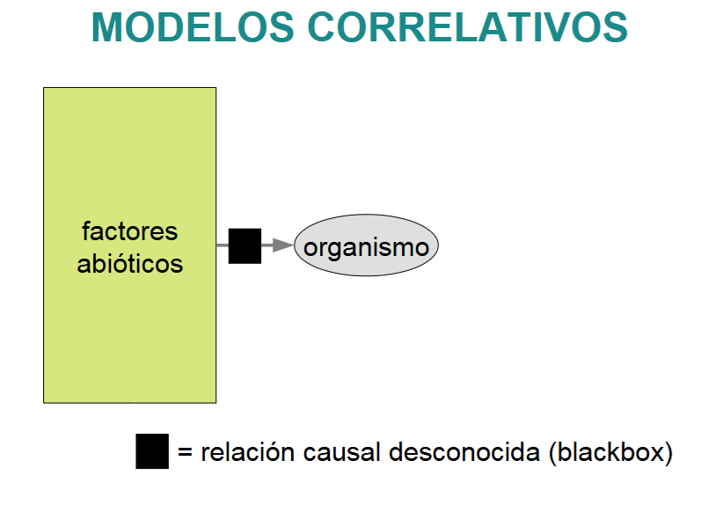
https://gbif.es/wp-content/uploads/2019/06/sesion_1.pdf

Slide 33
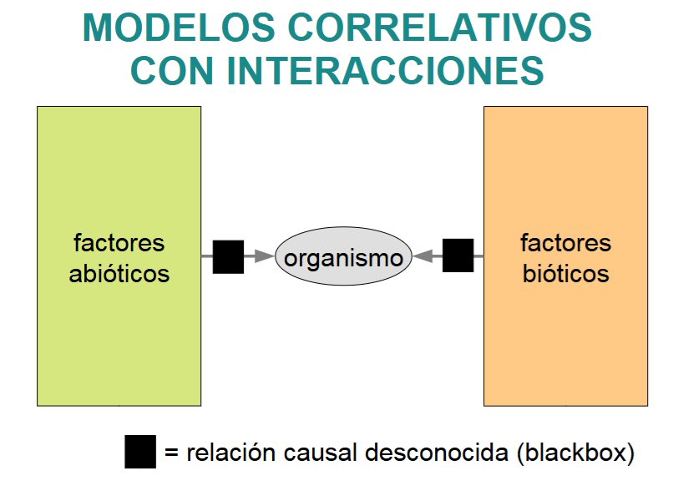
https://gbif.es/wp-content/uploads/2019/06/sesion_1.pdf

Slide 34
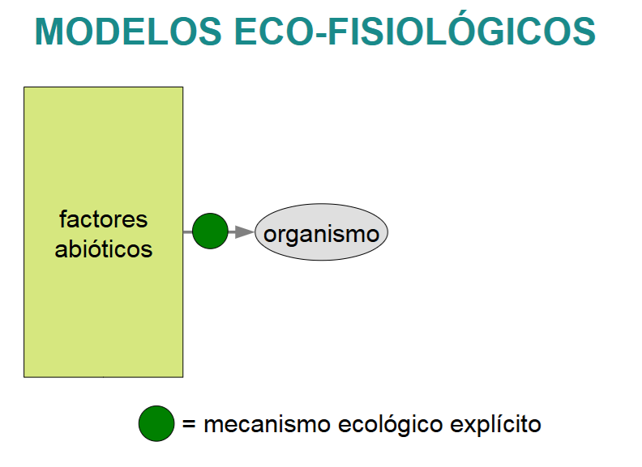
https://gbif.es/wp-content/uploads/2019/06/sesion_1.pdf

Slide 35
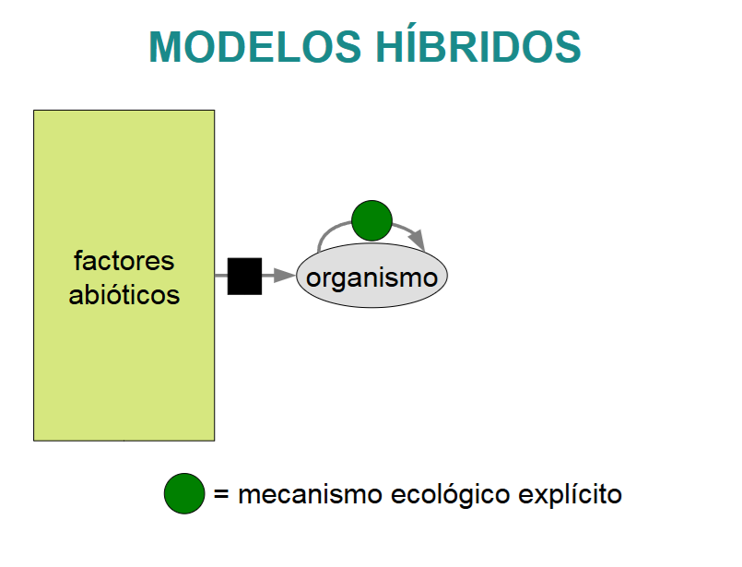
https://gbif.es/wp-content/uploads/2019/06/sesion_1.pdf

Slide 36
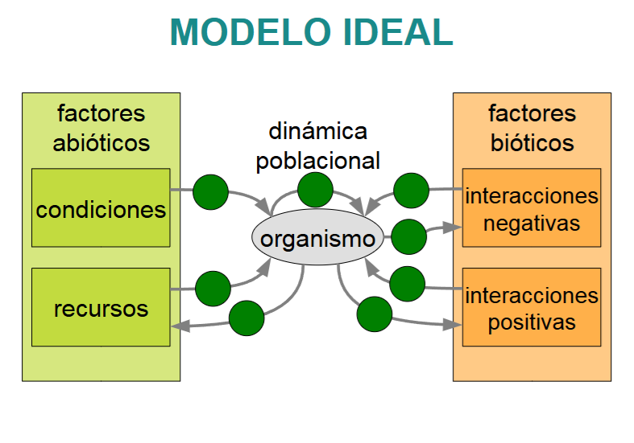
https://gbif.es/wp-content/uploads/2019/06/sesion_1.pdf

Slide 37
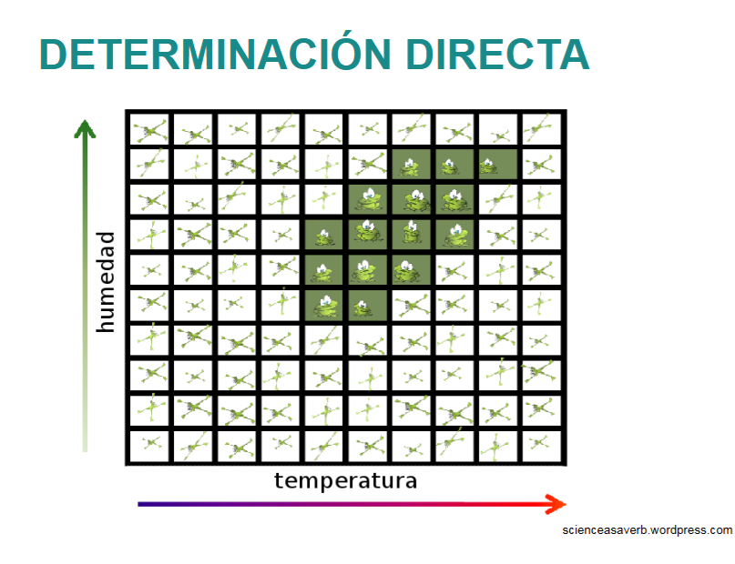
https://gbif.es/wp-content/uploads/2019/06/sesion_1.pdf

Slide 38
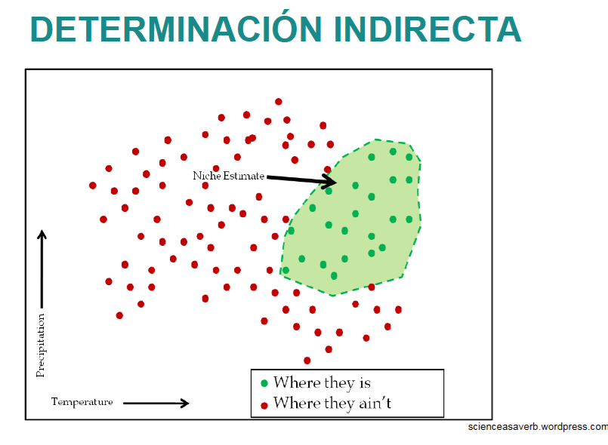
https://gbif.es/wp-content/uploads/2019/06/sesion_1.pdf

Slide 39
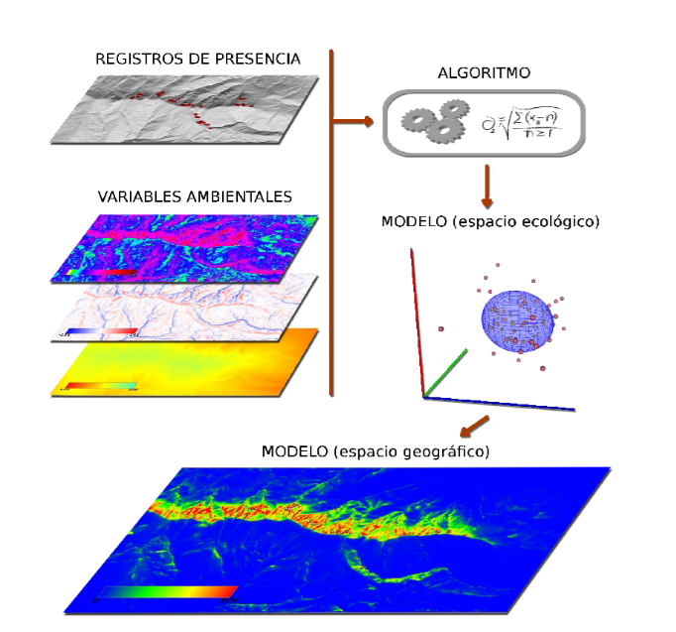
https://gbif.es/wp-content/uploads/2019/06/sesion_1.pdf

Slide 40
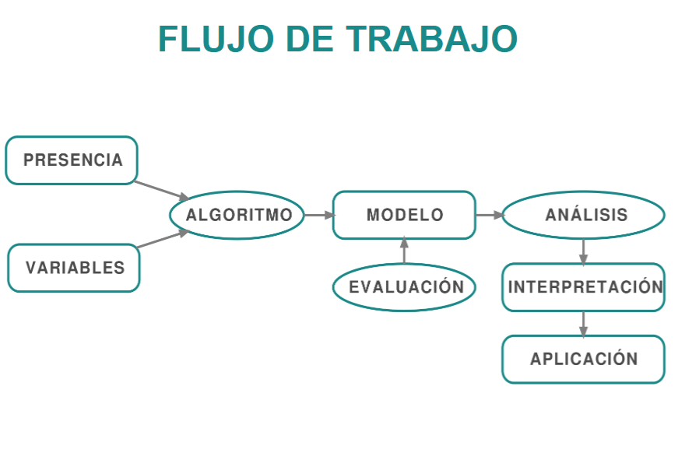
https://gbif.es/wp-content/uploads/2019/06/sesion_1.pdf

Slide 41
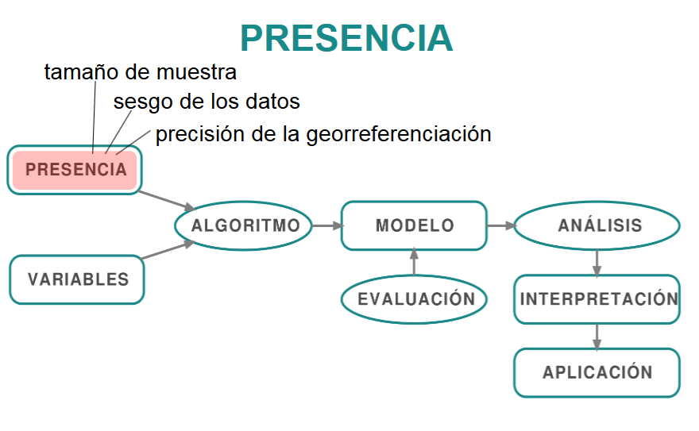
https://gbif.es/wp-content/uploads/2019/06/sesion_1.pdf

