Slide 1
Gap Analysis: Main issues in geographical coordinates (CURATION + WORKFLOW)
November 6, 2025
Alliance Bioversity International & CIAT

Slide 2
The workflow for a gap analysis

Slide 3
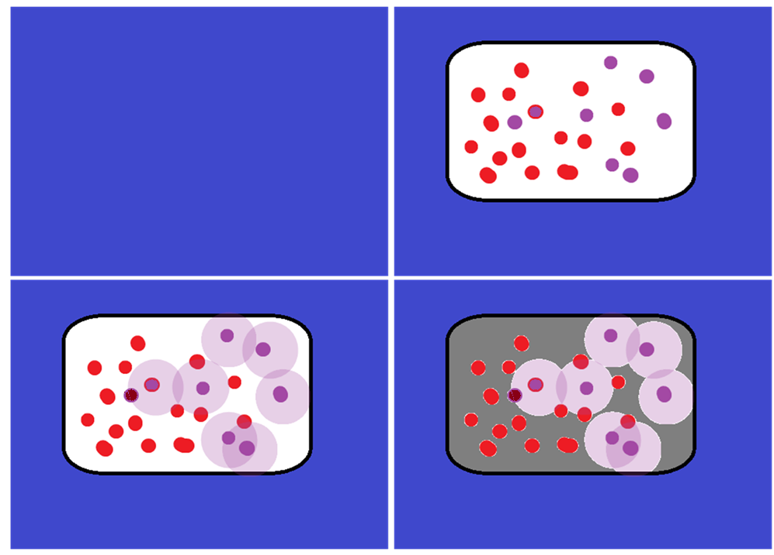




A
B
Germplasm
Other coordinates
Collected germplasm area
Species occurrences
Realized niche
Potential area to be collected
C
D
Sampled germplasm
Where to collect

Slide 4
Basics of data curation
Activity
What respond?
Taxonomic data
Geographical coordinates
Environmental information
The species that I am analyzing have other scientific names or it is even a valid name?
How accurate is the geographical information found for my species?
What environmental information can be used to model the species distribution of the species?

Slide 5
Why is important to curate geographical coordinates?

Slide 6

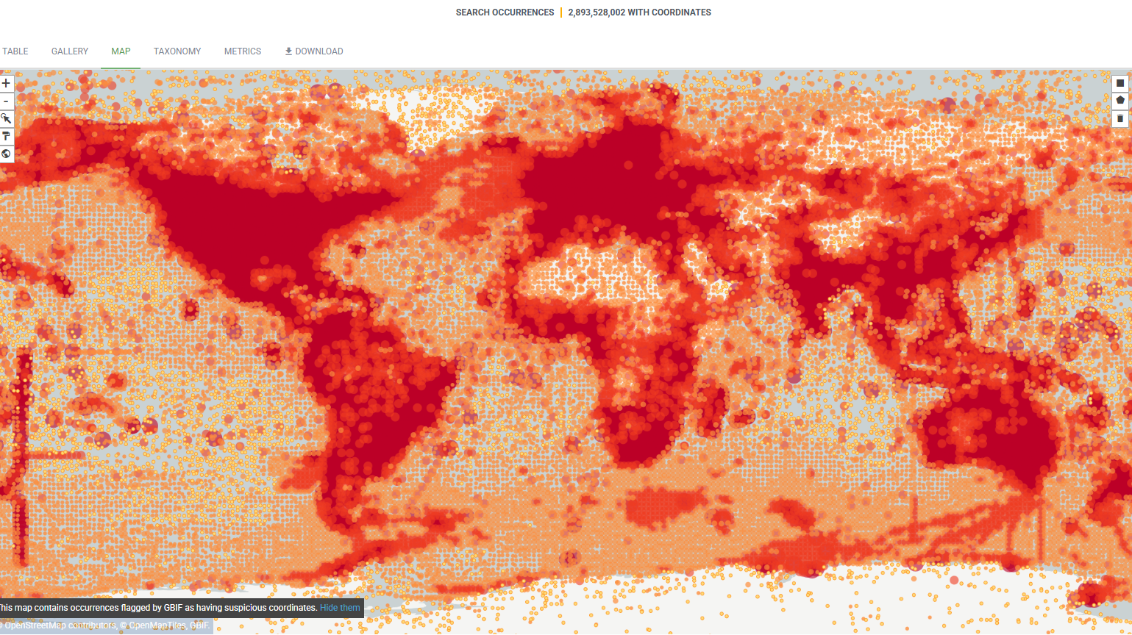
Databases need curation!

Slide 7
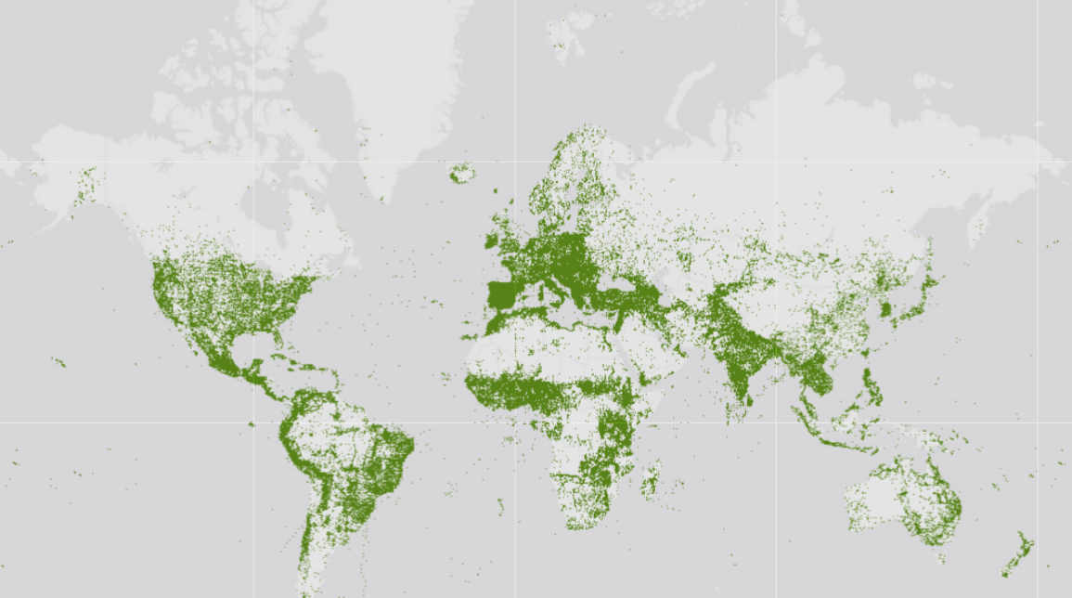


Slide 8
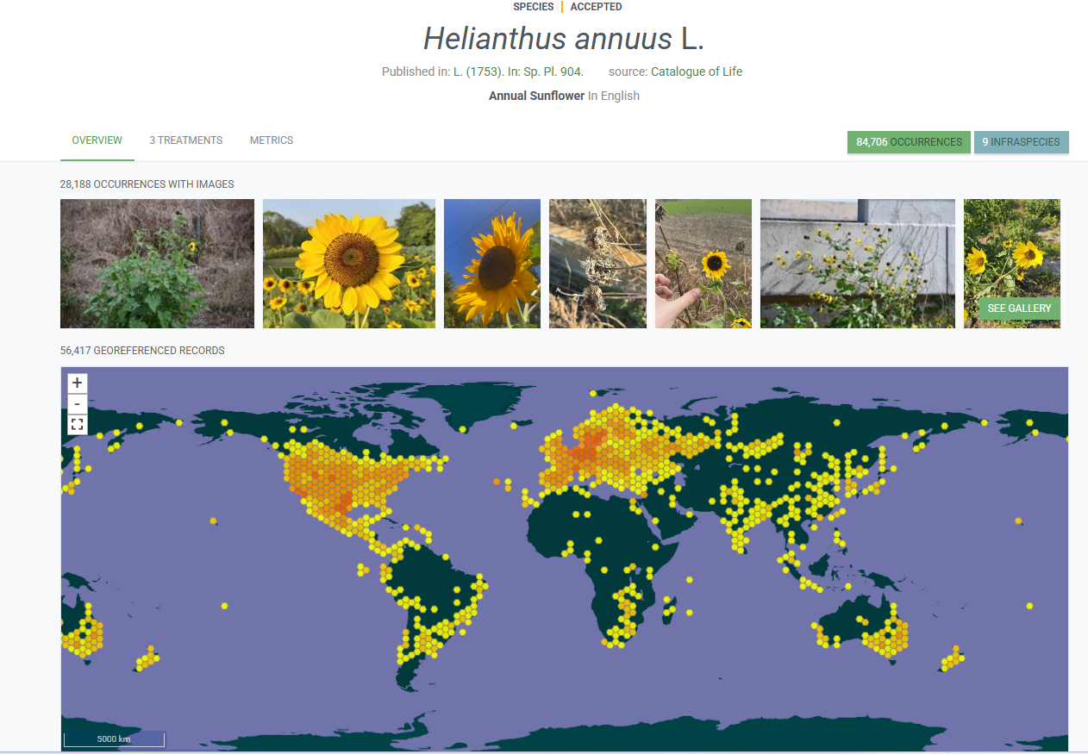
https://www.gbif.org/species/9206251

Slide 9
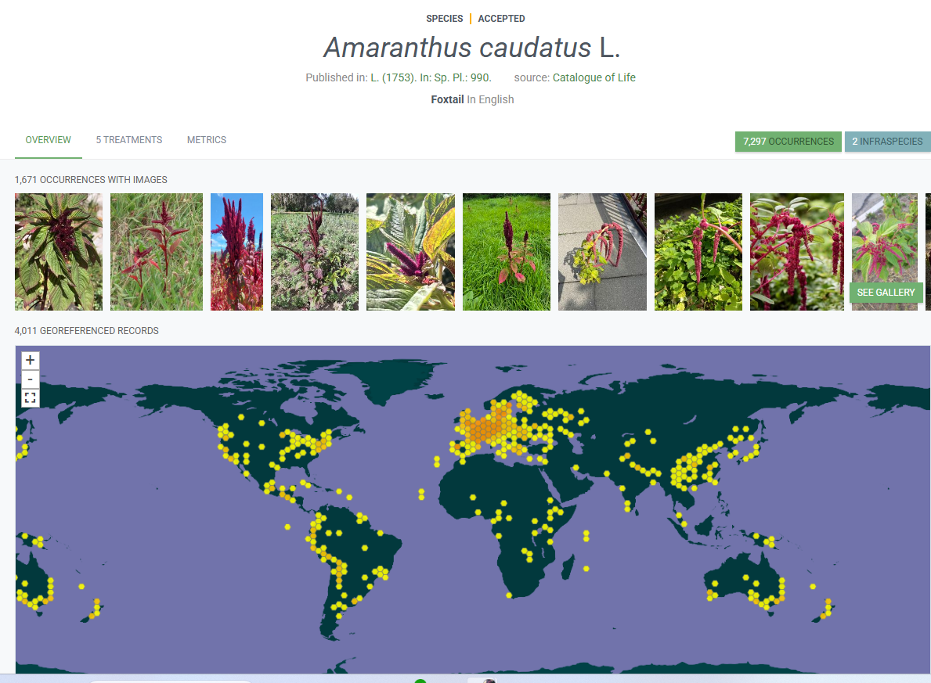
https://www.gbif.org/species/6109611

Slide 10
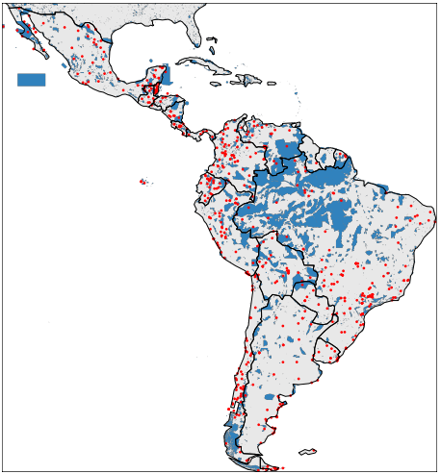
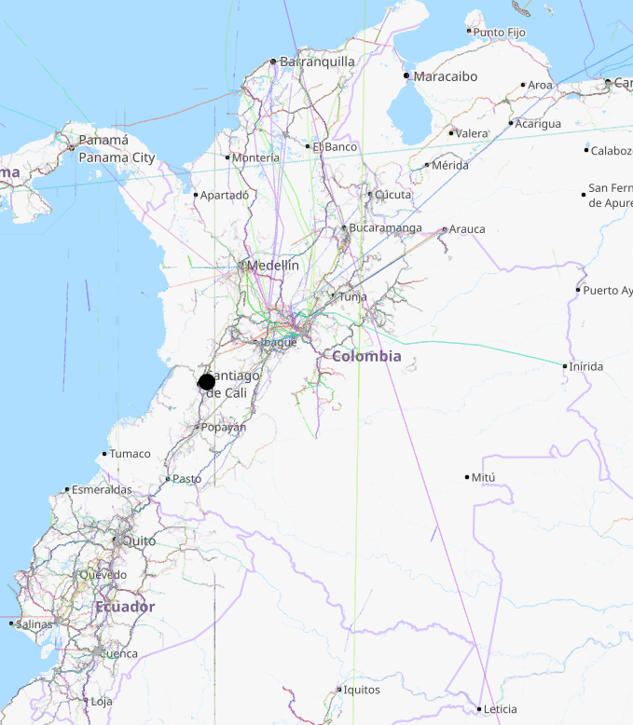
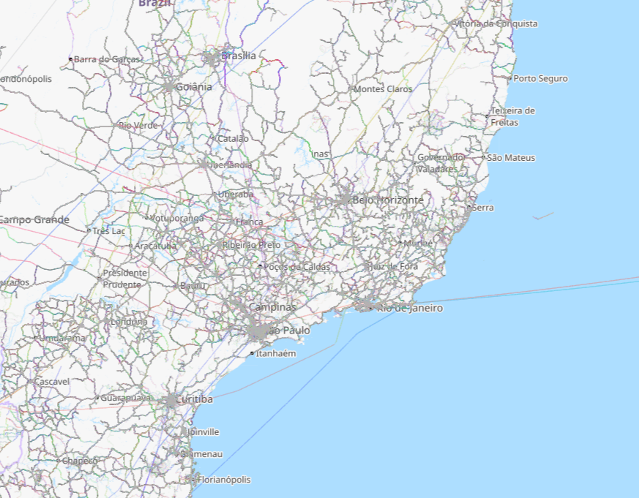
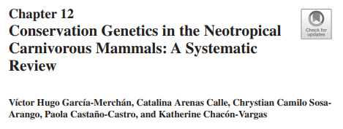
Sampling bias is common in biological collections!
1
Roadsides
Cities
Accessible areas
1 2
2

Slide 11
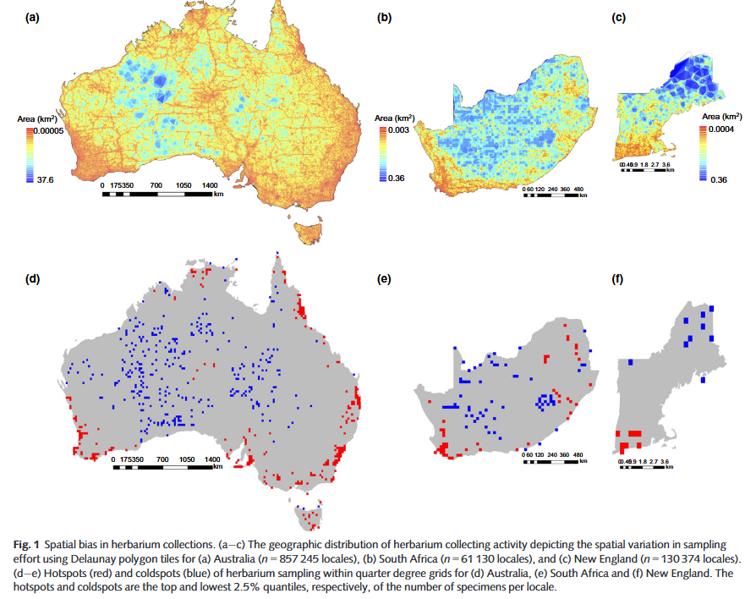
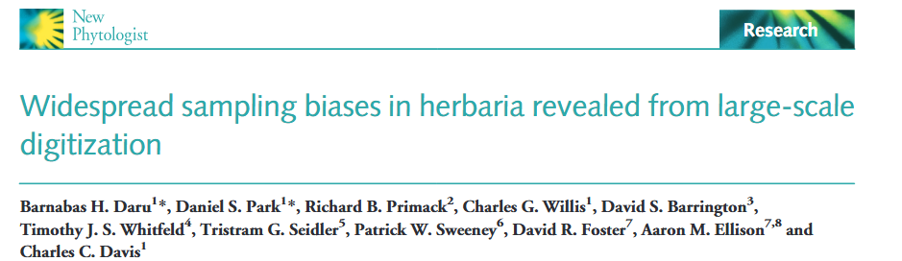
Herbarium specimens tended to be collected closer than expected to roads and herbaria (P < 0.01)
More than 50% of herbarium specimens were collected within 2 km of road-sides in all three ﬂoras
A tendency for specimens to be collected at lower elevation

Slide 12
Main issues in coordinates
Missing coords (some issues):
Inaccurate geographical information reported
Disappeared administrative regions and countries
Protected sites (e.g., Federal protected areas in USA in the case of H. paradoxus)

Slide 13
Main issues in coordinates
Accuracy
Changes between formats
Duplicated coords
Commas instead period (e.g. 1,2999; 1.2999)
Wrong Longitude and Latitude
Wrong coords format! (e.g. UTM, decimal degress, hours, minute, second)
Unknown datum!
Coords in sea
Truncated coords (E.g. longitude represented as latitude)

Slide 14
Examples of geographical coordinates issues

Slide 15
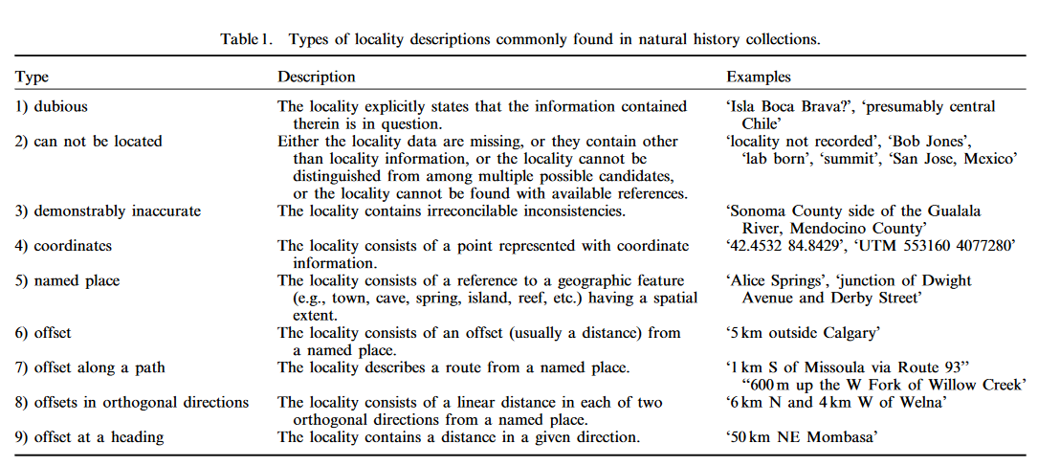
Examples of descriptions in natural history collections:
Wieczorek et al., 2004

Slide 16
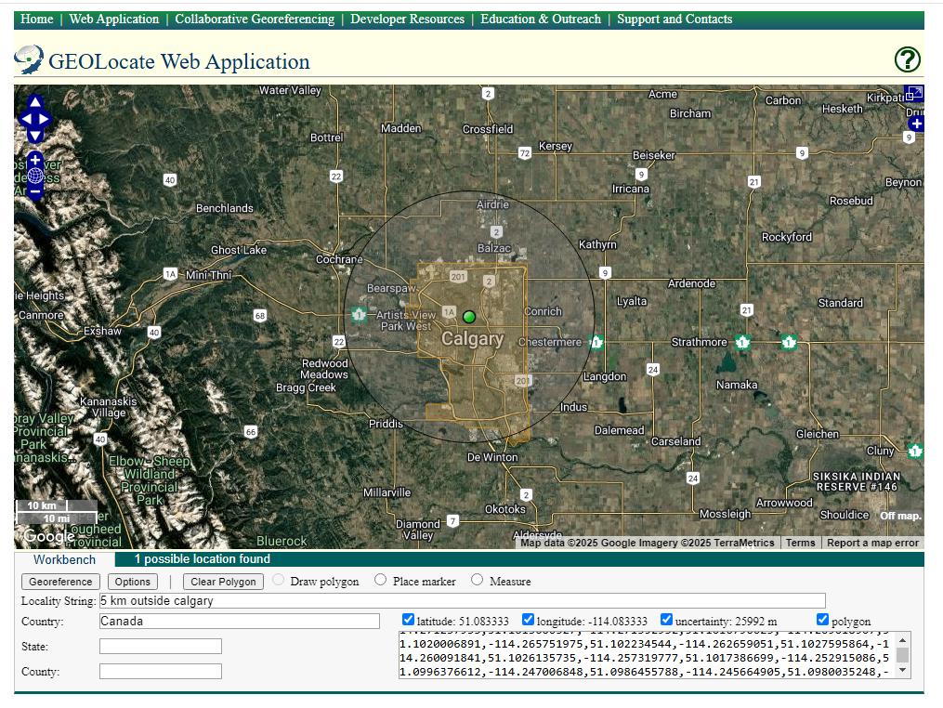
High uncertainty is present! (what is the exact location?)

Slide 17
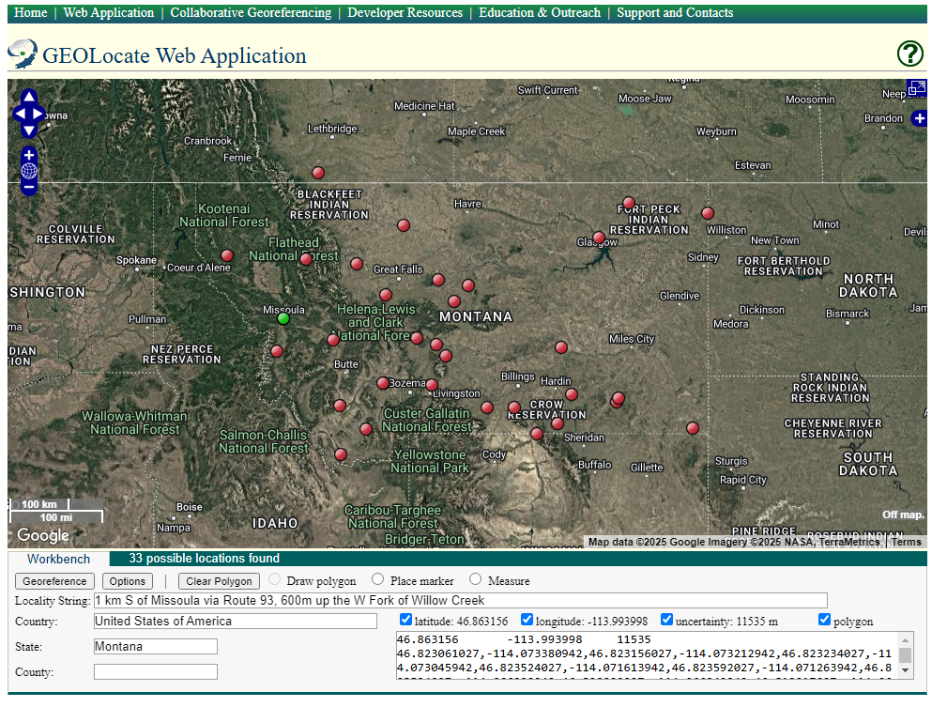
33 possible locations!

Slide 18
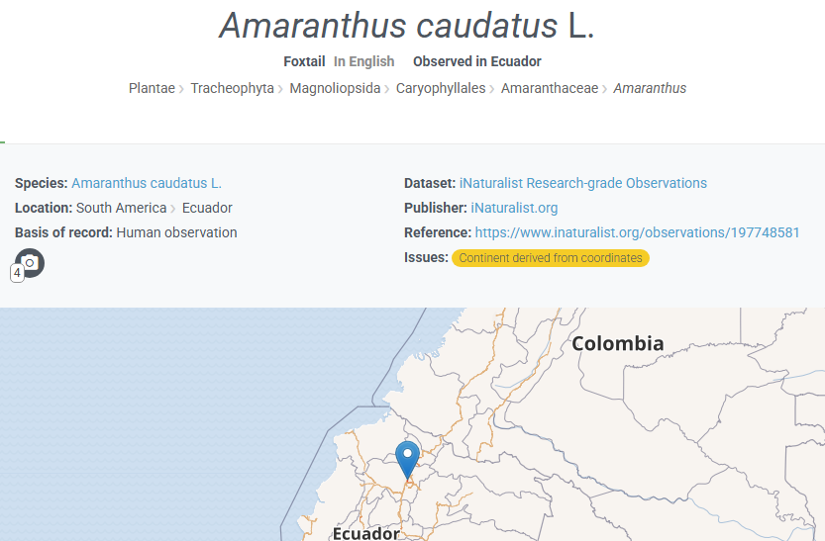
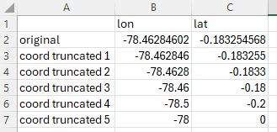
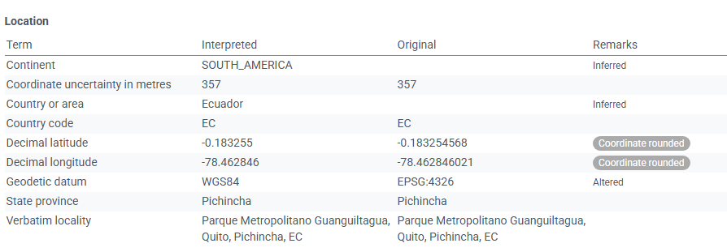
Let's see accuracy:
https://www.gbif.org/occurrence/4516468723

Slide 19
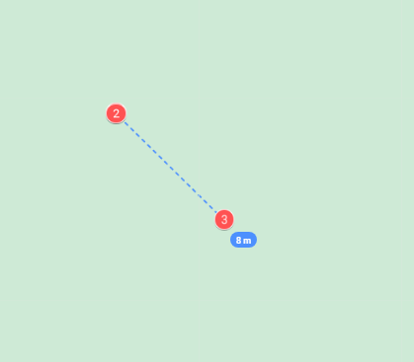
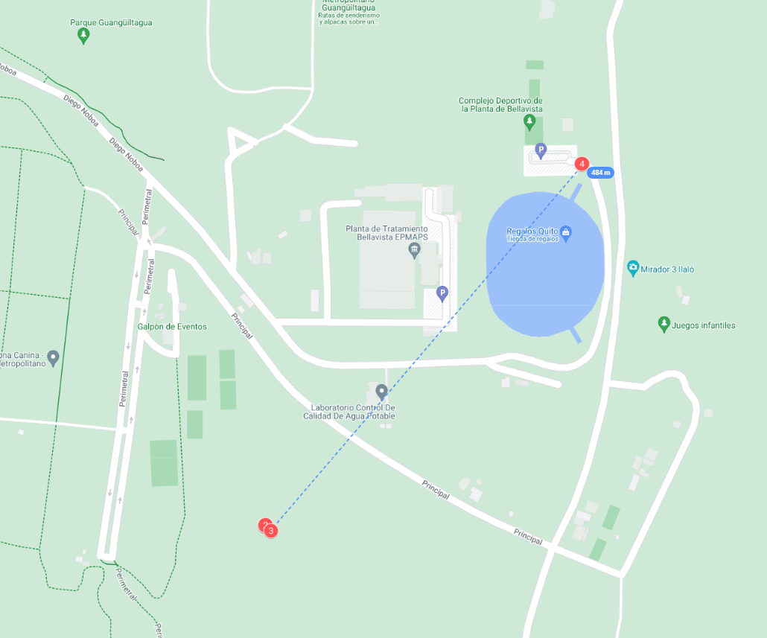
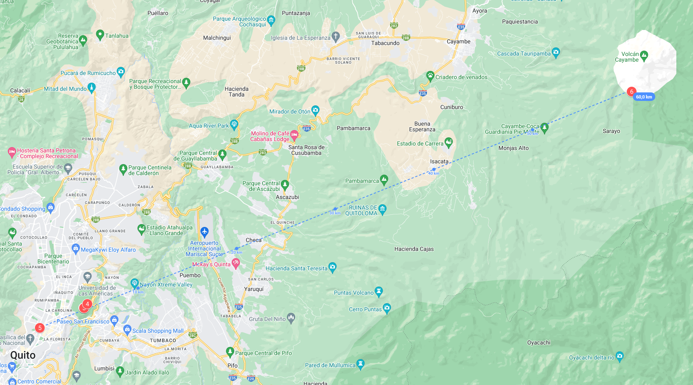
https://www.google.com/maps/d/edit?mid=19tZfXiauYtgdmlOj4iMZFddwSJo8SRE&usp=sharing

Slide 20
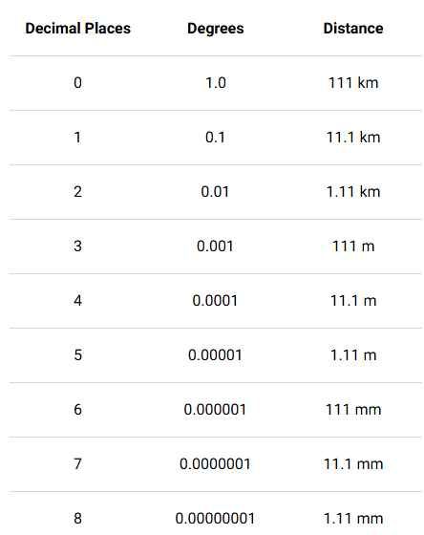
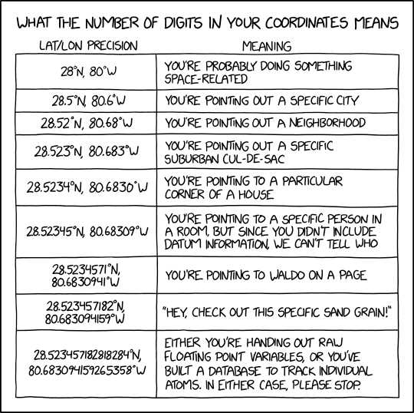
The accuracy is important in geographical data!
https://support.garmin.com/en-US/?faq=hRMBoCTy5a7HqVkxukhHd8

Slide 21
Error types in geographical coordinates
Duplicated coordinates:
Different accessions can have the same coordinates, but their related information can be different.
Common_names | Latitude | Longitude
Rochelas | 2.9167 | -75
Rochelas | 2.9167 | -75
Rochelas | 2.9167 | -75
Revoltura | 2.9167 | -75
Revoltura | 2.9167 | -75
Revoltura | 2.9167 | -75

Slide 22
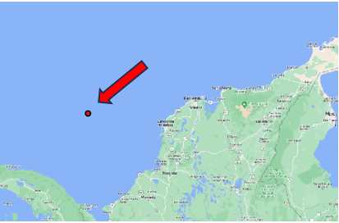
Error types in geographical coordinates
Coordinates in the ocean:

Slide 23
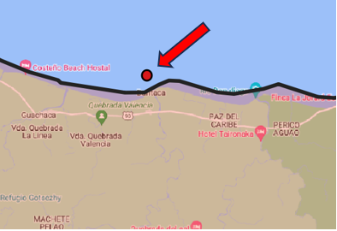
Error types in geographical coordinates
Low coordinates precision:
Coordinates can fall right outside the correct region or country.

Slide 24
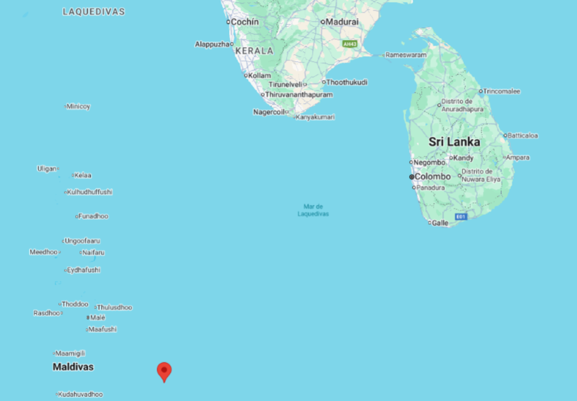
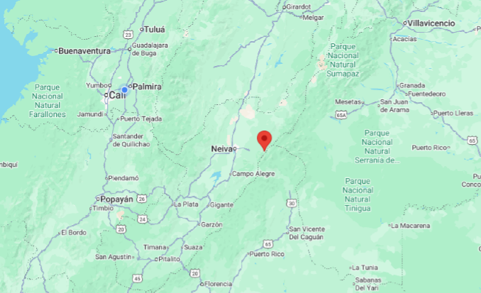
Error types in geographical coordinates
Inverted coordinates sign :
Either the latitude, the longitude, or both have the wrong sign.
A conversion was done from degrees, minutes, and seconds, but the hemisphere (W/E, N/S) was not considered in the conversion.
Latitude | Longitude
2.9167 | 75
2.9167 | -75

Slide 25
Error types in geographical coordinates
Zero coordinates:
There can be a lack of standard reporting of missing data
Latitude | Longitude
0 | 0
0 | -75

Slide 26
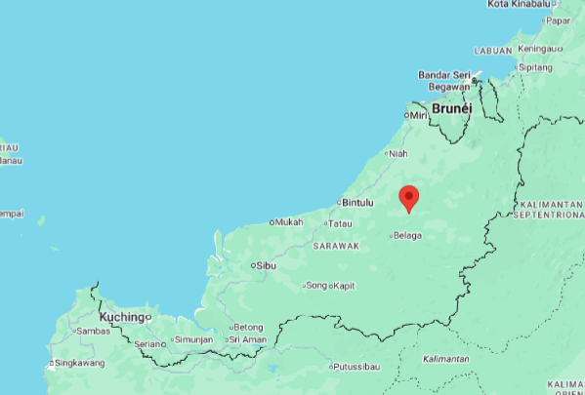
Error types in geographical coordinates
Coordinates out of collecting country
Country of collection in the passport data does not match to where the coordinate falls.
*The donor country is reported whereas the actual collection location
Country | Latitude | Longitude
Colombia | 3.029 | 114.028
Colombia | 2.9167 | -75
Colombia | 2.9167 | -75

Slide 27
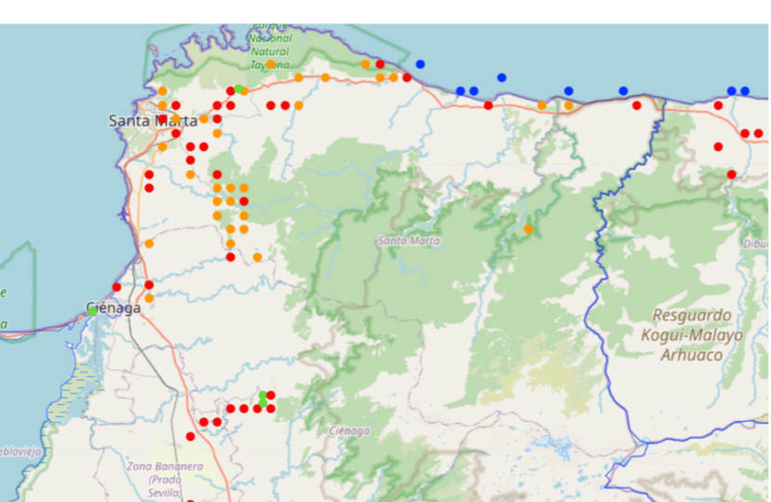
Error types in geographical coordinates
Straight-line pattern in latitude or longitude:
Sampling effort?
Errors in coordinates?
?

Slide 28
Error types in geographical coordinates
Decimal degrees
Missing E/W and/or N/S letters
Common_names | Latitude | Longitude
Rochelas | 2.9167 º N | 75 º W
Revoltura | 2.9167N | 75W
Revoltura | 2.9167N | 75
Common_names | Latitude | Lat_letter | Longitude | Lon_letter
Rochelas | 2.9167 | N | 75 | W
Revoltura | 2.9167 | N | 75 | W
Revoltura | 2.9167 | N | 75

Slide 29
Error types in geographical coordinates
Degrees, Minutes, Seconds (DMS)
Missing symbols º or ’ or “, or missing values at degree, minute or second
Common_names | Latitude | Longitude
Rochelas | 40º 42’46”N | 74º 0’ 22”W
Revoltura | 40 42 46 N | 74 0’ 22”W
Revoltura | 40º 42’46 N | 74º 0’ 22”
Rochelas | 40º 42’N | 74º 22

Slide 30
Error types in geographical coordinates
Degrees and Decimal minutes (DMM)
Missing symbols º or ’ or “, or missing values at degree, minute or second
Common_names | Latitude | Longitude
Rochelas | 40º 42.767’N | 74º 0.367’W
Revoltura | 40 N | 74 22 W
Revoltura | 40º 42’46 | 74º 0’ 22”
Rochelas | 40 42 N | 74 22

Slide 31
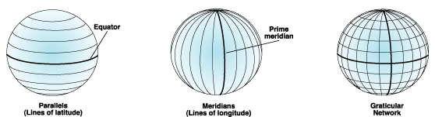
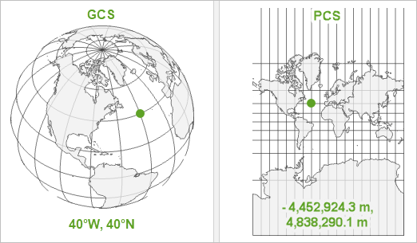
Error types in geographical coordinates
Datum
A datum provides a frame of reference for measuring locations on the surface of the earth. It defines the origin and orientation of latitude and longitude lines
WGS 1984 (The most used)
Geographic Coordinate System (GCS)
Define locations on a model of the surface of the earth
WGS 1984 (The most used)

Slide 32
Geographical coordinates
How to evaluate the quality of geographical coordinates reported for a given accession?
Ideas?

Slide 33
How to evaluate the quality of geographical coordinates reported for a given accession? Ideas?

Slide 34
Georeferentiation
Obtaining geographical information from passport data

Slide 35
How to obtain records from existent data (Georeferentiation)
https://www.geo-locate.org/ (Lets try georeferencing some data!)
Wieczorek et al., 2004

Slide 36
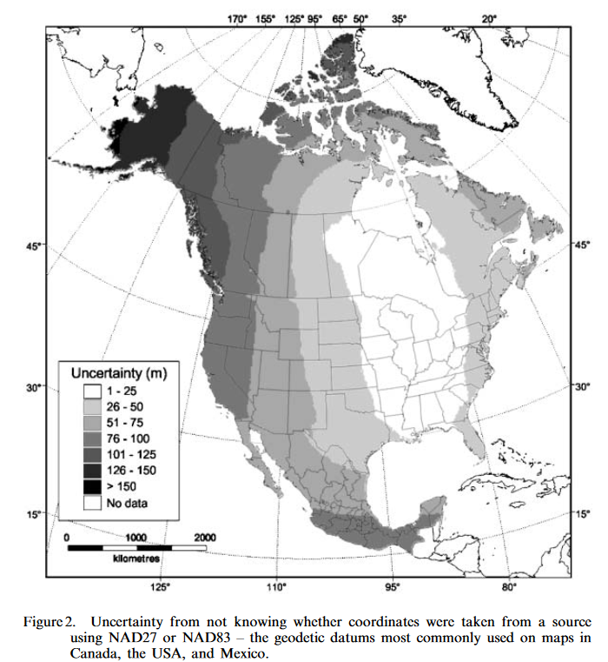
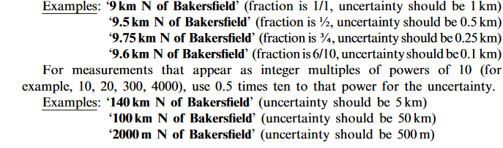
The uncertainty matters
Point-radius method:
The point-radius method describes a locality as a coordinate pair and a distance from that point (that is, a circle)

Slide 37
Recommendations to report geographical data How to report geographical data!

Slide 38
There is not a unique way to report data. Nevertheless…
Follow Multicrop Passport Descriptors (MCPD)! https://cgspace.cgiar.org/server/api/core/bitstreams/7947d48c-5cf1-4164-8c61-fa276d658463/content
Follow Darwin Core Standards! http://rs.tdwg.org/dwc
Follow FAO standards! https://www.fao.org/4/i3704e/i3704e.pdf

Slide 39
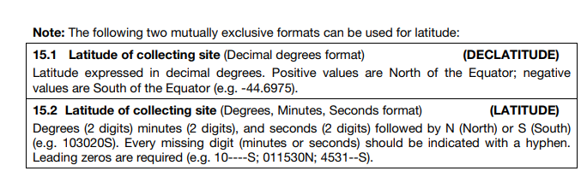
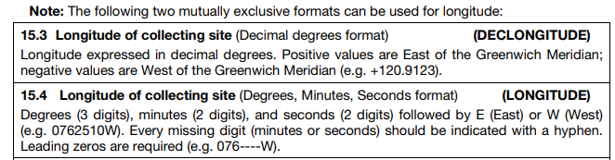
MCDP

Slide 40
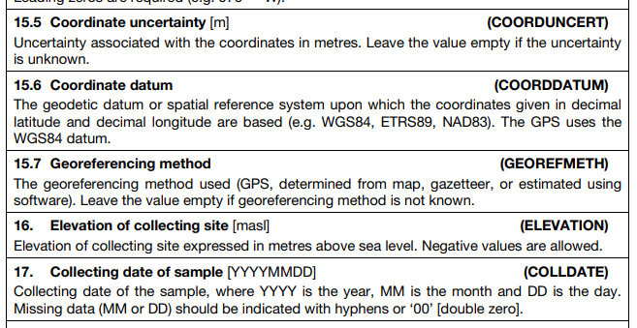

Slide 41
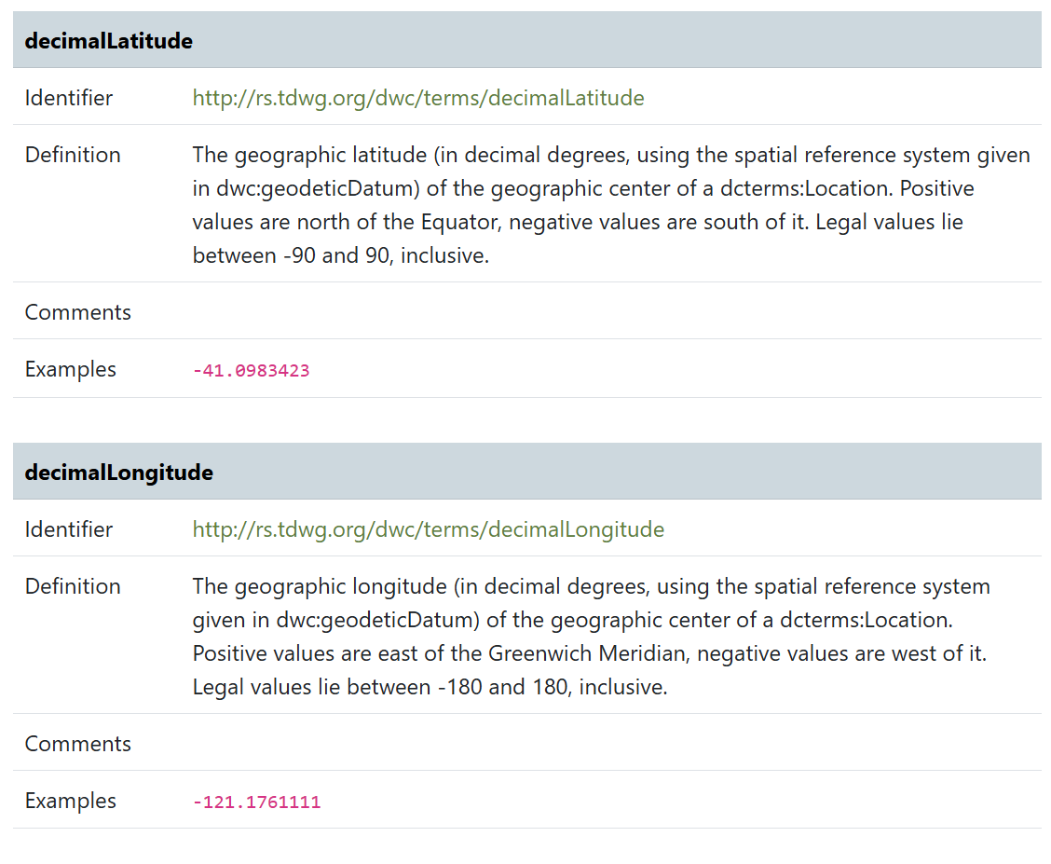
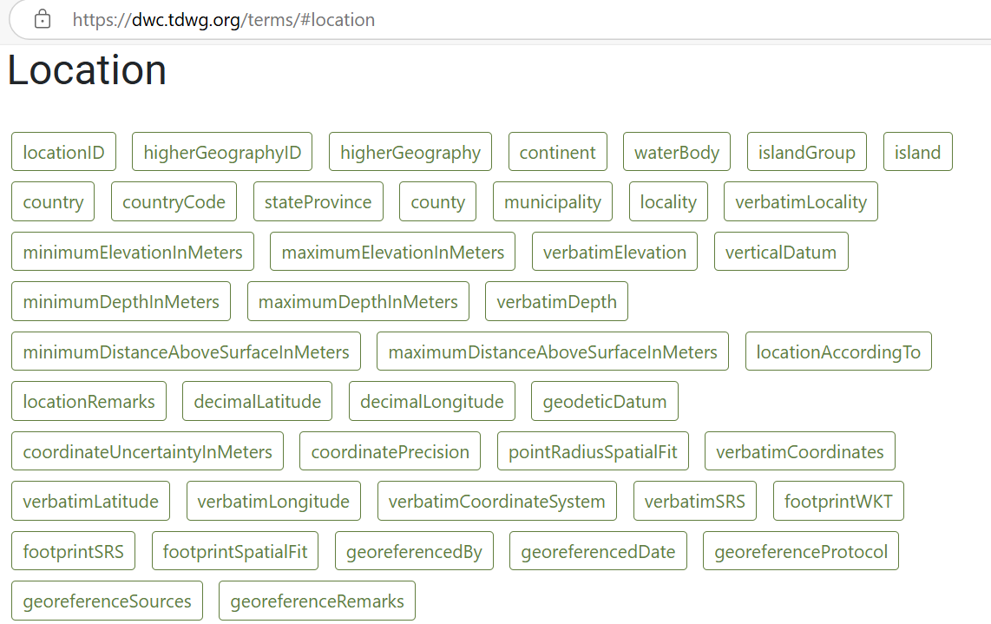
DarwinCore

Slide 42
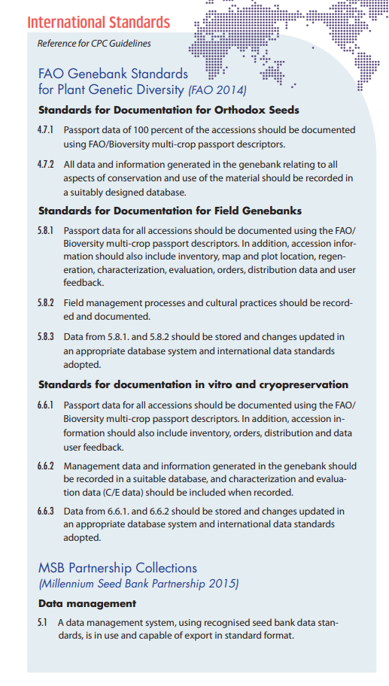
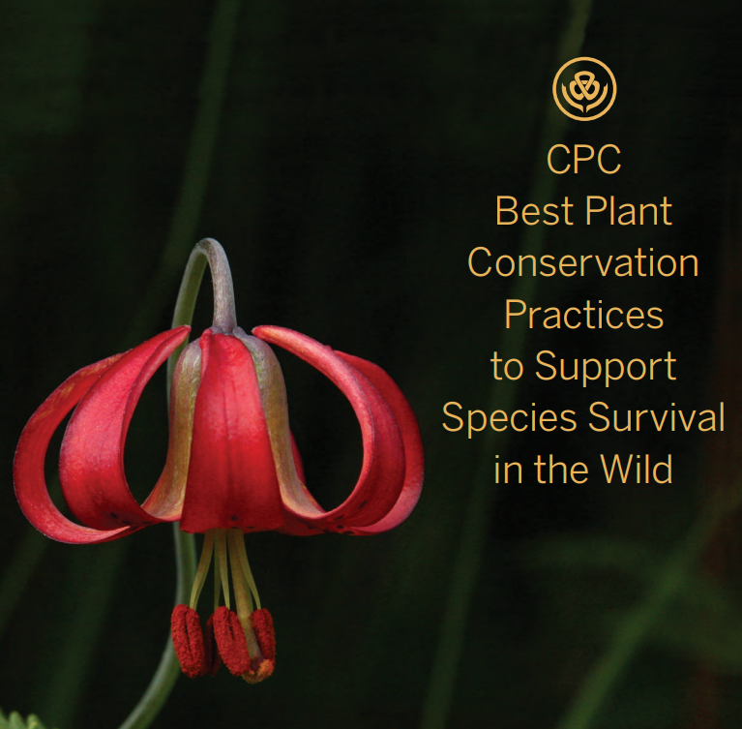

Slide 43


Slide 44
What did we do to obtain data for the gap analyses?

Slide 45
The questions
Establish type of analysis to do
Is the taxon a crop wild relatives or a landrace?
Search the data
What data do I need to run the analysis?
What databases should I use and how to download the data?
Preprocessing (Observe data)
Are there records with dirty coords?
Preprocessing (clean data)
How can I obtain clean coords?
Do I have enough records for the analysis?
Is the data accurate for the analysis?
What format or requirements are need to performance the analysis?
What kind of clean procedure should I do
How can I obtain germplasm records from GBIF?
What is the geographical region to model?

Slide 46
The questions + the procedures
Establish type of analysis to do
Is the taxon a crop wild relatives or a landrace? (DEFINE LANDRACE OR CWR GAP ANALYSIS)
Search the data
What data do I need to run the analysis? (GERMPLASM AND HERBARIUM DATA)
What databases should I use and how to download the data? (DEFINE DATABASES TO USE: WIEWS, GENESYS, GBIF, USDA)
Preprocessing (Observe data)
Preprocessing (clean data)
Is the data accurate for the analysis? (VISUALIZE DATA)
What format or requirements are need to performance the analysis? (CHECK COORDS FORMAT)
What kind of clean procedure should I do? (DEFINE IF GEOREFERENCIATION, APPLY GQS)
Are there records with dirty coords? (VISUALIZE)
How can I obtain clean coords? (APPLY GQS)
Do I have enough records for the analysis? (VISUALIZE AND COUNT Germplasm and Herbaria data)
How can I obtain germplasm records from GBIF? (USE FAO WIEWS + INDEX HERBARIORUM)
What is the geographical region to model? (DEFINE AREA TO DOWNLOAD RECORDS AND ENVIRONMENTAL LAYERS!)

Slide 47
What a gap analysis step by step looks like!

Slide 48
Germplasm
Other coordinates
Collected germplasm area
Species occurrences
Realized niche
Potential area to be collected
Sampled germplasm
Where to collect

Slide 49

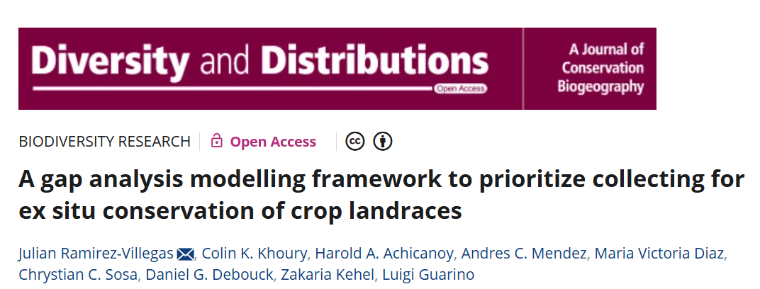
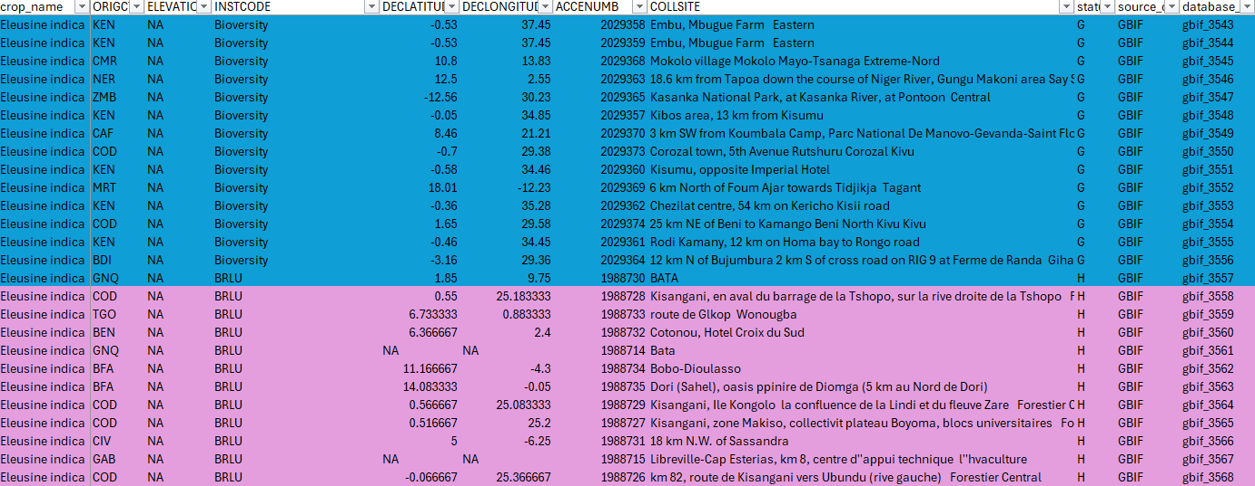




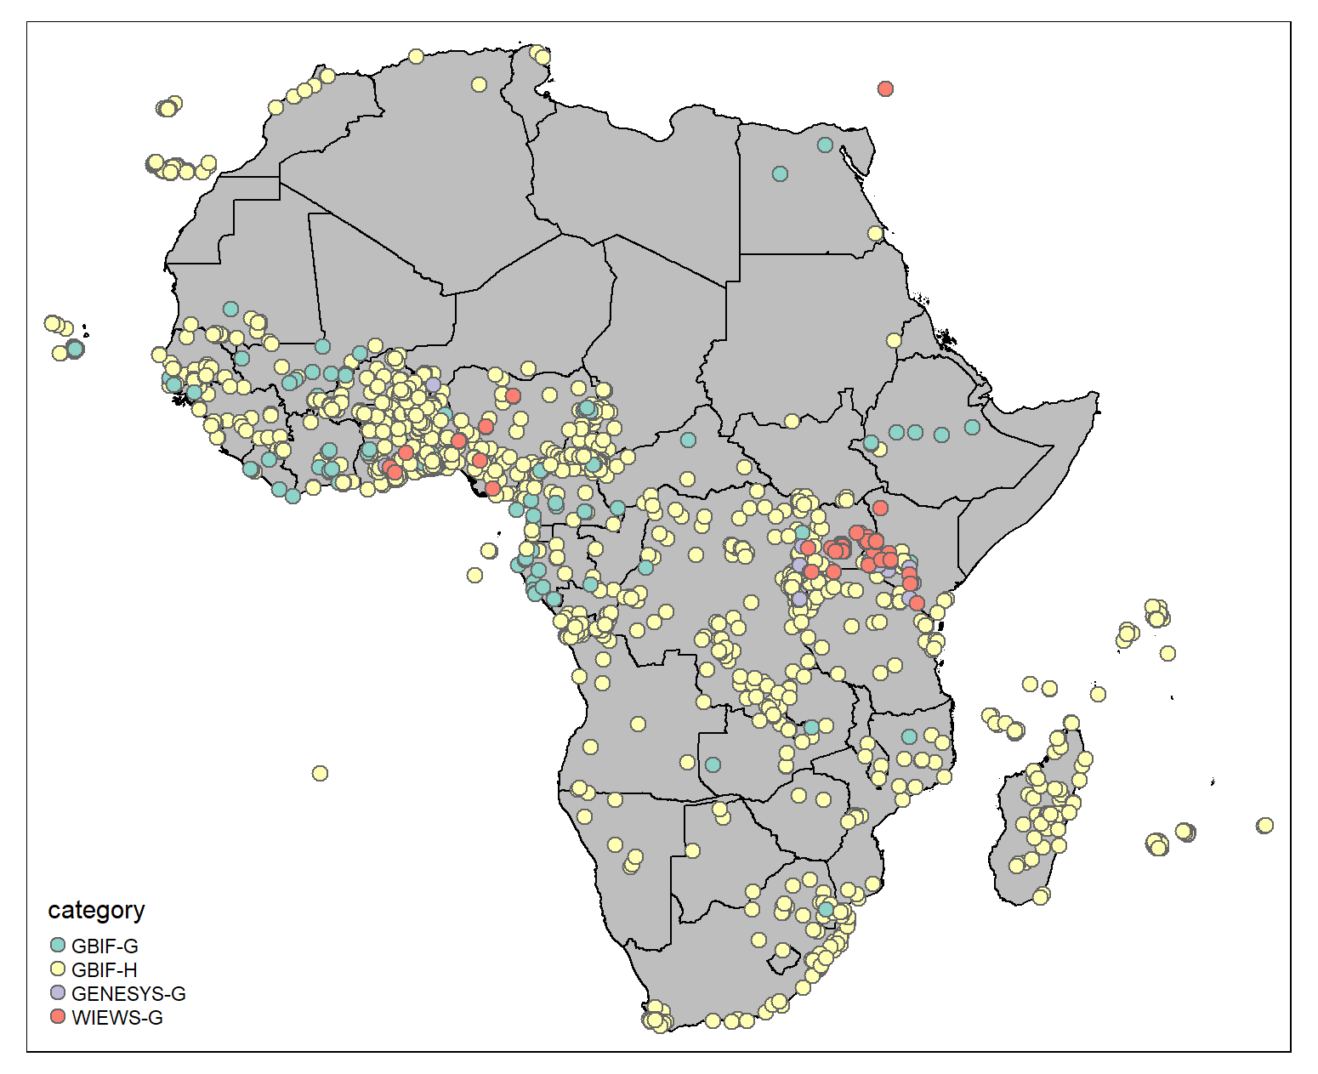
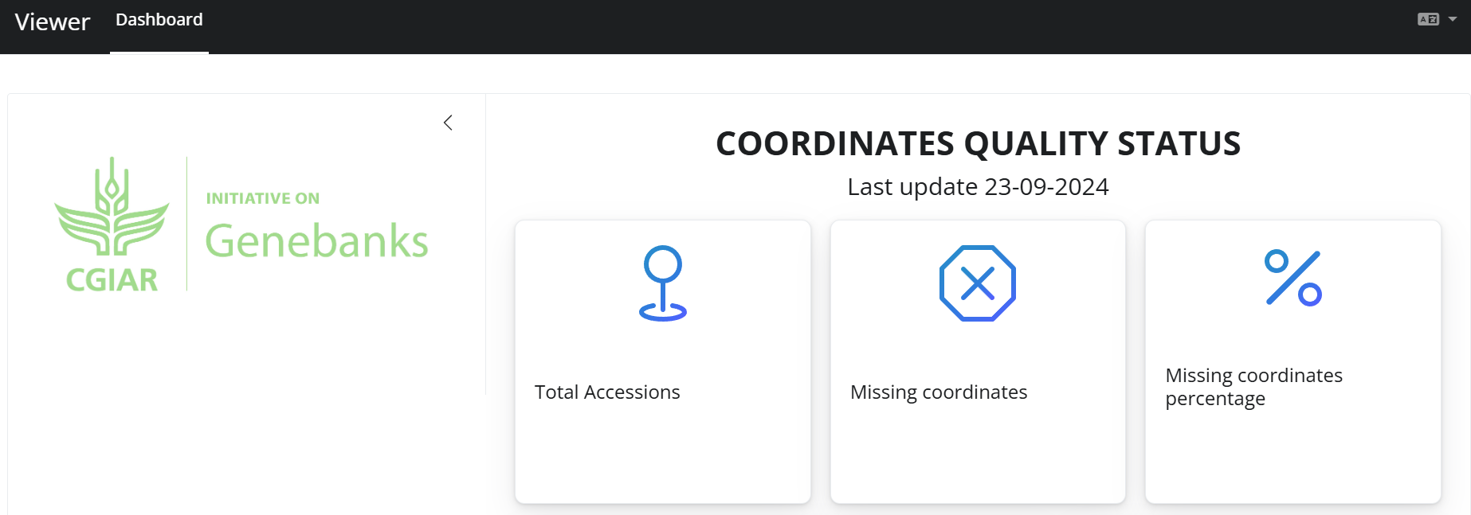
Download
Define taxa status for the analysis
Obtain Germplasm and herbarium records from GBIF

Slide 50
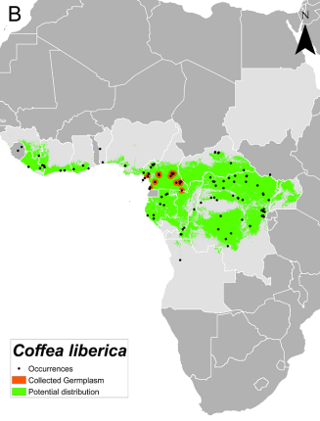
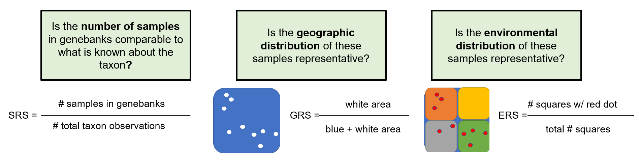
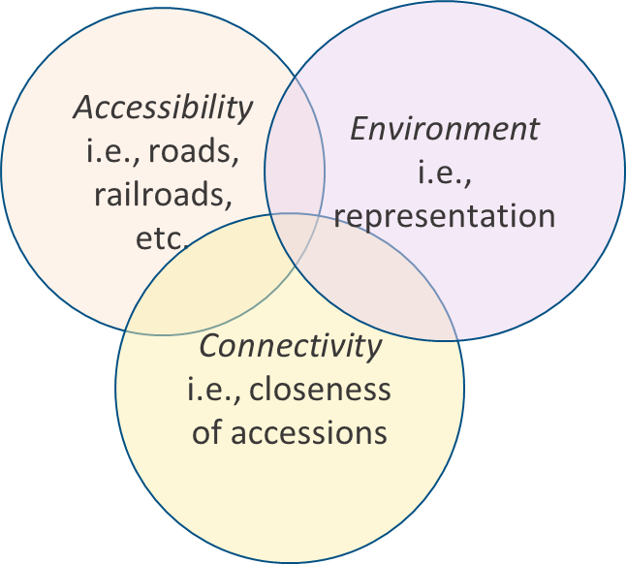
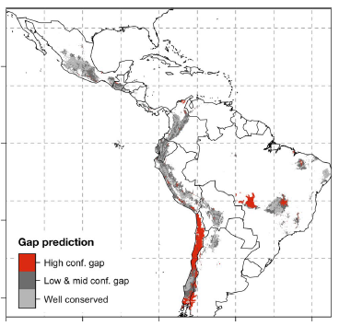
Differences between gap analysis methodologies
CWR =
Needs all records!
Landraces =
Andean genepool
(Beans)
Only based on coords

Slide 51
The workflow for a gap analysis

Slide 52
A
B

Germplasm
Other coordinates
Collected germplasm area
Species occurrences
Realized niche
Potential area to be collected
C
D
Sampled germplasm
Where to collect

Slide 53
Questions?

