Slide 1
Introduction to R
November 5, 2025
Alliance Bioversity International & CIAT

Slide 2


What is R?
It is an object-oriented programming language, focused on computation or statistical processing.
It is free and open source.
It integrates a wide variety of graphical and statistical techniques.
It is a very understandable programming language.

Slide 3
Why to use R
It is a tool that allows us to automate many processes
It is easy to understand and use
It has a large community of developers worldwide
It is equipped with the most up-to-date statistical analysis techniques
And many more …

Slide 4

RStudio Desktop
It is an IDE or integrated development environment.
It is a program that integrates several functionalities oriented to facilitate the programming of routines.
It has a more developed graphical GUI interface.In most cases they are multiplatform.
By integrating all the tools in one place it makes our life easier.
We can download it from this link:
https://posit.co/downloads/

Slide 5
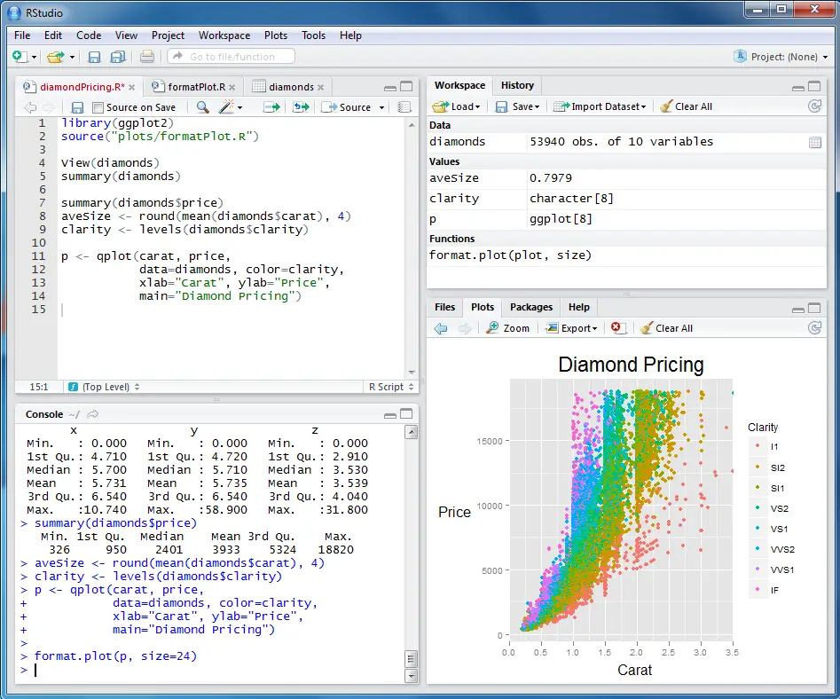
RStudio (GUI)
1
3
Script editor
Console/Terminal
Workspace
Graph viewer, library and help page
4
2

Slide 6
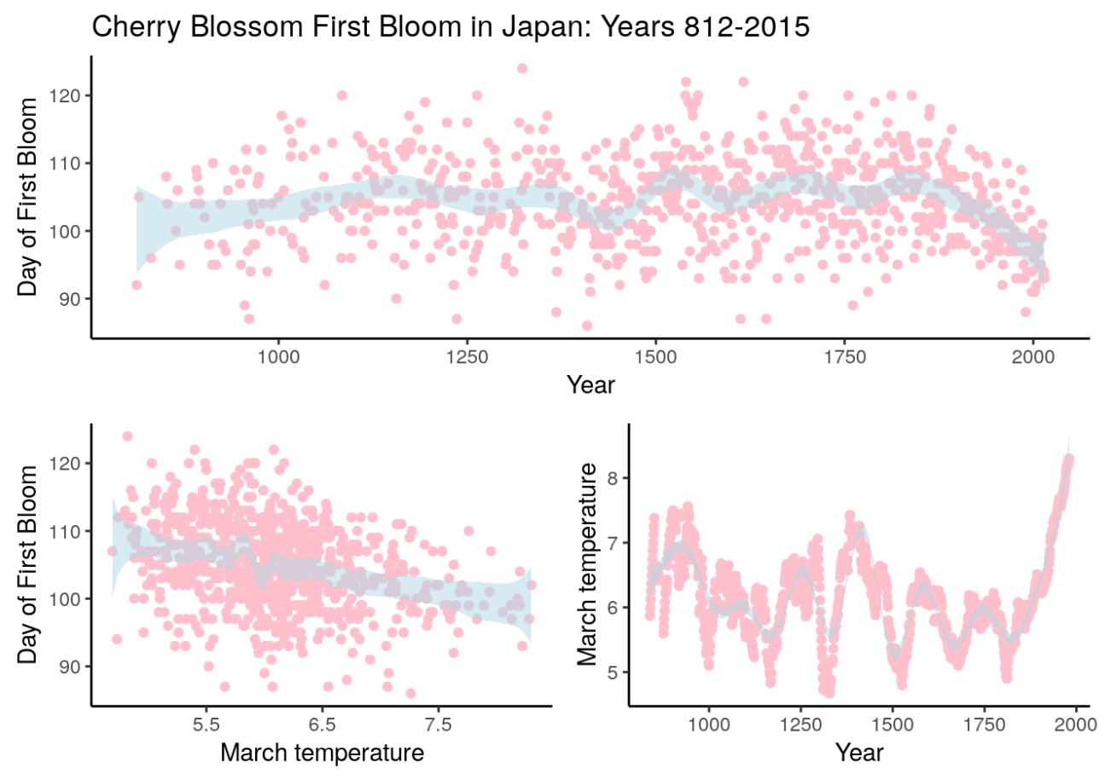
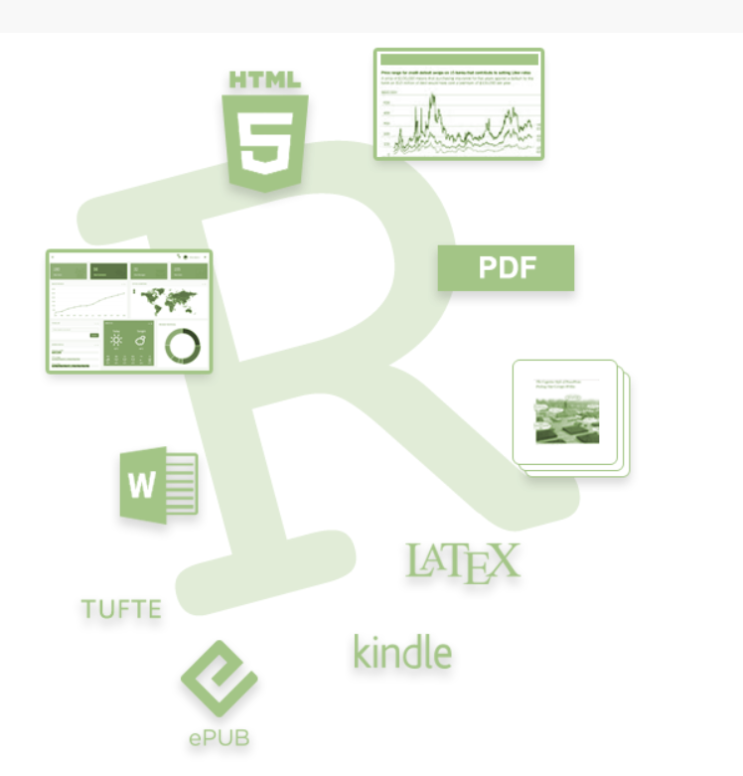
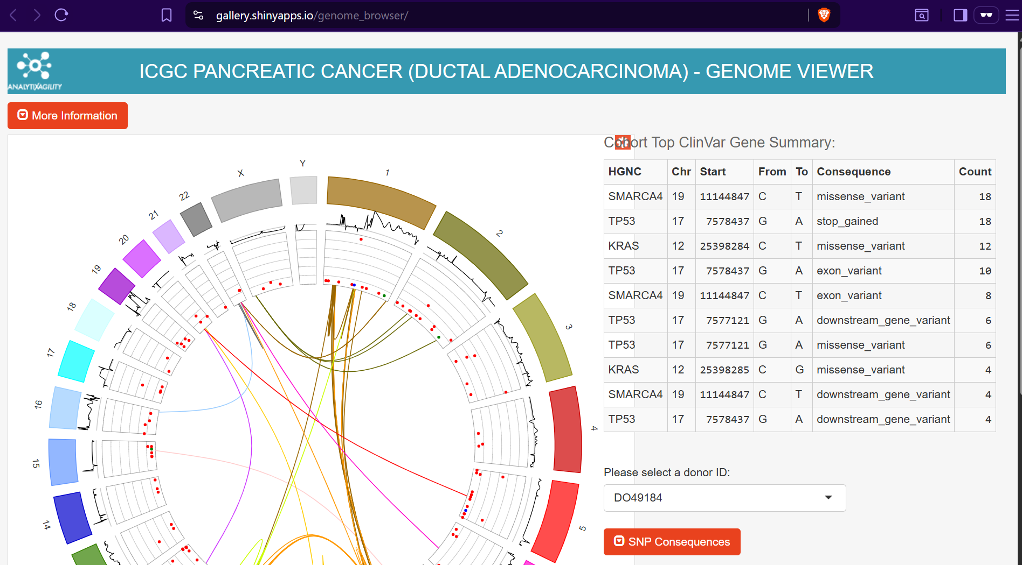

Slide 7
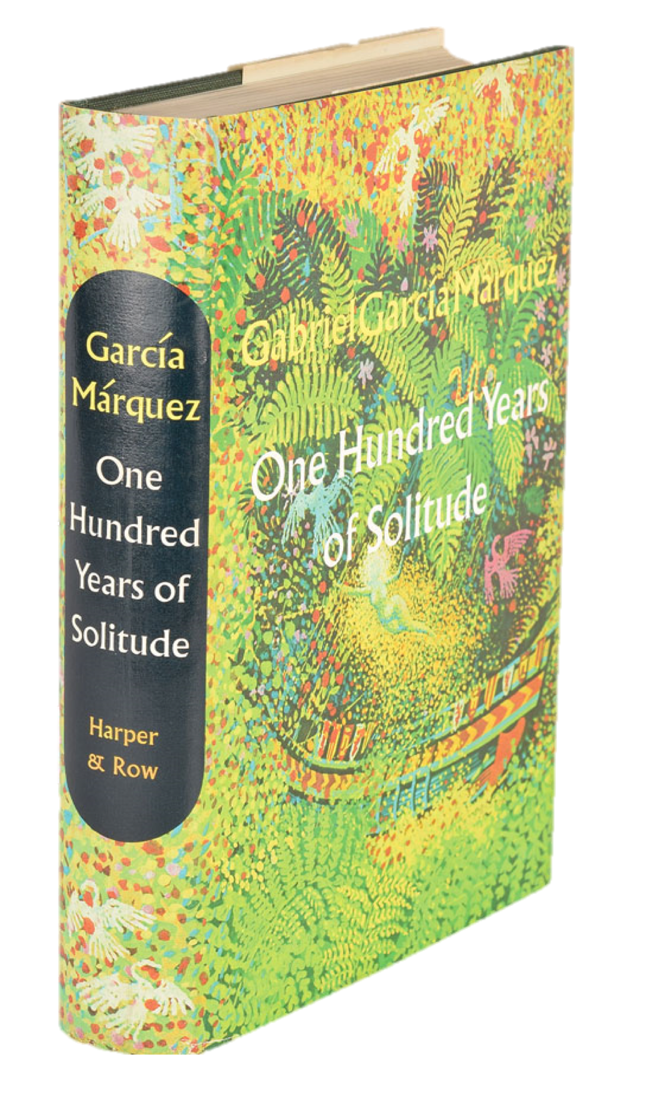
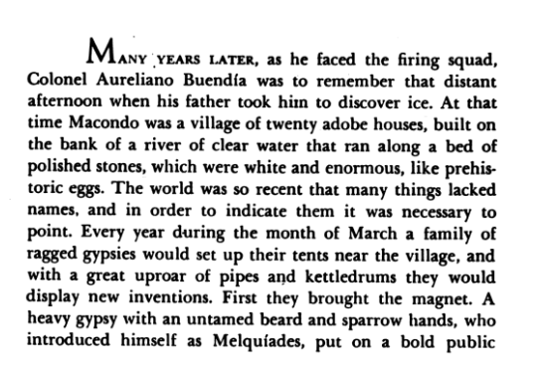

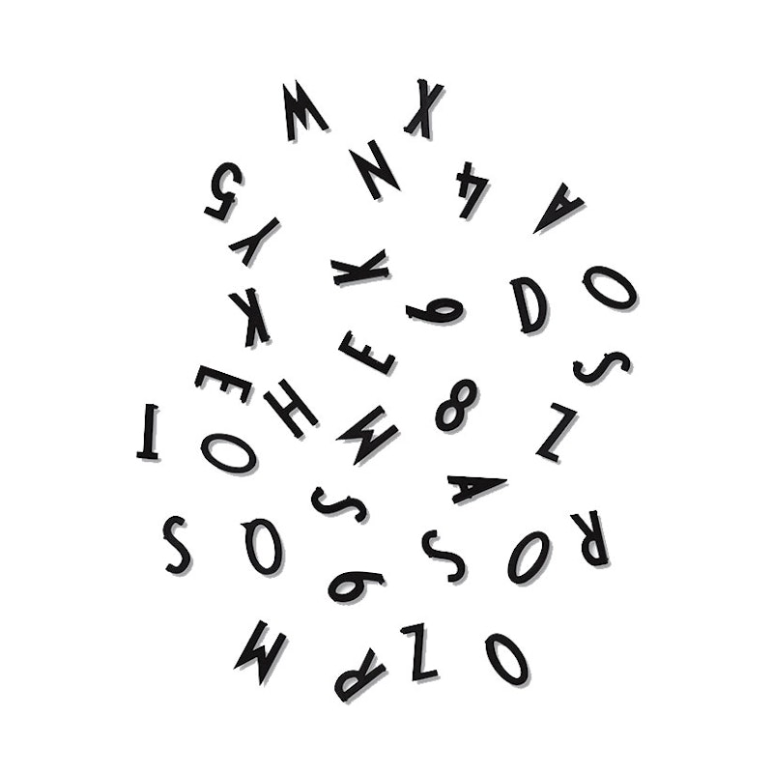
Book
Paragraph
Words
Letters

Slide 8

Basic concepts

Slide 9
What is an object/variable?
In object-oriented programming, an object is an empty container that the programmer can fill with whatever they decide.
These containers are often referred to as "variables" in R due to the common use of the term in statistics.
Variables are composed of values that have different types, such as text, numeric, logical, integer, and others.
Variable names cannot contain spaces, special characters, or numbers at the beginning.
var_name <- value
Assignment symbol

Slide 10
Types of values in R
Logical: TRUE, FALSE
Integers: 1, 2, 3, 4, ...
Real Numbers: 1.342, 3.45565, 0.0879985
Character/Text: “string,” “text”
Missing Values: NA
Non-calculable values: NaN
Very large/small values: Inf, -Inf
Null values: NULL
How can you identify the type of values in a variable?
R provides tools for determining the types of values:
is(variable) and class(variable). These commands display the value type on the screen.

Slide 12
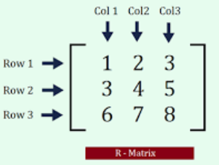
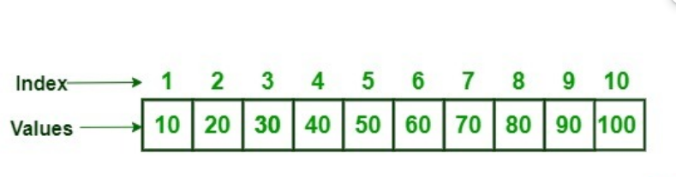
Vectors and matrices – Basic data structures
Vectors:
In programming, objects often consist of multiple ordered and indexed values.
These are referred to as “vectors" in R and are fundamental to the programming process.
Often, variables are composed of vectors.
Matrices:
A collection of elements (numbers) arranged in rows and columns.
Every row and column is considered a vector.
Matrices must have a fixed number of rows and columns.

Slide 13
Indexing
All objects/variables in R have a way to access their elements.
Vectors: Elements are ordered sequentially, starting from position 1.
Access syntax: Variable[position].
Matrices: Access elements by specifying the row and column indices.
Matrix[row number, column number] – extracts a single cell value.
Matrix[row number, ] – extracts the entire row.
Matrix[, column number] – extracts the entire column.

Slide 15
Exercise
Create a vector containing the first ten letters of the alphabet.
Assign it to the variable “vec_exercise”.
Obtain the letters in positions 3, 7, and 9, then print them in the console.
Obtain the first five letters.
Obtain the last five letters.
Reverse the order of the “vec_exercise”.

Slide 16
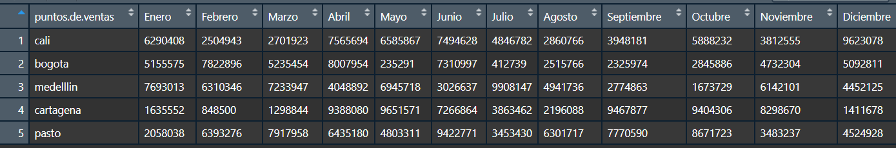
Data frames
They are like matrices.
They are organized into rows and columns.
You can name both rows and columns.
They allow all types of values and do not affect each other.
This is the most used format.
All of its elements are easily accessible.

Slide 18
Filter by row
Filters are always necessary when managing and processing databases.
R provides several methods for filtering vectors, matrices, and data frames.
vector[ logical condition ]
data.frame[ logical condition , ]

Slide 20
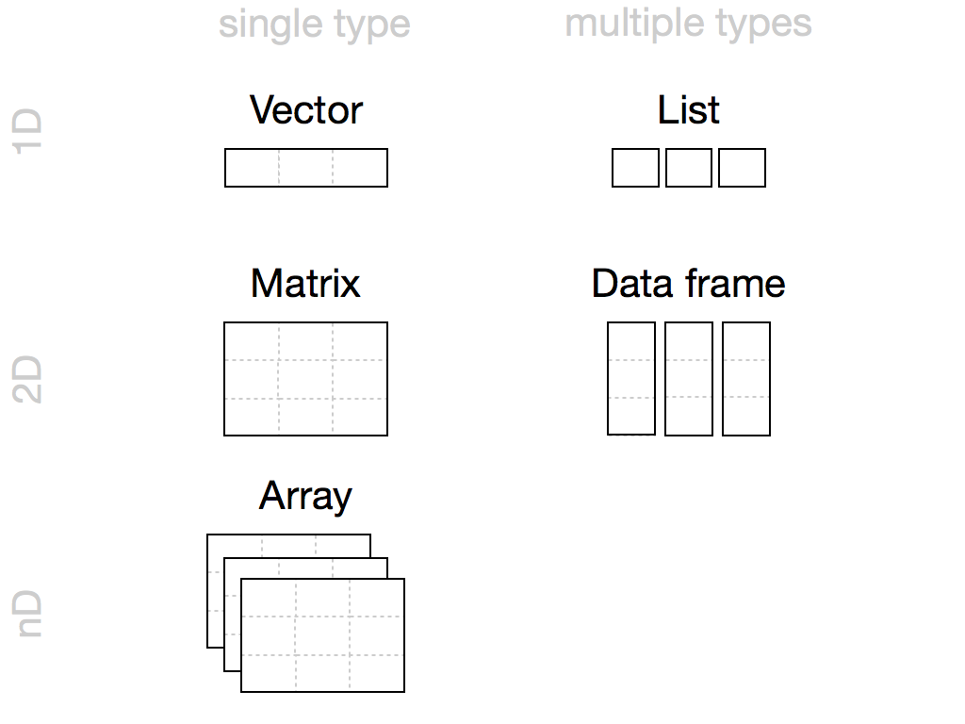

Slide 21
Algorithmic thinking
A set of systematic operations performed to solve a type of problem.
Algorithmic thinking involves abstraction, modeling the problem, logical deduction, synthesizing a solution, and writing the correct algorithm.
Process
Input
Output

Slide 22
Exercise
Scenario:
The first monthly sales totals for four stores in the listed cities for 2024 are provided. Calculate each store's total sales for the quarter.
Identify the inputs.
Define the desired outcome.
Establish steps to process inputs and convert them into the desired outcomes.
 | Month
Sales points | January | February | March
Cali | 3643 | 4652 | 2145
Bogotá | 2011 | 4345 | 4708
Medellín | 2820 | 1995 | 3273
Cartagena | 4487 | 3574 | 4832

Slide 23
Solution
 | Month
Sales points | January | February | March | Total
Cali | 3643 | 4652 | 2145 | 10440
Bogotá | 2011 | 4345 | 4708 | 11064
Medellín | 2820 | 1995 | 3273 | 8088
Cartagena | 4487 | 3574 | 4832 | 12893
Inputs:
Table showing monthly sales totals.
The rows contain records of sales points in cities.
The columns contain monthly sales data.
Processing:
Sum the rows and enter the total in the last column.
Outputs:
Table showing the sum of monthly sales (quarter total) for each sales point.
What if I am interested in total sales per year?

Slide 24

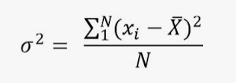
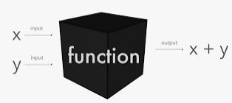
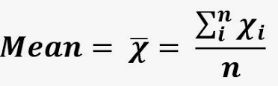
Functions

Slide 25
What is a function?
A function is a type of object.
It is the foundation of all programming in R.
A function is defined as a set of processes or algorithms that perform a specific task or calculation.
Functions require INPUT values, PROCESS them, and must return an OUTPUT.
Process
Input
Output

Slide 26
How are functions defined in R?
Functions have a specific structure:
A name must be assigned to the function.
Input values must be specified. These values can be of any type or structure that we have seen before, such as data frames, vectors, or matrices.
The function should perform an operation based on the input values.
Finally, it must return at least one object, which can be of any type.

Slide 28
Function | Description
mean() | Calculates the arithmetic mean of a numeric vector.
sum() | It returns the sum of all the elements in a vector or array.
length() | It returns the number of elements in a vector or list.
head() | Displays the first few rows of a data frame or the initial elements of a vector.
tail() | Displays the last few rows of a data frame or the final elements of a vector.
seq() | Generates a sequence of numbers based on a specified start number, end number, and step size.
sort() | It sorts a vector in ascending or descending order.
paste() | Concatenates strings using a specified separator.
which() | It identifies the indices of the elements in a vector that meet a given condition.
table() | It creates a frequency table of the elements in a vector or factor.

Slide 29
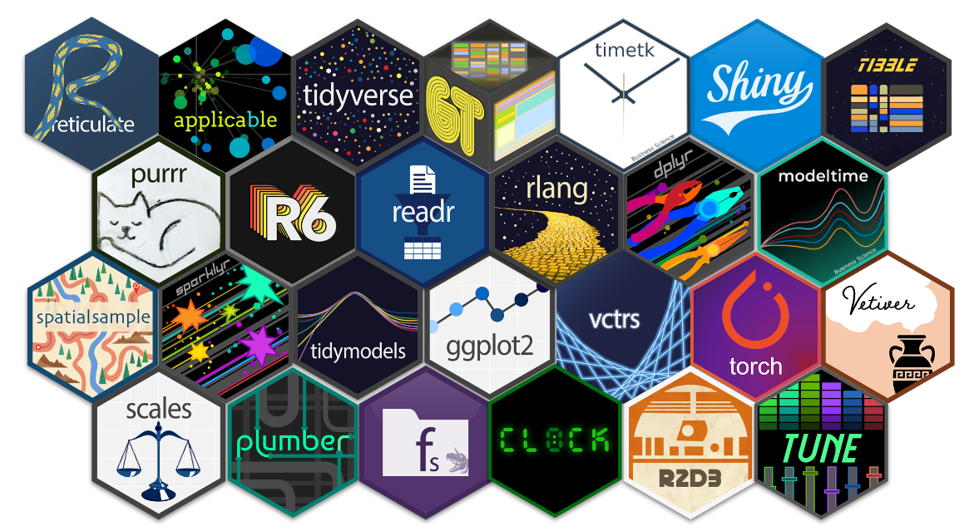
R libraries

Slide 30
What is a library?
In R, packages or libraries are sets of functions designed to solve a variety of problems, primarily statistical ones.
R comes with a series of installed packages called "base“, which contain basic statistical processing functions.
R provides the ability to install new packages when our operations or processes require more specialized functions that are not included in the "base" package.
Each package includes helpful documentation explaining the contents, functions, and other details.
R offers a massive catalog of packages thanks to the large community dedicated to developing new ones.
Essentially, there is a package designed for almost any task we can think of or need to perform. You just need to know how to find it.

Slide 31
How are packages installed in R?
install.packages(“package_name”)
This command downloads the package from the CRAN repository.
This command should only be called once.
The package will be installed, but it has not been called yet.
library(package_name)
This function loads the package functions into the R session.
It's good practice to load the libraries at the beginning of the script only.
or simply:
library(pacman); pacman::p_load(package_name)
Unquoted

Slide 32
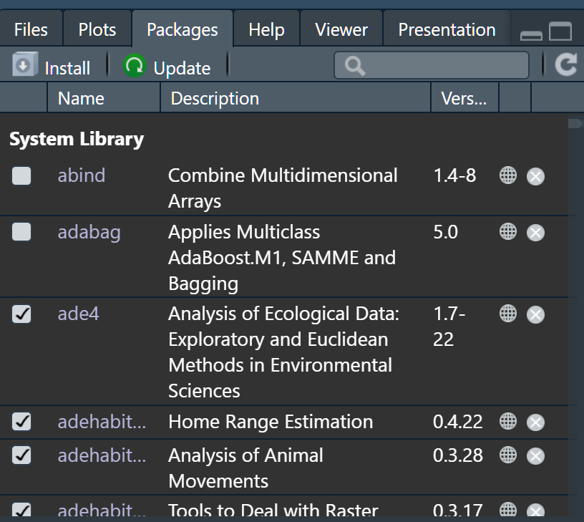
You can check which packages are installed and loaded into the R session.

Slide 33
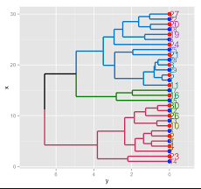
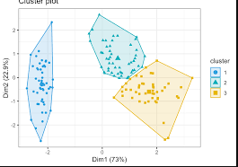
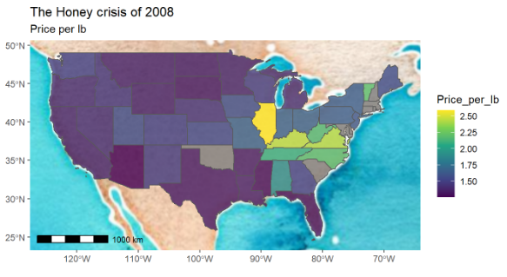
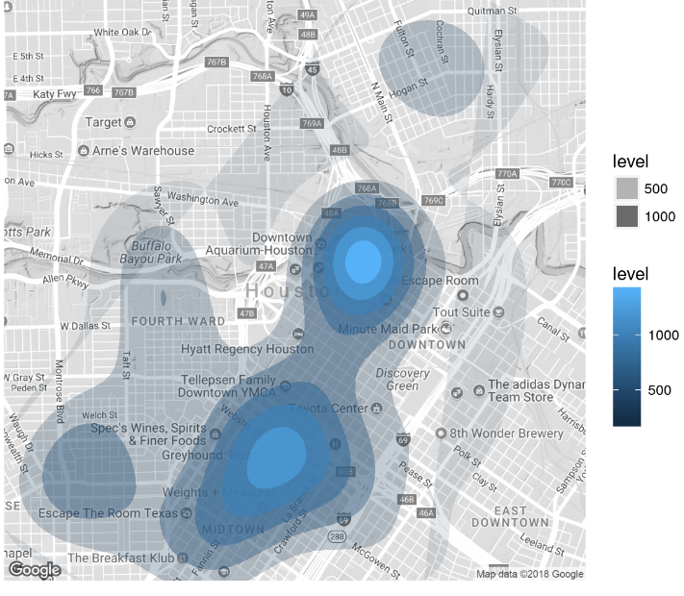

Slide 34
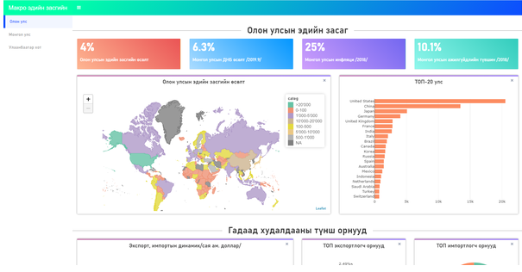
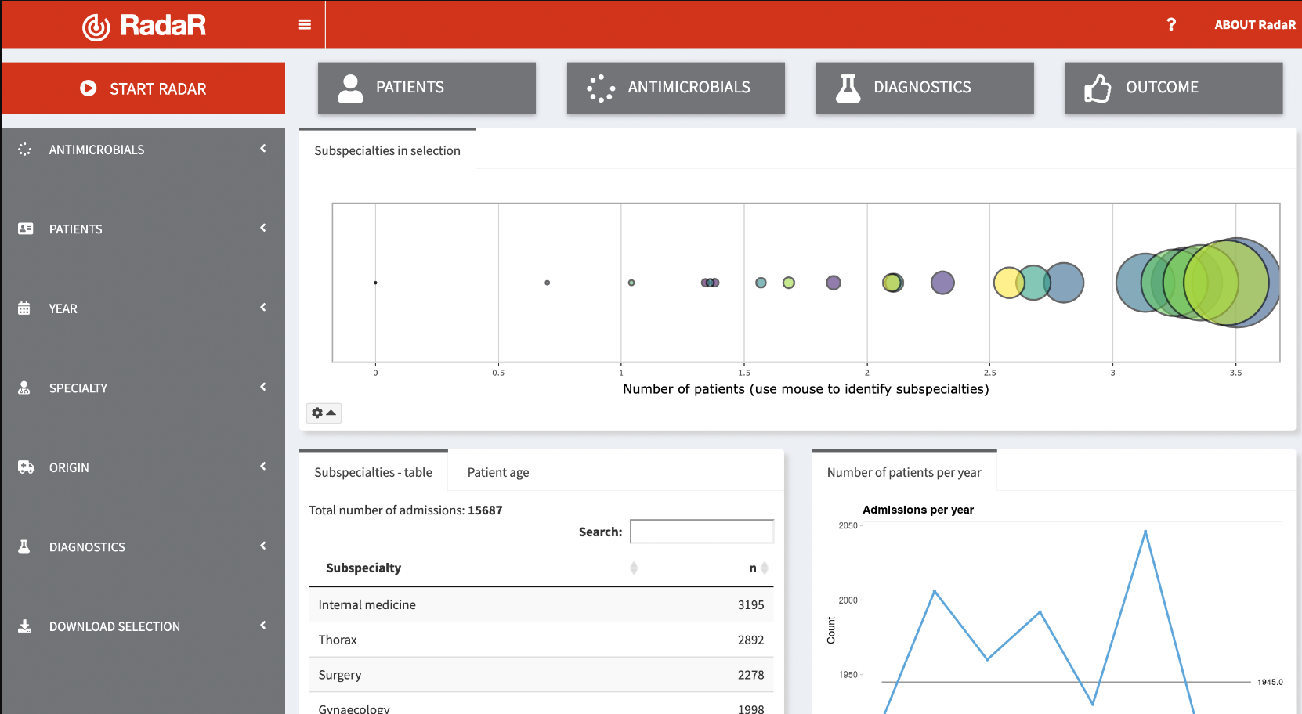


Slide 35
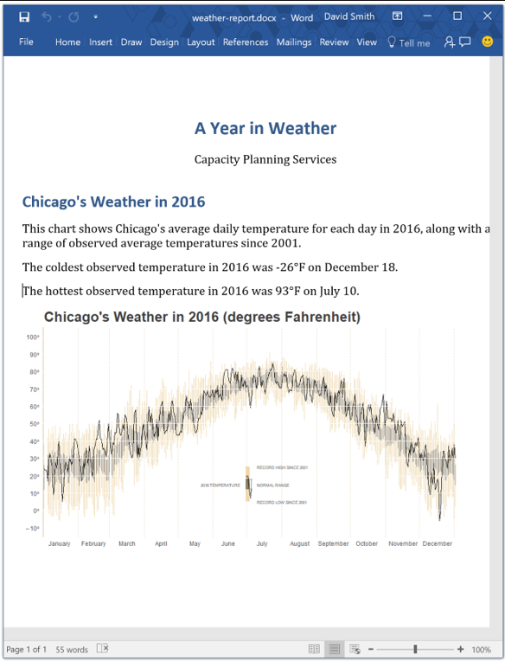


Slide 36
Questions?

