Slide 1
Some algorithms use, ensembles in SDMs and examples

Slide 2
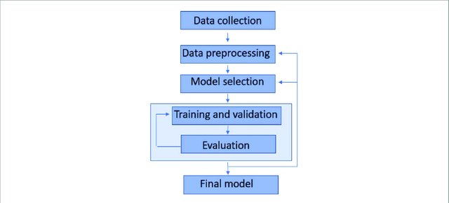
How a model workflow looks like?
https://iopscience.iop.org/article/10.1088/2633-1357/ab805d

Slide 3
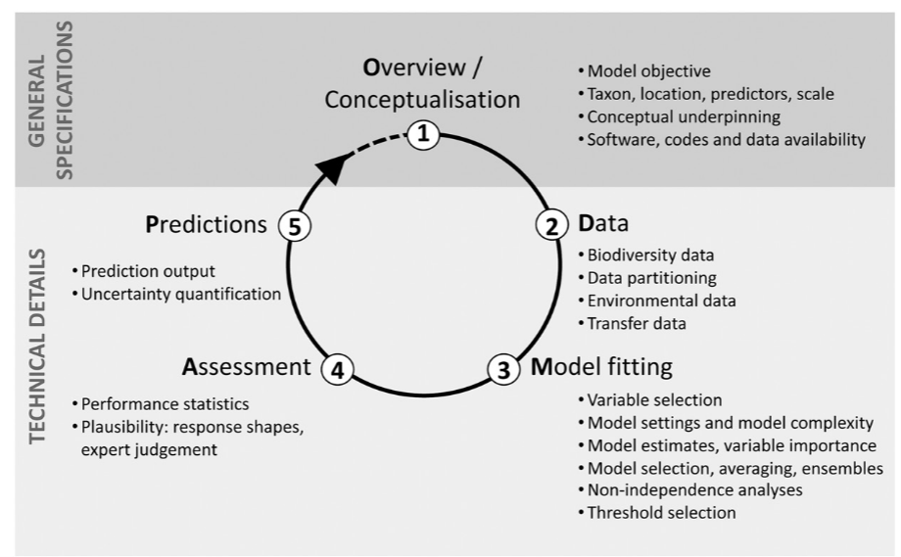
The recipe for a species distribution model (ODMAP)
Zurell et al., 2020

Slide 4
Why just use one model?
Exercise

Slide 5
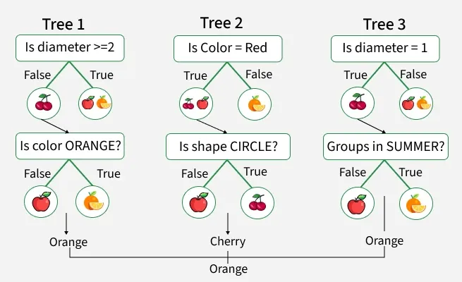
Random forest
https://www.geeksforgeeks.org/r-language/random-forest-approach-in-r-programming/

Slide 6
GLM
A probability distribution for the response variable
A linear predictor function of the predictor variables
A link function that connects the linear predictor to the response variable's mean.
Families: Logistic, binomial, etc…

Slide 7
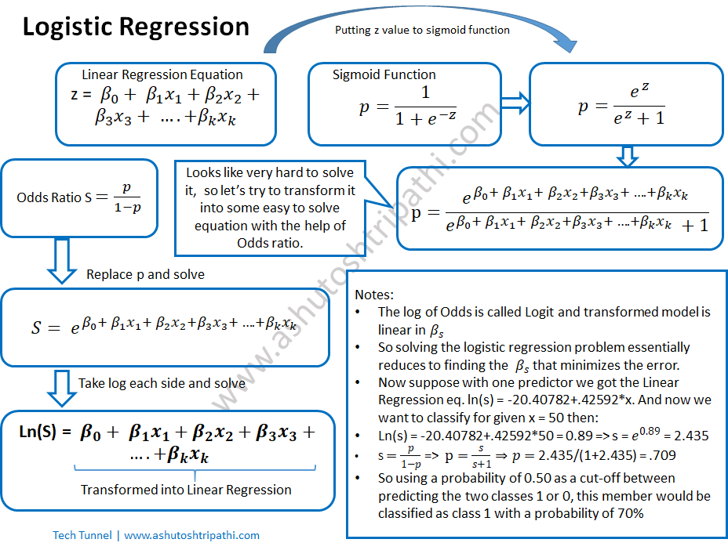
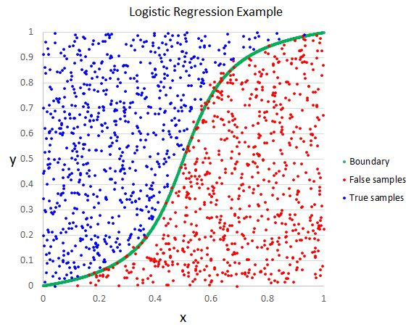
https://ashutoshtripathi.com/2019/06/17/logistic-regression-with-an-example-in-r/
https://machine-learning.paperspace.com/wiki/logistic-regression

Slide 8
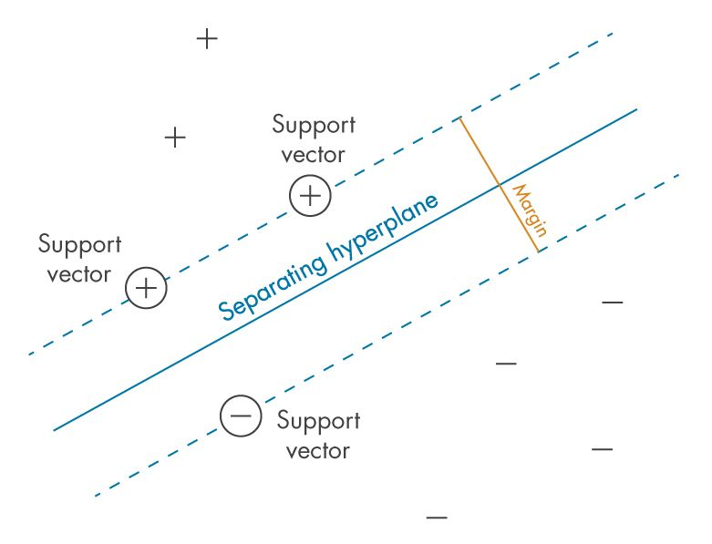
SVM
https://la.mathworks.com/discovery/support-vector-machine.html
https://la.mathworks.com/discovery/support-vector-machine.html

Slide 9
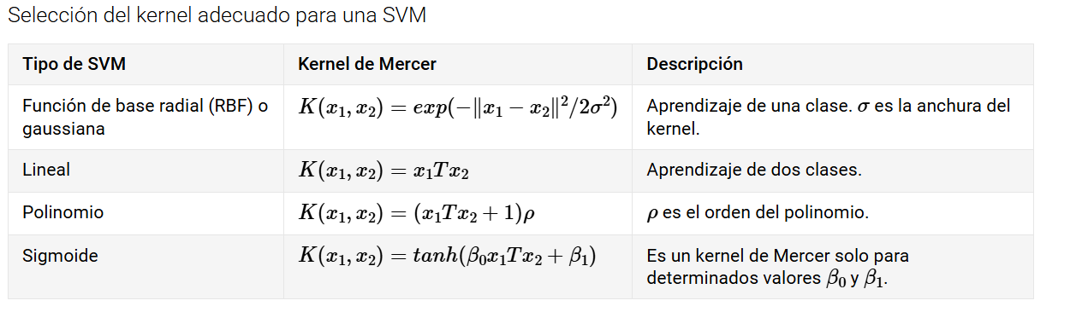

Slide 10
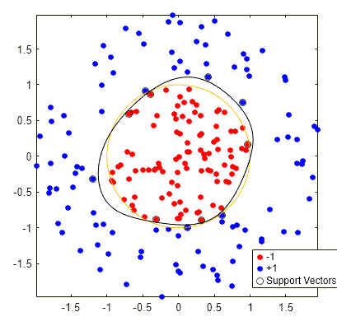

Slide 11
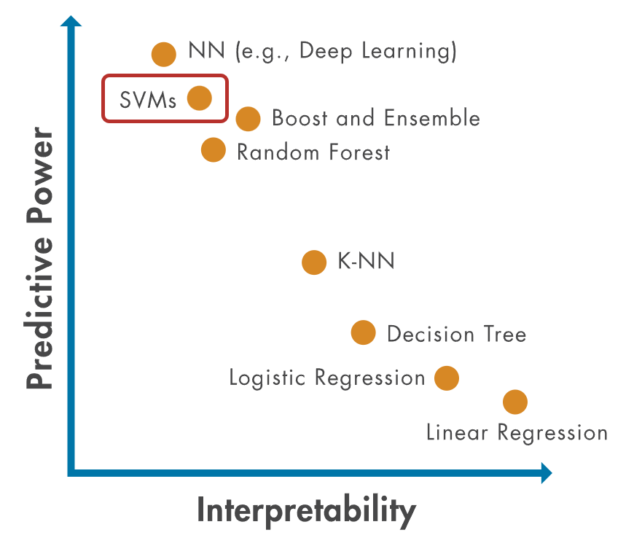
https://la.mathworks.com/discovery/support-vector-machine.html

Slide 12
Why to think in ensemble models?
Exercise

Slide 13
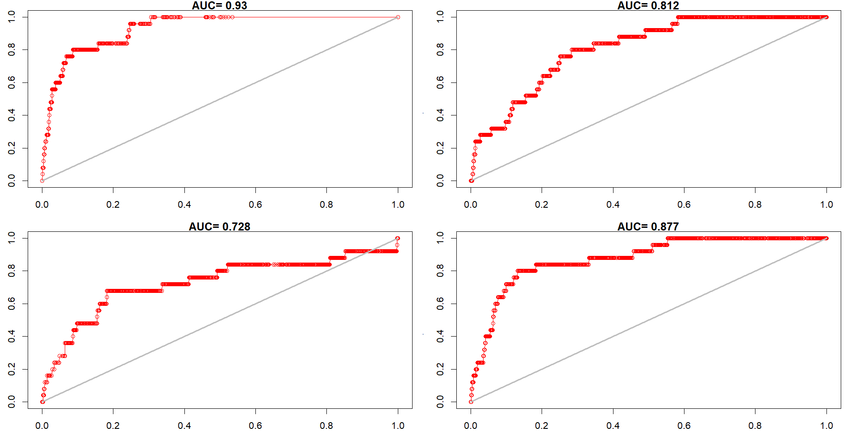

Slide 14
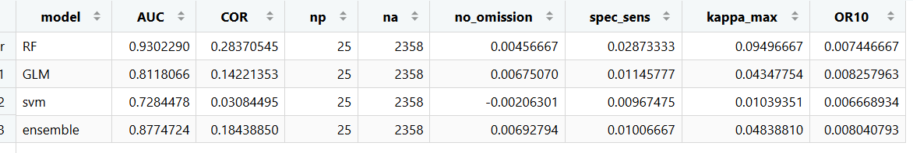
Ejercicio: Bactris gasipaes

Slide 15
Why to think in ensemble models?
Exercise

Slide 16
Ensembles

Slide 17
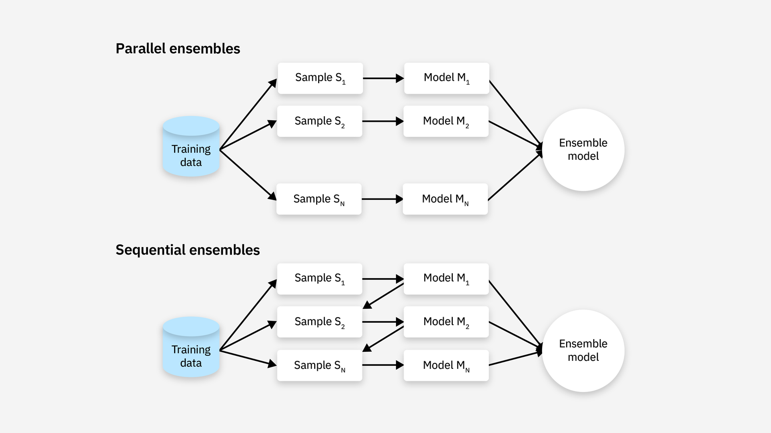
Ensemble types

Slide 18
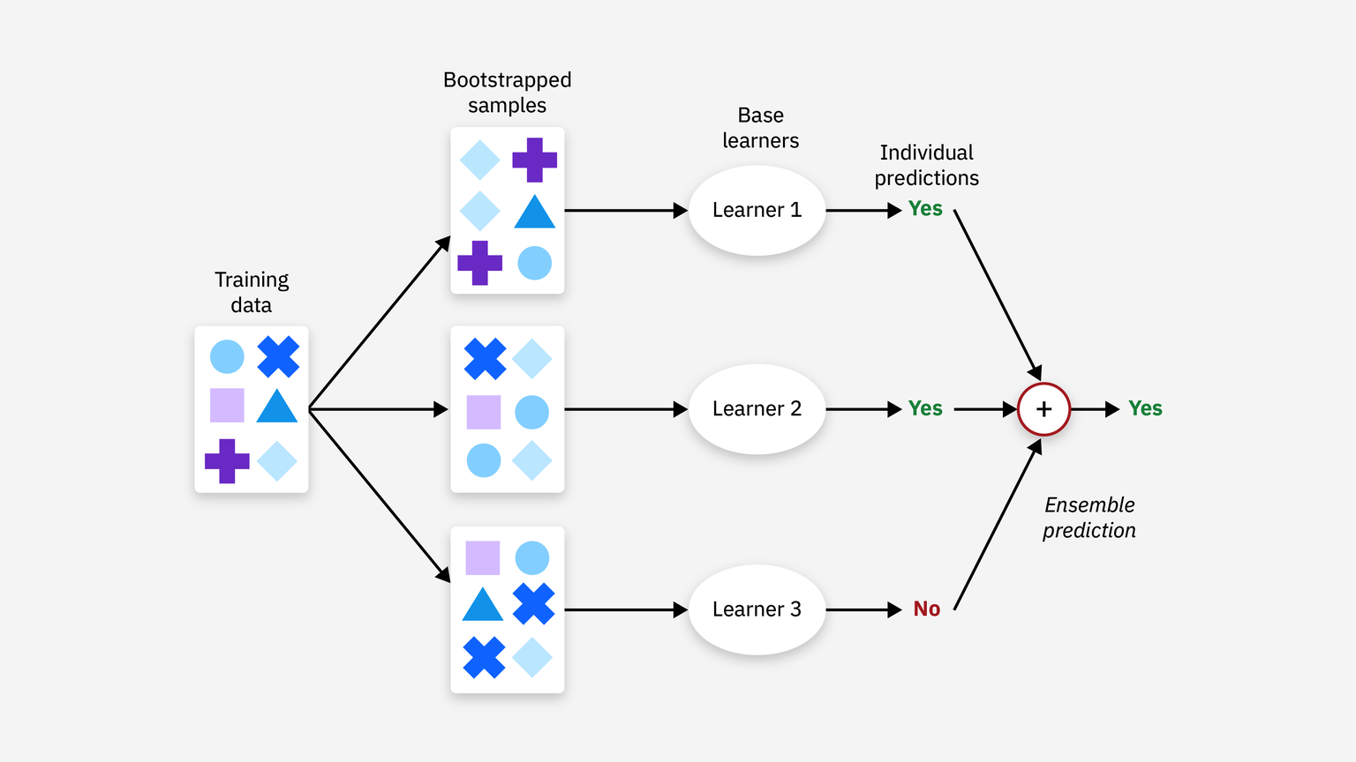
Bagging
Models trained independently
Random subsets of training data
Voting or averaging
https://www.geeksforgeeks.org/machine-learning/a-comprehensive-guide-to-ensemble-learning/
https://www.ibm.com/think/topics/ensemble-learning

Slide 19
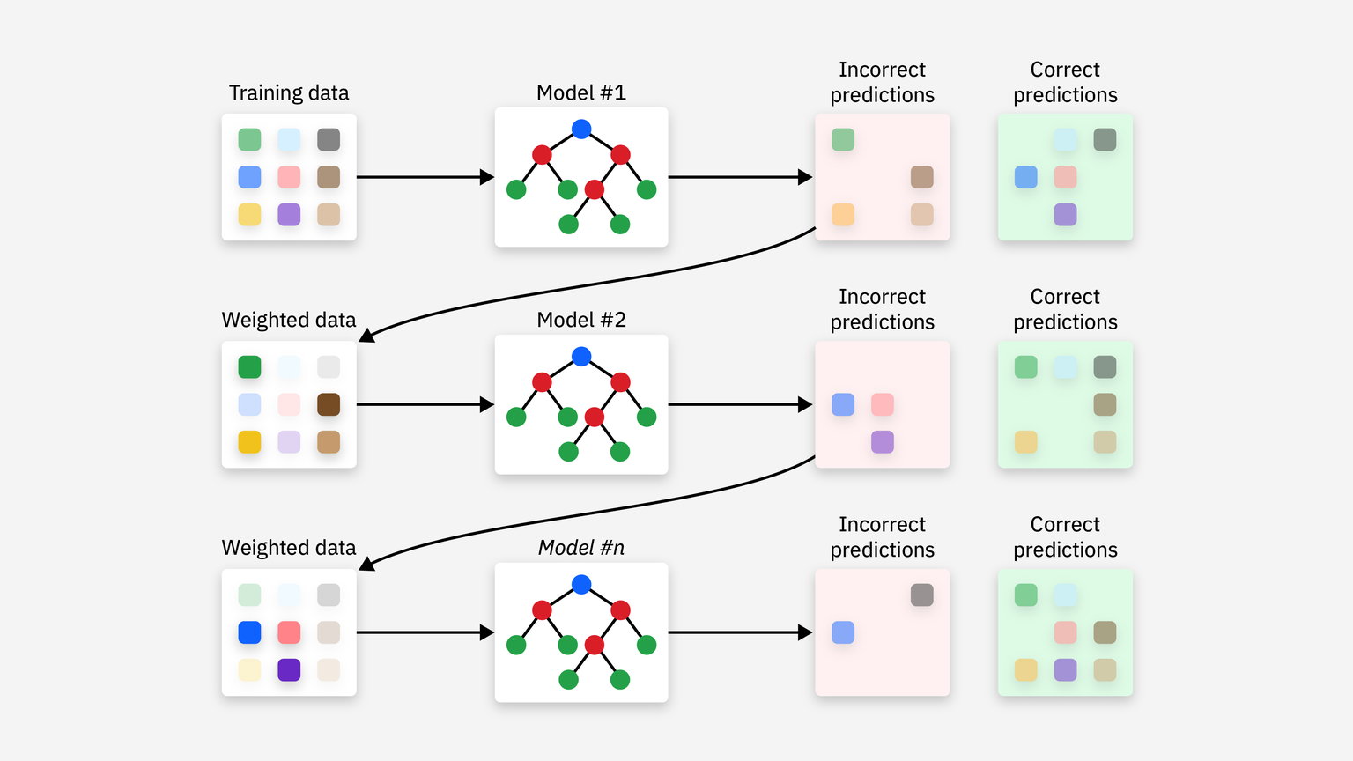
Boosting
Models trained one after another
Fixing errors
Weighted combination of all models
https://www.geeksforgeeks.org/machine-learning/a-comprehensive-guide-to-ensemble-learning/
https://www.ibm.com/think/topics/ensemble-learning

Slide 20
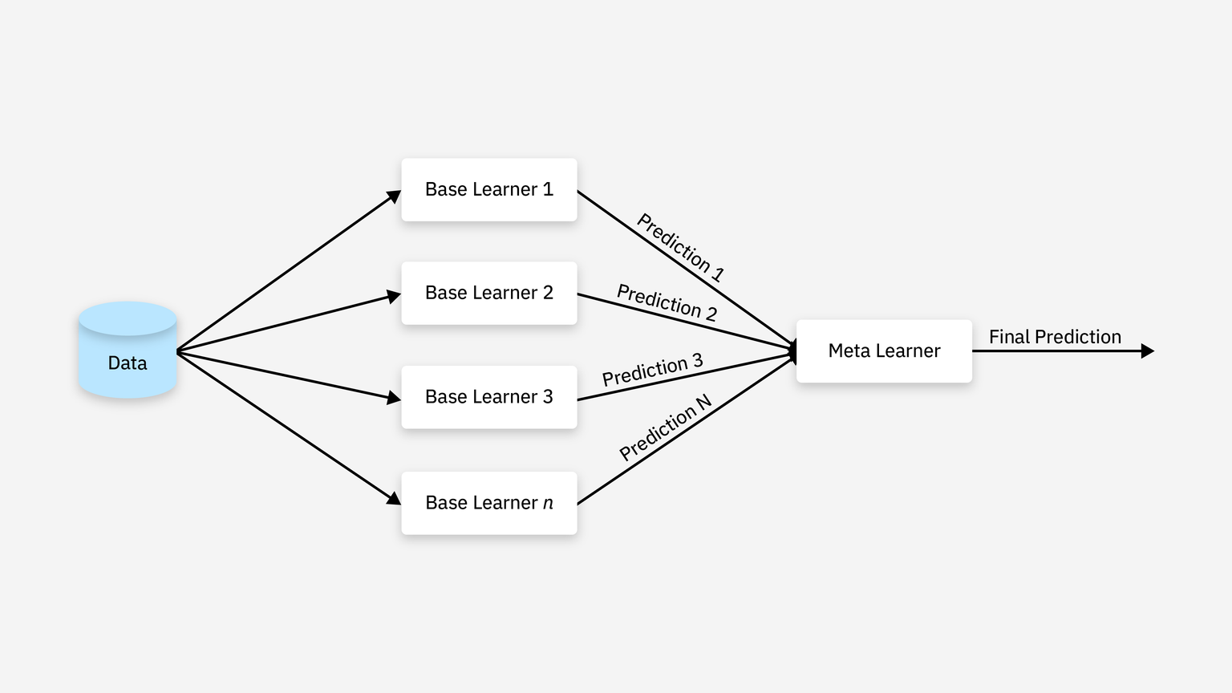
Stacking
Multiple different models are inputs
Task: create a meta learner(final model)
https://www.geeksforgeeks.org/machine-learning/a-comprehensive-guide-to-ensemble-learning/
https://www.ibm.com/think/topics/ensemble-learning

Slide 21
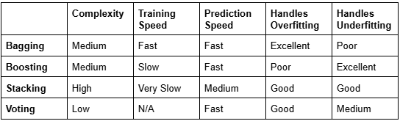
https://medium.com/@duygujones/ensemble-learning-combining-models-for-better-machine-learning-d75d7be66b10

Slide 22
Ejercicio: Bactris gasipaes

Slide 24
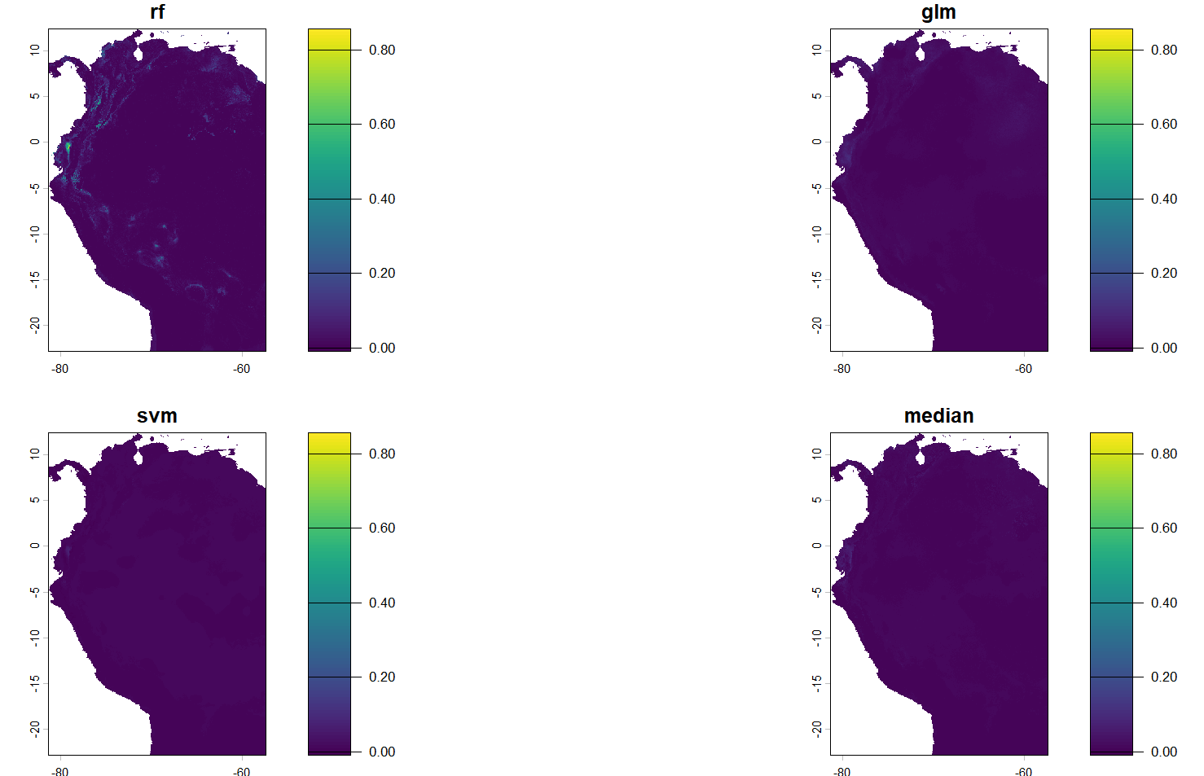
Using median

Slide 25
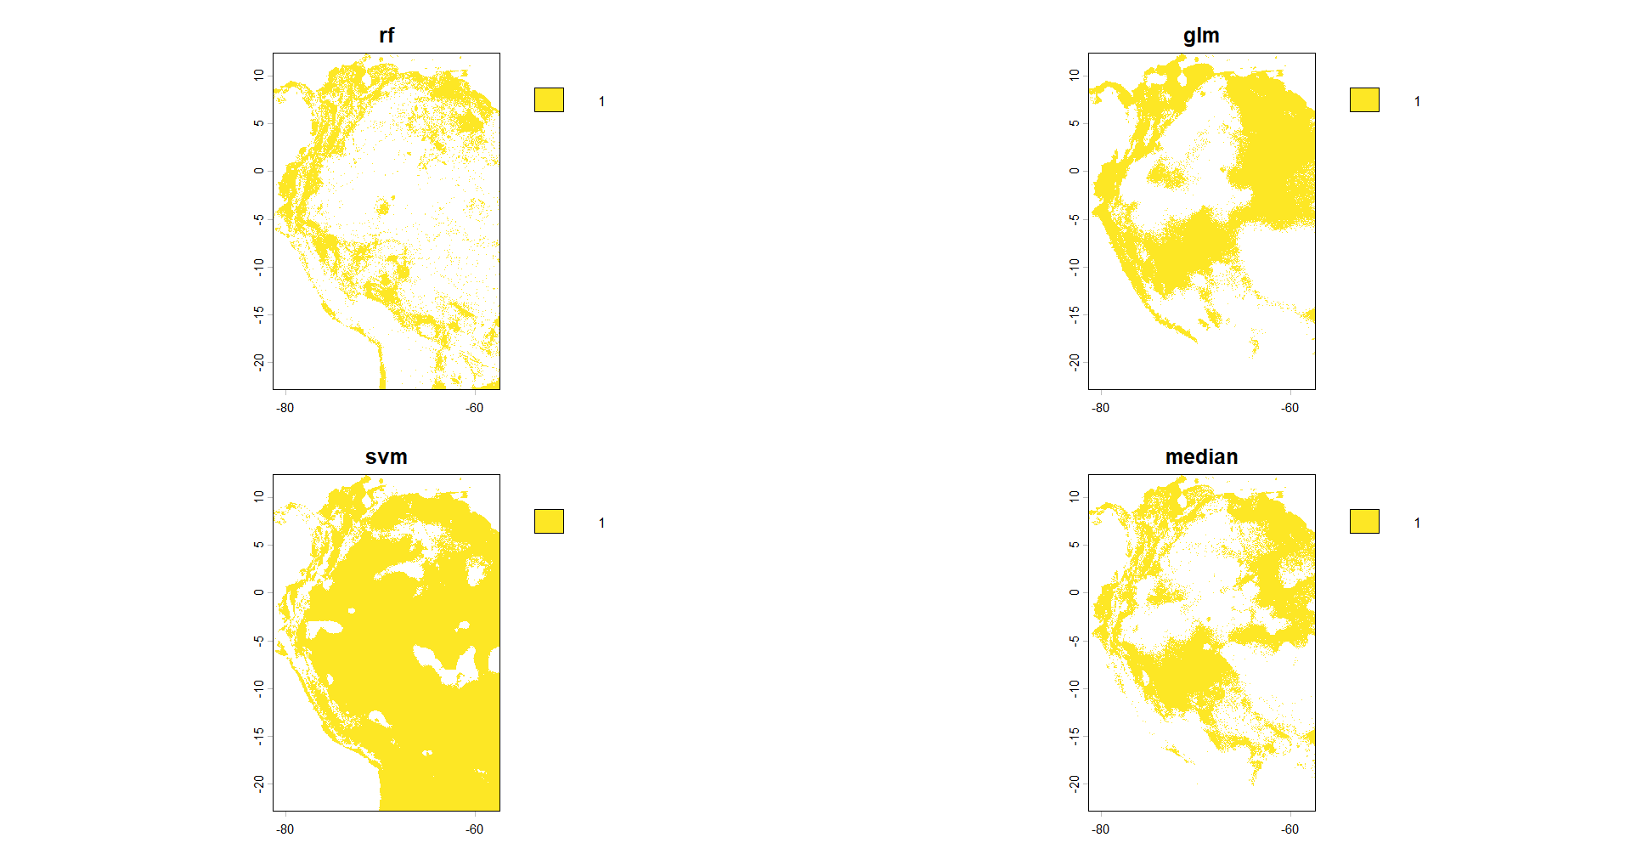
Using thresholds

Slide 26
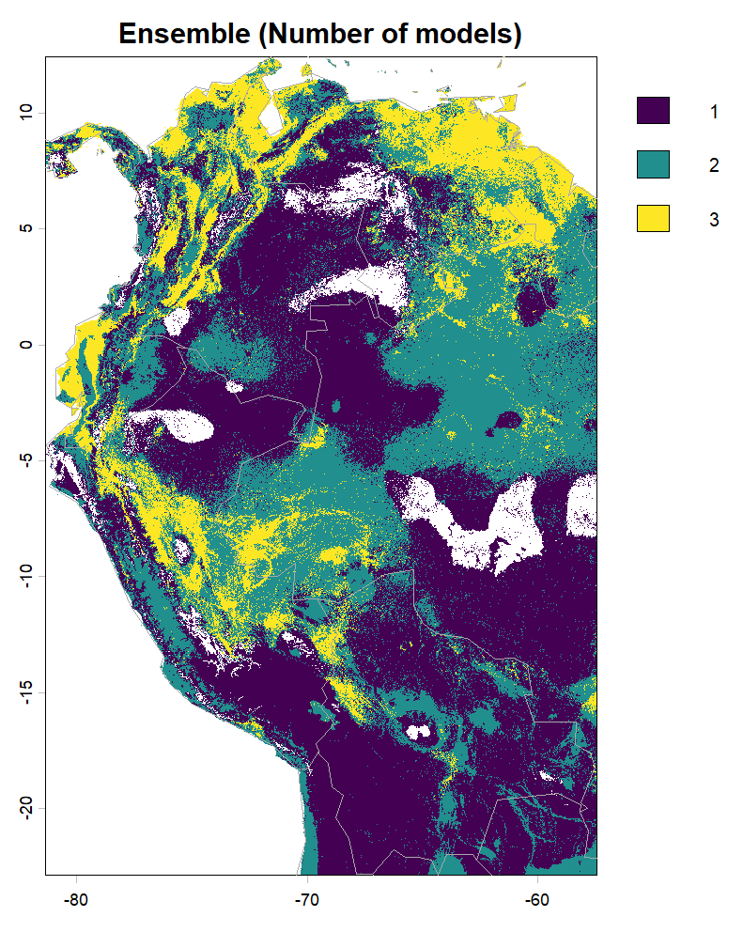
Using sum of thresholded models

Slide 27
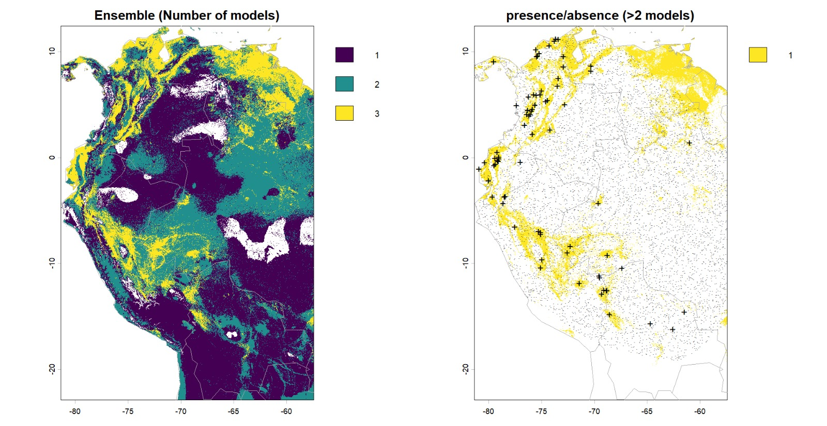
Reclassiflying sum of models to presence (Used in climate change)

Slide 28
Hands on, go to R!

