Slide 1
Species Distribution models
(Theory and examples)
Alliance Bioversity International & CIAT

Slide 2
Before using the gap analysis methodologies (Summary)
Definition of a model
Niche concept
Species distribution models
Inputs curation
Examples using R

Slide 3
The workflow for a gap analysis

Slide 4
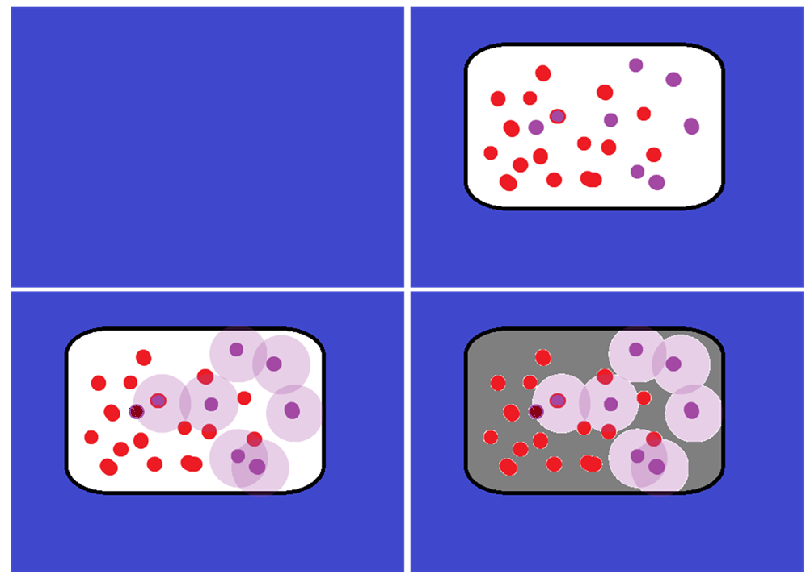




A
B

Germplasm
Other coordinates
Collected germplasm area
Species occurrences
Realized niche
Potential area to be collected
C
D
Sampled germplasm
Where to collect

Slide 6
What is a model?

Slide 7
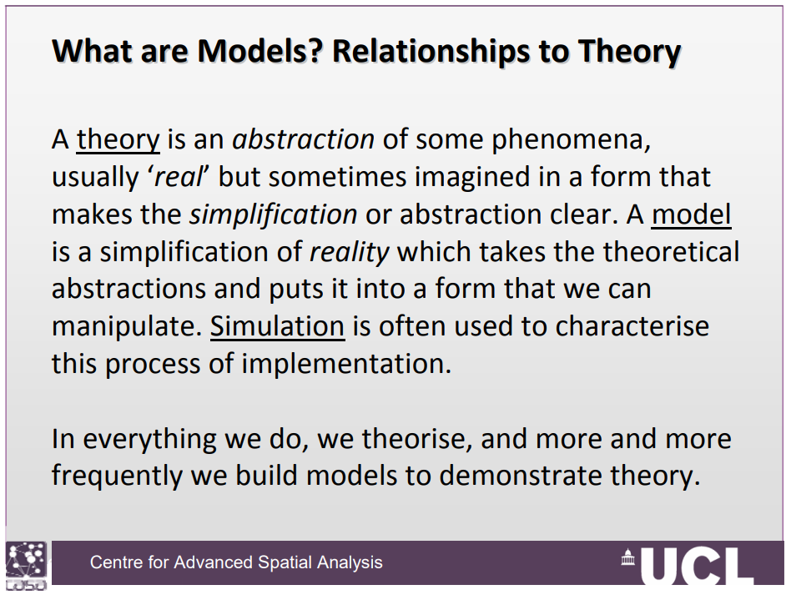

Slide 8
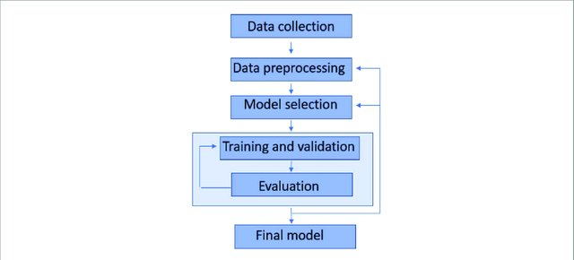
How a model workflow looks like?
https://iopscience.iop.org/article/10.1088/2633-1357/ab805d

Slide 9
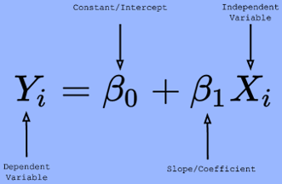
Models can be simple or complex
simple

Slide 10
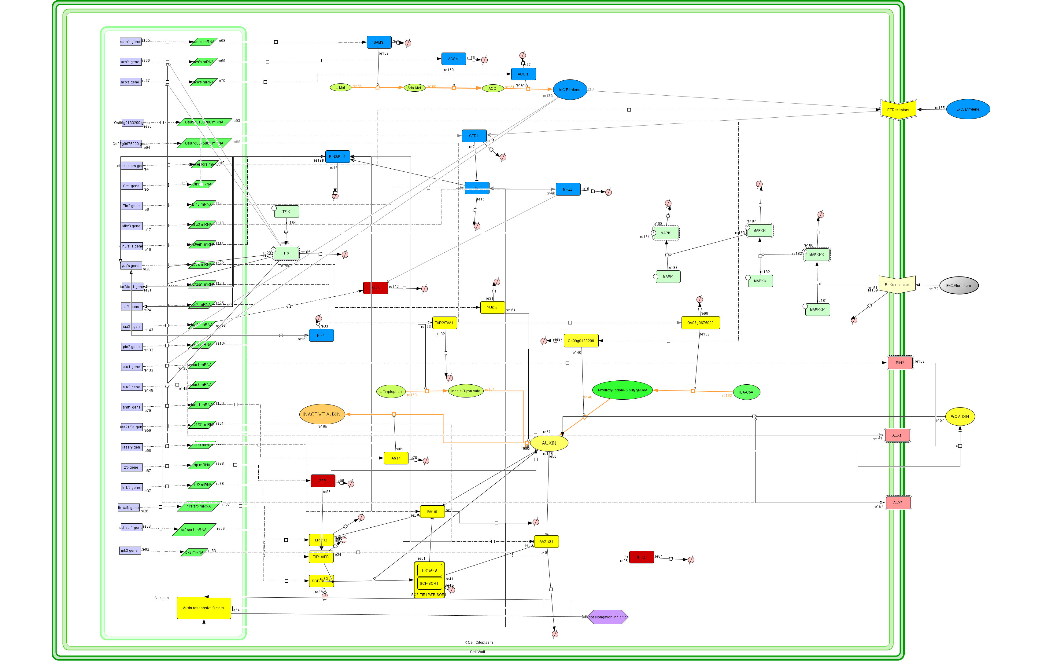
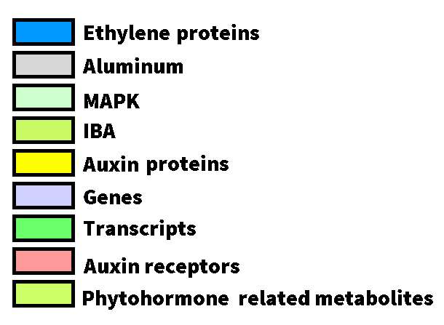
Complex
127 molecules
117 reactions

Slide 11
How can obtain the geographical distribution of a species using environmental data?

Slide 12
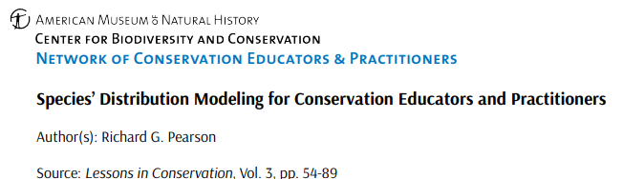
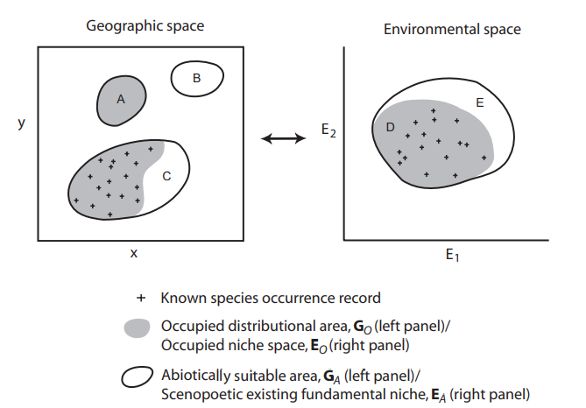
What is a niche?
If the environmental conditions encapsulated within the fundamental niche are plotted in geographical space, then we have the potential distribution
Niche and species distribution are not synonyms!
Hutchinson’s concept of niche: hypervolume of the multidimensional space defined by a set of environmental variables, within which a species can maintain a viable population

Slide 13
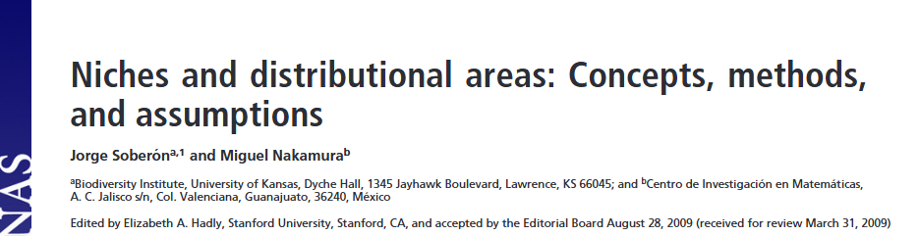
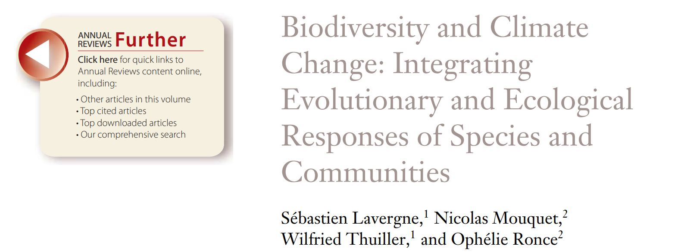
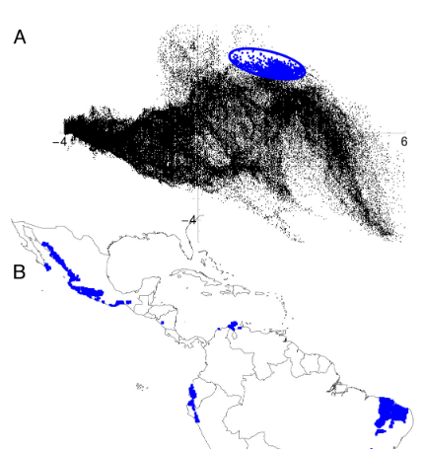
What is a niche?
Hutchinson’s concept of niche: hypervolume of the multidimensional space defined by a set of environmental variables, within which a species can maintain a viable population
Habitat suitability models: statistical models that predict species’ potential distributions by combining known occurrence records with environmental data (so-called niche-based models)
Adaptive potential: the capacity of species or populations to evolve in response to changes in environmental conditions whether biotic or abiotic

Slide 14
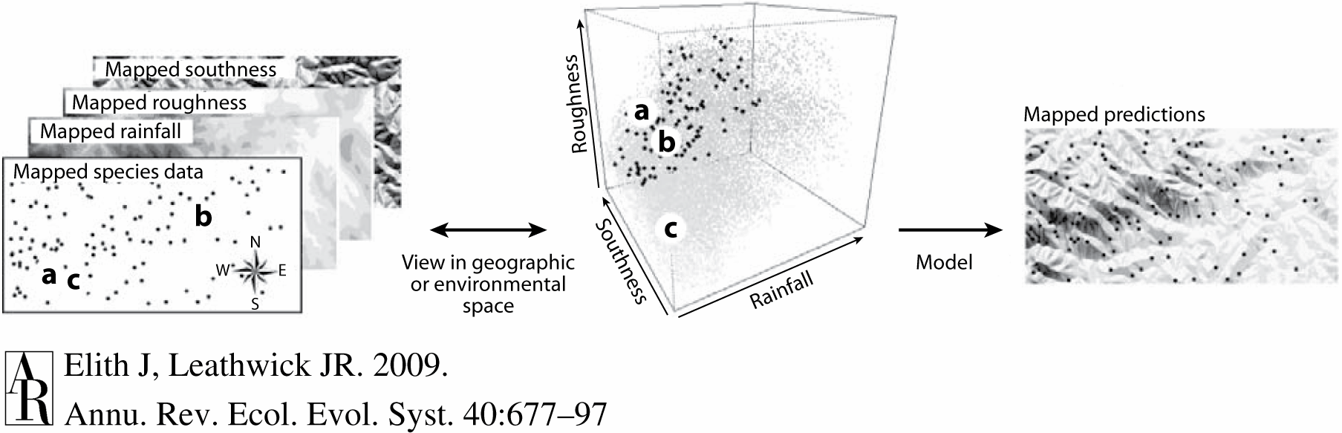
The species distribution model workflow:

Slide 15
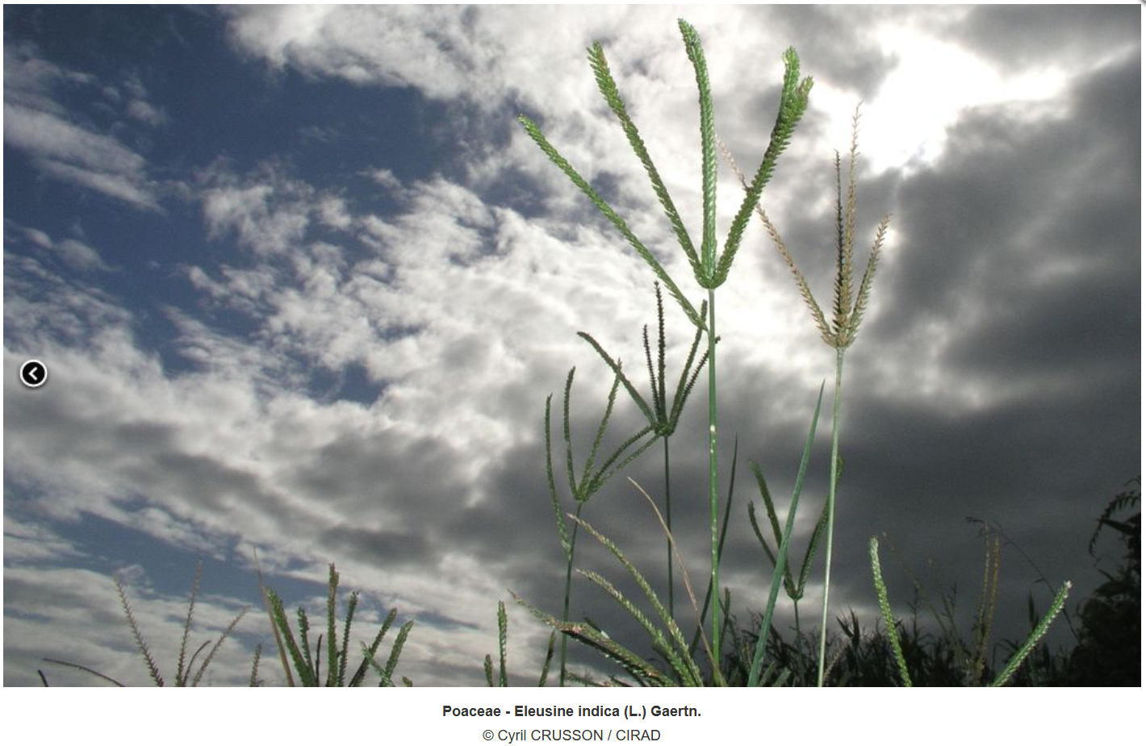
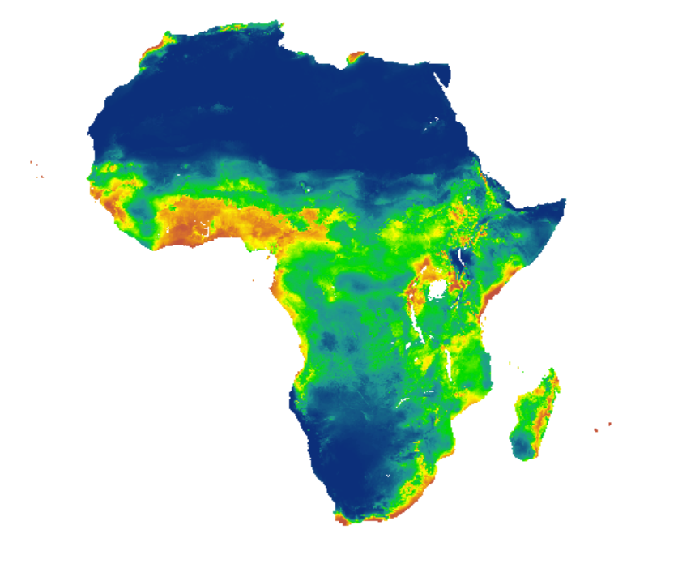
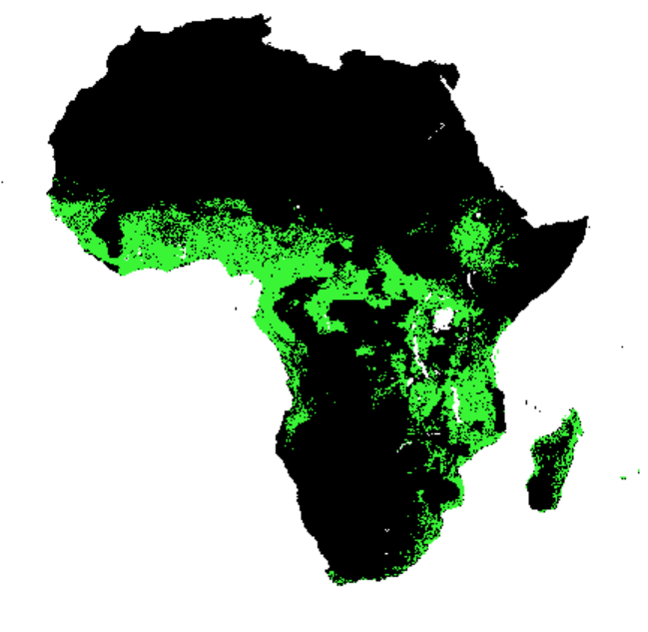
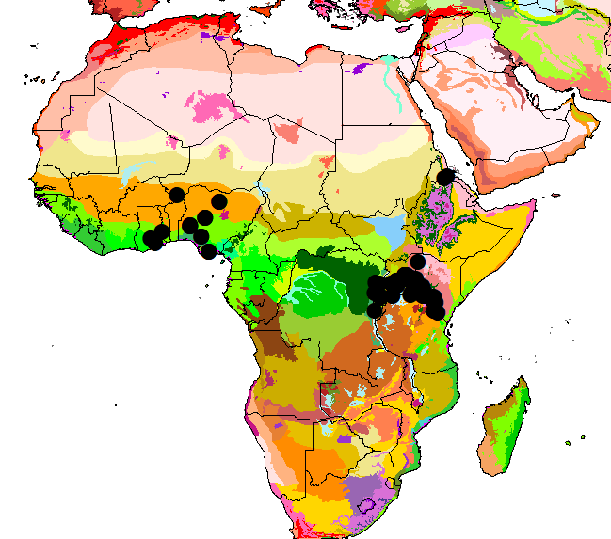
An example using E. indica

Slide 16

What could be a recipe to create an SDM?
https://www.freepik.com/free-photo/top-view-food-ingredients-with-vegetable-soup-bowl-notebook_12253324.htm#fromView=keyword&page=1&position=0&uuid=d2696821-6a07-481e-8172-69b3b091065c&query=Food+recipe

Slide 17
ODMAP!
Overview
Data
Model fitting
Assessment
Predictions
https://www.freepik.com/free-photo/top-view-food-ingredients-with-vegetable-soup-bowl-notebook_12253324.htm#fromView=keyword&page=1&position=0&uuid=d2696821-6a07-481e-8172-69b3b091065c&query=Food+recipe

Slide 18
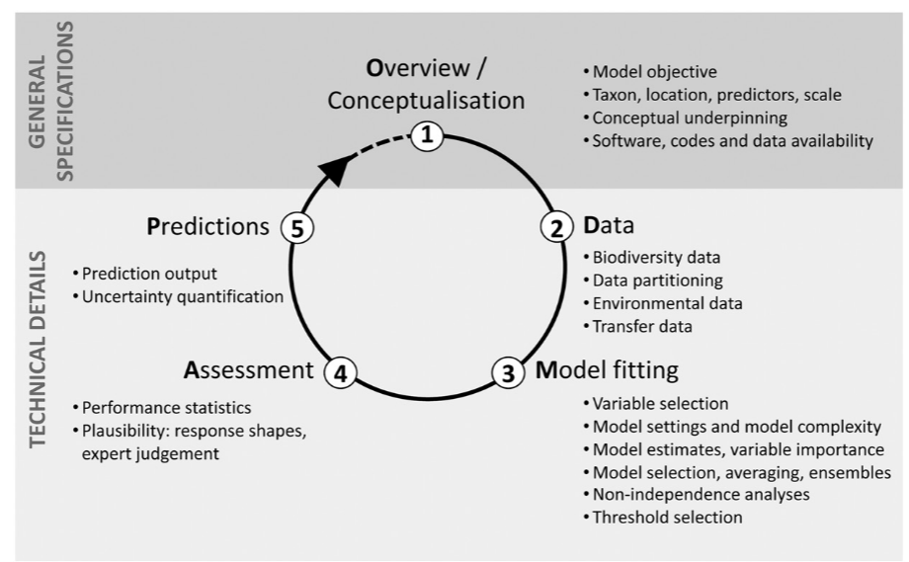
The recipe for a species distribution model (ODMAP)
Zurell et al., 2020

Slide 19
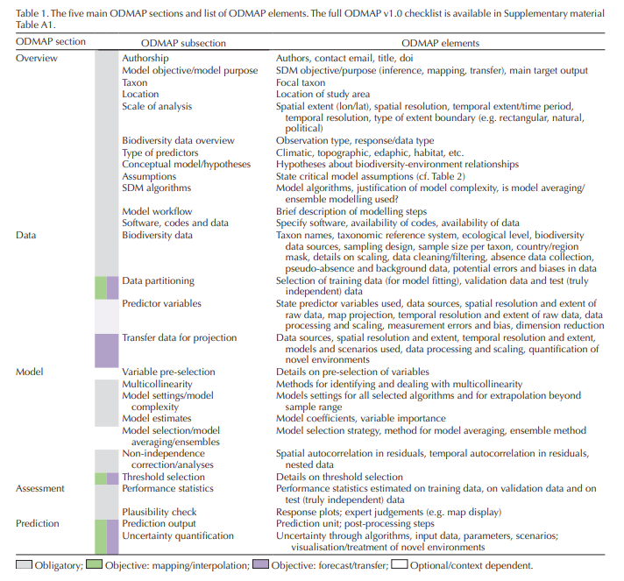
Preprocessing
Zurell et al., 2020

Slide 20
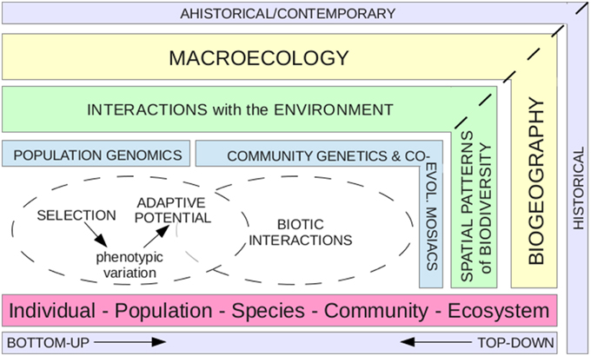
Frontiers | Integrating a Population Genomics Focus into Biogeographic and Macroecological Research

Slide 21
Overview: What is the purpose of make a SDM for gap analysis?

Slide 22
Exercise:
What is the purpose of a SDM for a gap analysis?
What geographical area information should I use?
What geographical extension should I use?

Slide 23
Data (preprocessing)

Slide 24
Basics of data curation
Activity
What respond?
Taxonomic data
Geographical coordinates
Environmental information
The species that I am analyzing have other scientific names or it is even a valid name?
How accurate is the geographical information found for my species?
What environmental information can be used to model the species distribution of the species?

Slide 25

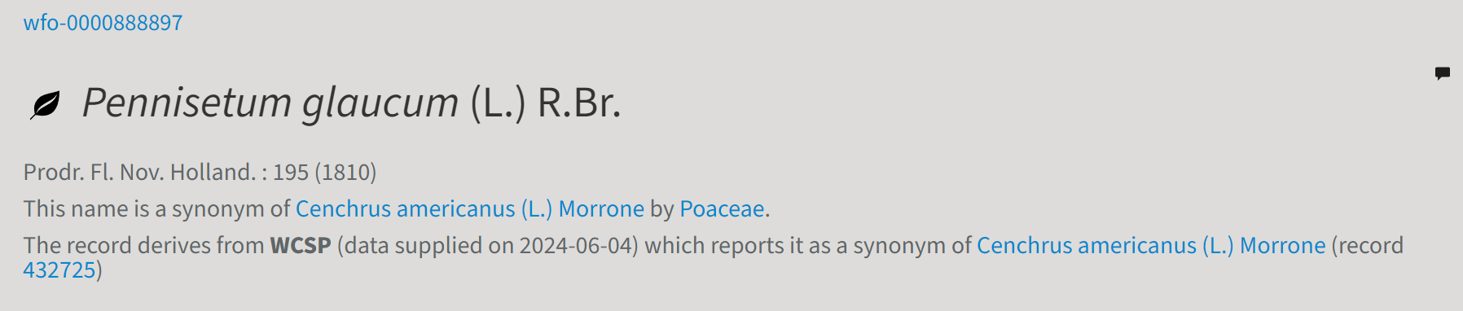
Taxonomic data

Slide 26
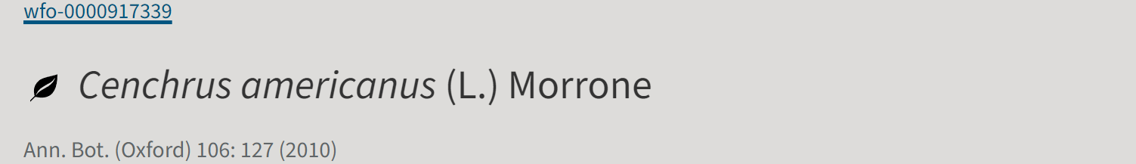
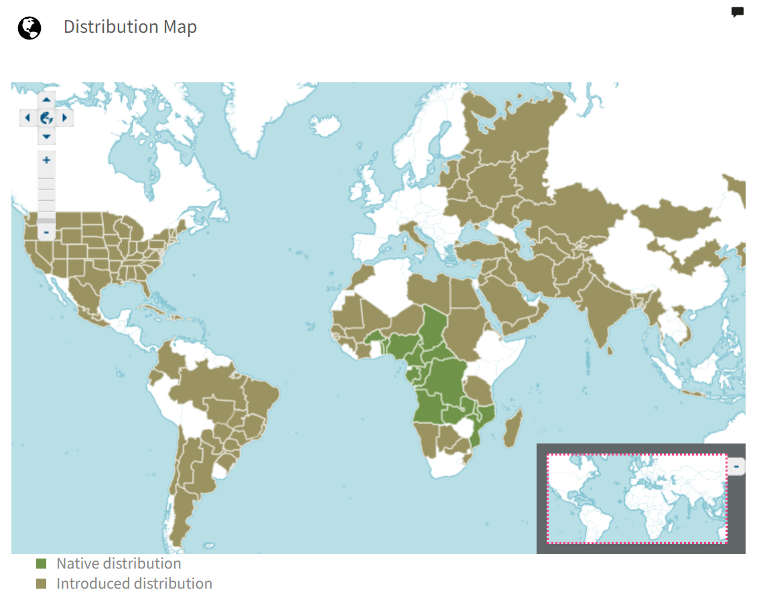

Slide 27
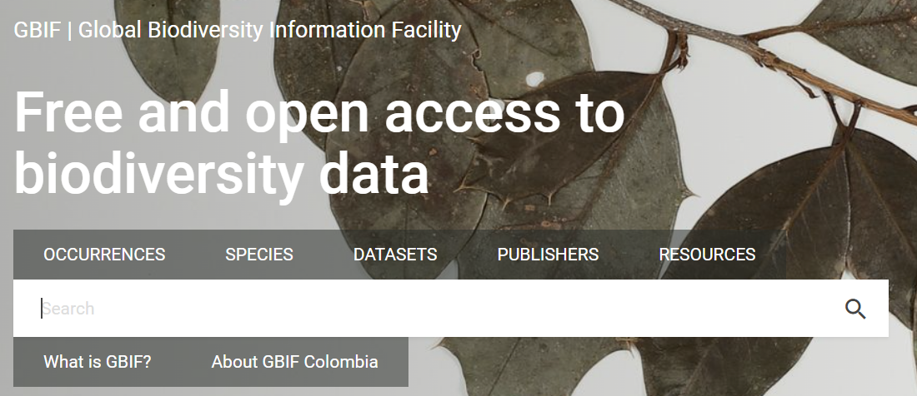
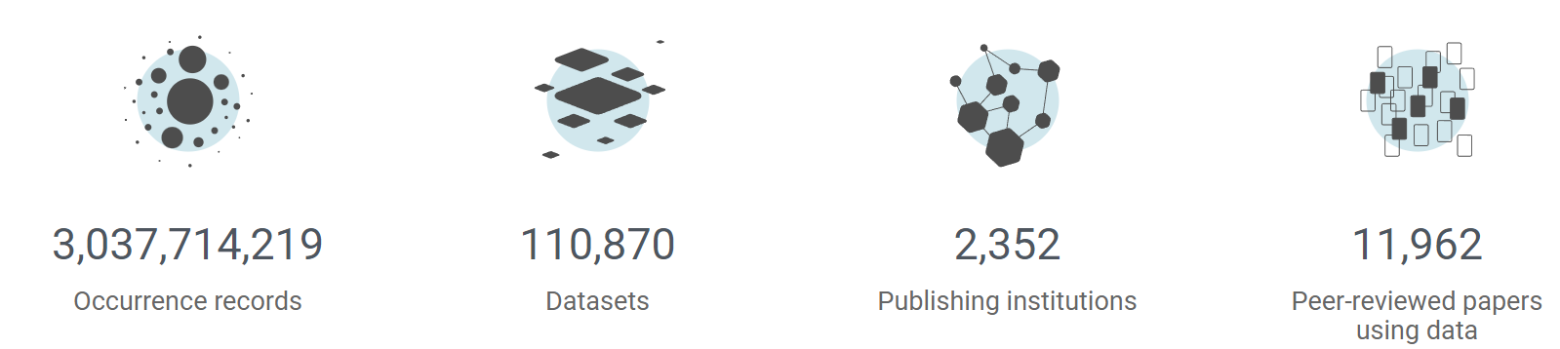
Where should I search for records?
GBIF: Dirty information (Needs curation!)

Slide 28
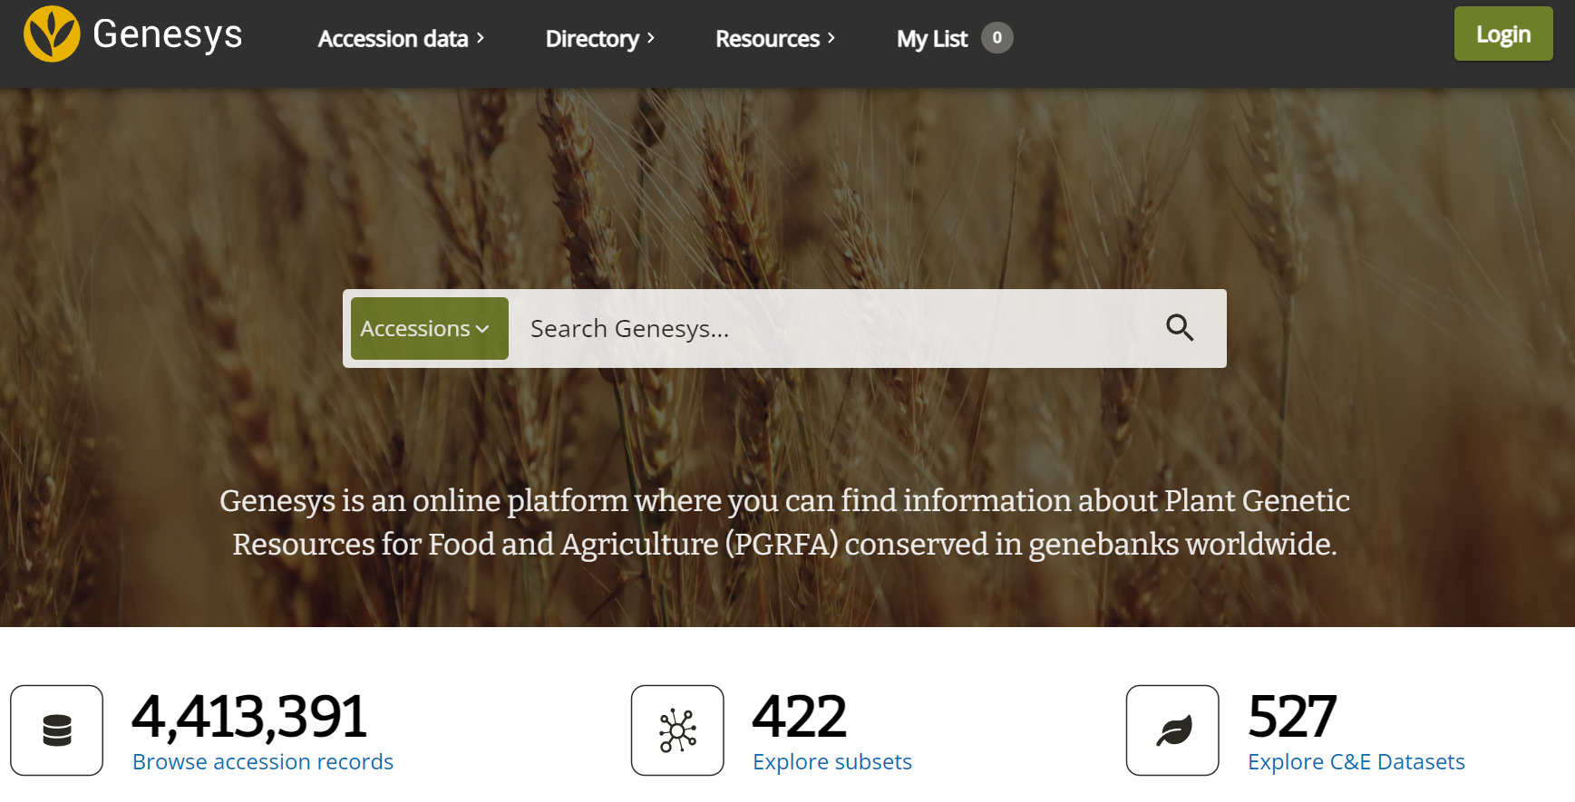

Slide 29
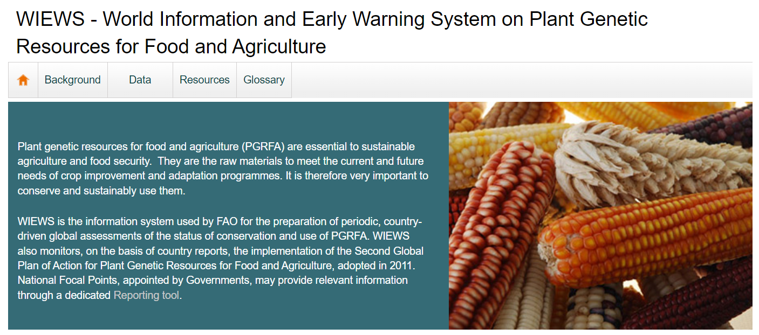

Slide 30
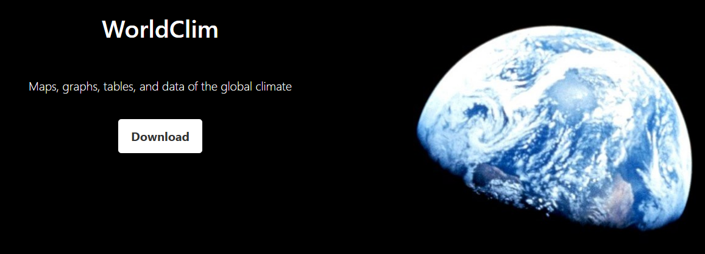
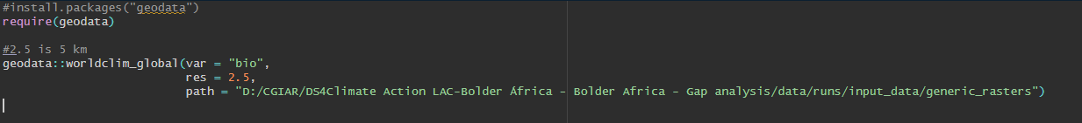
In R:

Slide 31
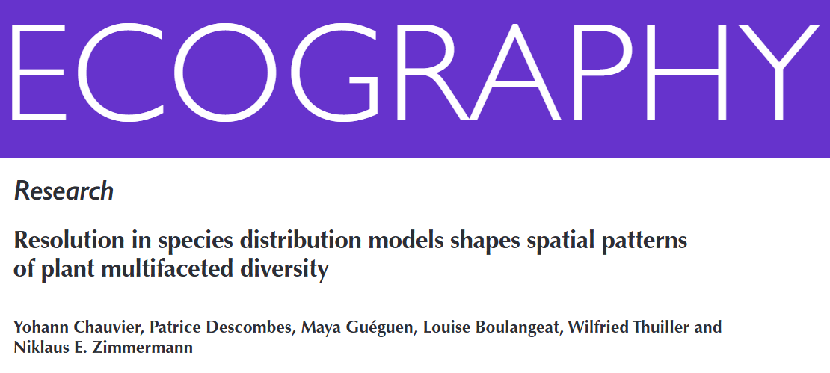
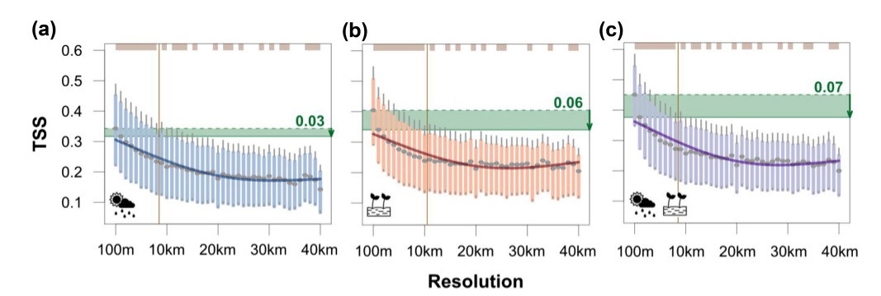
Why the geographical scale matters?

Slide 32
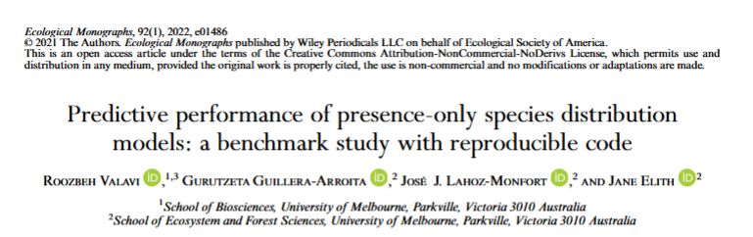
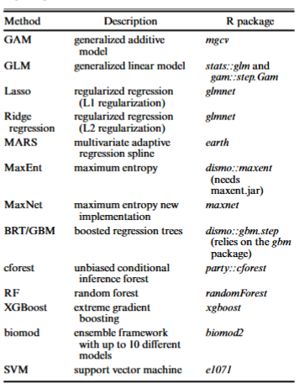
What model should I use?
MaxEnt or maxnet, XGBoost among the prefer ones
Use an ensembles of models?

Slide 33
Some terms:
Presence-only data: Data obtained only from geographical coordinates
Presence: localities where a species was found
Background: Points that represents the extent of the study (represent available environment)
Hyperparameter: It is a configuration variable that controls the learning process of a machine learning model and must be set before training begins
Feature: real-valued functions based on environmental data
Entropy: A measure of dispersedness
Probability density functions: Describe the relative likelihood of random variables over their range; can be univariate or multivariate

Slide 34
How can obtain the geographical distribution of a species using environmental data?

Slide 35
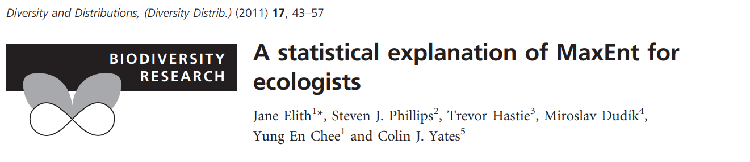
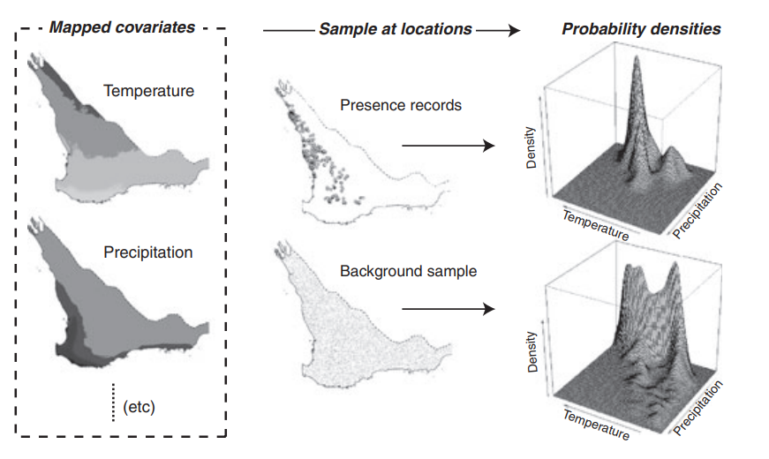

Slide 36
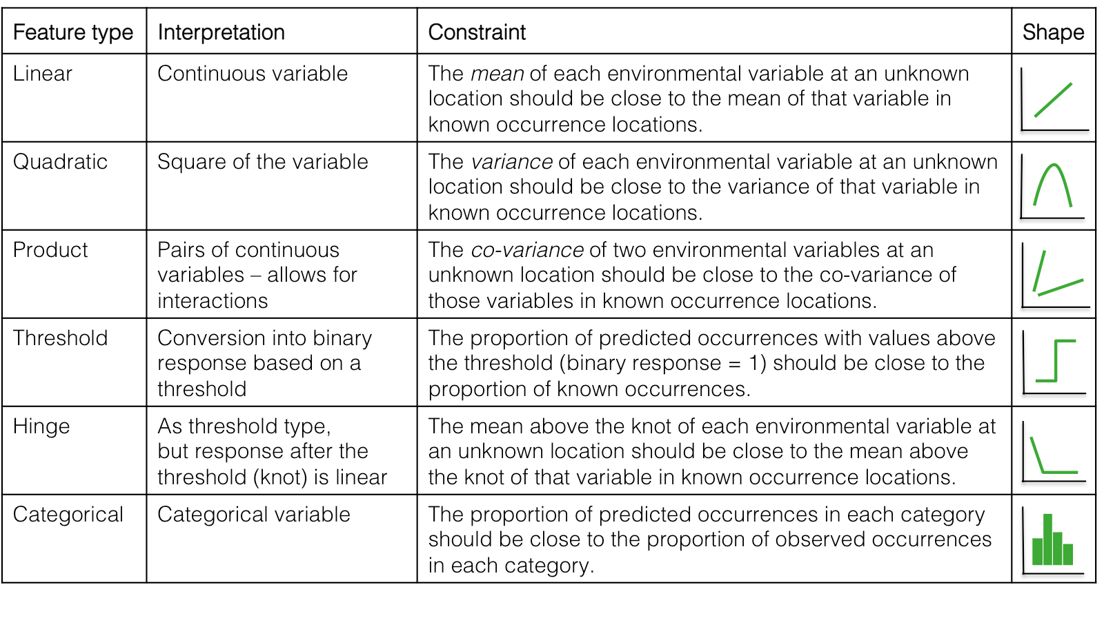
Features

Slide 37
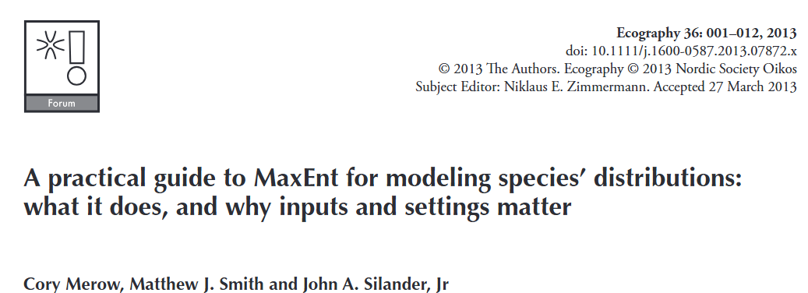
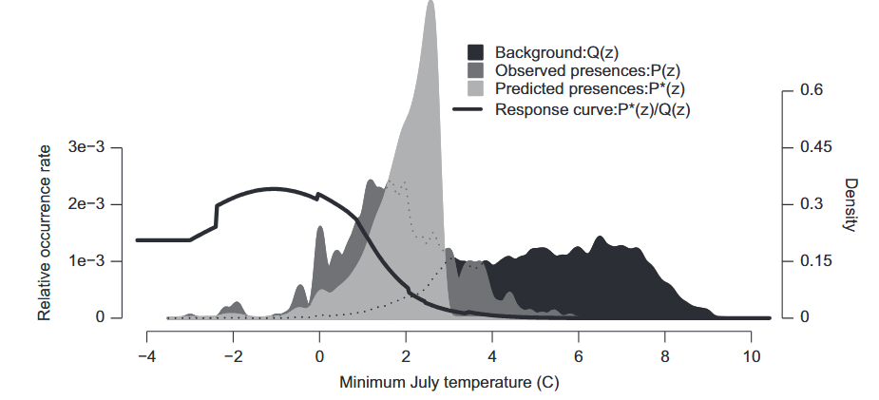
Estimates the distribution (geographic range) of a species by finding the distribution which has maximum entropy
Minimizing entropy respect background

Slide 38
Model fitting

Slide 39
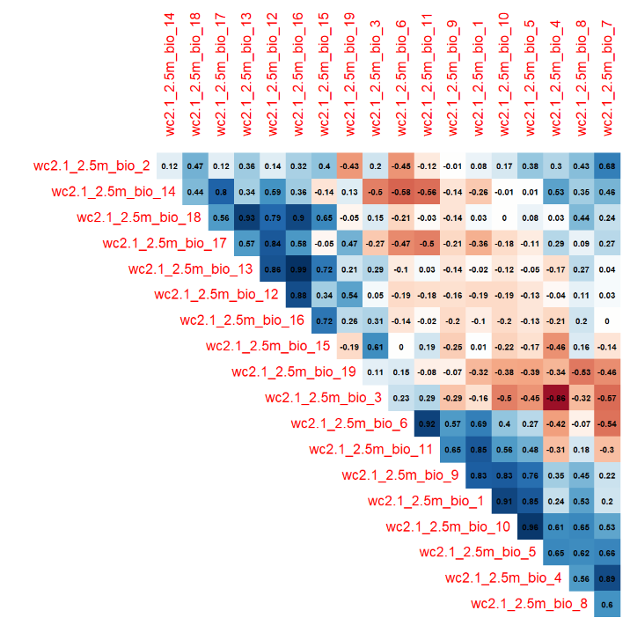
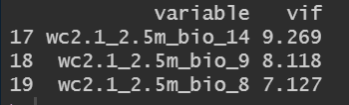
Select variables
Avoid Multicollinearity
Ways to reduce Multicollinearity:
  Correlation (e.g. <0.7)
  Variance Inflation Factor (VIF <10)
  Principal component Analysis (PCA)

Slide 40
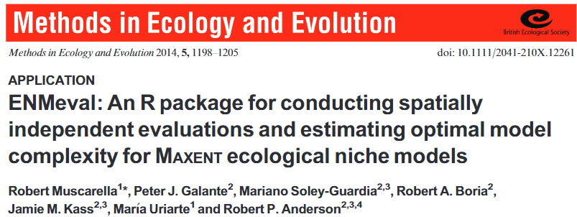
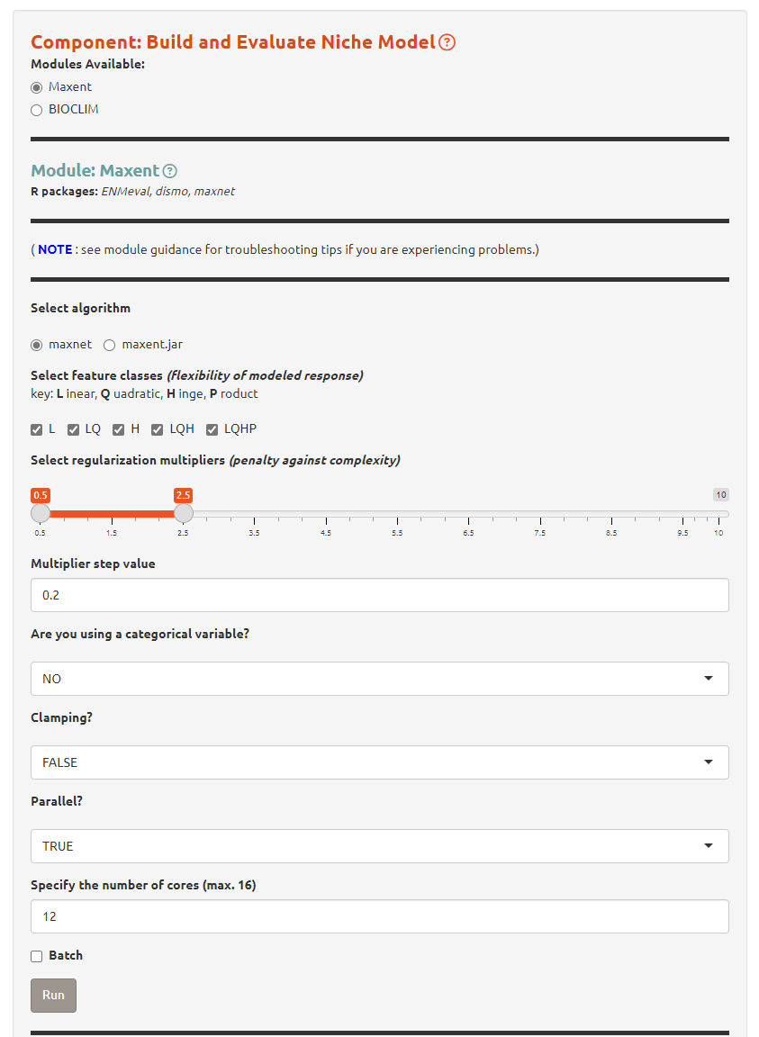
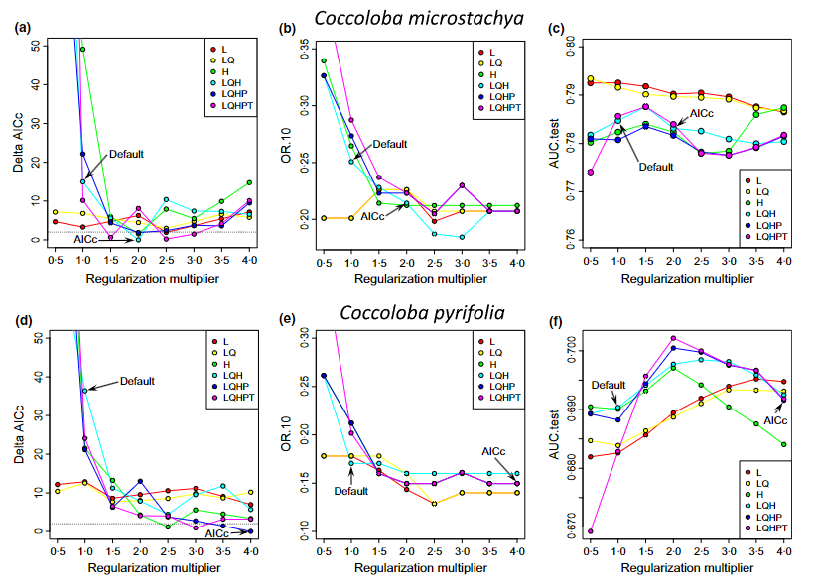
Calibration
Reduce overfitting!

Slide 41
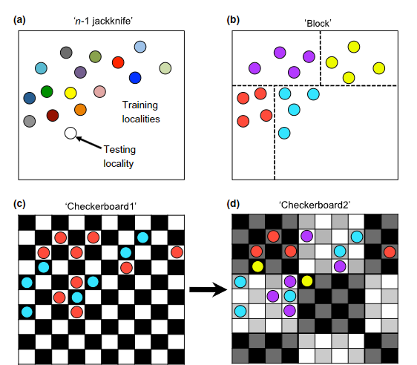
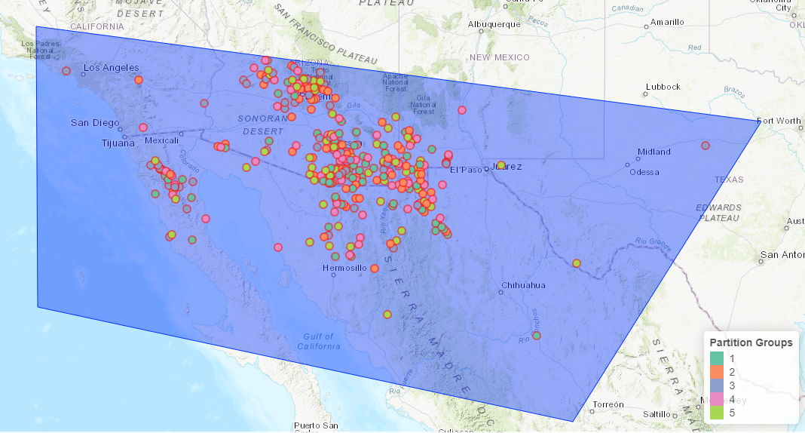
K-Folding
Spatial independent evaluation

Slide 42
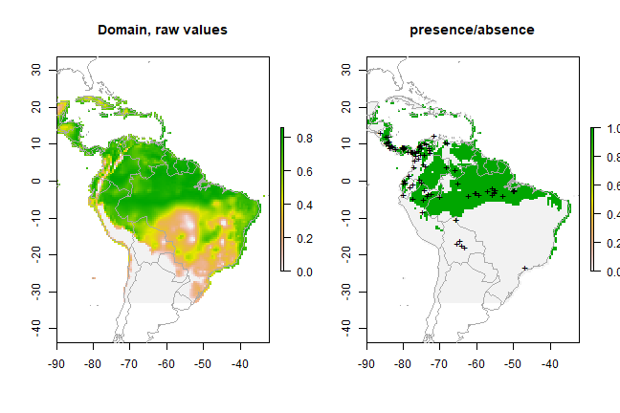
What cut-off value should I use to say that a species is present or absent?
Threshold: Designating areas above a suitability level as within species range!
  Maximum sum of specificity and sensitivity
  Minimum training presence
  10th percentile training presence
https://babichmorrowc.github.io/post/2019-04-12-sdm-threshold/

Slide 43
Assessment

Slide 44
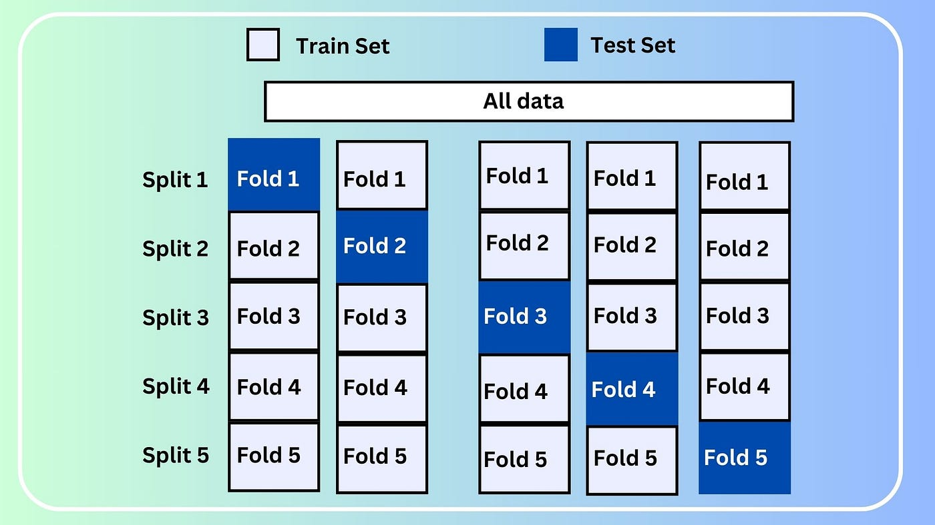
How can obtain good results? (Do not use only one training dataset) (try K-fold)
https://medium.com/@bididudy/the-essential-guide-to-k-fold-cross-validation-in-machine-learning-2bcb58c50578

Slide 45
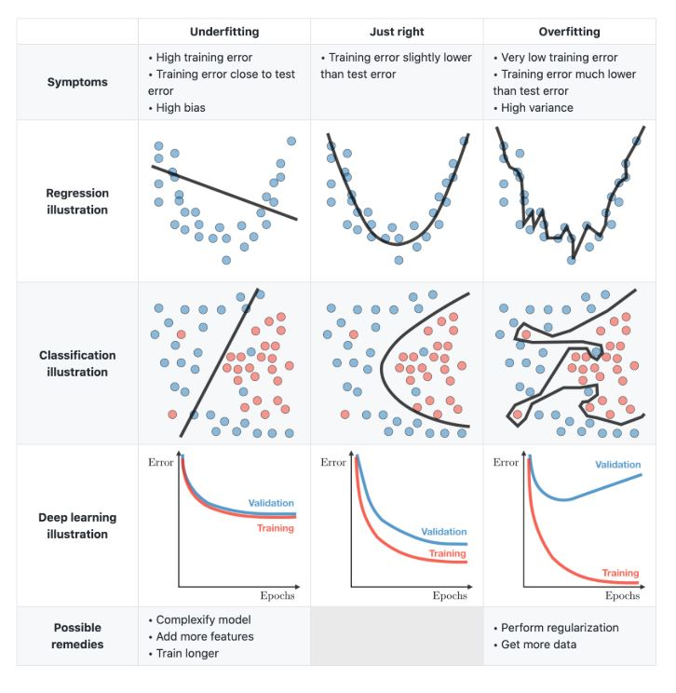
There are no silver bullets!
When too good is not good?
https://www.kaggle.com/discussions/getting-started/166897

Slide 46
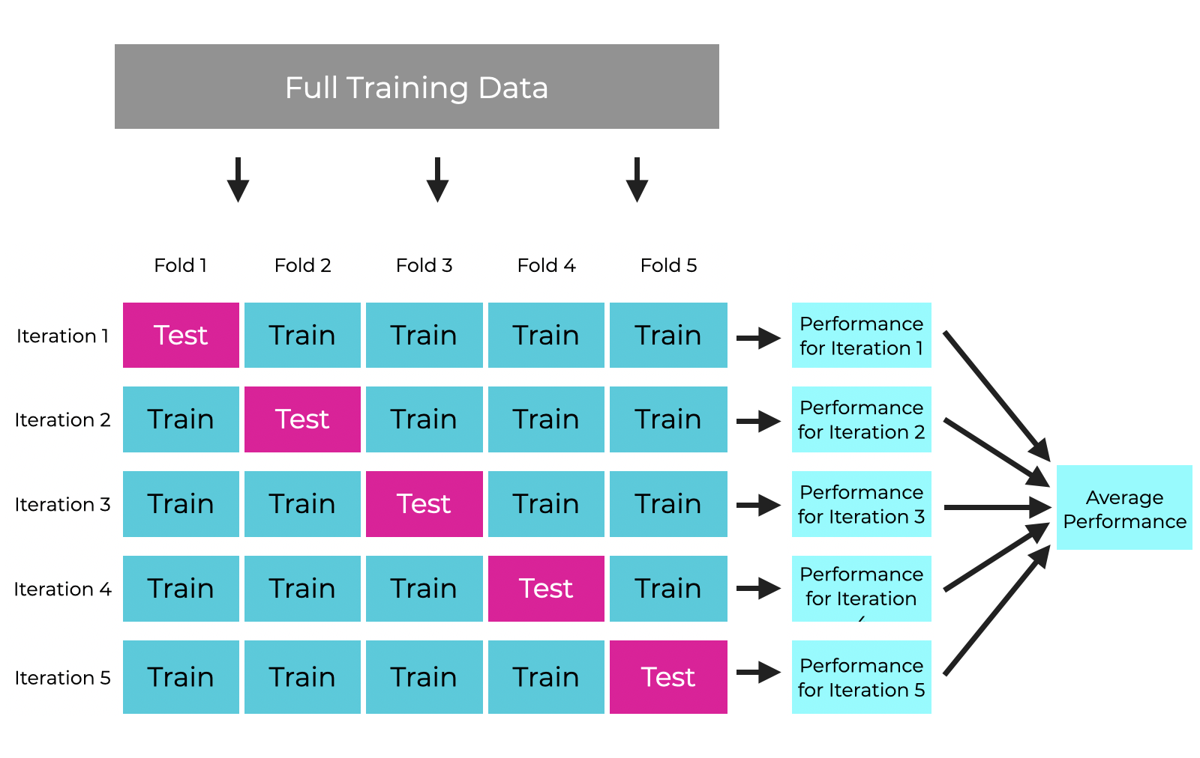
Crossvalidation (Evaluation)
https://www.sharpsightlabs.com/blog/cross-validation-explained/

Slide 47
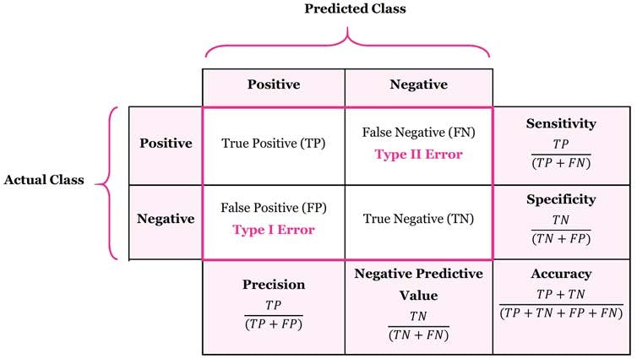
Evaluation (Confusion matrix)
https://encord.com/glossary/confusion-matrix/

Slide 48
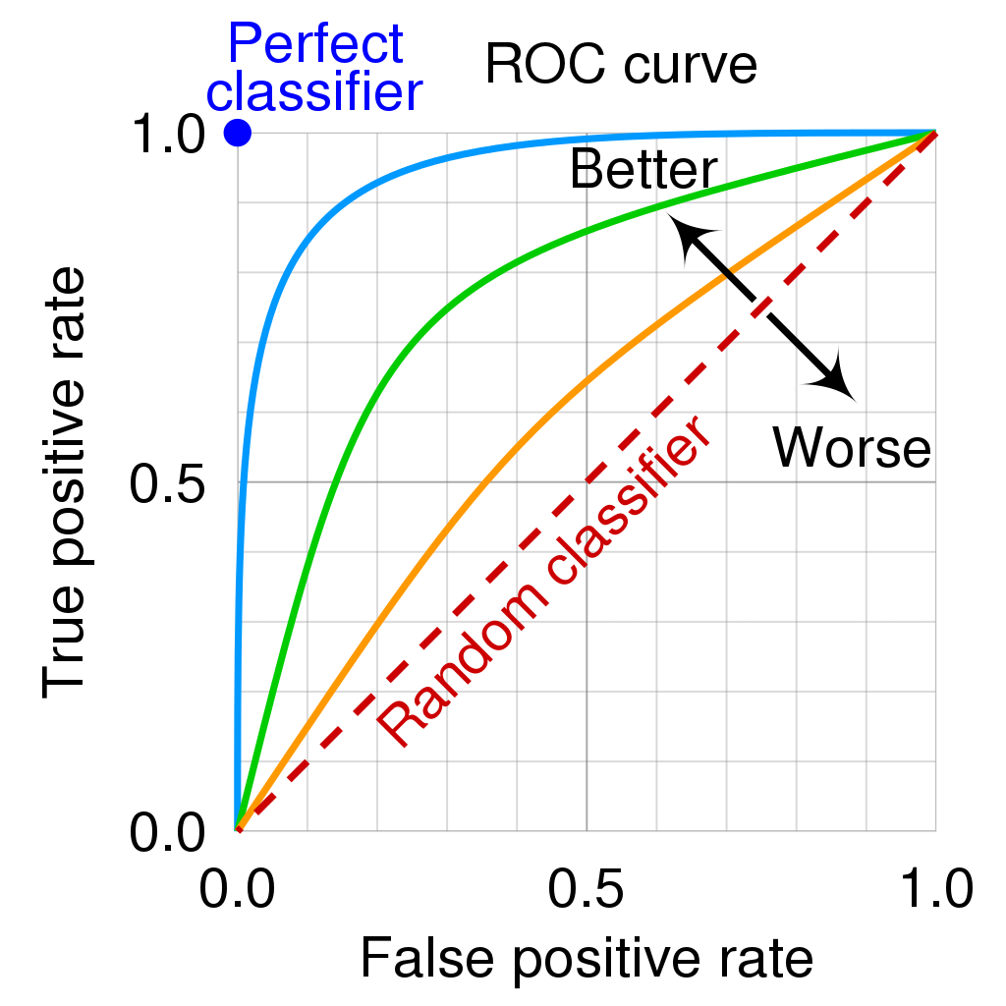
AUC-ROC (receiver operating characteristic curve)
AUC = 1: Perfect prediction
AUC > 0.9: Excellent
AUC 0.7-0.9: Good
AUC 0.5-0.7: Poor
AUC = 0.5: Random prediction
https://community.deeplearning.ai/t/roc-curve-and-auc-area-under-the-roc-curve/224140/2

Slide 49
Predictions

Slide 50



The multivariate environmental similarity surface (MESS)
Negative MESS: Model extrapolation
Positive MESS: values within environmental ranges of presence records

Slide 51




Slide 52

AUC | presences | absences | sensitivity | specificity | TSS | Threshold (max TSS)
0.850 | 1255 | 12550 | 0.852 | 0.664 | 0.517 | 0.357

Slide 53

Exercise: Use Bactris gasipaes data to get a SDM!

Slide 54


Slide 55



Slide 56


Slide 57



Slide 58


Slide 59

Reduce spatial bias!

Slide 60

Create background

Slide 61


Slide 62


Slide 63



Slide 64

Be patient, ENMEval is calibrating the model!

Slide 65

Which one to use?

Slide 66
Time to interpret outcomes

Slide 67


Slide 68

Thresholding for gap analysis!

Slide 70
I want to Project my model to other countries

Slide 71



Slide 72


Slide 73


Slide 74


Slide 75
Saving

Slide 76


Slide 77


Slide 78
A
B


Germplasm
Other coordinates
Collected germplasm area
Species occurrences
Realized niche
Potential area to be collected
C
D
Sampled germplasm
Where to collect

Slide 79
Questions?

