Slide 1
Modeling scenarios and Climate change

Slide 2
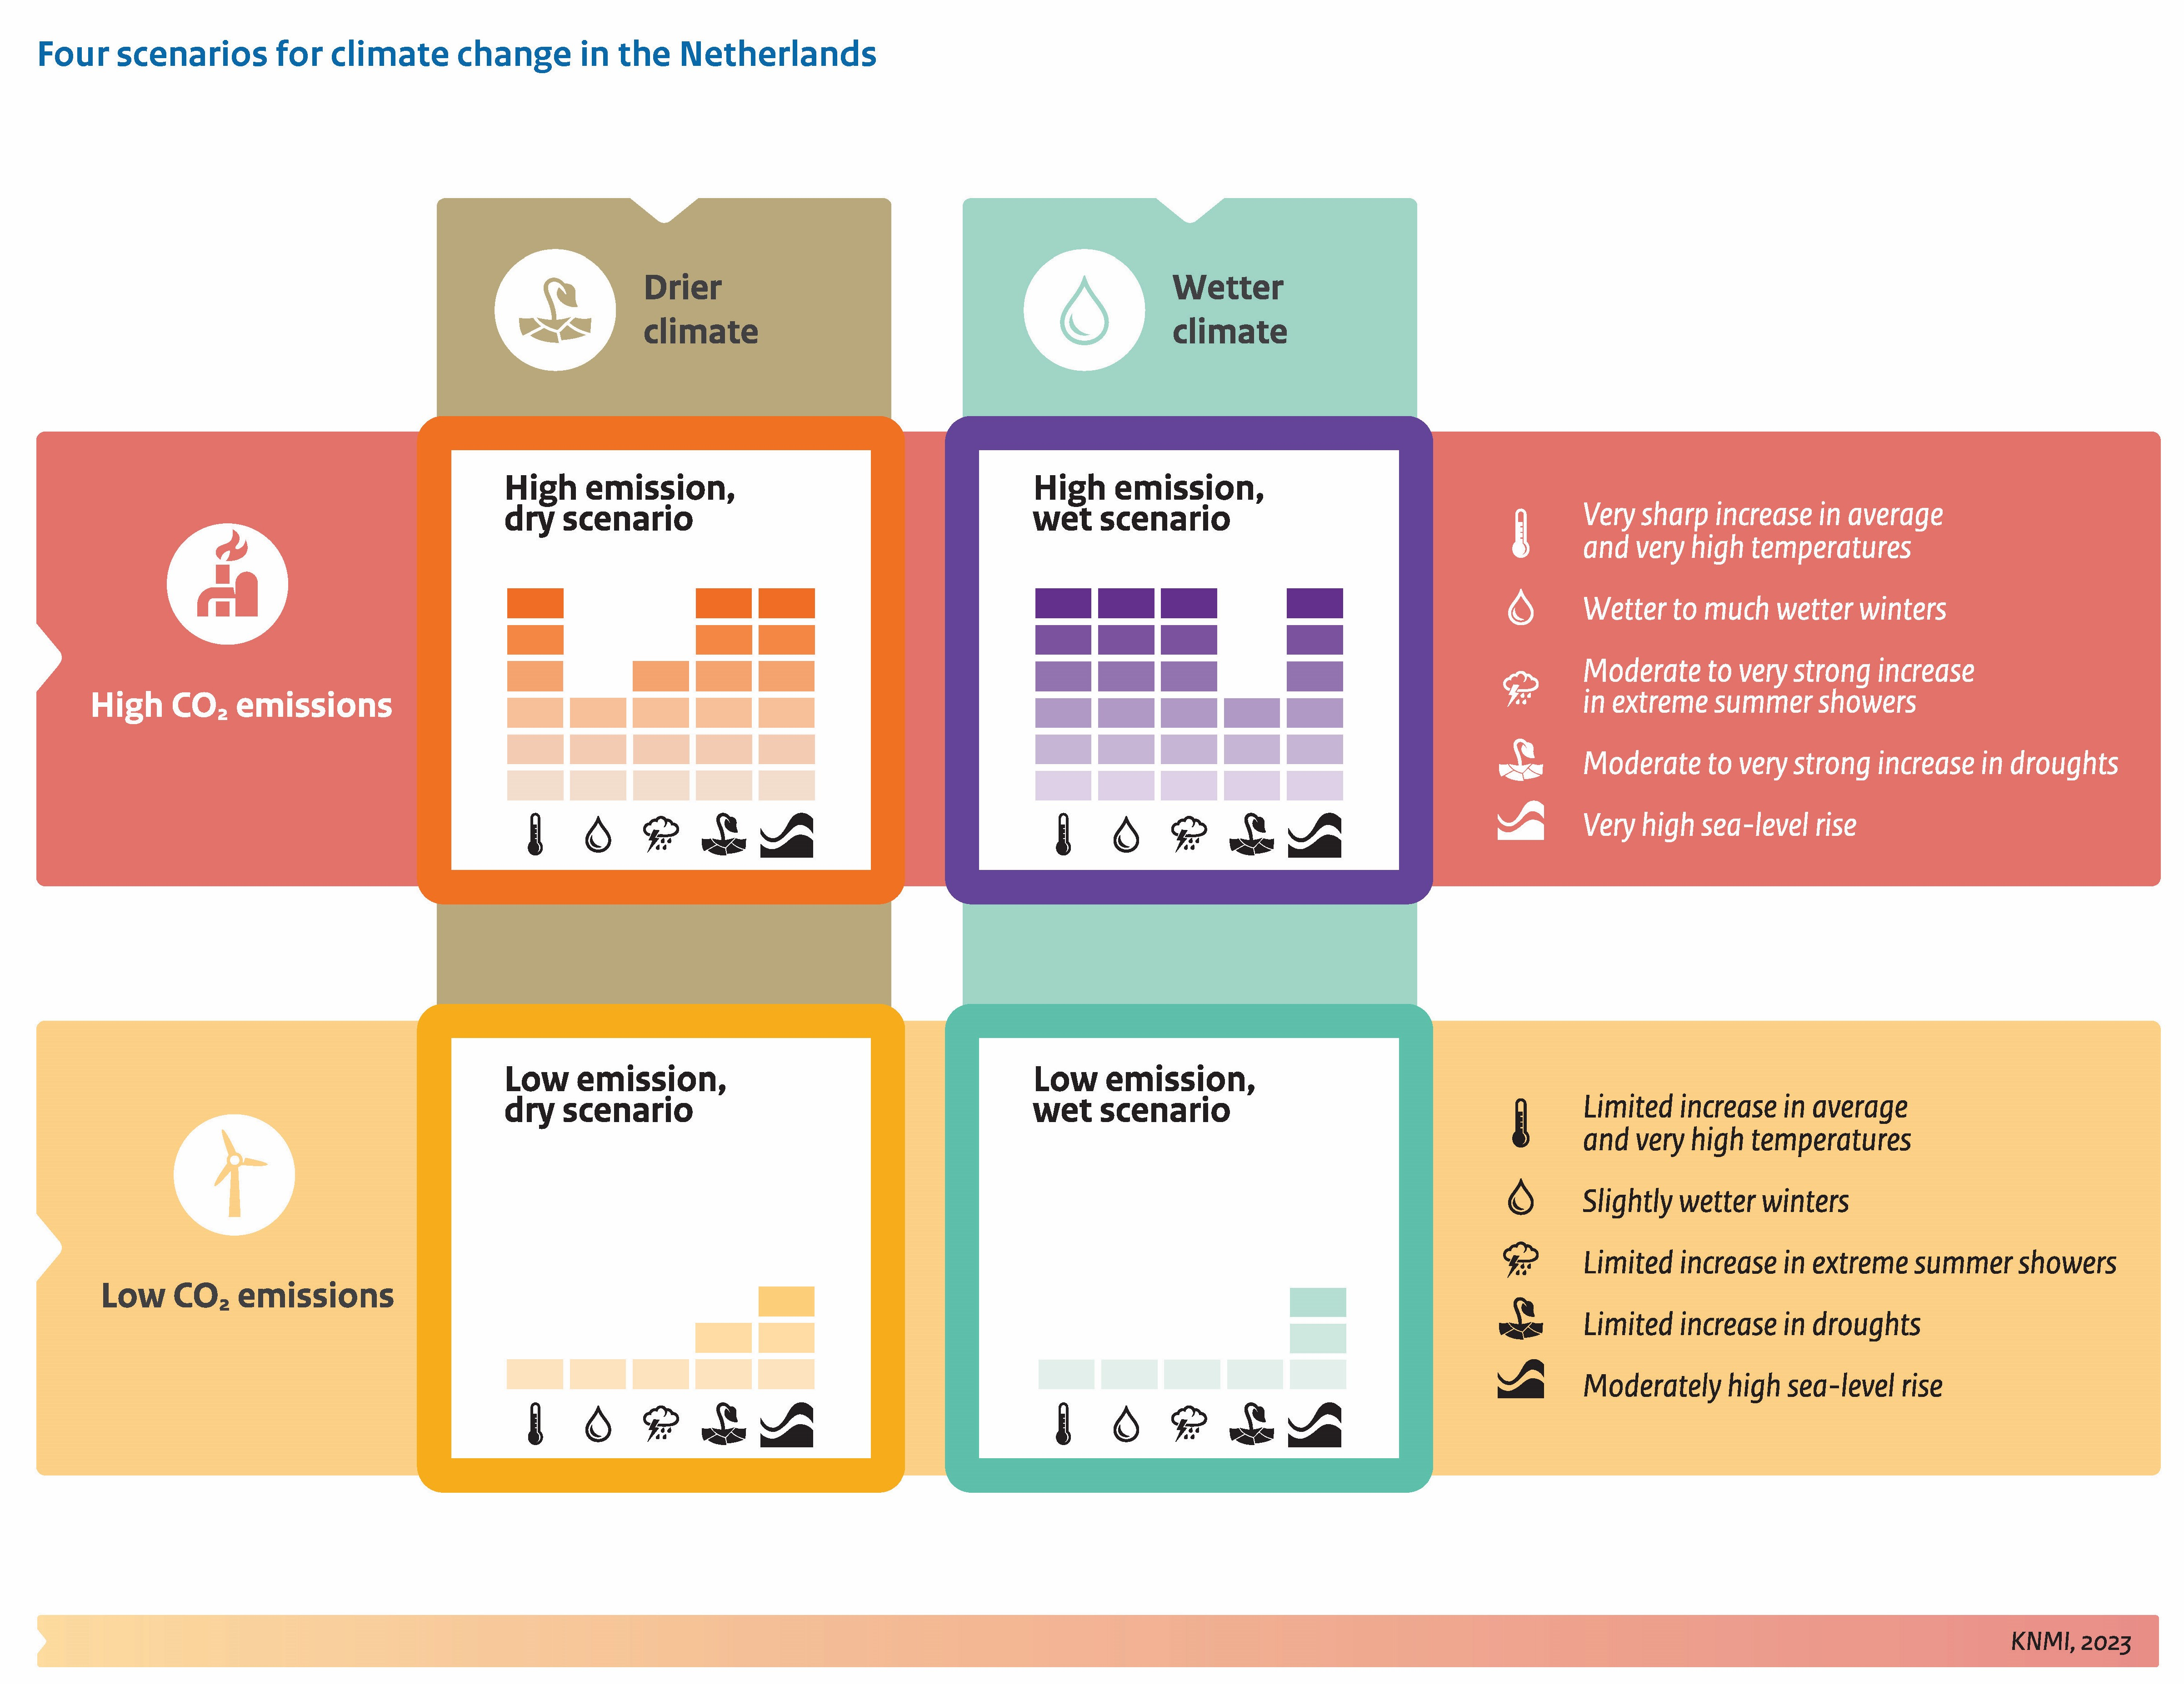
What is an scenario?
https://eiffel.un-ihe.org/EIFFEL-prod/cc-scenarios.html

Slide 3
What a scenario looks like:
Allow use several datasets in a project
Diferent narrative to test
Allow different Projections
Multiple pathways
Allow comparisons

Slide 4
Climate change
Long-term shift in the Earth's average temperatures and weather conditions.
https://www.bbc.com/news/articles/c9w15nggj58o

Slide 5
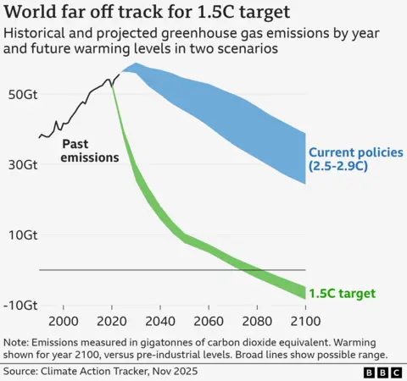
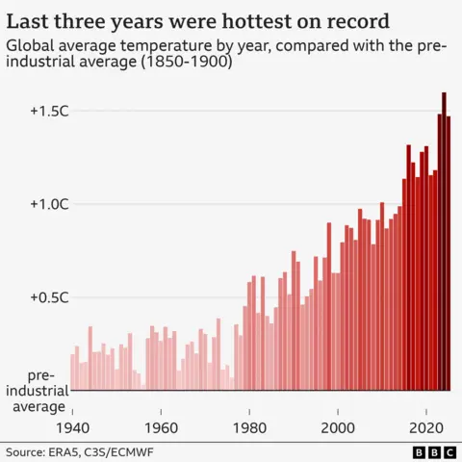
https://www.bbc.com/news/articles/c9w15nggj58o

Slide 6
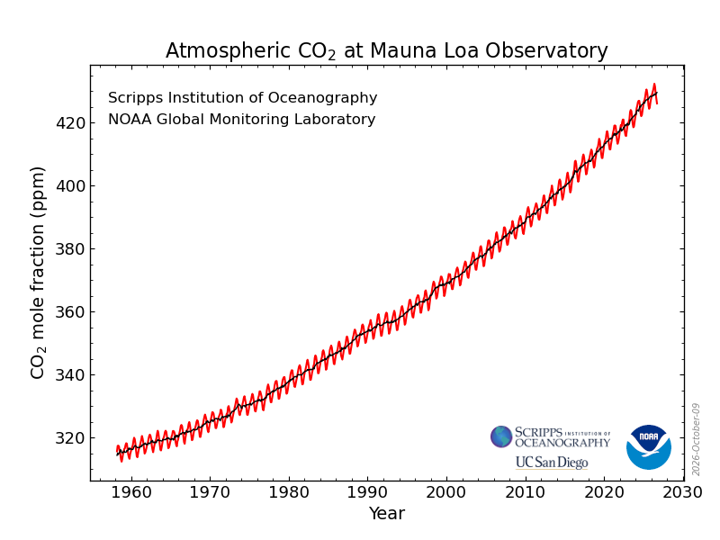
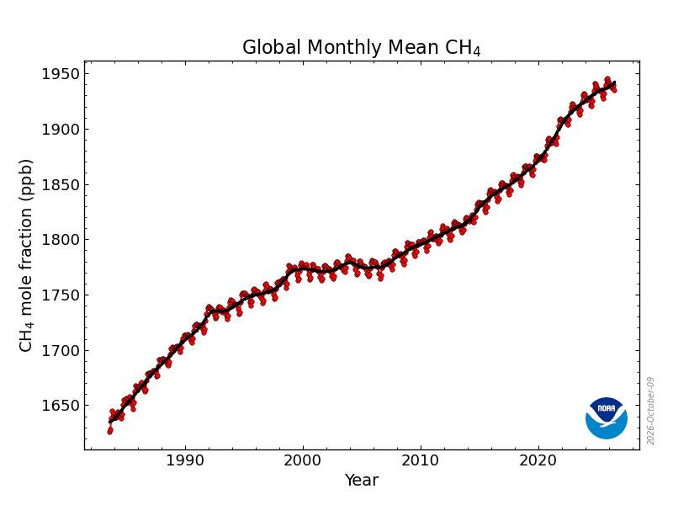
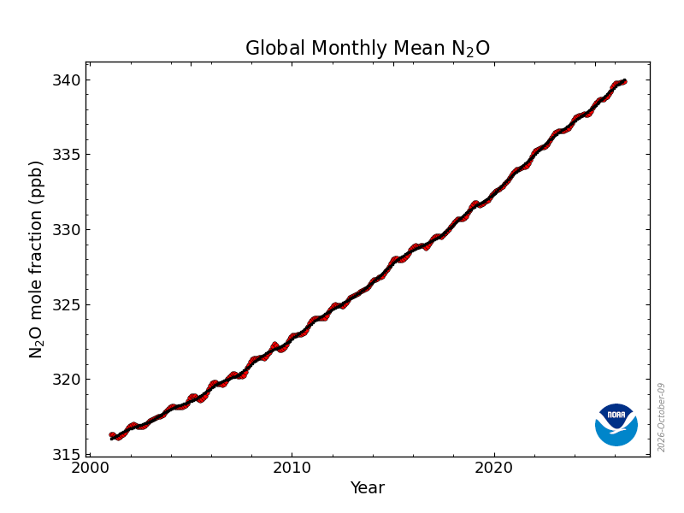
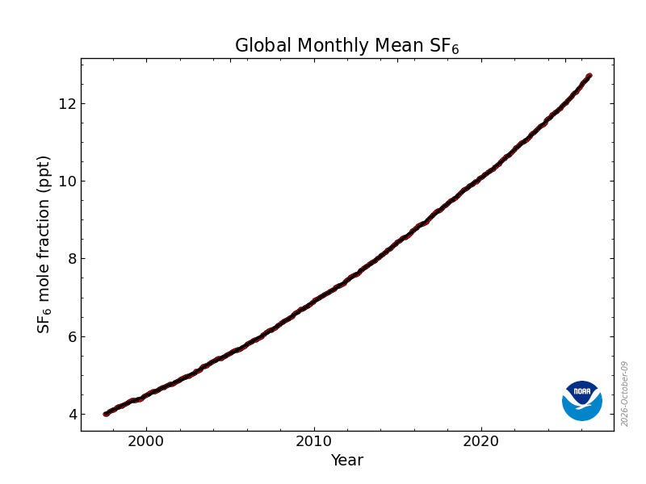
https://gml.noaa.gov/ccgg/trends/

Slide 7

https://www.ipcc.ch/

Slide 8
New concepts:

Slide 9
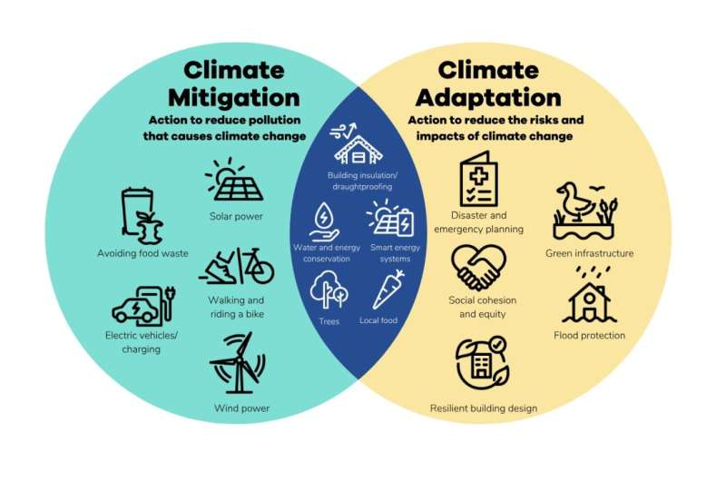
https://phys.org/news/2025-10-climate-key-piece-puzzle.html

Slide 10
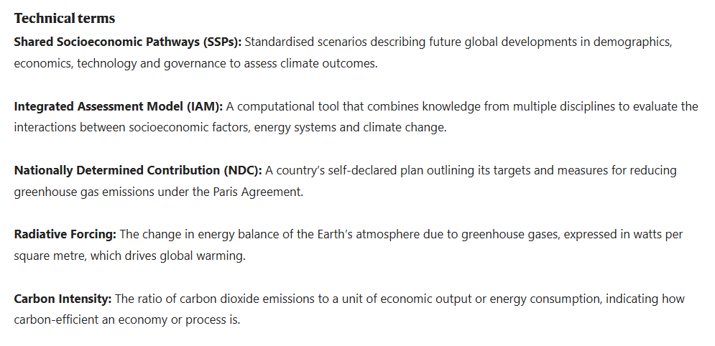
Key concepts:
https://www.nature.com/nature-index/topics/l4/shared-socioeconomic-pathways-and-climate-change-mitigation

Slide 11
What scientific community does to study climate change?

Slide 12
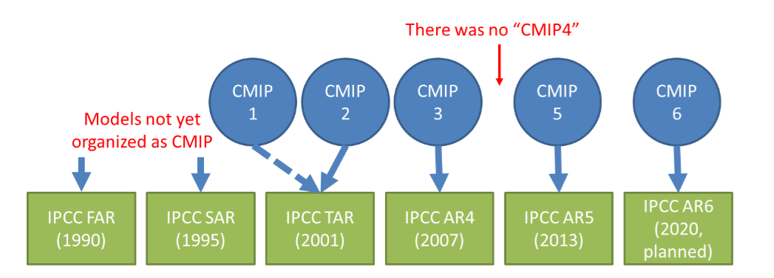
Assessment reports
https://www.ipcc.ch/site/assets/uploads/2020/11/TGICA_Fact_Sheet_CMIP5_data_provided_at_the_IPCC_DDC_Ver_1_2016.pdf

Slide 13
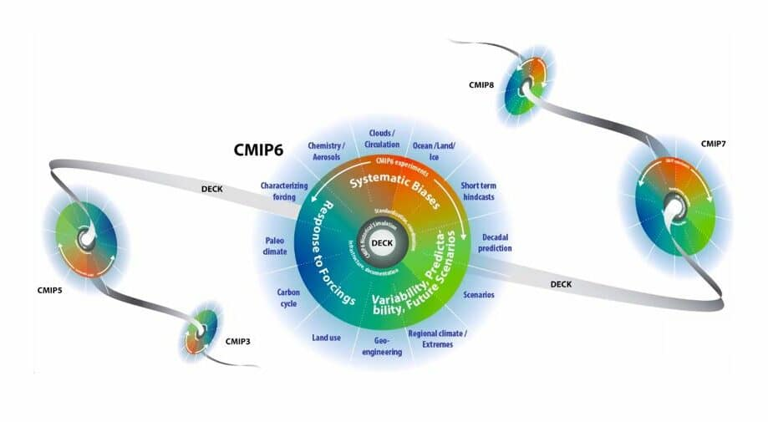
Coupled Model Intercomparison Project
https://wcrp-cmip.org/cmip-phases/

Slide 14
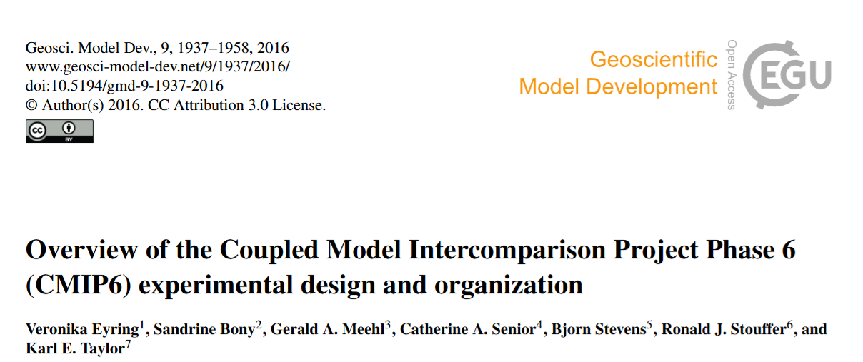
How does the Earth system respond to forcing?
What are the origins and consequences of systematic model biases?
How can we assess future climate changes given internal climate variability, predictability, and uncertainties in scenarios?

Slide 15
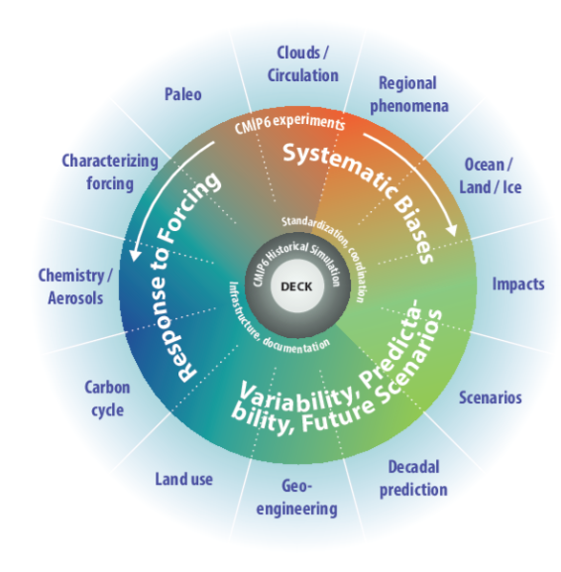
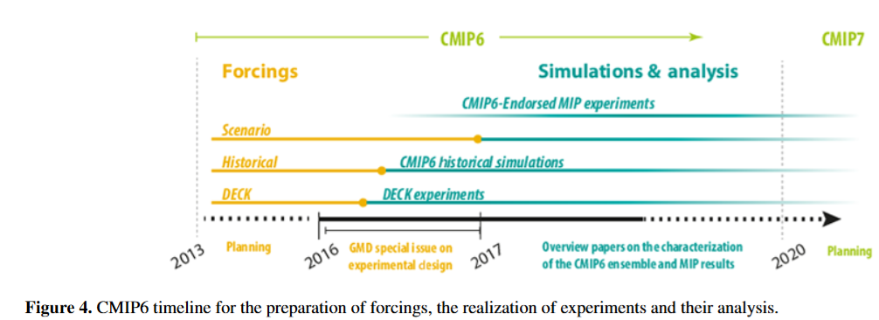
º

Slide 16
Climate change scenarios

Slide 17
Representative Concentration Pathways (RCP)

Slide 18
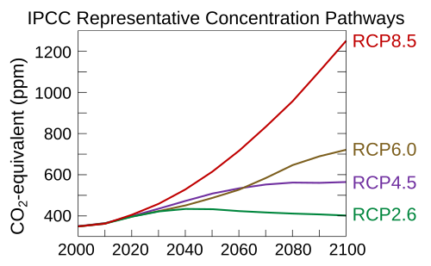
Representative Concentration Pathways (RCP)
2.6, 4.5, 6, and 8.5 W/m²
Based on radiactive forcing
Population Growth
Economic Activity
Energy Intensity
Socio-economic Development
Land Use Change
Climate Policy

Slide 19
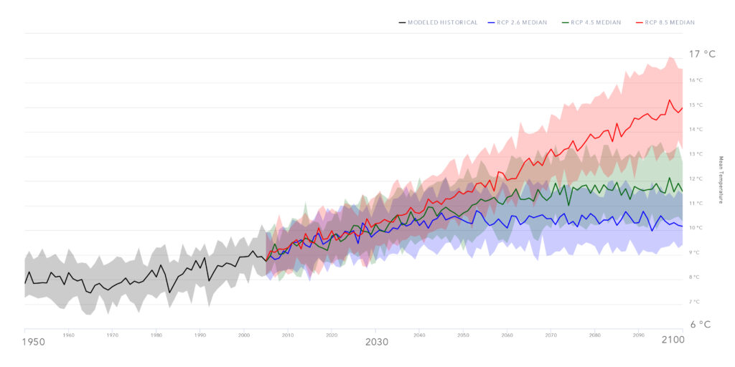
https://climatedata.ca/resource/emissions-scenarios-rcps/

Slide 20
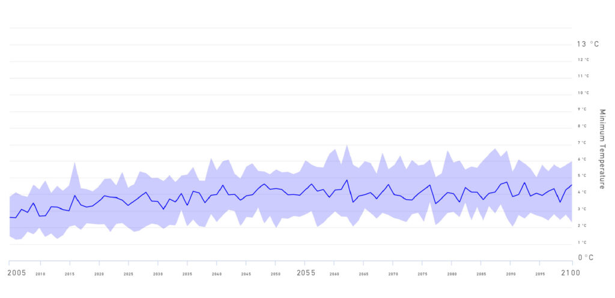
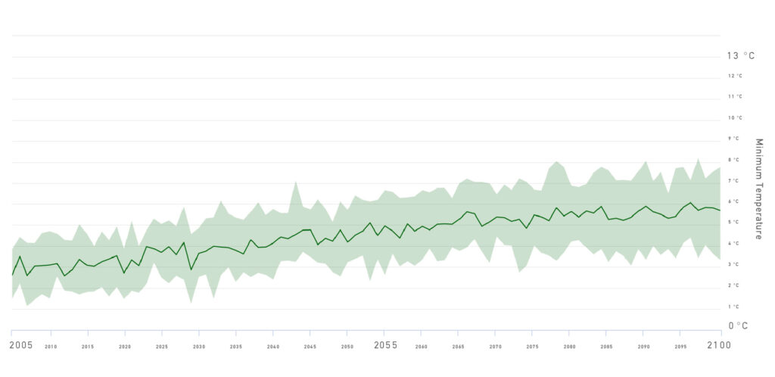
RCP 2.6 (Δ 1°C)
RCP 4.5 (Δ 3°C)
https://climatedata.ca/resource/emissions-scenarios-rcps/

Slide 21
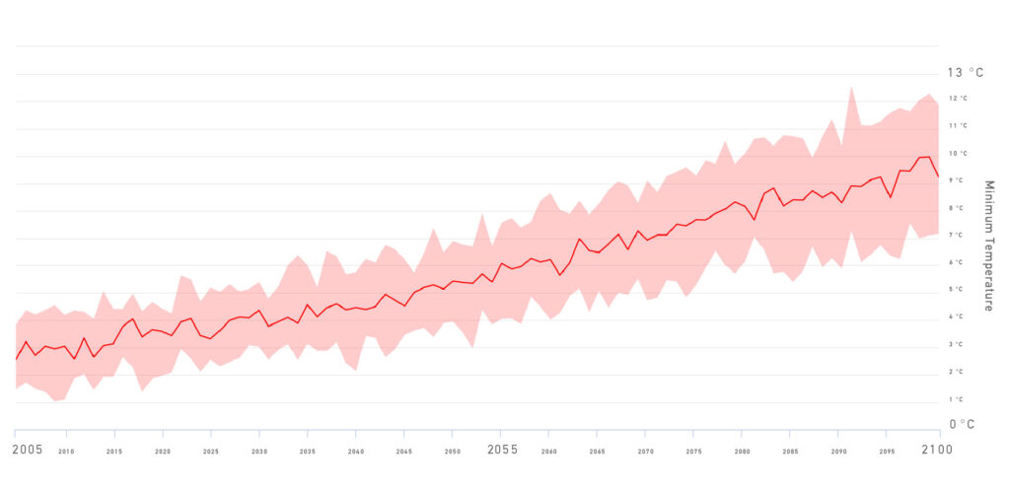
RCP 8.5 (Δ 6.3°C)
https://climatedata.ca/resource/emissions-scenarios-rcps/

Slide 22
RCPs are only based on radiactive forcing but what about policies?
Solution: lets try the SSPs

Slide 23
Shared Socioeconomic Pathways (SSPs)

Slide 24
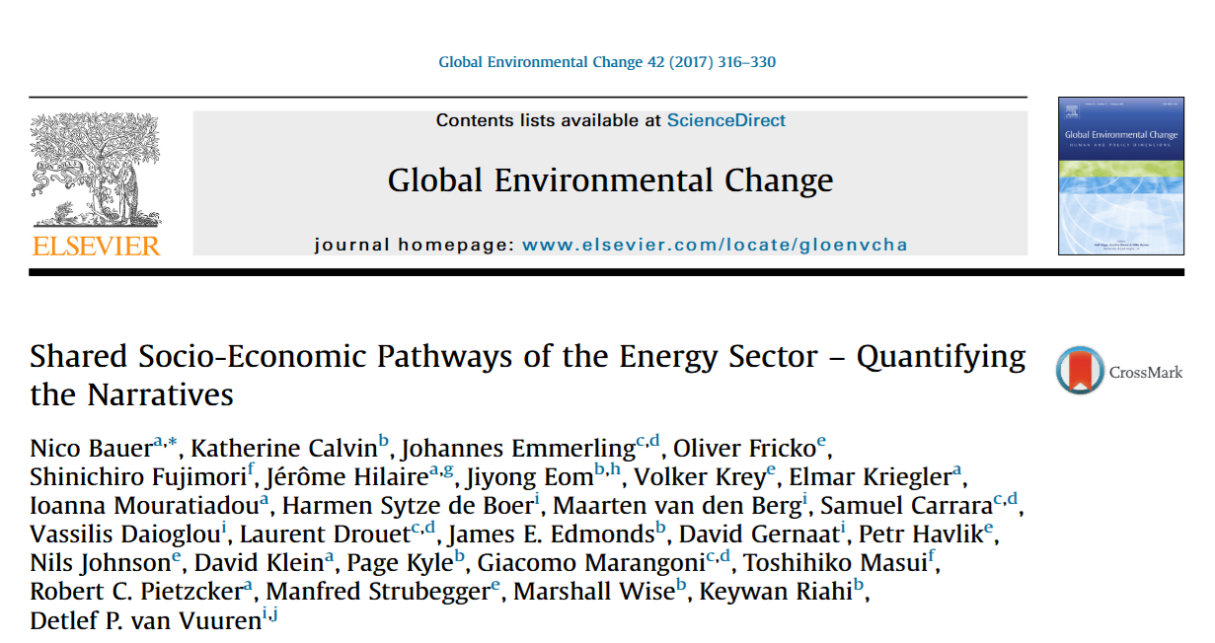

Slide 25
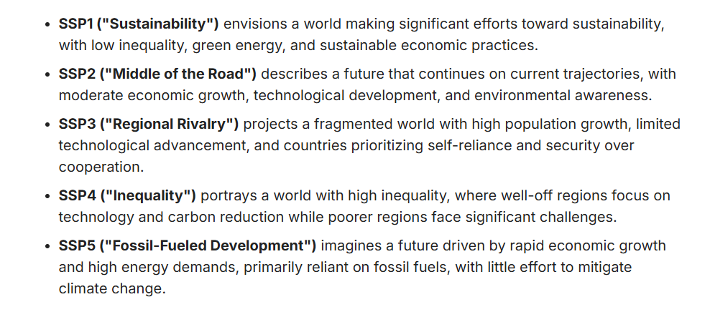

Slide 26
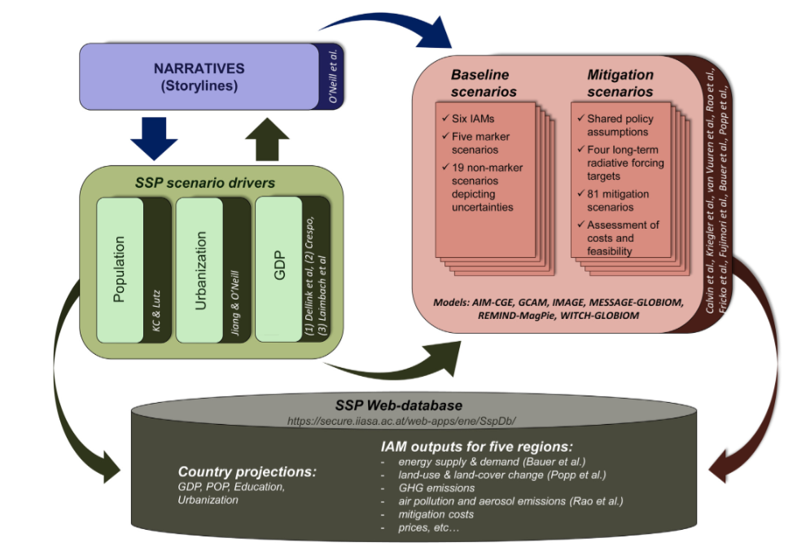
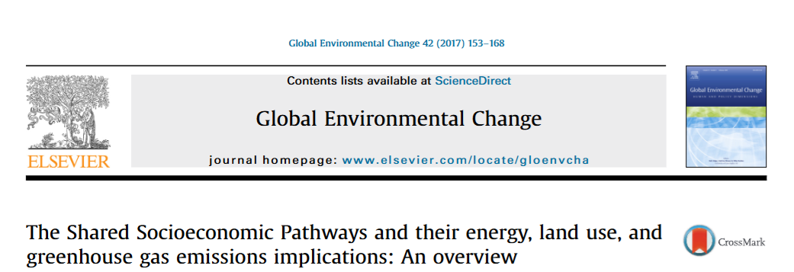

Slide 27
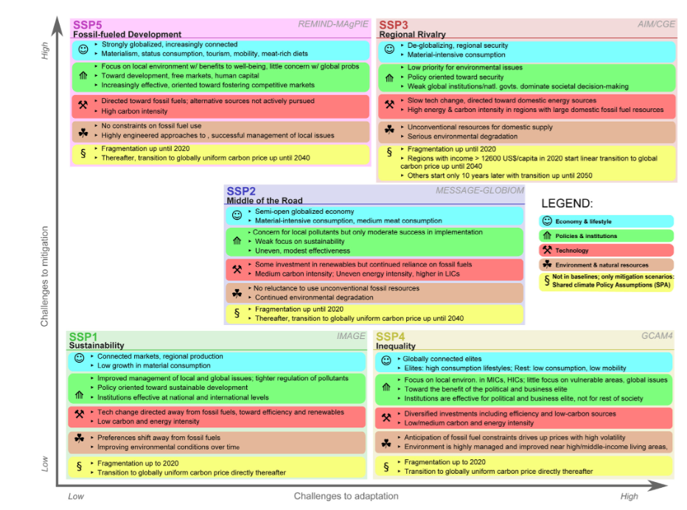

Slide 28
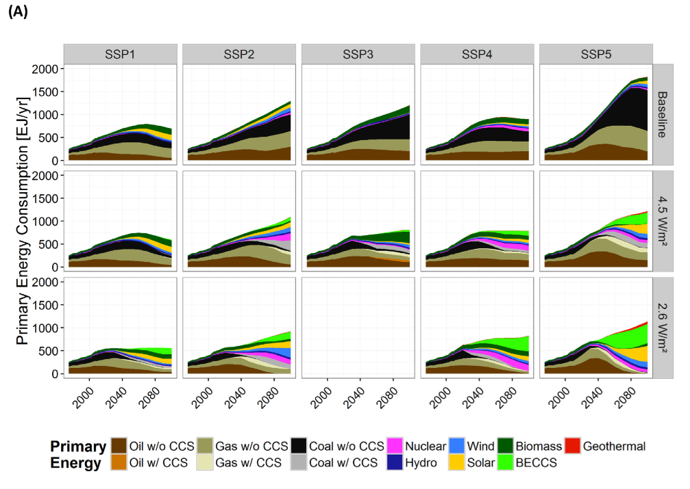

Slide 29
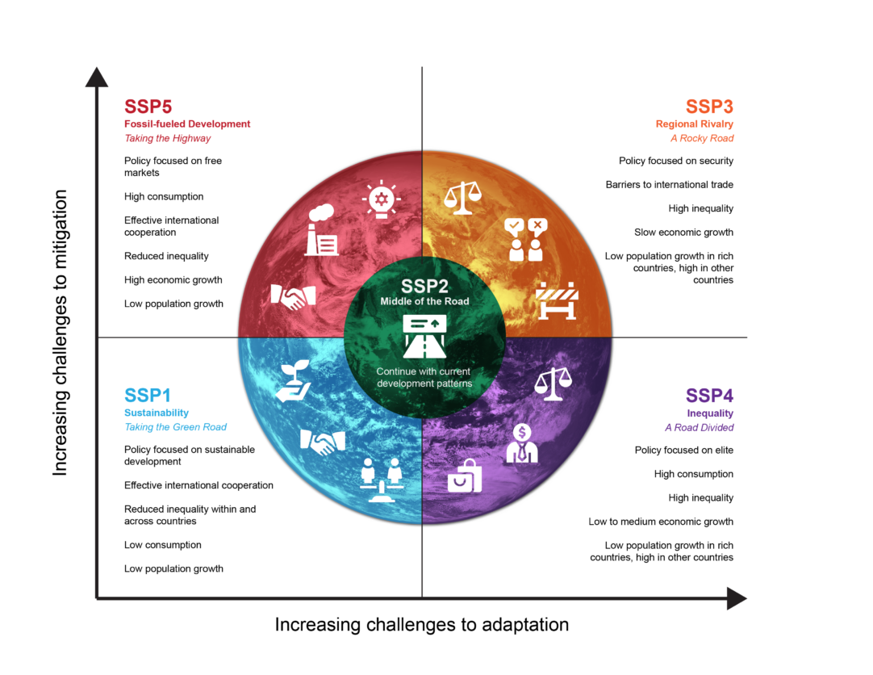
https://climatedata.ca/resource/understanding-shared-socio-economic-pathways-ssps/

Slide 30
What about layers for Species distribution models tasks?

Slide 31
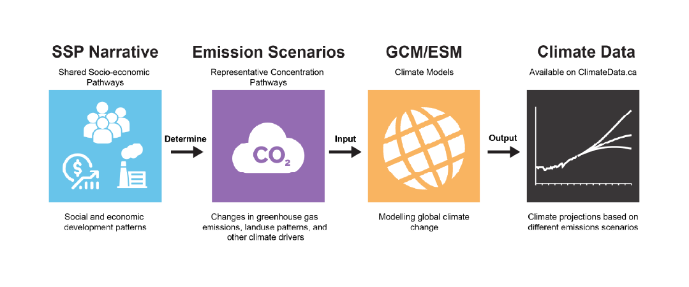
https://phys.org/news/2025-10-climate-key-piece-puzzle.html

Slide 32
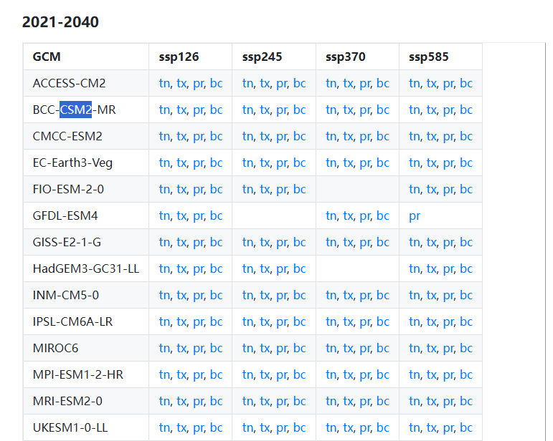
Bioclimatic layers information
Periods
SSPs
GCMs
2021-2040
2041-2060
2061-2080
2081-2100
ssp126
ssp245
ssp370
ssp585

Slide 33
Bioclimatic layers information
Periods
SSPs
GCMs
Choose period
Choose your SSPs
Predict to GCMs

Slide 34
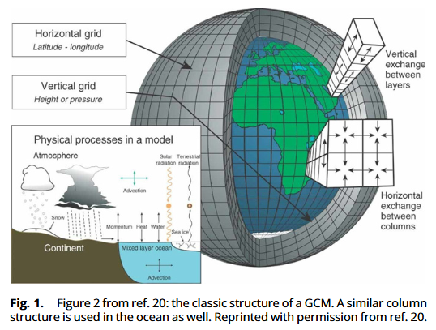
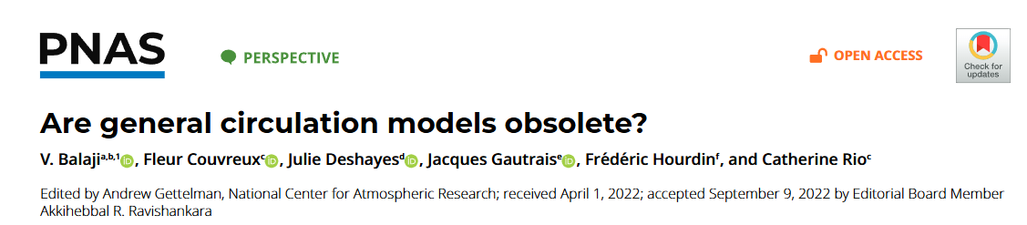
Global Circulation models: maths!
Mathematical models
Let´s consider fluid flow, termal energy, and exchange

Slide 35
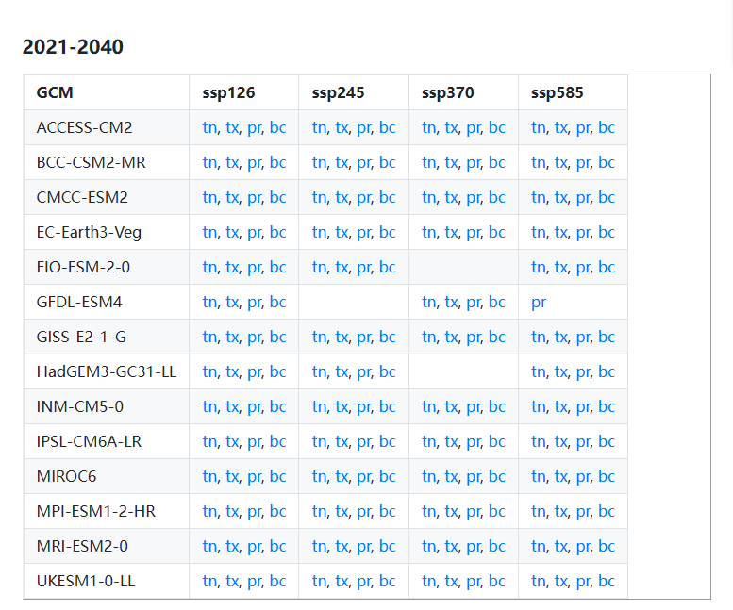
https://www.worldclim.org/data/cmip6/cmip6climate.html

Slide 36
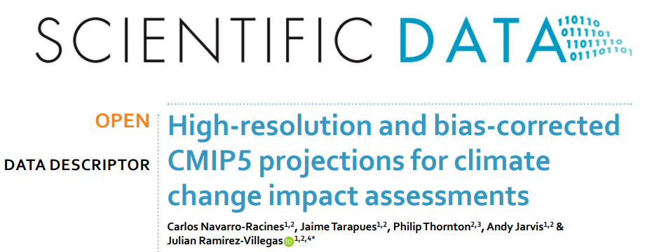

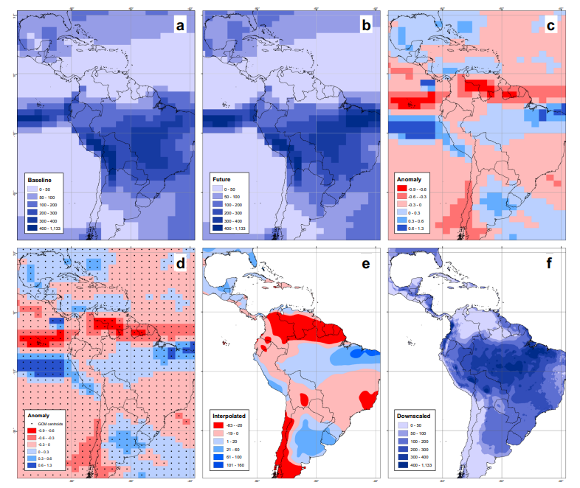

Downscaling
Apply dynamical approach: reproduce local climate to adjust to new finer Resolution
Apply statistical approach:

Slide 37
SDM in climate change context

Slide 38
Bioclimatic layers information
Periods
SSPs
GCMs
2021-2040
2041-2060
2061-2080
2081-2100
ssp126
ssp245
ssp370
ssp585

Slide 39
In SDMs:
GCMs
SSPs
Periods
Predict your SDM to GCMs
Apply threshold to get binary map
Create a thresholded consensus
Quantify uncertainty!
Quantify impacts!
Obtain projections for your SSPs
Quantify impacts!

Slide 40
Quantifying impacts
INGREDIENTS
Consensus map for your SSPs using your future projections
Current thresholded map
RECIPE:
Reclassify presence for future as 2
Perform a subtractions between future and present:
New values: 2-> New areas; 1-> Kept areas; -> -1 Lost areas
Get the areas in km2

Slide 41
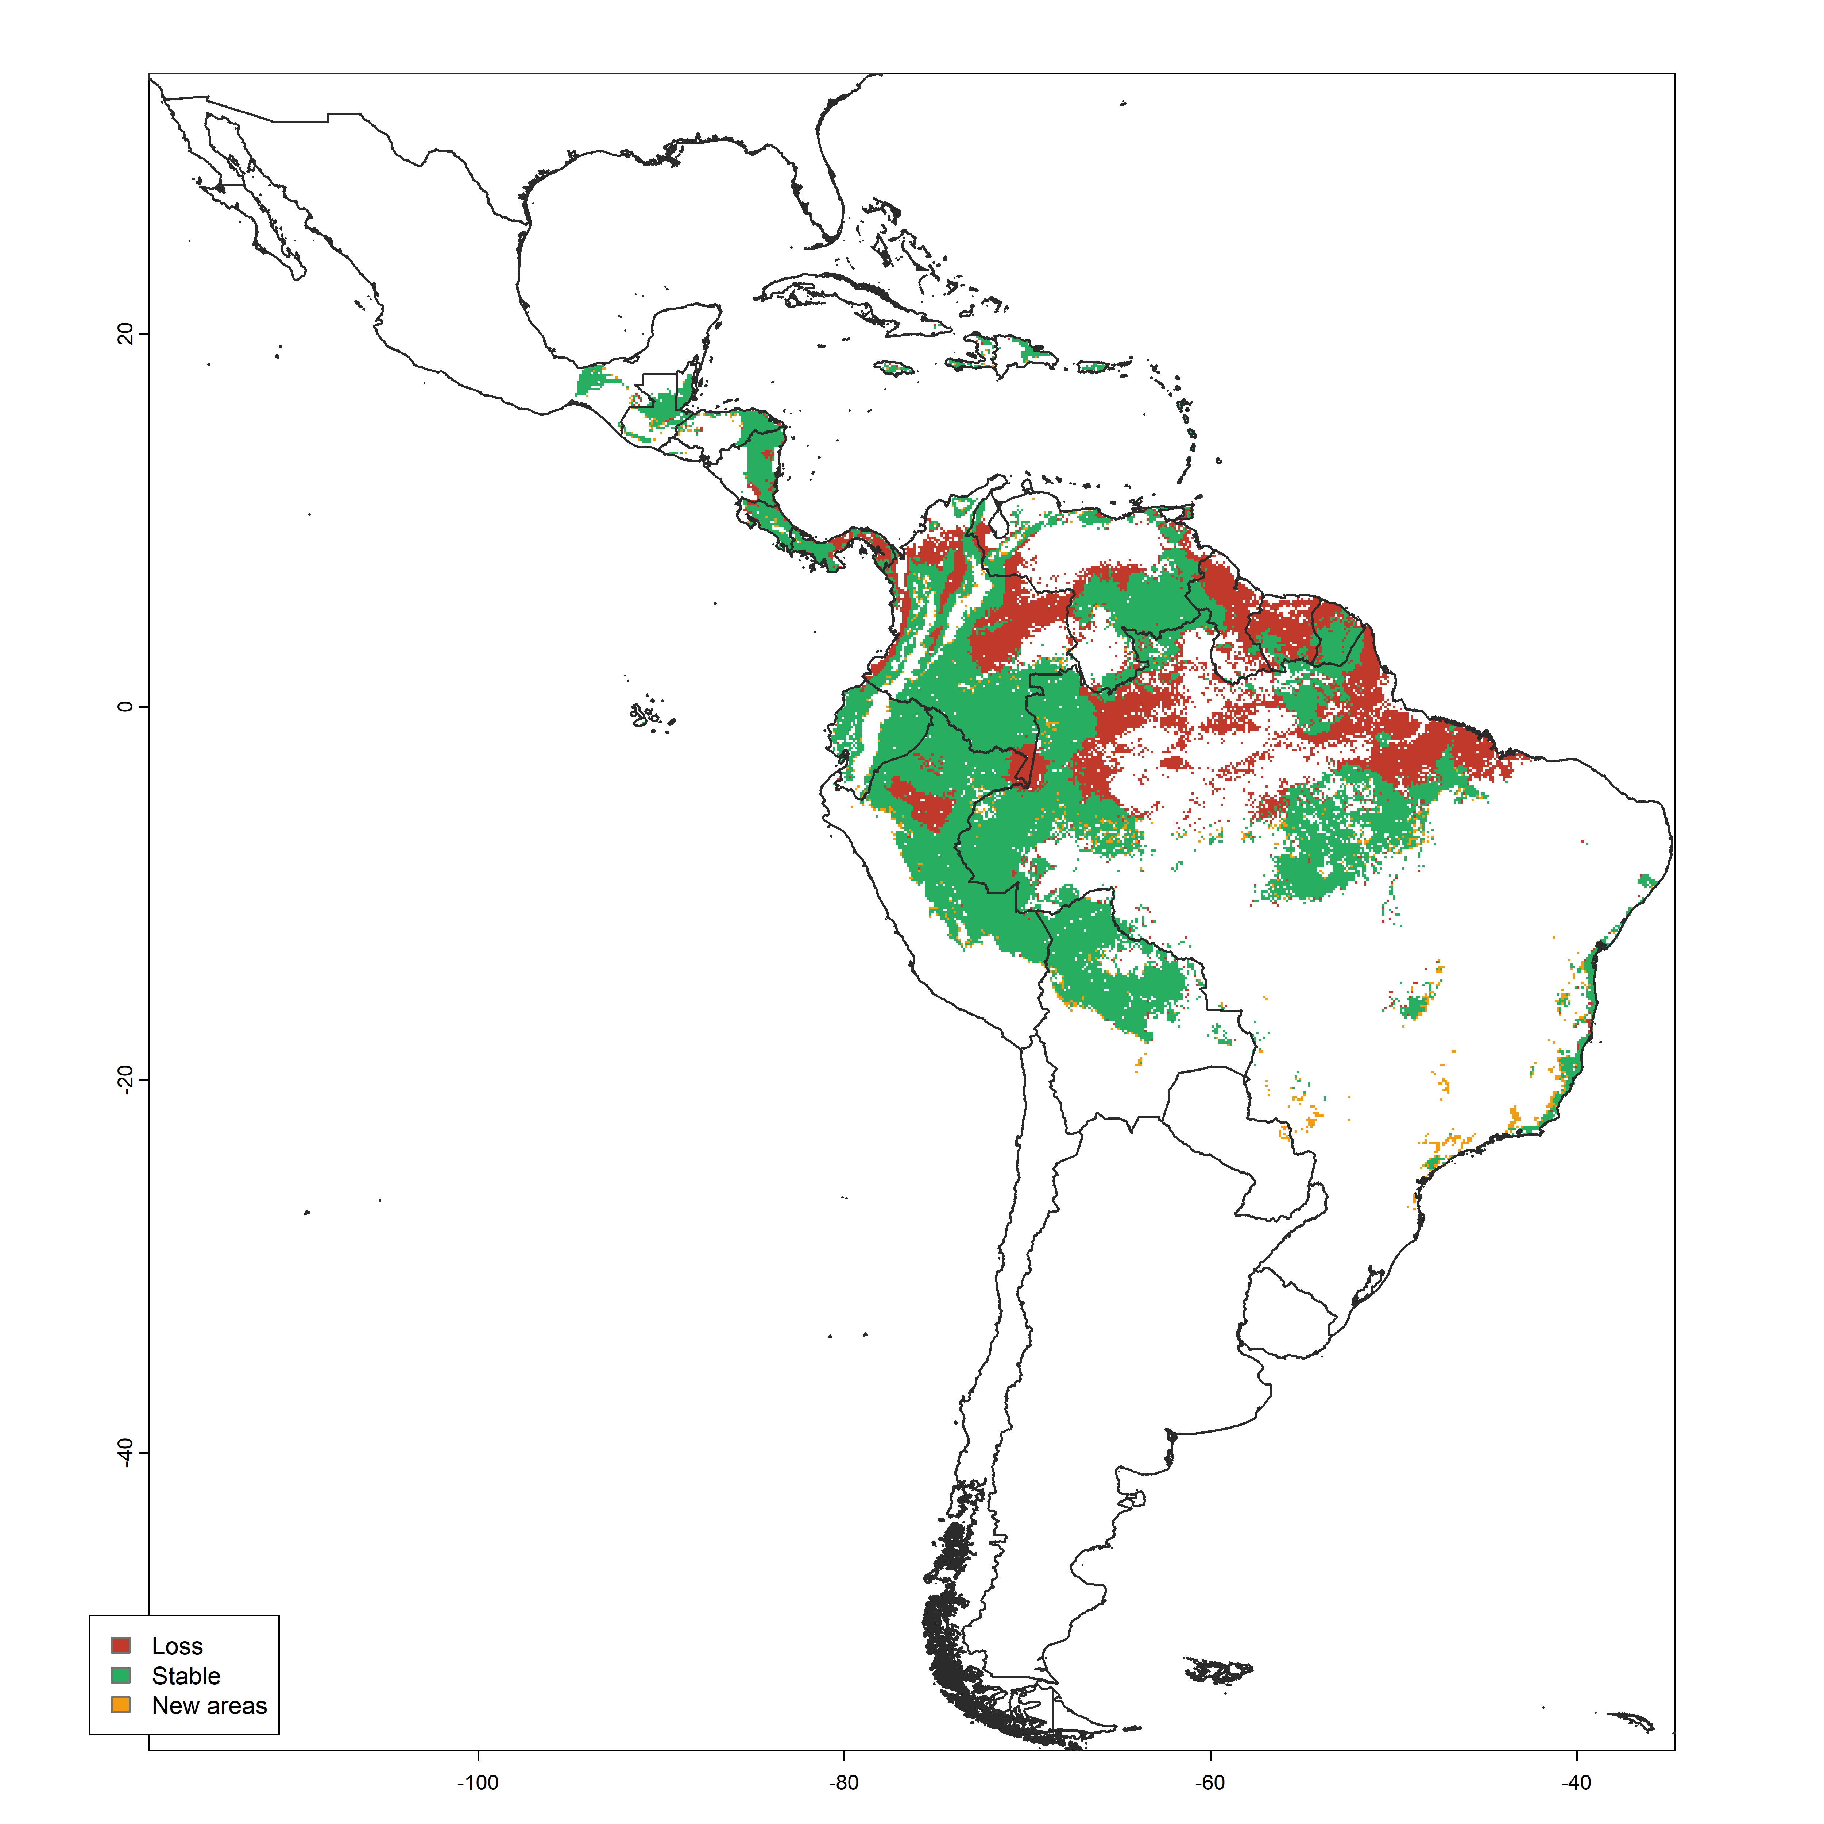
Bactris gasipes example
Thomas et al, 2027
(In progress) - > almost edible 9000 species

Slide 42
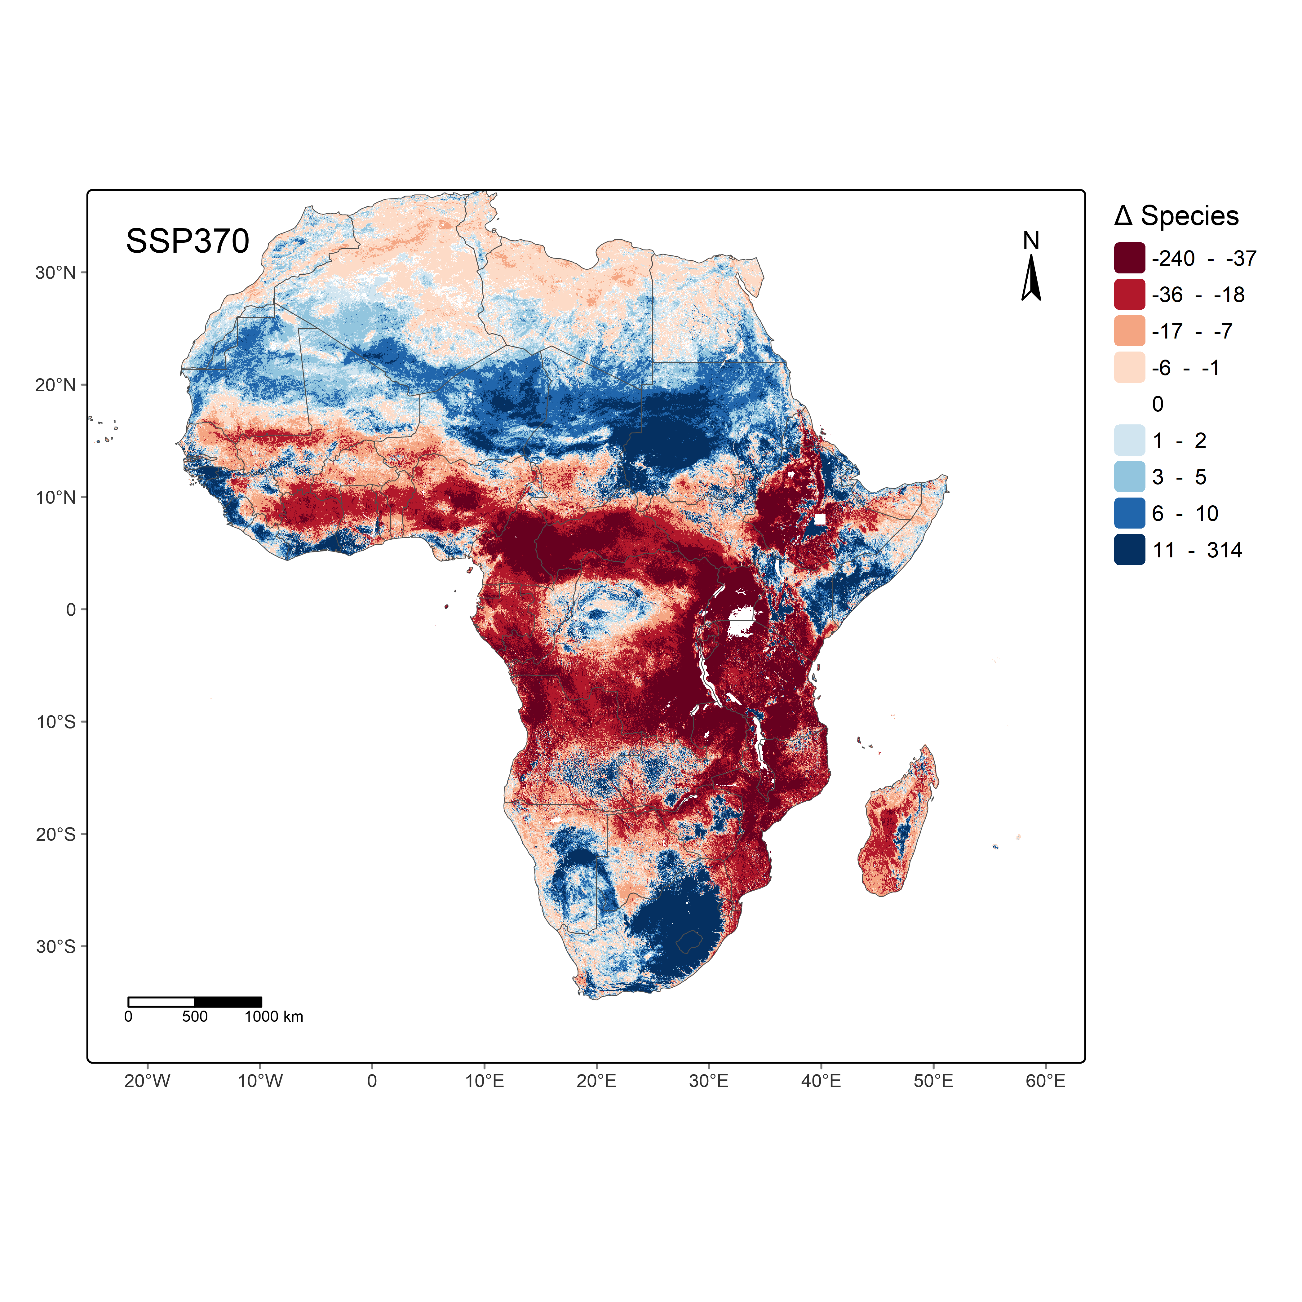
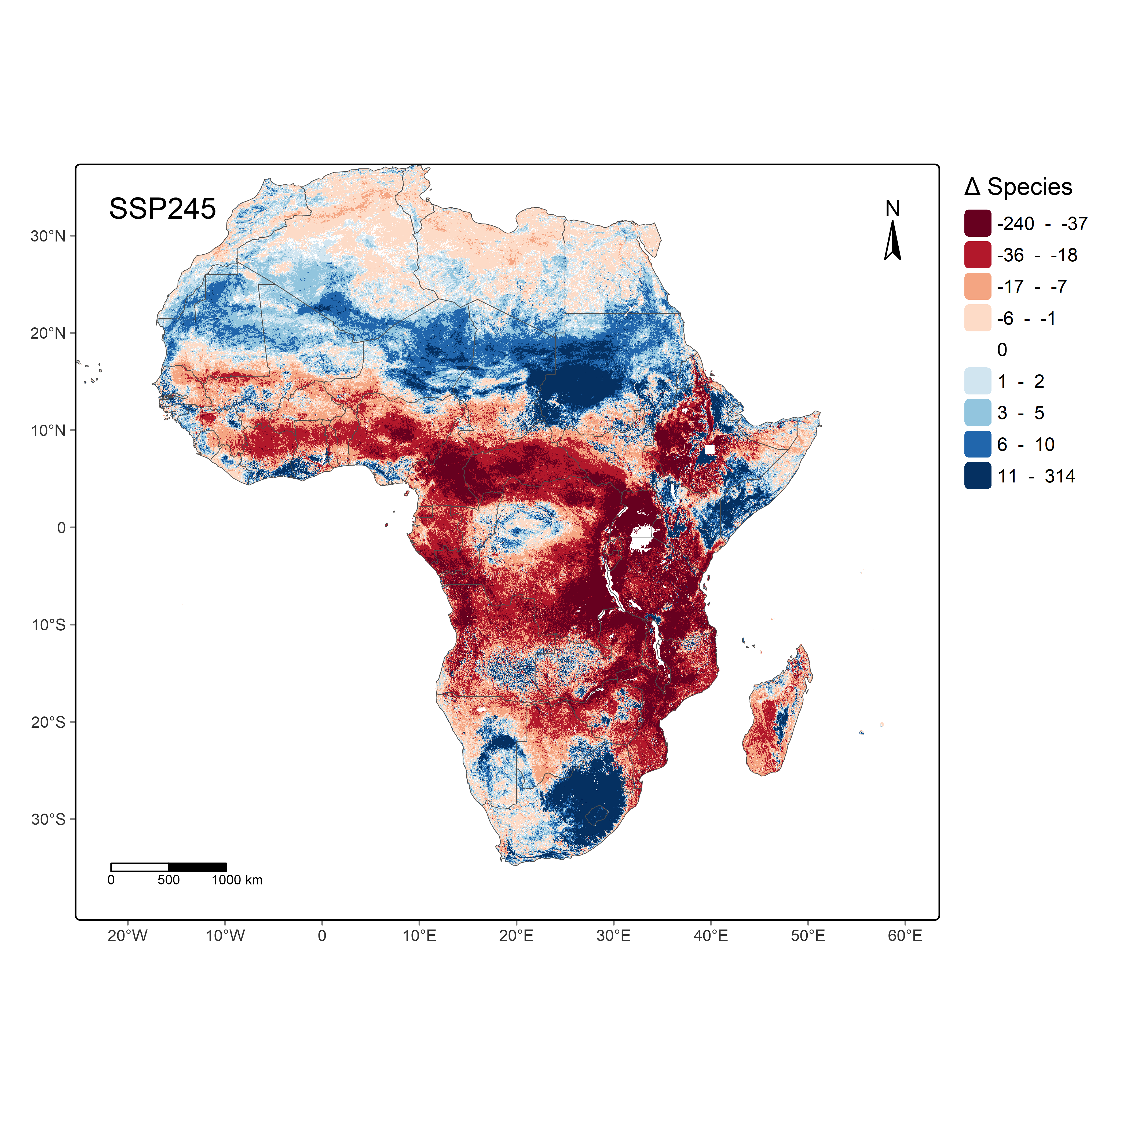
Using threshold projected models for biodiversity
Thomas et al, 2027 (In progress)

Slide 43
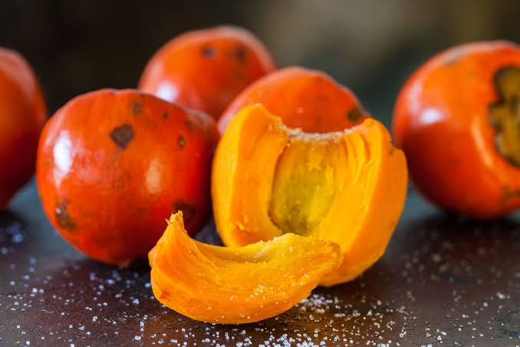
what are the possible new areas for peach palm establishment in the coffee region?
https://blog.amigofoods.com/chontaduro/

Slide 44
SDM + Climate change layers + Projections + Analysis

Slide 45
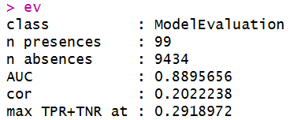
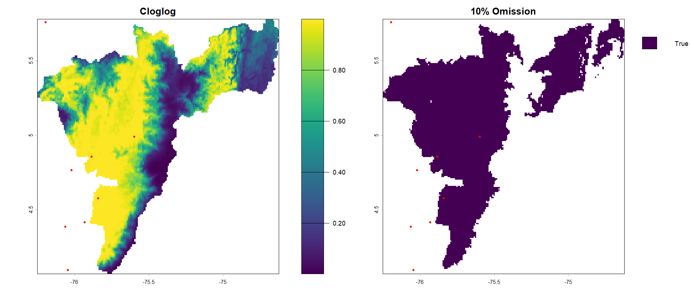

Slide 46
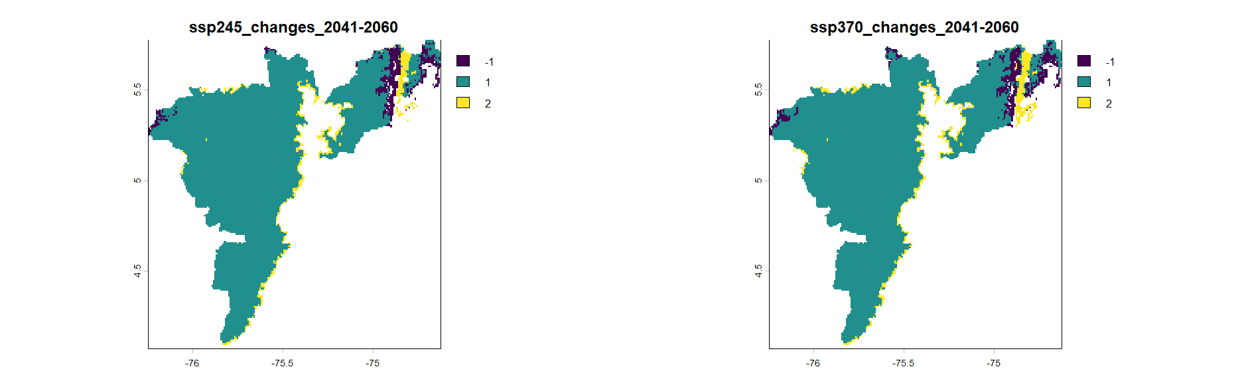

Slide 47
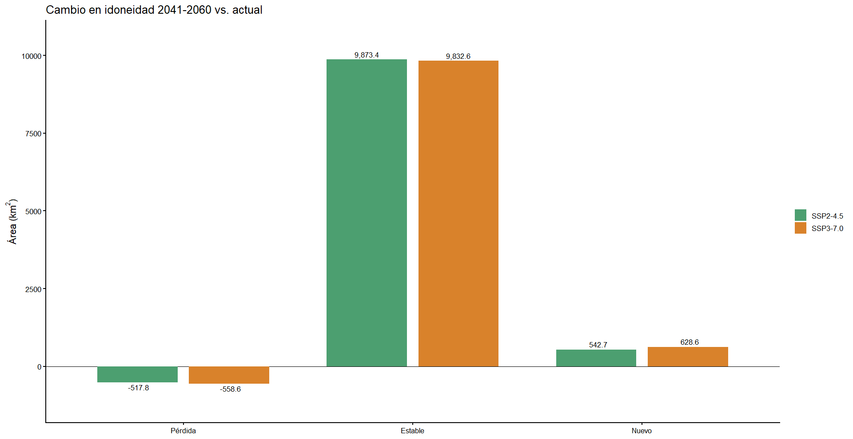
Expansion to new areas

Slide 48
No sensitive species?

Slide 49

(Futuro-Presente)/Presente x 100

Slide 50
what are the possible new areas for S. portoricensis establishment in the coffee region?

Slide 51
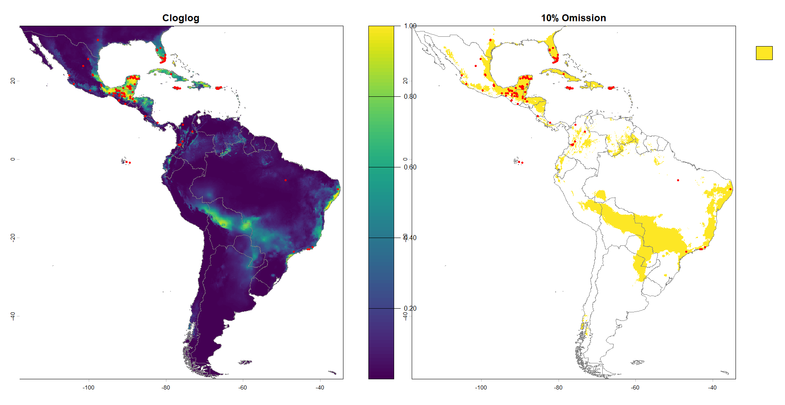

Slide 52
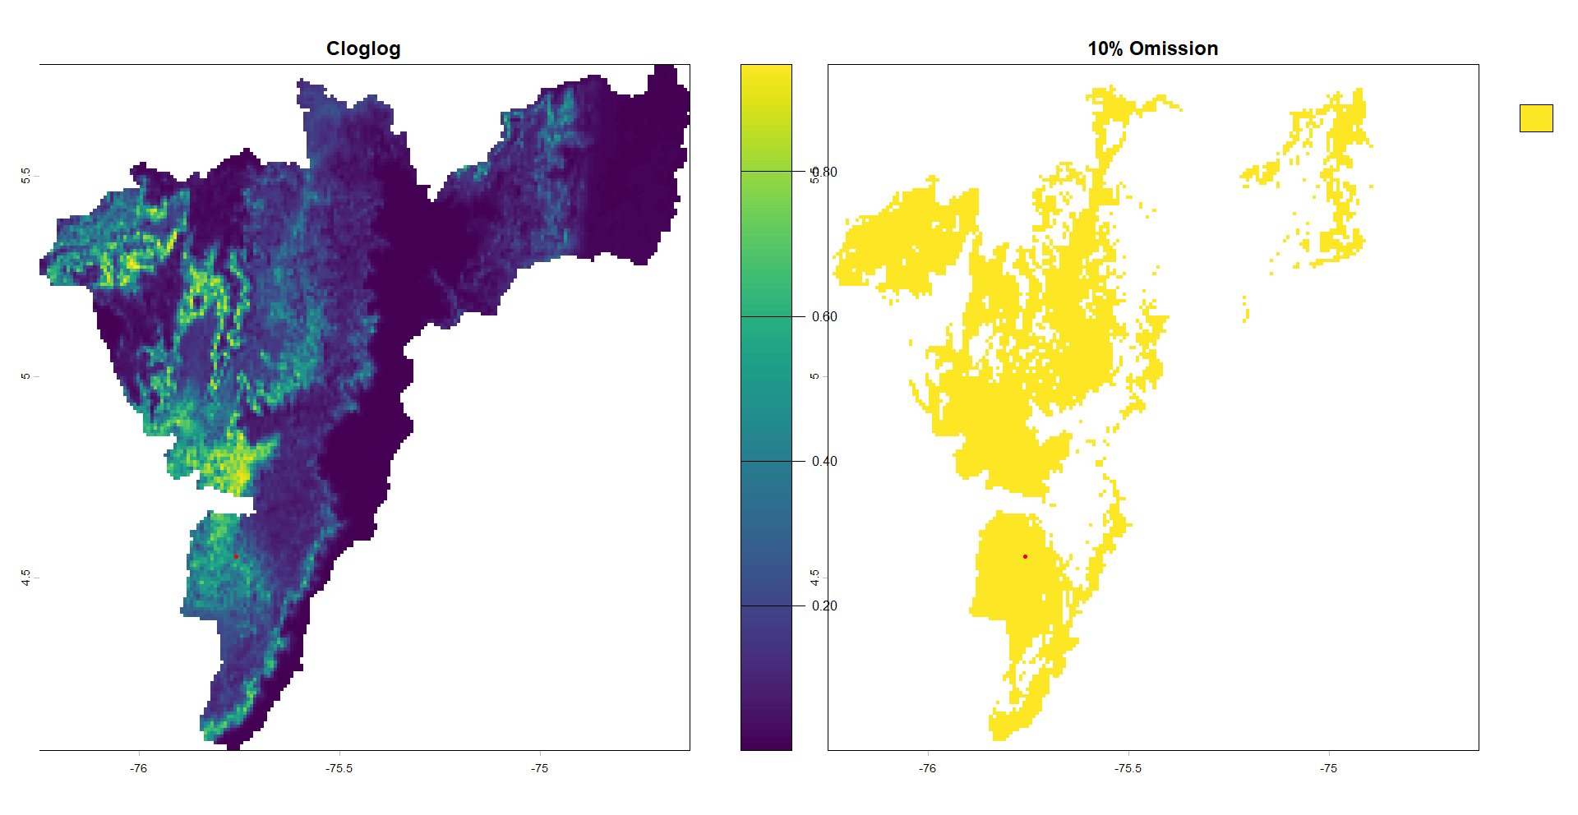

Slide 53
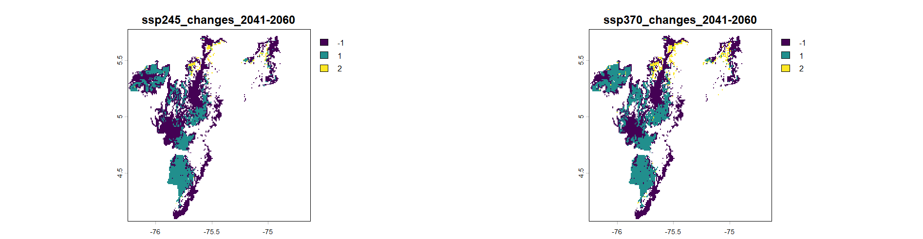

Slide 54
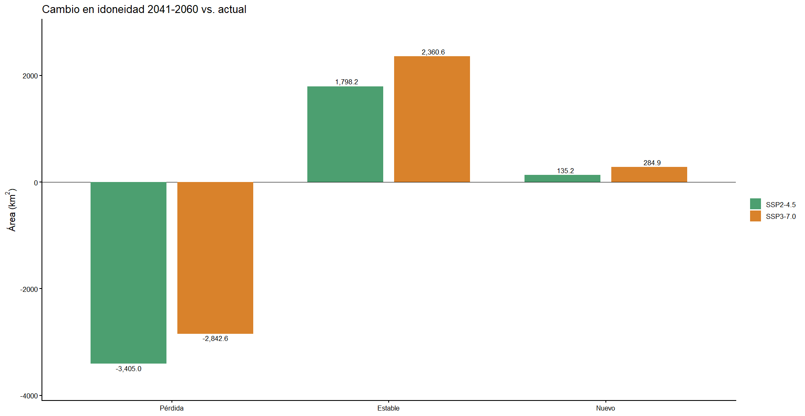
Expansion to new areas
Expansion to new areas

Slide 55

(Futuro-Presente)/Presente x 100

Slide 56
Invasive species behavior?

